Slide 1

Internet of Things Project using Python (CSE 4110) Mid-Term Project Presentation on Raspberry Pi Pico Bluetooth Home Automation System using Voice Recognition
Presented by
Siddhant Vatsyayan
Syed Eebad Reza
Supervisor
Dr. Om Prakash Das,
Asst. Prof., CIOT, ITER
Mr. Bhanja Kishor Swain,
Asst. Prof., CIOT, ITER
Department of Computer Science and Engineering
Institute of Technical Education & Research (FET)
Siksha ‘O’ Anusandhan Deemed to be University, Bhubaneswar
January, 2024

Slide 2
Contents
Introduction
Literature Survey
Design Scheme
Testing, Analysis, And Evaluation
Socio-economic Issues Associated With The Project
Engineering Tools And Standards
Conclusion

Slide 3
Introduction
01
IOT Revolution
The IoT revolution has transformed the way we interact with the physical world, enabling the collection and exchange of data from interconnected devices.
02
Home Automation Significance
Efficiency & Conveniences
Energy Conservation
Flexibility & Remote Control
Personalized Comforts
03
Project Extension
Building upon a normal Bluetooth Controlled Home Automation project, this project introduces voice command as control mechanism.

Slide 4
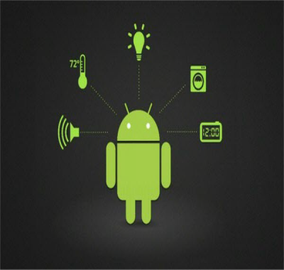
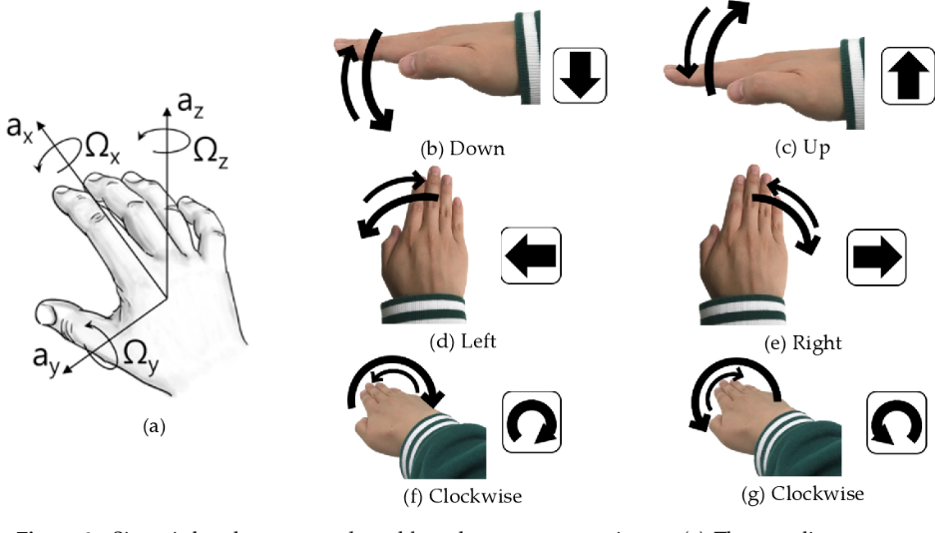
Literature Survey
Home automation system using Android application
Smart-lighting
Smart door lock
Smart sensors (Humidity, Temp.)
Home Automation system based on Gesture Human-Machine Interface (GHMI)
Kitchen Chimneys
Smart Tv’s

Slide 5
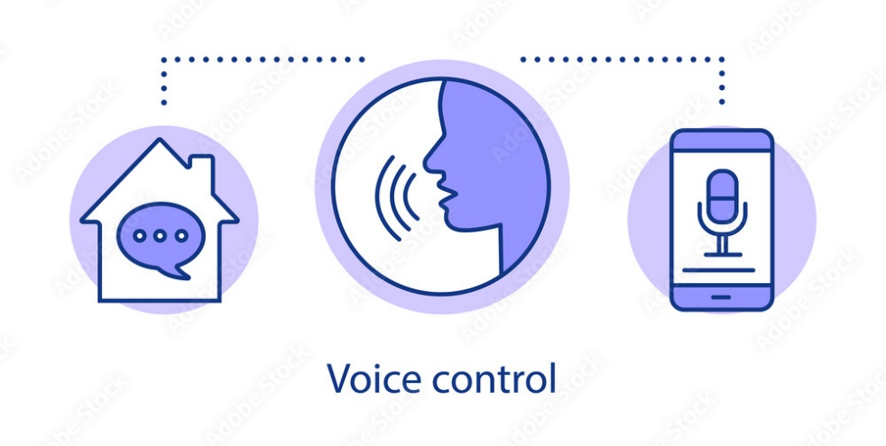
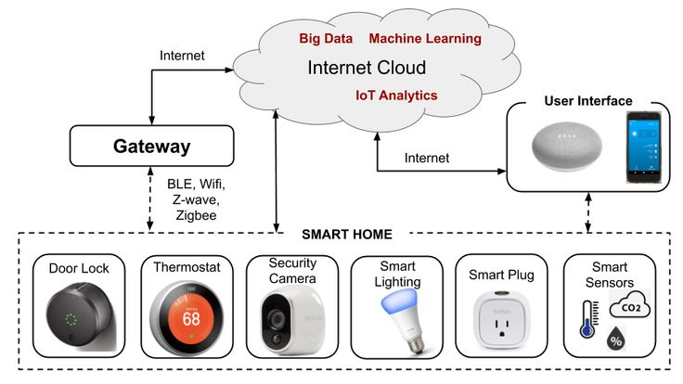
Literature Survey
Home Automation System Using Voice Recongnition Module HM2007
Smart-lighting
Smart plugs (Turn on/off)
Smart sensors (Humidity, Temp.)
Home Automation System Using Speech Recognition and Machine learning
Allowing users to interact with the home automation system in a more conversational manner, like asking "What's the weather today?" or "Tell me about my schedule."

Slide 6
Design Scheme
Components
The Home Automation project utilizes the following components:
Raspberry Pi Pico W microcontroller
HC05 Bluetooth Module
5 V 4-Relay Module
0.5 W Bulbs
Bread Board
Jumper Wires
5 V adapter

Slide 7
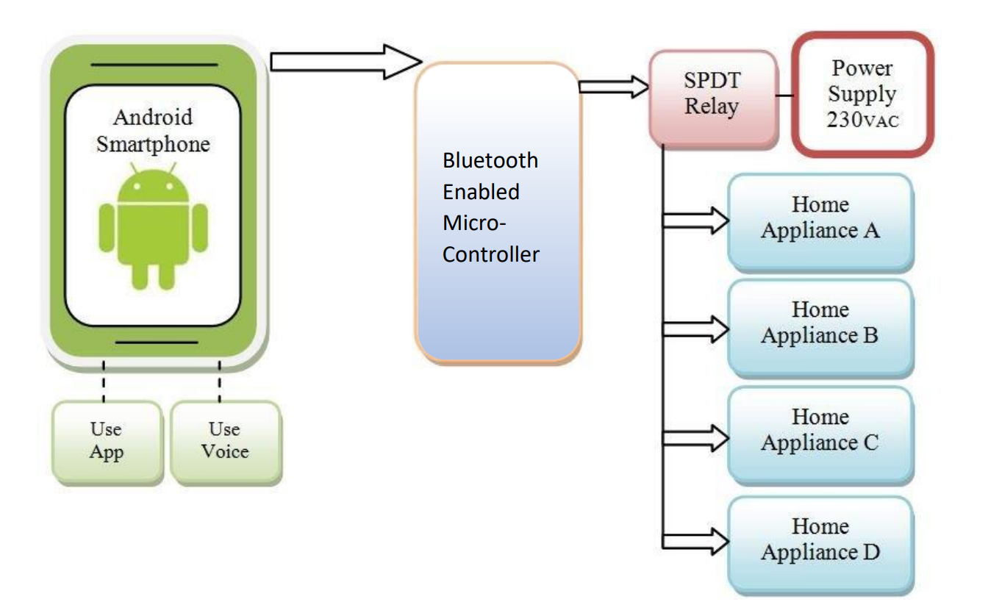
Design Scheme
Block Diagram

Slide 8
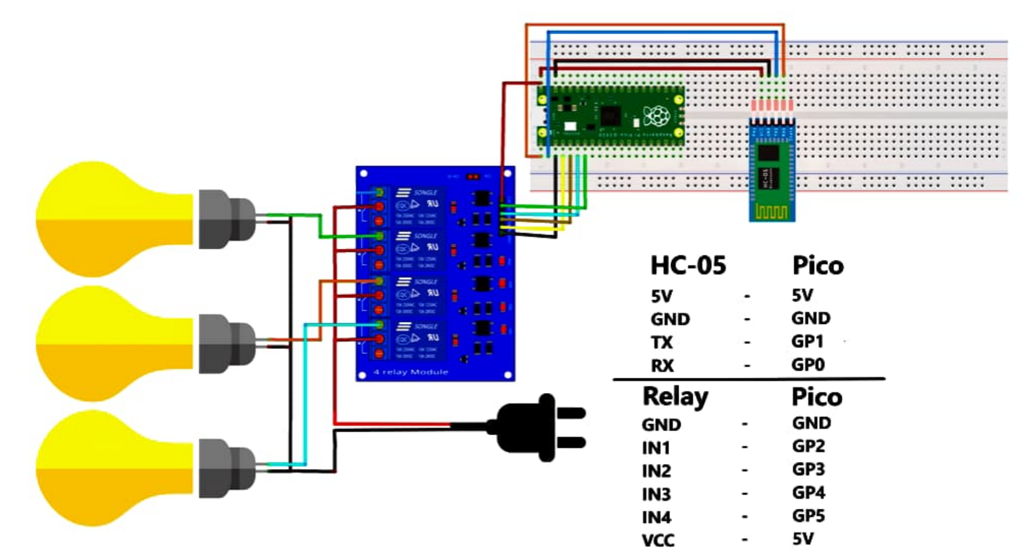
Design Scheme
Circuit Diagram Diagram

Slide 9
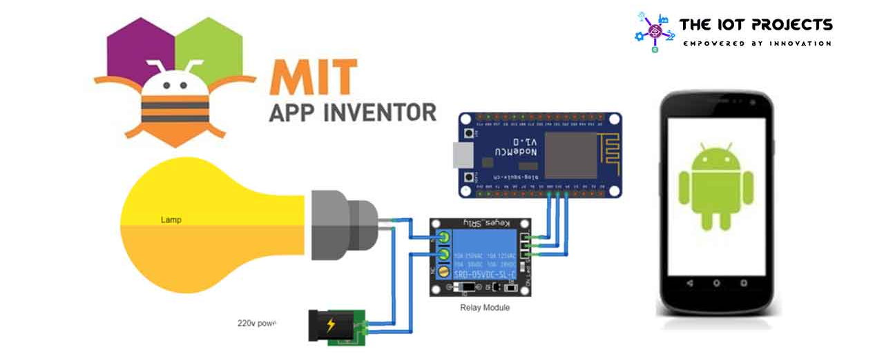
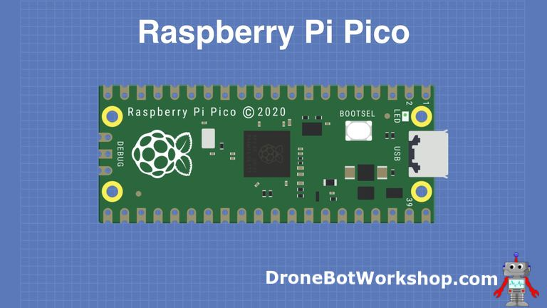
Design Scheme
MIT App Inventor
Open Source
Web-Based Platform
Blocks Editor
Real-Time Testing
Educational Focus
Community Support

Slide 10
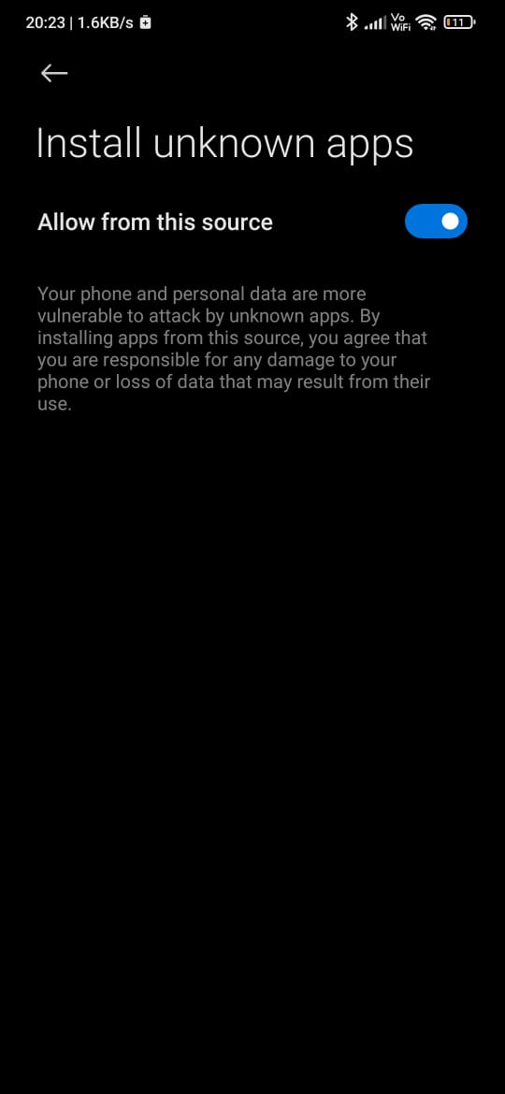
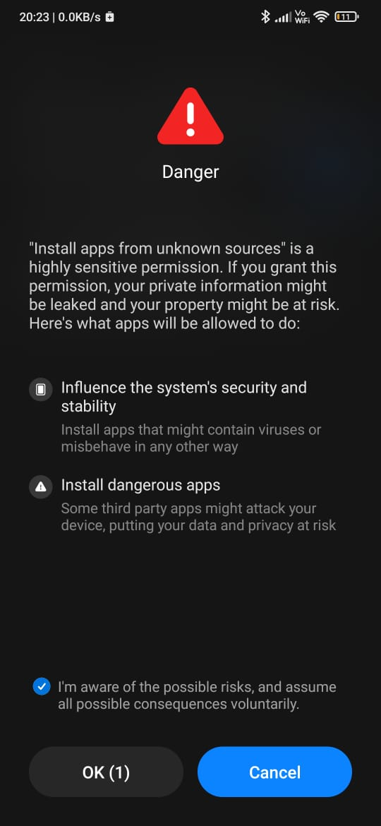
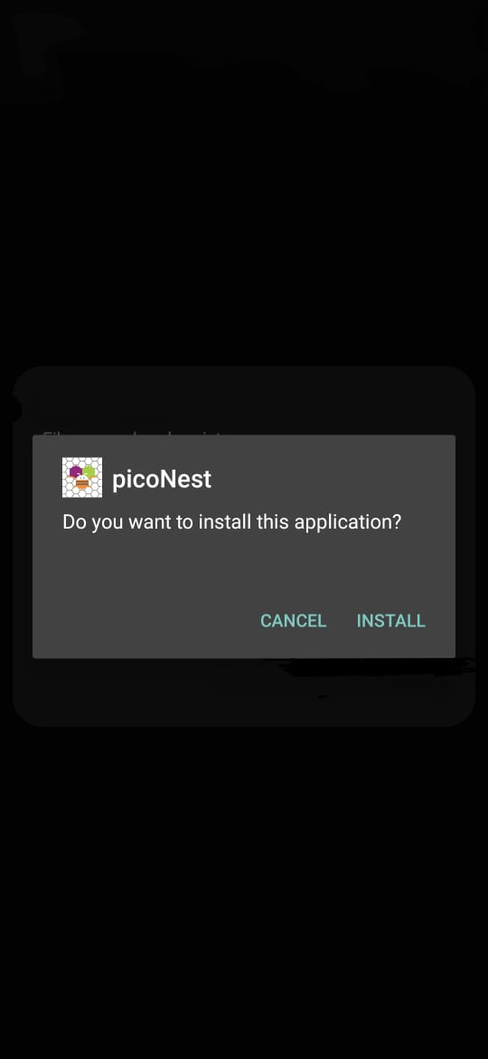
Testing
How to ensure the app works correctly

Slide 11
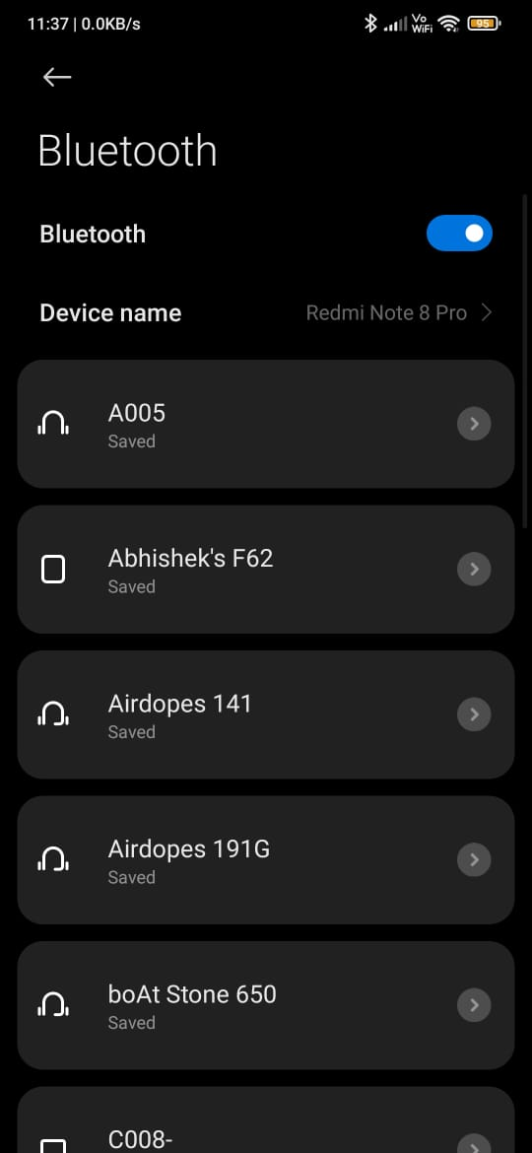
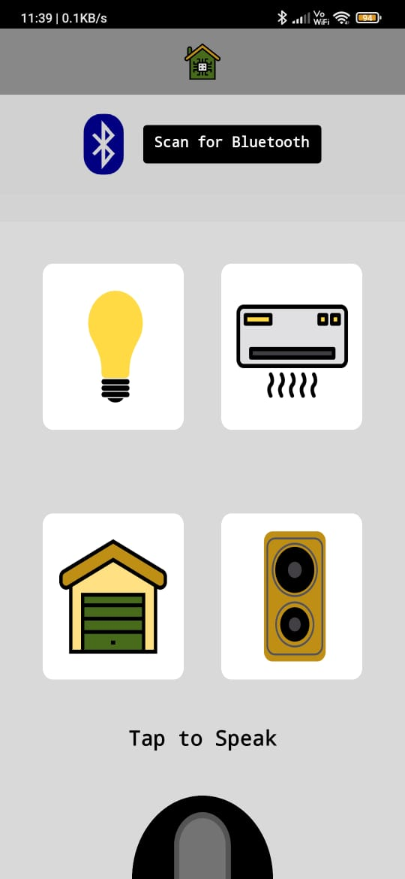
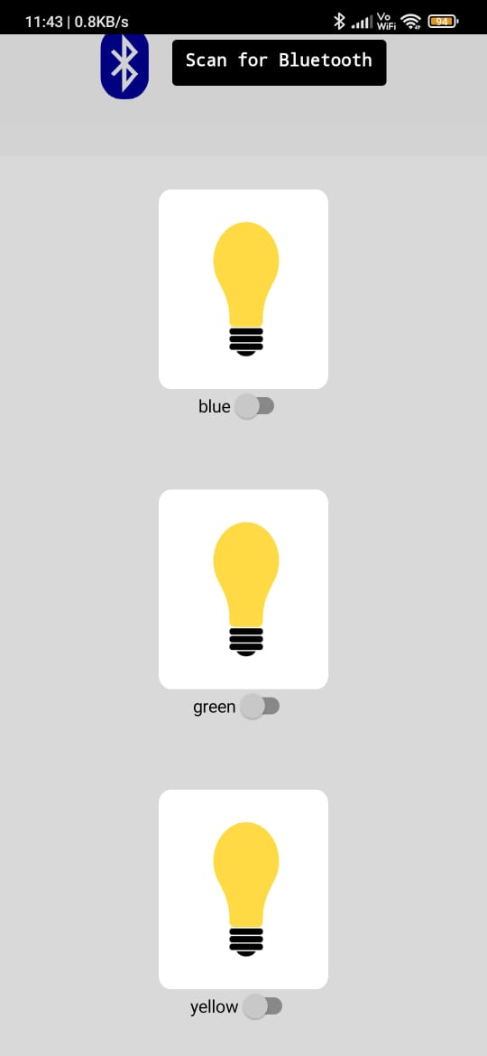
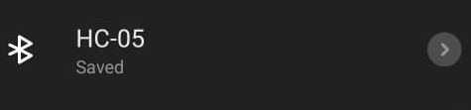
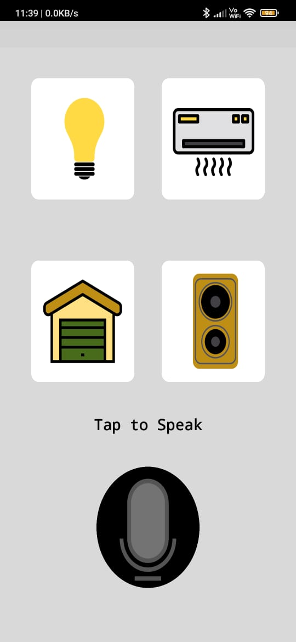
Testing
How to ensure the app works correctly

Slide 12
Evaluation
Pros
Voice Recognition
Real-Time Testing
Programming Blocks
Beginner Friendly
Cloud Storage
Cons
Screen Limitation
Security
OS Limitation

Slide 13
Socio-economic Issues Associated With The Project
Affordability and Accessibility
Technological Literacy and Education
Data Privacy and Security
Job Displacement
Dependence on Technology

Slide 14




Engineering Tools And Standards
01
Programming Languages
MicroPython programming language and Thonny used for IoT application development with Raspberry Pi Pico W.
02
Libraries
A UART (Universal Asynchronous Receiver-Transmitter) library facilitates serial communication between microcontrollers or devices
03
MIT App Inventor
MIT App Inventor is a user-friendly, visual programming environment that enables individuals without coding experience to create Android applications

Slide 15
Conclusion
Technological Innovation:
The Voice Controlled Home Automation project showcases significant technological innovation, employing Raspberry Pi Pico and HC05 Bluetooth Module for seamless device control through voice commands.
Socio-Economic Awareness:
Beyond technology, the project underscores the importance of considering socio-economic factors, emphasizing the need for accessibility, affordability, and inclusivity in the adoption of smart home solutions.

Slide 16


