Slide 1
IOT (ROBOISM) – 24 July 2022 Name: Brij Mohan Singh Branch: Electrical Engineering Admission no. : 21JE0251
Blink LED
WiFi Scanning
Connecting to WiFi
Creating a Web Server + Send Data + Receive Data from Server
Now Controlling Led from the server by sending “on” and “off” Messages ( Simulation Video in GitHub)

Slide 2
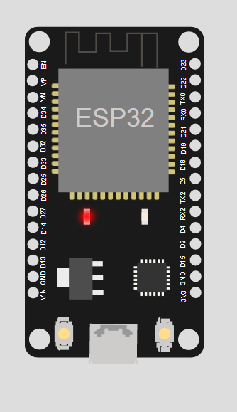
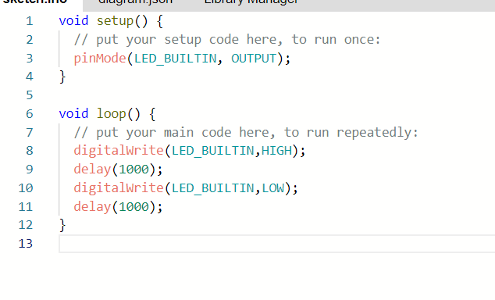
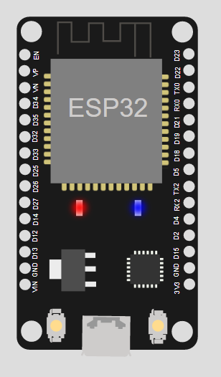
BLINKING LED
sketch.ino - Wokwi Arduino and ESP32 Simulator

Slide 3
Wifi Scanning
#include "WiFi.h"
void setup()
{
Serial.begin(115200);
WiFi.mode(WIFI_STA);
WiFi.disconnect();
delay(100);
Serial.println("Setup done");
}
void loop()
{
Serial.println("scan start");
int n = WiFi.scanNetworks();
Serial.println("scan done");
if (n == 0) {
Serial.println("no networks found");
} else {
Serial.print(n);
Serial.println(" networks found");
for (int i = 0; i < n; ++i) {
Serial.print(i + 1);
Serial.print(": ");
Serial.print(WiFi.SSID(i));
Serial.print(" (");
Serial.print(WiFi.RSSI(i));
Serial.print(")");
Serial.println((WiFi.encryptionType(i) == WIFI_AUTH_OPEN)?" ":"*");
delay(10);
}
}
Serial.println("");
delay(5000);
}

Slide 4
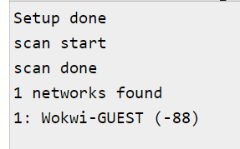
OUTPUT

Slide 5
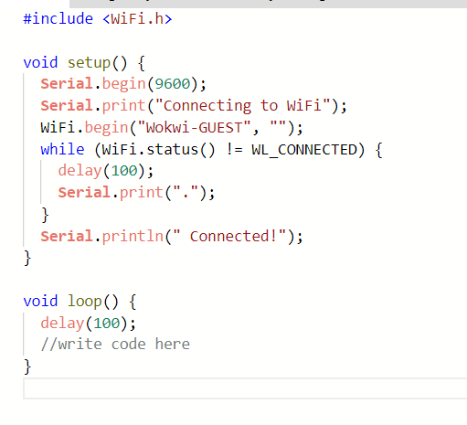
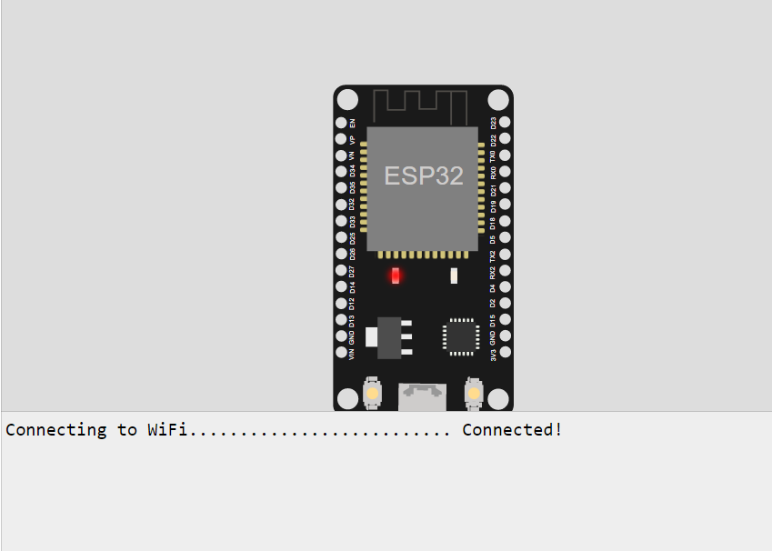
Connecting to Wifi
sketch.ino - Wokwi Arduino and ESP32 Simulator

Slide 6
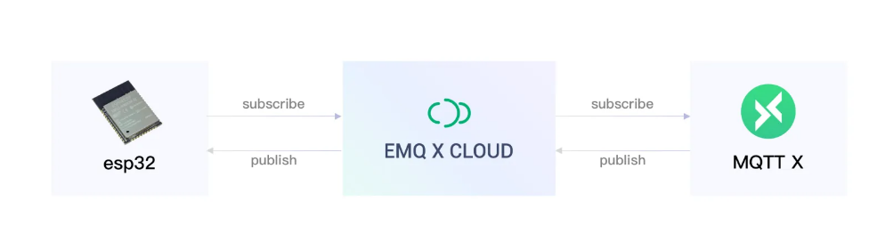
ESP32 Web Server (Using MQTT)

Slide 7
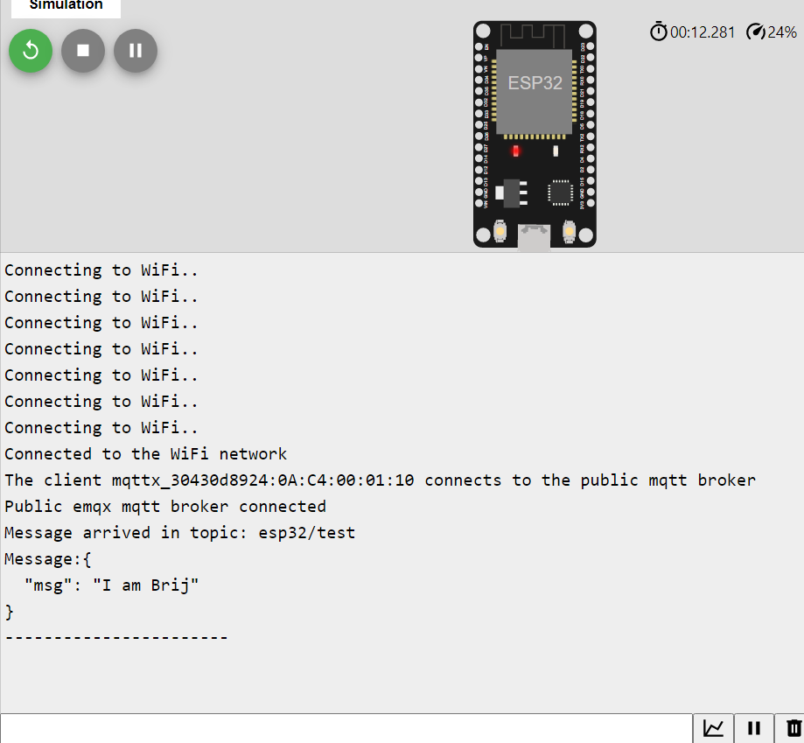
Connecting, Sending and receiving message from server

Slide 8
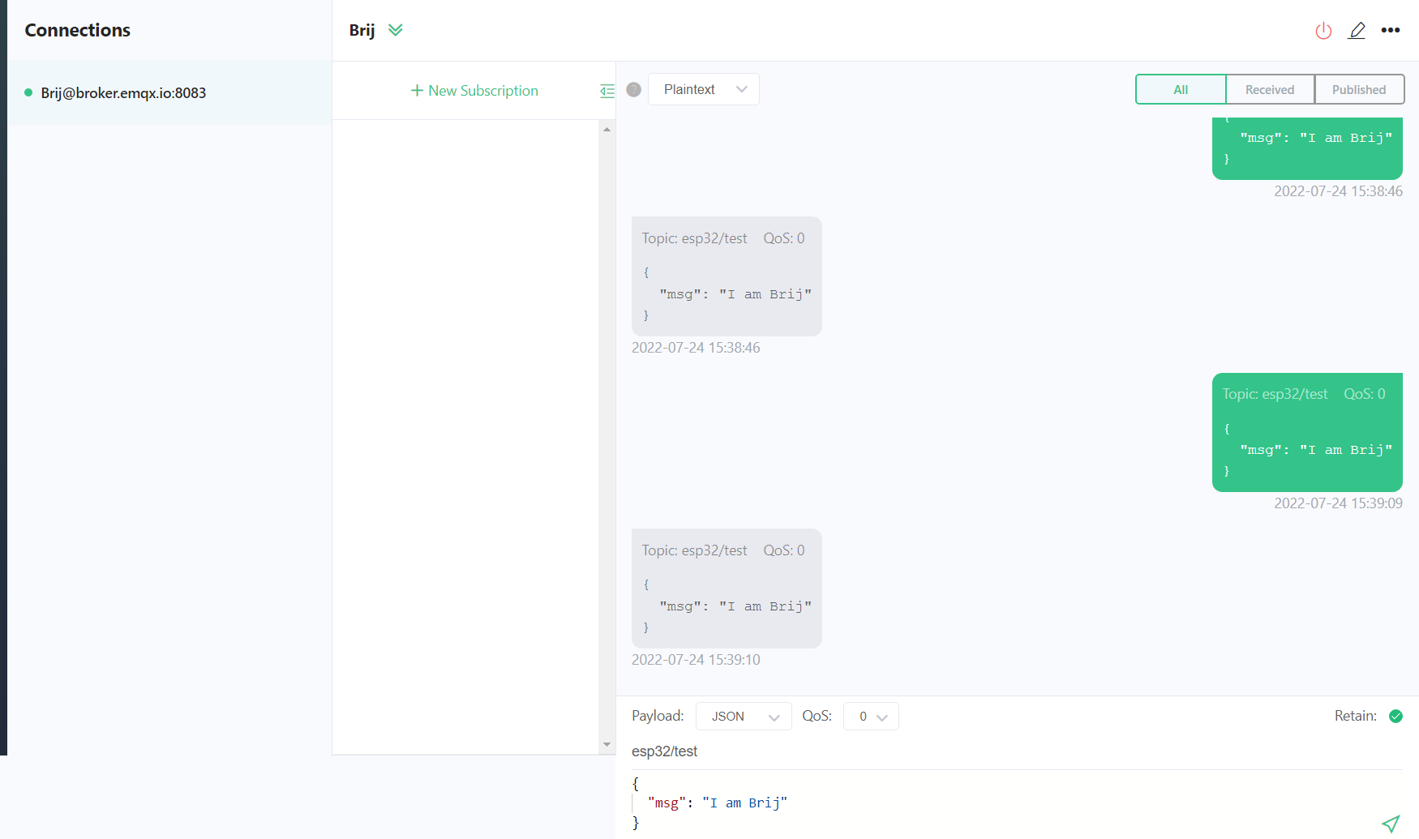
Server Side

Slide 9
Code
#include <WiFi.h>
#include <PubSubClient.h>
// WiFi
const char *ssid = "Wokwi-GUEST"; // Enter your WiFi name
const char *password = ""; // Enter WiFi password
// MQTT Broker
const char *mqtt_broker = "broker.emqx.io";
const char *topic = "esp32/test";
const char *mqtt_username = "";
const char *mqtt_password = "";
const int mqtt_port = 1883;
WiFiClient espClient;
PubSubClient client(espClient);

Slide 10
void setup() {
// Set software serial baud to 115200;
Serial.begin(115200);
// connecting to a WiFi network
WiFi.begin(ssid, password);
while (WiFi.status() != WL_CONNECTED) {
delay(500);
Serial.println("Connecting to WiFi..");
}
Serial.println("Connected to the WiFi network");
//connecting to a mqtt broker
client.setServer(mqtt_broker, mqtt_port);
client.setCallback(callback);
while (!client.connected()) {
String client_id = "mqttx_30430d89";
client_id += String(WiFi.macAddress());
Serial.printf("The client %s connects to the public mqtt broker\n", client_id.c_str());
if (client.connect(client_id.c_str(), mqtt_username, mqtt_password)) {
Serial.println("Public emqx mqtt broker connected");
} else {
Serial.print("failed with state ");
Serial.print(client.state());
delay(2000);
}
}

Slide 11
// publish and subscribe
client.publish(topic, "Hi");
client.subscribe(topic);
}
void callback(char *topic, byte *payload, unsigned int length) {
Serial.print("Message arrived in topic: ");
Serial.println(topic);
Serial.print("Message:");
for (int i = 0; i < length; i++) {
Serial.print((char) payload[i]);
}
Serial.println();
Serial.println("-----------------------");
}
void loop() {
client.loop();
}
sketch.ino - Wokwi Arduino and ESP32 Simulator

Slide 12
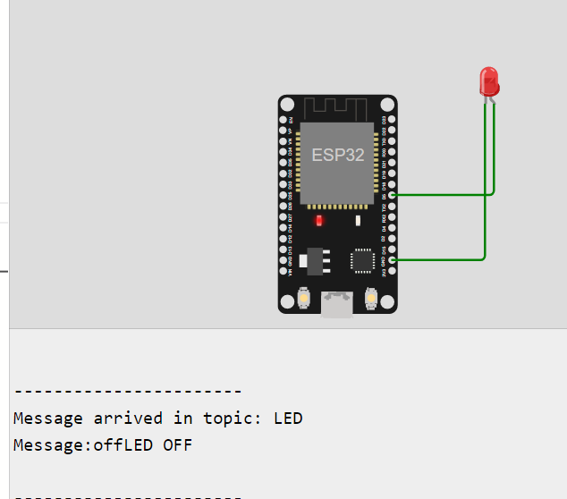
Controlling an LED from Server

Slide 13
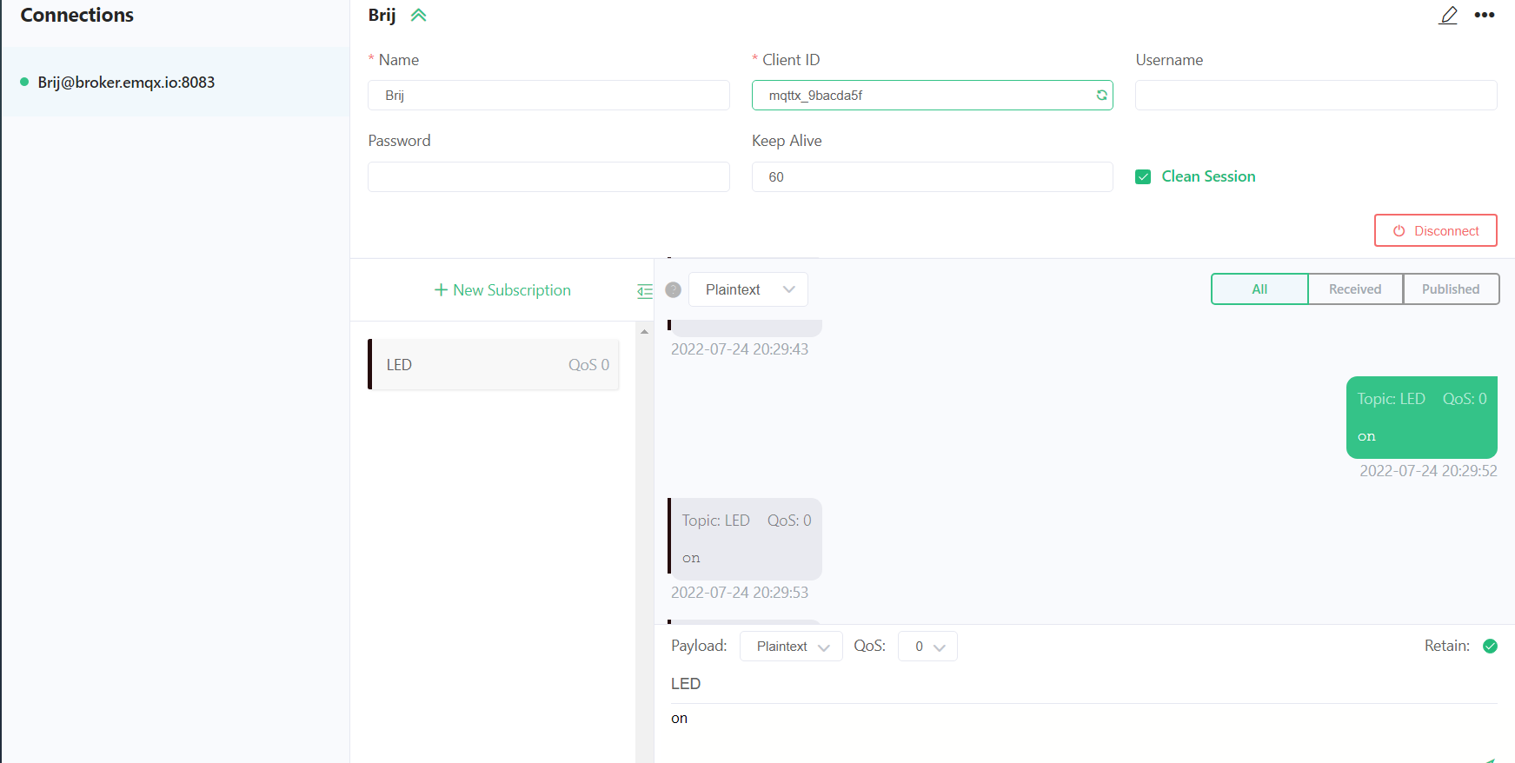
Now we we will send “ on “ Message from server

Slide 14
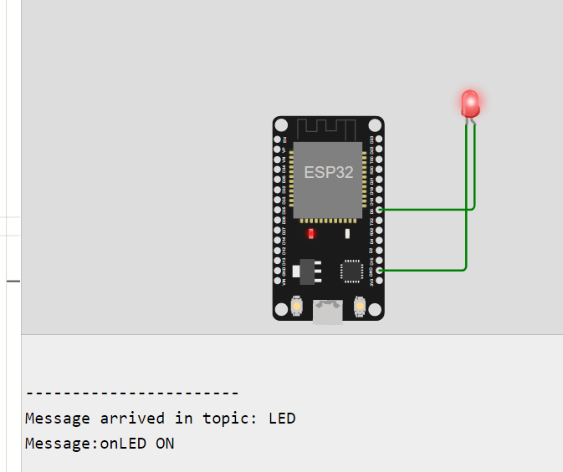
Now we we will send “ on “ Message from server
sketch.ino - Wokwi Arduino and ESP32 Simulator

Slide 15
Code
#include <WiFi.h>
#include <PubSubClient.h>
#define LED 5
// WiFi
const char *ssid = "Wokwi-GUEST"; // Enter your WiFi name
const char *password = ""; // Enter WiFi password
// MQTT Broker
const char *mqtt_broker = "broker.emqx.io";
const char *topic = "LED";
const char *mqtt_username = "";
const char *mqtt_password = "";
const int mqtt_port = 1883;
WiFiClient espClient;
PubSubClient client(espClient);
void setup() {
// Set software serial baud to 115200;

Slide 16
pinMode(LED, OUTPUT);
Serial.begin(115200);
// connecting to a WiFi network
WiFi.begin(ssid, password);
while (WiFi.status() != WL_CONNECTED) {
delay(500);
Serial.println("Connecting to WiFi..");
}
Serial.println("Connected to the WiFi network");
//connecting to a mqtt broker
client.setServer(mqtt_broker, mqtt_port);
client.setCallback(callback);
while (!client.connected()) {
String client_id = "mqttx_9bacda5f";
client_id += String(WiFi.macAddress());
Serial.printf("The client %s connects to the public mqtt broker\n", client_id.c_str());
if (client.connect(client_id.c_str(), mqtt_username, mqtt_password)) {
Serial.println("Public emqx mqtt broker connected");
} else {
Serial.print("failed with state ");
Serial.print(client.state());
delay(2000);
}
}

Slide 17
// publish and subscribe
client.publish(topic, "Hi");
client.subscribe(topic);
}
void callback(char *topic, byte *payload, unsigned int length) {
Serial.print("Message arrived in topic: ");
Serial.println(topic);
Serial.print("Message:");
String message;
for (int i = 0; i < length; i++) {
message = message + (char) payload[i]; // convert *byte to string
}
Serial.print(message);
if (message == "on") { digitalWrite(LED, HIGH);
Serial.println("LED ON");} // LED on
if (message == "off") { digitalWrite(LED, LOW);
Serial.println("LED OFF");} // LED off
Serial.println();
Serial.println("-----------------------");
}
void loop() {
client.loop();
}

