Slide 1
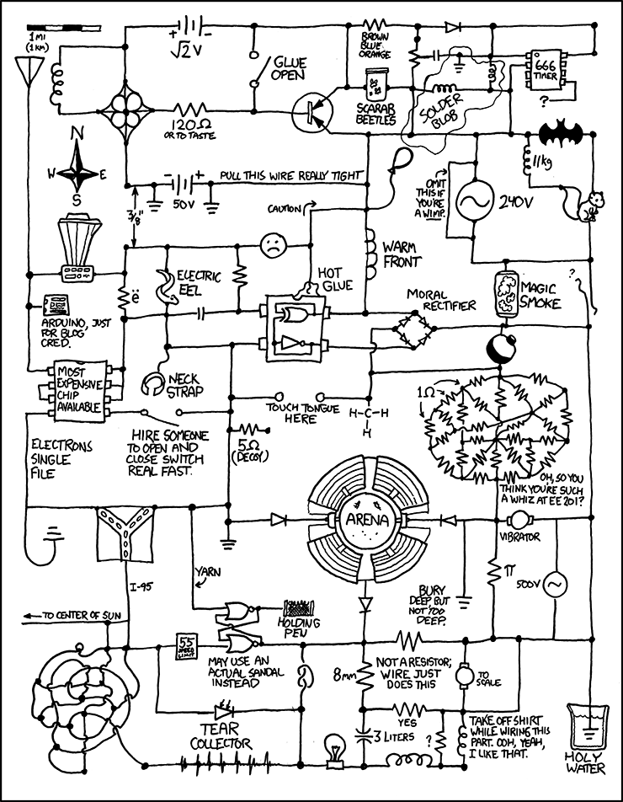
EECS 370
DIGITAL LOGIC REVIEW SESSION
Austin Maliszewski
Branden Ghena
Slides heavily borrowed (stolen) from
V. Bertacco,
R. Dick,
T. Austin,
S. Mahlke,
K. Sakallah &
F. Vahid

Slide 2
Agenda
Lots more slides than we have time to talk about!
But they’ll go online for your reference.
Quick review of lots of things:
Transistors
Gates
Important Combinational Circuits (decoders/muxes)
Adders (RCA/CLA)
Sequential elements (latches/flip-flops)
The Single Cycle LC-2K (ever so briefly)
FSMs
IEEE Floating Point
Your questions!

Slide 3
The CMOS Transistor
2.3
CMOS transistor
Basic switch in modern ICs
A positive
voltage here...
...attracts electrons here,
turning the channel between
the source and drain into
a conductor
a
nMOS
gate
1
0
gate
o
xide
IC pa
c
kage
sou
r
ce
drain
conducts
does not
conduct
pMOS
gate
1
0
(
a
)
IC
Silicon -- not quite a conductor or insulator:
Semiconductor
does not
conducts
conduct

Slide 4














Logic Gates
NOT
$$x$$
$$x′$$
$$x$$
$$y$$
AND
$$xy$$
$$x$$
$$y$$
OR
$$x+y$$
$$x$$
$$y$$
XOR
$$x⨁y=x^{′}y+xy′$$
$$x$$
$$y$$
NAND
$${\left(xy\right)}^{′}=x^{′}+y′$$
$$x$$
$$y$$
NOR
$${\left(x+y\right)}^{′}=x^{′}y′$$
$$x$$
$$y$$
XNOR
$$x⨀y=x^{′}y′+xy$$

Slide 5
More Gates
2.8
1
NAND
1
NOR
NAND
NOR
XOR
XNOR
x
x
x
F
F
x
y
y
y
F
y
a
x
y
F
x
y
F
x
y
F
x
y
F
x
F
0
0
1
0
0
1
0
0
0
0
0
1
0
1
1
0
1
0
0
1
1
0
1
0
x
y
1
0
1
1
0
0
1
0
1
1
0
0
y
1
1
0
1
1
0
1
1
0
1
1
1
0
0
NAND: Opposite of AND (“NOT AND”)
NOR: Opposite of OR (“NOT OR”)
XOR: Exactly 1 input is 1, for 2-input XOR. (For more inputs -- odd number of 1s)
XNOR: Opposite of XOR (“NOT XOR”)
NAND same as AND with power & ground switched
nMOS conducts 0s well, but not 1s (reasons beyond our scope) – so NAND is more efficient
Likewise, NOR same as OR with power/ground switched
NAND/NOR more common
AND in CMOS: NAND with NOT
OR in CMOS: NOR with NOT

Slide 6
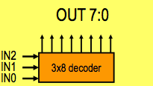
Controller Components
Decoder
What does it do?
IN | OUT
000 | 0000_0001
001 | 0000_0010
010 | 0000_0100
011 | 0000_1000
etc. | …

Slide 7
Decoder Circuit
Symbol:

Slide 8
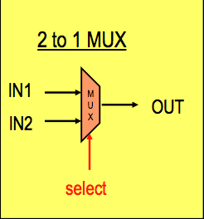
Controller Components
Multiplexor (MUX)
What does it do?
OUT = (select) ? IN1 : IN2

Slide 9
Multiplexer (Mux)
A mux is a digital switch
The output copies one of n data inputs, depending on the value of the select inputs
Implementation:
Product terms are mutually exclusive!

Slide 10
Binary Addition
How do we add two binary numbers?
Just like elementary school!
If we have a fixed number of bits (which is usually the case), a carry out of the most significant column indicates that there’s not enough bits to hold the sum value. This case is referred to as overflow.

Slide 11
Addition Implementation
Addition of two 1-bit binary numbers, A and B – requires two output bits, which we’ll call S (sum) and C (carry).
XOR Operation
Implementation:
This circuit is called a Half Adder (HA)

Slide 12
What if we want to add larger numbers?
What’s missing from HA?
Need to add carry-in (C_{i}) input!

Slide 13
Final Circuit:
This circuit is called a Full Adder (FA)
After all that design work, we really just have 2 HAs with an OR gate
To make an n-bit adder, simply cascade Full Adders to make a Ripple Carry Adder:
A₃
B₃
A₂
B₂
A₁
B₁
A₀
B₀
A
B
C₃
A
B
C₂
A
B
C₁
A
B
C₄
C_{o}
FA
C_{i}
C_{o}
FA
C_{i}
C_{o}
FA
C_{i}
C_{o}
FA
C_{i}
C₀
S
S
S
S
S₃
S₂
S₁
S₀

Slide 14
Carry Look-Ahead Adder
A
B
S
G₁
P₁
C₁
G₀
Full
adder
X
P₀
Y
C₀
g
p
C
G
P
C
EECS 370: Introduction to Computer Organization
14

Slide 15
8-bit Carry Look-ahead Adder
1 1 0 1 0 0 1 0
0 1 0 0 1 0 1 1 1 0 1 1 0 0 1 1
X
X
X
X
X
X
X
X
0
1
1
1
1
0
1
0
0 1 0 0 1 1 0 1 1 0 0 1
Y
Y
Y
Y
0 1 1 1
1
1
0
0
0 0 1 1 1 0
Y
Y
1 0
1
0
0 0 1 1 1 1 0 1
+ 1 0 0 1 0 1 0 1
1 1 0 1 0 0 1 0
0 0 1
Y
0
0
Carry
EECS 370: Introduction to Computer Organization
15

Slide 16
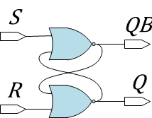




SR (Set-Reset) Latch
$$QB$$
$$Q$$
S | R | Q | QB | Function
0 | 0
0 | 1
1 | 0
1 | 1
$$S$$
$$R$$
Cross-Coupled NOR Gates

Slide 17
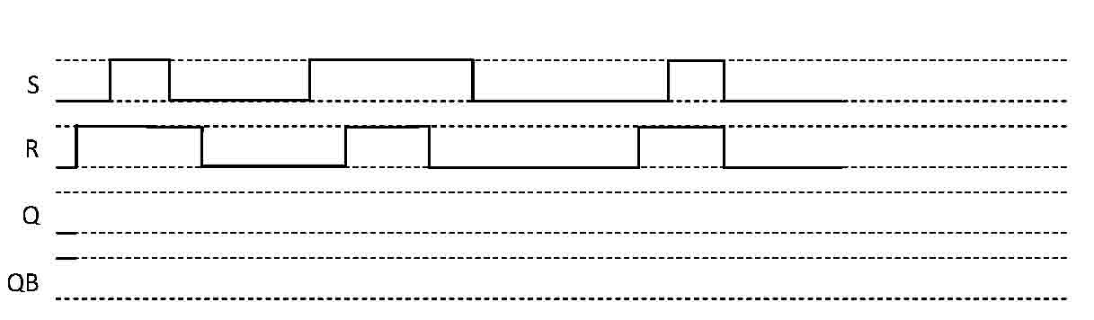
SR Latch Timing
$$QB$$
$$Q$$
S | R | Q | QB | Function
0 | 0
0 | 1
1 | 0
1 | 1
$$S$$
$$R$$

Slide 18
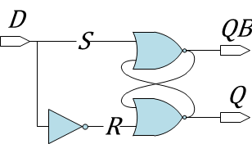
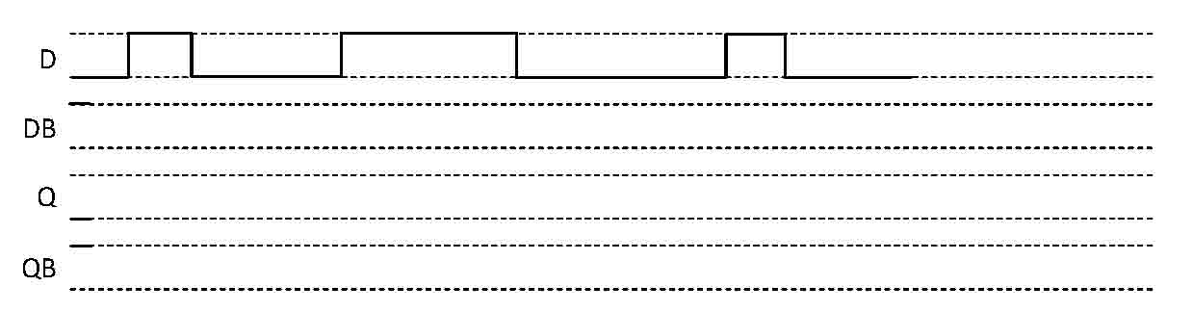
D (Data or Delay) Latch
D | Q | QB | Function
0
1

Slide 19
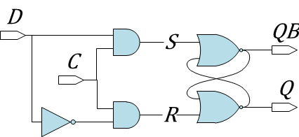
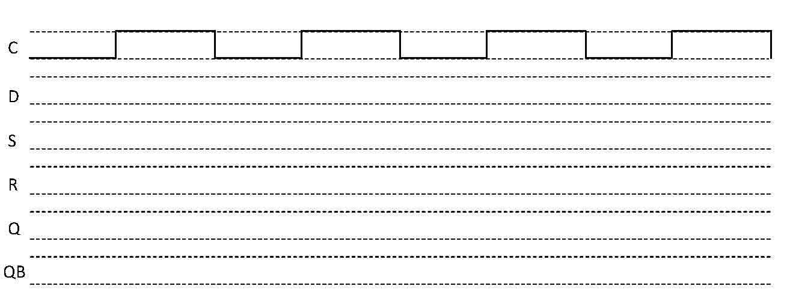
Clocked Level-Sensitive D Latch

Slide 20
Edge Triggered D Flip-flop
Want a device that will sample its inputs only once per clock cycle
Indicates edge-trigged behavior
“Double-door” analogy

Slide 21
Pull light switch revisited: D flip-flop implementation
Only one light toggle per clock cycle!
This device is known as a toggle flip-flop

Slide 22
Why Clocked Logic?
Clocking specifies a time by which all combinational operations are “done”.
What happens in between doesn’t matter.
This is super important.

Slide 23
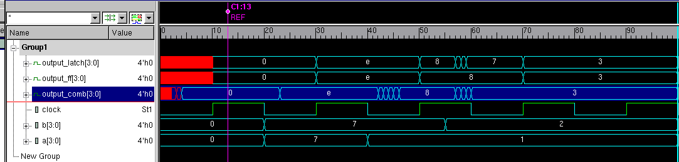
AN Example of Why This matters
Delays in combinational circuits are very real. Here’s an example with a ripple carry adder.

Slide 24
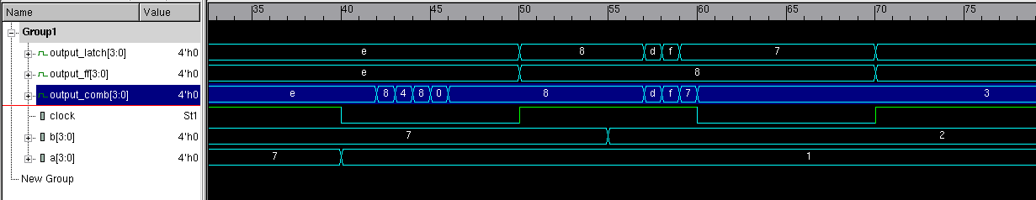
An Example of why this matters
Let’s zoom in on the interesting part.
The value of a goes from 7 to 1 here

Slide 25
An Example of why this matters
Let’s zoom in on the interesting part.
There’s propagation delay before the adder even starts to change values.

Slide 26
An Example of why this matters
Let’s zoom in on the interesting part.
The value stabilizes

Slide 27
An Example of why this matters
Let’s zoom in on the interesting part.
The next clock edge comes along

Slide 28
An Example of why this matters
Let’s zoom in on the interesting part.
The latch opens up
(and shows new value)
The flip-flop grabs new value.

Slide 29
An Example of why this matters
Let’s zoom in on the interesting part.
B changes now,
while the clock is still high.

Slide 30
An Example of why this matters
Let’s zoom in on the interesting part.
Again, there’s propagation delay before the adder starts to change.

Slide 31
An Example of why this matters
Let’s zoom in on the interesting part.
The value in the latch changes too!

Slide 32
An Example of why this matters
Let’s zoom in on the interesting part.
The next falling edge comes along

Slide 33
An Example of why this matters
Let’s zoom in on the interesting part.
The adder stabilizes.

Slide 34
An Example of why this matters
Let’s zoom in on the interesting part.
The latch locked with the wrong value!

Slide 35
An Example of why this matters
Let’s zoom in on the interesting part.
The next positive edge comes along

Slide 36
An Example of why this matters
Let’s zoom in on the interesting part.
Latch opens again
Flip-flop grabs new value

Slide 37
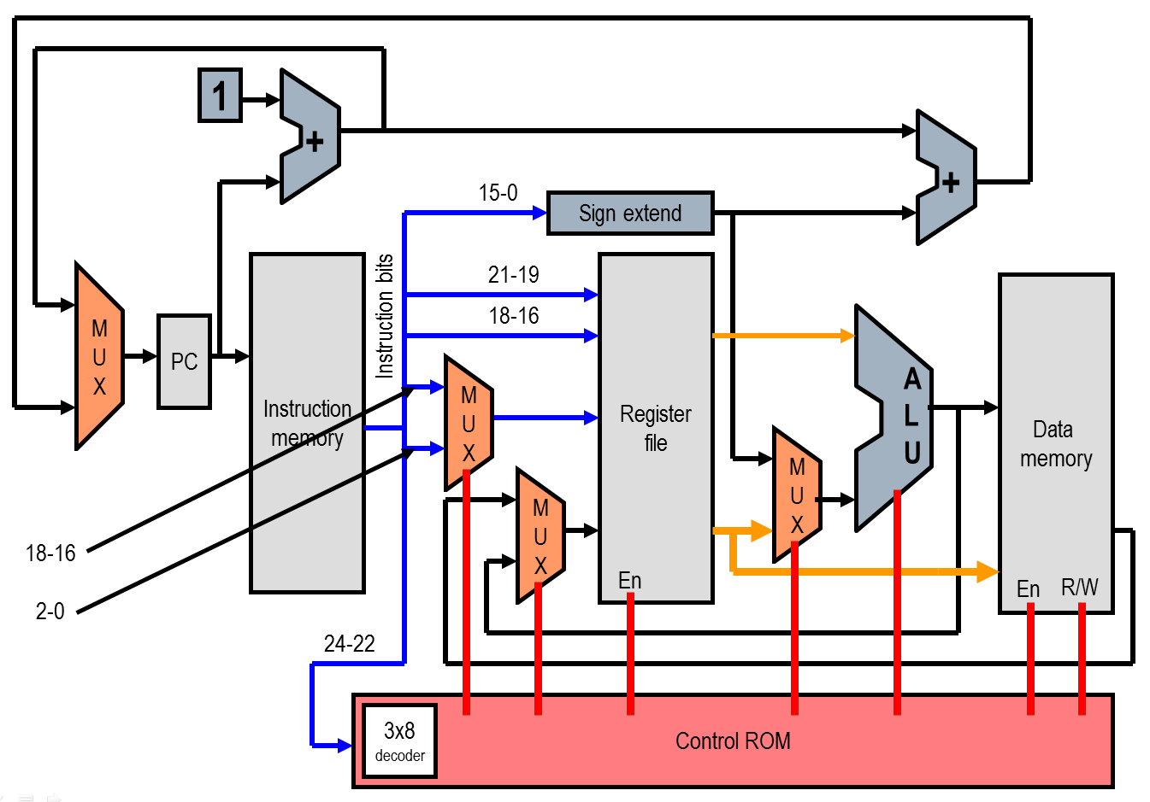
Single CYCLE CPU

Slide 38
Finite State Machines
An abstract machine that can be in one of a finite number of states at a time.
Transitions between states occur based on input.
For each state, a transition matrix is defined that determines which state is next based on the input.
Usually implemented in hardware with numbered states, and using D Flip-flops

Slide 39
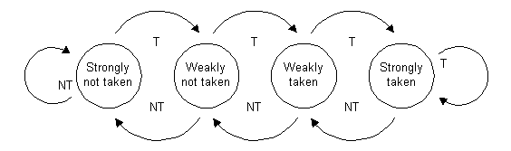
A Simple FSM
You’ll see this again later…
Implemented as a two bit counter:
Increments on T
Decrements on NT (not T)
00
01
10
11
http://en.m.wikipedia.org/wiki/File:Branch_prediction_2bit_saturating_counter.gif

Slide 40
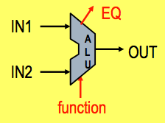
ARITHMETIC LOGIC UNIT
Schematic Diagram

Slide 41


ARITHMETIC LOGIC UNIT
Schematic Diagram
Implementation
~&

Slide 42
IEEE Floating point format (single precision)
EECS 370: Introduction to Computer Organization
42
Sign bit: (0 is positive, 1 is negative)
Significand: (also called the mantissa; stores the 23 most significant bits after the decimal point)
Exponent: used biased base 127 encoding
Add 127 to the value of the exponent to encode:
-127 → 00000000 1 → 10000000
-126 → 00000001 2 → 10000001
… …
0 → 01111111 128 → 11111111
How do you represent zero ? Special convention:
Exponent: -127 (all zeroes ), Significand 0 (all zeroes), Sign + or -

Slide 43
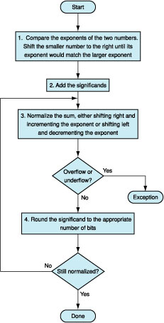
Floating point Addition
EECS 370: Introduction to Computer Organization
43
Shift smaller exponent right to match larger.
Add significands
Normalize and update exponent
Check for “out of range”

Slide 44
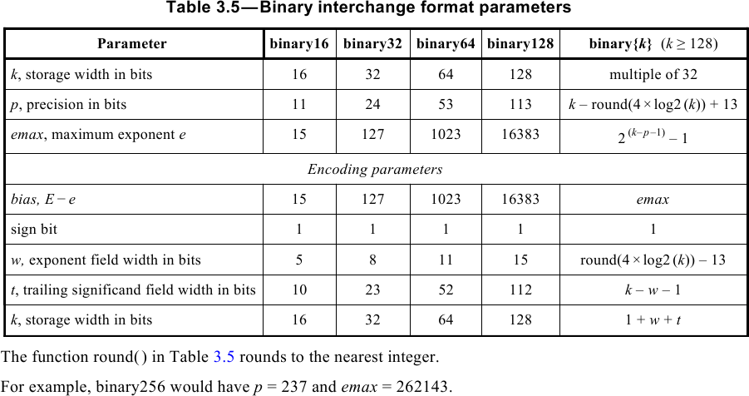
More or less precision and range (continued)

