Slide 1
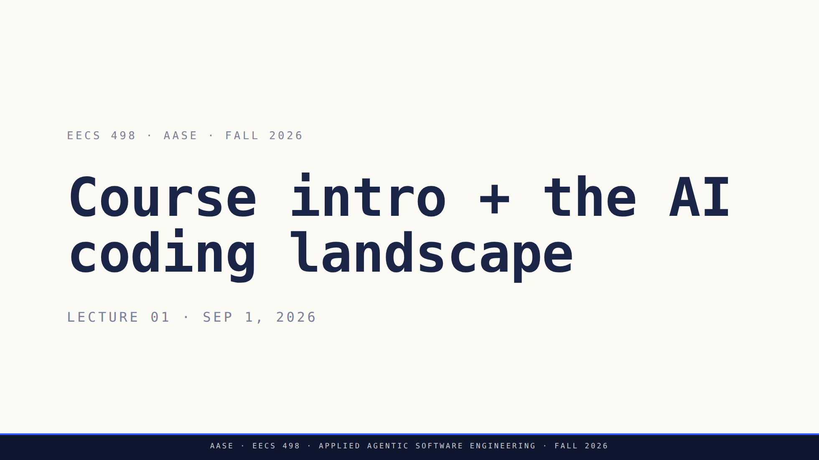
Notes:
Title slide. Energy up. Today is Day 1.
The arc of the lecture: orient → land the philosophy → discussion → then (and only then) the tool.

Slide 2
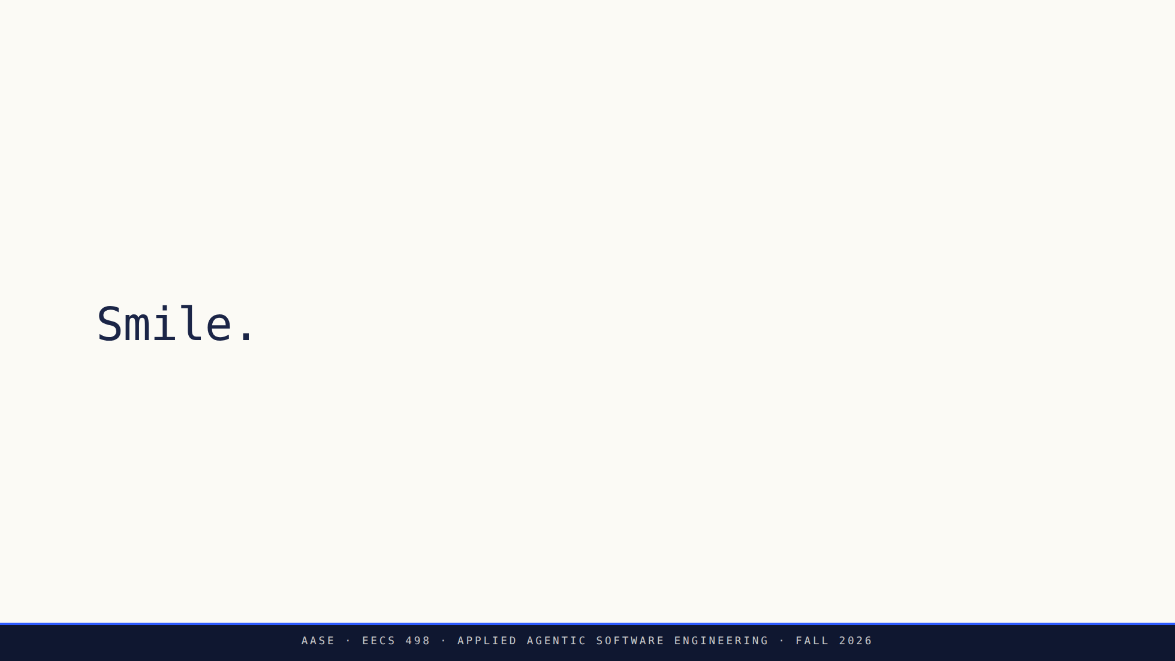
Notes:
Beat one. Just the word. Let them actually do it — wait for it.
Embodied cognition: posture and expression move cognitive performance.

Slide 3
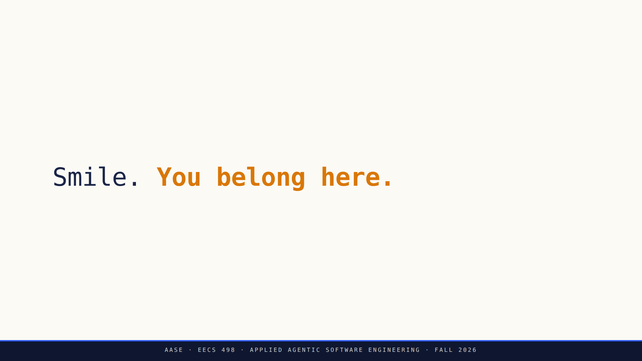
Notes:
Beat two, appended. Now the reason.
Neighbor affirmation: turn and tell them. Then move.

Slide 4
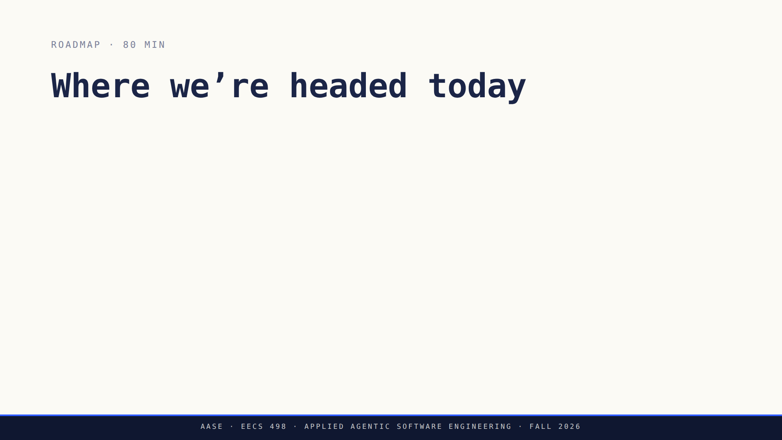
Notes:
Land the arc. Note: tool comes LAST. We earn the tool by talking principles first.

Slide 5
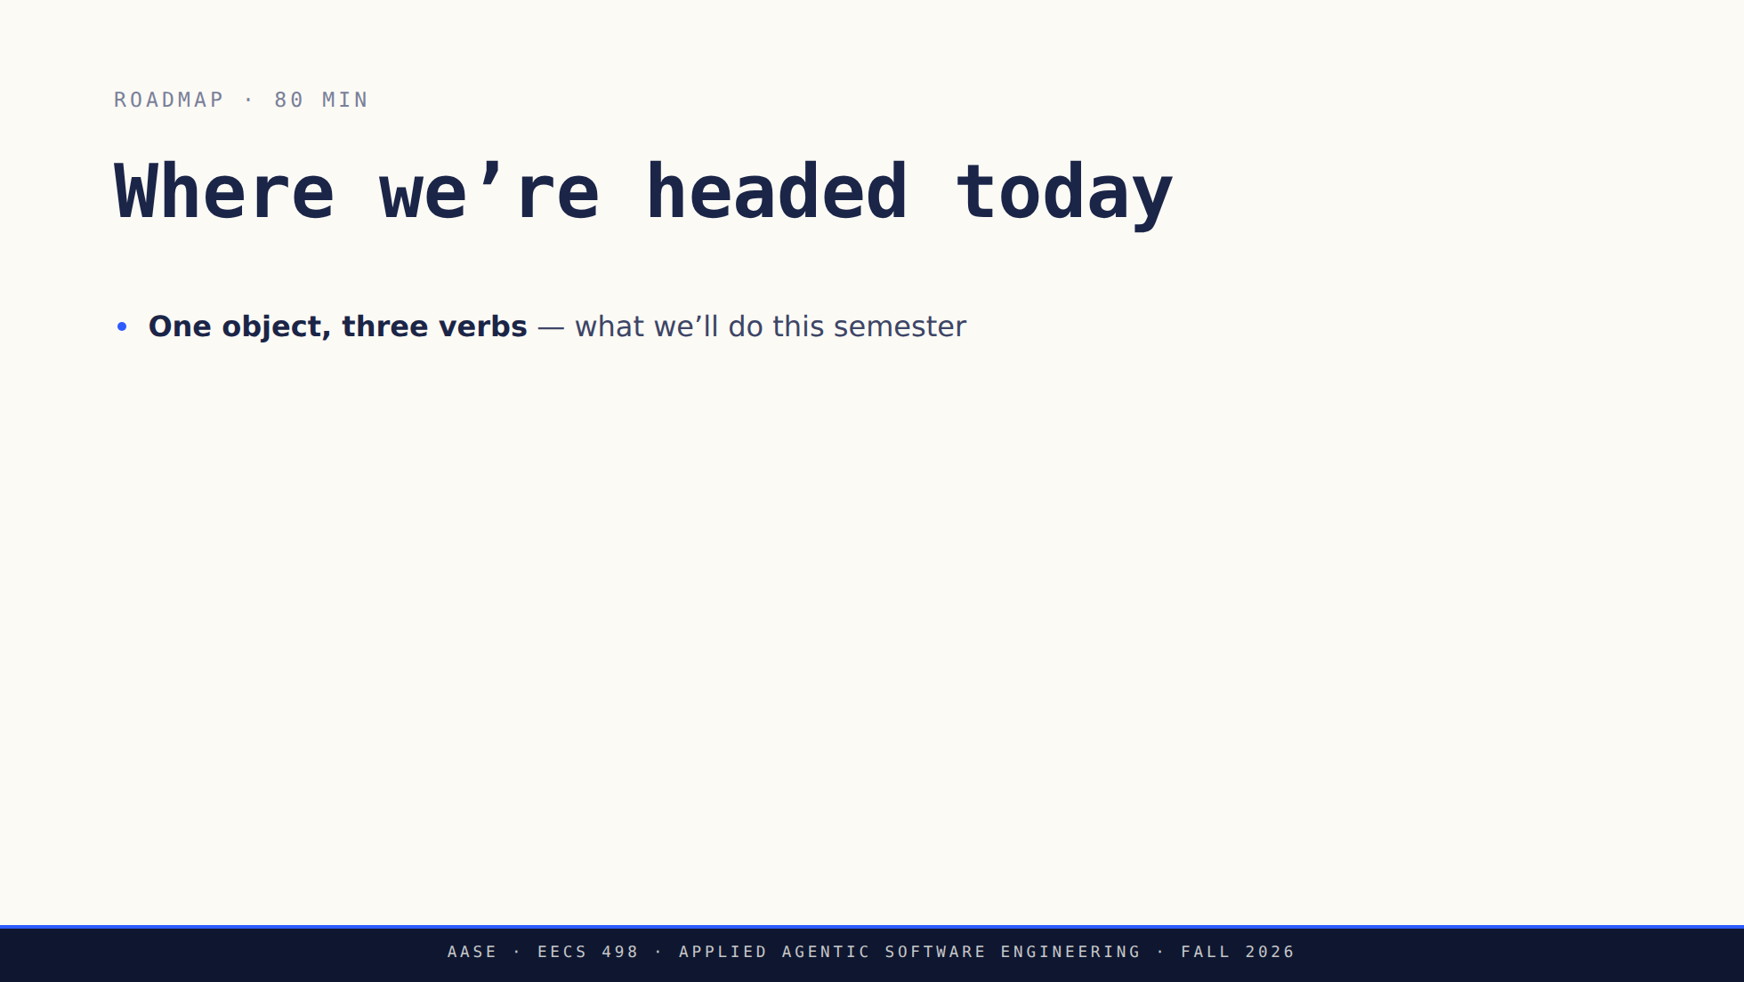
Notes:
Land the arc. Note: tool comes LAST. We earn the tool by talking principles first.

Slide 6
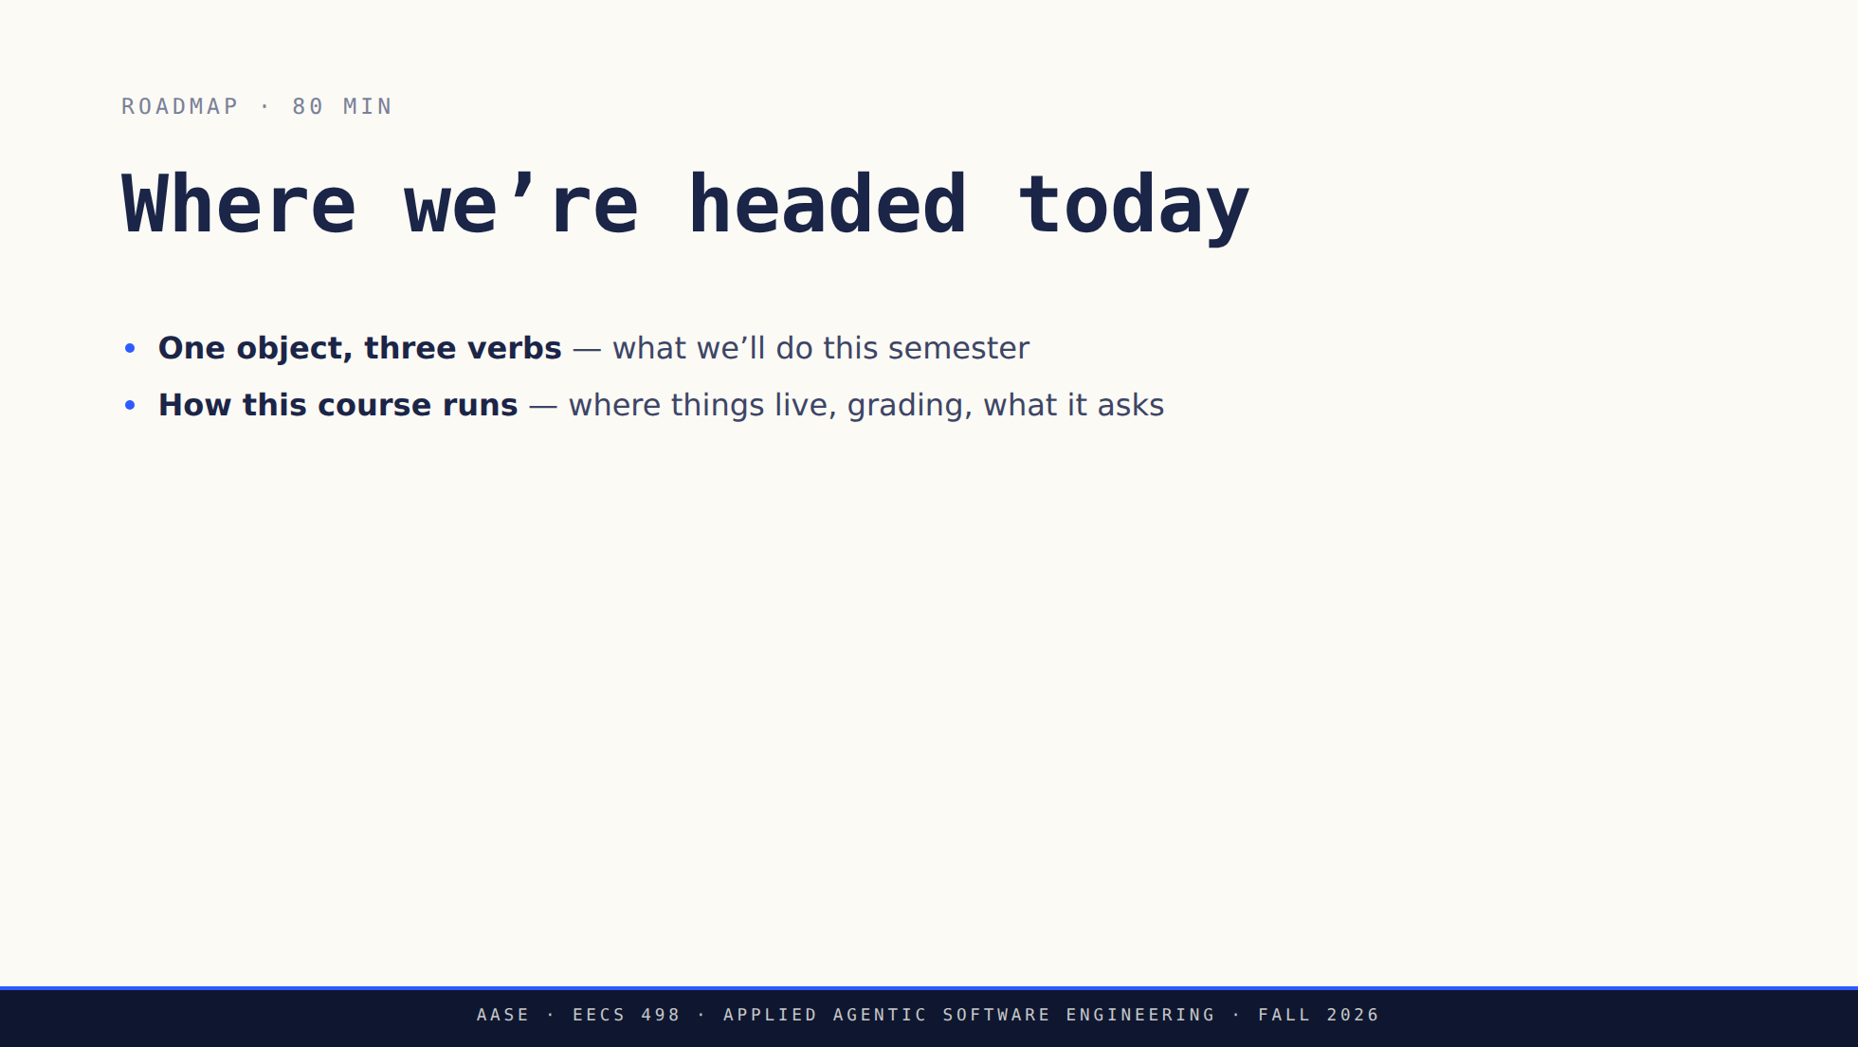
Notes:
Land the arc. Note: tool comes LAST. We earn the tool by talking principles first.

Slide 7
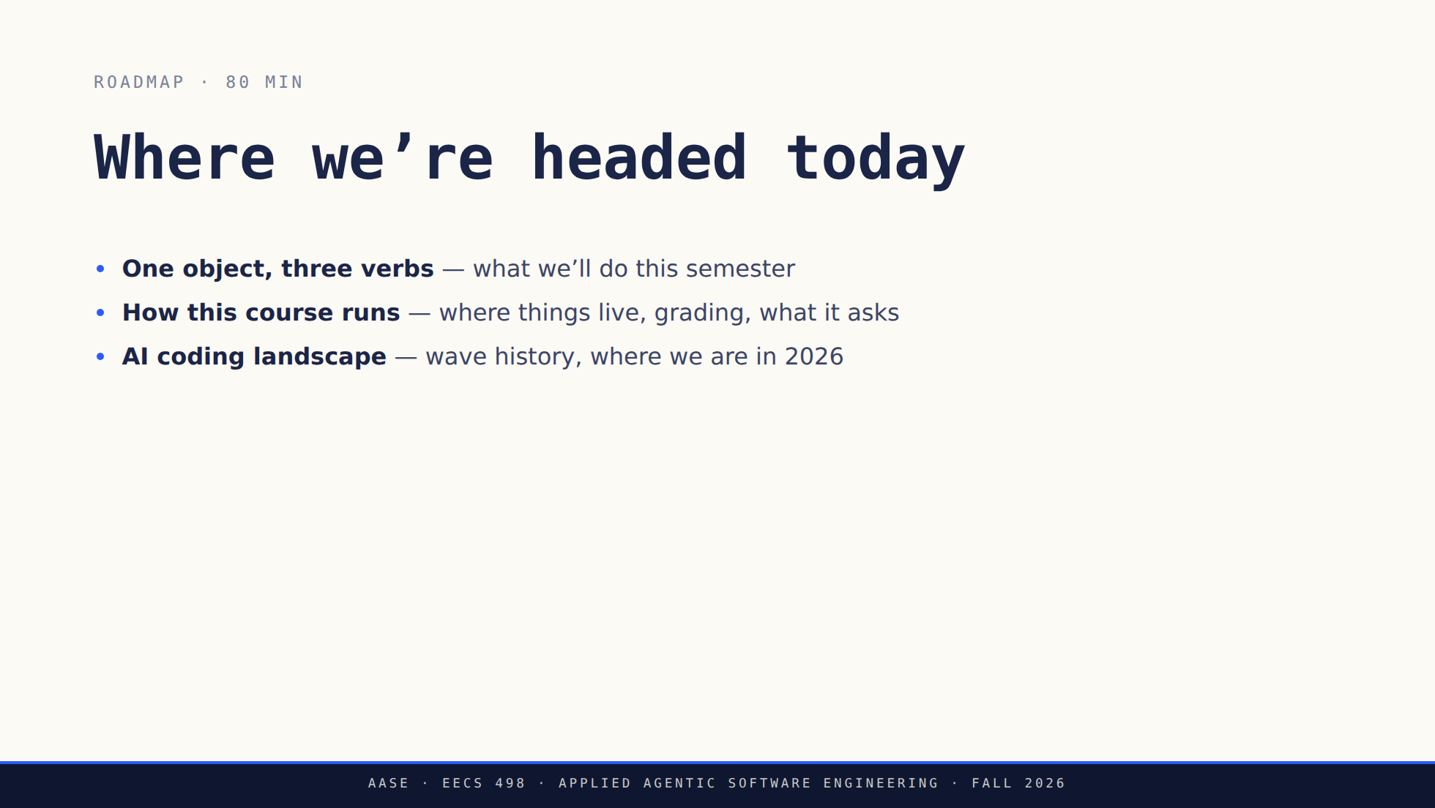
Notes:
Land the arc. Note: tool comes LAST. We earn the tool by talking principles first.

Slide 8
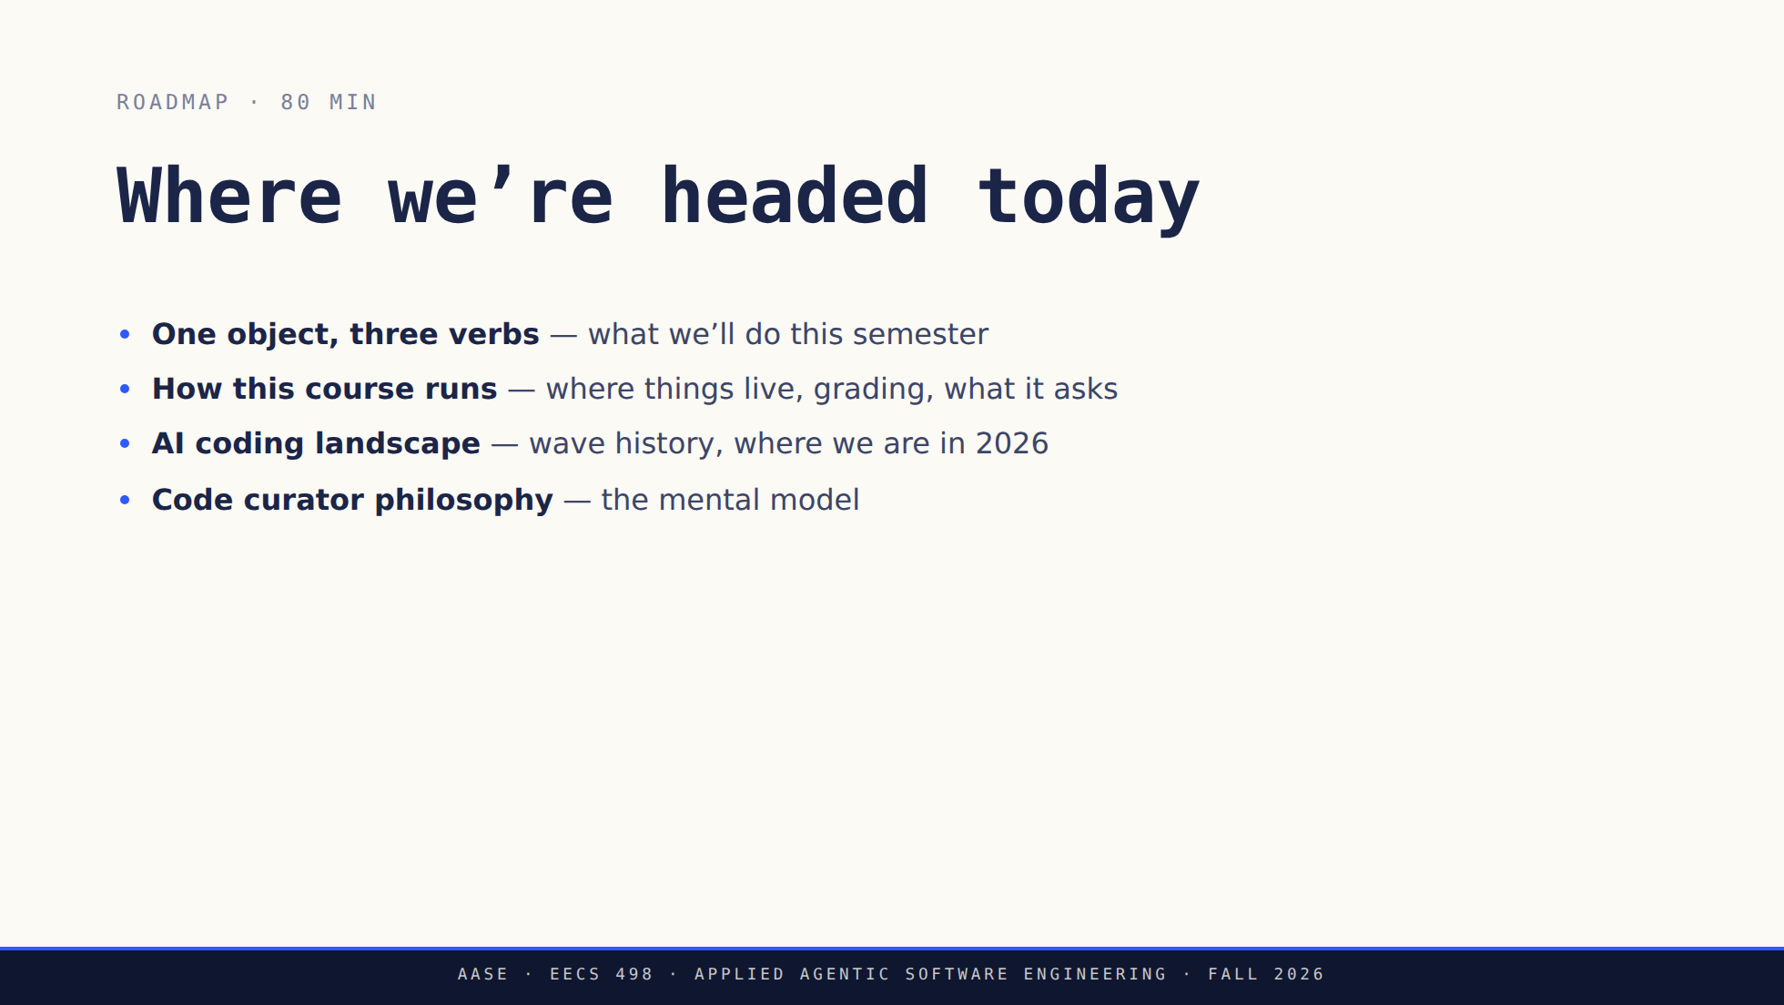
Notes:
Land the arc. Note: tool comes LAST. We earn the tool by talking principles first.

Slide 9
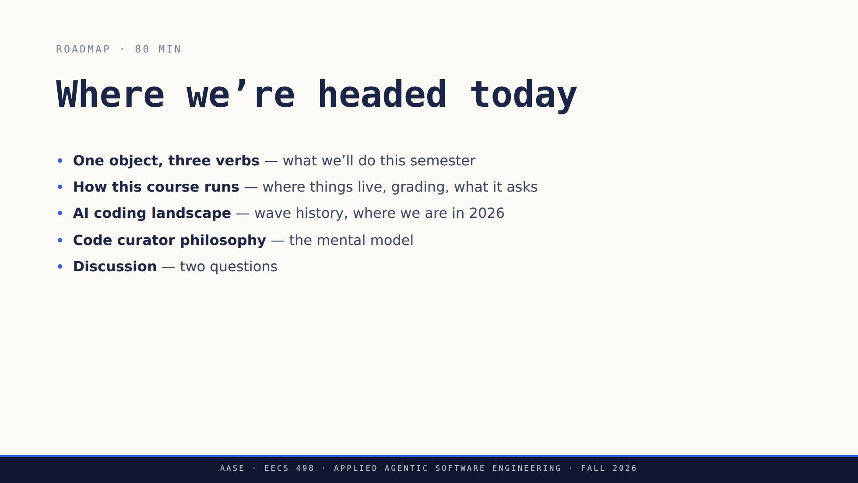
Notes:
Land the arc. Note: tool comes LAST. We earn the tool by talking principles first.

Slide 10
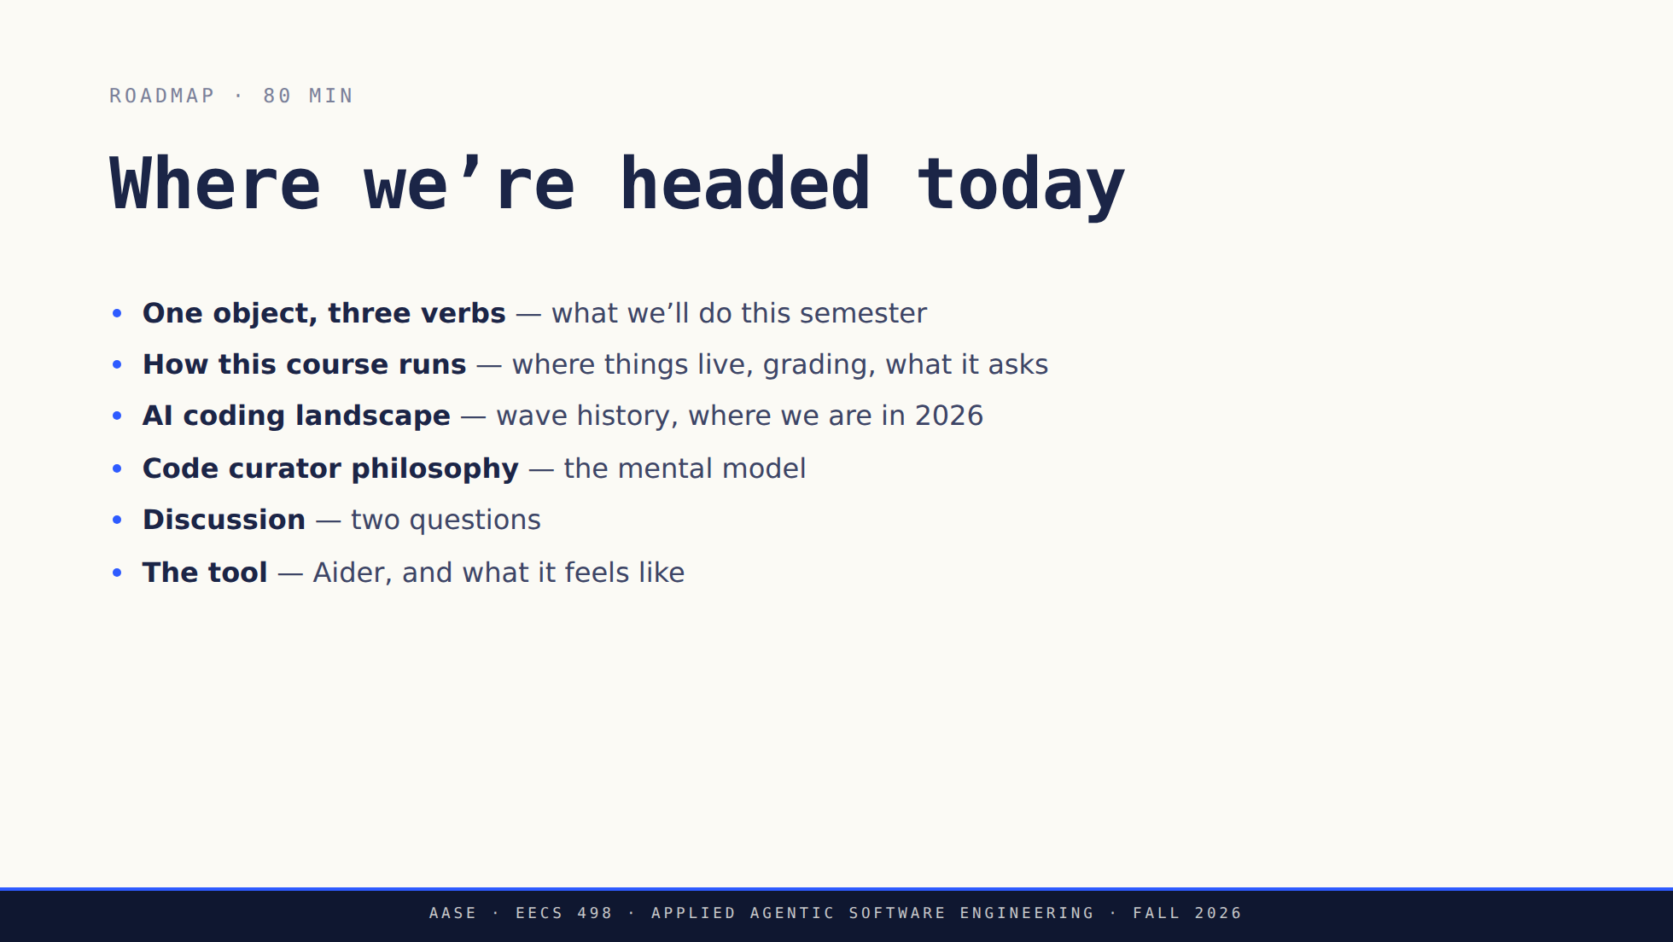
Notes:
Land the arc. Note: tool comes LAST. We earn the tool by talking principles first.

Slide 11
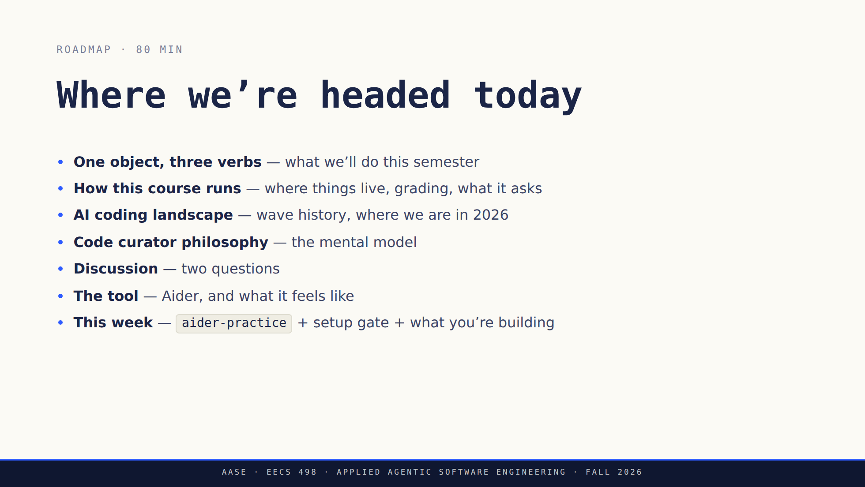
Notes:
Land the arc. Note: tool comes LAST. We earn the tool by talking principles first.

Slide 12
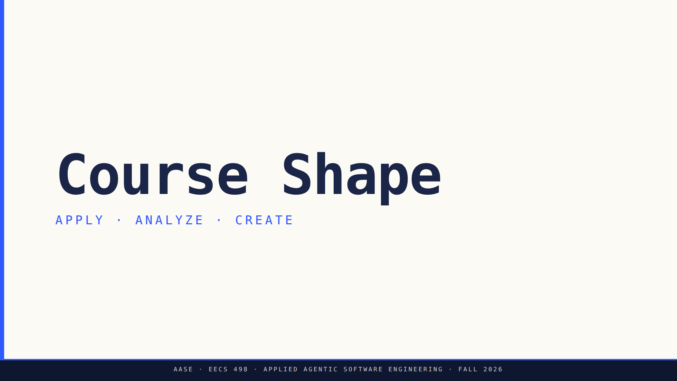
Notes:
Bridge: Now that we've named our presence, here's the 15-week shape.

Slide 13
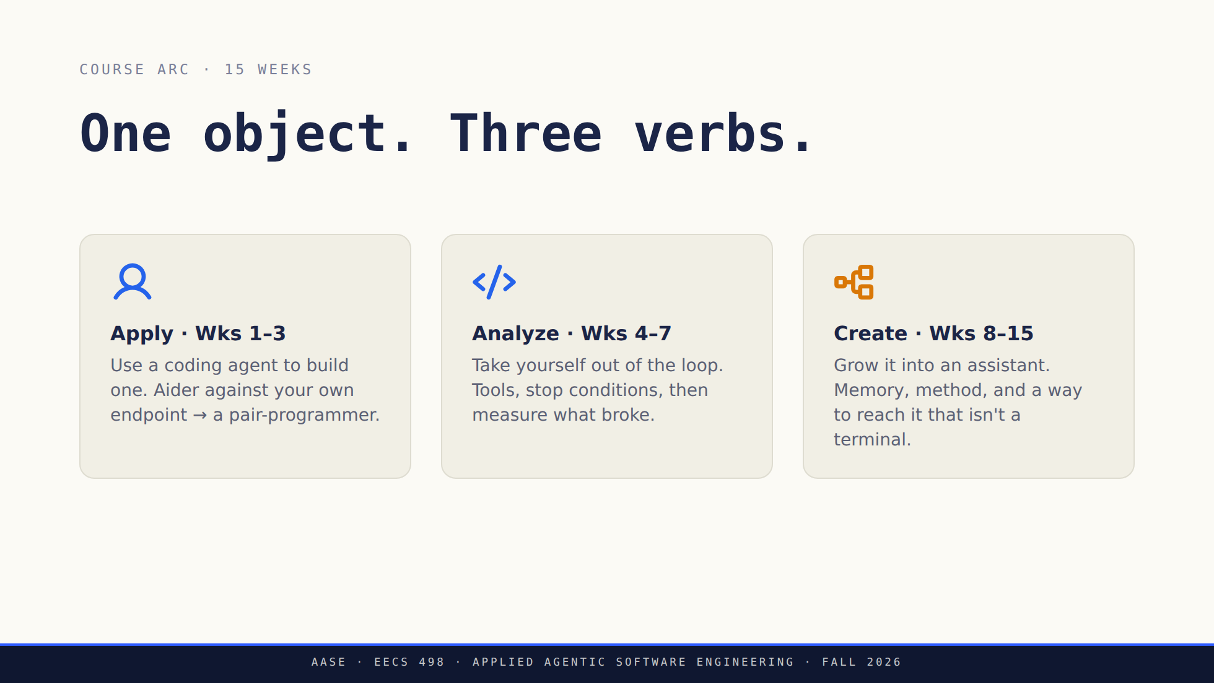
Notes:
Create in amber: it's the destination, the "moment" of the slide.
Say the line out loud: it is all ONE repository, weeks 1 to 15.

Slide 14
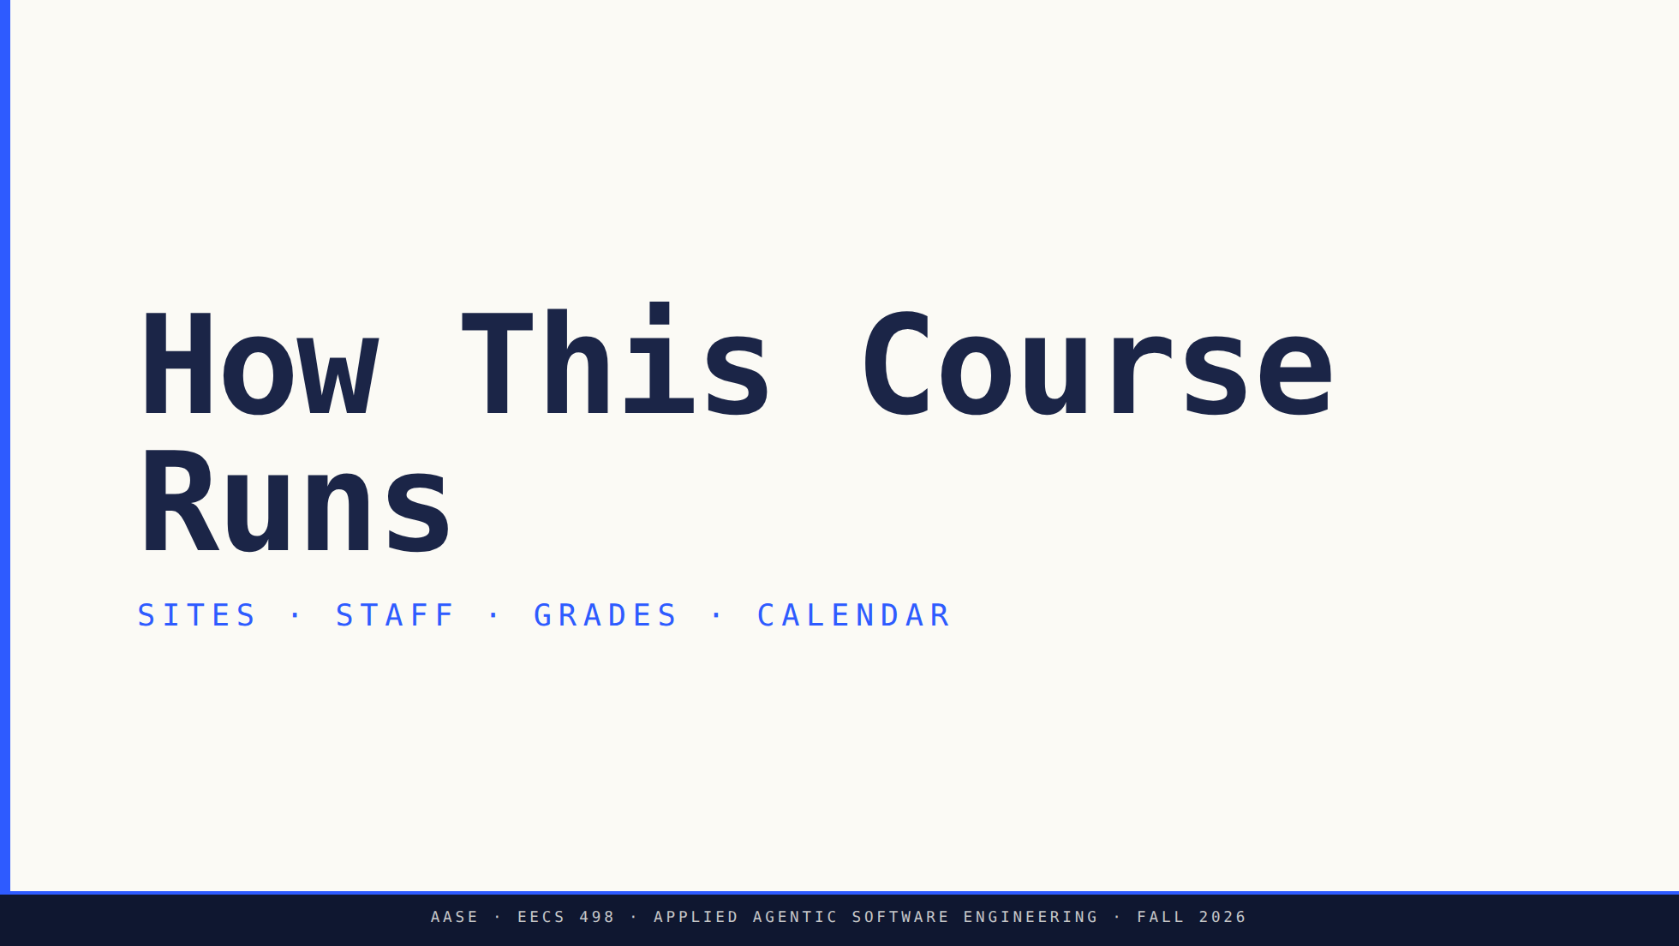
Notes:
Brisk. The syllabus carries detail; this is the map. But slow down on
integrity and on the hackathon evenings.

Slide 15
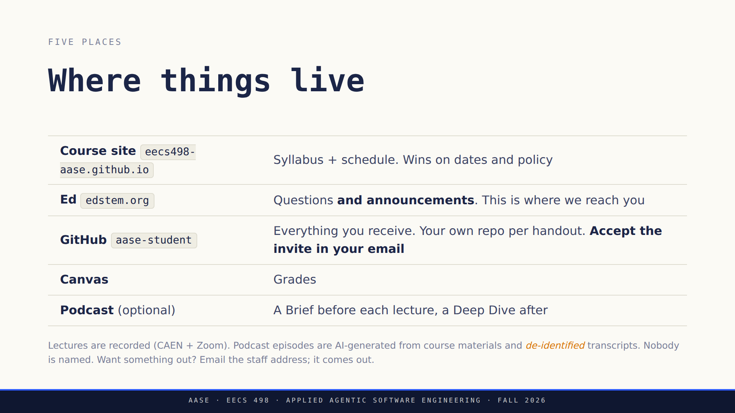
Notes:
Say the recording line plainly, don't bury it. Ed is the one they must
actually check — the podcast announcement is already up there.

Slide 16
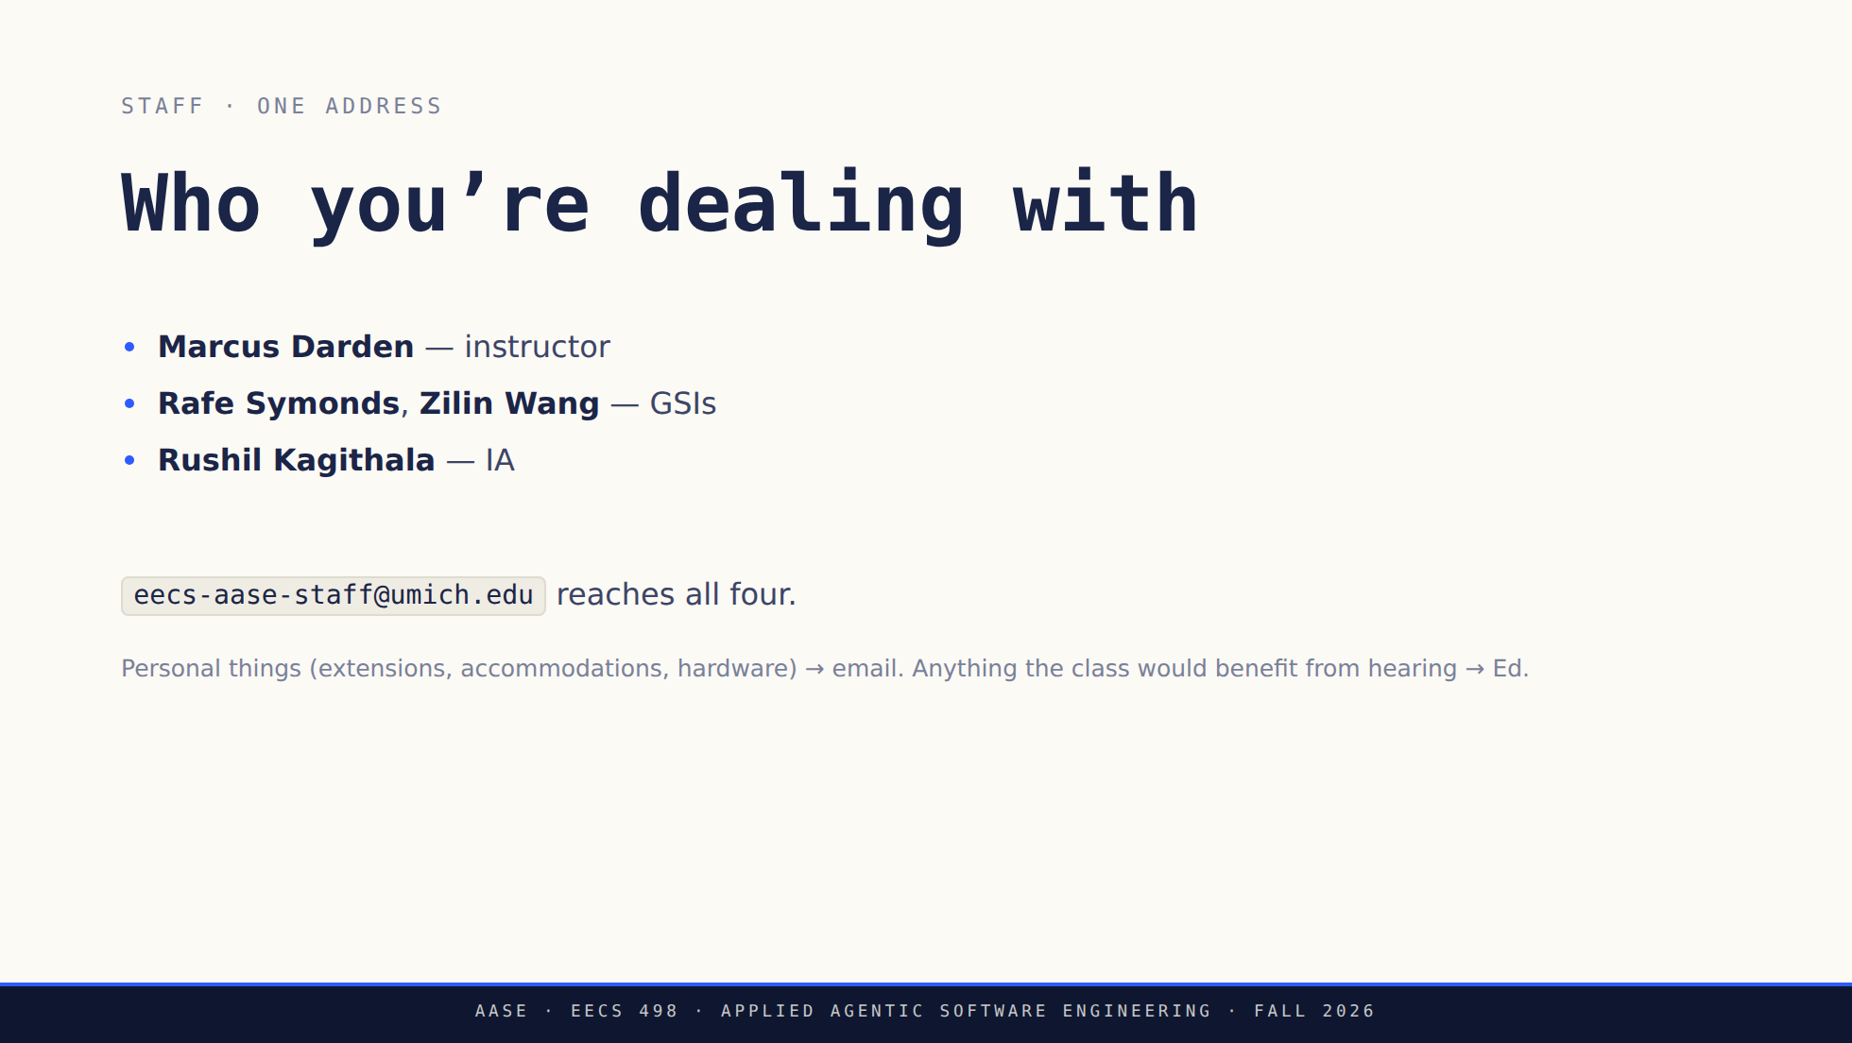
Notes:
Office hours start this week; confirmed times and rooms go up on Ed.

Slide 17
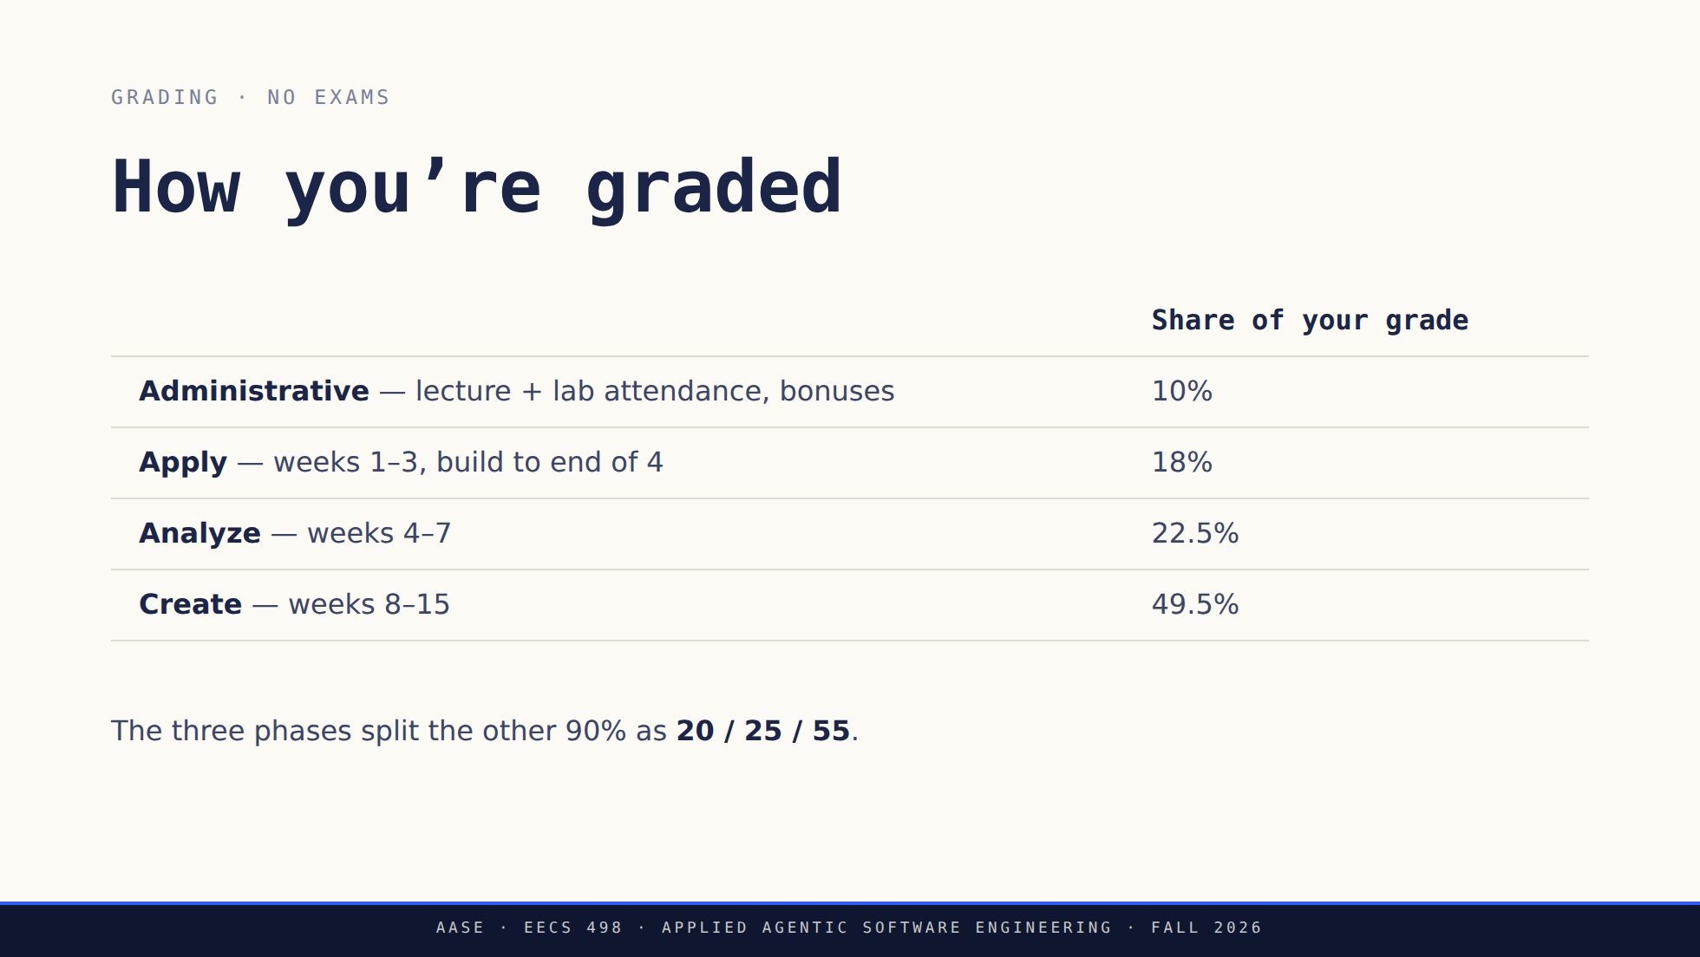
Notes:
The gate framing matters: it kills the "did I pass" anxiety and makes
running it early the obvious move.

Slide 18
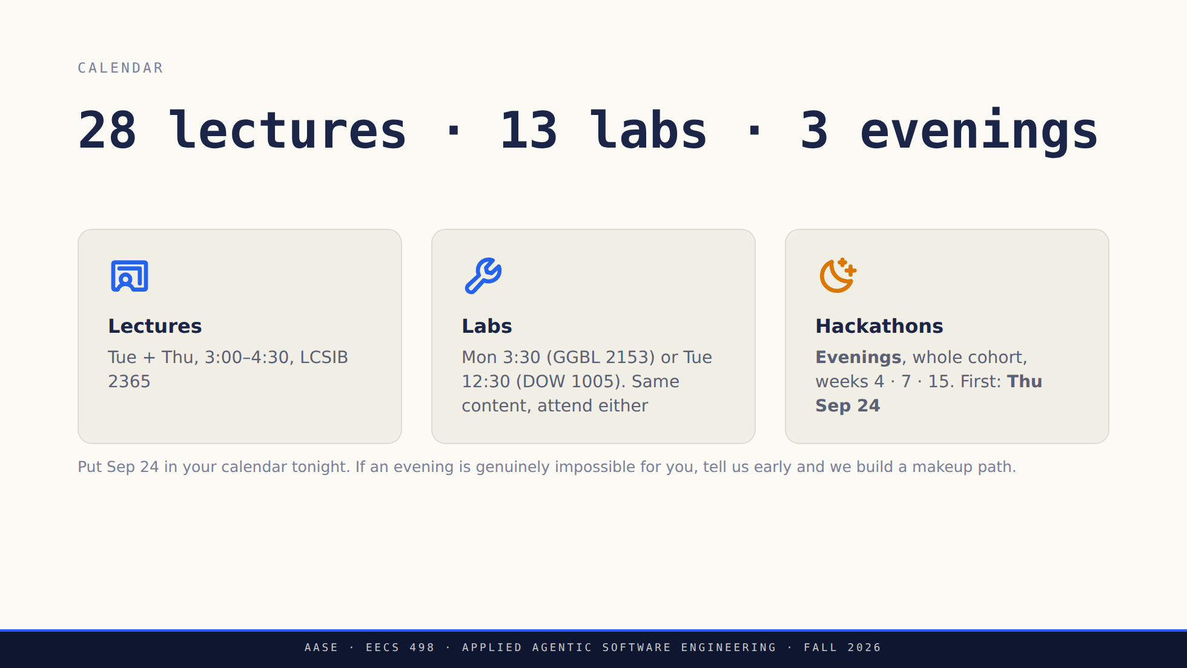
Notes:
Land the evening commitment now. Someone in this room has a job or a
kid and needs three weeks of warning, not three days.

Slide 19
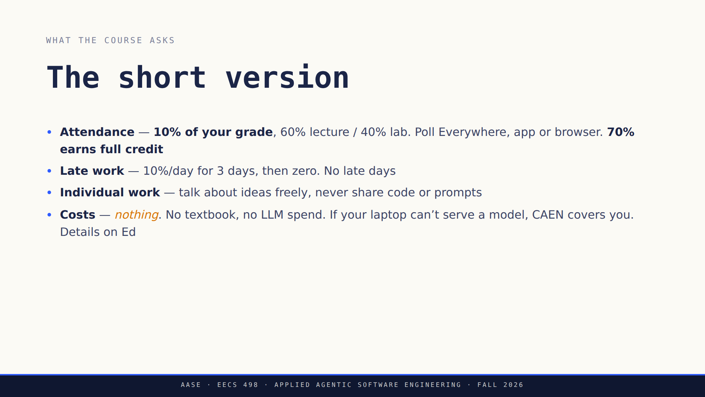
Notes:
Costs gets the serif emphasis: it's the promise that makes the local
model policy fair, and it's why nobody needs a subscription.

Slide 20
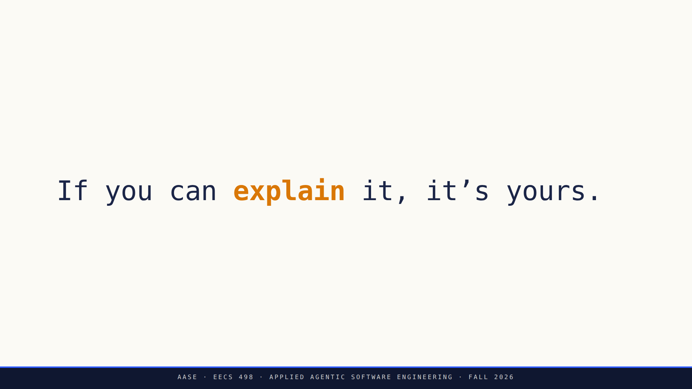
Notes:
THE slide of the day. Slow down.
AI use is required here, not tolerated. What's graded is understanding:
explain any line you hand in, document tools/models/prompts. If you
can't explain it, it isn't yours — and that's an Honor Code matter.

Slide 21
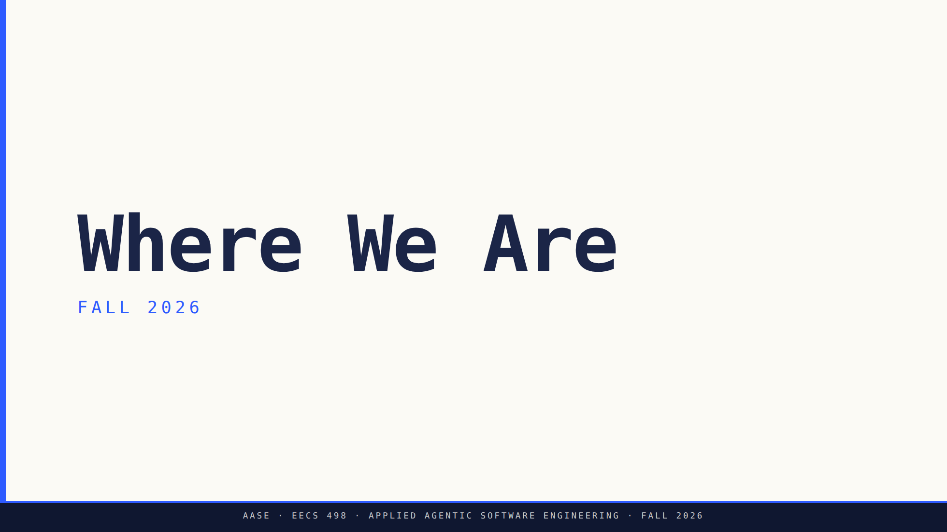
Notes:
Bridge: Before we go further into our plan, situate where we are in the industry.

Slide 22
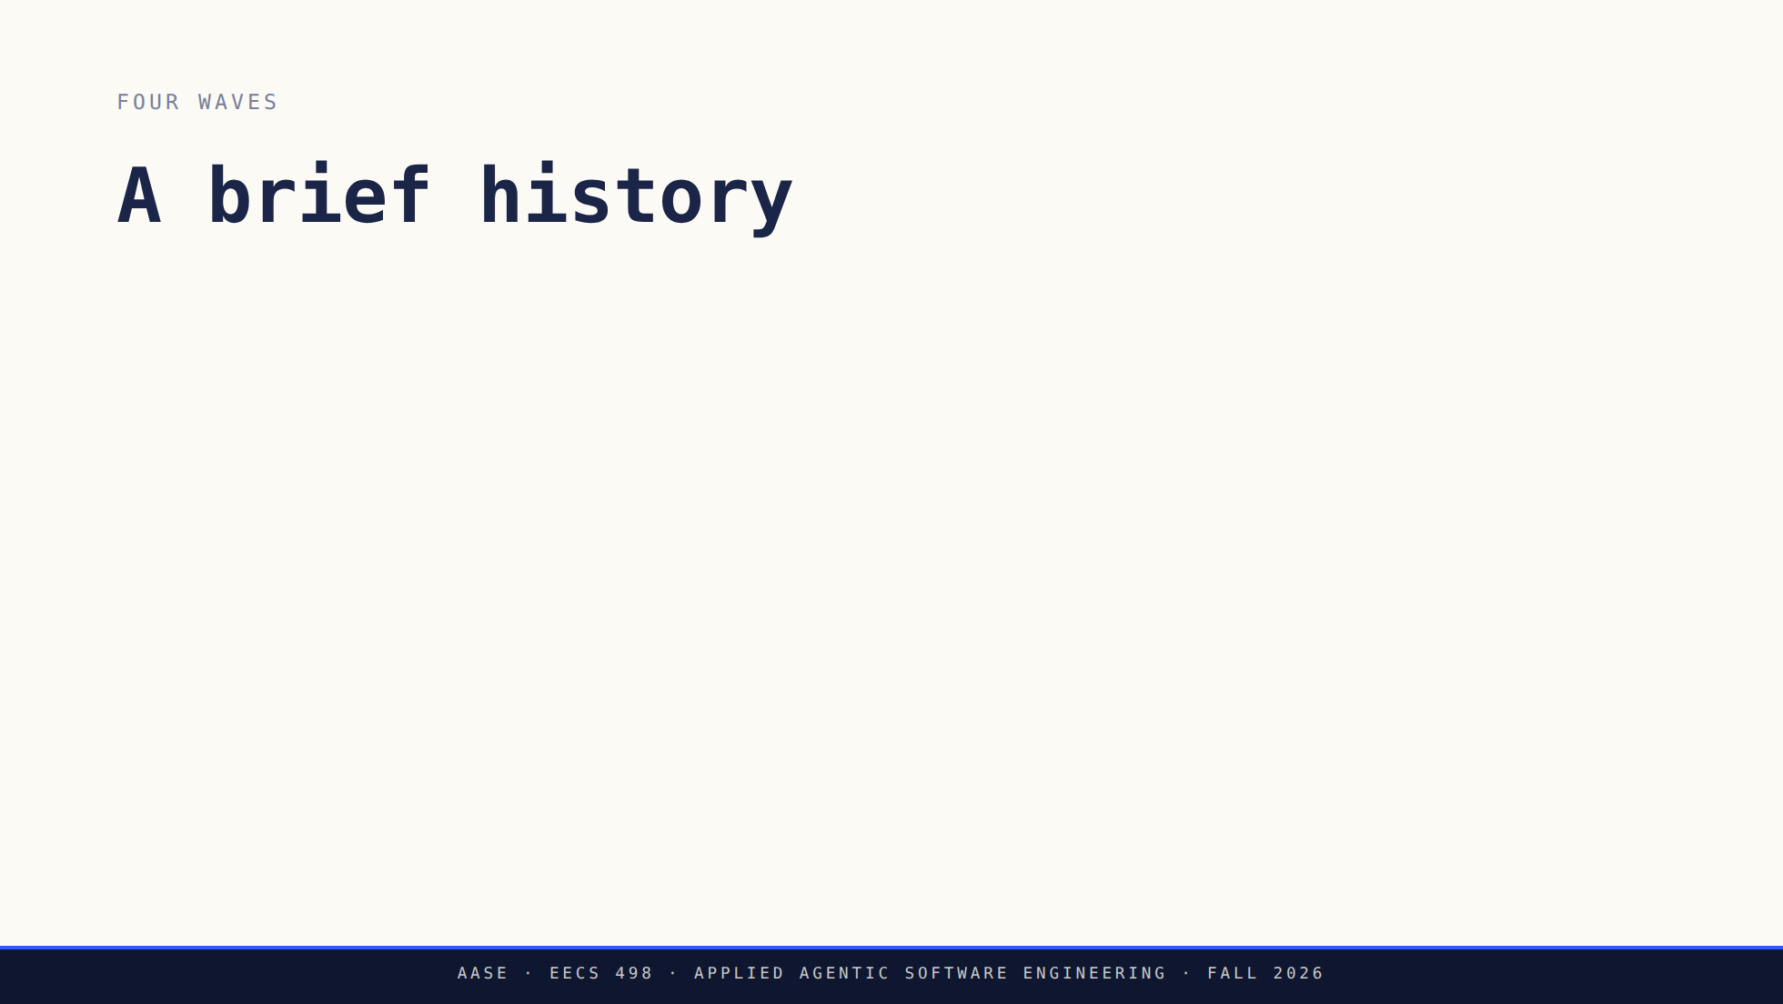
Notes:
Autocomplete predates wave 1 — Kite, TabNine — but Copilot is where it
became load-bearing, so that is where the clock starts.
Most students entered at Wave 3. We're heading to Wave 4 by December.

Slide 23
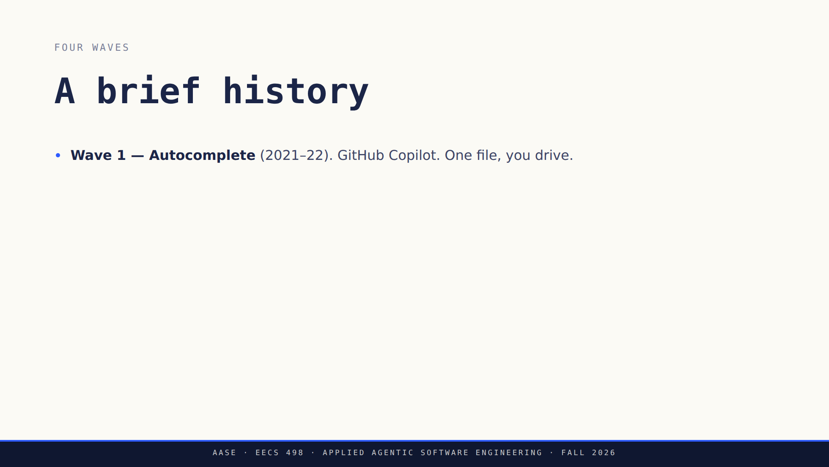
Notes:
Autocomplete predates wave 1 — Kite, TabNine — but Copilot is where it
became load-bearing, so that is where the clock starts.
Most students entered at Wave 3. We're heading to Wave 4 by December.

Slide 24
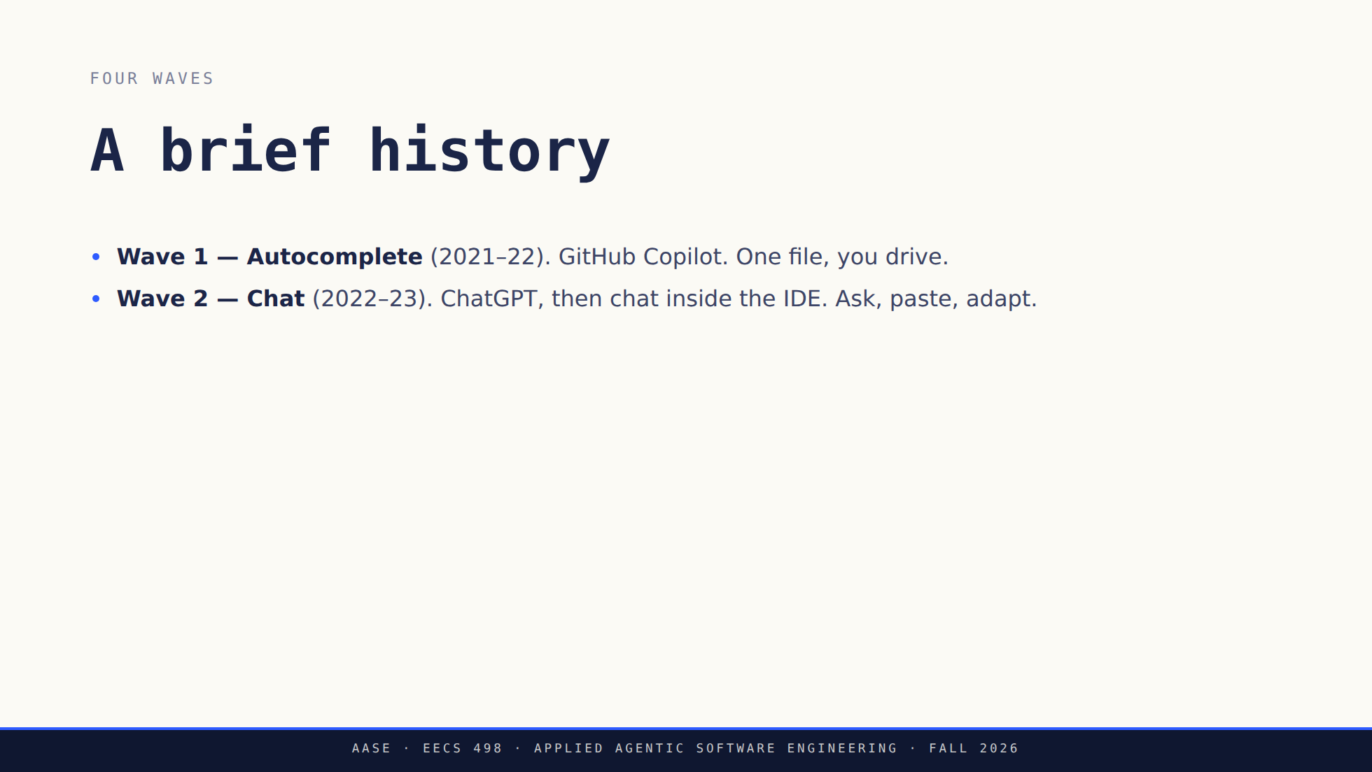
Notes:
Autocomplete predates wave 1 — Kite, TabNine — but Copilot is where it
became load-bearing, so that is where the clock starts.
Most students entered at Wave 3. We're heading to Wave 4 by December.

Slide 25
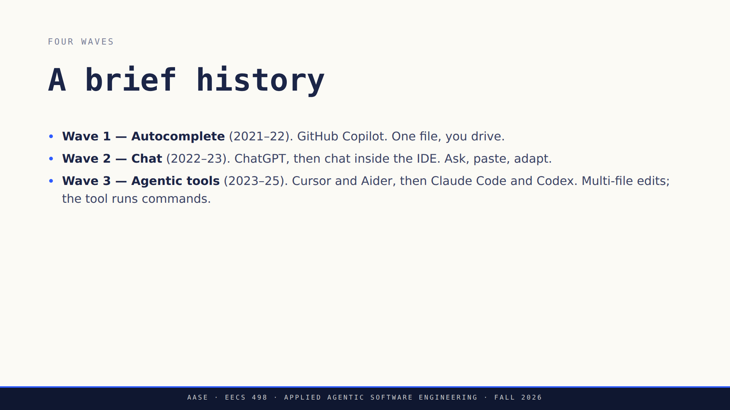
Notes:
Autocomplete predates wave 1 — Kite, TabNine — but Copilot is where it
became load-bearing, so that is where the clock starts.
Most students entered at Wave 3. We're heading to Wave 4 by December.

Slide 26
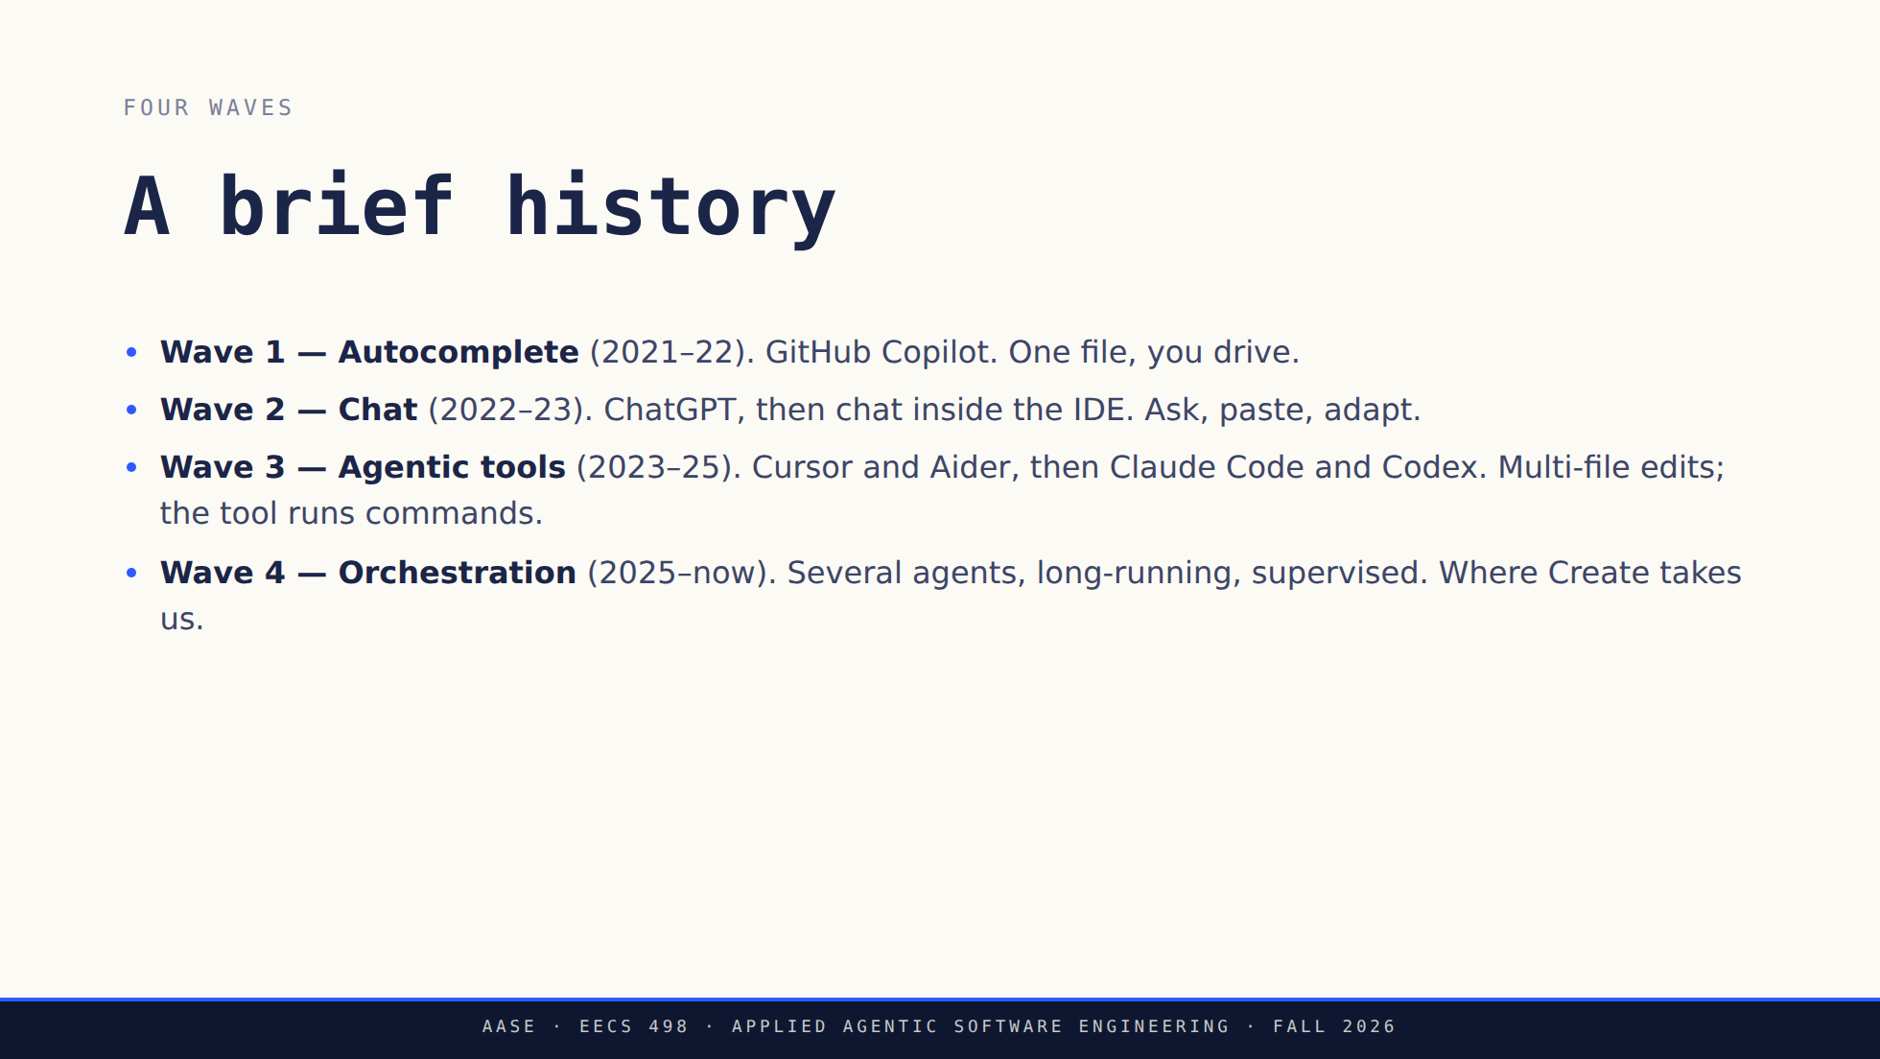
Notes:
Autocomplete predates wave 1 — Kite, TabNine — but Copilot is where it
became load-bearing, so that is where the clock starts.
Most students entered at Wave 3. We're heading to Wave 4 by December.

Slide 27
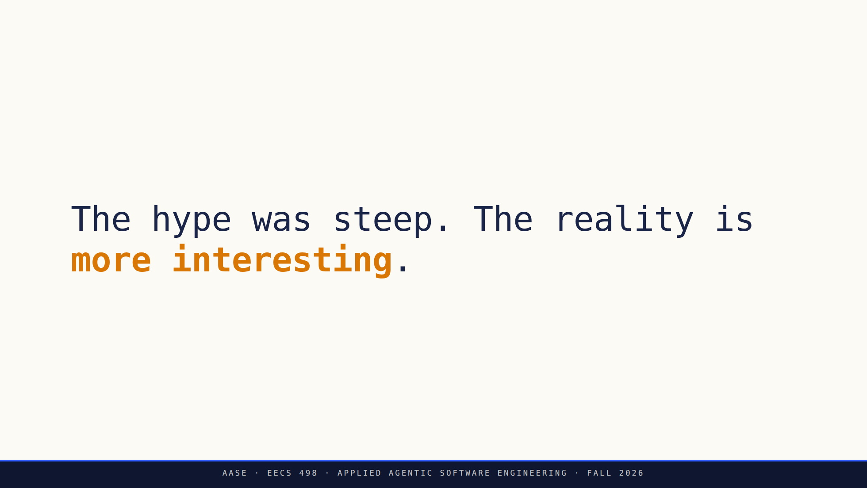
Notes:
Honesty moment. AI did not replace programmers. A new category of workflow emerged.
The developers who learned to work WITH AI became dramatically more productive.

Slide 28
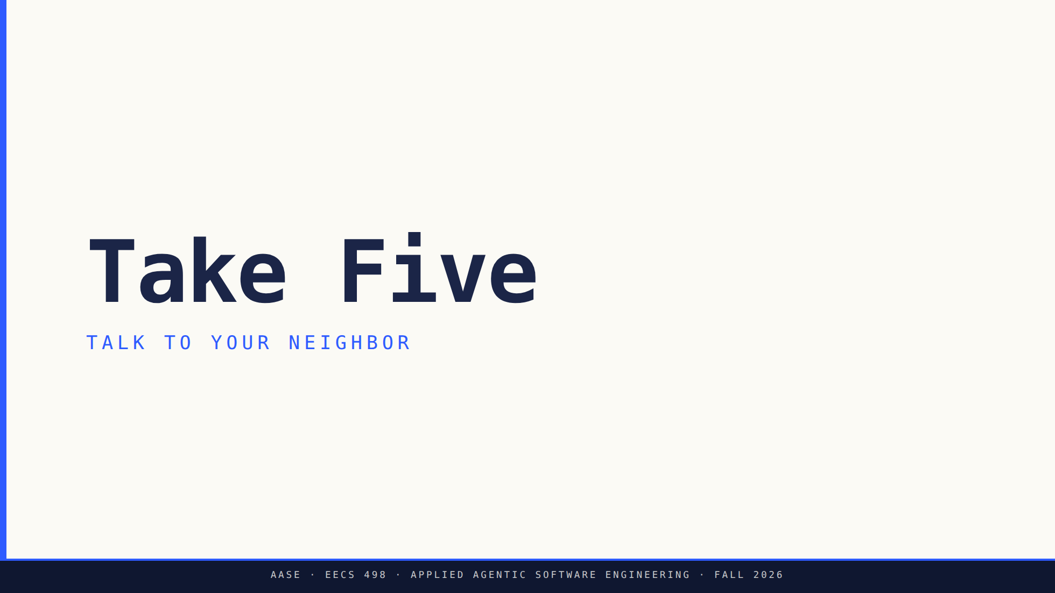
Notes:
Bridge: Pause. Connect this to your own experience before we layer on the philosophy.

Slide 29
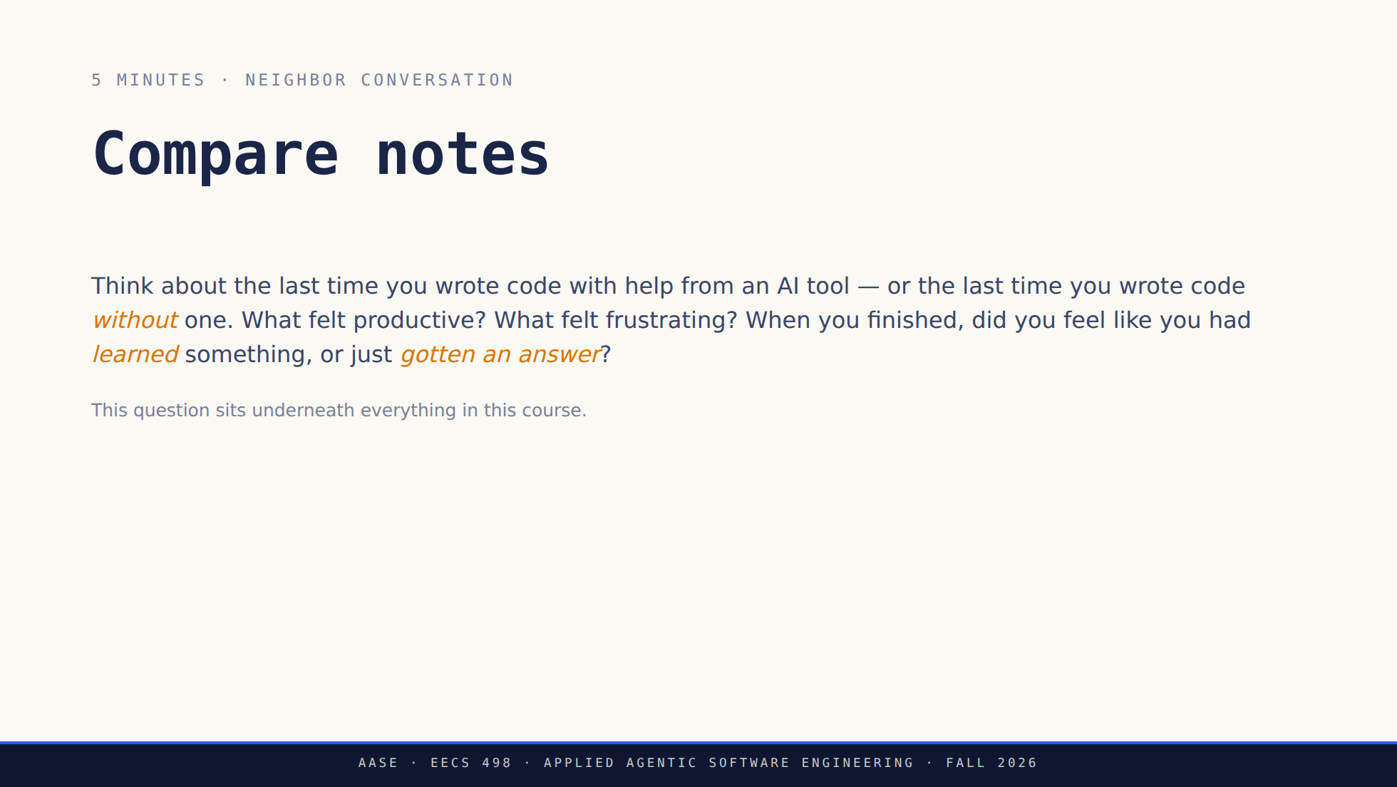

Slide 30
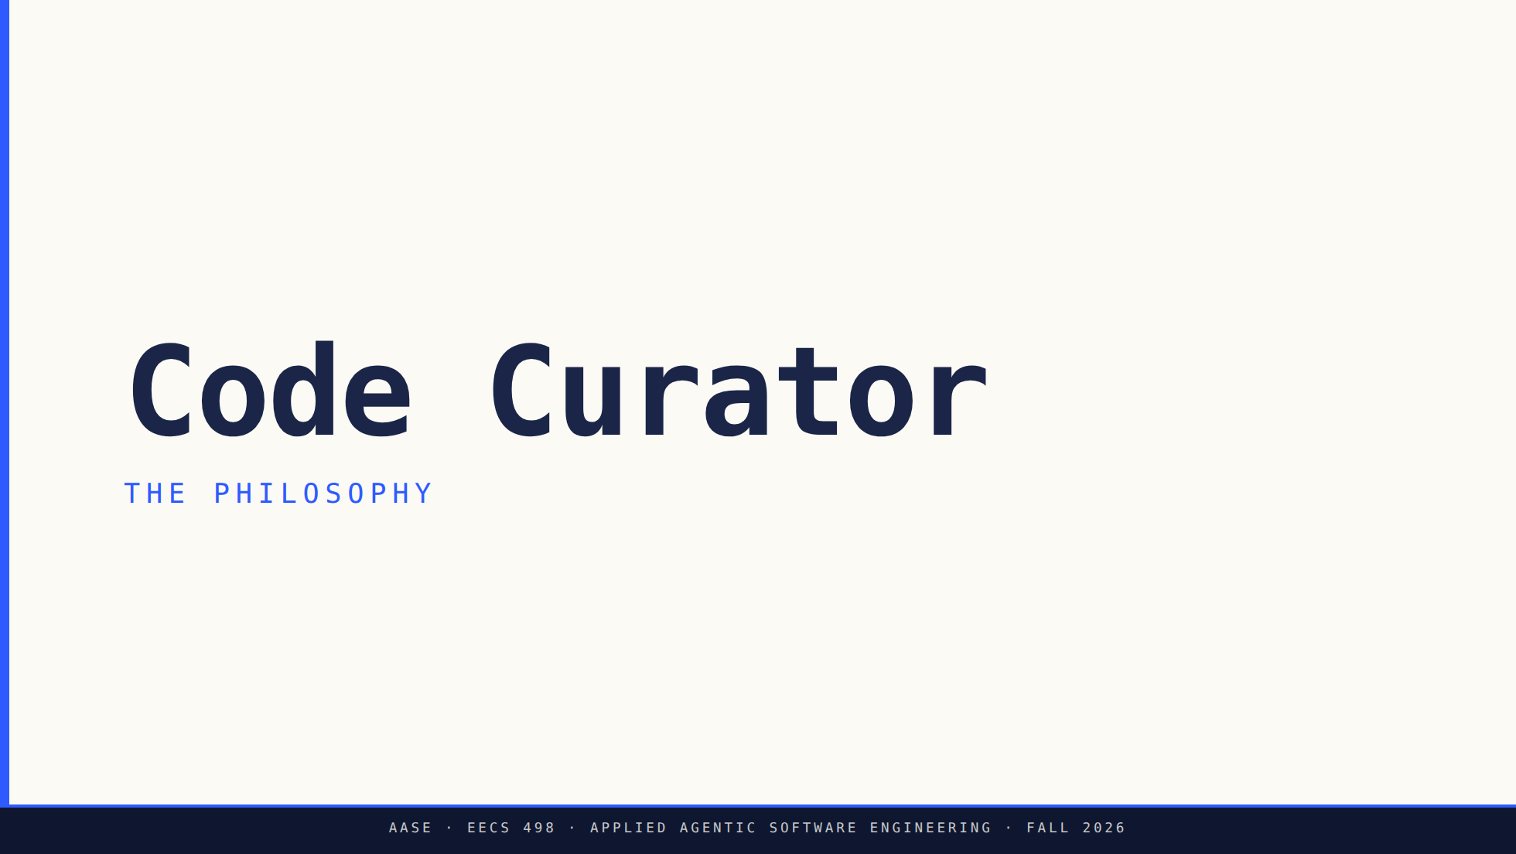
Notes:
Bridge: Hold whatever you just discussed with your neighbor. Here's the mental model that reframes it.

Slide 31
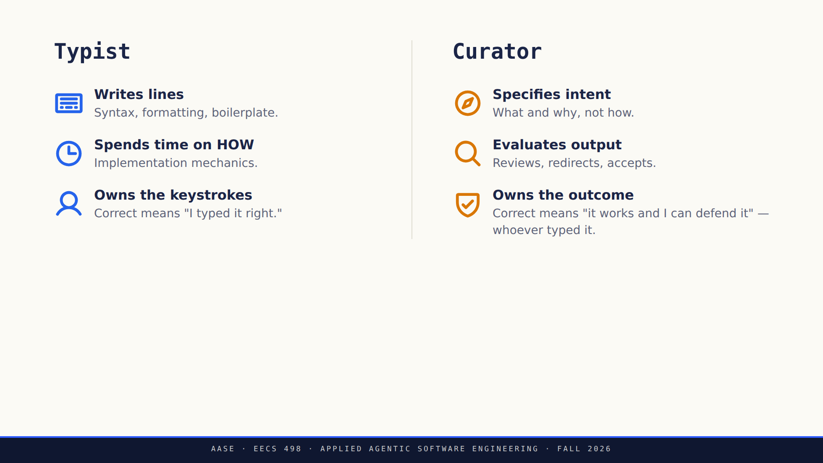
Notes:
The philosophical shift. Same engineer, different time allocation.

Slide 32
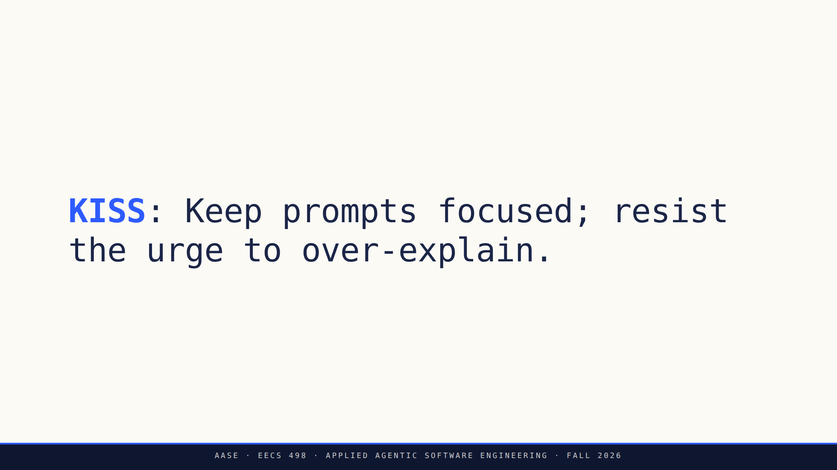
Notes:
Not the networking protocol. KISS in this course = clarity beats verbosity.

Slide 33
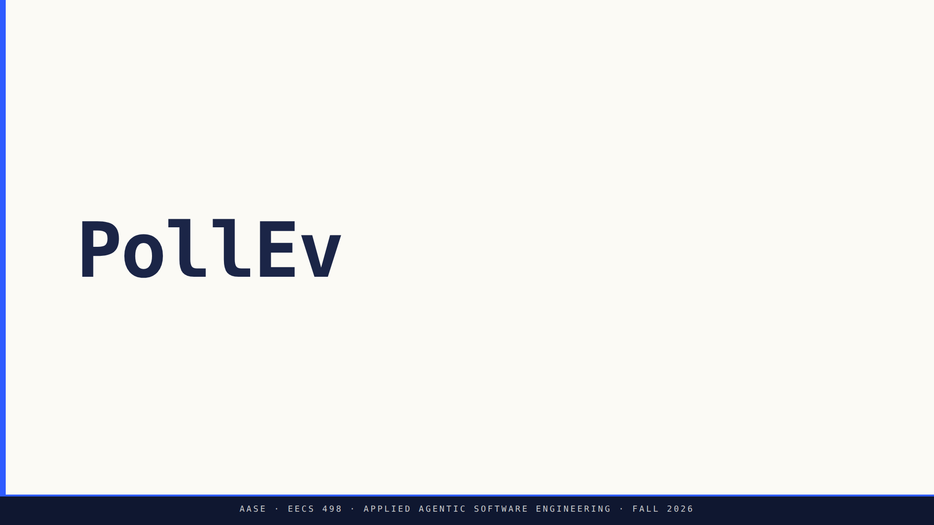
Notes:
Presenter cue only — switch to the browser tab holding the activity.
Set it live, read the question and all four options aloud, give it ~60s,
show results, then come back to the deck.

Slide 34
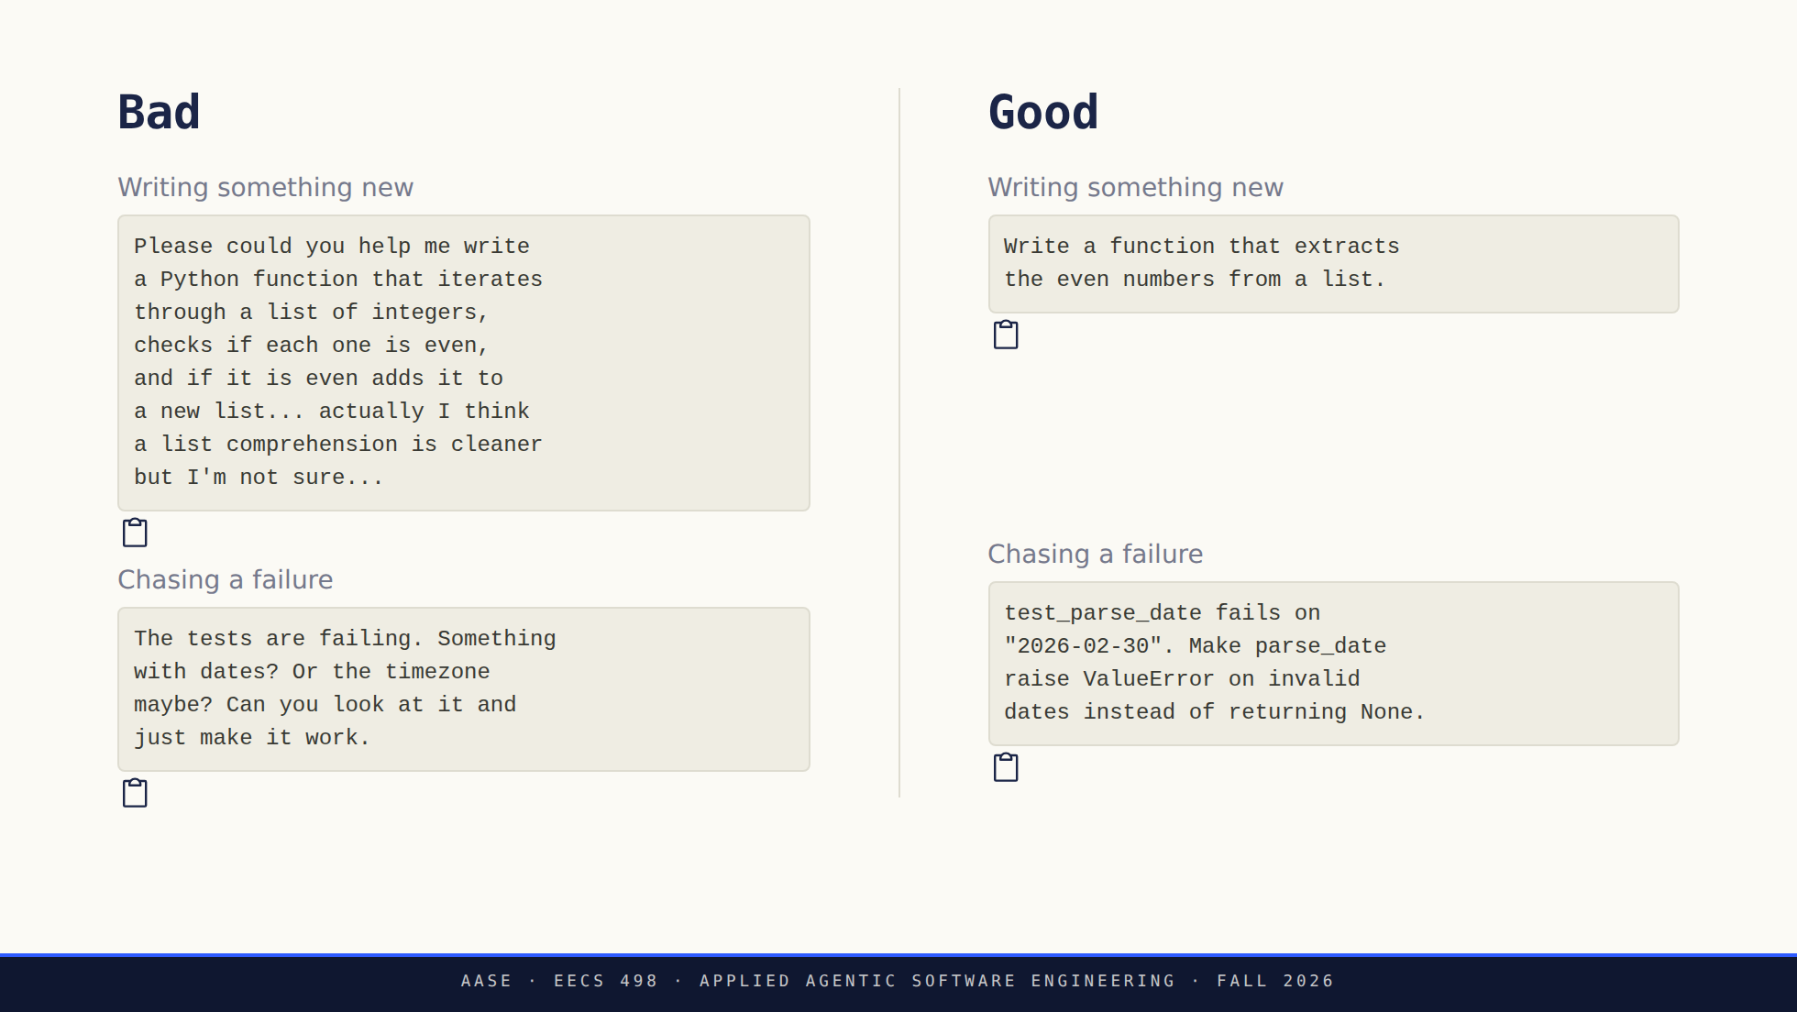
Notes:
B almost always produces better results. The model infers the rest.
Adding caveats compounds ambiguity; it doesn't resolve it.

Slide 35
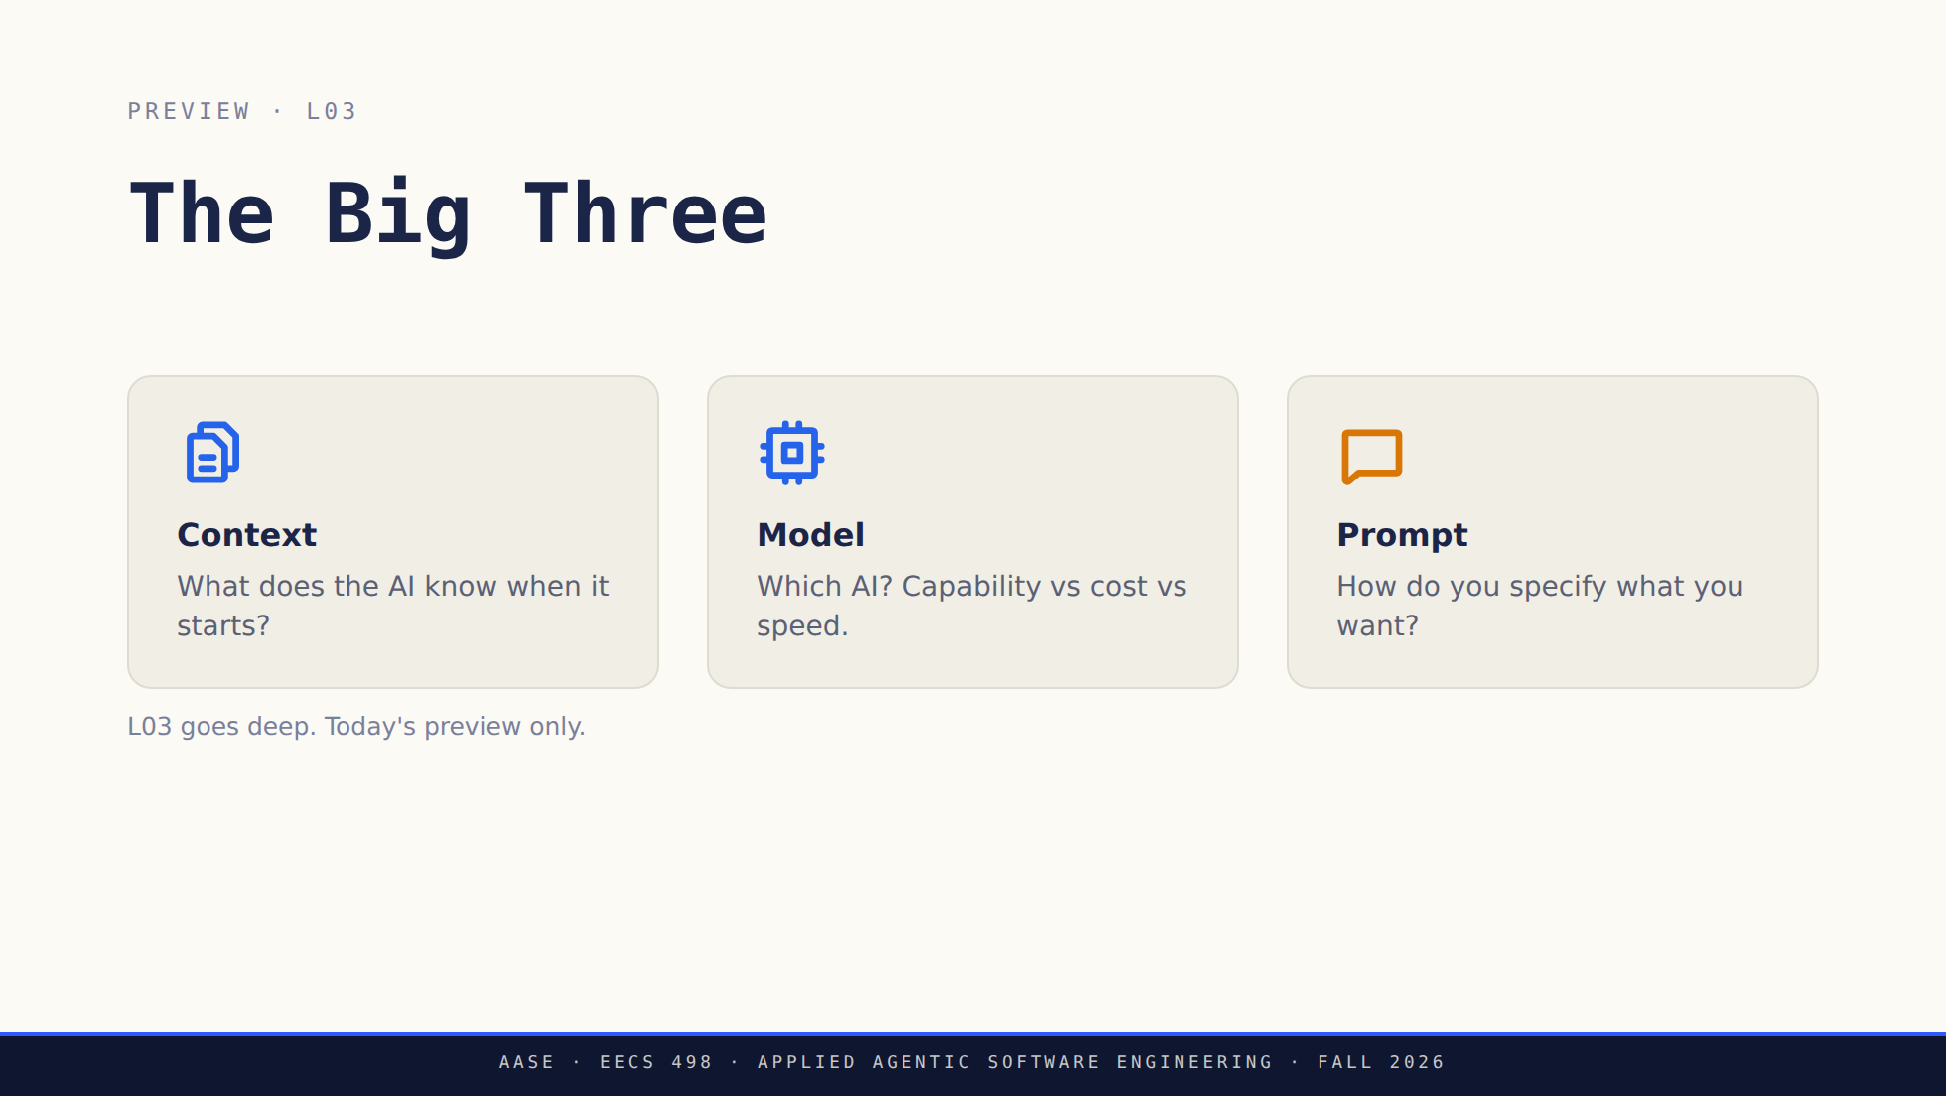

Slide 36
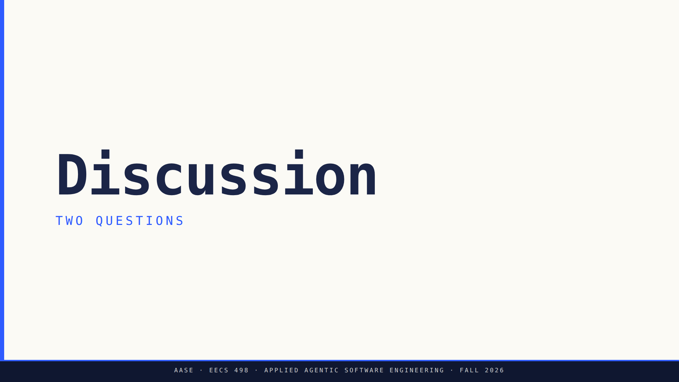
Notes:
Bridge: We've named the principle. Two questions to pressure-test it.

Slide 37

Notes:
Q1 → CS fundamentals still matter; you evaluate the output.
Q2 → learning, security-critical, deep maintenance.

Slide 38
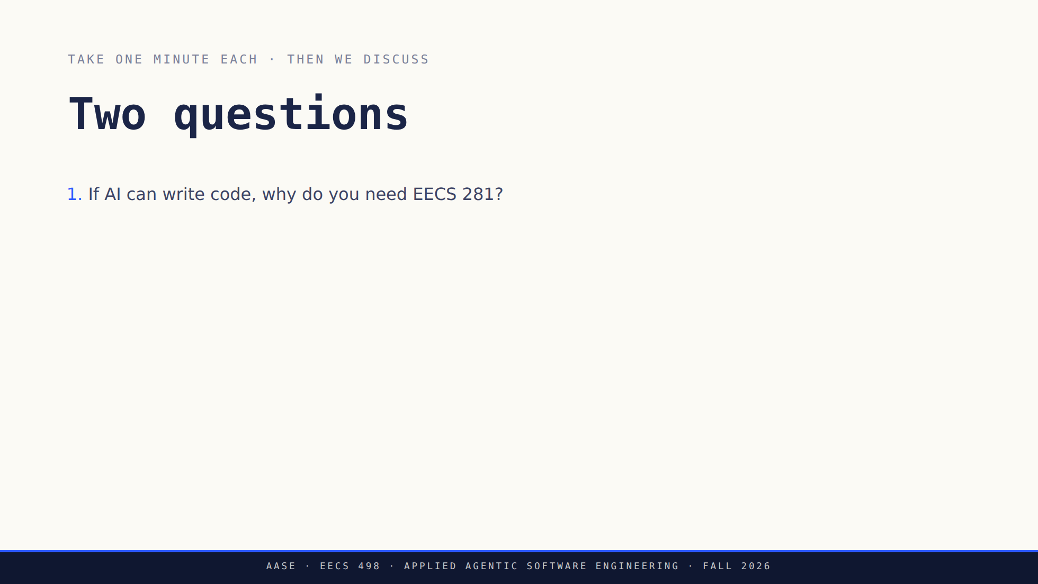
Notes:
Q1 → CS fundamentals still matter; you evaluate the output.
Q2 → learning, security-critical, deep maintenance.

Slide 39
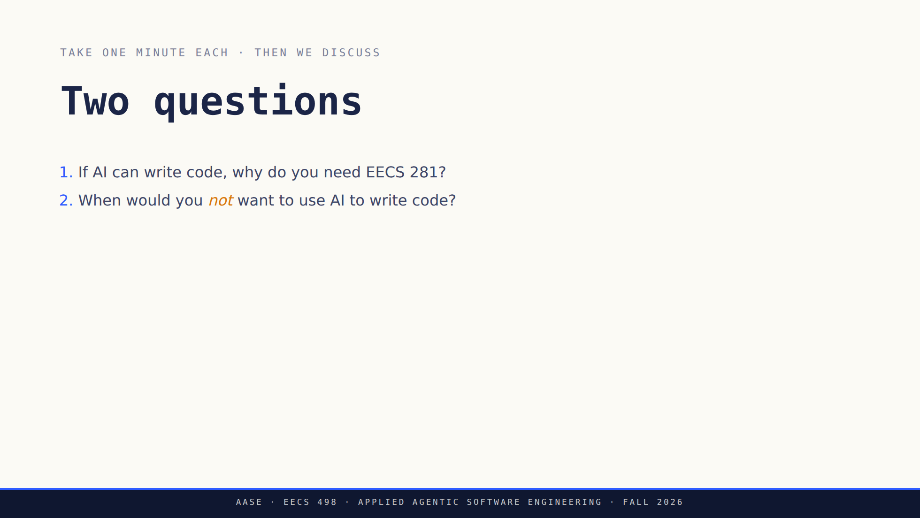
Notes:
Q1 → CS fundamentals still matter; you evaluate the output.
Q2 → learning, security-critical, deep maintenance.

Slide 40
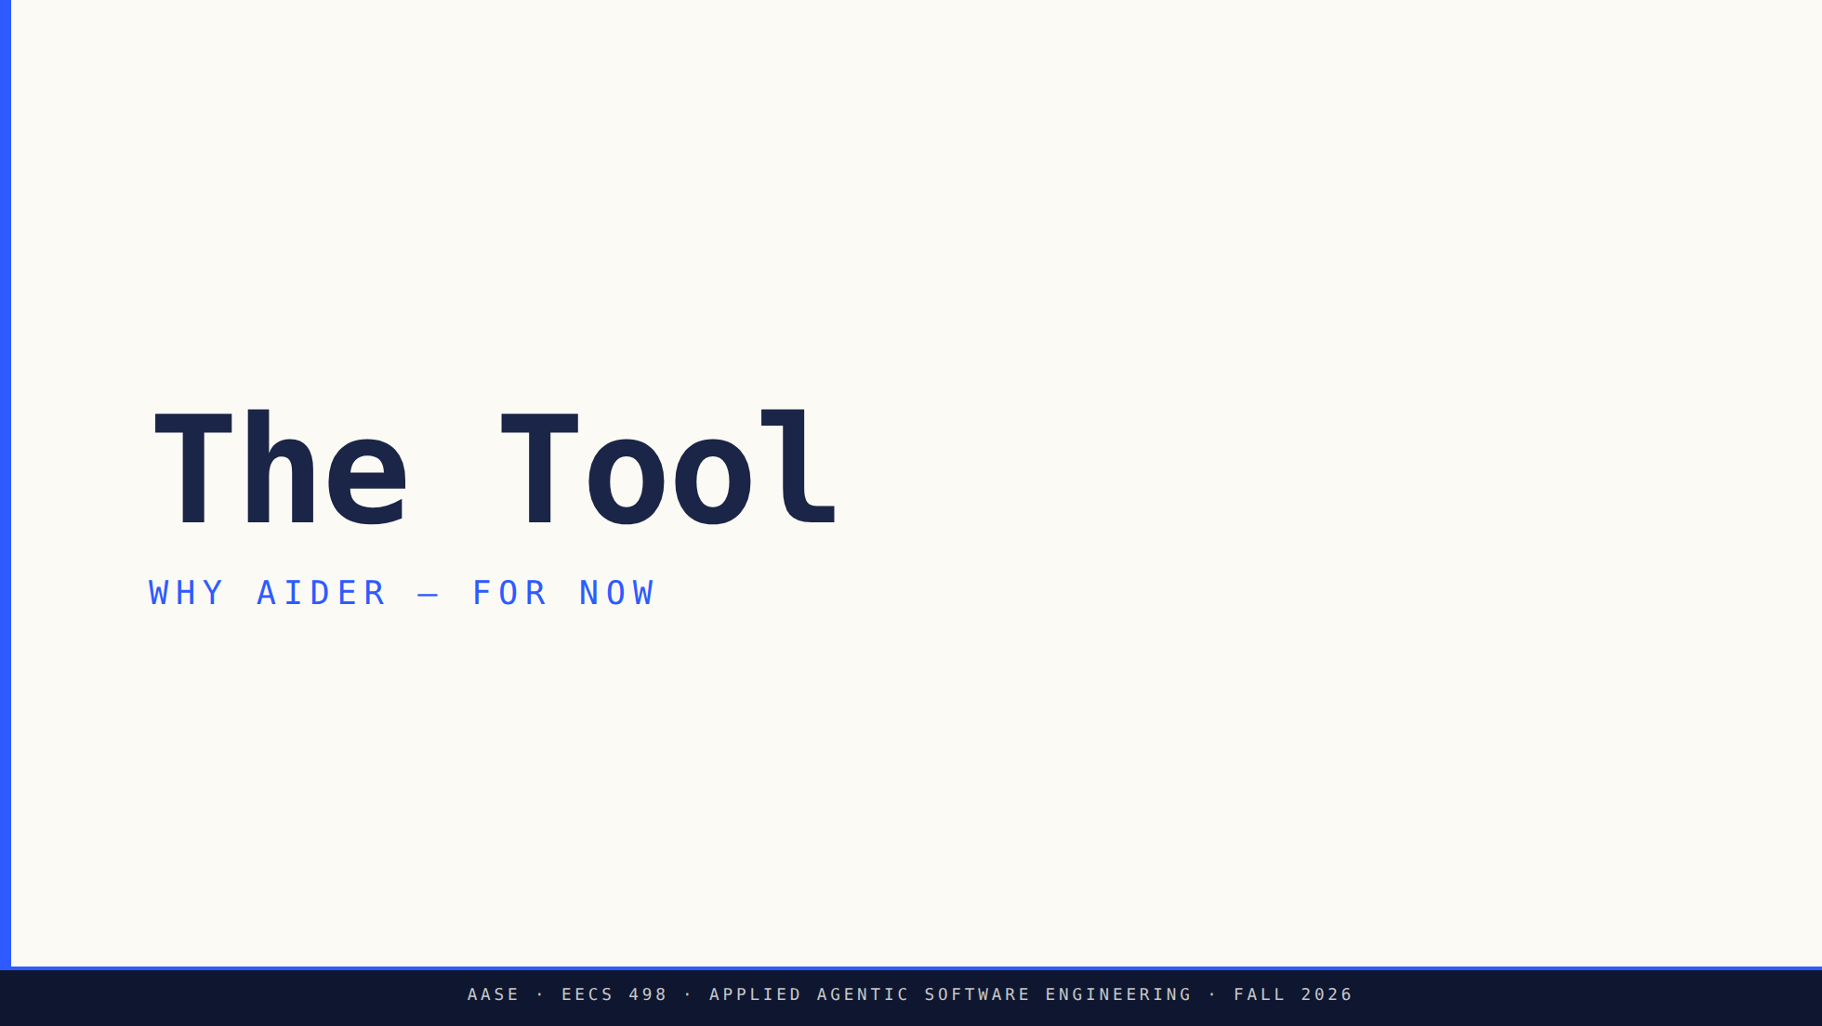
Notes:
Bridge: We've talked principles. NOW the tool — and only because principles came first.

Slide 41
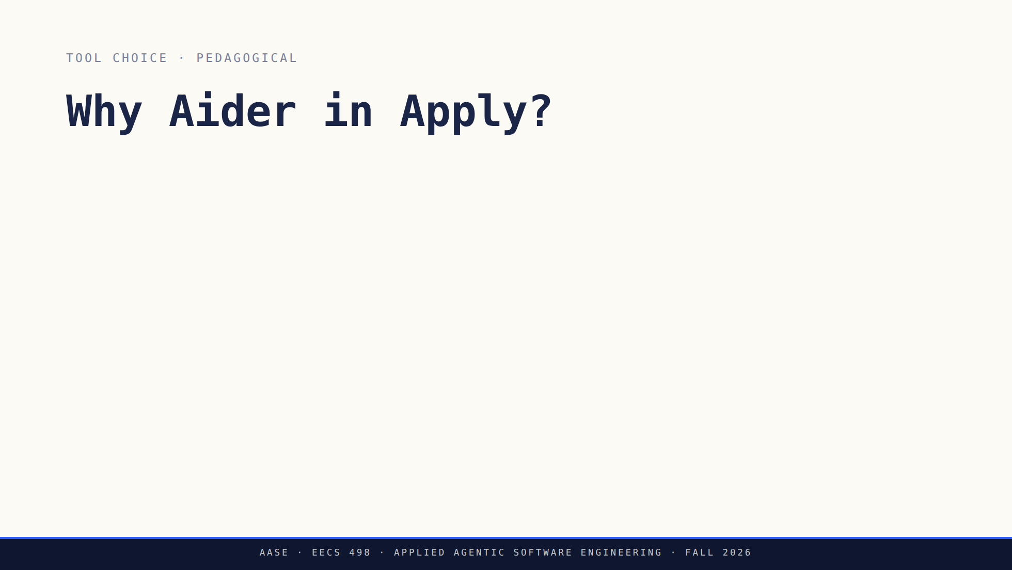
Notes:
Land reason 2 hard: your model is a line of config, not a dependency.
That is why this course costs nothing to take.
Claude Code arrives in L05 as a DEMO. No account needed. Say it plainly.

Slide 42
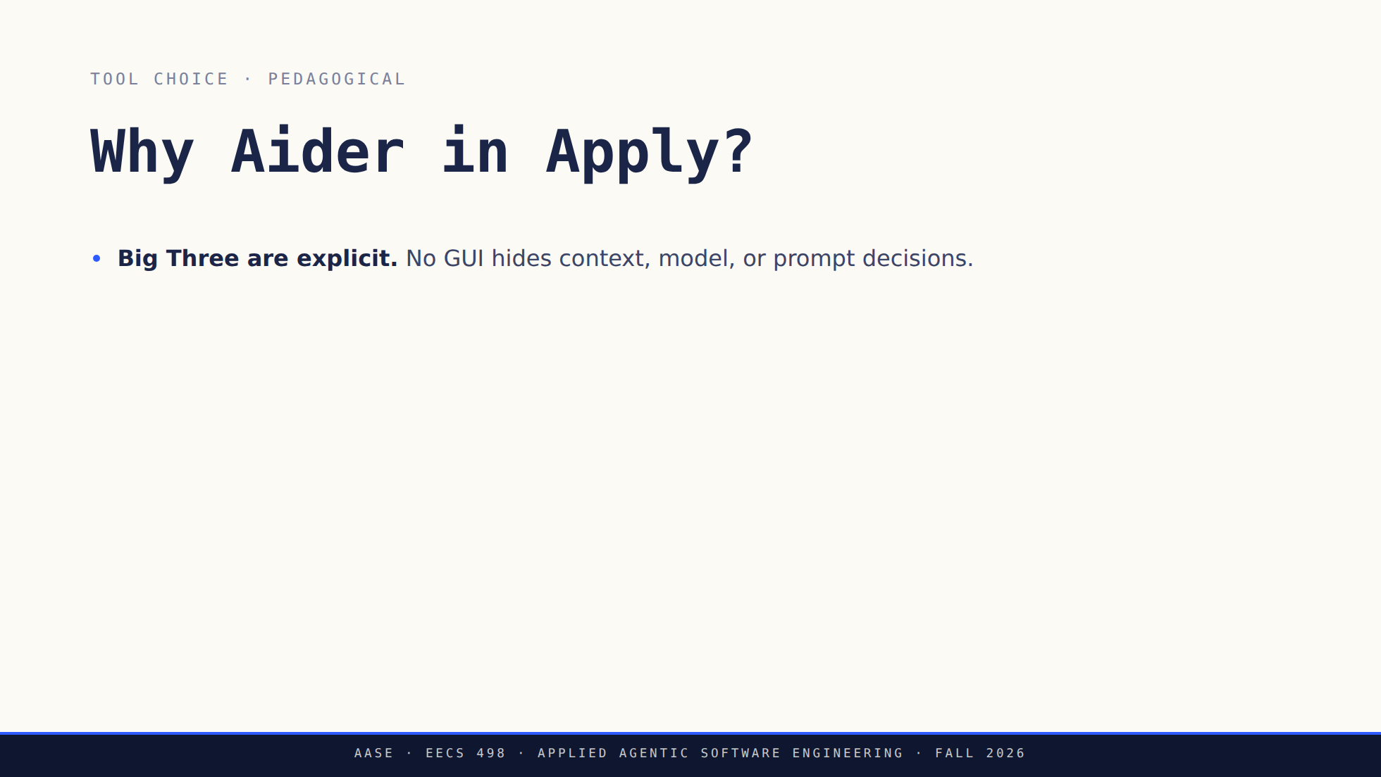
Notes:
Land reason 2 hard: your model is a line of config, not a dependency.
That is why this course costs nothing to take.
Claude Code arrives in L05 as a DEMO. No account needed. Say it plainly.

Slide 43
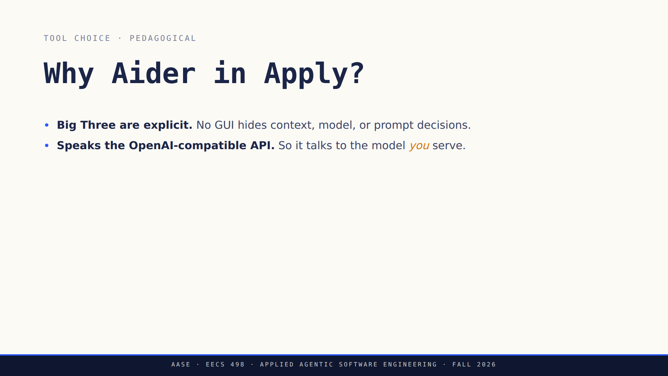
Notes:
Land reason 2 hard: your model is a line of config, not a dependency.
That is why this course costs nothing to take.
Claude Code arrives in L05 as a DEMO. No account needed. Say it plainly.

Slide 44
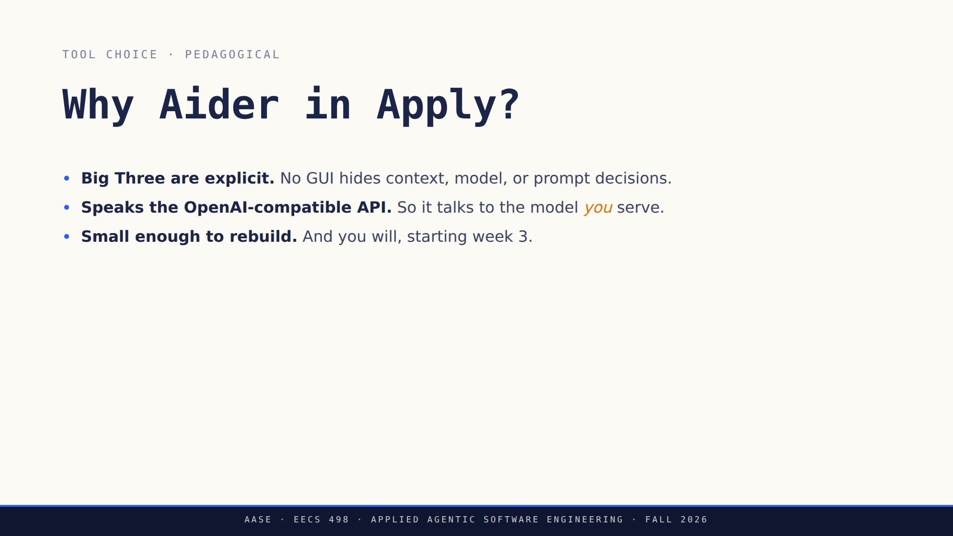
Notes:
Land reason 2 hard: your model is a line of config, not a dependency.
That is why this course costs nothing to take.
Claude Code arrives in L05 as a DEMO. No account needed. Say it plainly.

Slide 45
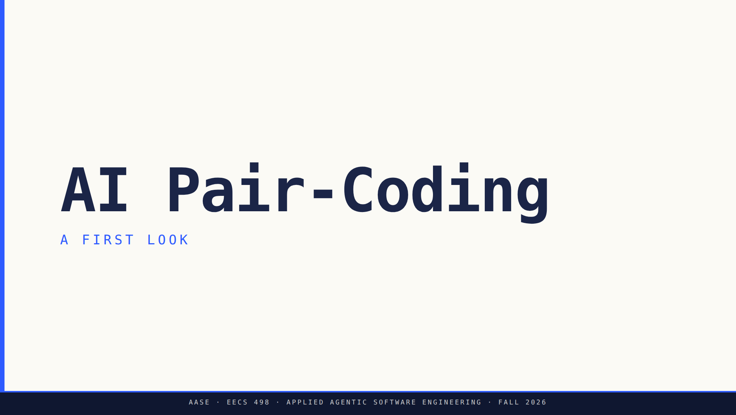
Notes:
Bridge: A few minutes — not a tutorial — of what AI pair-coding actually feels like.
Setup was the Setup Lab; the commands are `aider-practice`. Today, just feel the loop.

Slide 46
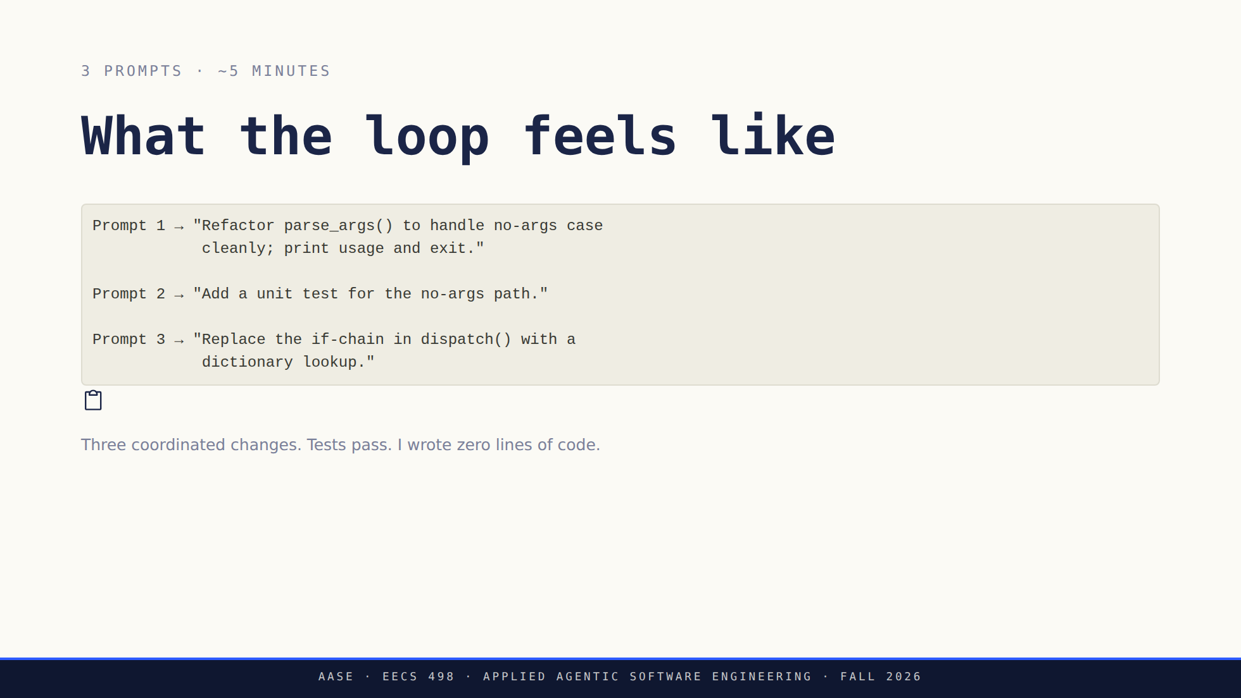

Slide 47
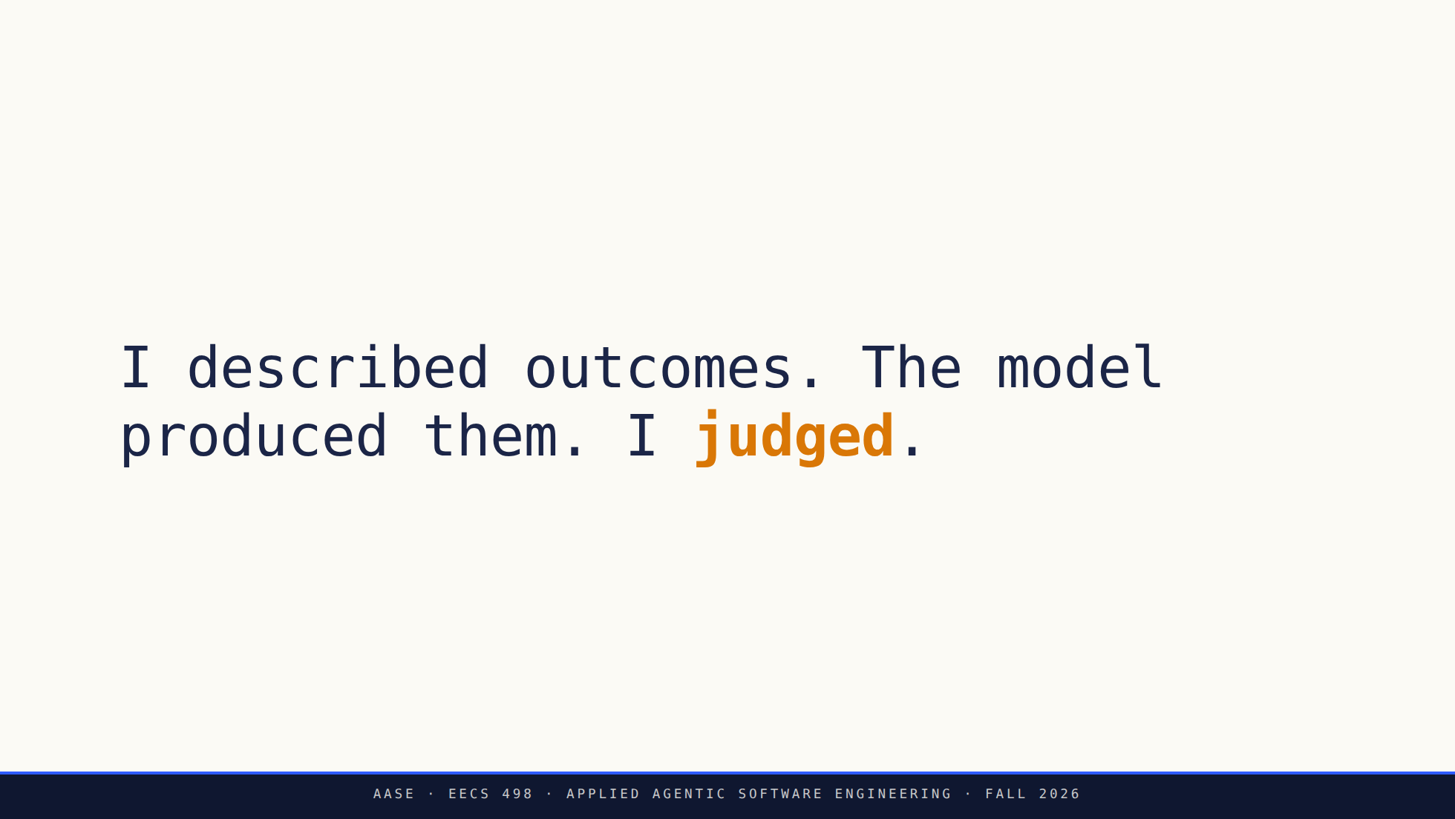
Notes:
That's the collaboration shape. Not the commands — the shape.

Slide 48
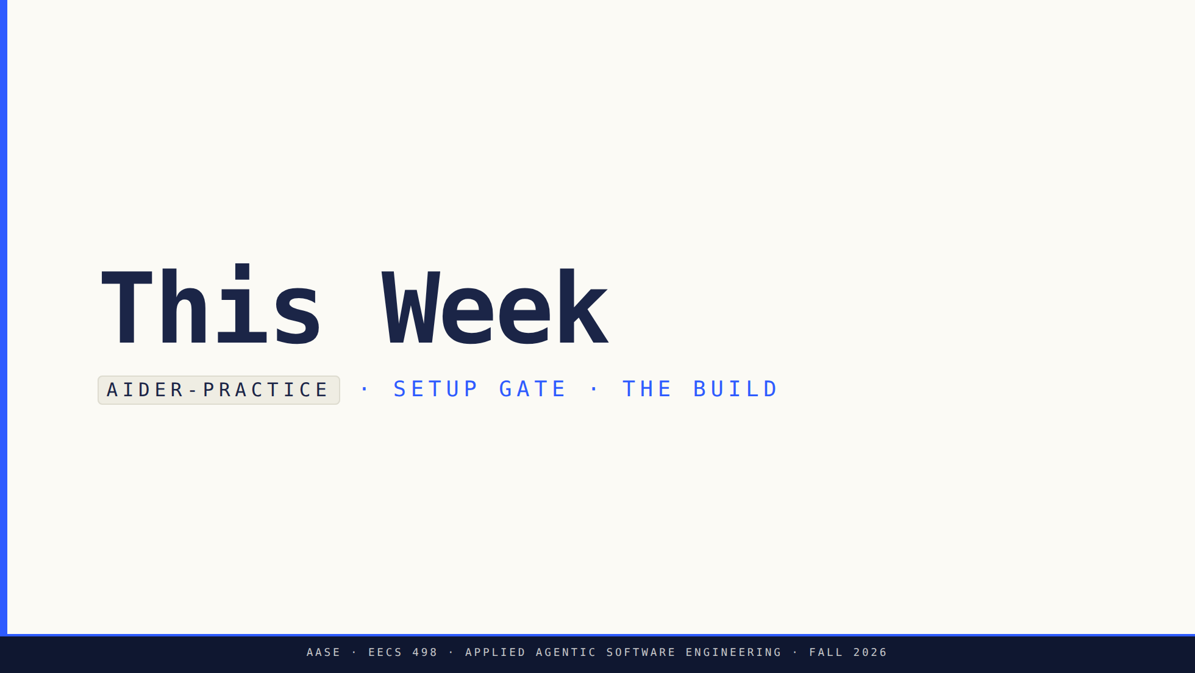
Notes:
Bridge: Setup is on you. Here's exactly how the week works.

Slide 49
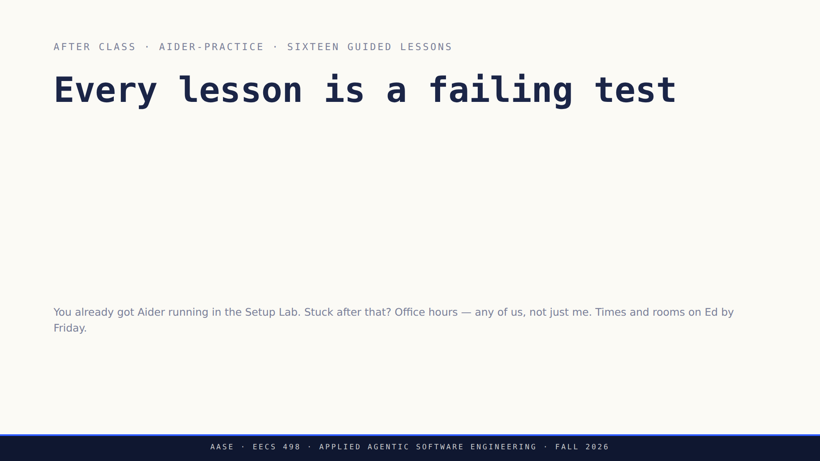

Slide 50
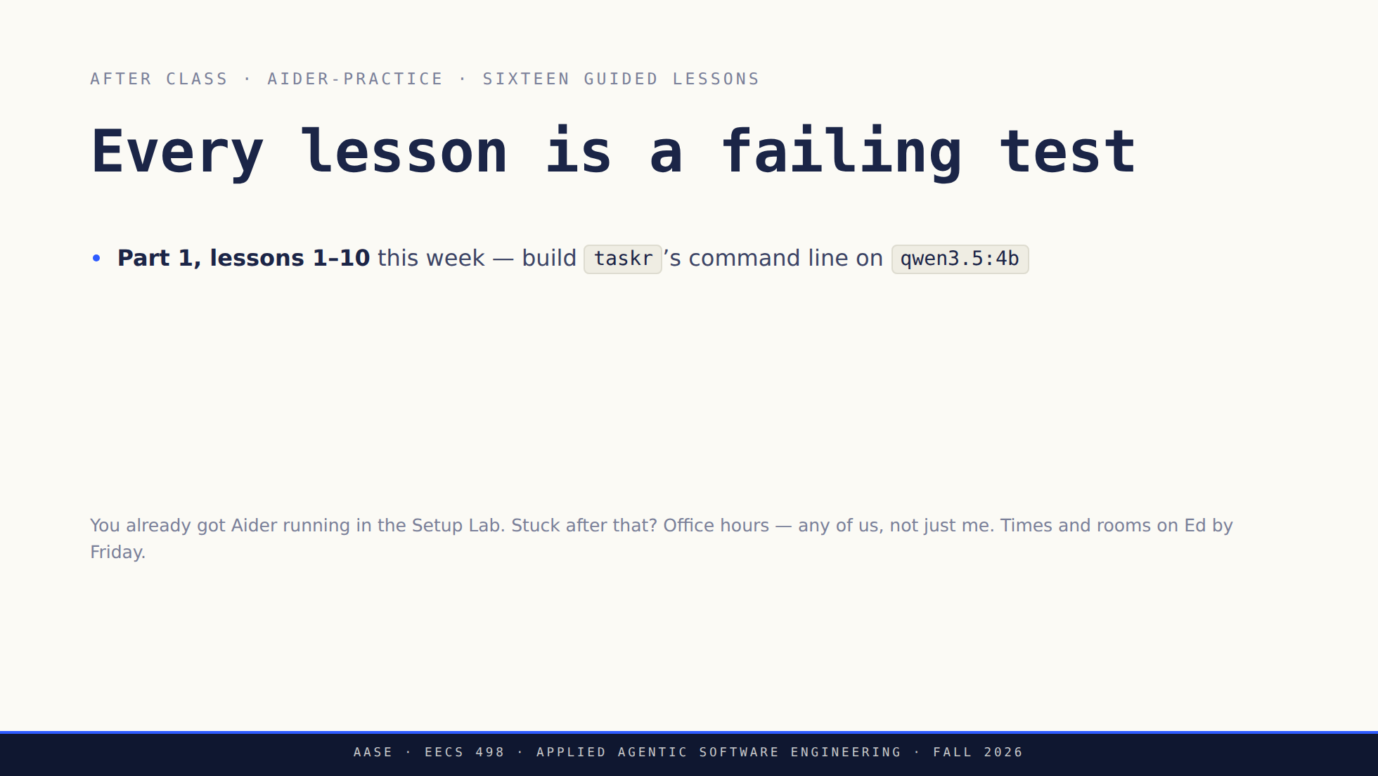

Slide 51
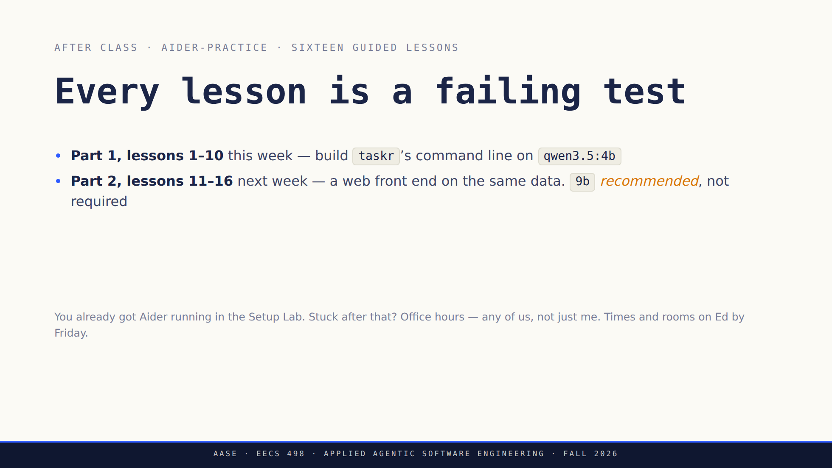

Slide 52


Slide 53


Slide 54


Slide 55


Slide 56

Notes:
The durable thing is the framework. Tools come and go. Claude Code and
Codex are already the successors; say so if it comes up.

Slide 57


