Slide 1
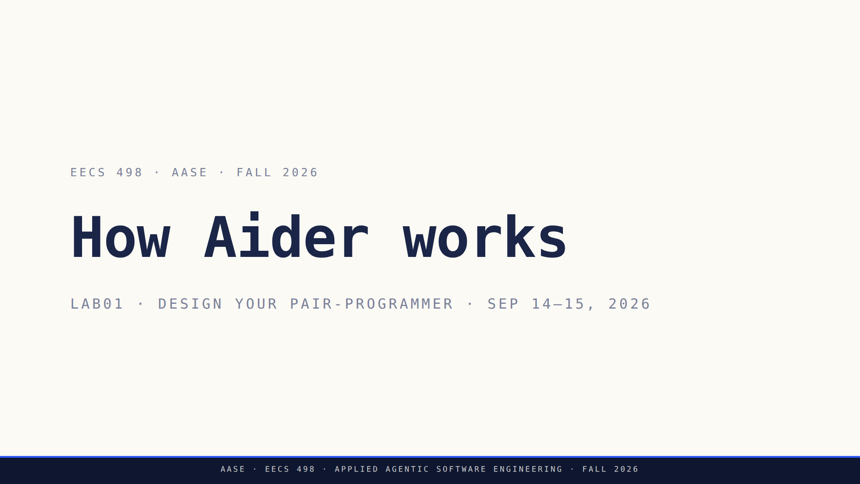
Notes:
Two halves. The first takes apart the tool they have been using since Lab00.
The second hands them the build and gives them 45 minutes to start designing.
Finish instruction at minute 65 and protect the work block.

Slide 2
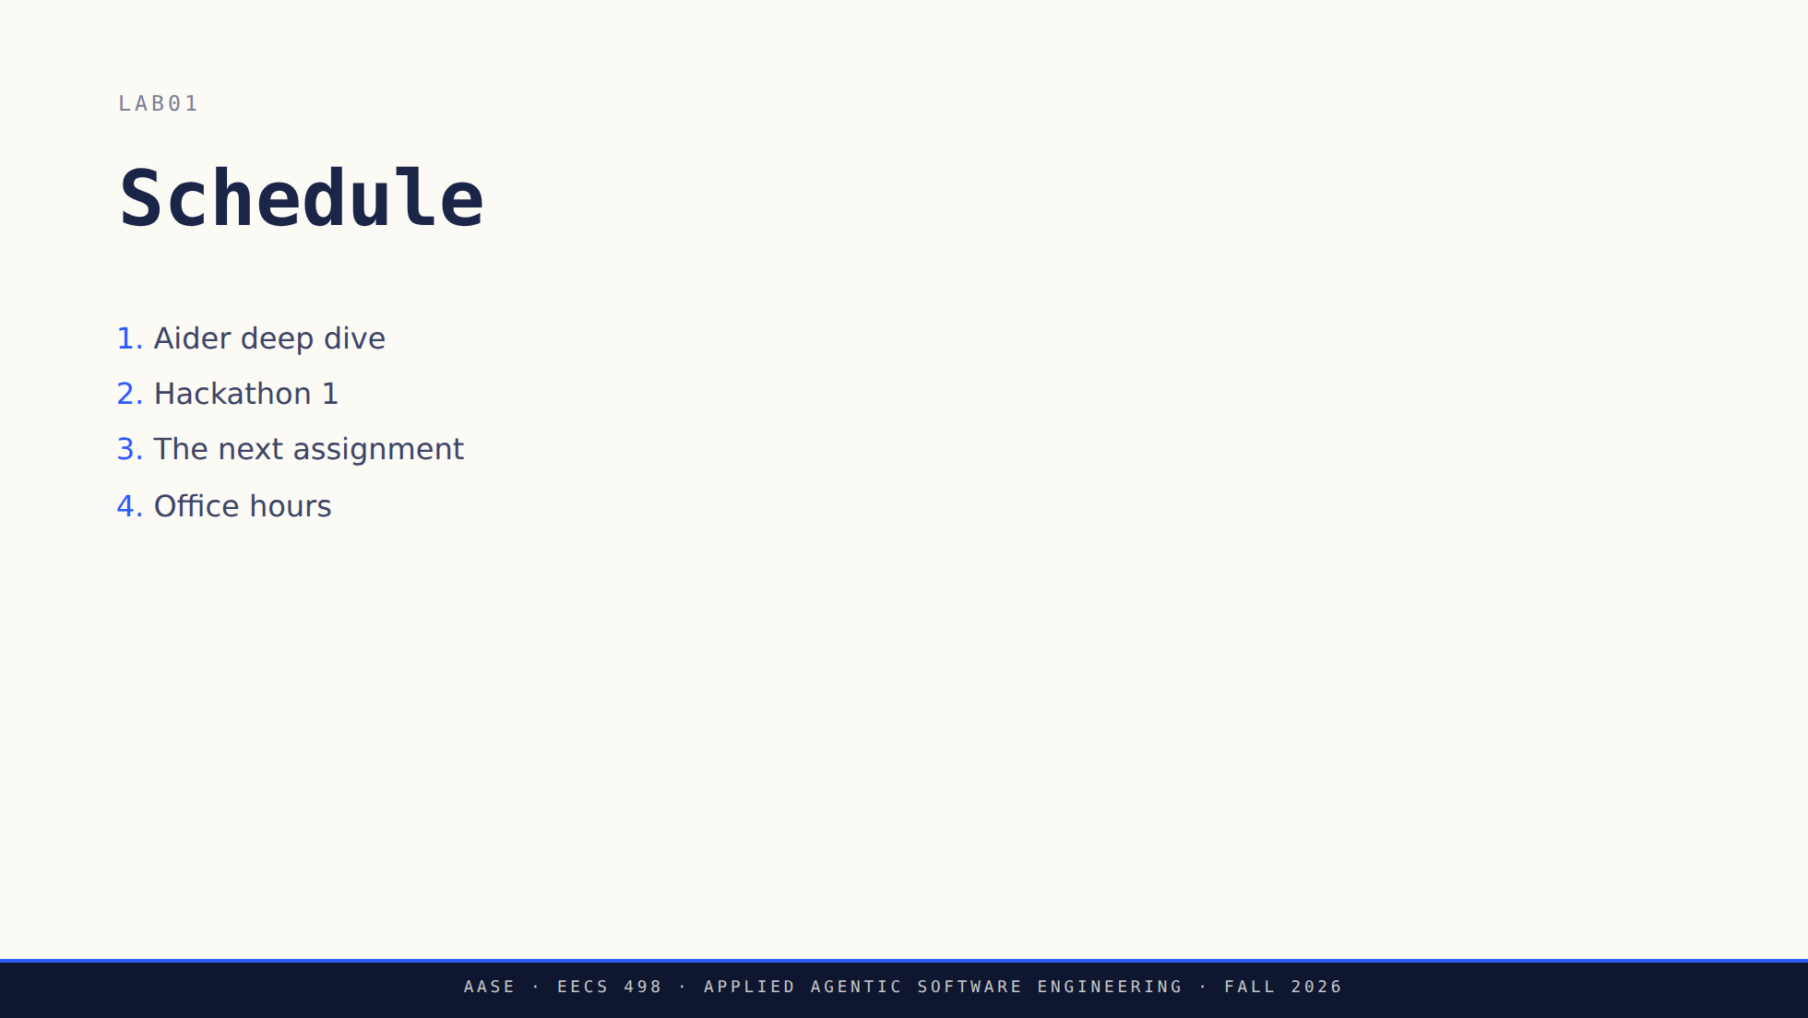
Notes:
Put this up while the room settles and leave it up. The agenda is part of the
first block, not an extra segment in front of it.
Say out loud that the second half is genuinely office hours: they work, you
circulate, and nobody hands anything in today. Students who have been told all
term that labs end in a checkoff will not believe it unless you say it. The
slide no longer says so, so this is on you to say.
Do not preview the build past the word itself. The reveal is still yours to
make in the third section.

Slide 3
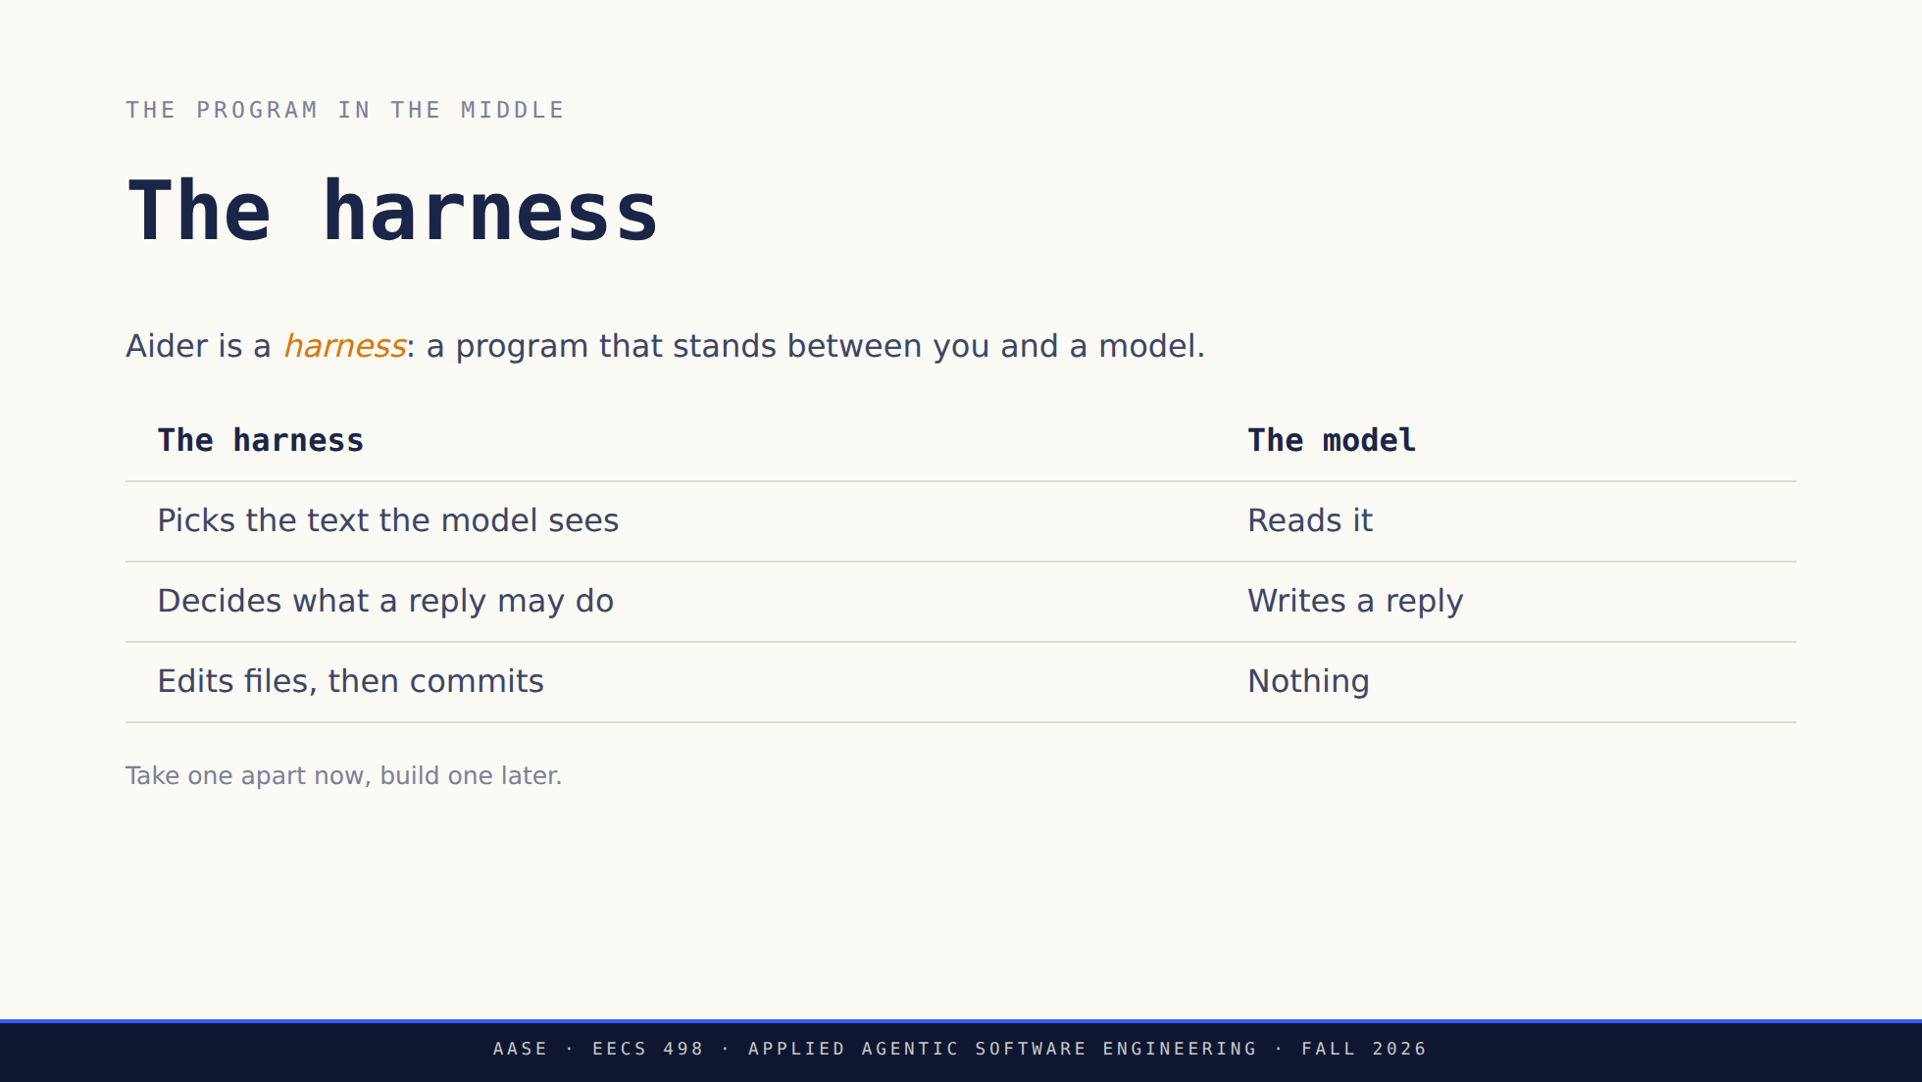
Notes:
This is the slide the deck was missing. Sixteen practice lessons gave them the
muscle memory and none of the model, and the word "harness" is the one they
need, because it is the thing they build in Stage 1 and extend in Analyze.
Say the right-hand column out loud. The model's entire contribution is one
block of text. Every effect on their machine is the left column acting on it.
If anyone asks about models, endpoints or config: MODEL-POLICY.md, and it is
not today's subject. qwen3.5:9b recommended, 4B permitted, any compatible
endpoint.

Slide 4
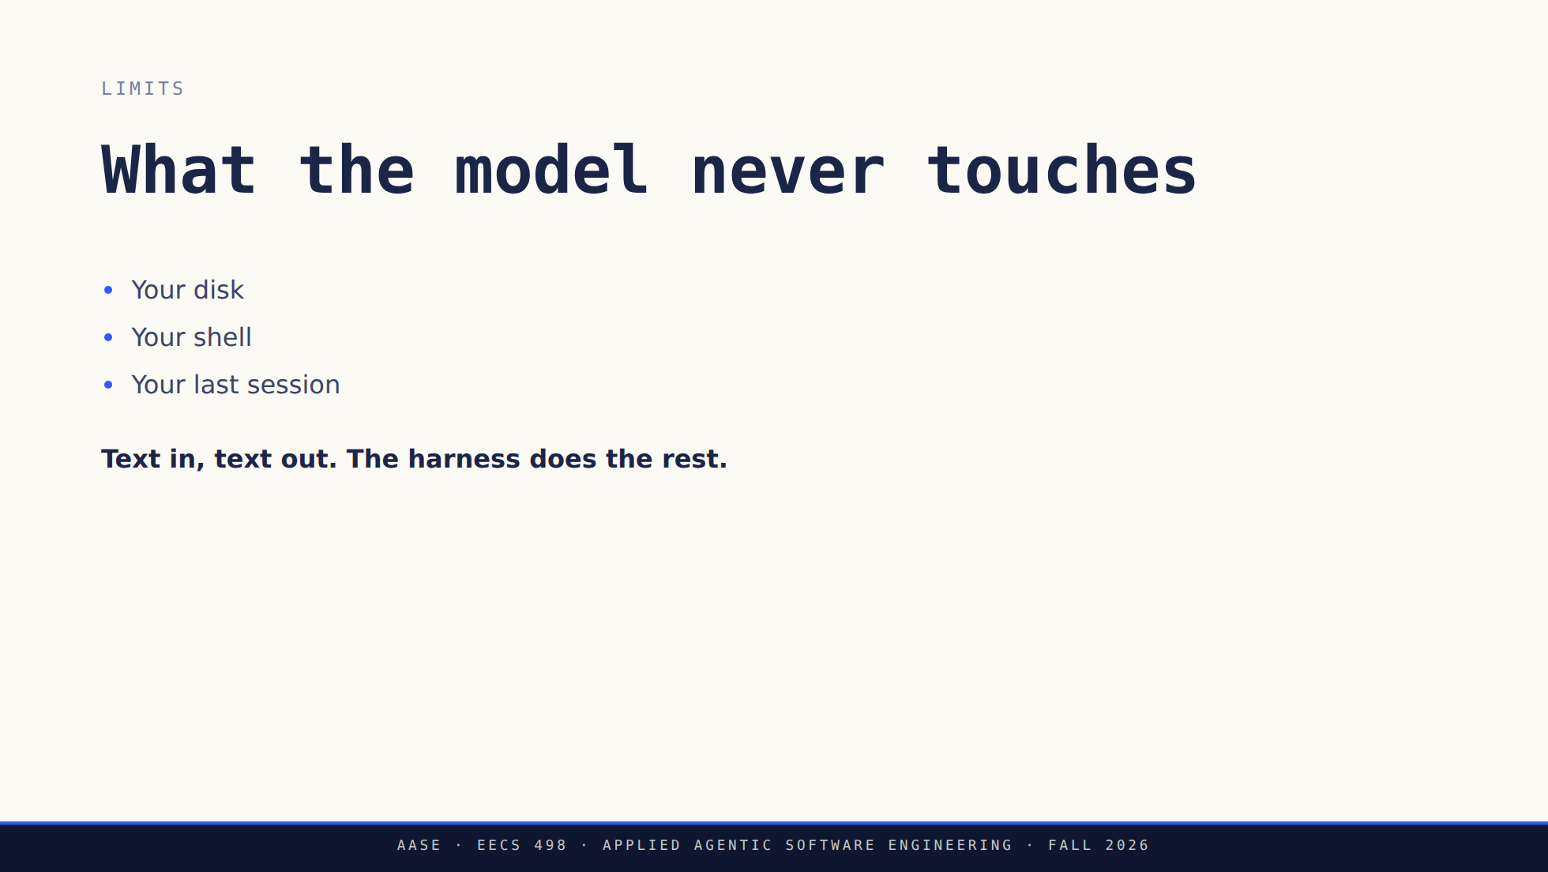
Notes:
Three negatives, and each one is a design decision somebody made rather than a
limitation of the model.
The third is the one that surprises people: there is no memory between
sessions. Continuity is the harness resending the history, which is why
history spends their token budget later in the deck.
The 4B and the 9B are asked for different reply shapes, whole files against
diffs. That is why a classmate's session looks different from theirs, and why
the trace in the next ten minutes may not match what they ran in practice.
Worth saying here, not worth a slide.

Slide 5
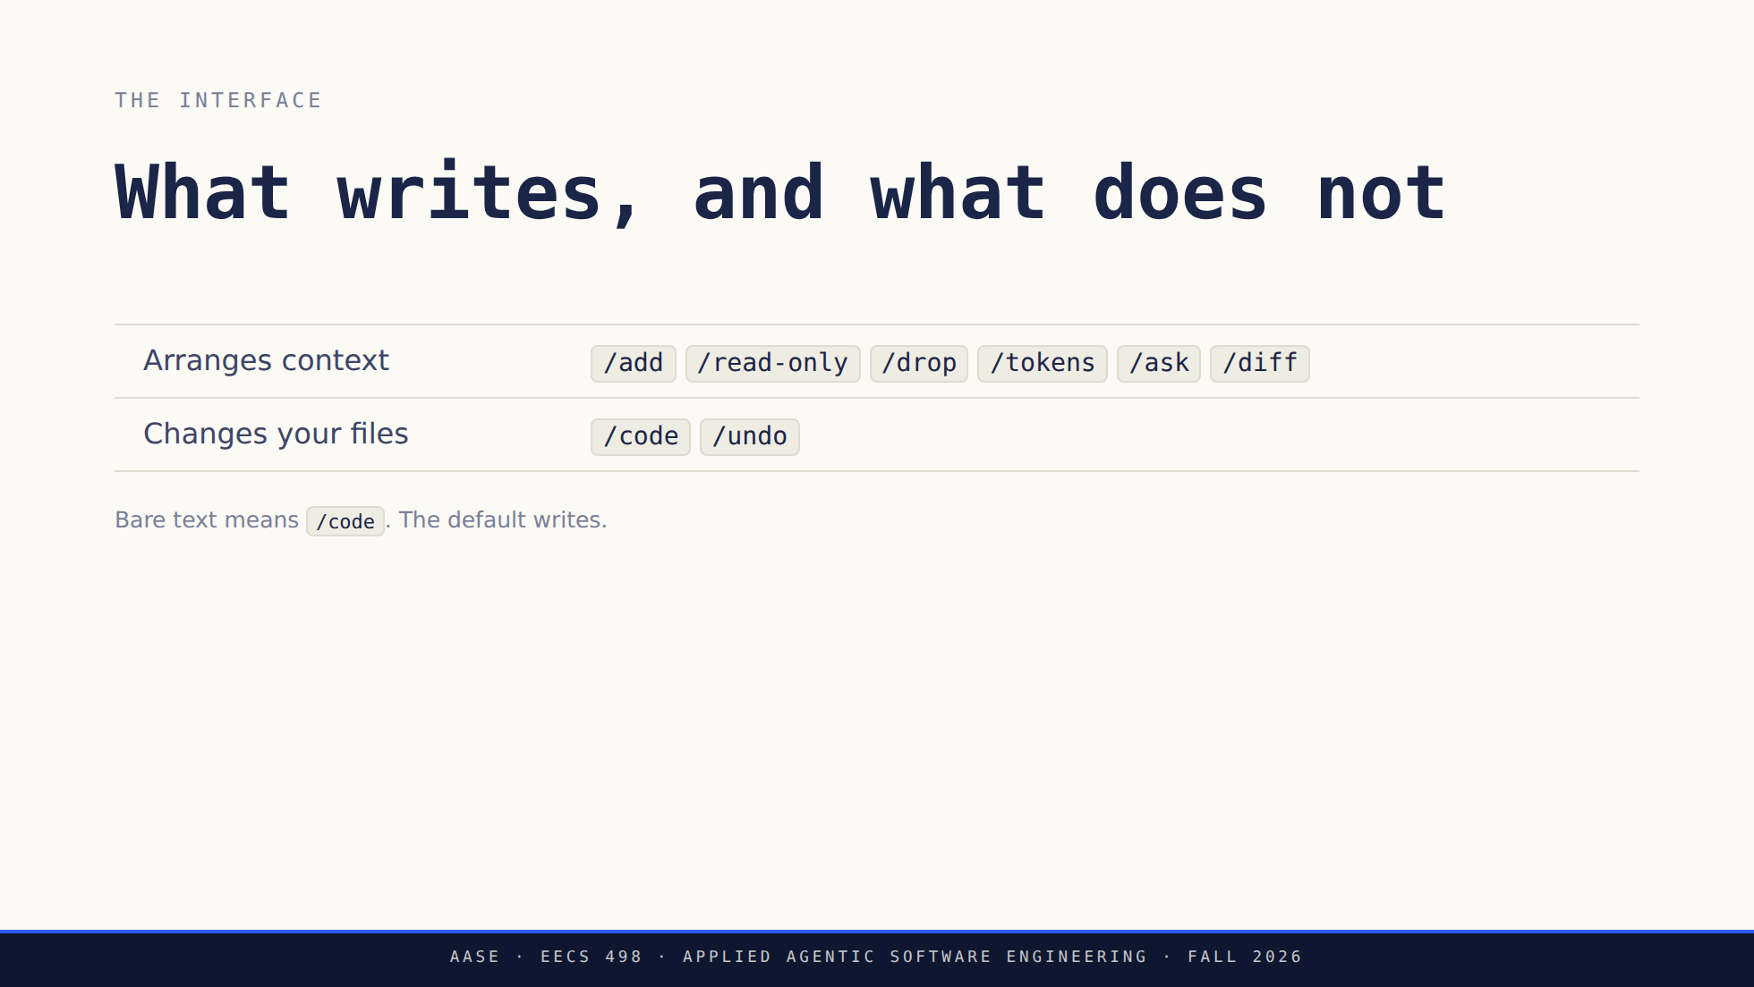
Notes:
Two commands in the whole set touch the repository, and one of those is the
undo. That asymmetry is the approval layer they are about to build, visible in
a tool they already use.
/help lists more than this and the set moves between versions. Run it live if
asked rather than reciting.

Slide 6
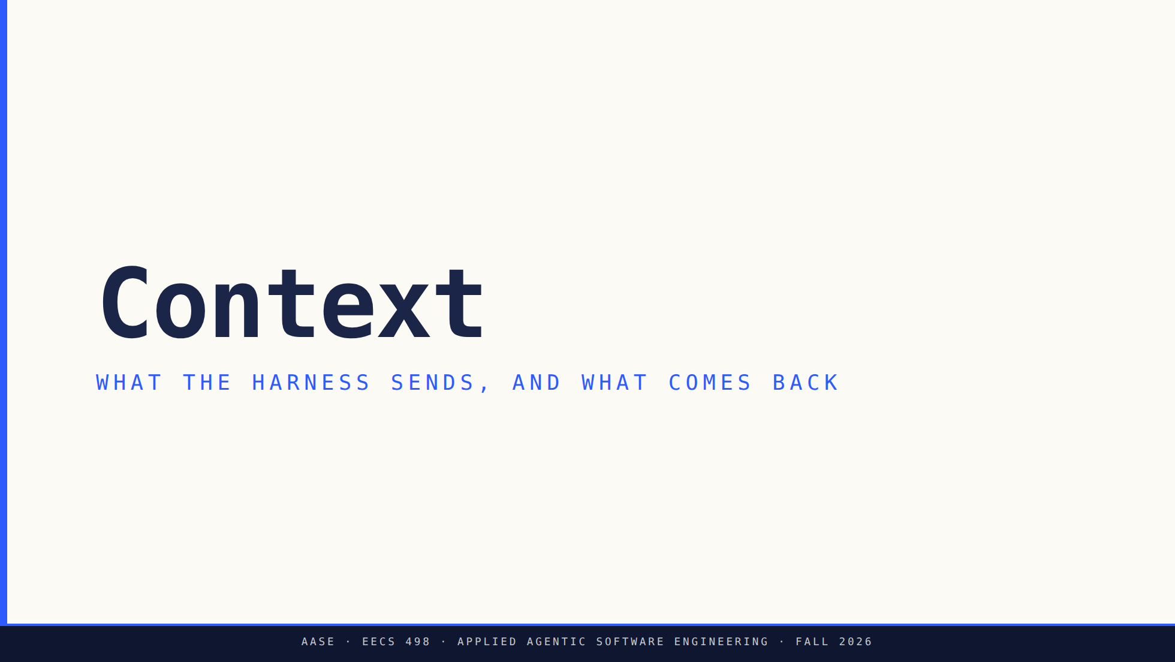
Notes:
This block is now about context rather than a walkthrough of a whole turn
(instructor cuts 2026-09-13). Most of it is the repo map, because that is the
part nobody has met before and the part that quietly spends their budget.
Say up front that only the reply belongs to the model. Everything else in this
block is the harness deciding what the model gets to see.

Slide 7
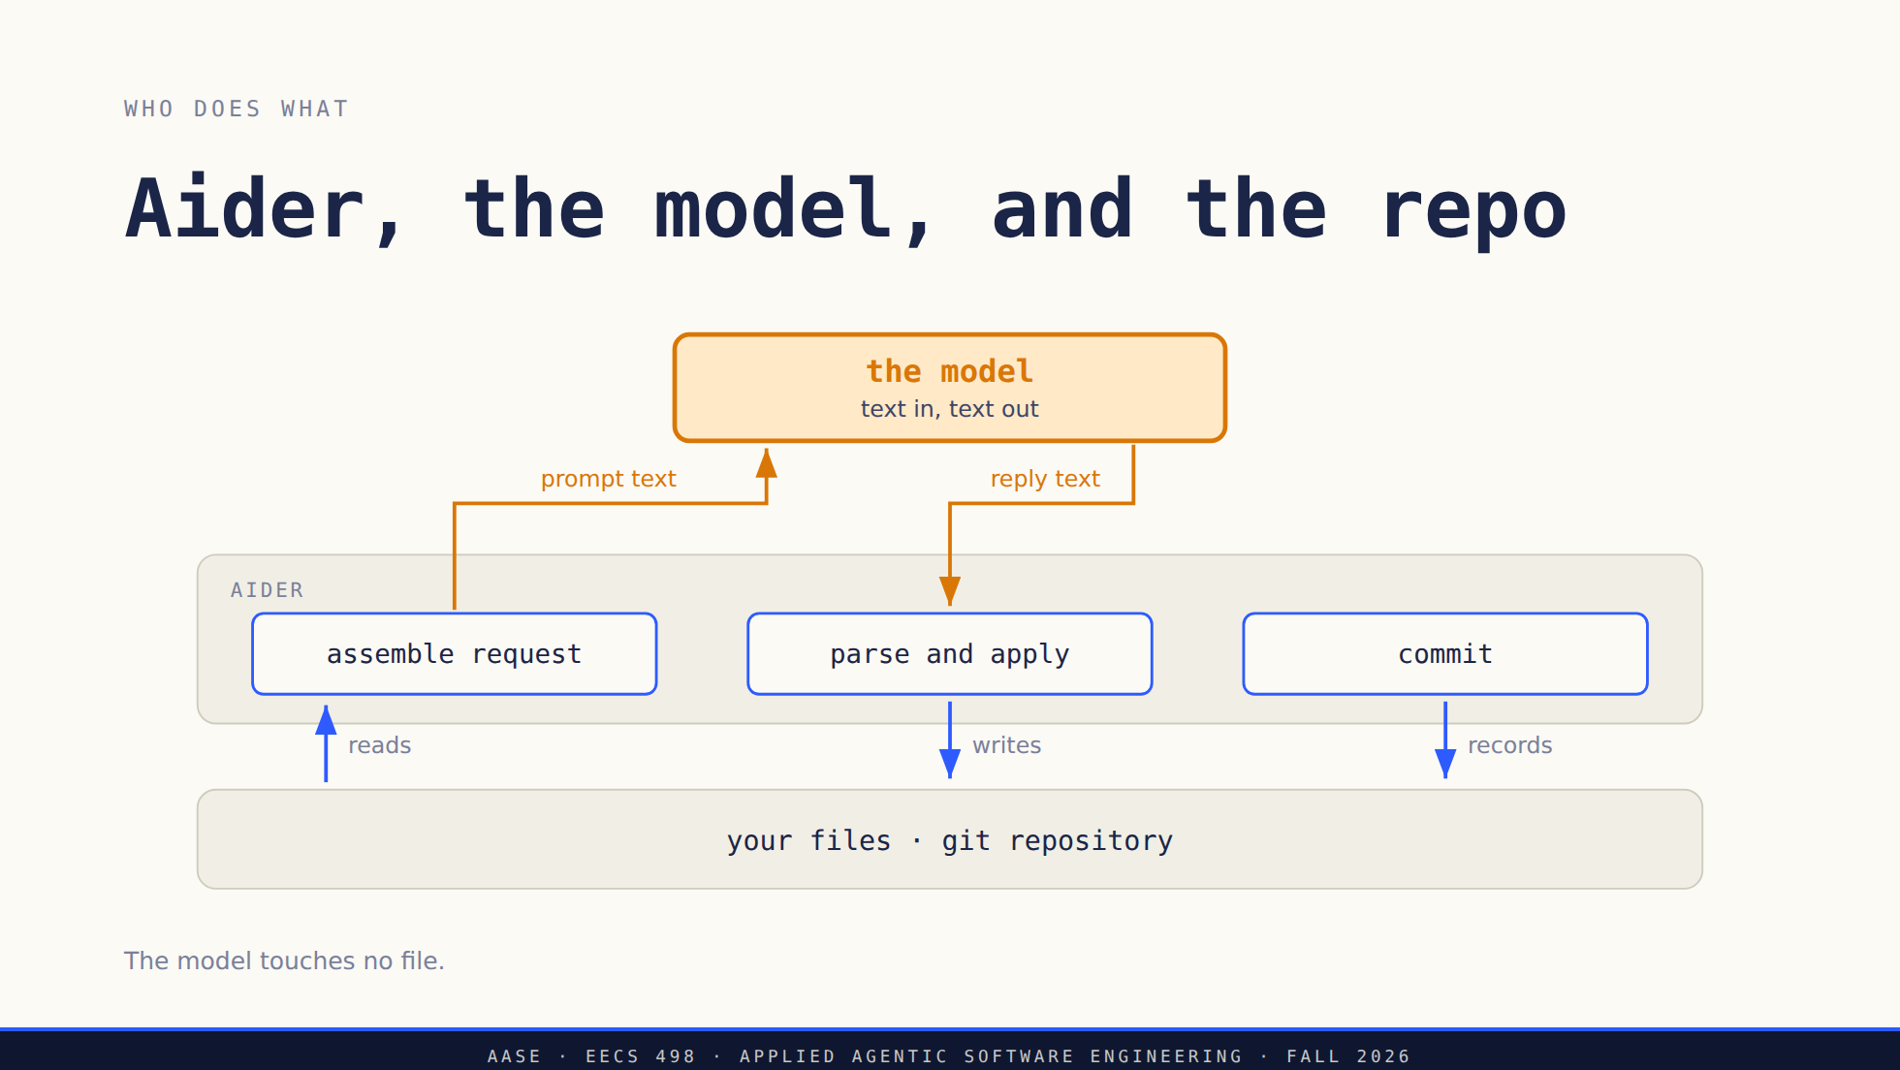
Notes:
Ask the room to find the arrow that writes a file. There is not one leaving the
amber box. The model produced text, and a program decided what to do with it.
This is a picture of Aider, not a required architecture for their build. They
will draw their own version of this in a week.

Slide 8
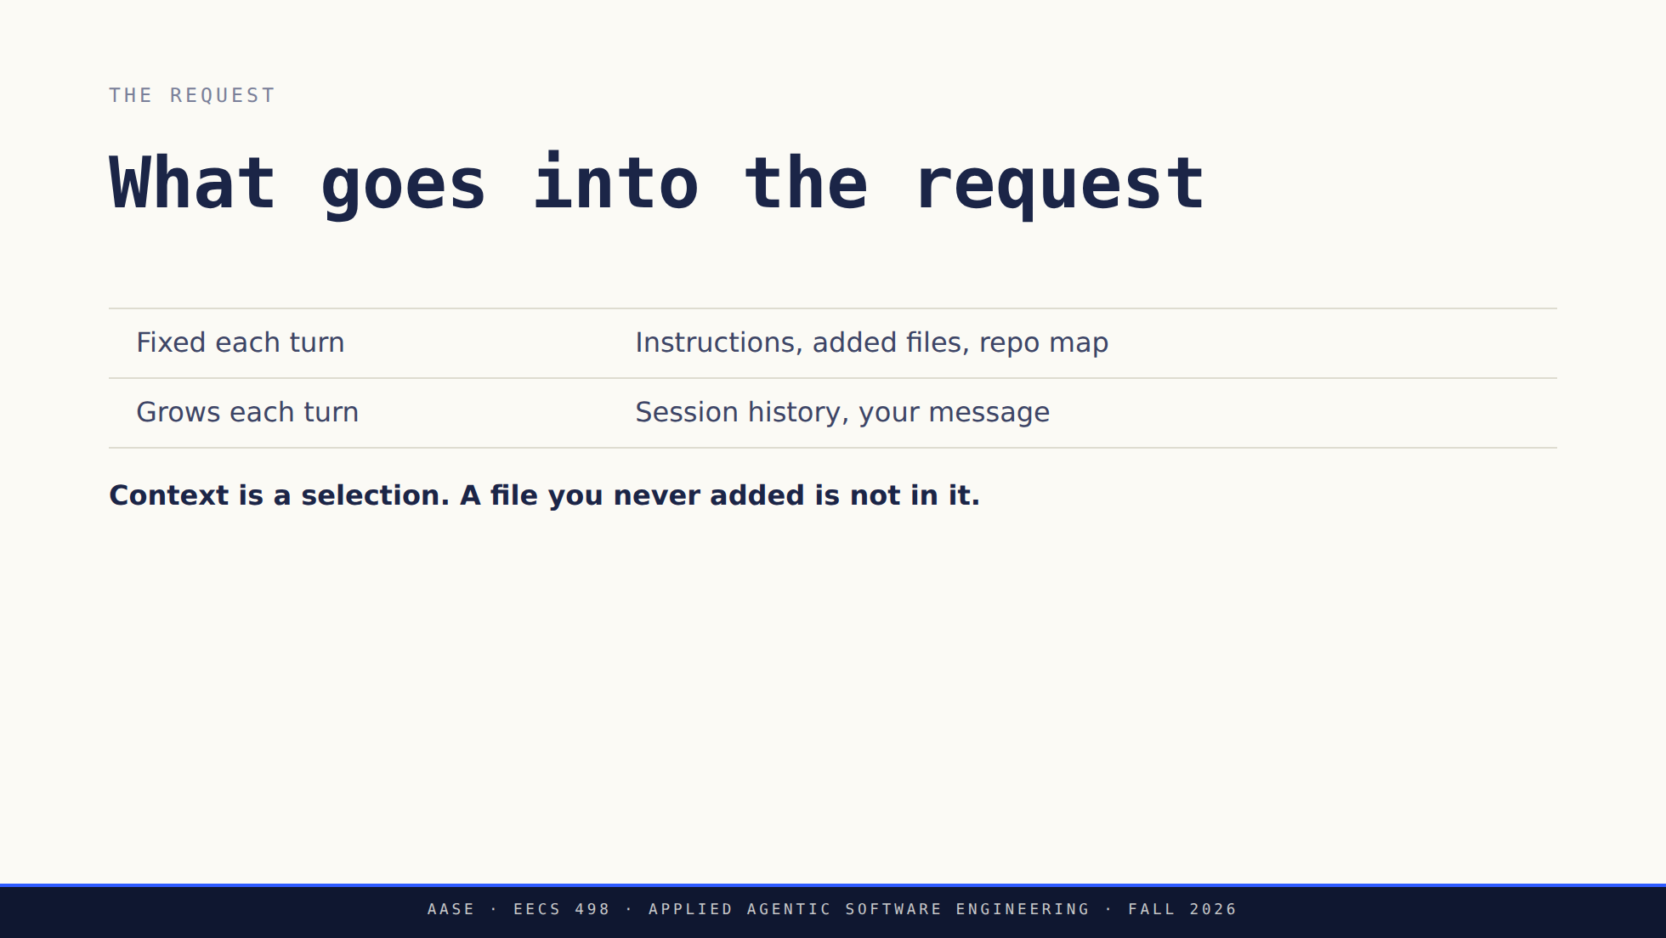
Notes:
Do not claim a fixed seven-part ordering. What actually goes into the prompt
depends on the coder, the model and the settings, and it changes between
releases. The list above is the shape, not the wire format.
Ask what the model would need in order to change three files consistently, when
nothing has told it which three. That question sets up the repo map.
The /add slide was cut on 2026-09-13 because they have been doing this for two
weeks. Two things it carried, worth saying if anyone asks rather than putting
back on the glass: added files can be rewritten while read-only files can only
be cited, and adding the whole package is not a selection strategy, it is a way
to spend the budget.

Slide 9
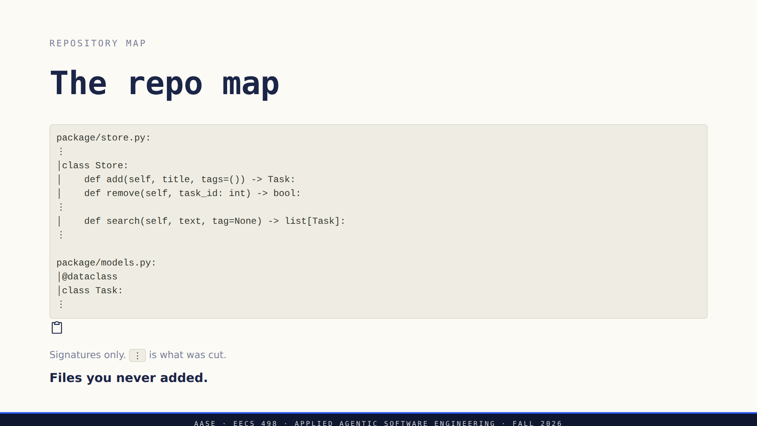
Notes:
Point at the vertical bars: that is aider quoting source lines. Point at the
dots: that is everything it decided not to spend tokens on.
Ask what this is for. The answer is on the next slide: it is aider guessing
what you would have typed /add for.

Slide 10
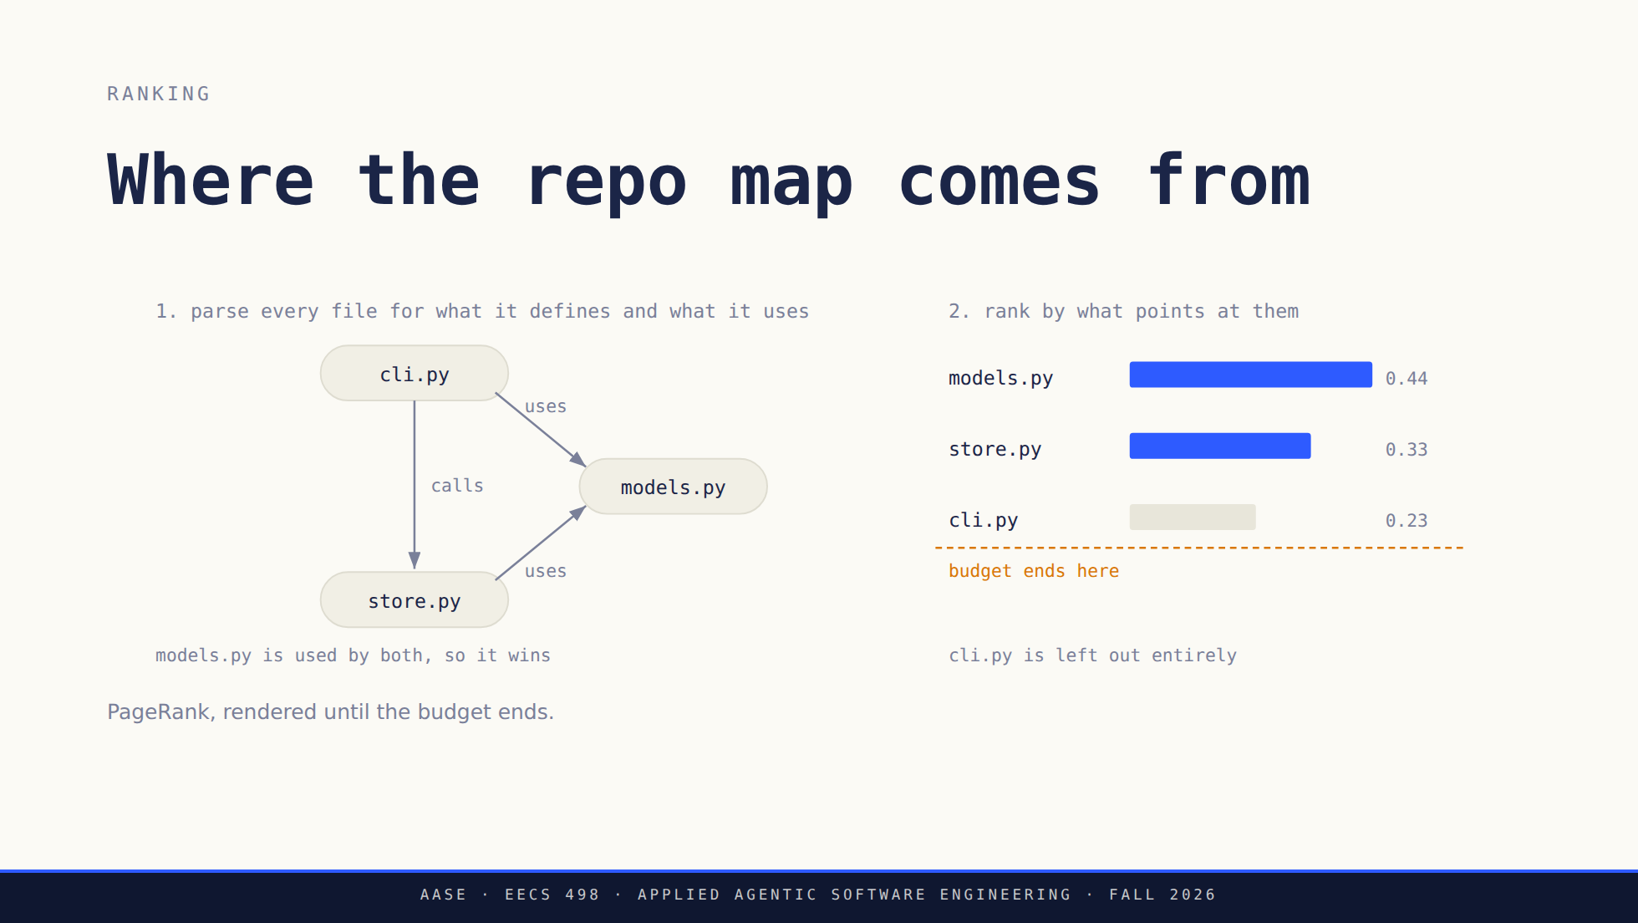
Notes:
Off the slide and worth saying: the ranking is tilted toward files you just
mentioned, and aider renders down the list until the tokens run out.
Say the ranking rule plainly: a file that lots of other files depend on scores
high, because it is probably the one you need to know about.
The dashed line is the point. It is not "here is your repo," it is "here is as
much of your repo as fits," and whatever falls under the line is invisible to
the model. 867 lines of aider to guess what you would have typed /add for.

Slide 11
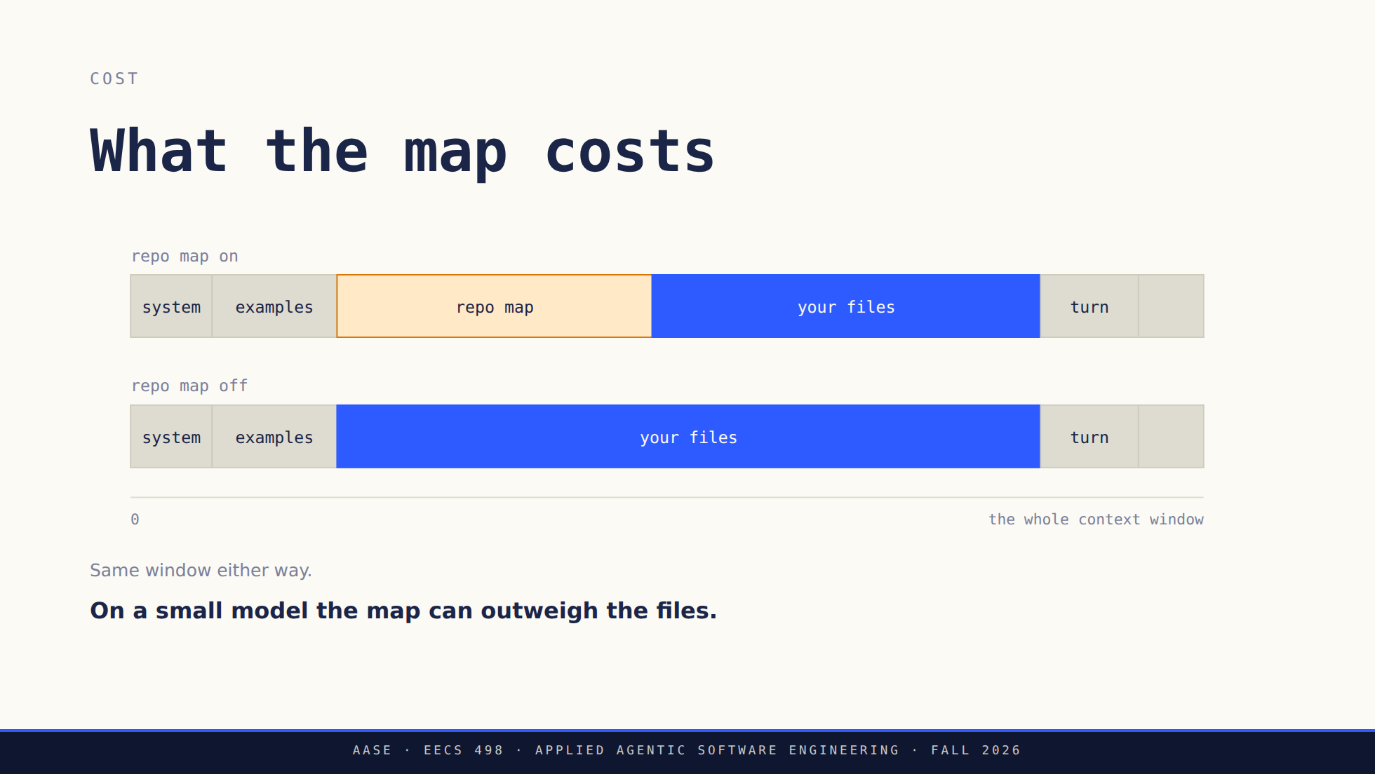
Notes:
Off the slide: on a small model the map often costs more than the files it was
guessing about.
This is why aider-practice turns it down. On a 4B with a small window the map
can eat a third of the budget to describe files the model then cannot see the
insides of anyway.
It is out of scope for the build. Say so here, so nobody spends week 4 on it.

Slide 12
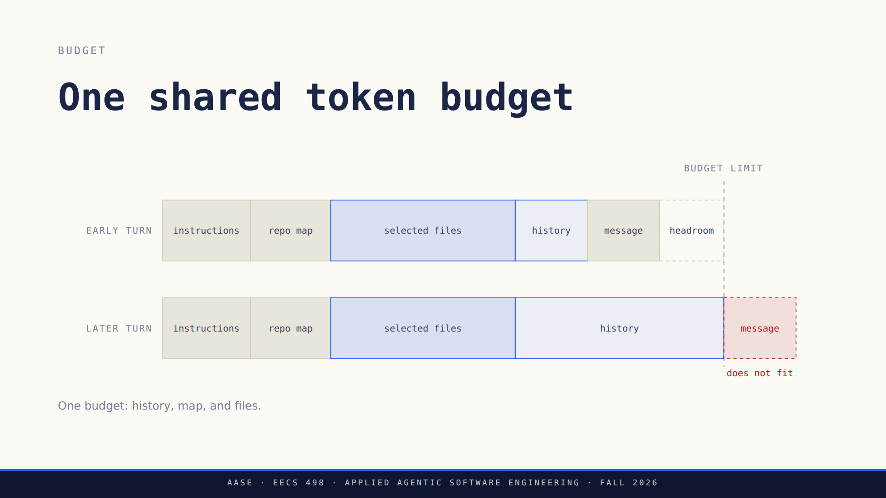
Notes:
Ask what they would drop first and what has to survive. Their Stage 1 contract
keeps the system instructions, the current request and the added file contents,
and refuses an oversized required input instead of silently trimming it. That
refusal is a design decision they have to write down and test.

Slide 13
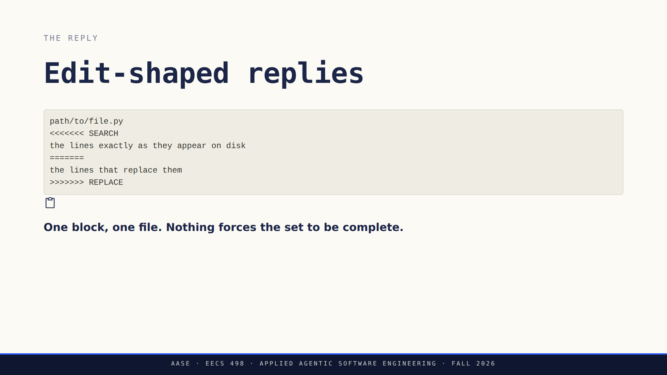
Notes:
Ask what a block like this does not tell you. It names one file. A change that
needs three files needs three blocks, and nothing in the format obliges the
model to produce all three. A student who reads one well-formed block sees a
finished feature.
Nothing has changed on disk yet. This is a proposal in a chat reply.

Slide 14
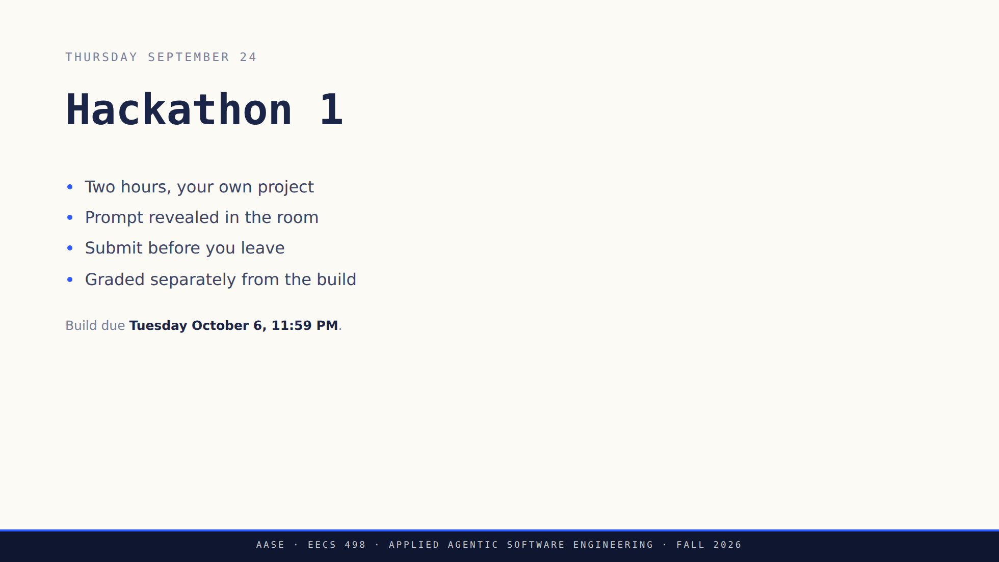
Notes:
Three minutes including logistics. Room, time and the model in the workspace are
announced by staff. Do not invent any of them here.
Say the accommodations line out loud: conflicts and accommodations go to staff
now, not the week of.
The caption is the only place in the deck a student sees the build deadline, now
that the after-lab slide is gone. Do not skip past it.

Slide 15
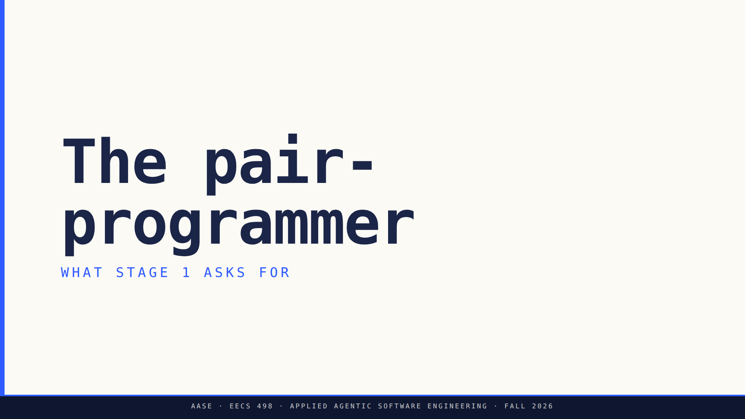
Notes:
Minutes 40 to 58. This is the reveal. They have spent two weeks driving a
harness and the last half hour taking one apart; now they build one.
Lead with what the thing is, not with the paperwork. The packet carries the
requirements and they can read it.

Slide 16
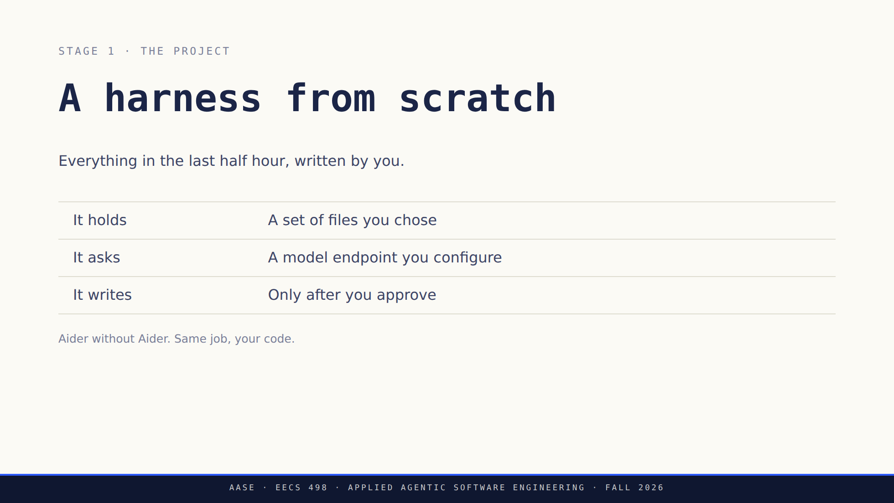
Notes:
Say the one-sentence version out loud: a terminal pair-programmer over files
you select, talking to an endpoint you configure, that never edits without
asking. Everything else in the packet is detail under that sentence.
It is not a clone of Aider and it does not need to be. No repo map, no lint
loop, no architect mode. What it must have is the spine they just watched.
If somebody asks how big it is: smaller than they fear, and the specification
work is the part that decides how long it takes.

Slide 17
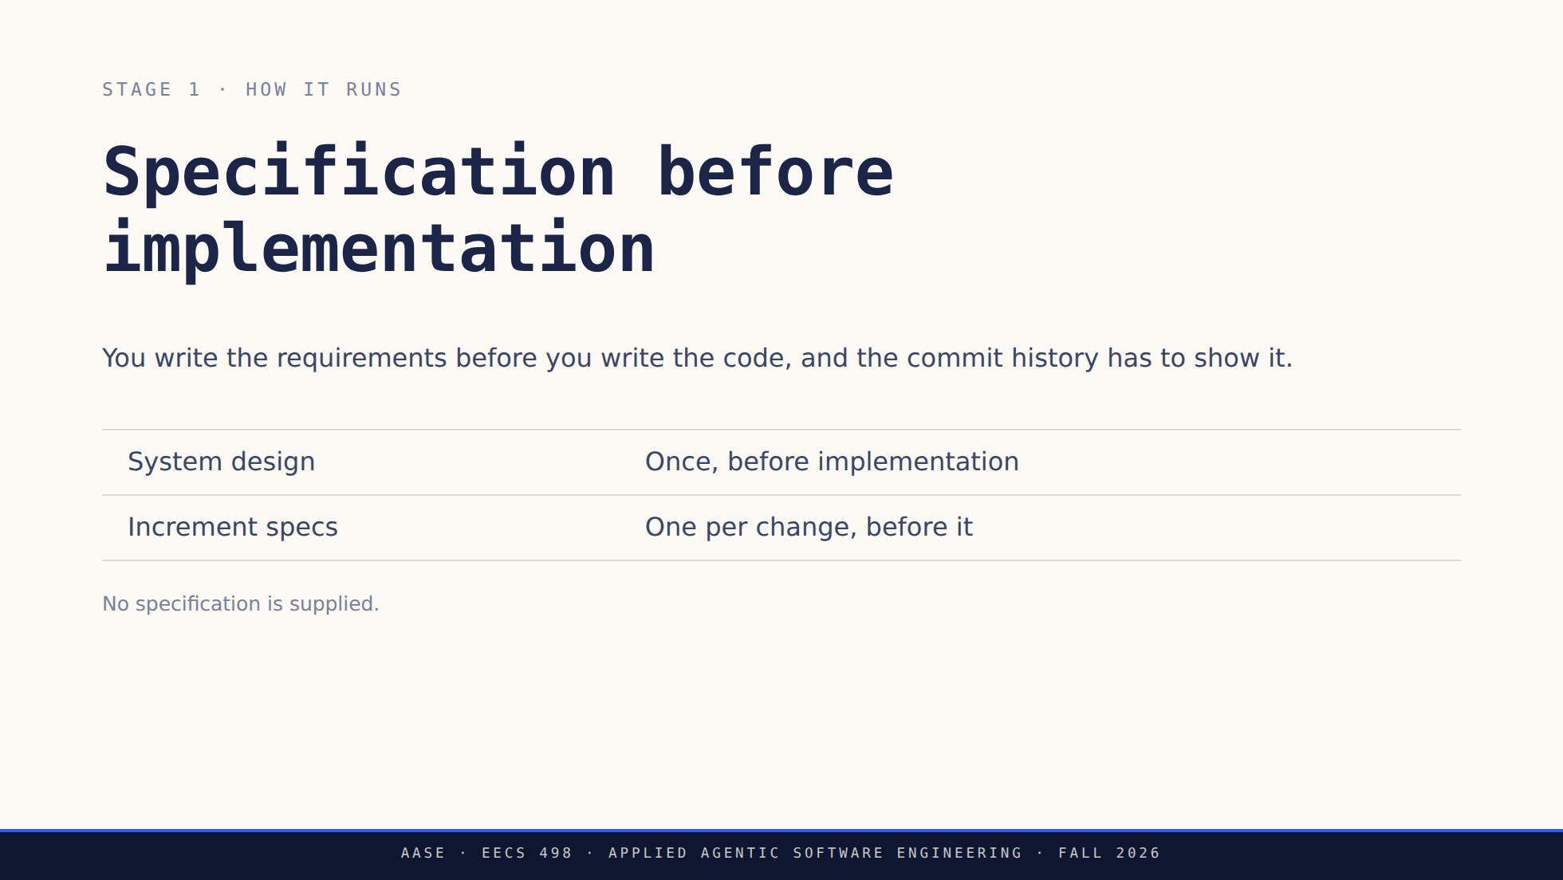
Notes:
This is the whole shape of Stage 1 and the thing most of them will get wrong by
starting with code. Nobody hands them a specification: they write their own
requirements, their own acceptance criteria, and their own increments.
The history is evidence, not bureaucracy. A design committed after the code it
describes earns nothing, and they cannot reconstruct it at the end.
Increment specs are what an Aider session can actually execute: scoped context,
ordered tasks, a checkable result.

Slide 18
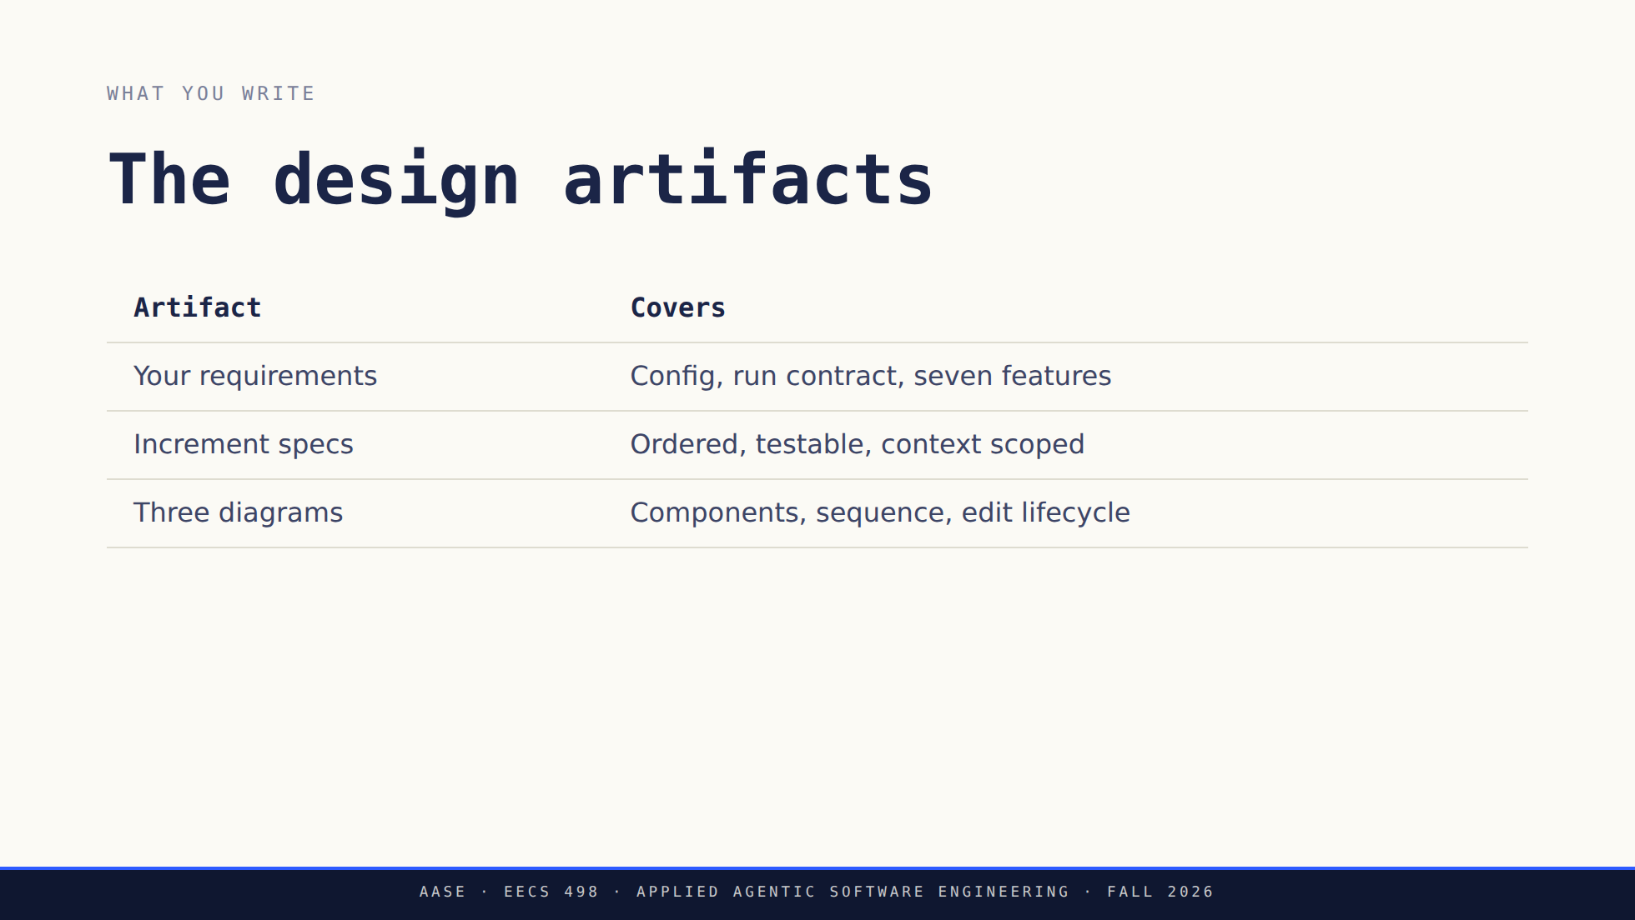
Notes:
Their requirements have to cover the configuration and execution contracts as
well as the seven features, with observable outcomes, edge cases and exclusions,
and each one has to trace to an acceptance criterion of their own.
The diagrams describe their system, not Aider. Copying this morning's picture
earns nothing. Mermaid is enough, labels have to be legible and accurate, and
there is no length requirement anywhere in this section.

Slide 19
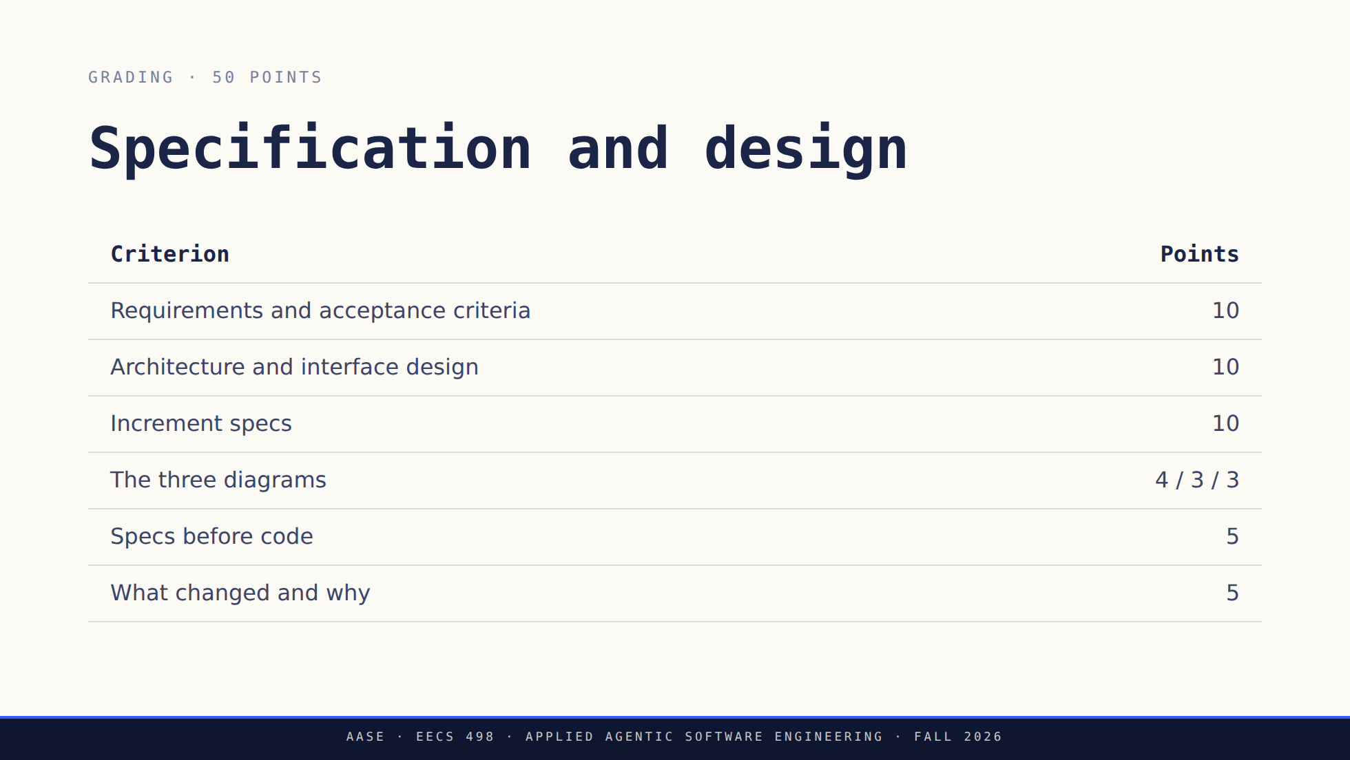
Notes:
Do not read the table out. The one thing worth saying: a part they designed and
did not implement keeps its design credit as long as it is labelled.
Architecture credit includes explaining where tool execution, a replacement
endpoint client and a non-terminal interface would fit, without building them.
The last two rows are read from git history rather than from a document. Specs
before code is scored on commit order, and what changed and why is the
reconciliation between the design they started with and the system they
finished. A design that worked does not need an invented failure.

Slide 20
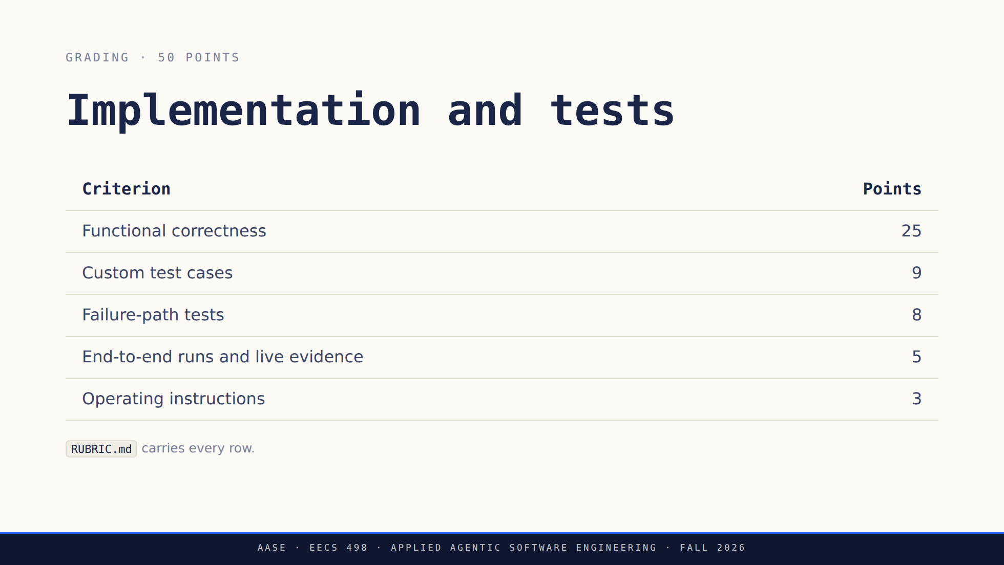
Notes:
100 points across two sections of 50. These are build points, not course-grade
percentages: the build is 4.5% of the course.
Functional correctness is the seven features, scored one row each in RUBRIC.md.
Half credit exists for behavior that partly works, so an unfinished feature is
not a zero.
Test count and coverage earn nothing by themselves. A test earns credit when it
asserts an outcome and isolates the filesystem. Weakening an assertion to turn
the suite green is scored as what it is.
Configuration sits inside F1's five points and is not a gate.
Staff read the repository snapshot at the deadline, run their own tests, and
work through ACCEPTANCE.md. There is no hidden suite and no requirement that is
not in SPEC.md. Routine tests use fakes rather than a live model; live checks
are documented separately and opt in, and an honestly reported failed live
attempt still earns its evidence points.
Send them to RUBRIC.md rather than reading rows aloud. It names the requirement
IDs each row scores.

Slide 21
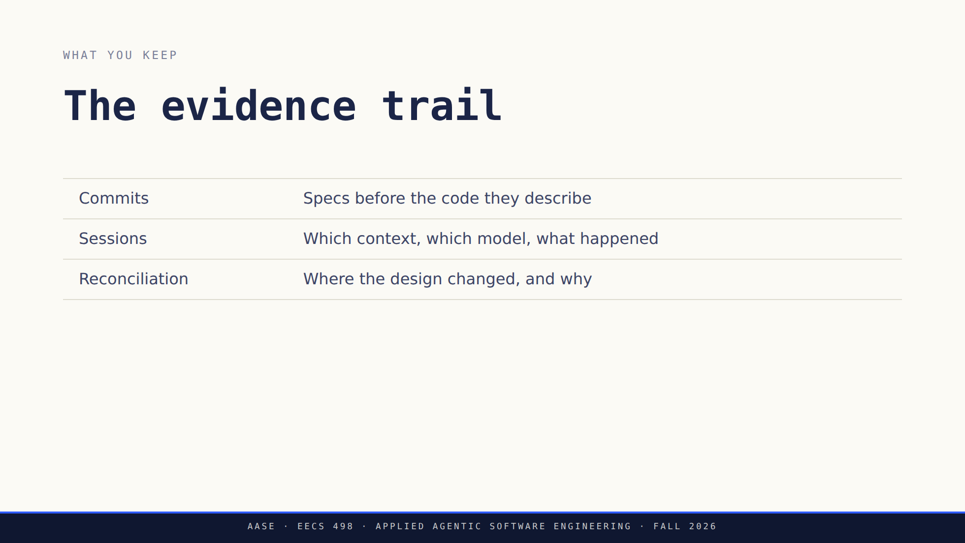
Notes:
None of this can be reconstructed the night before, which is why it is worth a
minute here. Commits and reconciliation are the last two scored rows on the
specification slide.
Sessions and model disclosure are required but score no points of their own.
They are what lets staff follow the rest of the evidence, so a submission
without them loses credit wherever a claim cannot be checked.

Slide 22
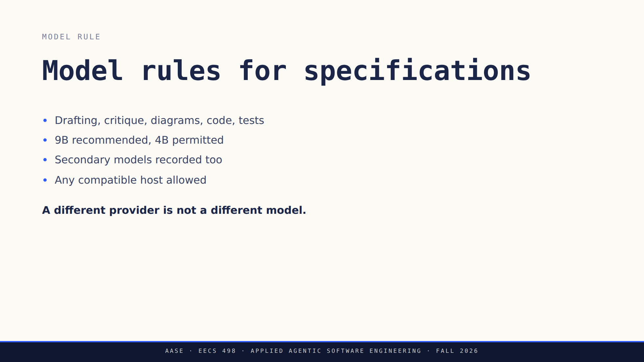
Notes:
Exact model IDs and the observed-session exception are in the assignment packet.
Read them from there rather than from memory.
The pattern being ruled out is a frontier model for the design followed by a
local model for the code. Keep the sessions, disclose real aliases and any
quantization you know about.

Slide 23
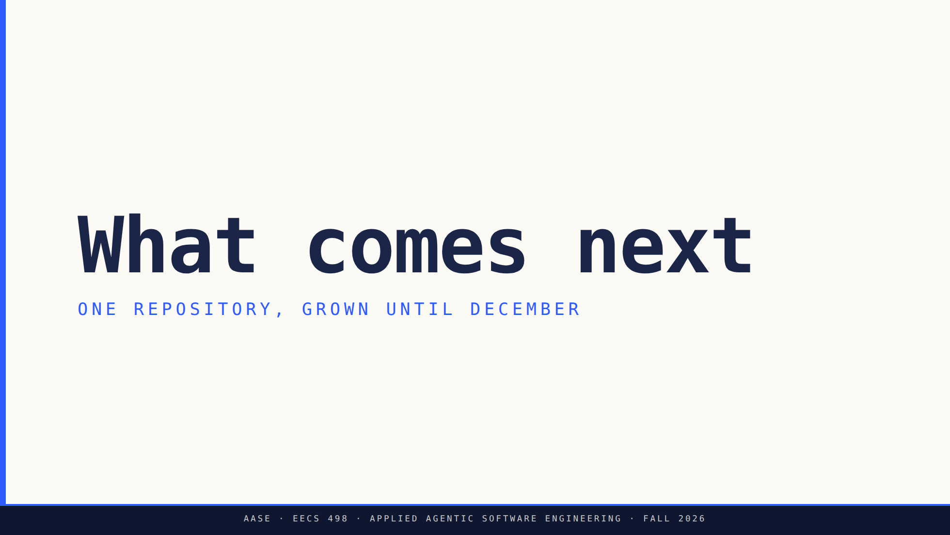
Notes:
Minutes 58 to 65. Short. The point is the arc, not a tour of tools.
Nothing here is a Stage 1 dependency and no subscription is needed for this
course.

Slide 24
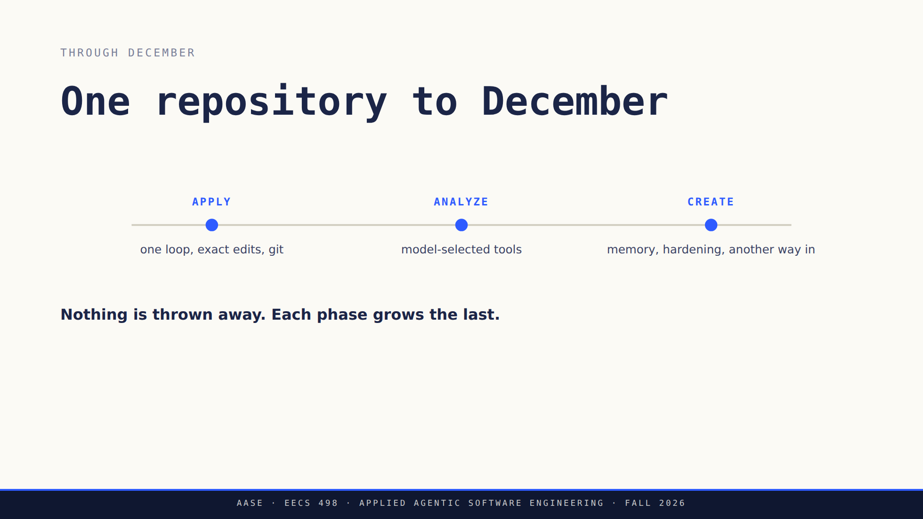
Notes:
Walk the timeline left to right and say what changes at each dot: first the
human is in the loop, then the model picks the tools, then it keeps state and
survives contact with real work.
Build advice that used to sit on this slide and still belongs in the room: one
small checkable result first, and keep the phase snapshots.
Do not estimate the workload out loud. Do say that a runnable slice early is
what keeps the December integration from being a surprise.

Slide 25
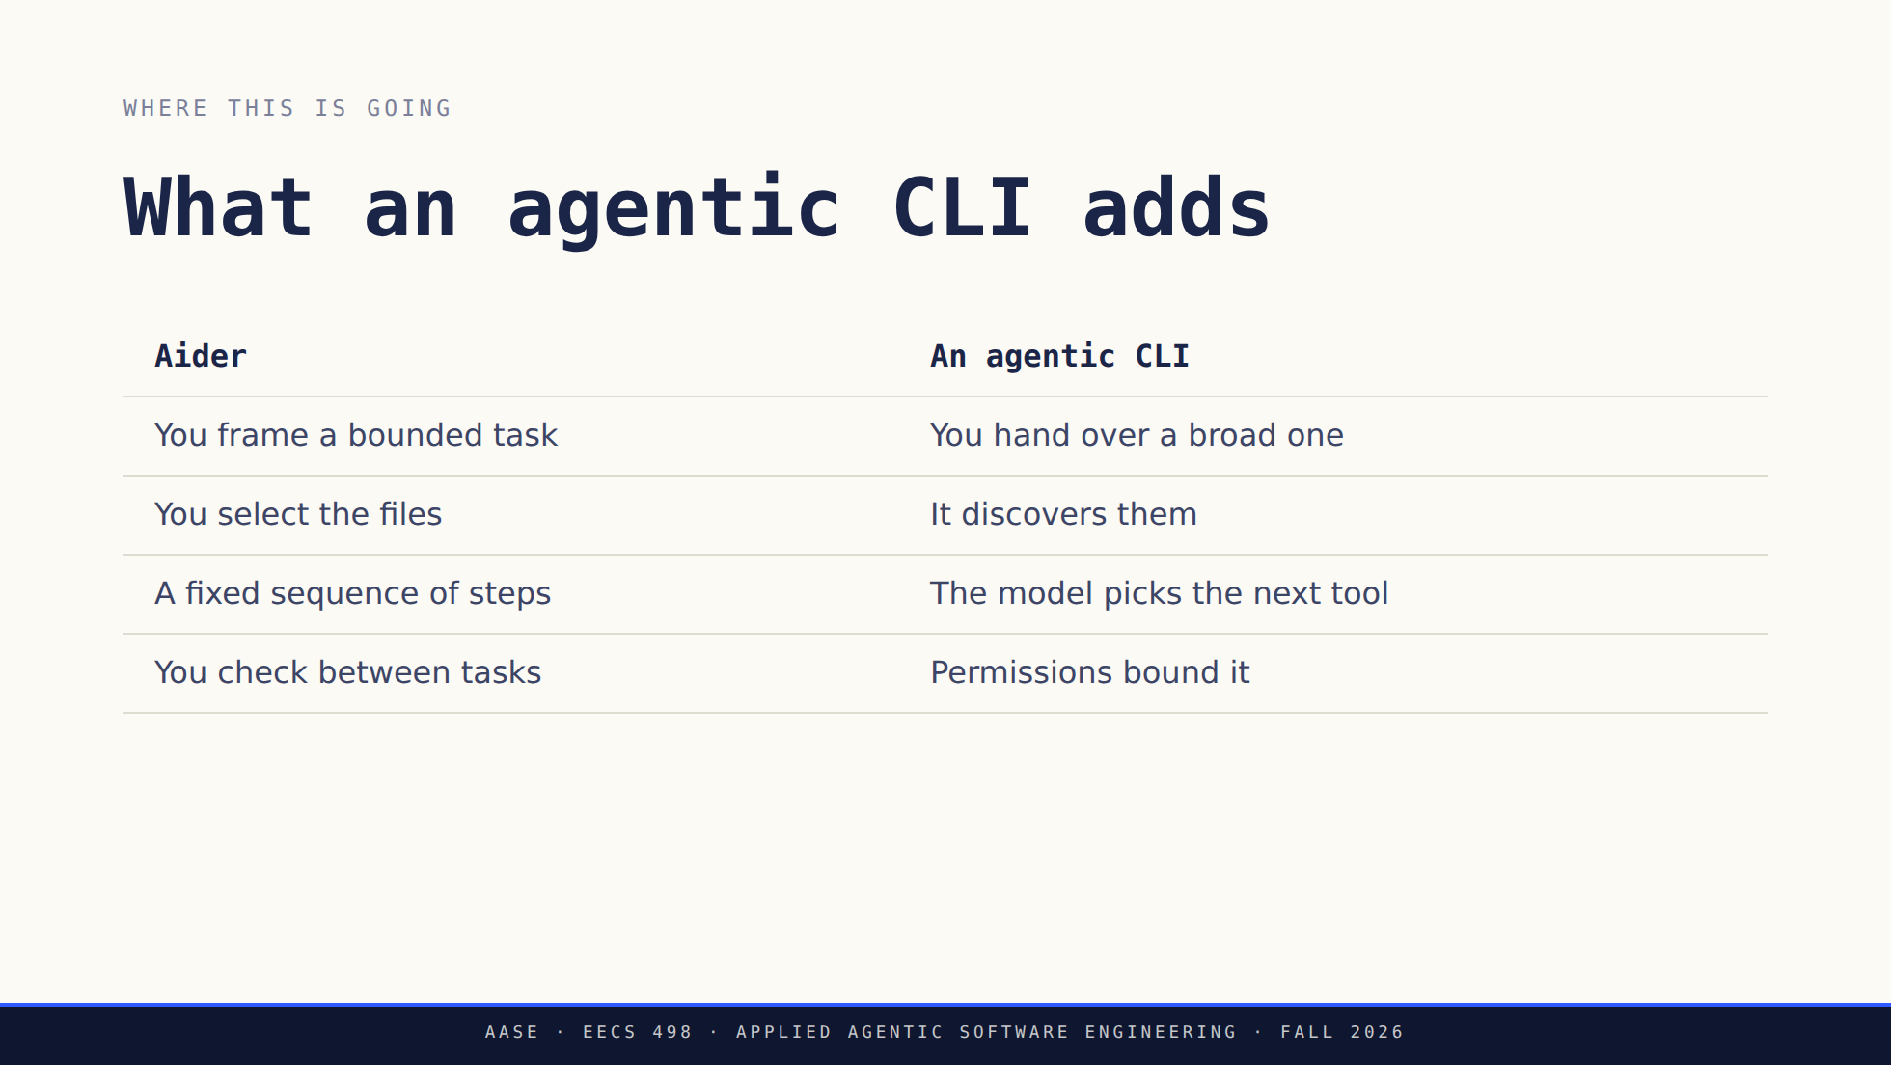
Notes:
Do not turn the left column into a weakness. Aider automates plenty. What
changes on the right is who decides the next action.
Source: https://code.claude.com/docs/en/overview

Slide 26
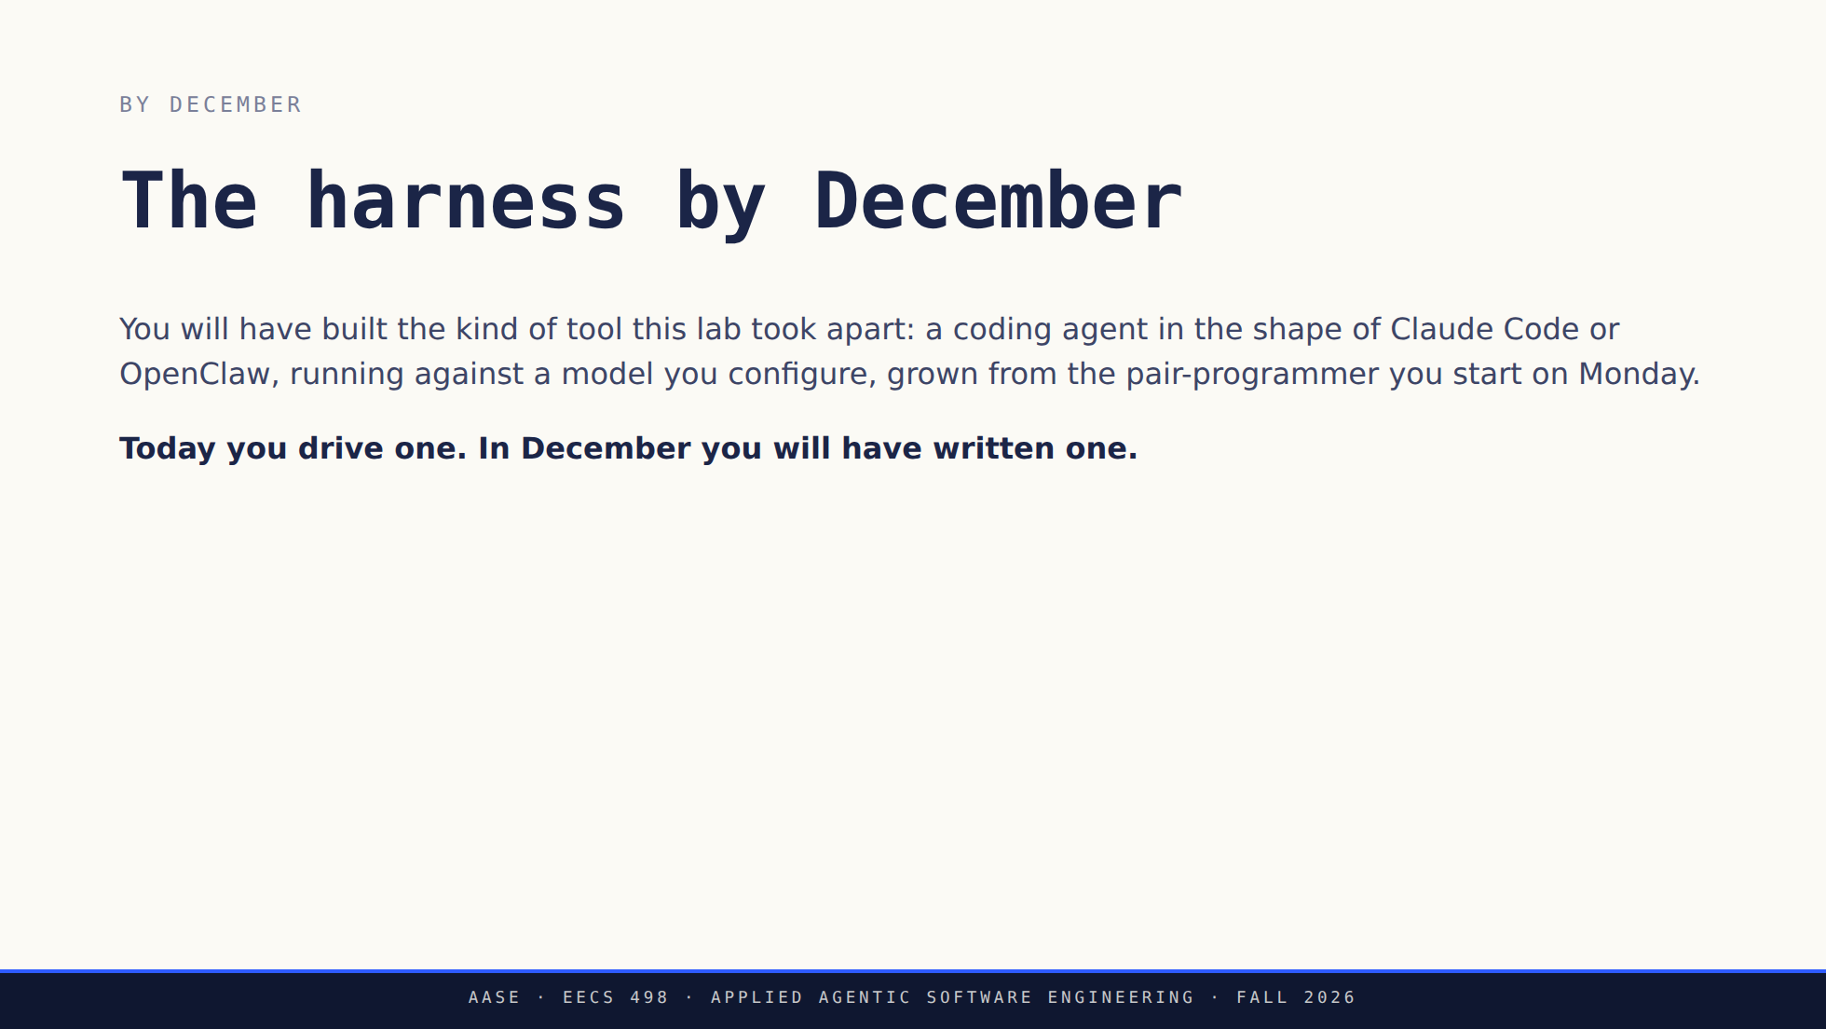
Notes:
This is the last thing they hear before office hours, so land it and stop.
Name the two tools as a shape, not as a target to clone and not as something
they need an account for. What makes it that shape is the list they will build:
tools the model chooses, an approval layer, state that survives a run, more
than one way in.
The design habit to start now: when a decision could close off one of those,
leave a boundary rather than an implementation. That is the useful half of the
slide this replaced.

Slide 27

Notes:
Stop talking. Staff circulate from here. Leave the deck up so students can page
back through it themselves.
This is the point where you say plainly that nothing is due at the end of
today. Most of them will still expect a checkoff.

Slide 28


