Slide 1
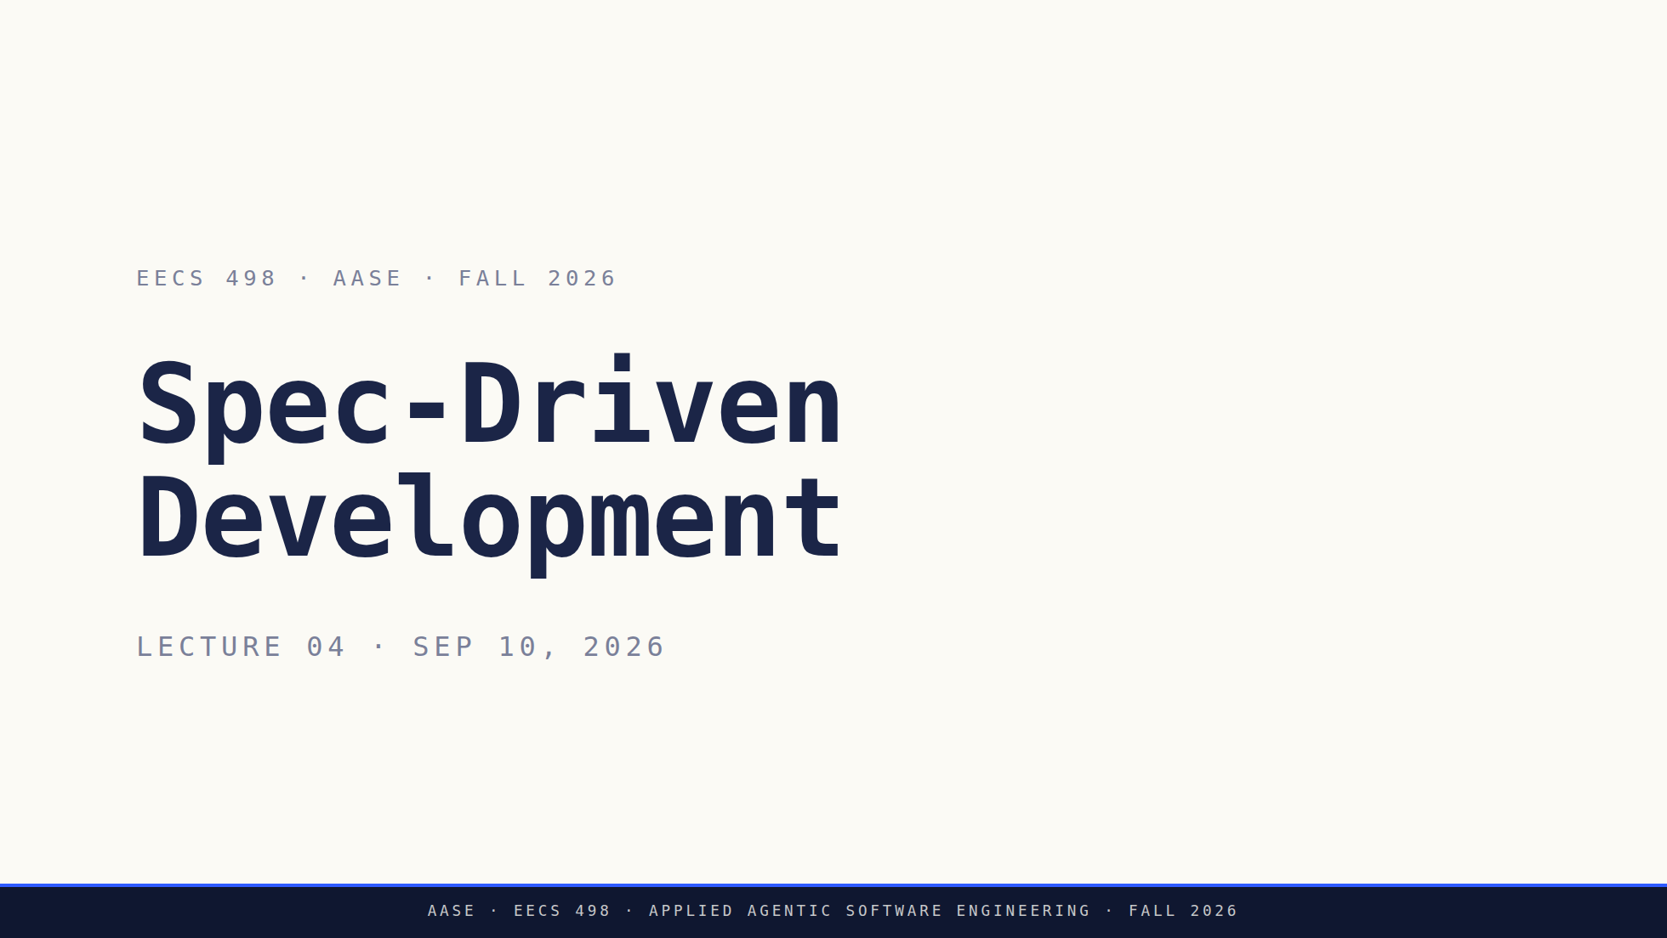
Notes:
The last technique before you build. Today: IDKs + specs + Architect Mode.
After today they have everything for Lab01 and the build. RED

Slide 2
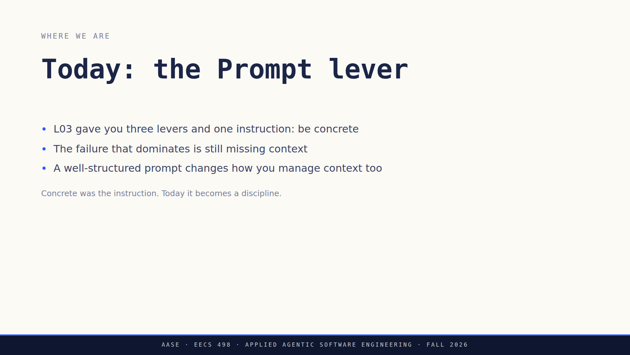
Notes:
Don't re-teach the Big Three. One line, then move. The third bullet is the
one worth landing: a spec names its own file boundaries, so writing one is
context management whether or not you call it that.

Slide 3
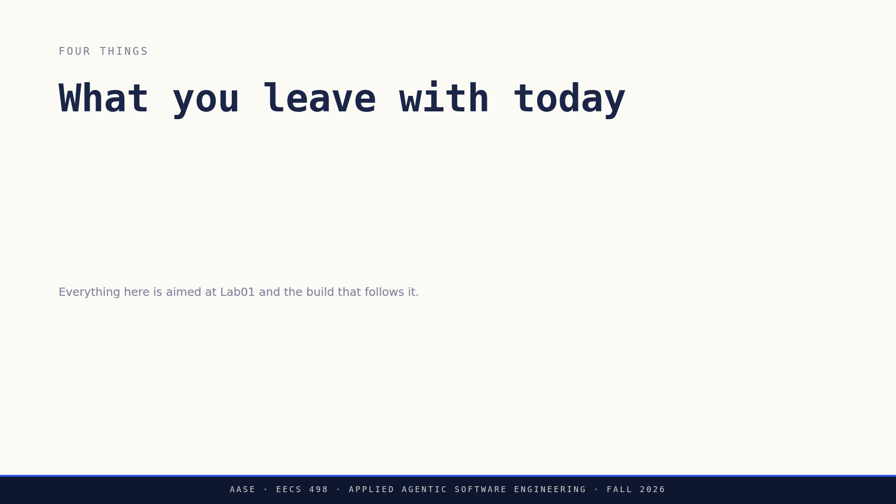
Notes:
Four clicks, four things, no elaboration on any of them. Each one gets its
own block later. This slide exists so they can tell where they are when the
lecture turns.

Slide 4
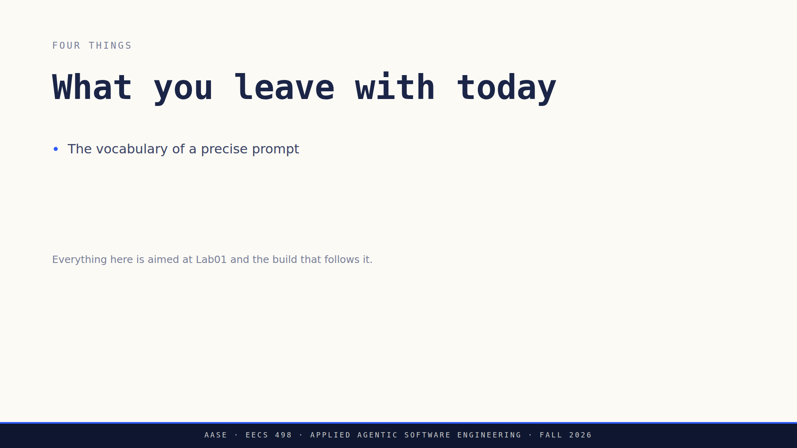
Notes:
Four clicks, four things, no elaboration on any of them. Each one gets its
own block later. This slide exists so they can tell where they are when the
lecture turns.

Slide 5
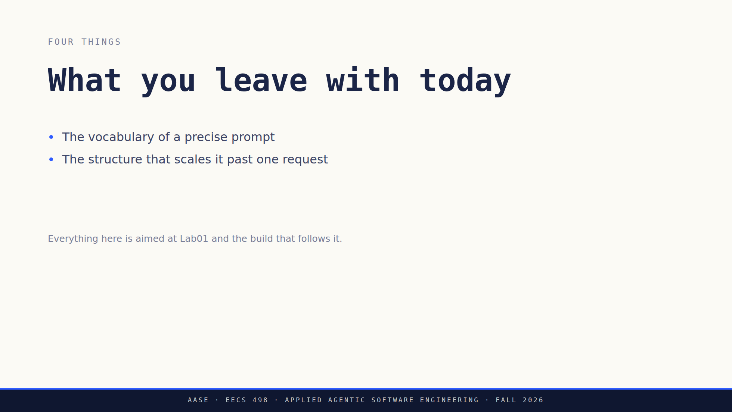
Notes:
Four clicks, four things, no elaboration on any of them. Each one gets its
own block later. This slide exists so they can tell where they are when the
lecture turns.

Slide 6
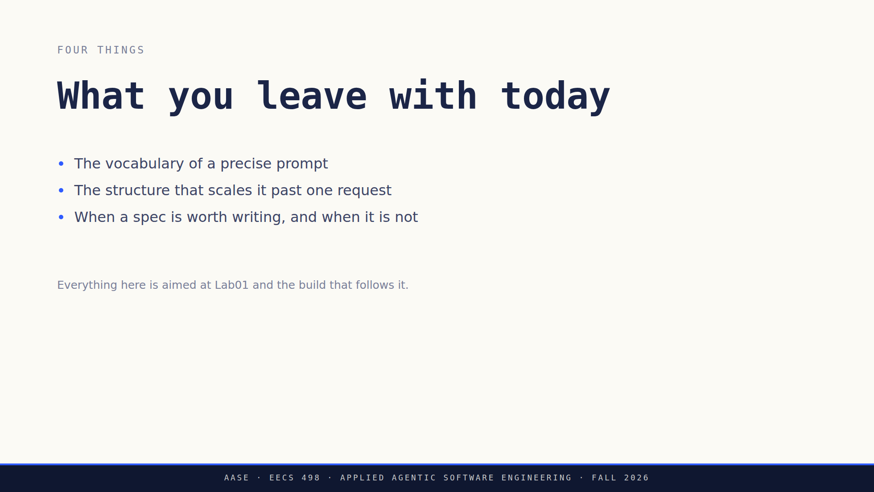
Notes:
Four clicks, four things, no elaboration on any of them. Each one gets its
own block later. This slide exists so they can tell where they are when the
lecture turns.

Slide 7
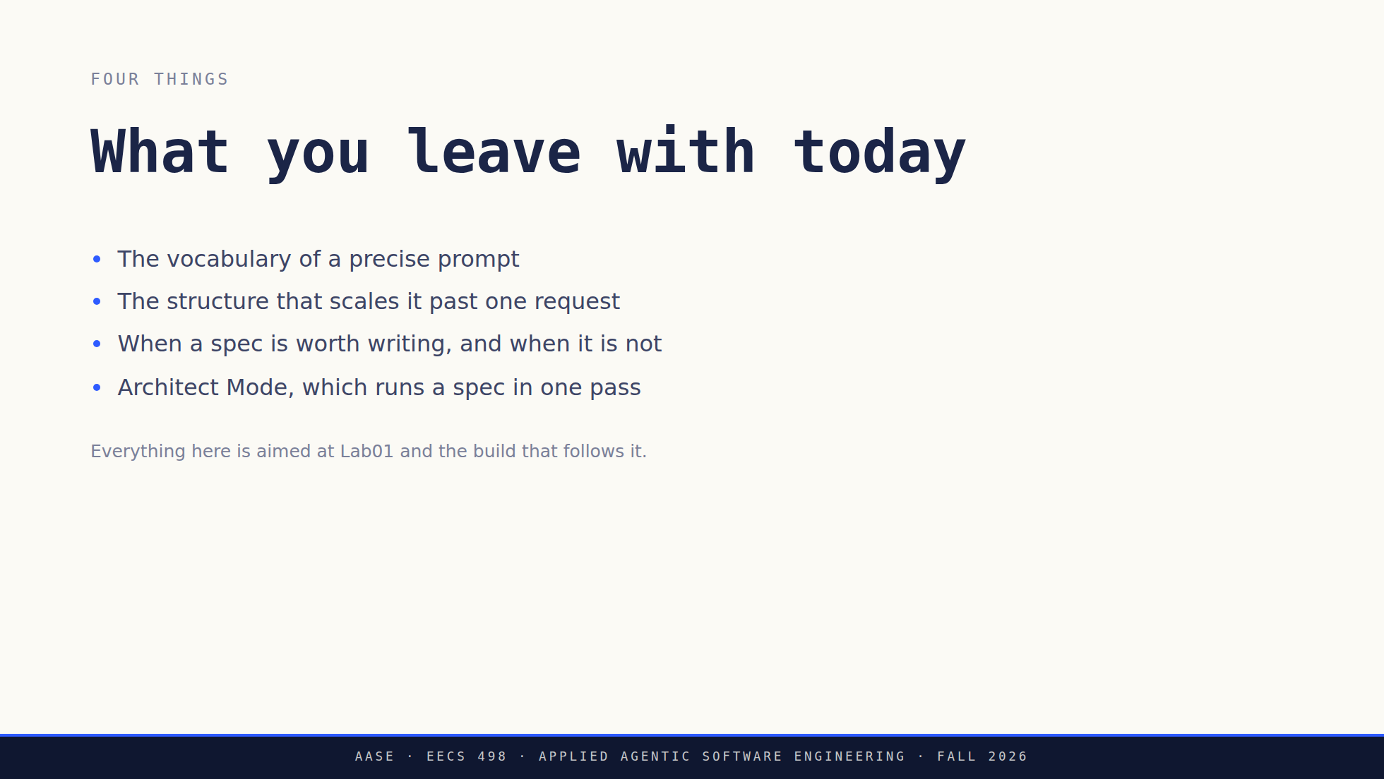
Notes:
Four clicks, four things, no elaboration on any of them. Each one gets its
own block later. This slide exists so they can tell where they are when the
lecture turns.

Slide 8
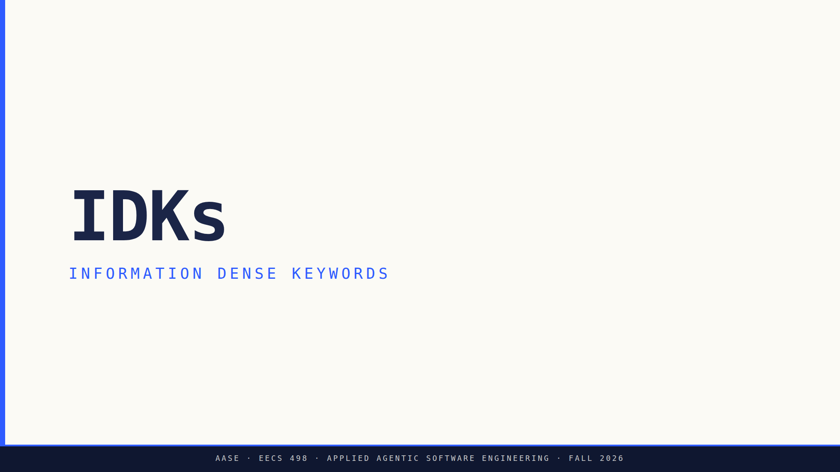
Notes:
Divider. Say what the acronym stands for once, out loud. IDK is not a term
they have met and it is about to be on every slide. GREEN

Slide 9
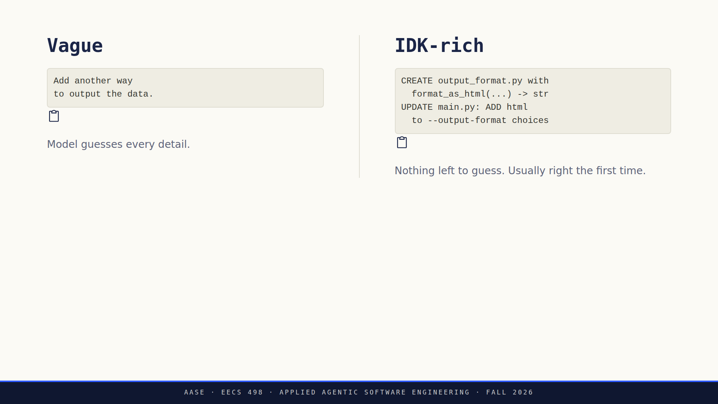
Notes:
Same codebase, same context, two prompts for the same task.
Read the vague one, then list what the model has to guess: a text file
instead of HTML, no CLI change, a print() where a function belonged. Any one
of those guesses can be wrong.
Then the right column, where nothing is left to guess.
The line to land: this is the difference between a prompt you keep
re-running with different words and one that lands the first time.

Slide 10
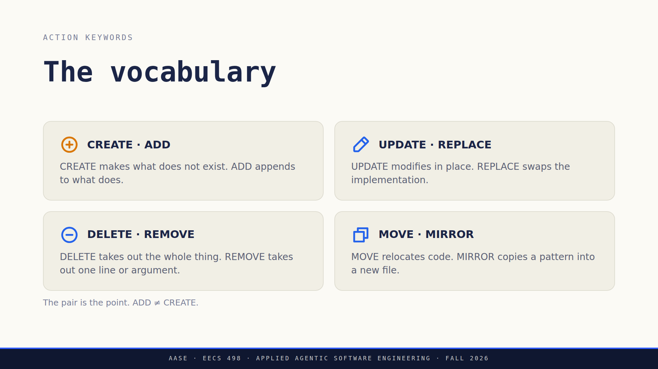
Notes:
Four pairs, eight verbs. Read the pairs, do not define each verb.
CREATE and ADD is the pair that matters, which is why it is the amber card.
ADD appends to something that exists, CREATE generates net new. Pick the
wrong one and the model does the wrong thing.

Slide 11
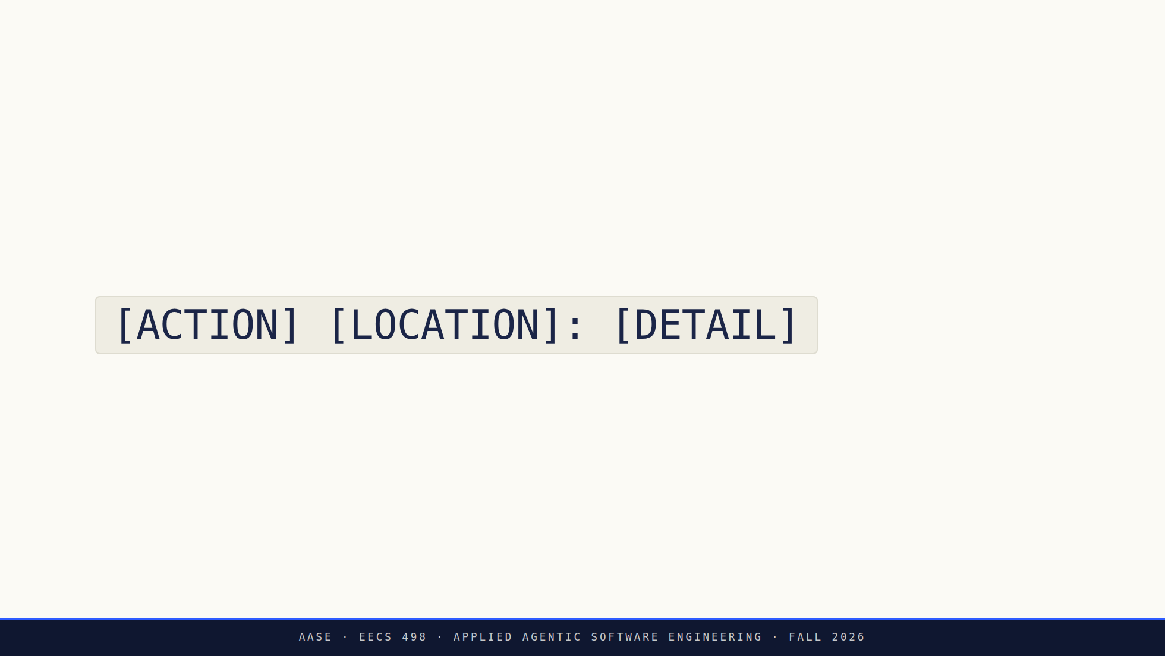
Notes:
The pattern. Repeatable. Compact. Predictable. YELLOW

Slide 12
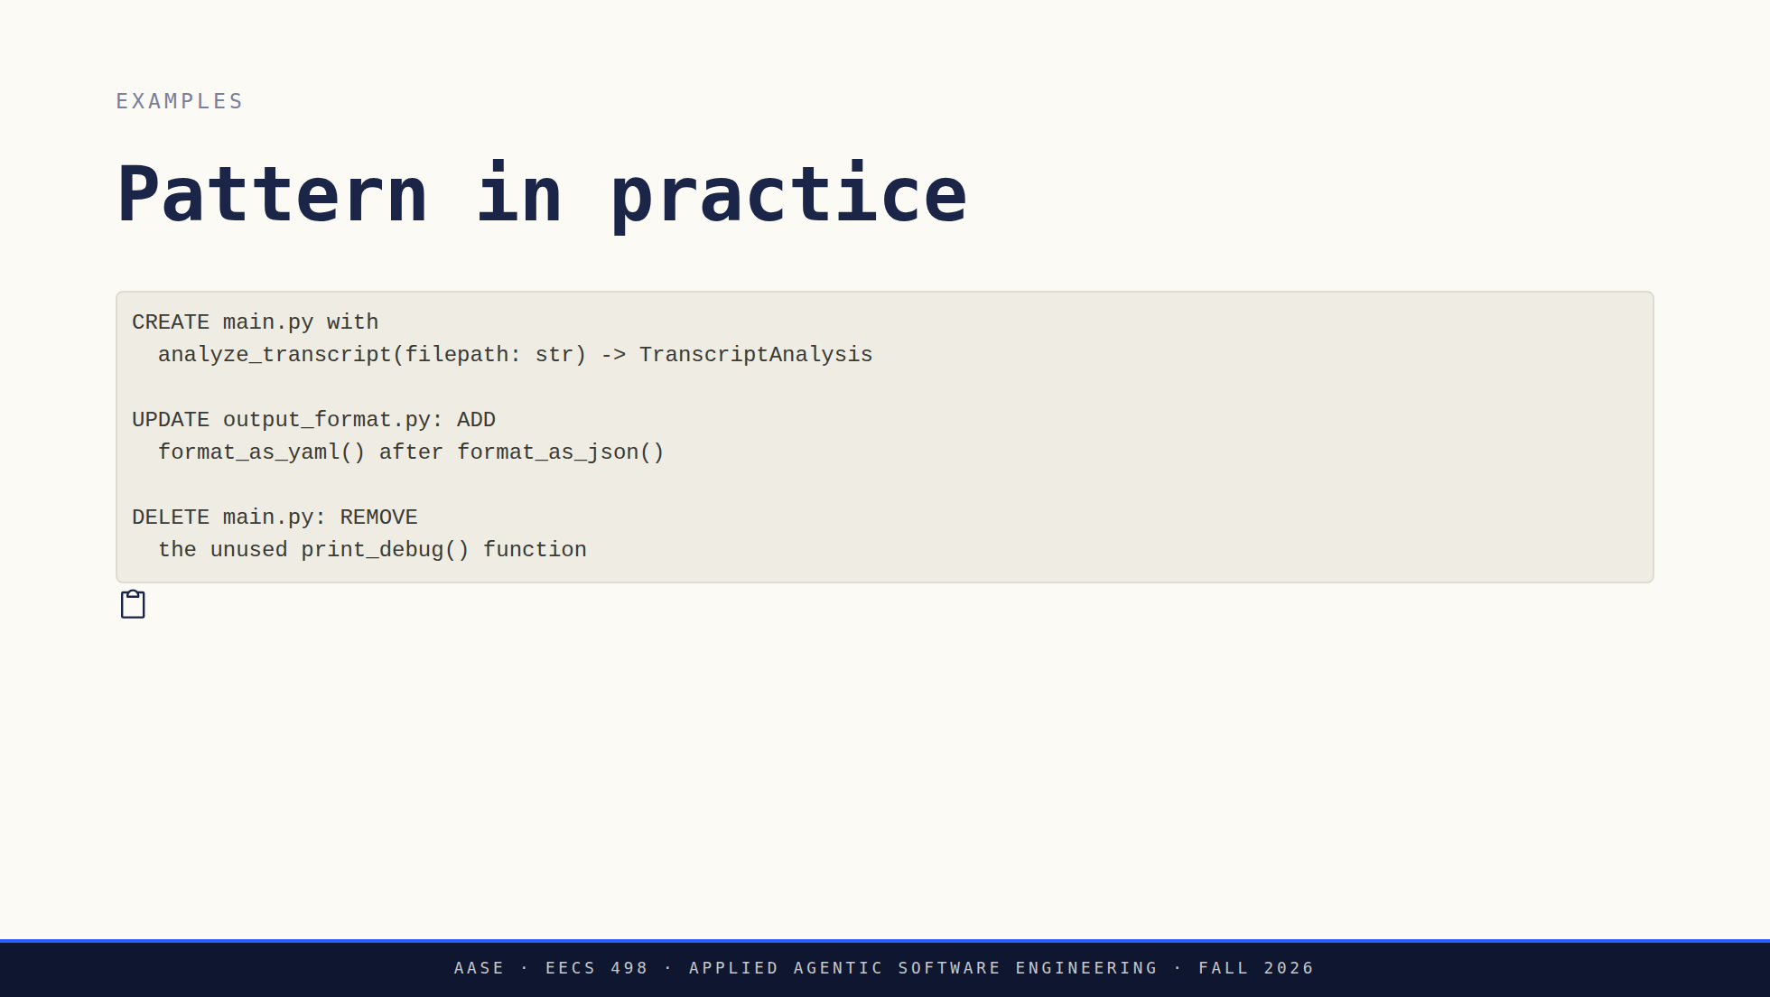
Notes:
Three examples, read as instructions rather than as text on a slide.
The point is cost. The pattern is shorter to write than a paragraph, not
longer, and it usually lands the first time instead of costing three rounds
of iteration.

Slide 13
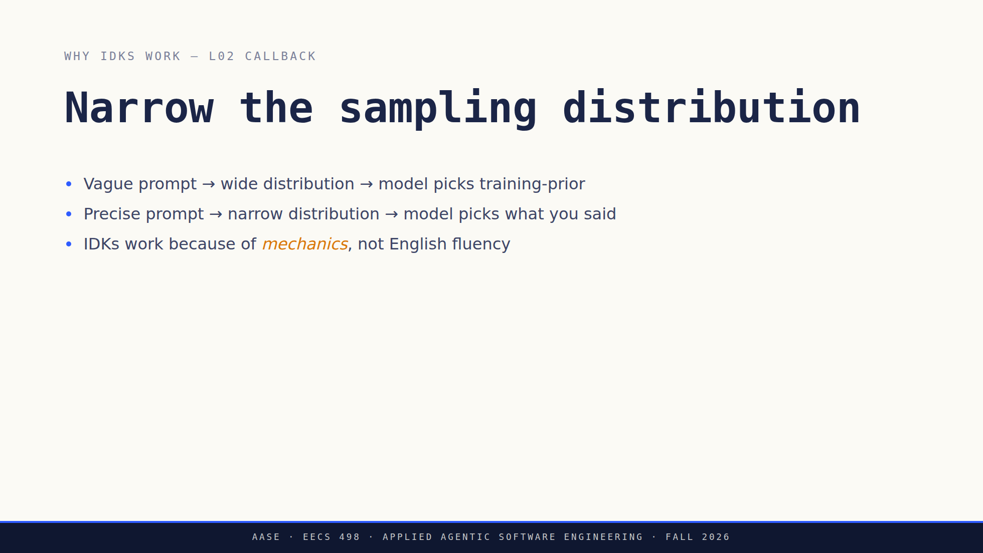
Notes:
The L02 callback, and the slide that stops IDKs from sounding like a style
preference. Autoregressive sampling: a vague prompt leaves the distribution
wide, so the model picks the most common completion in its training data. A
precise prompt narrows it, so the model picks what fits your constraints.
Say the last bullet plainly. IDKs work because of the mechanics, not because
the model understands English better.

Slide 14
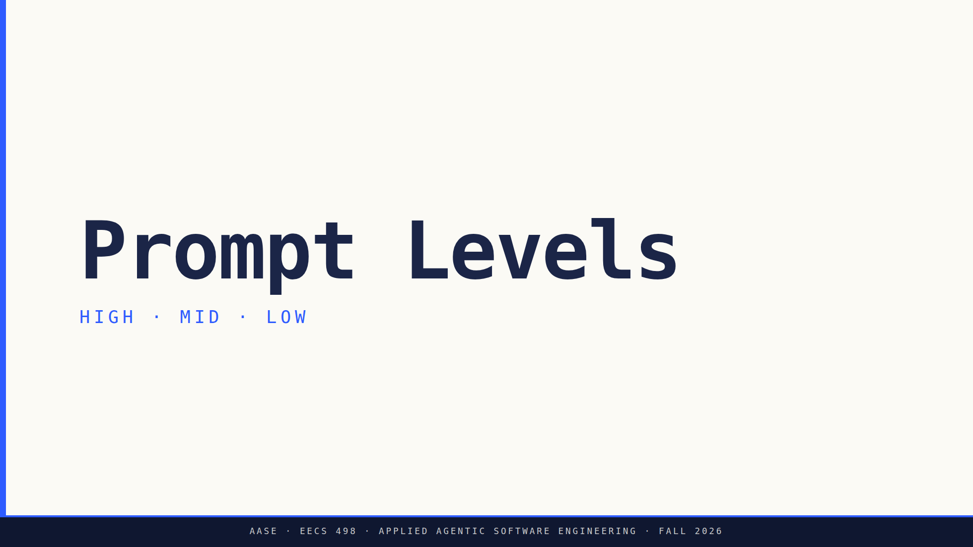
Notes:
Divider. High, mid, low, then advance

Slide 15
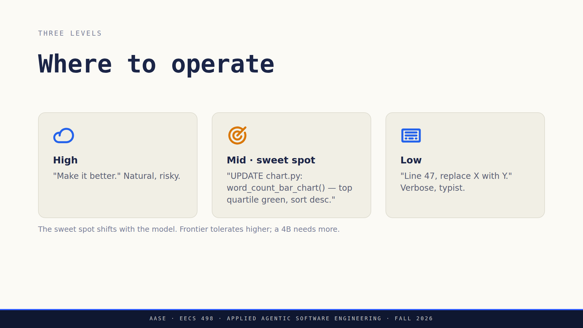
Notes:
Amber on the sweet spot — it's the moment of the slide.
The caption is the calibration point: don't hand them a fixed level, hand
them the habit of noticing which one their model needs today. ORANGE

Slide 16
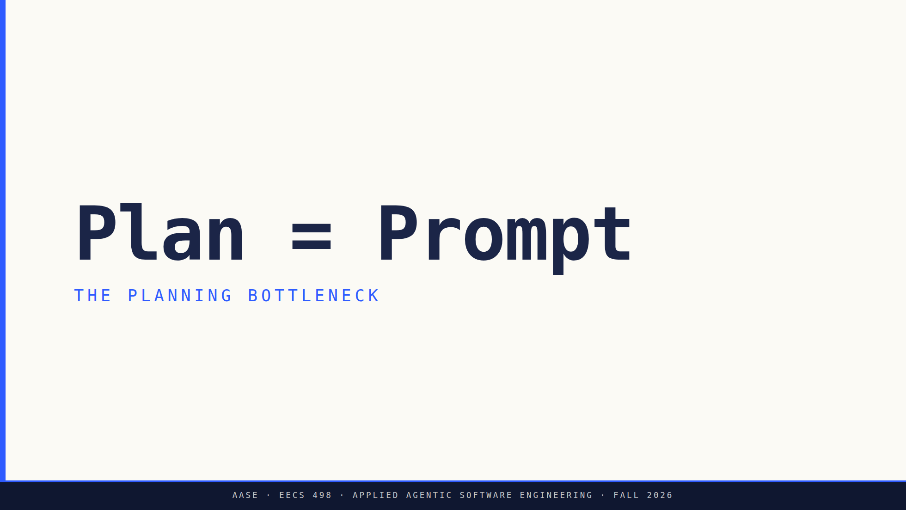
Notes:
Divider. Name it and advance. The argument is on the next slide, so do not
start making it here.

Slide 17
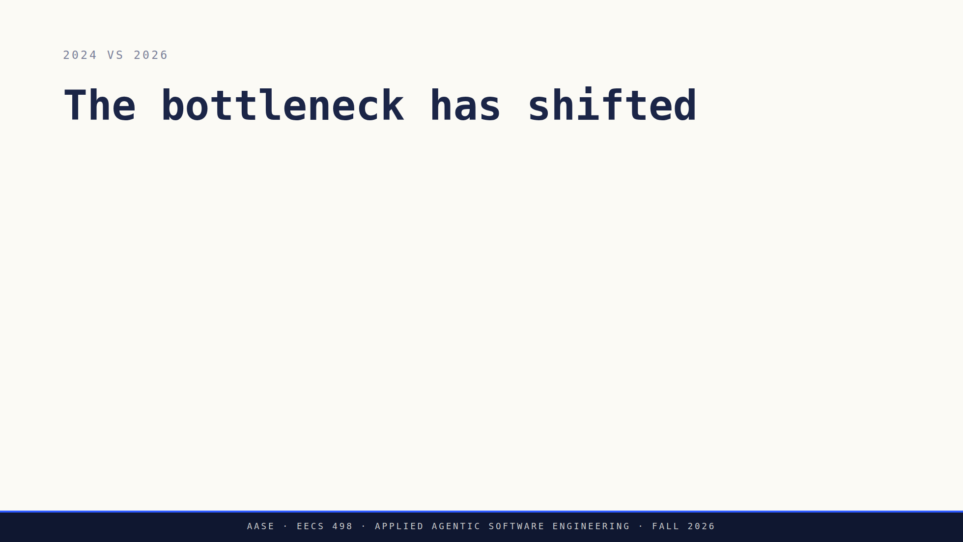
Notes:
The whole argument, five clicks. 2024 asked whether the AI could understand
you. 2026 asks whether you can say what you want.
Click four is the claim. The AI is the executor, you are the architect, and
the planning is the engineering work.
Click five is the asymmetry that prices it. A human contractor who gets an
ambiguous spec asks a clarifying question. An LLM does not, it guesses. So
ambiguity costs more here than it does with people, and writing a precise
spec is not extra work. It is the work.
The statement slide next is the payoff for this one. Do not say it here.

Slide 18
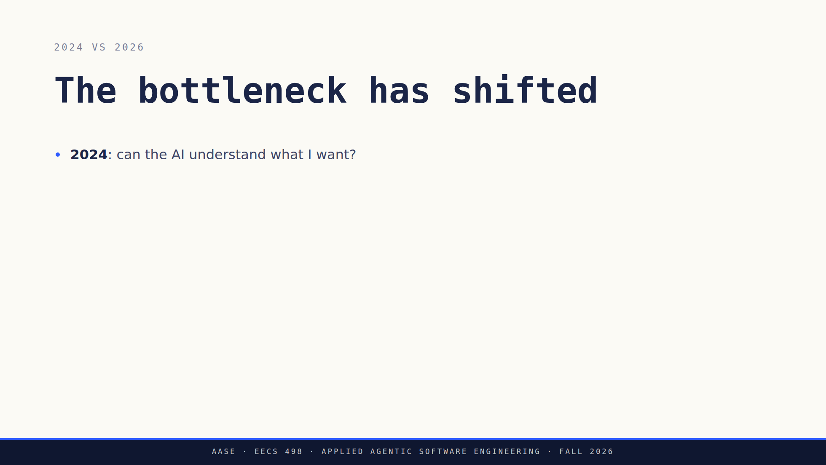
Notes:
The whole argument, five clicks. 2024 asked whether the AI could understand
you. 2026 asks whether you can say what you want.
Click four is the claim. The AI is the executor, you are the architect, and
the planning is the engineering work.
Click five is the asymmetry that prices it. A human contractor who gets an
ambiguous spec asks a clarifying question. An LLM does not, it guesses. So
ambiguity costs more here than it does with people, and writing a precise
spec is not extra work. It is the work.
The statement slide next is the payoff for this one. Do not say it here.

Slide 19
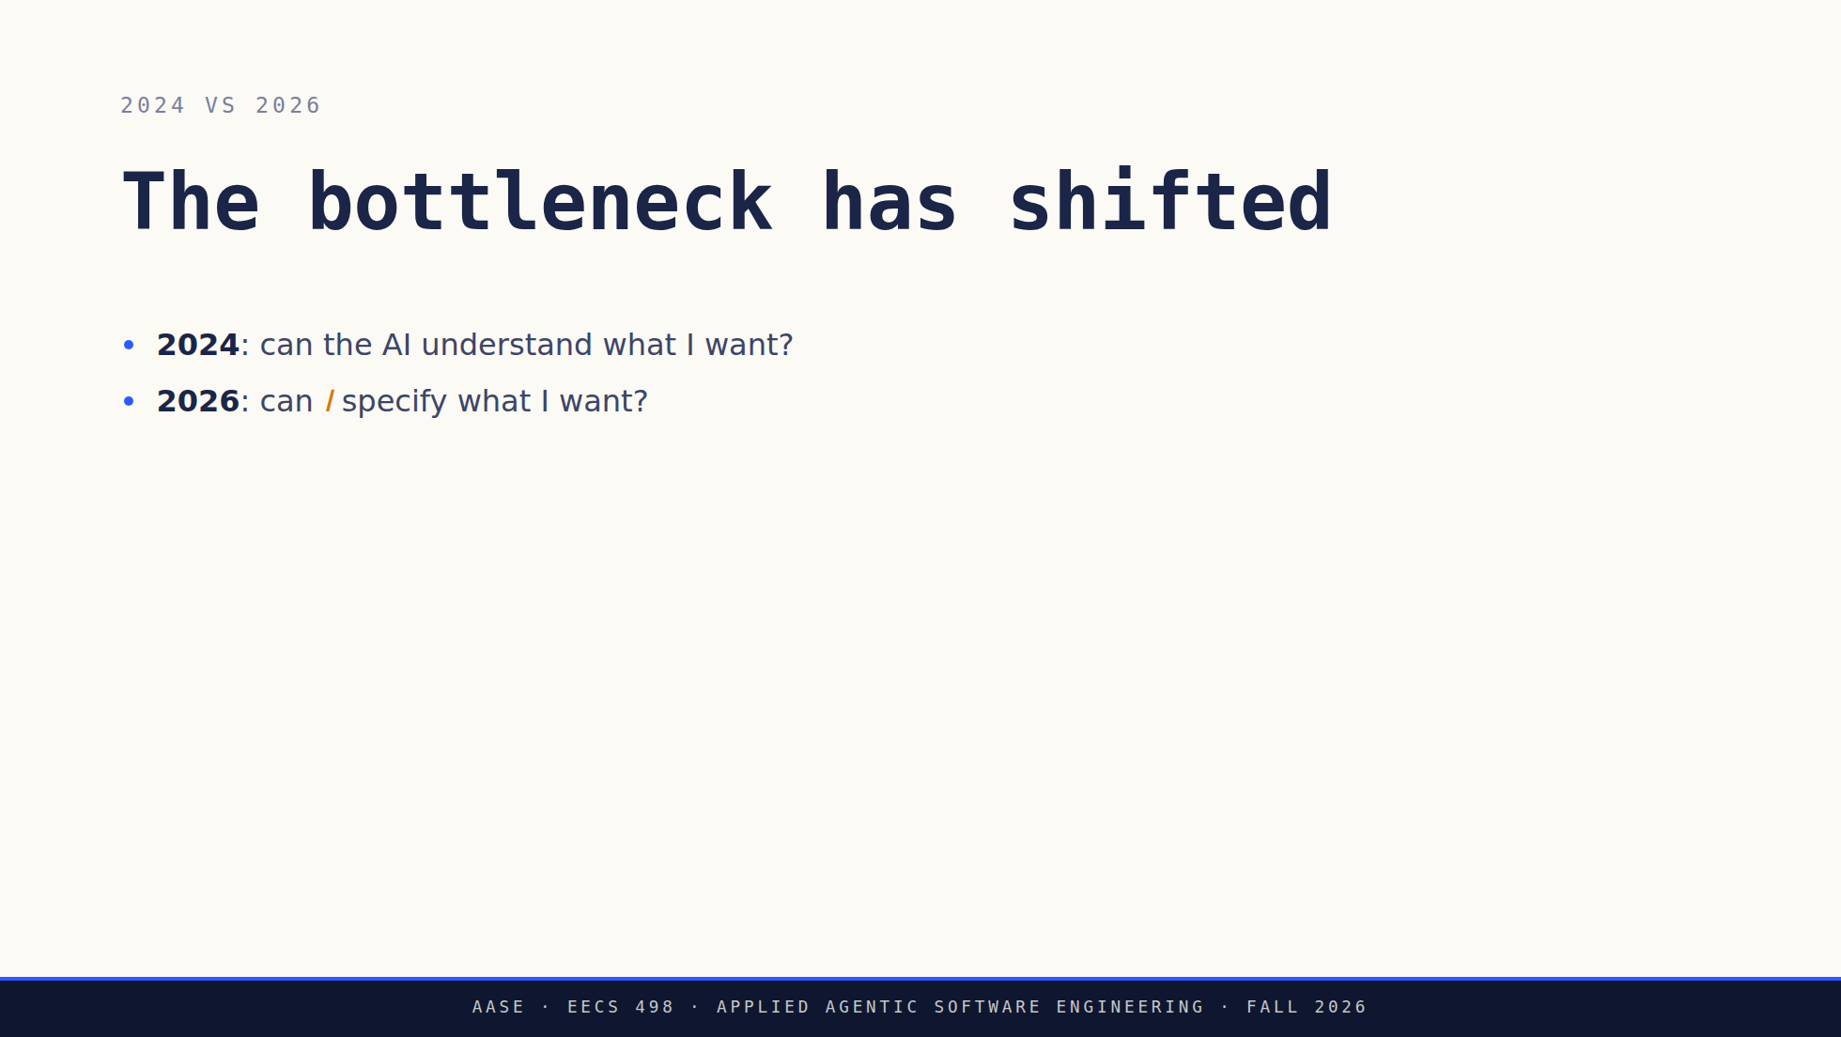
Notes:
The whole argument, five clicks. 2024 asked whether the AI could understand
you. 2026 asks whether you can say what you want.
Click four is the claim. The AI is the executor, you are the architect, and
the planning is the engineering work.
Click five is the asymmetry that prices it. A human contractor who gets an
ambiguous spec asks a clarifying question. An LLM does not, it guesses. So
ambiguity costs more here than it does with people, and writing a precise
spec is not extra work. It is the work.
The statement slide next is the payoff for this one. Do not say it here.

Slide 20
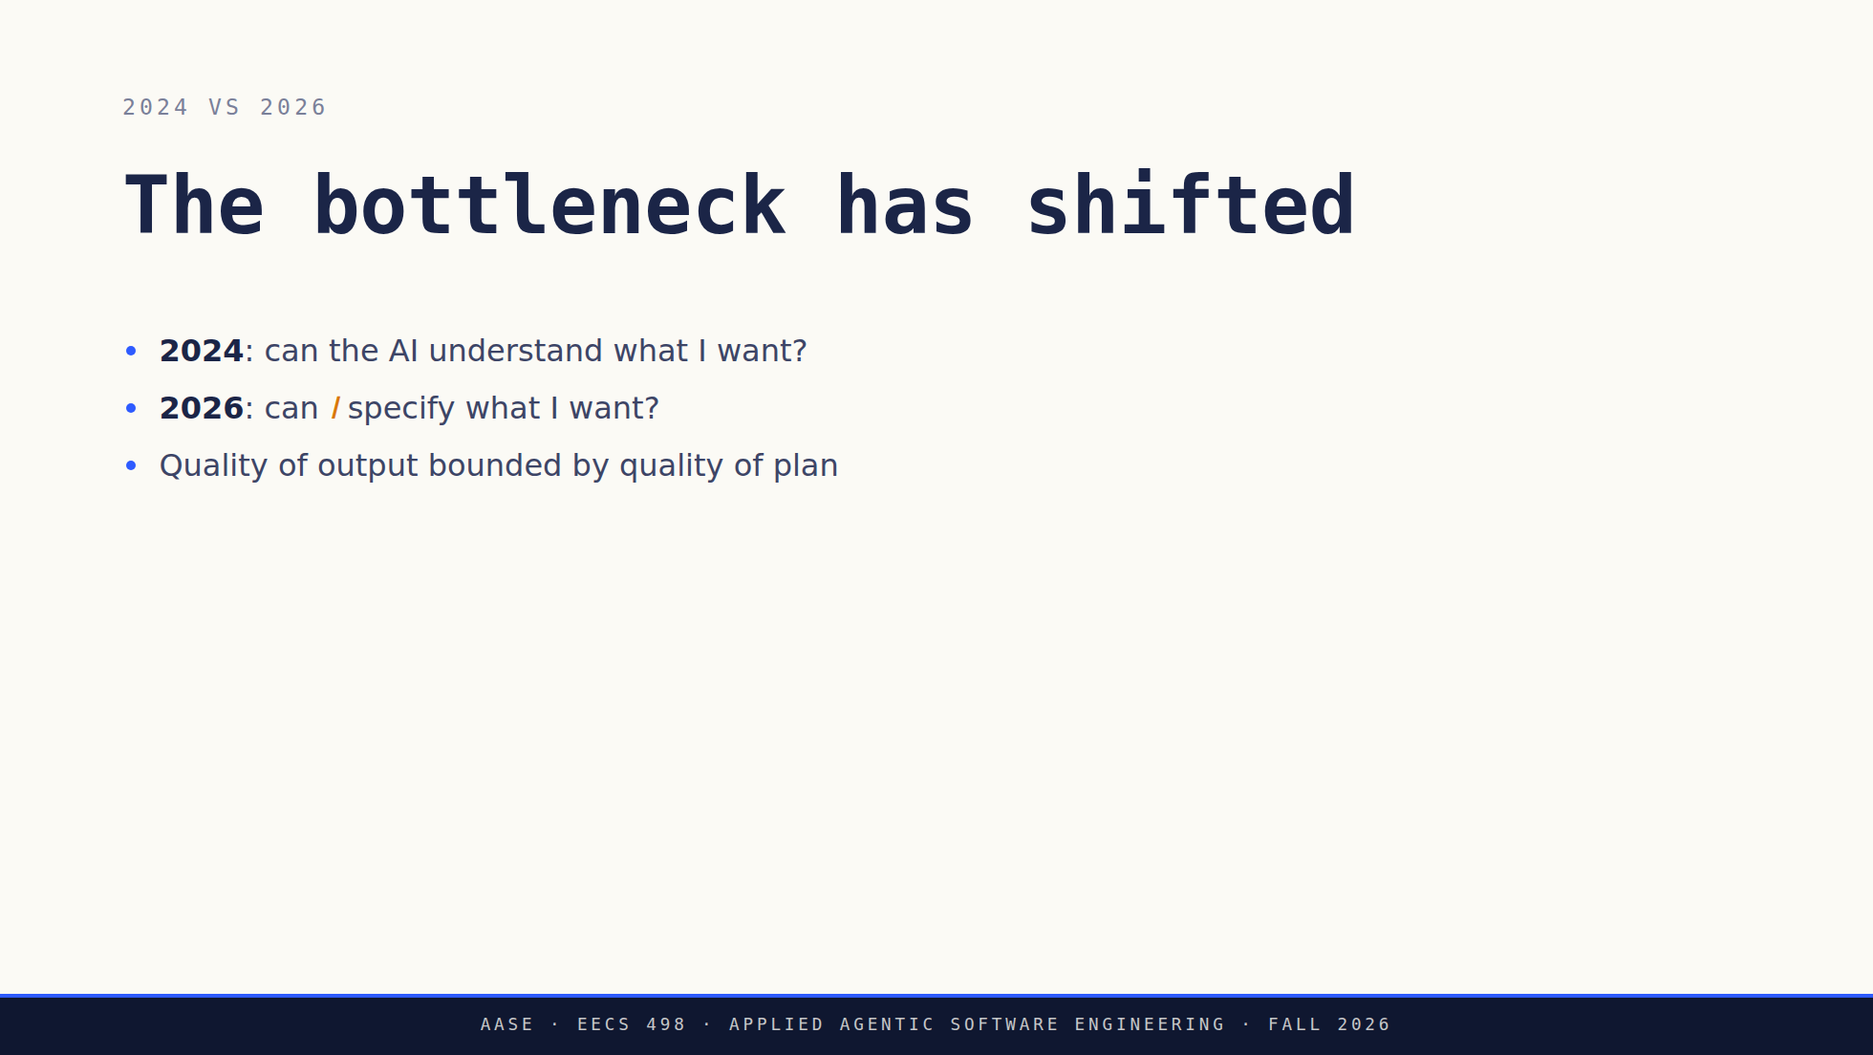
Notes:
The whole argument, five clicks. 2024 asked whether the AI could understand
you. 2026 asks whether you can say what you want.
Click four is the claim. The AI is the executor, you are the architect, and
the planning is the engineering work.
Click five is the asymmetry that prices it. A human contractor who gets an
ambiguous spec asks a clarifying question. An LLM does not, it guesses. So
ambiguity costs more here than it does with people, and writing a precise
spec is not extra work. It is the work.
The statement slide next is the payoff for this one. Do not say it here.

Slide 21
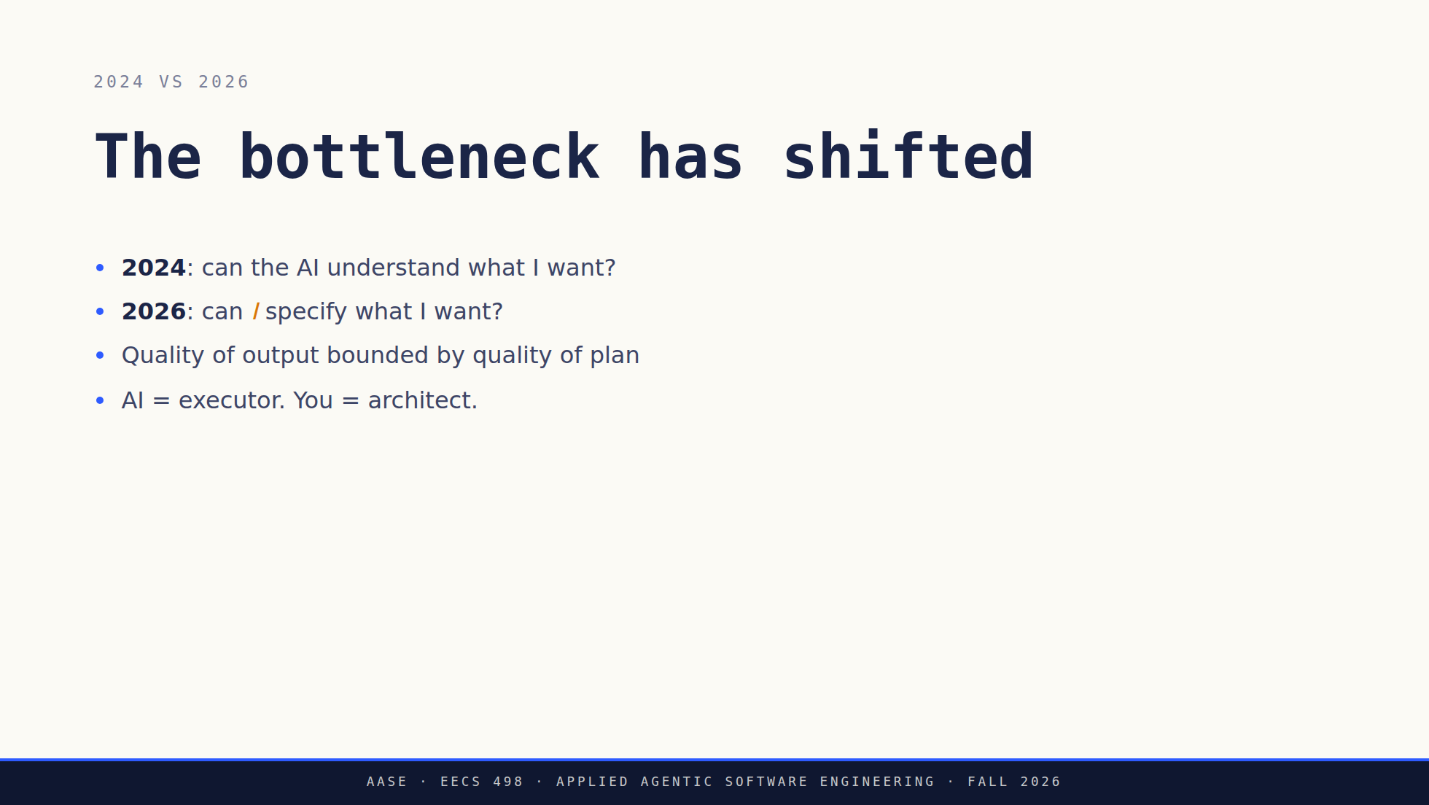
Notes:
The whole argument, five clicks. 2024 asked whether the AI could understand
you. 2026 asks whether you can say what you want.
Click four is the claim. The AI is the executor, you are the architect, and
the planning is the engineering work.
Click five is the asymmetry that prices it. A human contractor who gets an
ambiguous spec asks a clarifying question. An LLM does not, it guesses. So
ambiguity costs more here than it does with people, and writing a precise
spec is not extra work. It is the work.
The statement slide next is the payoff for this one. Do not say it here.

Slide 22
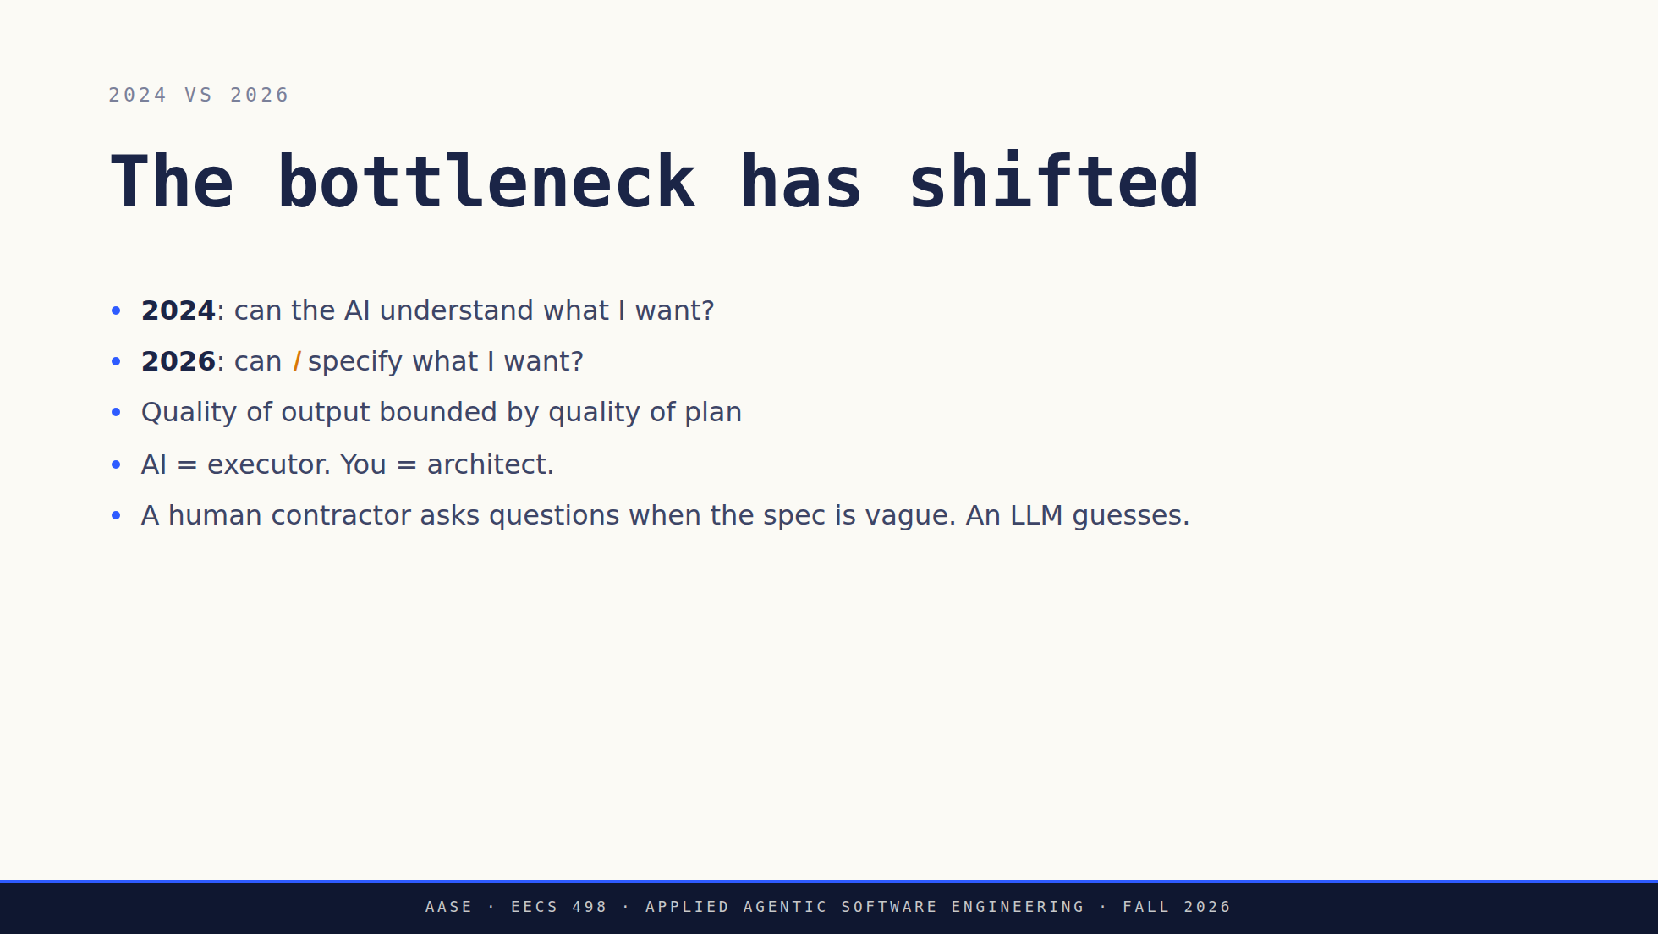
Notes:
The whole argument, five clicks. 2024 asked whether the AI could understand
you. 2026 asks whether you can say what you want.
Click four is the claim. The AI is the executor, you are the architect, and
the planning is the engineering work.
Click five is the asymmetry that prices it. A human contractor who gets an
ambiguous spec asks a clarifying question. An LLM does not, it guesses. So
ambiguity costs more here than it does with people, and writing a precise
spec is not extra work. It is the work.
The statement slide next is the payoff for this one. Do not say it here.

Slide 23
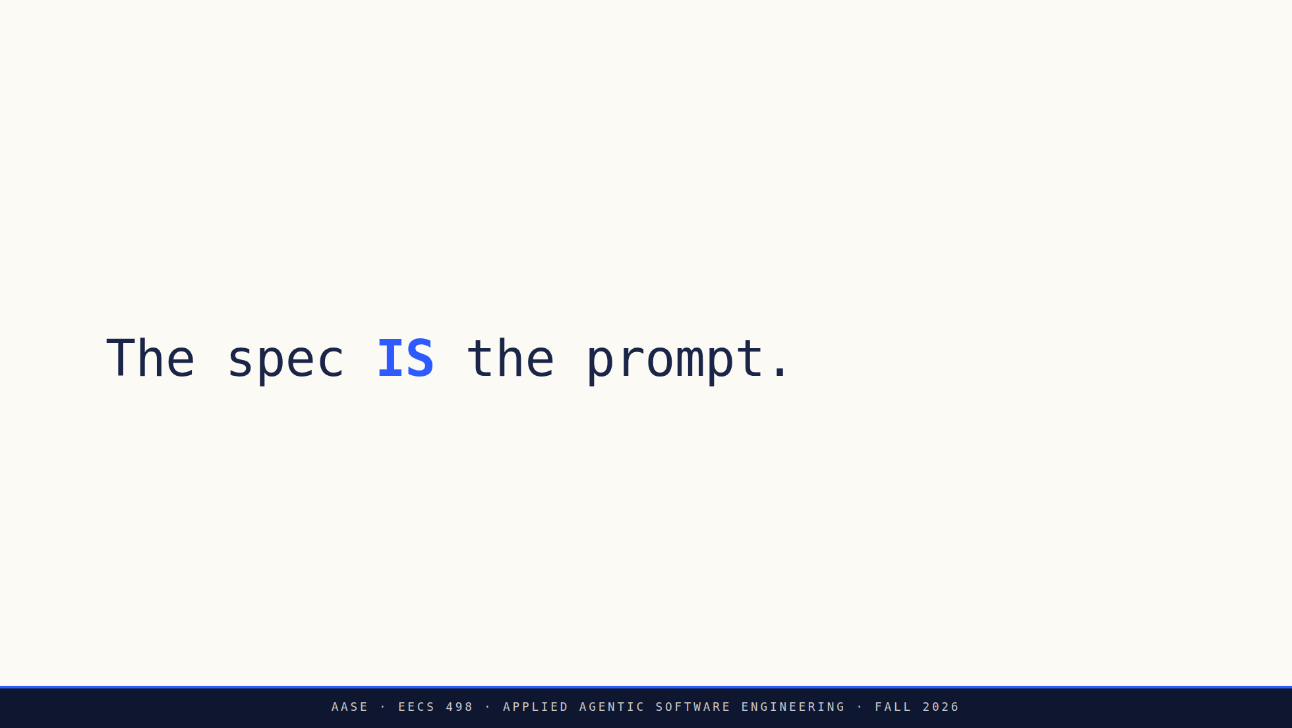
Notes:
The payoff for the slide before it. Not an artifact you produce before
you prompt. The spec IS the instruction.
Say it, then stop talking. Let it sit.

Slide 24
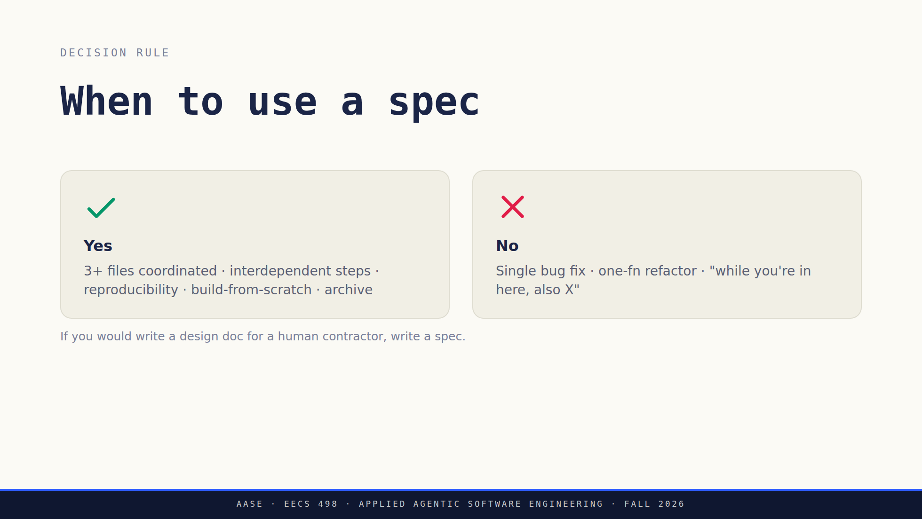
Notes:
Two semantic accents: emerald (works) and rose (don't). The one slide that earns it.
The caption is the rule. Say it, then let them apply it in the break.

Slide 25
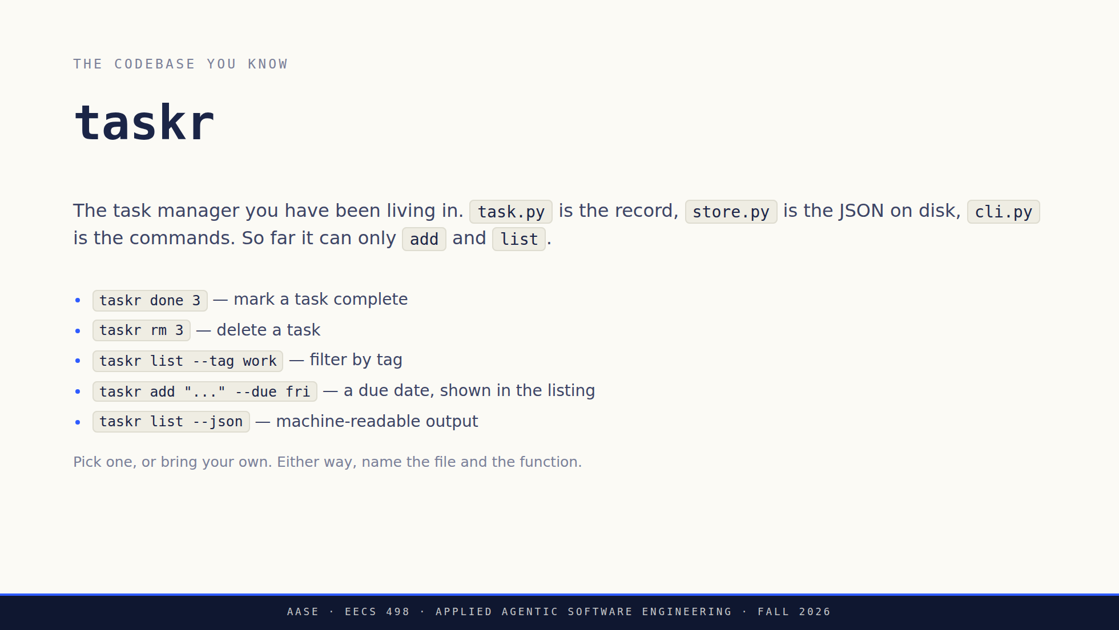
Notes:
This exists because "think of a change" is a cold start and the break is only
five minutes. Five options so nobody spends two of those minutes choosing.
They are deliberately different sizes, which is the calibration point. `done`
touches all three files, because a task has no done field yet: that is the one
where a high-level prompt breaks down. `list --json` is one function and
`to_dict()` already exists, so it survives a much higher level.
Say that out loud if the room needs a nudge: the answer to "how high can I go"
depends on how much of the change is already sitting in the codebase.

Slide 26
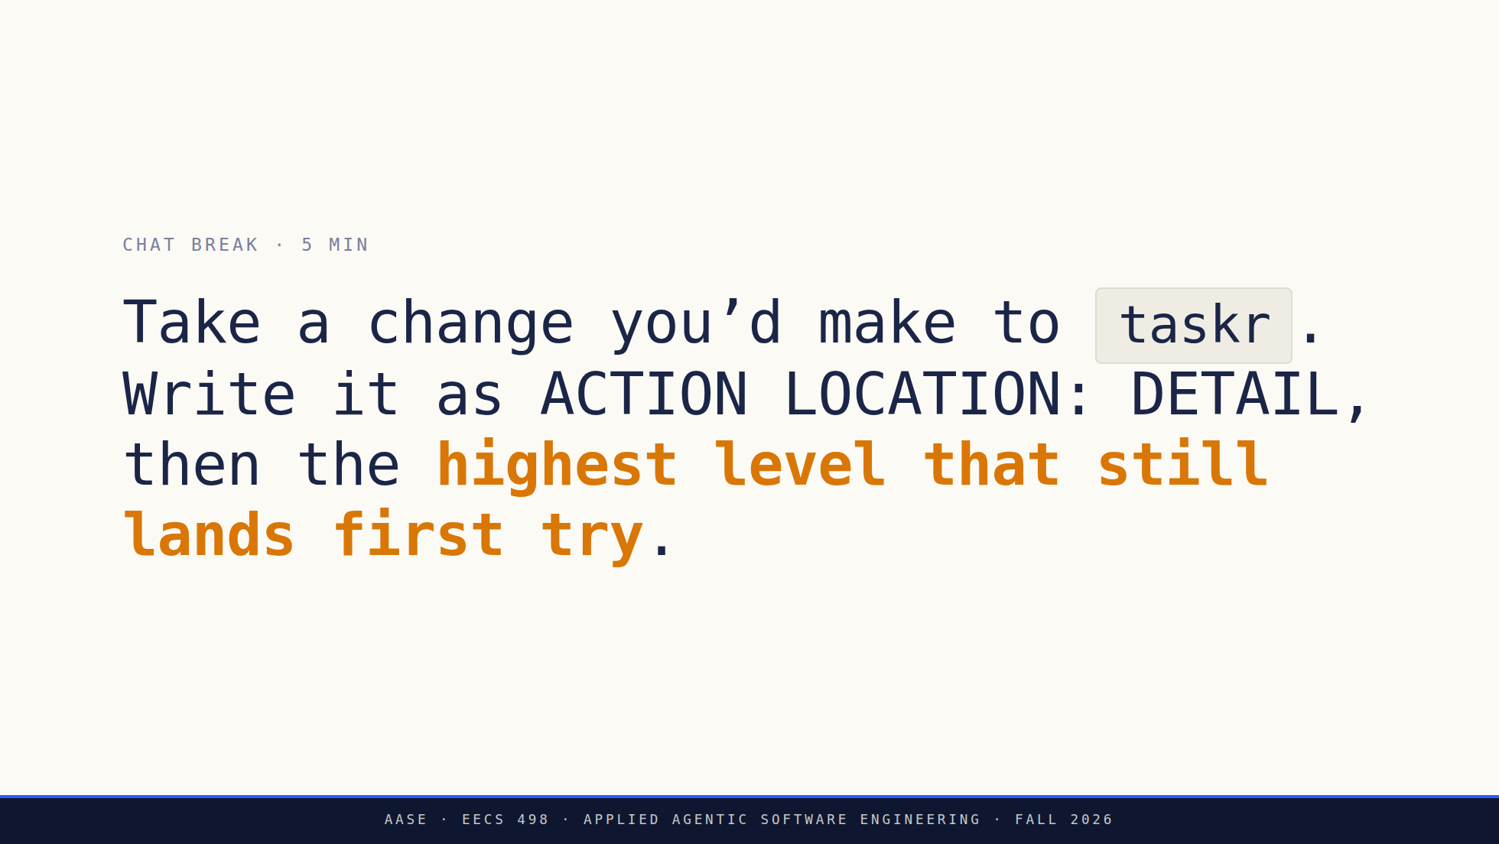
Notes:
0:35. The fixed break. Full prompt is the chat_break field in overview.md.
taskr on purpose: two weeks of aider-practice means every one of them knows
cli.py, store.py and task.py, and has already calibrated a model against
them. Nobody is blocked on unfamiliar code, which is what a five-minute
break cannot absorb.
Push them toward the highest level that still works, not the safest. The
point is calibration, and "what moved your line" is the question worth
pulling out loud at 0:39: the answer is almost always the model.
They can run it in Aider tonight, which is the whole reason it is taskr and
not something hypothetical.

Slide 27
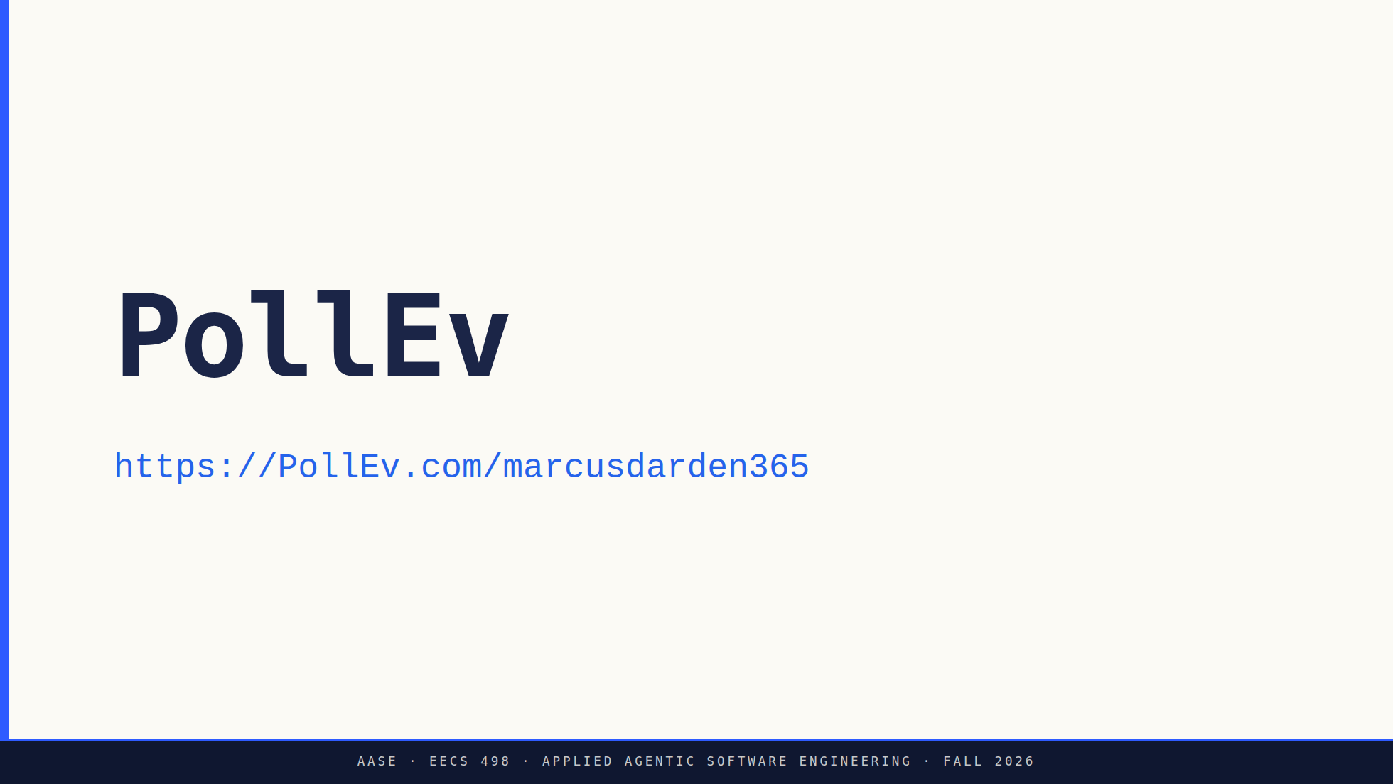
Notes:
The URL is on the slide so the back rows can join without asking. Leave it up
while they answer.
It is a div rather than the usual section subtitle on purpose: the theme
uppercases those, and a uppercased URL path is not the same path. Do not
"fix" it back to an h2.
Presenter cue otherwise. Switch to the browser tab holding the activity, set
it live, read the question and all four options aloud, give it about 60
seconds, show results, then come back to the deck.
This one counts toward attendance, unlike L01's test run. Say so.
Question, options, the answer and what to say after the results are in
assets/poll-everywhere.md. It is L02's needle in a haystack, and the answer
is the argument for the Context section they are about to be taught.

Slide 28

Notes:
Divider. Five sections. Advance.

Slide 29
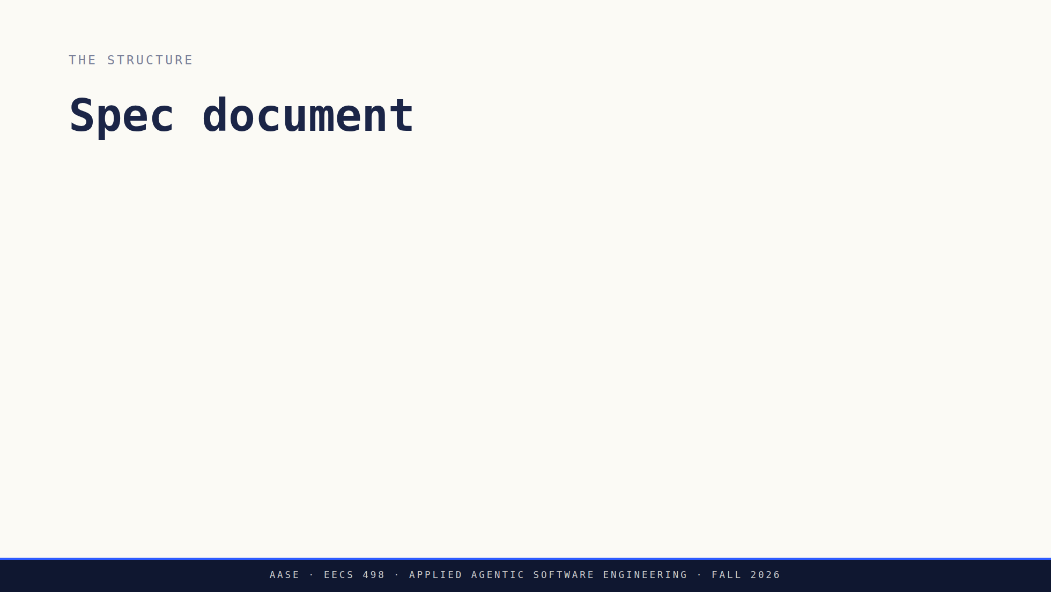
Notes:
The map, one click per section. Name each and move on, they get unpacked on
the next three slides.
Worth saying out loud that this is a markdown file, not a tool or a form.
They can write one in any editor today.

Slide 30
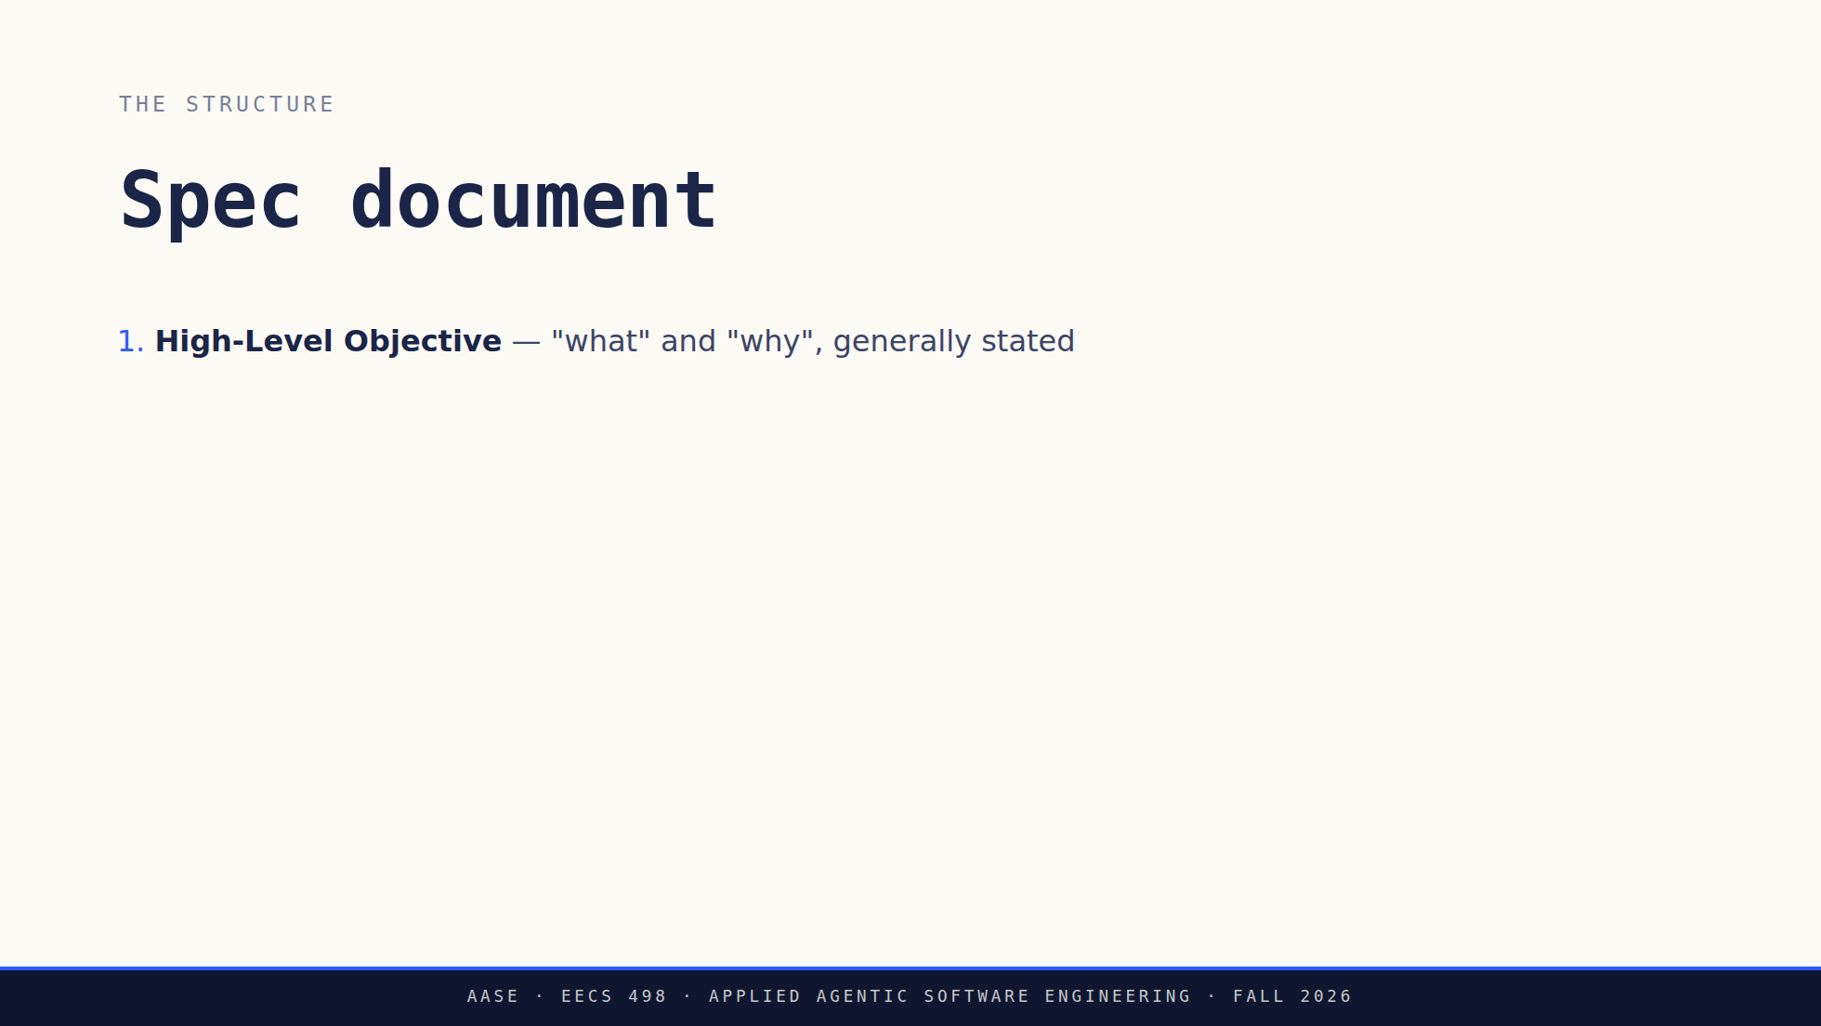
Notes:
The map, one click per section. Name each and move on, they get unpacked on
the next three slides.
Worth saying out loud that this is a markdown file, not a tool or a form.
They can write one in any editor today.

Slide 31
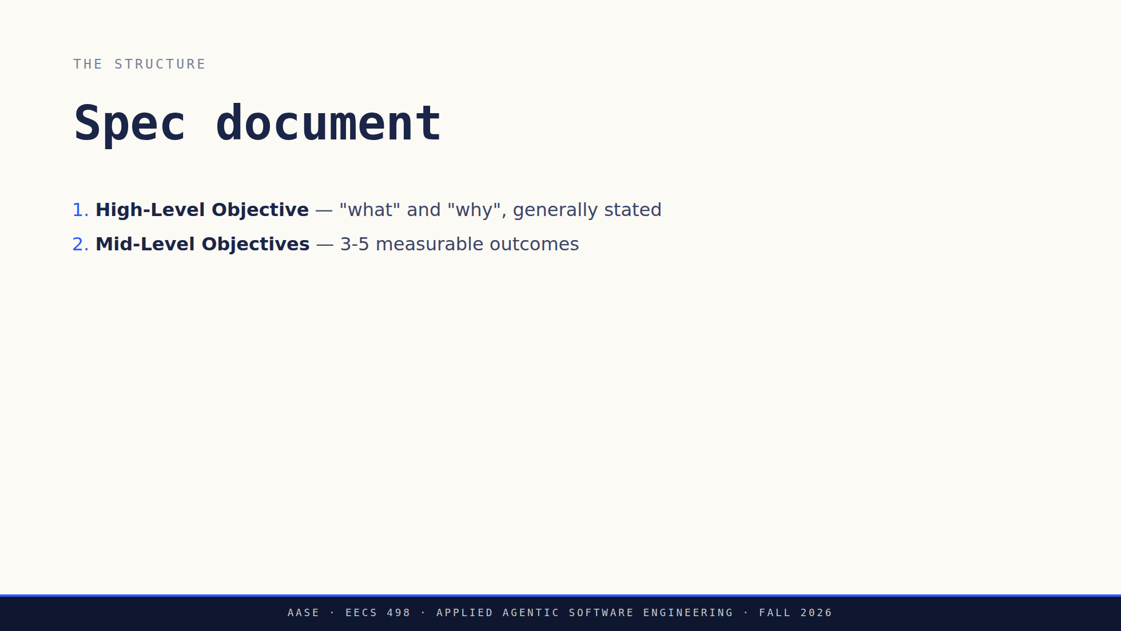
Notes:
The map, one click per section. Name each and move on, they get unpacked on
the next three slides.
Worth saying out loud that this is a markdown file, not a tool or a form.
They can write one in any editor today.

Slide 32
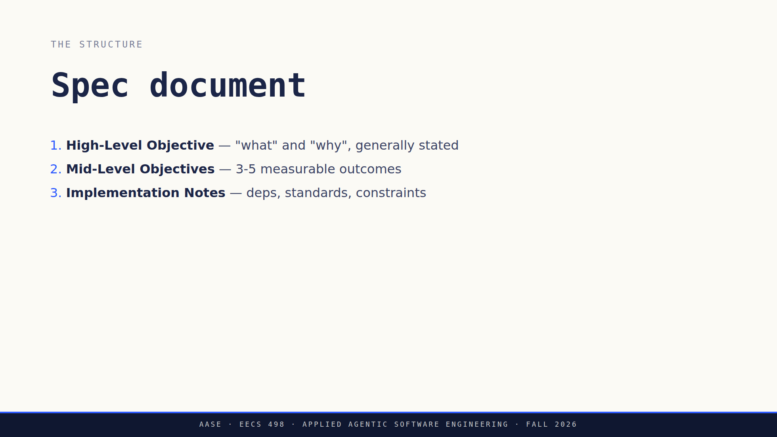
Notes:
The map, one click per section. Name each and move on, they get unpacked on
the next three slides.
Worth saying out loud that this is a markdown file, not a tool or a form.
They can write one in any editor today.

Slide 33
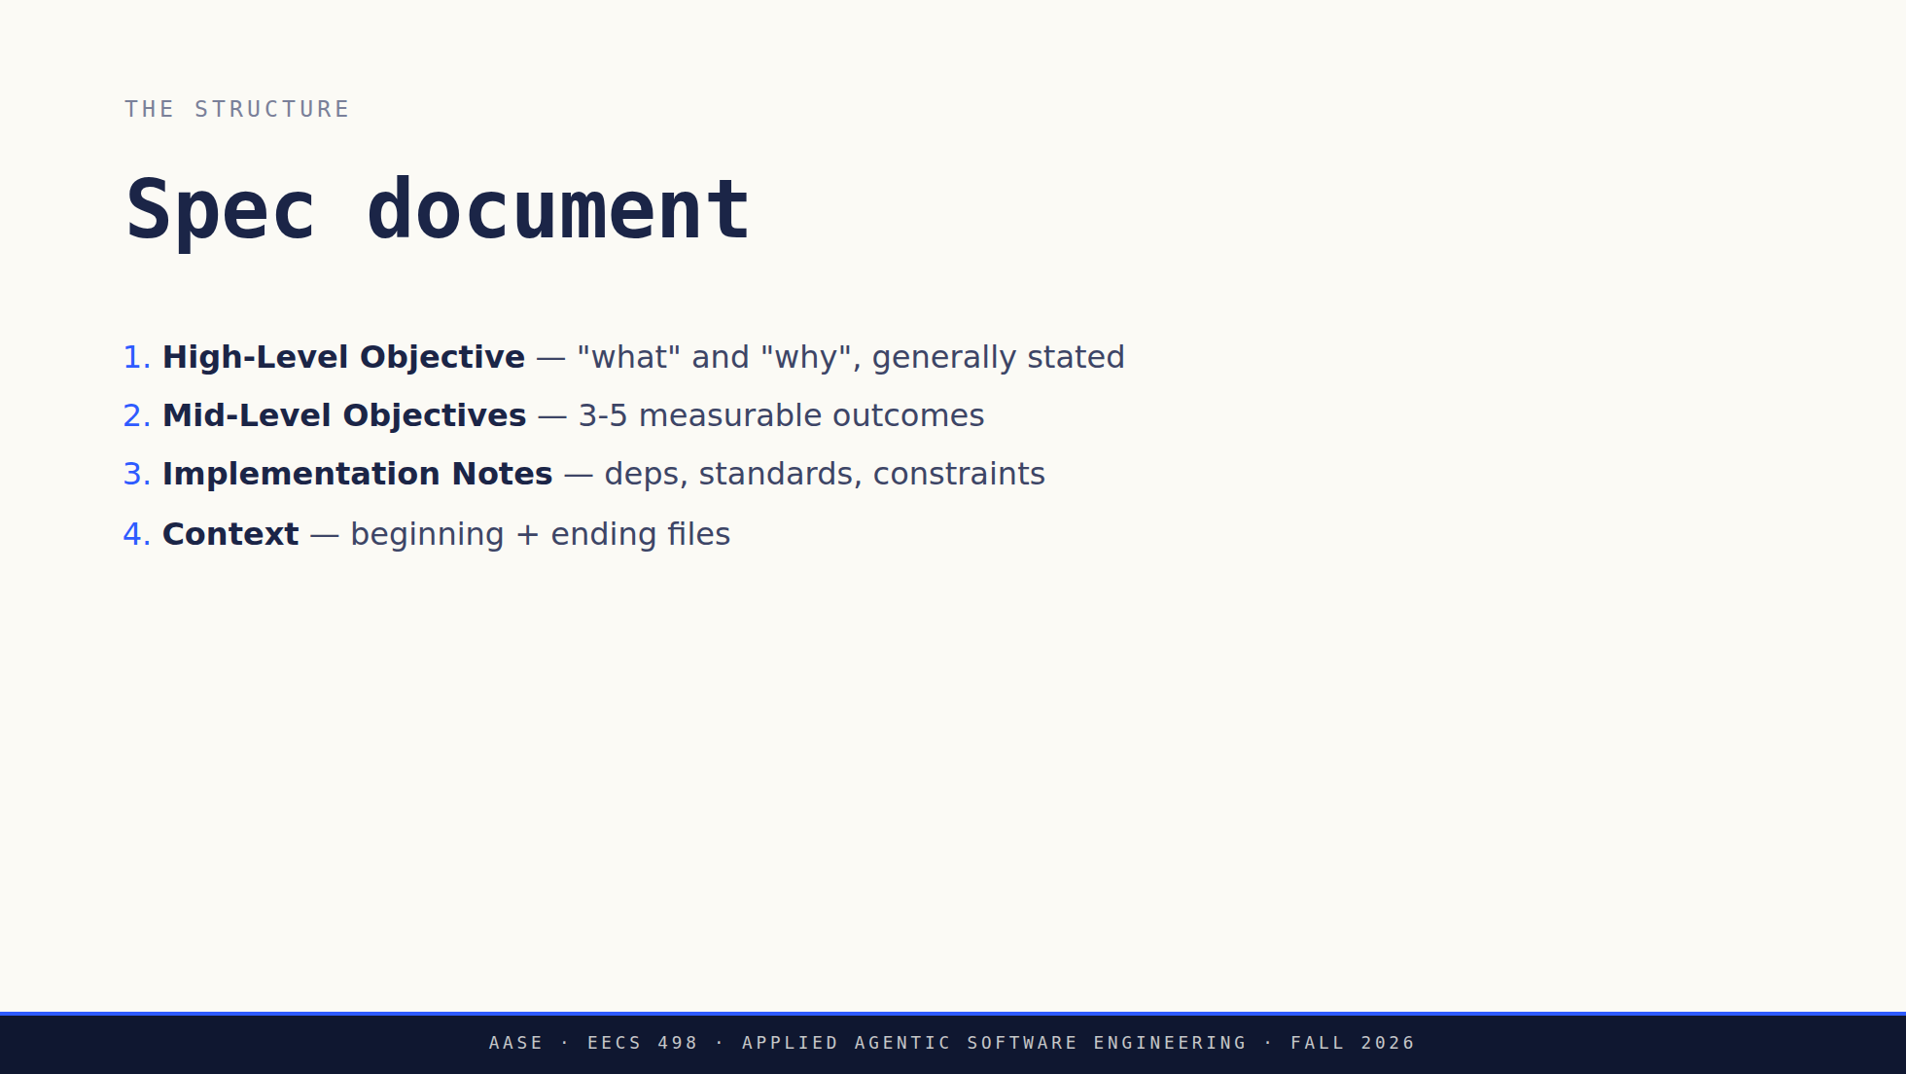
Notes:
The map, one click per section. Name each and move on, they get unpacked on
the next three slides.
Worth saying out loud that this is a markdown file, not a tool or a form.
They can write one in any editor today.

Slide 34
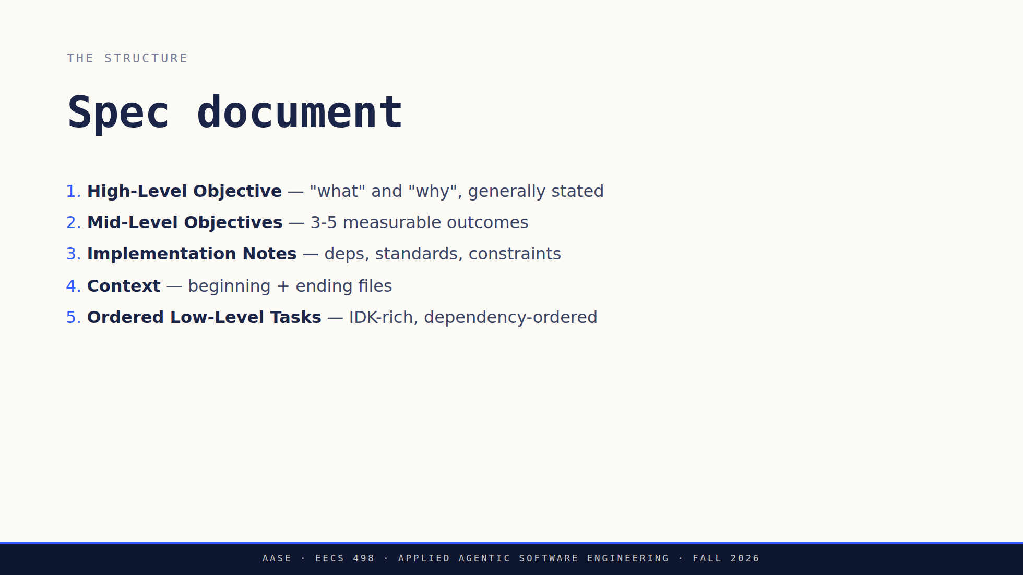
Notes:
The map, one click per section. Name each and move on, they get unpacked on
the next three slides.
Worth saying out loud that this is a markdown file, not a tool or a form.
They can write one in any editor today.

Slide 35
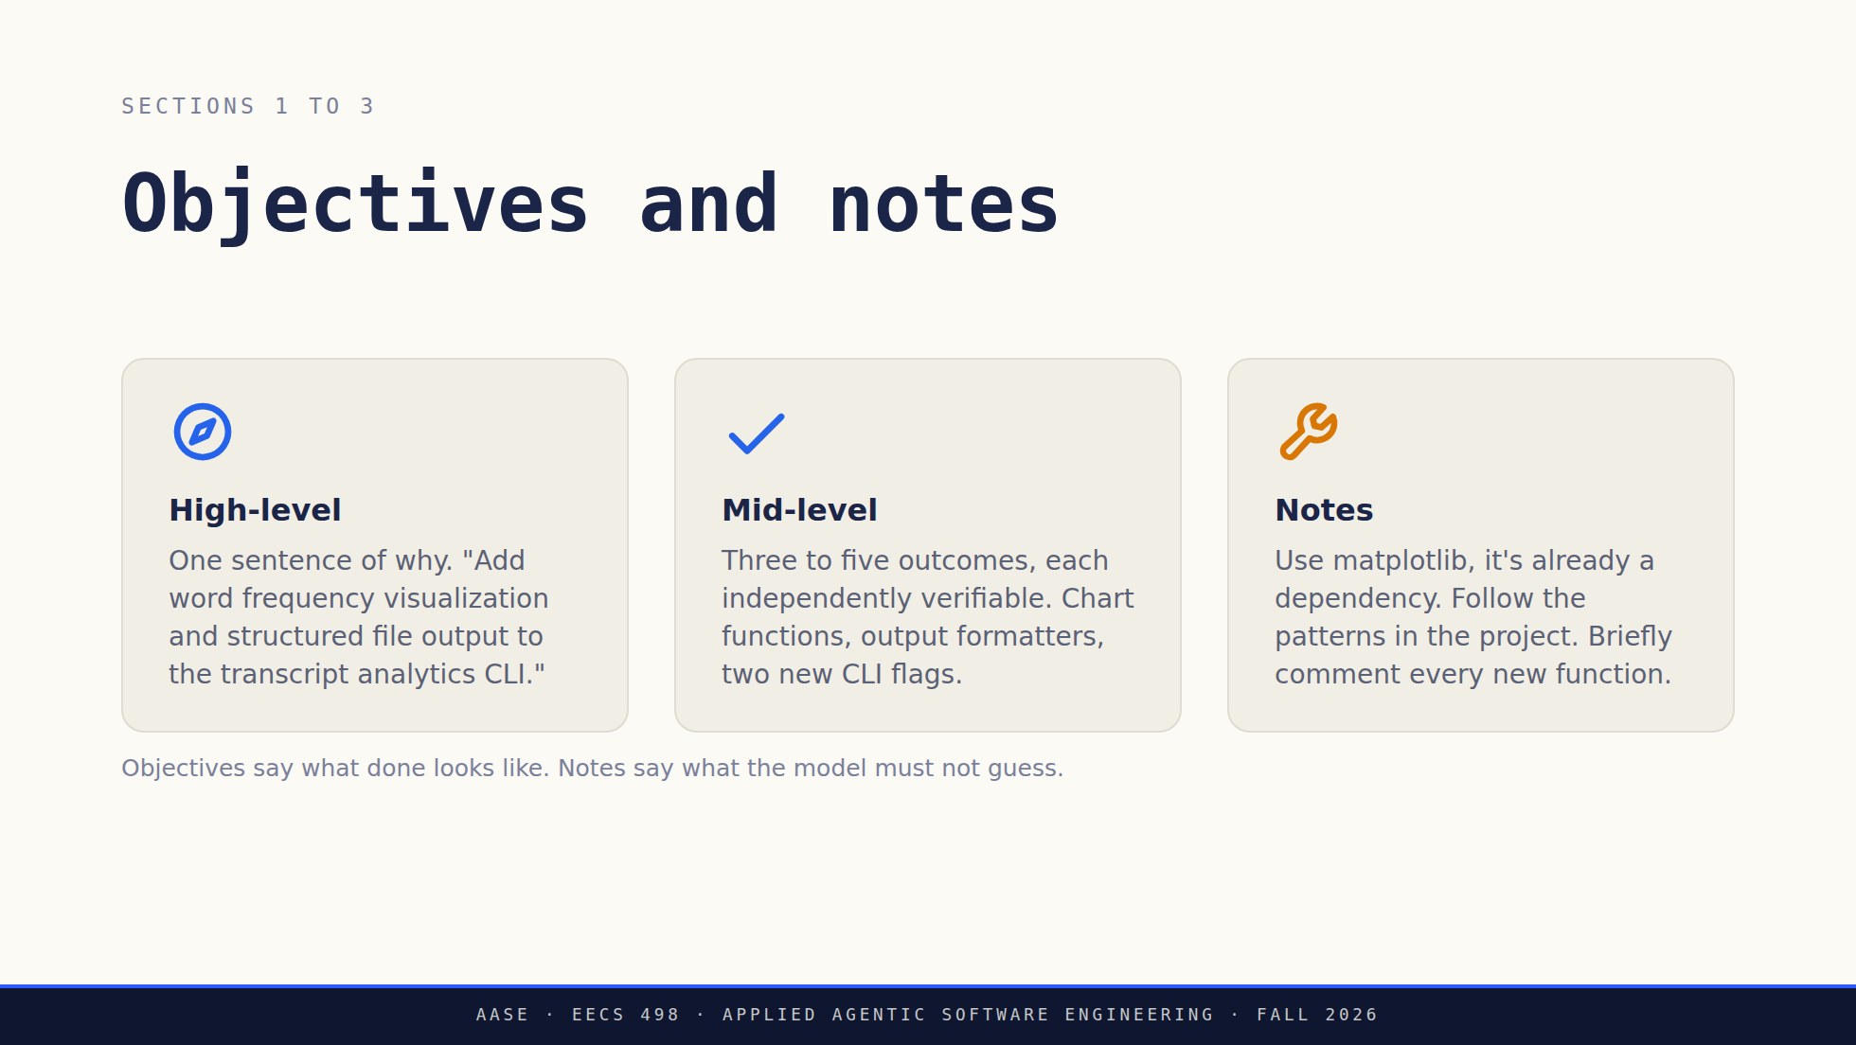
Notes:
Notes is where your engineering judgment goes. Anything you'd correct in
review, put here instead and skip the review round.

Slide 36
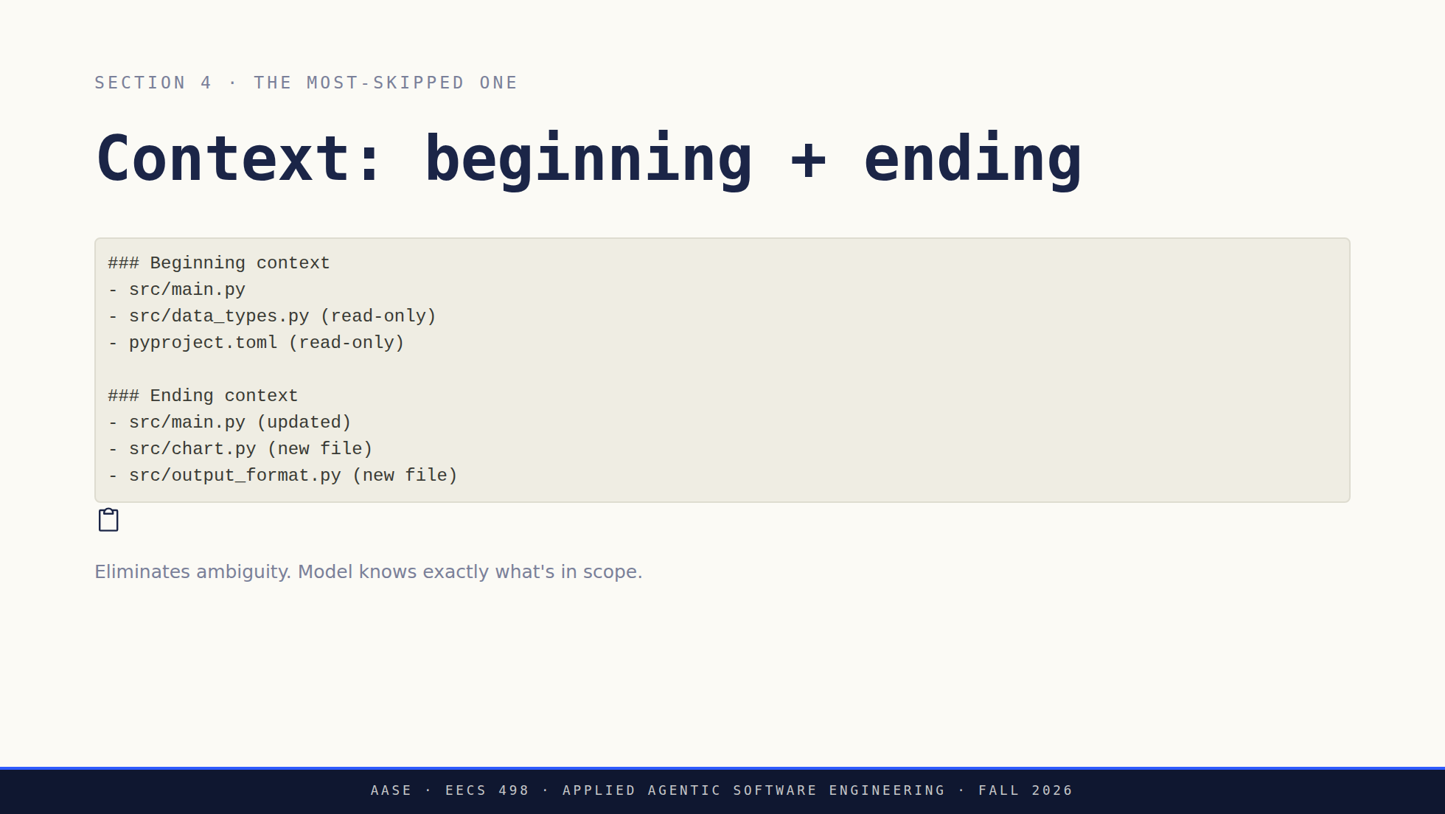
Notes:
The most often omitted section and the most important one, which is what the
label says. Say it that way.
Beginning context is what the model may read and edit. Ending context is
what should exist afterward. New files get (new file), untouchables get
(read-only).
This is the section that stops the model wandering into files you never
meant it to open. That sentence is the reason the section exists.

Slide 37
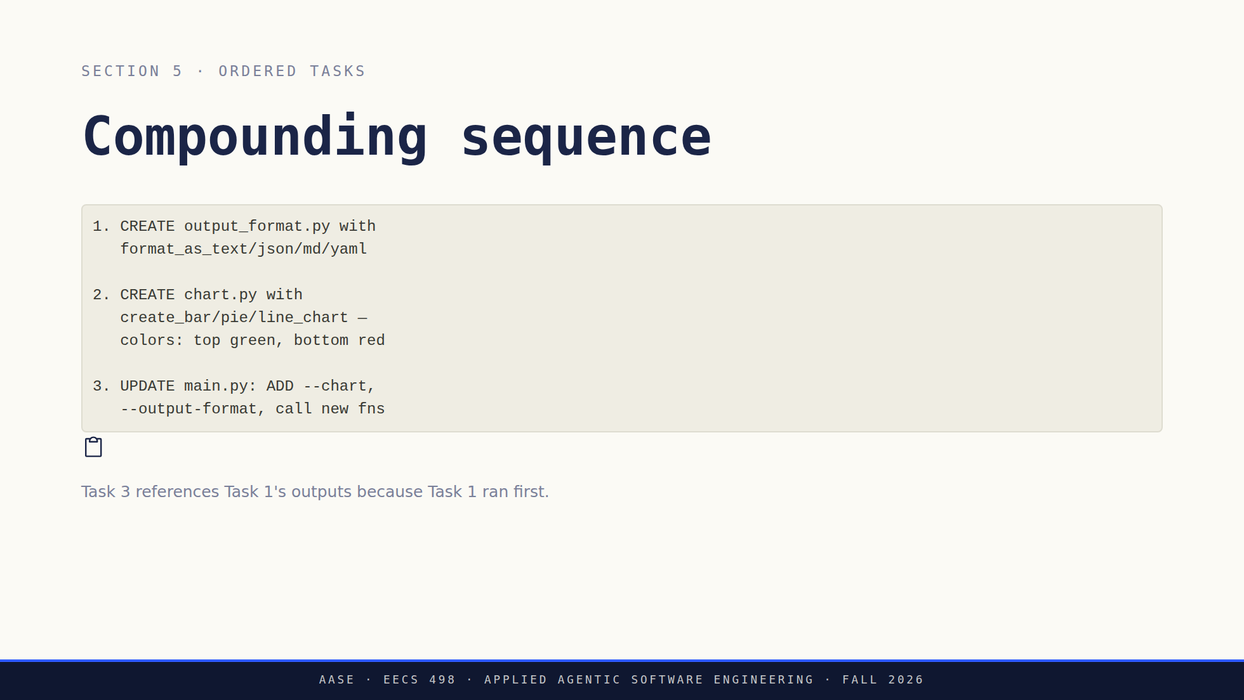
Notes:
Read the three tasks in order, then the caption. Task 3 can reference
format_as_json() because Task 1 already ran. The sequence carries the
dependencies so the model does not have to infer them.
Stay on this slide for that point. There is no separate slide for it.
Close on the analogy to how they already work: types first, then the
functions that use them, then the call sites.

Slide 38
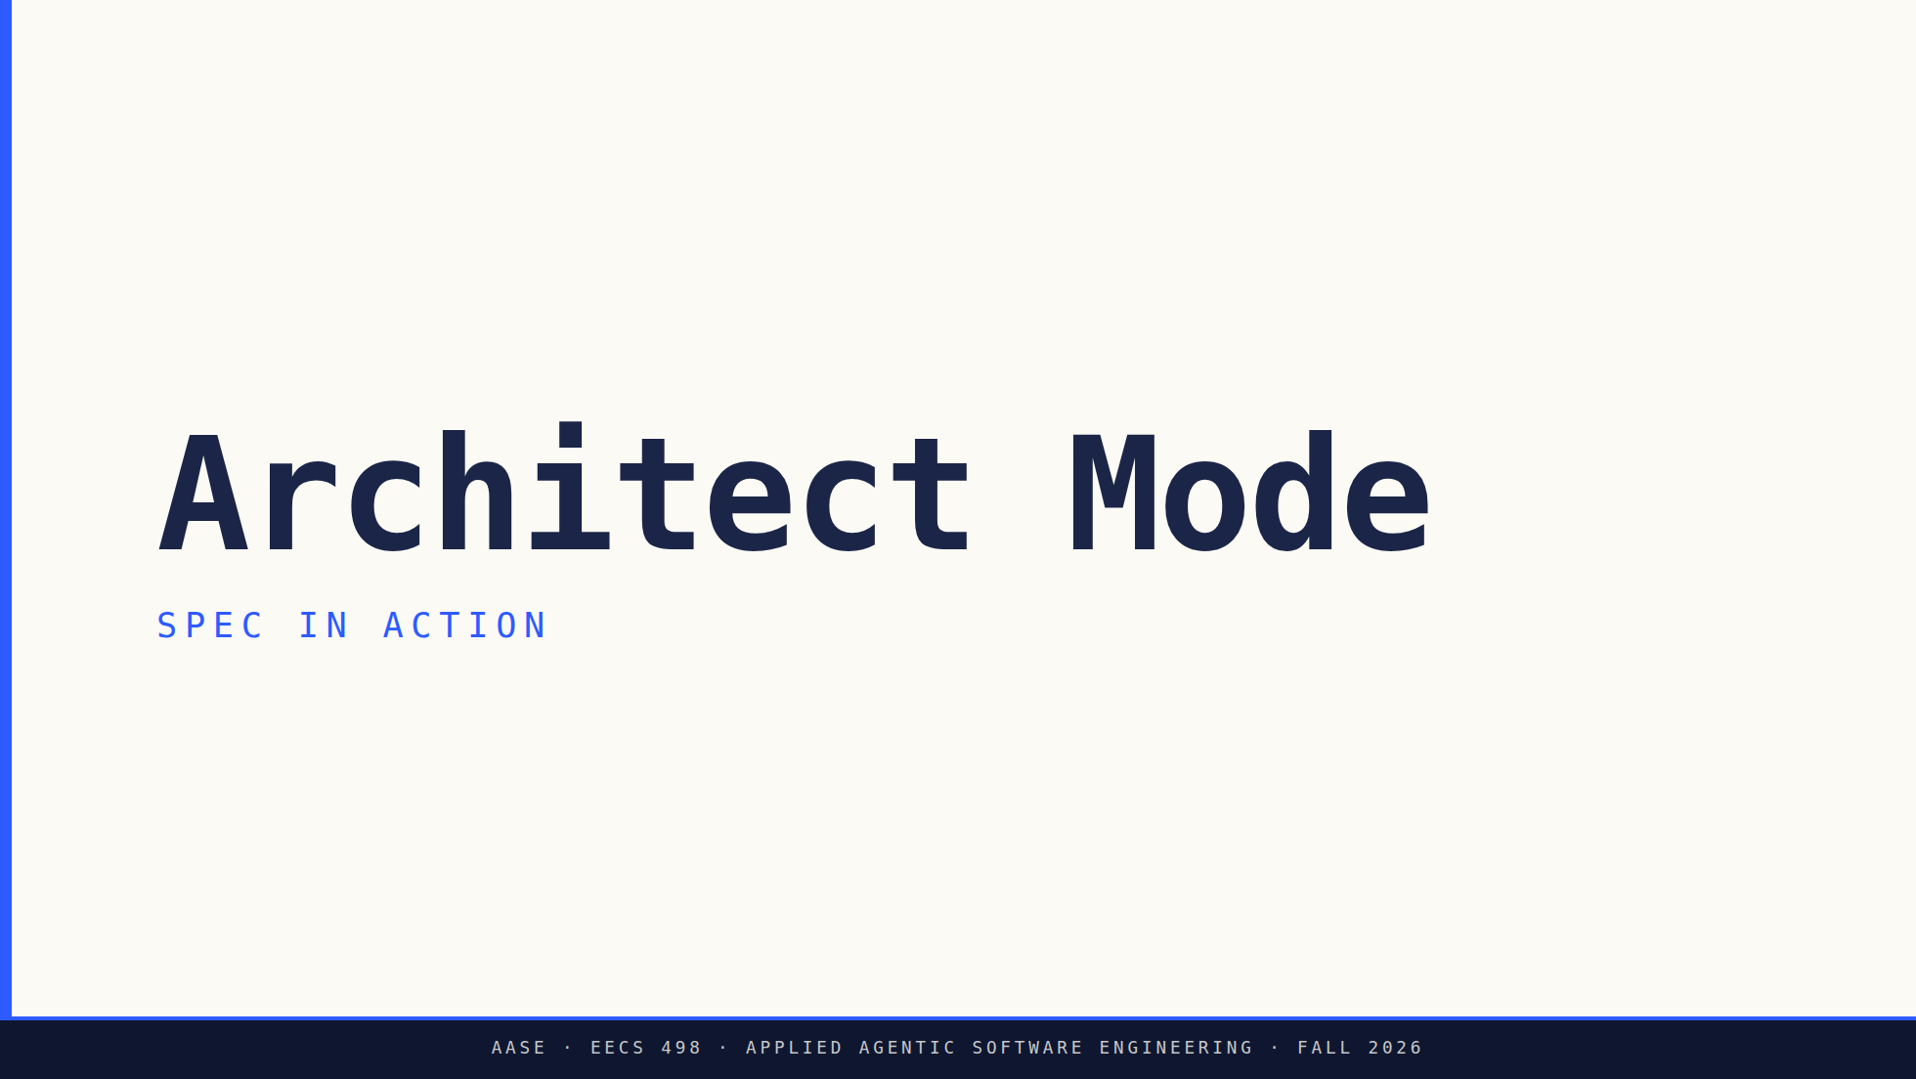
Notes:
Bridge: they have the five sections now. Watch one spec that has all five
run end to end, against a model on a laptop.
Mistakes come after the demo, not before. Do not preview them here.

Slide 39
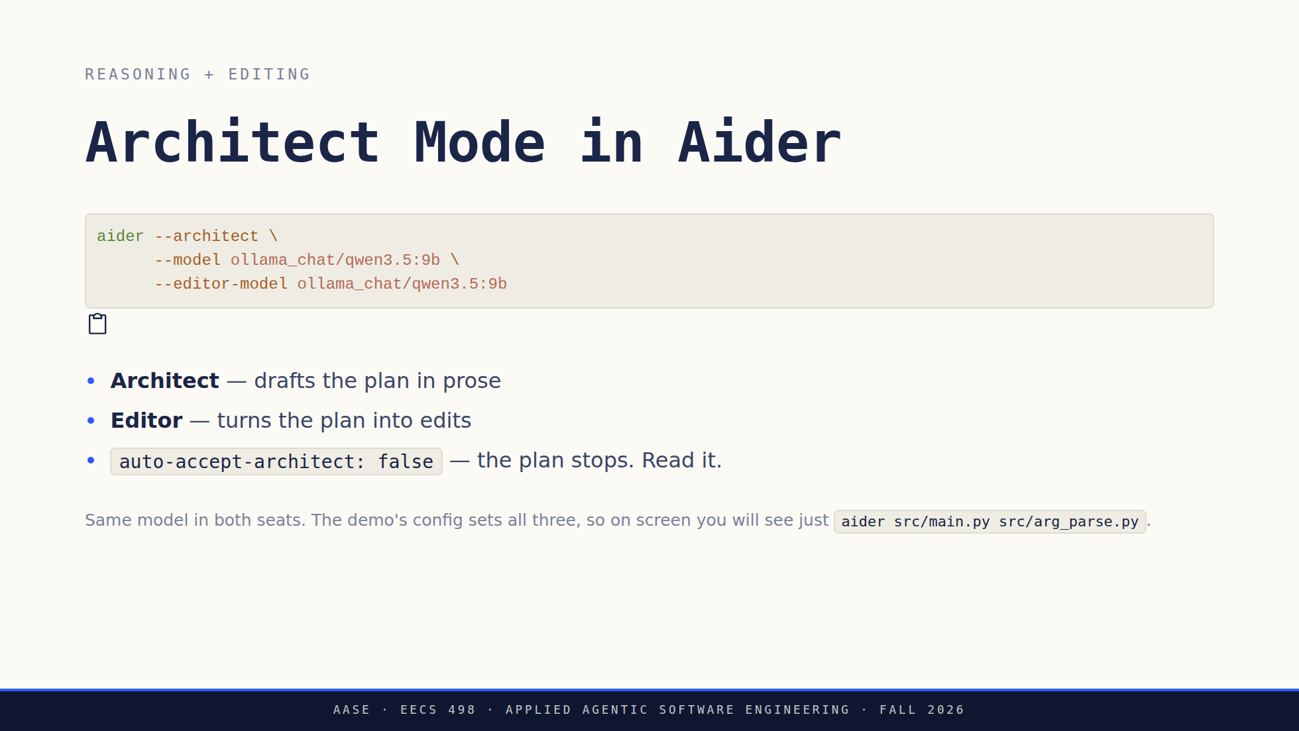
Notes:
Correct the assumption before they form it: two roles, not two models. Same
model in both seats is fine, and on a laptop it is usually what you want. A
small model is noticeably better at one job than at two, which is the whole
win. The 9B architect with the 4B editor is a fair experiment to run once,
not a requirement.
Third bullet is the one to land. aider-practice lesson 6 sets it false on
purpose, so the plan stops and waits. Nothing is on disk yet, so this is the
cheapest place in the workflow to catch a model that misunderstood you.
Flag it and move on: plan, then act, then check is a loop. They write one in
week 5.

Slide 40
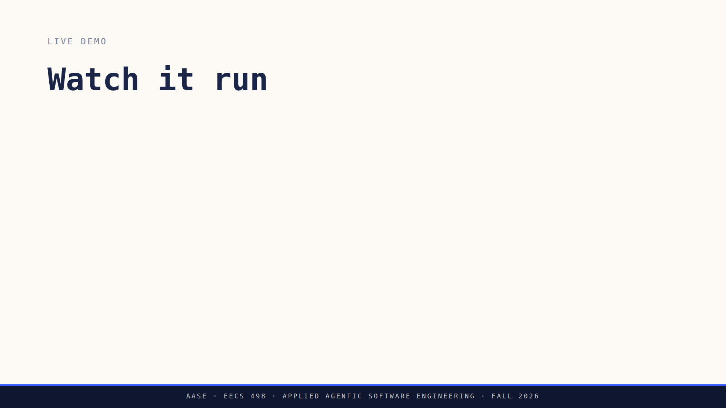
Notes:
Six clicks. Step 4 is the beat and it is the one you cannot cut.
Show the spec and walk its five sections before launching anything. Otherwise
the room watches output scroll without knowing what was asked for.
Read the banner against the spec on the other screen. Two files editable,
five read-only, and that is the Context section they were about to skip.
Aider implements (read-only); it is not a note to yourself.
Step 4: nothing is on disk. If it misunderstood you, this costs one
keystroke. After the edit it costs a /undo and four minutes of model time.
If aider asks "Add file to the chat?", answer S. The default is Yes and Yes
re-runs the architect, which loses the plan.
If it stalls, switch to the recording. Do not debug Python in front of the
room. Full runbook: assets/demo-runbook.md.

Slide 41
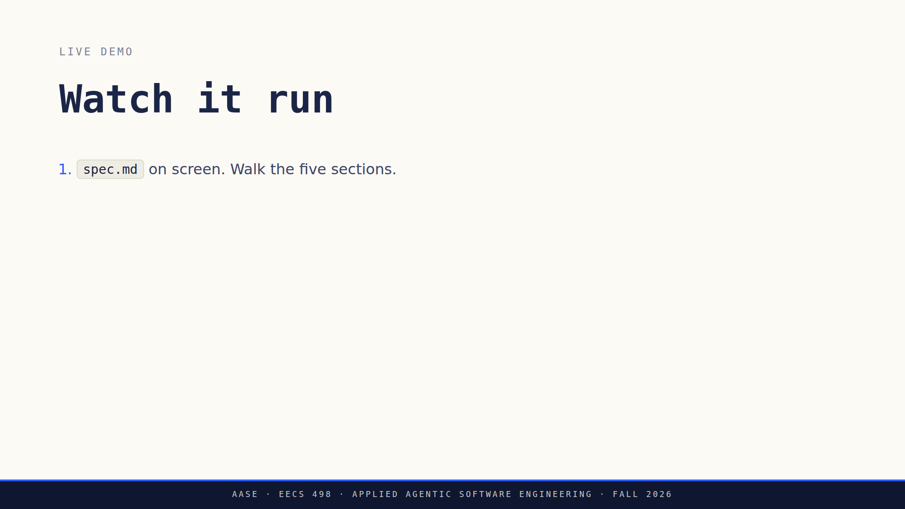
Notes:
Six clicks. Step 4 is the beat and it is the one you cannot cut.
Show the spec and walk its five sections before launching anything. Otherwise
the room watches output scroll without knowing what was asked for.
Read the banner against the spec on the other screen. Two files editable,
five read-only, and that is the Context section they were about to skip.
Aider implements (read-only); it is not a note to yourself.
Step 4: nothing is on disk. If it misunderstood you, this costs one
keystroke. After the edit it costs a /undo and four minutes of model time.
If aider asks "Add file to the chat?", answer S. The default is Yes and Yes
re-runs the architect, which loses the plan.
If it stalls, switch to the recording. Do not debug Python in front of the
room. Full runbook: assets/demo-runbook.md.

Slide 42
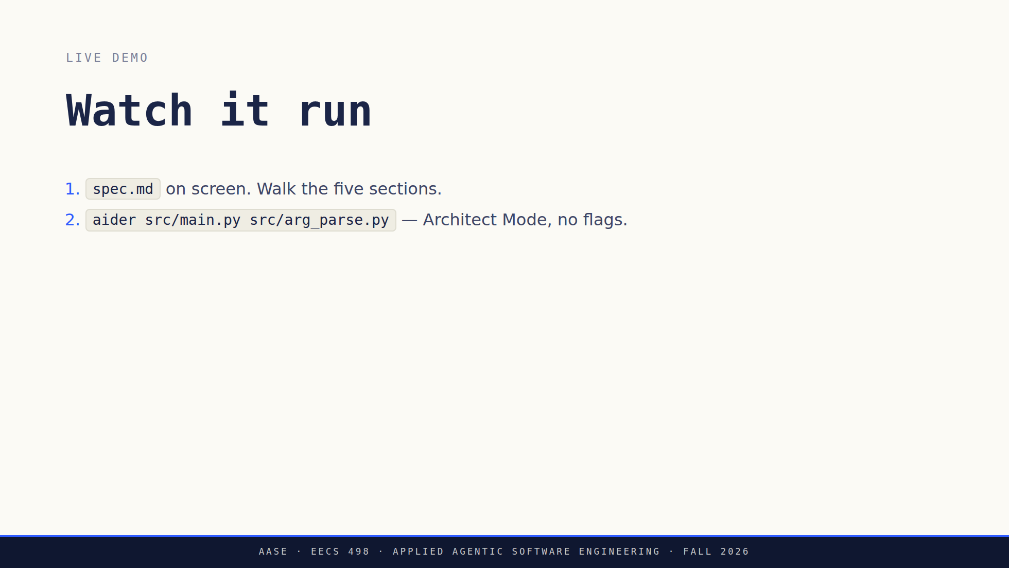
Notes:
Six clicks. Step 4 is the beat and it is the one you cannot cut.
Show the spec and walk its five sections before launching anything. Otherwise
the room watches output scroll without knowing what was asked for.
Read the banner against the spec on the other screen. Two files editable,
five read-only, and that is the Context section they were about to skip.
Aider implements (read-only); it is not a note to yourself.
Step 4: nothing is on disk. If it misunderstood you, this costs one
keystroke. After the edit it costs a /undo and four minutes of model time.
If aider asks "Add file to the chat?", answer S. The default is Yes and Yes
re-runs the architect, which loses the plan.
If it stalls, switch to the recording. Do not debug Python in front of the
room. Full runbook: assets/demo-runbook.md.

Slide 43
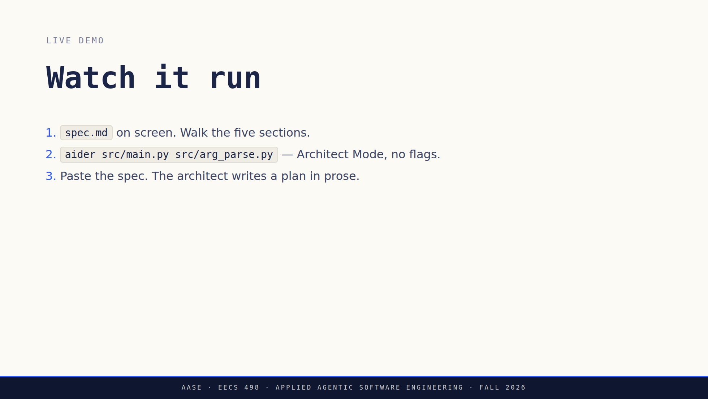
Notes:
Six clicks. Step 4 is the beat and it is the one you cannot cut.
Show the spec and walk its five sections before launching anything. Otherwise
the room watches output scroll without knowing what was asked for.
Read the banner against the spec on the other screen. Two files editable,
five read-only, and that is the Context section they were about to skip.
Aider implements (read-only); it is not a note to yourself.
Step 4: nothing is on disk. If it misunderstood you, this costs one
keystroke. After the edit it costs a /undo and four minutes of model time.
If aider asks "Add file to the chat?", answer S. The default is Yes and Yes
re-runs the architect, which loses the plan.
If it stalls, switch to the recording. Do not debug Python in front of the
room. Full runbook: assets/demo-runbook.md.

Slide 44
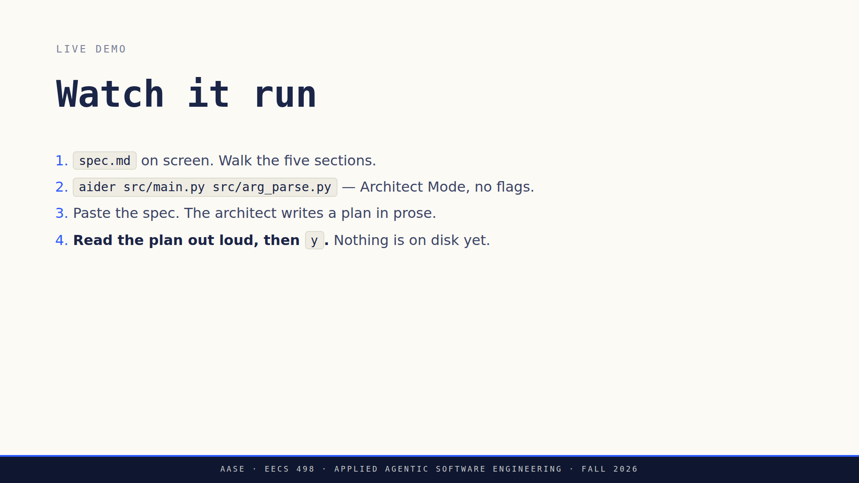
Notes:
Six clicks. Step 4 is the beat and it is the one you cannot cut.
Show the spec and walk its five sections before launching anything. Otherwise
the room watches output scroll without knowing what was asked for.
Read the banner against the spec on the other screen. Two files editable,
five read-only, and that is the Context section they were about to skip.
Aider implements (read-only); it is not a note to yourself.
Step 4: nothing is on disk. If it misunderstood you, this costs one
keystroke. After the edit it costs a /undo and four minutes of model time.
If aider asks "Add file to the chat?", answer S. The default is Yes and Yes
re-runs the architect, which loses the plan.
If it stalls, switch to the recording. Do not debug Python in front of the
room. Full runbook: assets/demo-runbook.md.

Slide 45
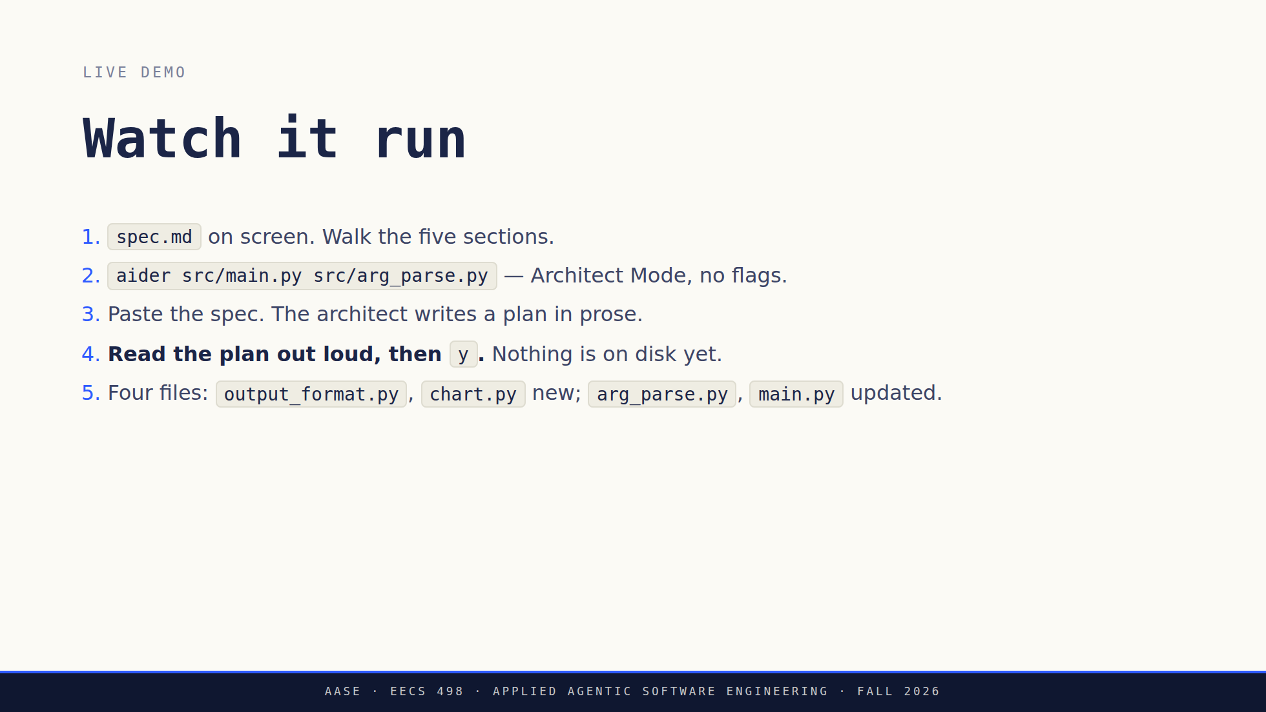
Notes:
Six clicks. Step 4 is the beat and it is the one you cannot cut.
Show the spec and walk its five sections before launching anything. Otherwise
the room watches output scroll without knowing what was asked for.
Read the banner against the spec on the other screen. Two files editable,
five read-only, and that is the Context section they were about to skip.
Aider implements (read-only); it is not a note to yourself.
Step 4: nothing is on disk. If it misunderstood you, this costs one
keystroke. After the edit it costs a /undo and four minutes of model time.
If aider asks "Add file to the chat?", answer S. The default is Yes and Yes
re-runs the architect, which loses the plan.
If it stalls, switch to the recording. Do not debug Python in front of the
room. Full runbook: assets/demo-runbook.md.

Slide 46
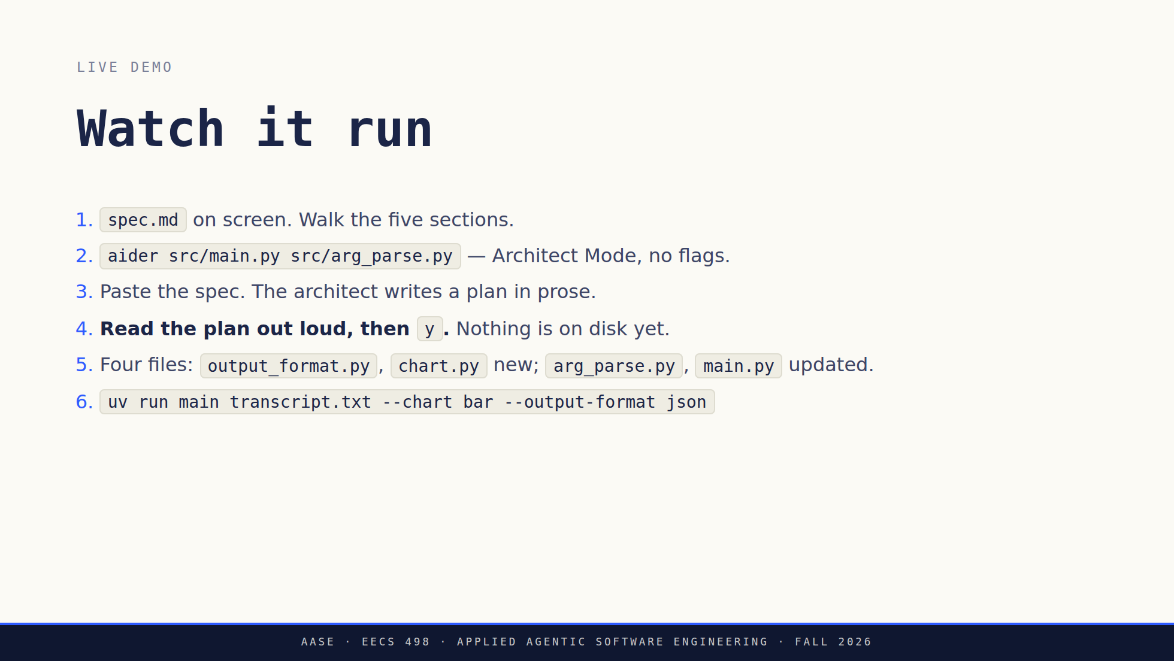
Notes:
Six clicks. Step 4 is the beat and it is the one you cannot cut.
Show the spec and walk its five sections before launching anything. Otherwise
the room watches output scroll without knowing what was asked for.
Read the banner against the spec on the other screen. Two files editable,
five read-only, and that is the Context section they were about to skip.
Aider implements (read-only); it is not a note to yourself.
Step 4: nothing is on disk. If it misunderstood you, this costs one
keystroke. After the edit it costs a /undo and four minutes of model time.
If aider asks "Add file to the chat?", answer S. The default is Yes and Yes
re-runs the architect, which loses the plan.
If it stalls, switch to the recording. Do not debug Python in front of the
room. Full runbook: assets/demo-runbook.md.

Slide 47
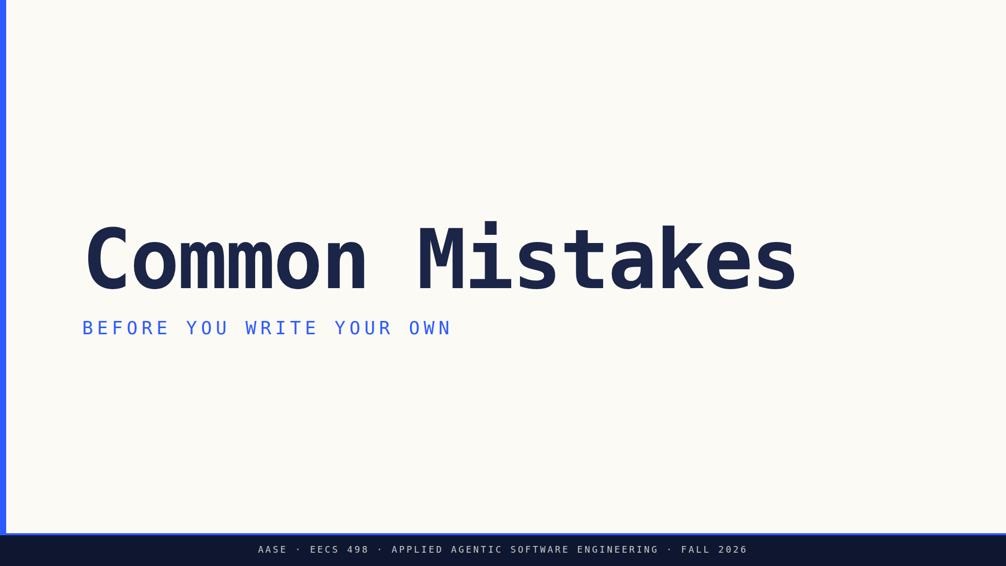
Notes:
Bridge: You have seen a clean spec run. Before you write your own, the four things graders consistently see go wrong.

Slide 48
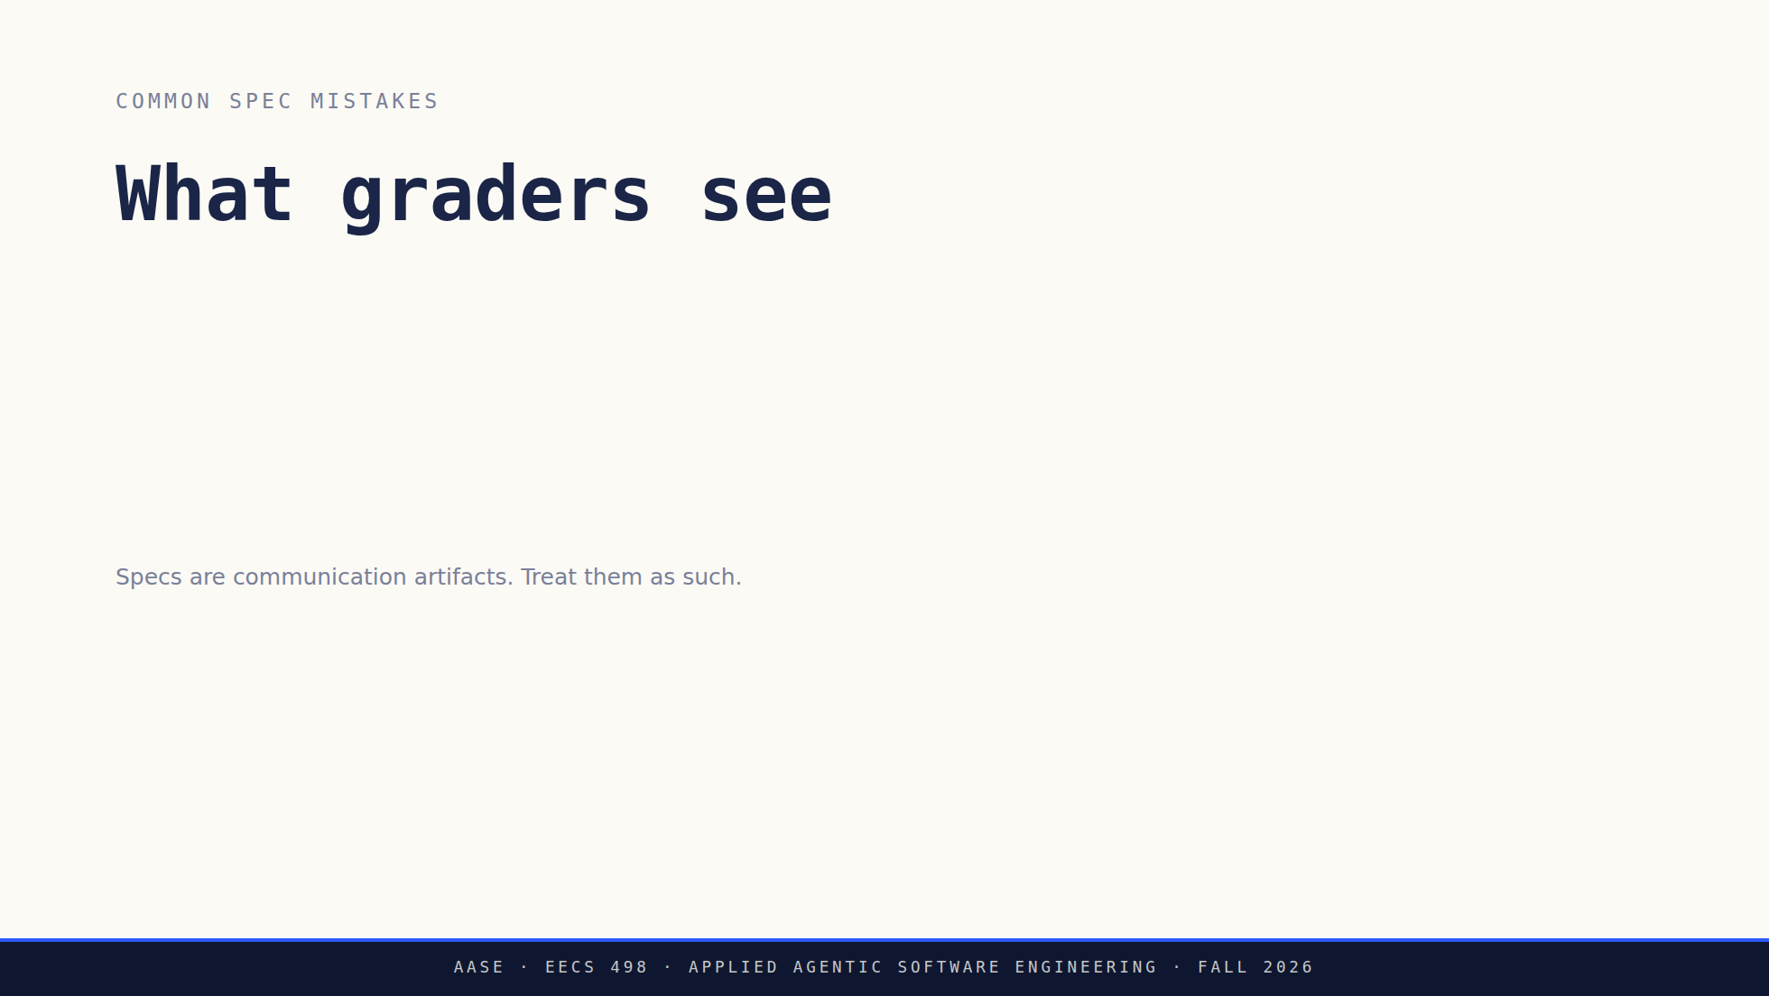
Notes:
Four clicks, and say plainly that you will see all four.
Code where instructions belong is the most common. They write the
implementation into the task instead of describing it.
The caption is the frame. A spec is a communication artifact, so the test is
whether another person could execute it.

Slide 49
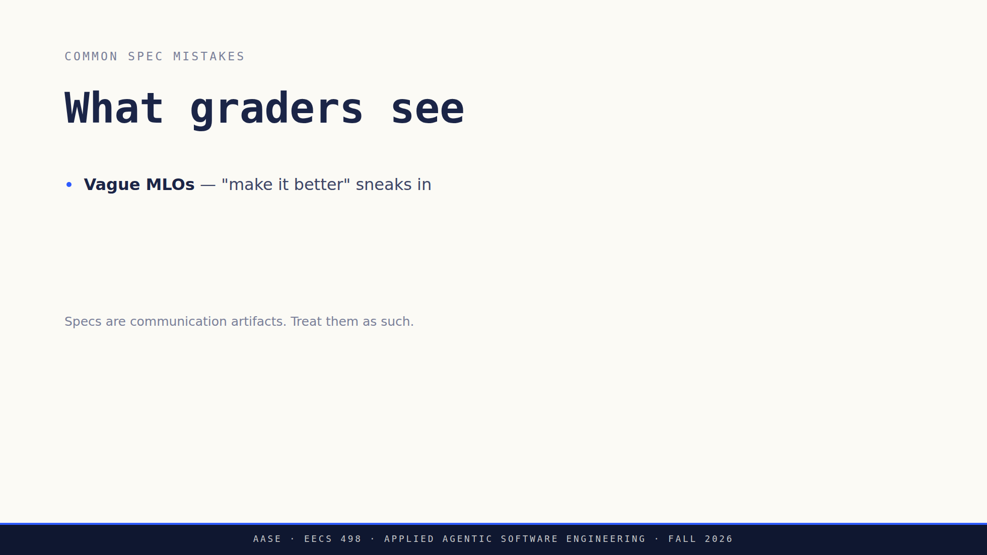
Notes:
Four clicks, and say plainly that you will see all four.
Code where instructions belong is the most common. They write the
implementation into the task instead of describing it.
The caption is the frame. A spec is a communication artifact, so the test is
whether another person could execute it.

Slide 50
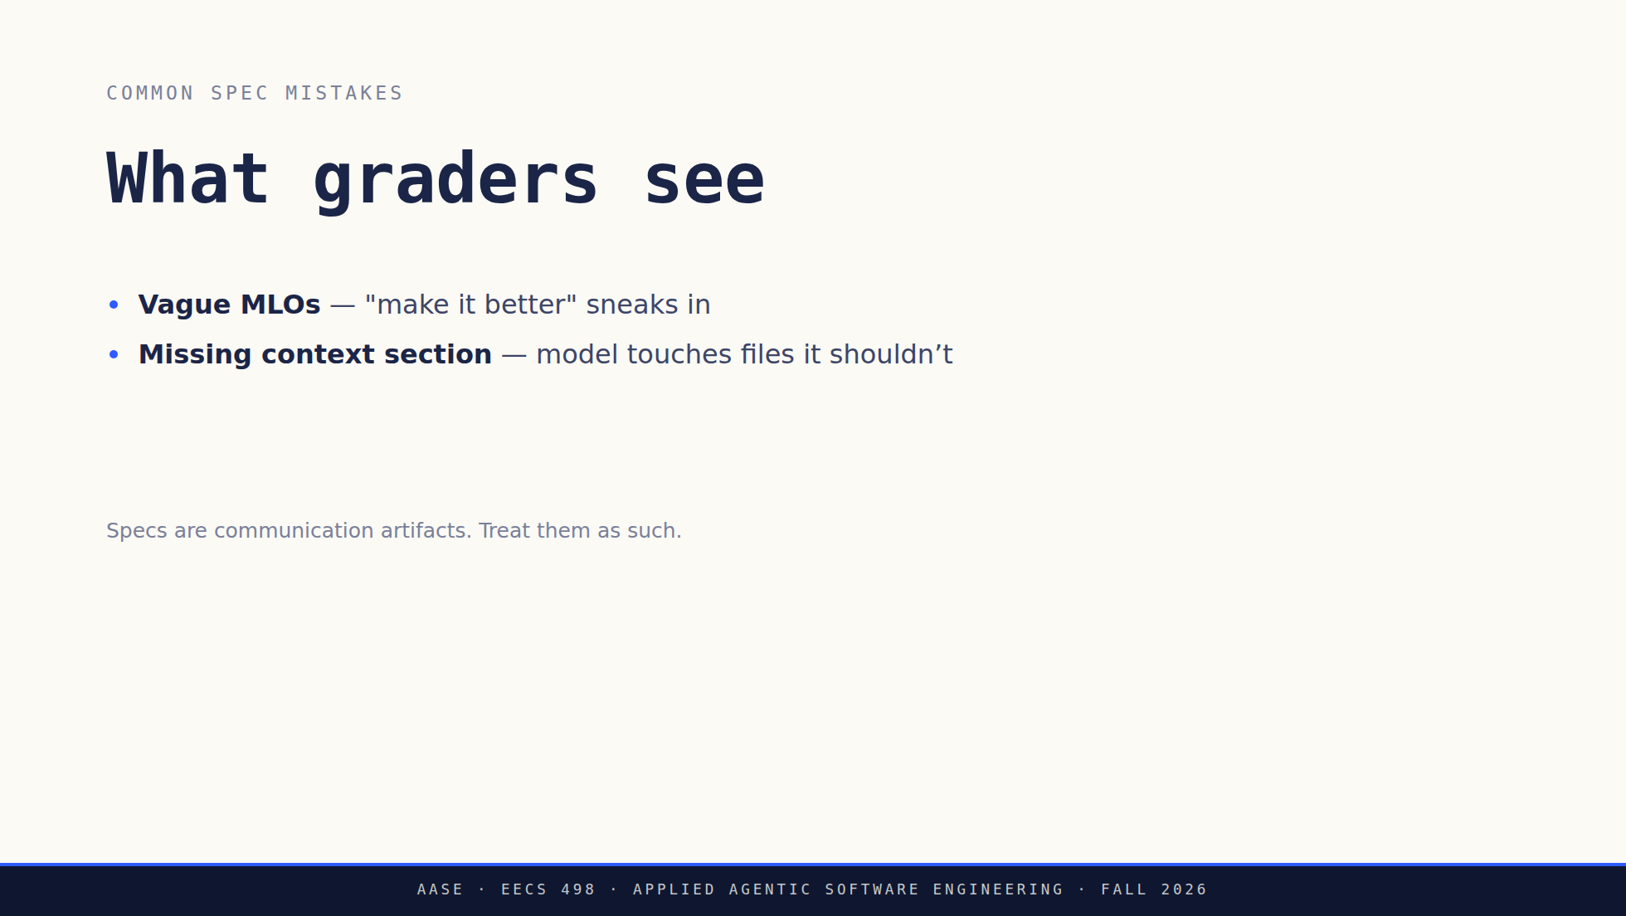
Notes:
Four clicks, and say plainly that you will see all four.
Code where instructions belong is the most common. They write the
implementation into the task instead of describing it.
The caption is the frame. A spec is a communication artifact, so the test is
whether another person could execute it.

Slide 51
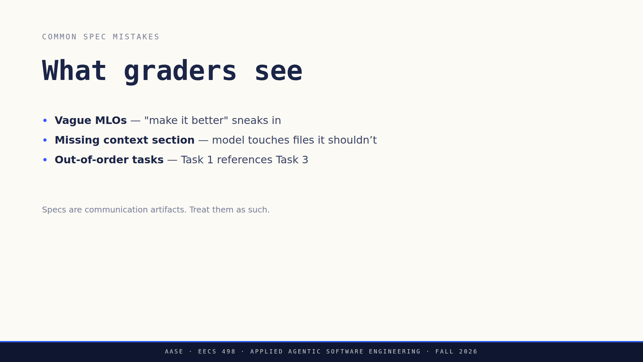
Notes:
Four clicks, and say plainly that you will see all four.
Code where instructions belong is the most common. They write the
implementation into the task instead of describing it.
The caption is the frame. A spec is a communication artifact, so the test is
whether another person could execute it.

Slide 52

Notes:
Four clicks, and say plainly that you will see all four.
Code where instructions belong is the most common. They write the
implementation into the task instead of describing it.
The caption is the frame. A spec is a communication artifact, so the test is
whether another person could execute it.

Slide 53

Notes:
Six clicks, one line each, no elaboration. They have heard all of it once
already. This is the version they write down.
If the clock is short, click through and land only the third one: the spec
is the instruction, not a document about it.

Slide 54

Notes:
Six clicks, one line each, no elaboration. They have heard all of it once
already. This is the version they write down.
If the clock is short, click through and land only the third one: the spec
is the instruction, not a document about it.

Slide 55

Notes:
Six clicks, one line each, no elaboration. They have heard all of it once
already. This is the version they write down.
If the clock is short, click through and land only the third one: the spec
is the instruction, not a document about it.

Slide 56

Notes:
Six clicks, one line each, no elaboration. They have heard all of it once
already. This is the version they write down.
If the clock is short, click through and land only the third one: the spec
is the instruction, not a document about it.

Slide 57

Notes:
Six clicks, one line each, no elaboration. They have heard all of it once
already. This is the version they write down.
If the clock is short, click through and land only the third one: the spec
is the instruction, not a document about it.

Slide 58

Notes:
Six clicks, one line each, no elaboration. They have heard all of it once
already. This is the version they write down.
If the clock is short, click through and land only the third one: the spec
is the instruction, not a document about it.

Slide 59

Notes:
Six clicks, one line each, no elaboration. They have heard all of it once
already. This is the version they write down.
If the clock is short, click through and land only the third one: the spec
is the instruction, not a document about it.

Slide 60

Notes:
Take two of the three out loud if the clock allows. Question 3 is the one
worth landing: standards you don't write down are standards the model
never had.

Slide 61

Notes:
Dates, said once and clearly. Setup gate and all sixteen aider-practice
lessons are due tomorrow, Friday September 11. Lab01 is Monday September 14
for the Monday section, Tuesday September 15 for the Tuesday section. The
build is due Tuesday October 6 at 11:59 PM.
Last click prevents a week of confusion. They are not building yet.
aider-practice finishes this week and the build starts after Lab01.

Slide 62

Notes:
Dates, said once and clearly. Setup gate and all sixteen aider-practice
lessons are due tomorrow, Friday September 11. Lab01 is Monday September 14
for the Monday section, Tuesday September 15 for the Tuesday section. The
build is due Tuesday October 6 at 11:59 PM.
Last click prevents a week of confusion. They are not building yet.
aider-practice finishes this week and the build starts after Lab01.

Slide 63

Notes:
Dates, said once and clearly. Setup gate and all sixteen aider-practice
lessons are due tomorrow, Friday September 11. Lab01 is Monday September 14
for the Monday section, Tuesday September 15 for the Tuesday section. The
build is due Tuesday October 6 at 11:59 PM.
Last click prevents a week of confusion. They are not building yet.
aider-practice finishes this week and the build starts after Lab01.

Slide 64

Notes:
Dates, said once and clearly. Setup gate and all sixteen aider-practice
lessons are due tomorrow, Friday September 11. Lab01 is Monday September 14
for the Monday section, Tuesday September 15 for the Tuesday section. The
build is due Tuesday October 6 at 11:59 PM.
Last click prevents a week of confusion. They are not building yet.
aider-practice finishes this week and the build starts after Lab01.

Slide 65

Notes:
Dates, said once and clearly. Setup gate and all sixteen aider-practice
lessons are due tomorrow, Friday September 11. Lab01 is Monday September 14
for the Monday section, Tuesday September 15 for the Tuesday section. The
build is due Tuesday October 6 at 11:59 PM.
Last click prevents a week of confusion. They are not building yet.
aider-practice finishes this week and the build starts after Lab01.

Slide 66

Notes:
Say the line the slide no longer has room for: Aider's spine, not its
feature list, and everyone builds the same seven.
Most of the room has not seen this list. It went public yesterday inside the
Lab01 deck and nothing pointed them at it, so read all seven aloud rather
than assuming. The next slide says which two of the seven today feeds directly, so this
is the setup for it, not a detour.
The description is the part they need first: they are building the thing they
have been driving for two weeks. F2 is /add and /drop, which is L03's demo,
and F4 is the spec written for one small model, which is the next slide.
Table matches Lab01's exactly, on purpose. The full spec with the checked
behaviors is in the packet repository they clone.

Slide 67

Notes:
Both cards are graded work, which is the label. Say that first.
Left card: seven features with no starter code is exactly the three or more
files, building from scratch case from the decision rule, so the spec is a
required deliverable. Be plain that the packet ships no application code, no
module layout and no tests.
Right card is the one worth the time. F4 is the instruction that tells a
model how to emit an edit. That is a spec written for an audience of one
small model, and it is the least forgiving one all term. Leave it vague and
the parser rejects the output, so nothing lands on disk.
Then the offer: bring a spec draft to office hours this week. The first one
will not be perfect, and that is fine.

Slide 68

Notes:
Say the no-account line plainly and early. Someone is already wondering
whether they have to buy something. It is a demo from the podium.
Same spec, more autonomous tool, different behavior, and the Big Three still
applies. What they are looking at is the mature version of the thing they
are about to build.

Slide 69


