Slide 1
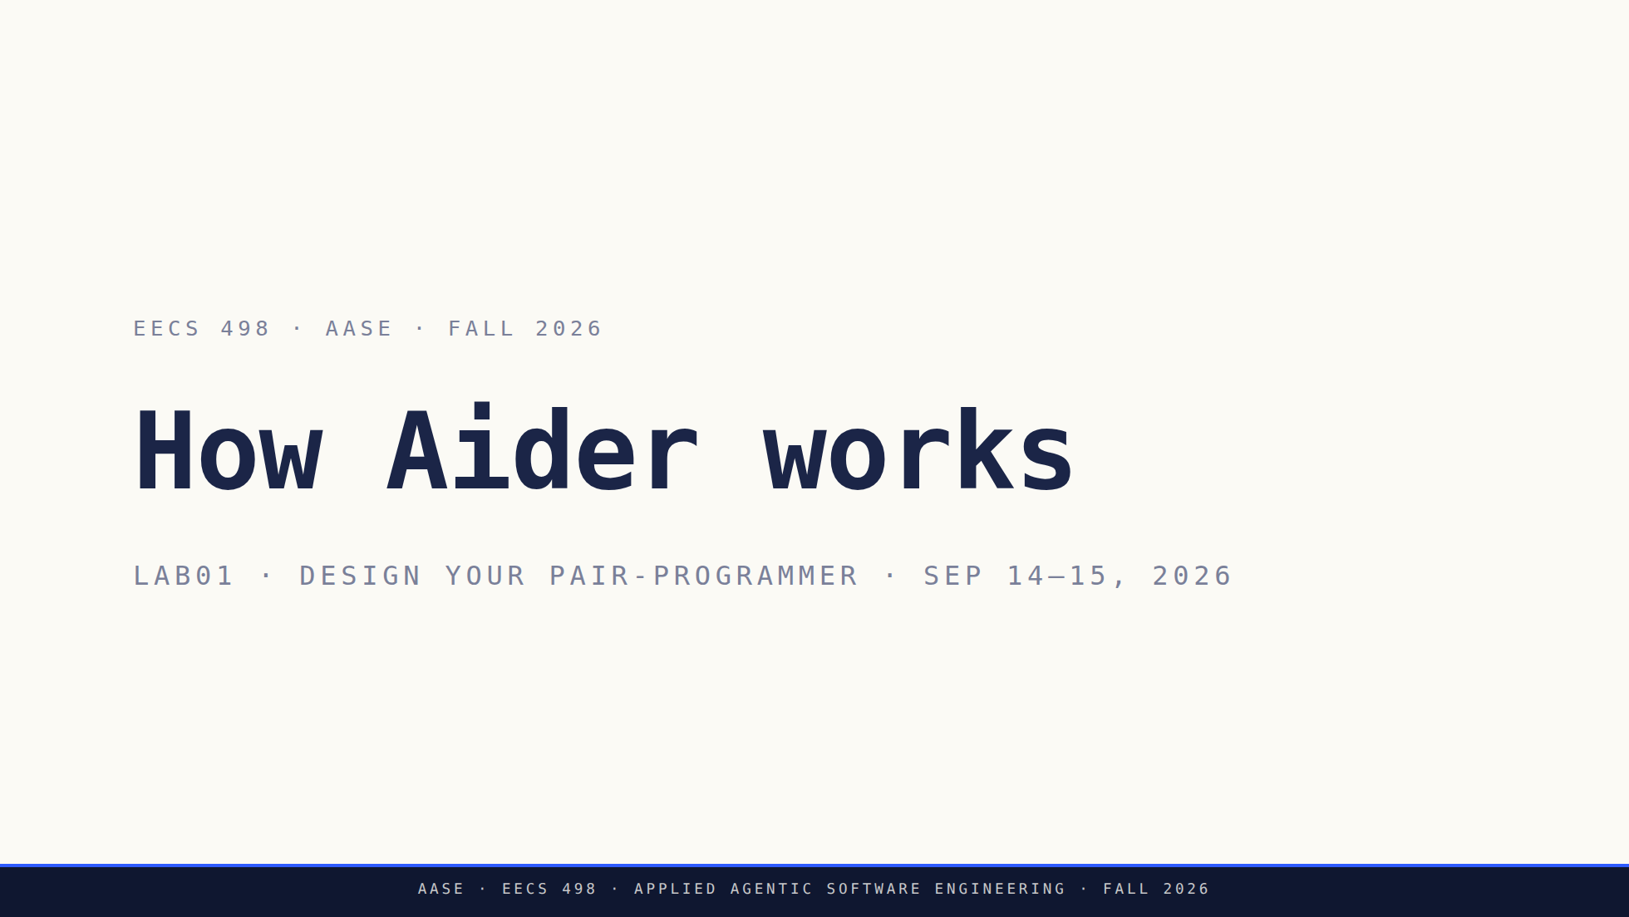
Notes:
Two halves. The first takes apart the tool they have been using since Lab00. The second hands them the build and gives them 45 minutes to start designing. Finish instruction at minute 65 and protect the work block.

Slide 2
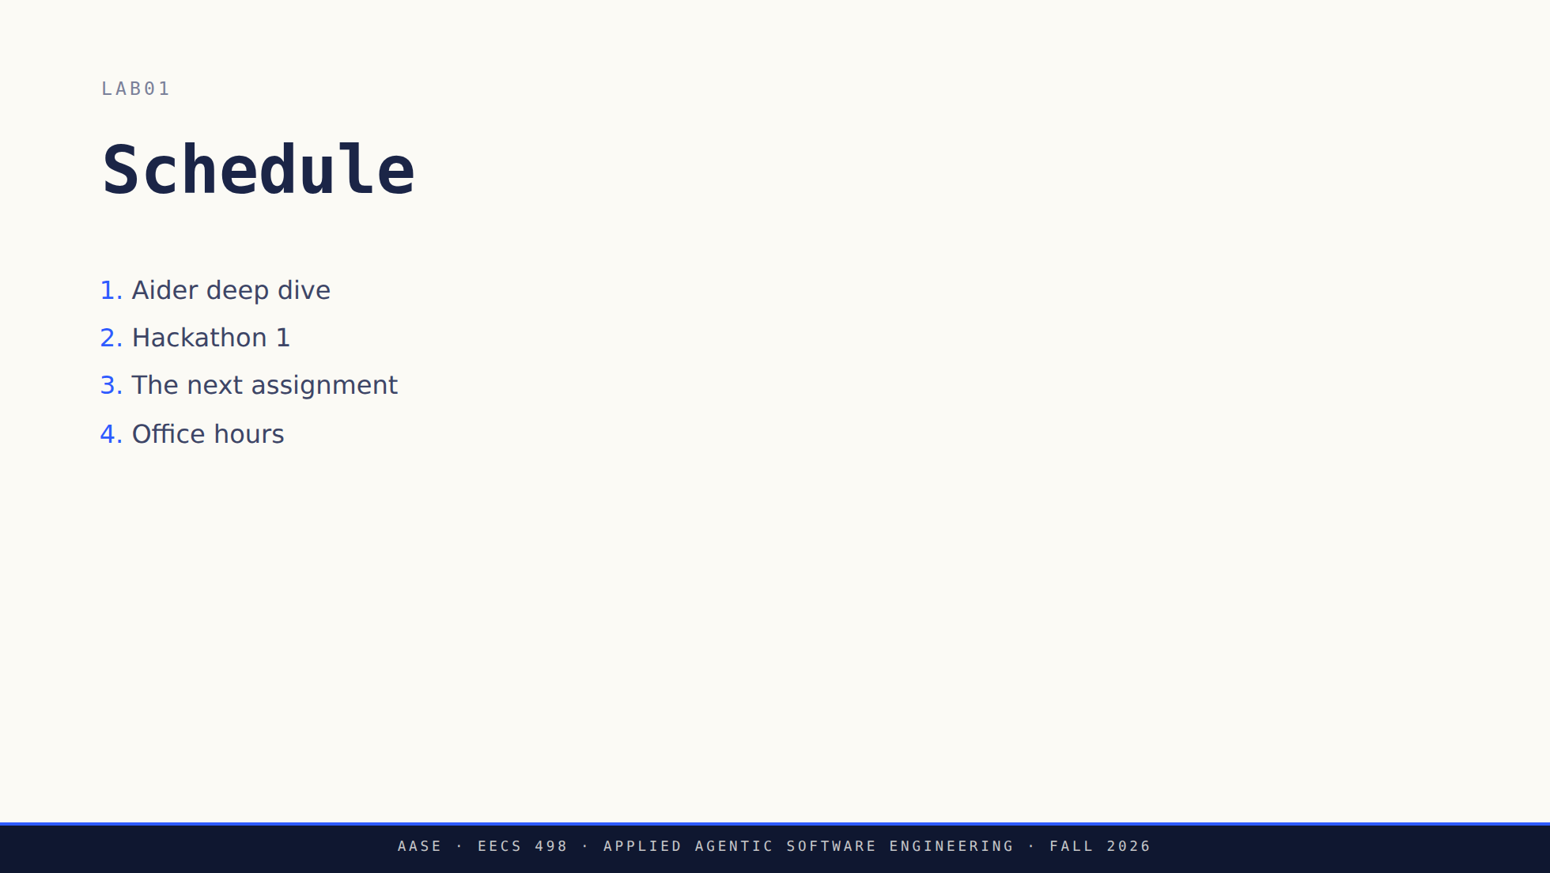
Notes:
Put this up while the room settles and leave it up. The agenda is part of the first block, not an extra segment in front of it. Say out loud that the second half is genuinely office hours: they work, you circulate, and nobody hands anything in today. Students who have been told all term that labs end in a checkoff will not believe it unless you say it. The slide no longer says so, so this is on you to say. Do not preview the build past the word itself. The reveal is still yours to make in the third section.

Slide 3
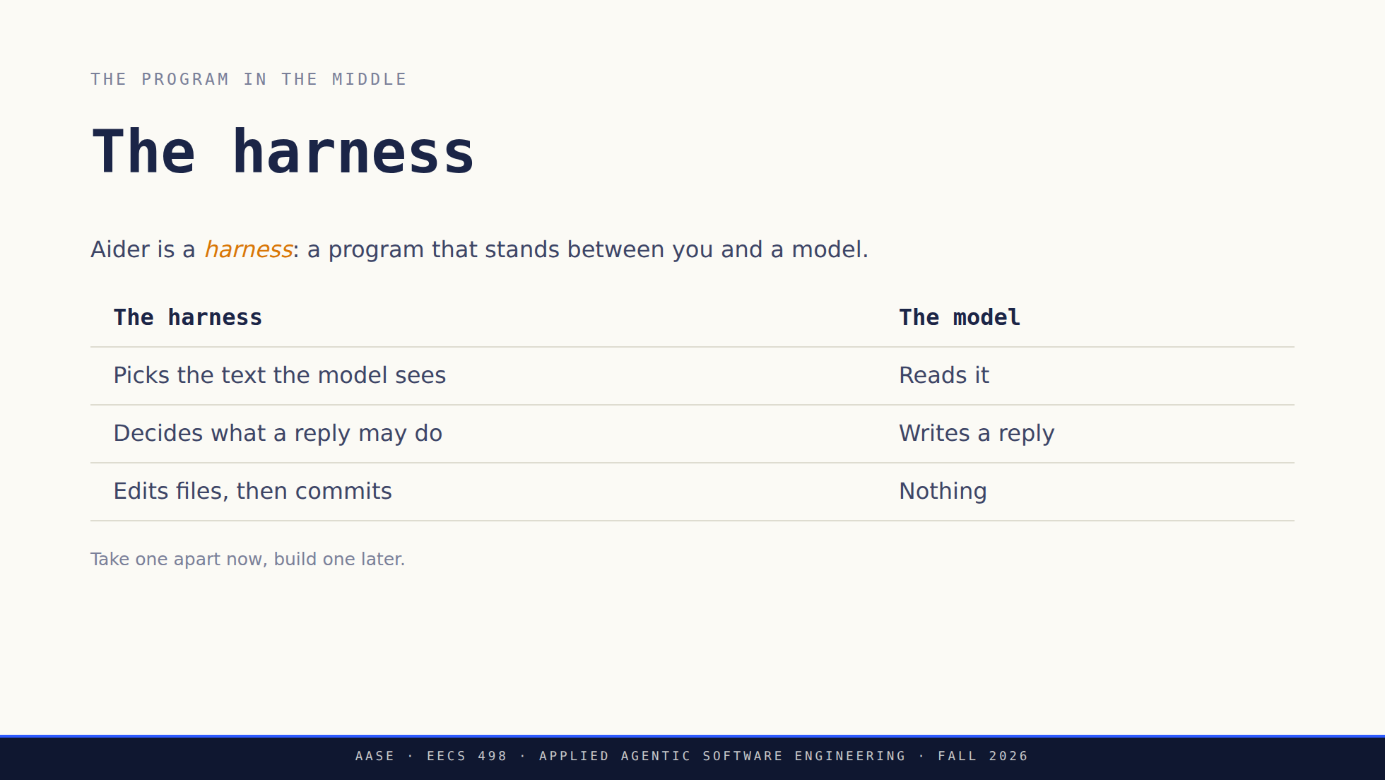
Notes:
This is the slide the deck was missing. Sixteen practice lessons gave them the muscle memory and none of the model, and the word "harness" is the one they need, because it is the thing they build in Stage 1 and extend in Analyze. Say the right-hand column out loud. The model's entire contribution is one block of text. Every effect on their machine is the left column acting on it. If anyone asks about models, endpoints or config: MODEL-POLICY.md, and it is not today's subject. qwen3.5:9b recommended, 4B permitted, any compatible endpoint.

Slide 4
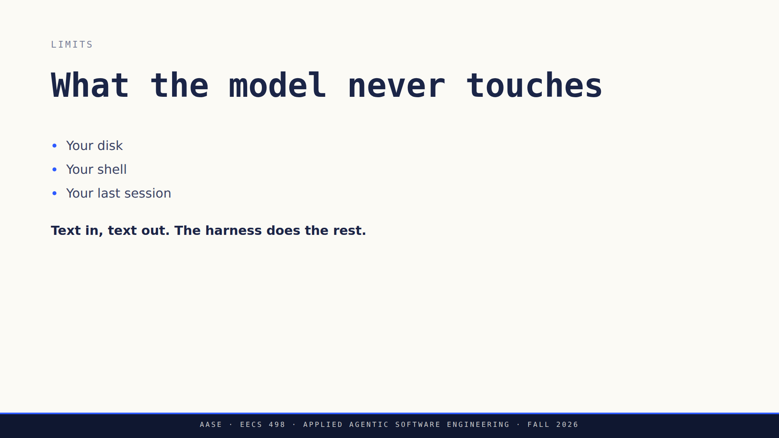
Notes:
Three negatives, and each one is a design decision somebody made rather than a limitation of the model. The third is the one that surprises people: there is no memory between sessions. Continuity is the harness resending the history, which is why history spends their token budget later in the deck. The 4B and the 9B are asked for different reply shapes, whole files against diffs. That is why a classmate's session looks different from theirs, and why the trace in the next ten minutes may not match what they ran in practice. Worth saying here, not worth a slide.

Slide 5
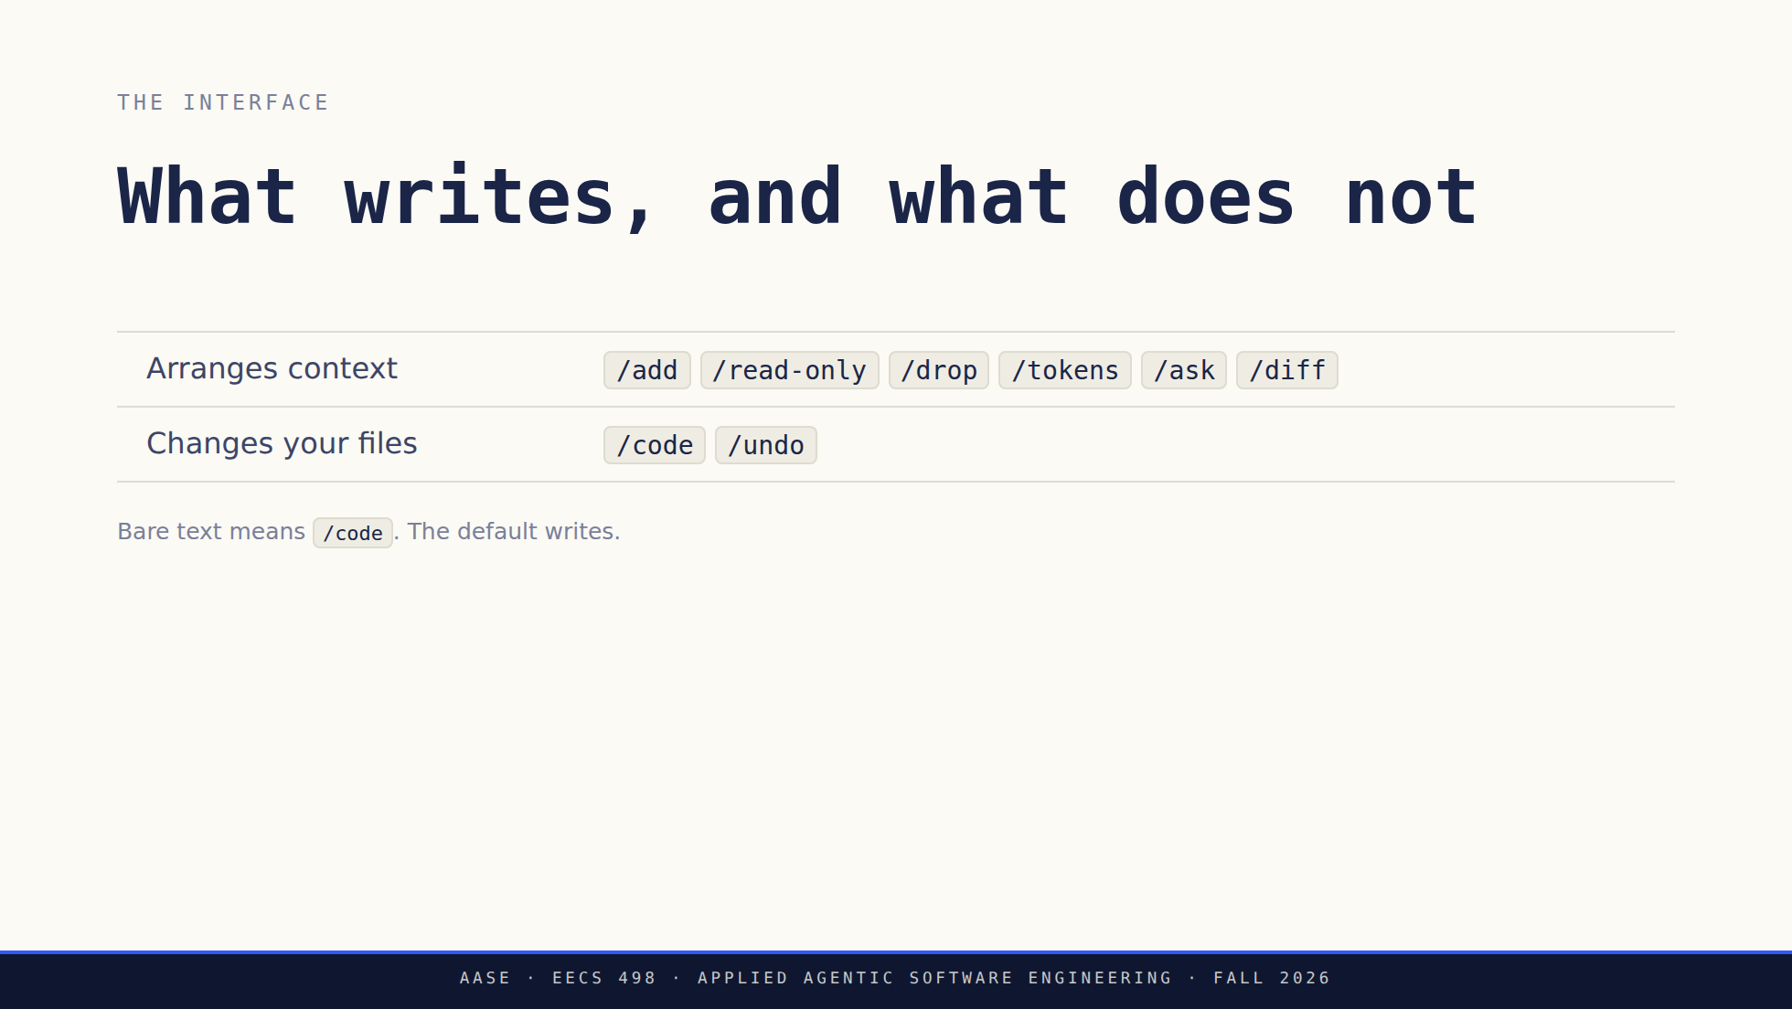
Notes:
Two commands in the whole set touch the repository, and one of those is the undo. That asymmetry is the approval layer they are about to build, visible in a tool they already use. /help lists more than this and the set moves between versions. Run it live if asked rather than reciting.

Slide 6
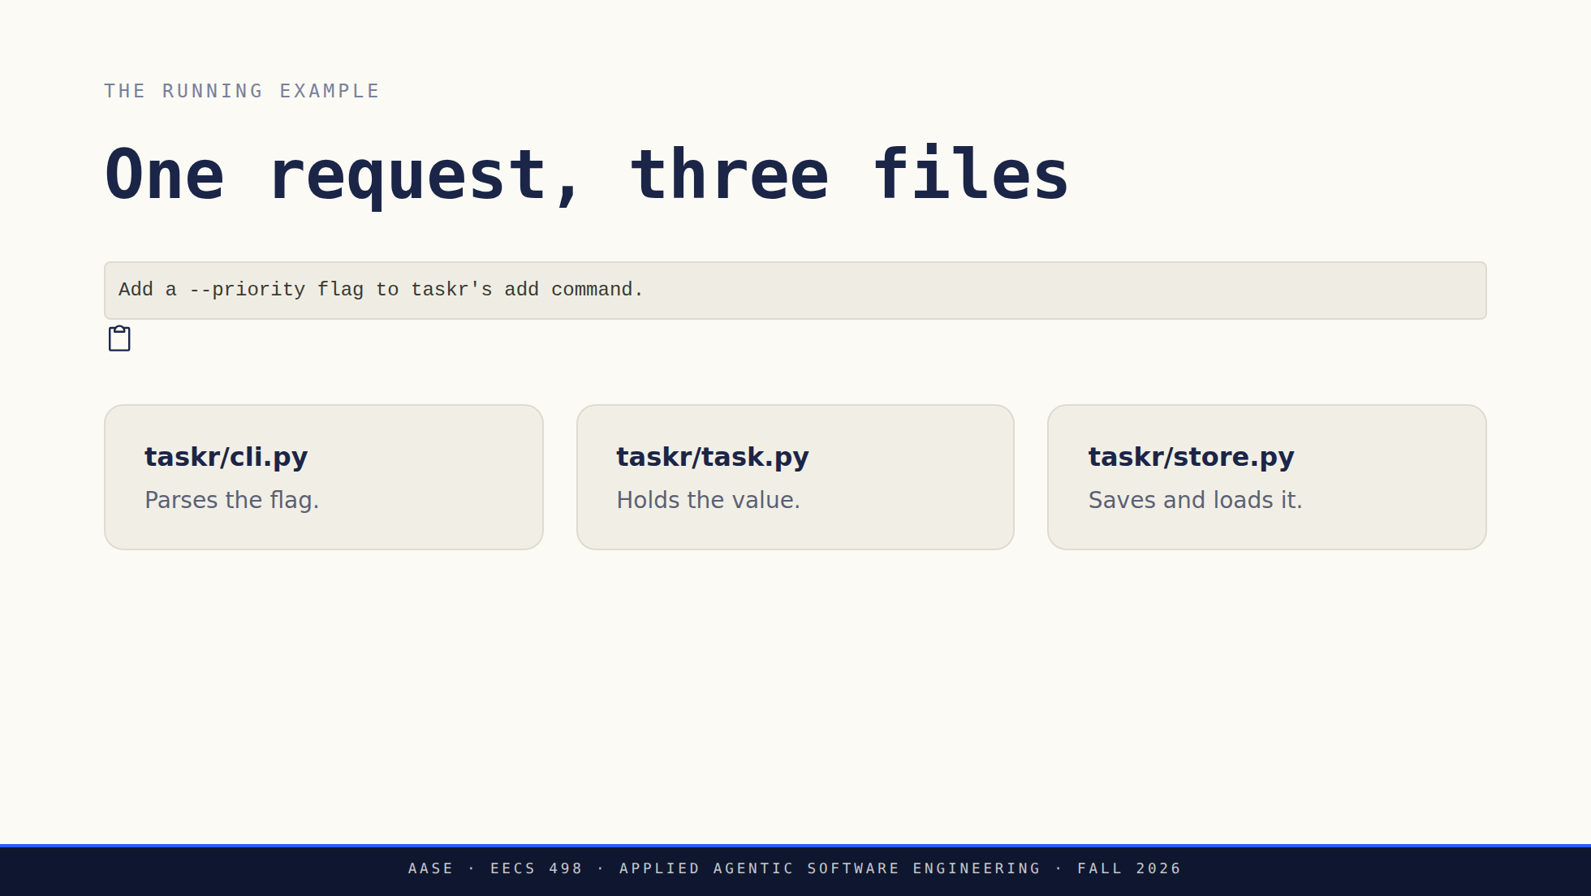
Notes:
They met this request in the practice lessons, in whole-file mode. Today's trace is diff mode and it is illustrative: a simplified turn, not a captured transcript of a particular model. The three files matter later, when the feature half-works.

Slide 7
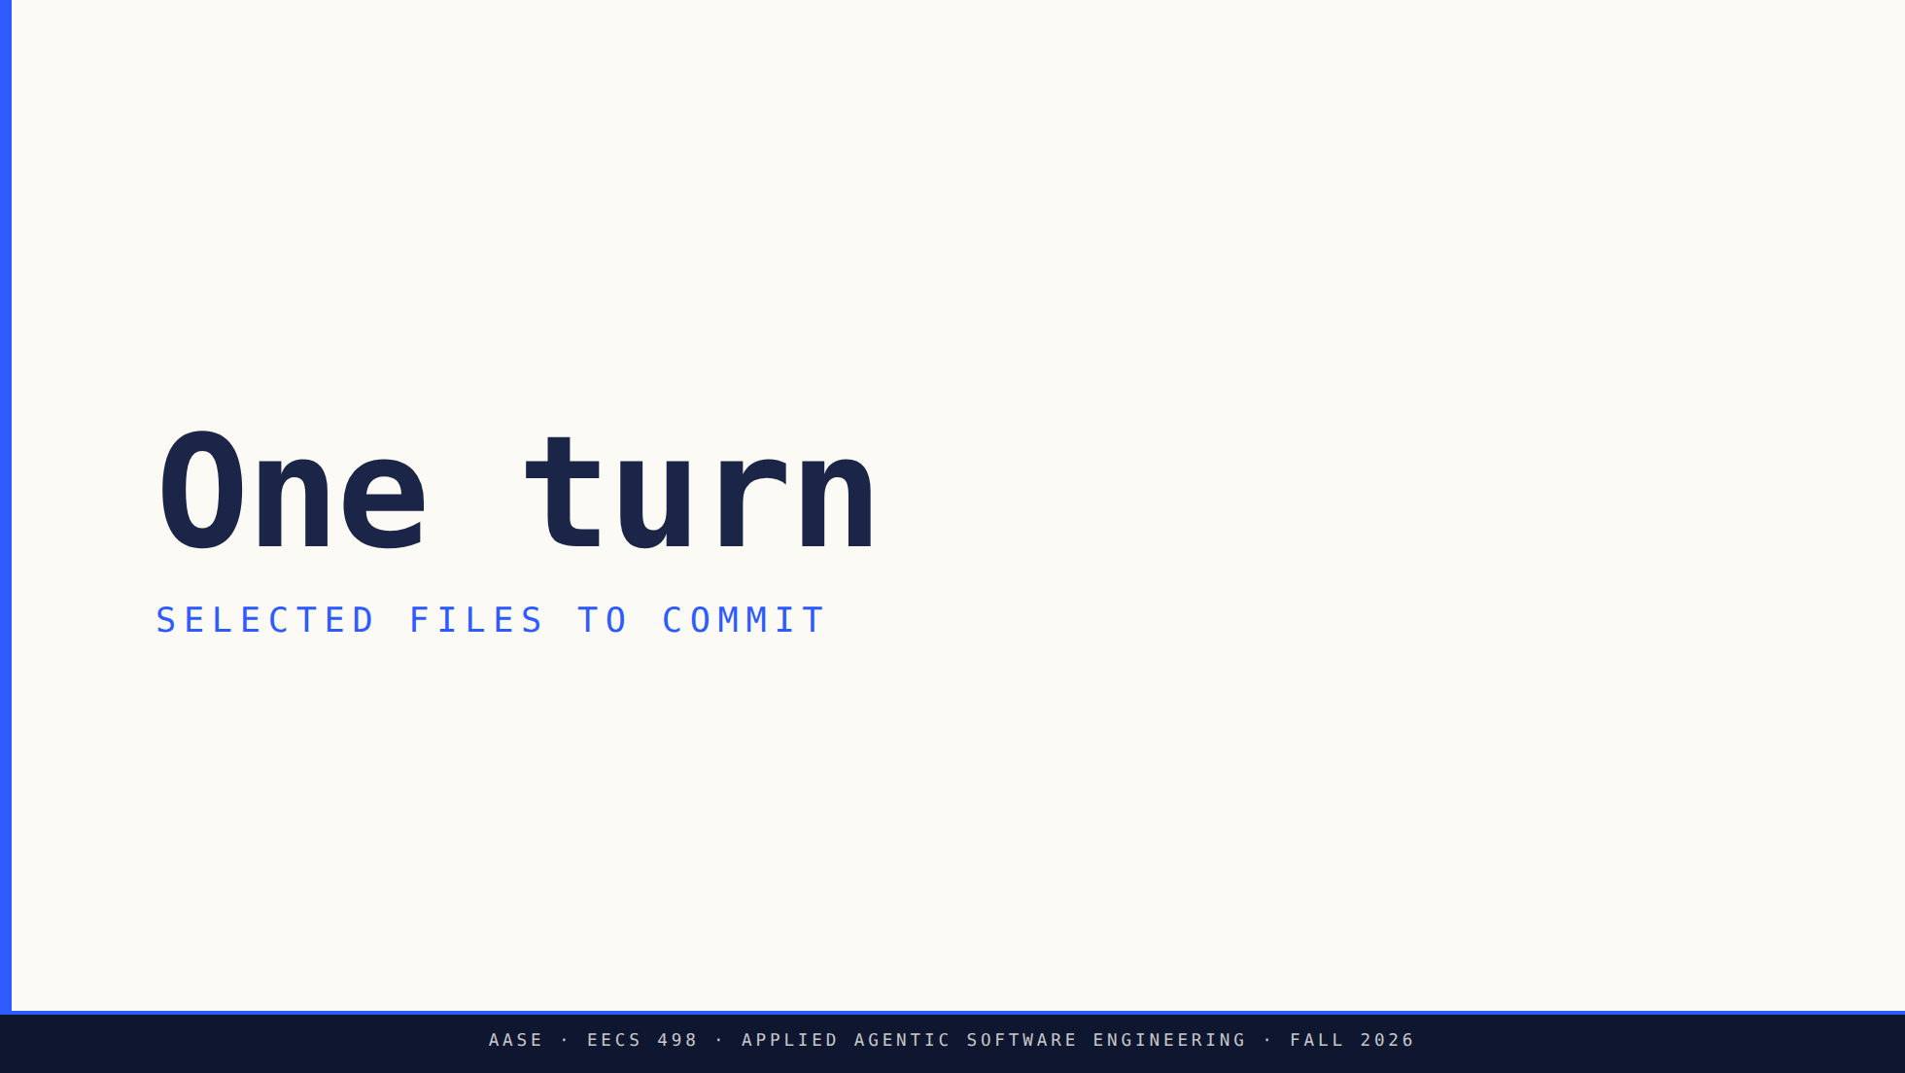
Notes:
Six steps. Say up front that only step 2 belongs to the model.

Slide 8
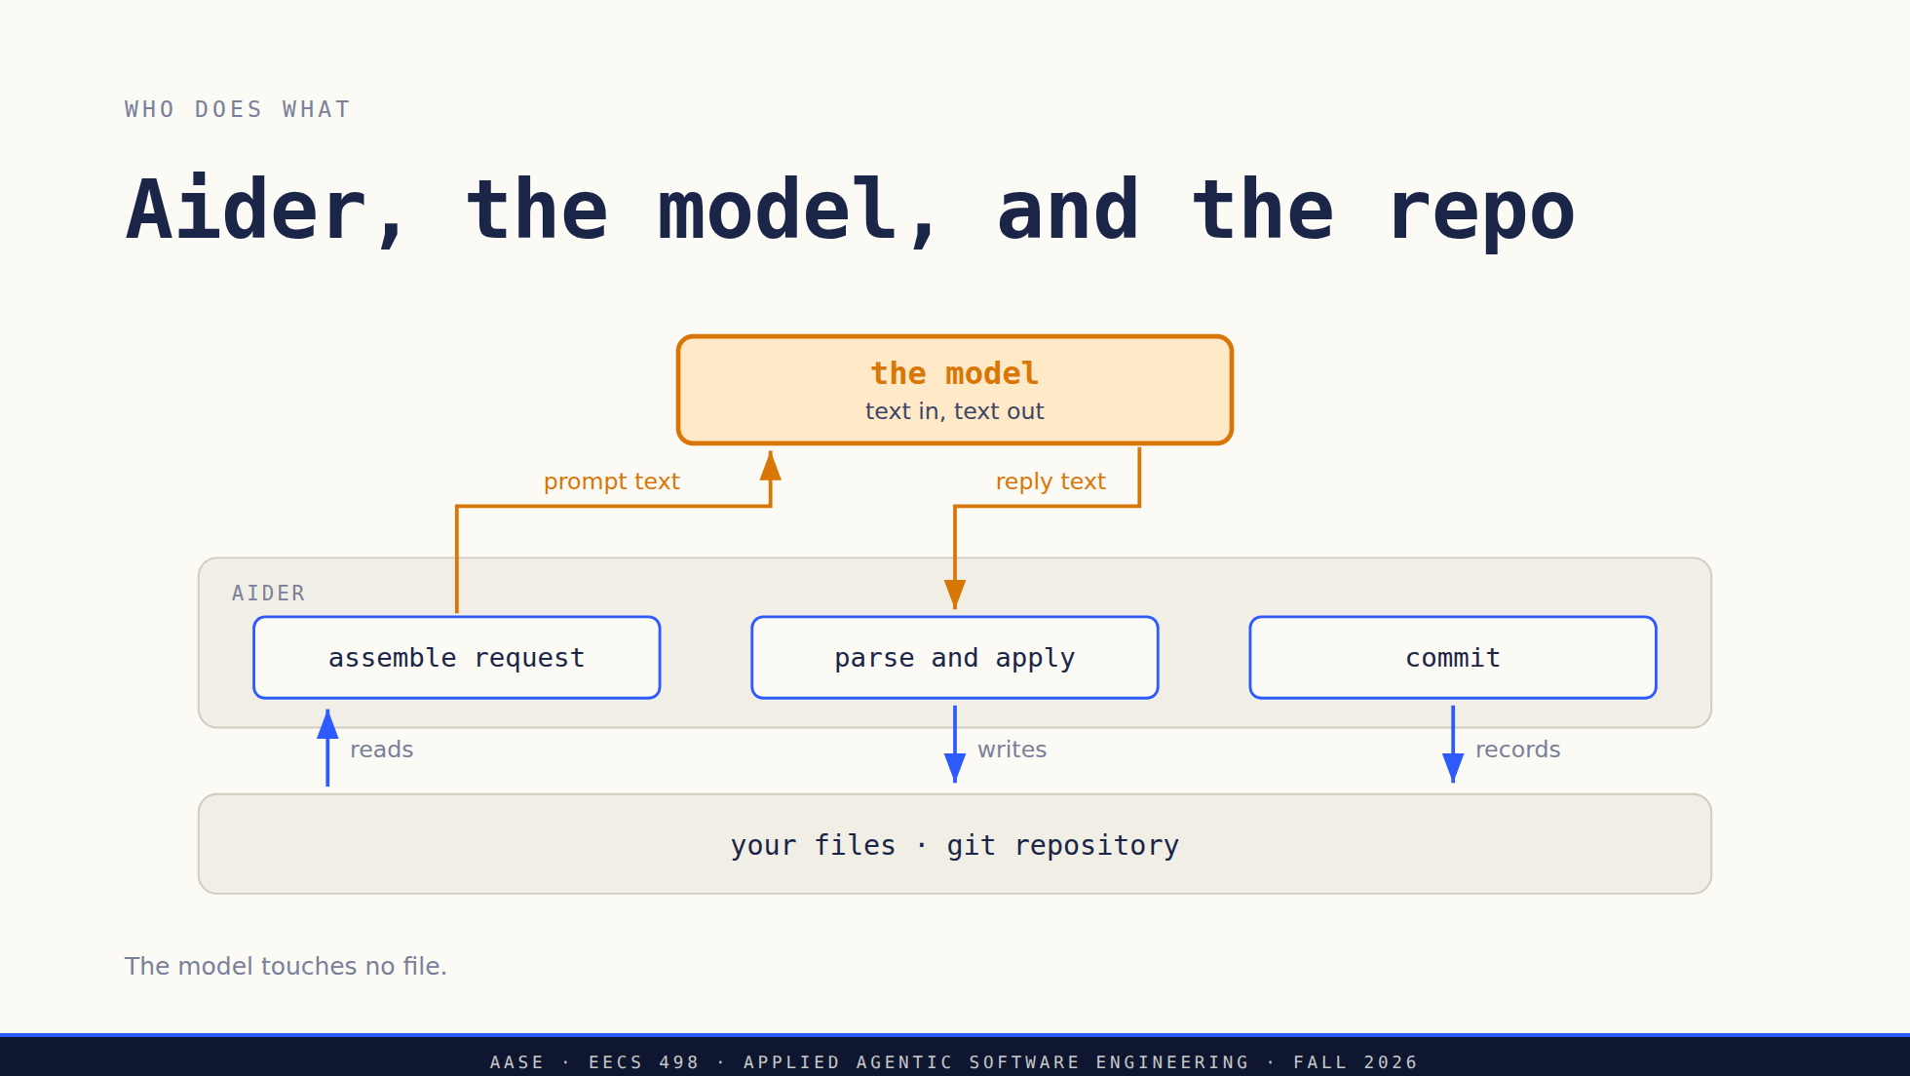
Notes:
Ask the room to find the arrow that writes a file. There is not one leaving the amber box. The model produced text, and a program decided what to do with it. This is a picture of Aider, not a required architecture for their build. They will draw their own version of this in a week.

Slide 9
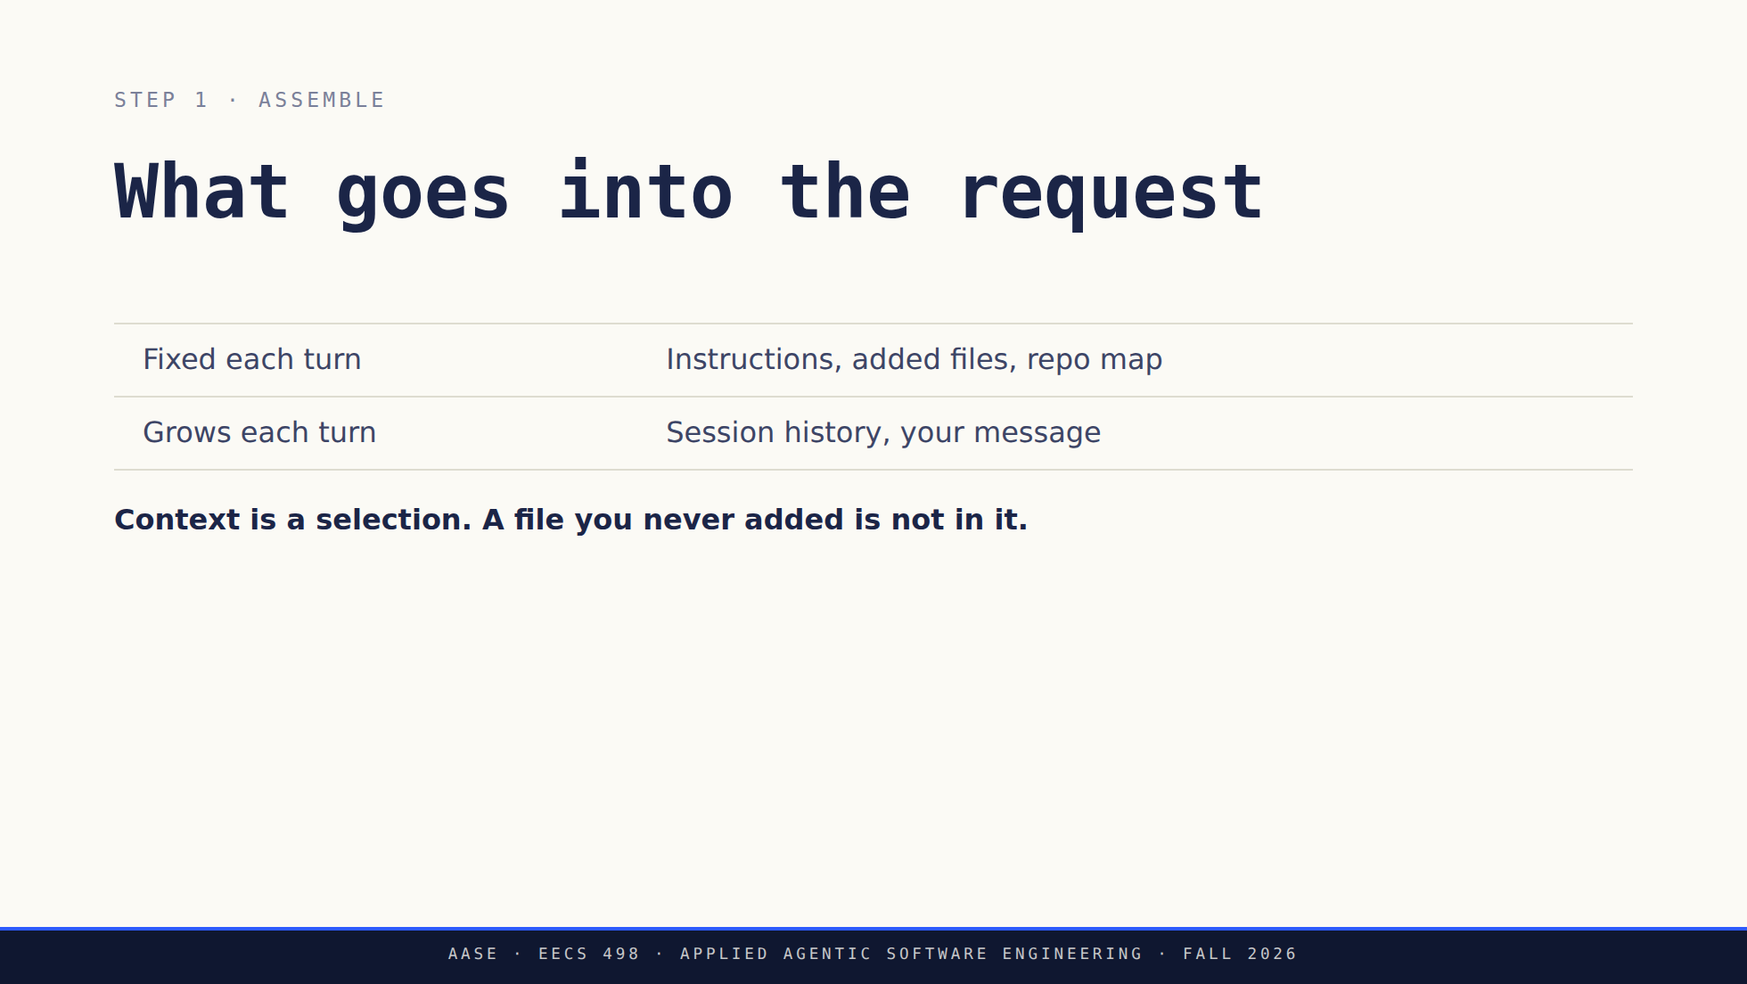
Notes:
Do not claim a fixed seven-part ordering. What actually goes into the prompt depends on the coder, the model and the settings, and it changes between releases. The list above is the shape, not the wire format. Ask what the model would need in order to add priority consistently to the CLI, the task and the store. That question sets up the next two slides.

Slide 10
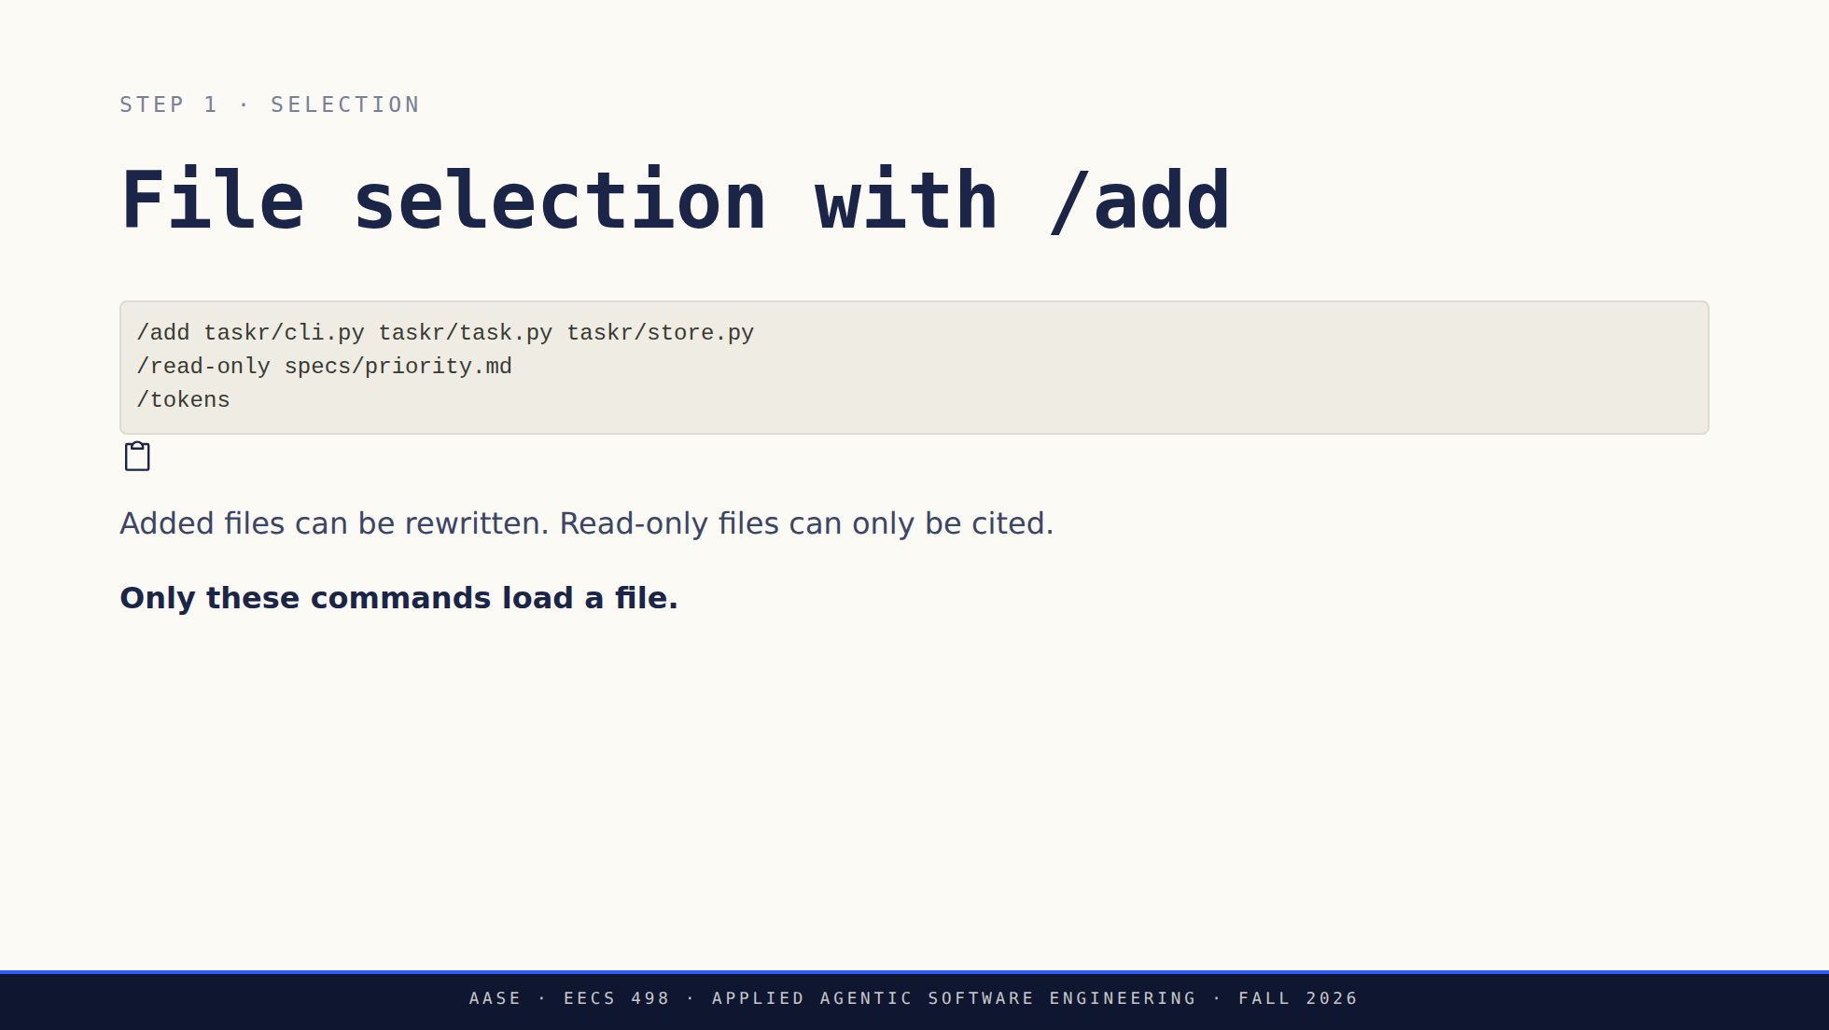
Notes:
Walk through why these three files and not the whole package. This is one sensible selection, not a rule to add everything. Read-only context still costs budget. /tokens tells you what you are spending, and nothing about whether the edit will be correct.

Slide 11
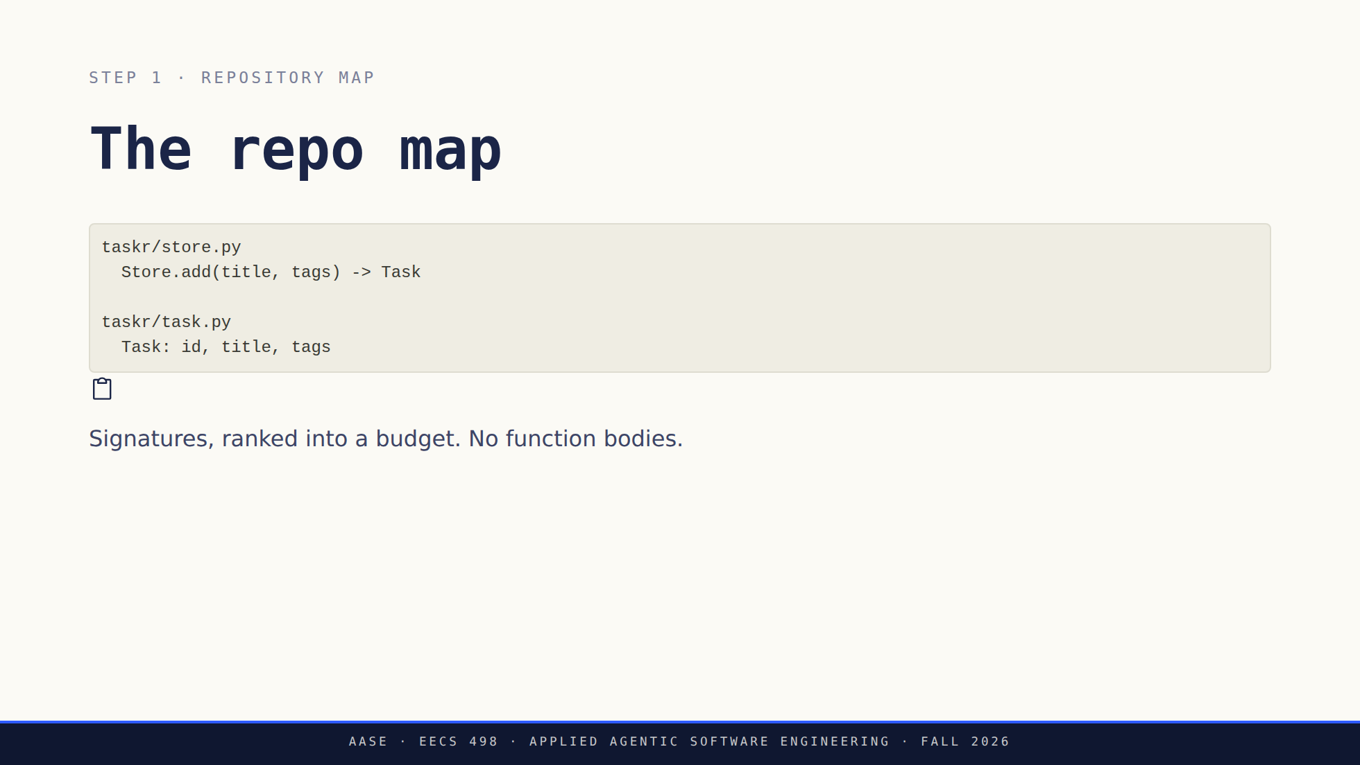
Notes:
The excerpt is illustrative. Do not promise the map contains every file, and do not use its silence as proof that a dependency is absent. When a student says "the model should have known," check whether they added the file or only let the map mention it. Source: https://aider.chat/docs/repomap.html Cut from the slide and worth saying: a signature tells you where to look, it does not tell the model how the function works. Students read a map line as evidence the model understands the function.

Slide 12
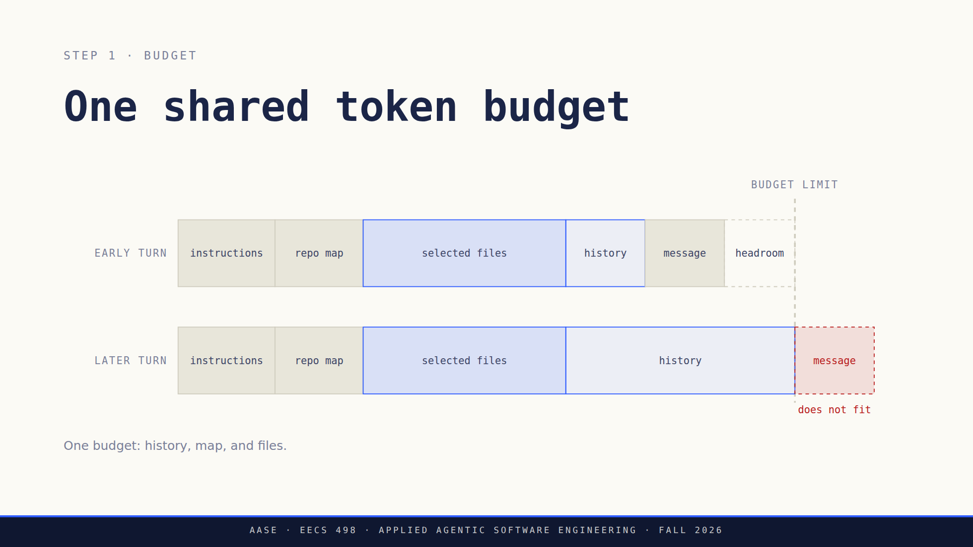
Notes:
Ask what they would drop first and what has to survive. Their Stage 1 contract keeps the system instructions, the current request and the added file contents, and refuses an oversized required input instead of silently trimming it. That refusal is a design decision they have to write down and test.

Slide 13
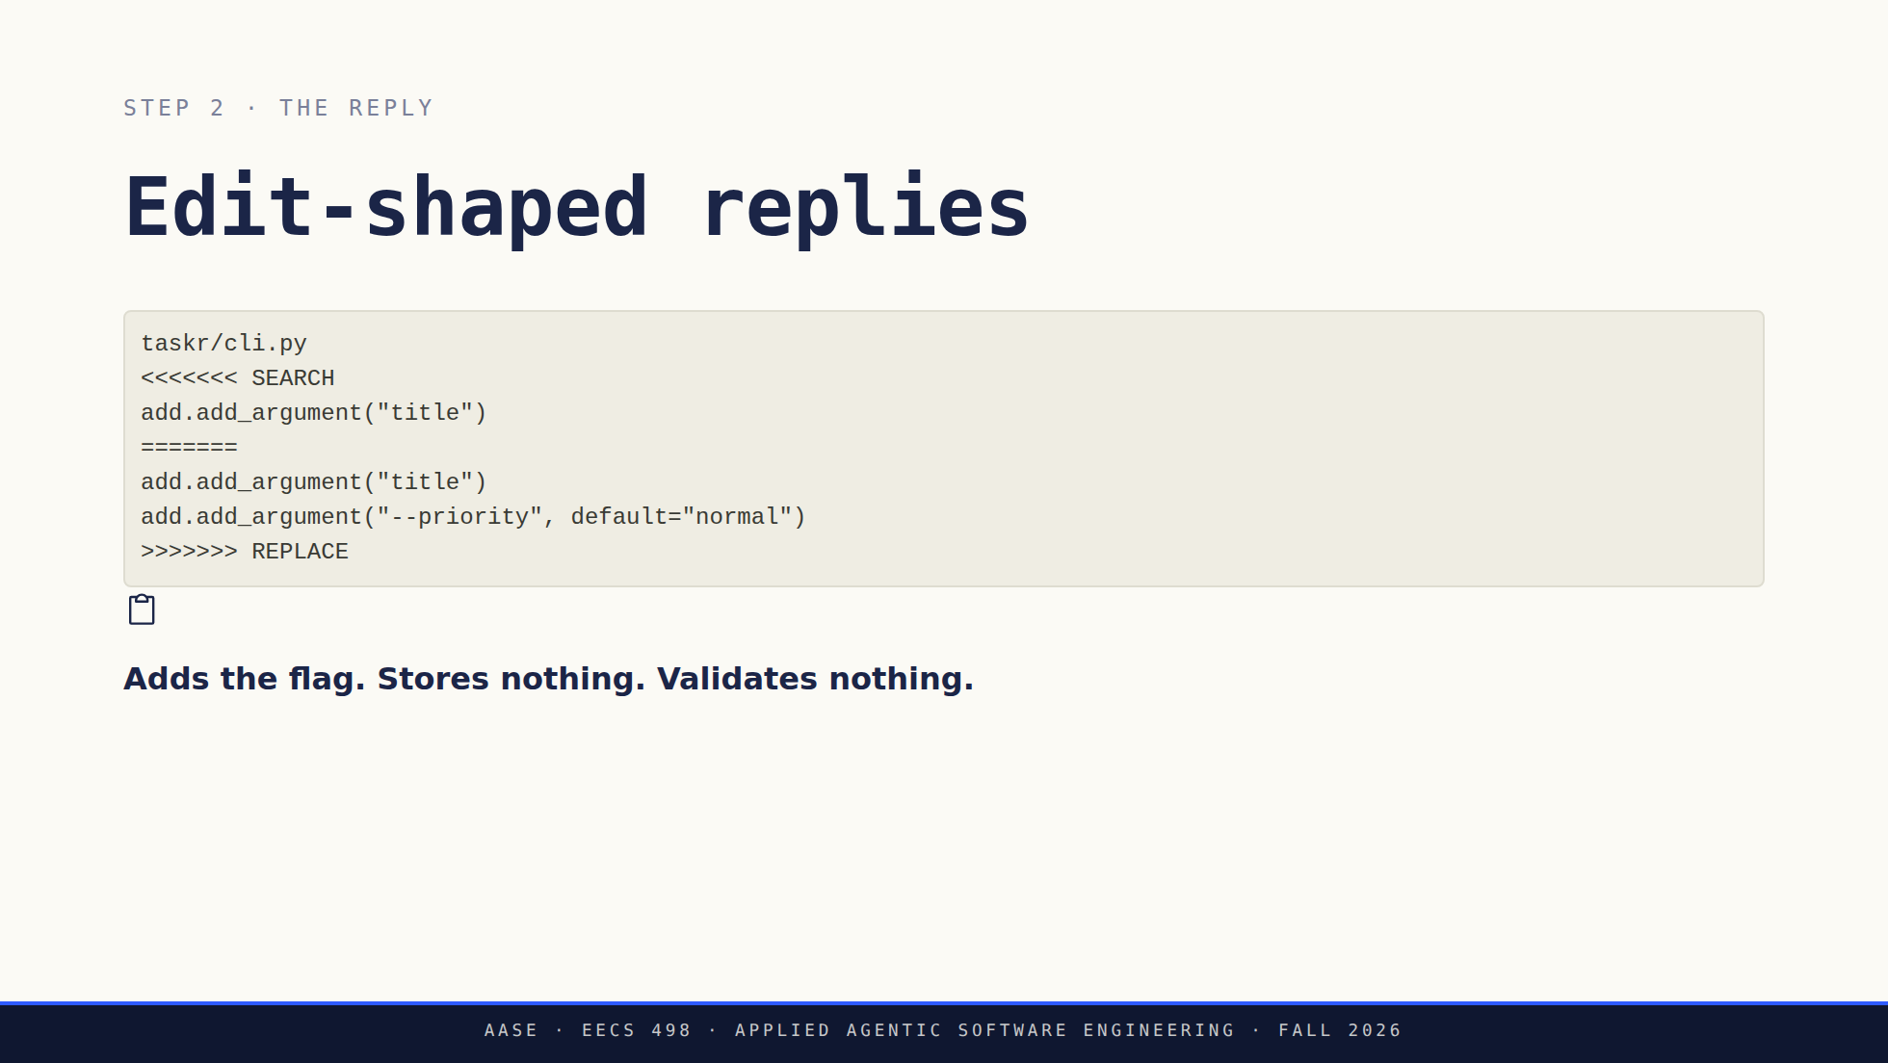
Notes:
Deliberately small and deliberately incomplete. Ask what is missing before you say it: task.py never gains the field, store.py never writes it. A student who reads only this block sees a finished feature. Nothing has changed on disk yet. This is a proposal in a chat reply.

Slide 14
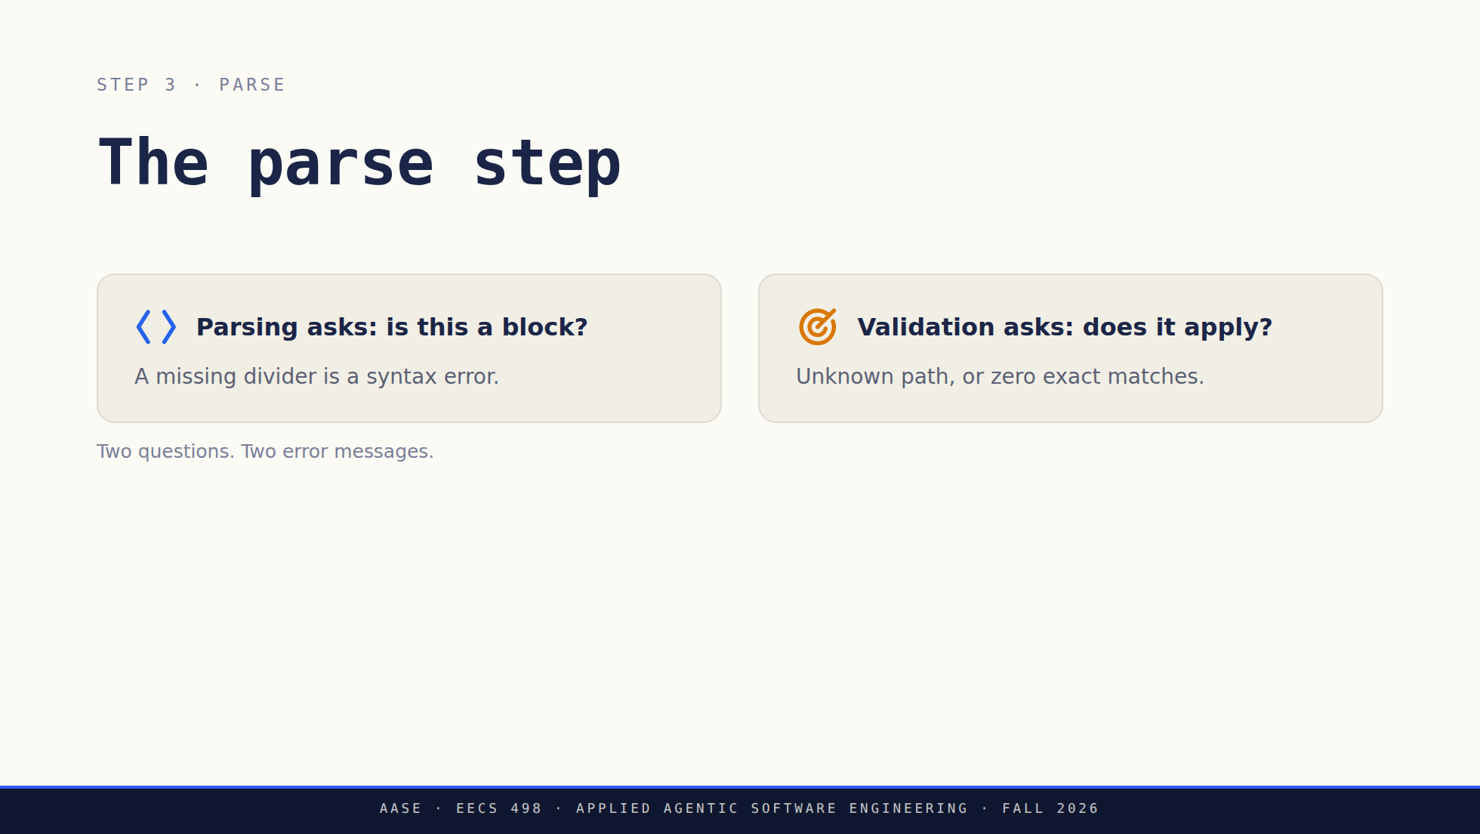
Notes:
Their design may split these across two functions or keep them in one. We grade the error behavior, not the signature. What we do want is that a malformed block and an unapplicable block are distinguishable to the person reading the output.

Slide 15
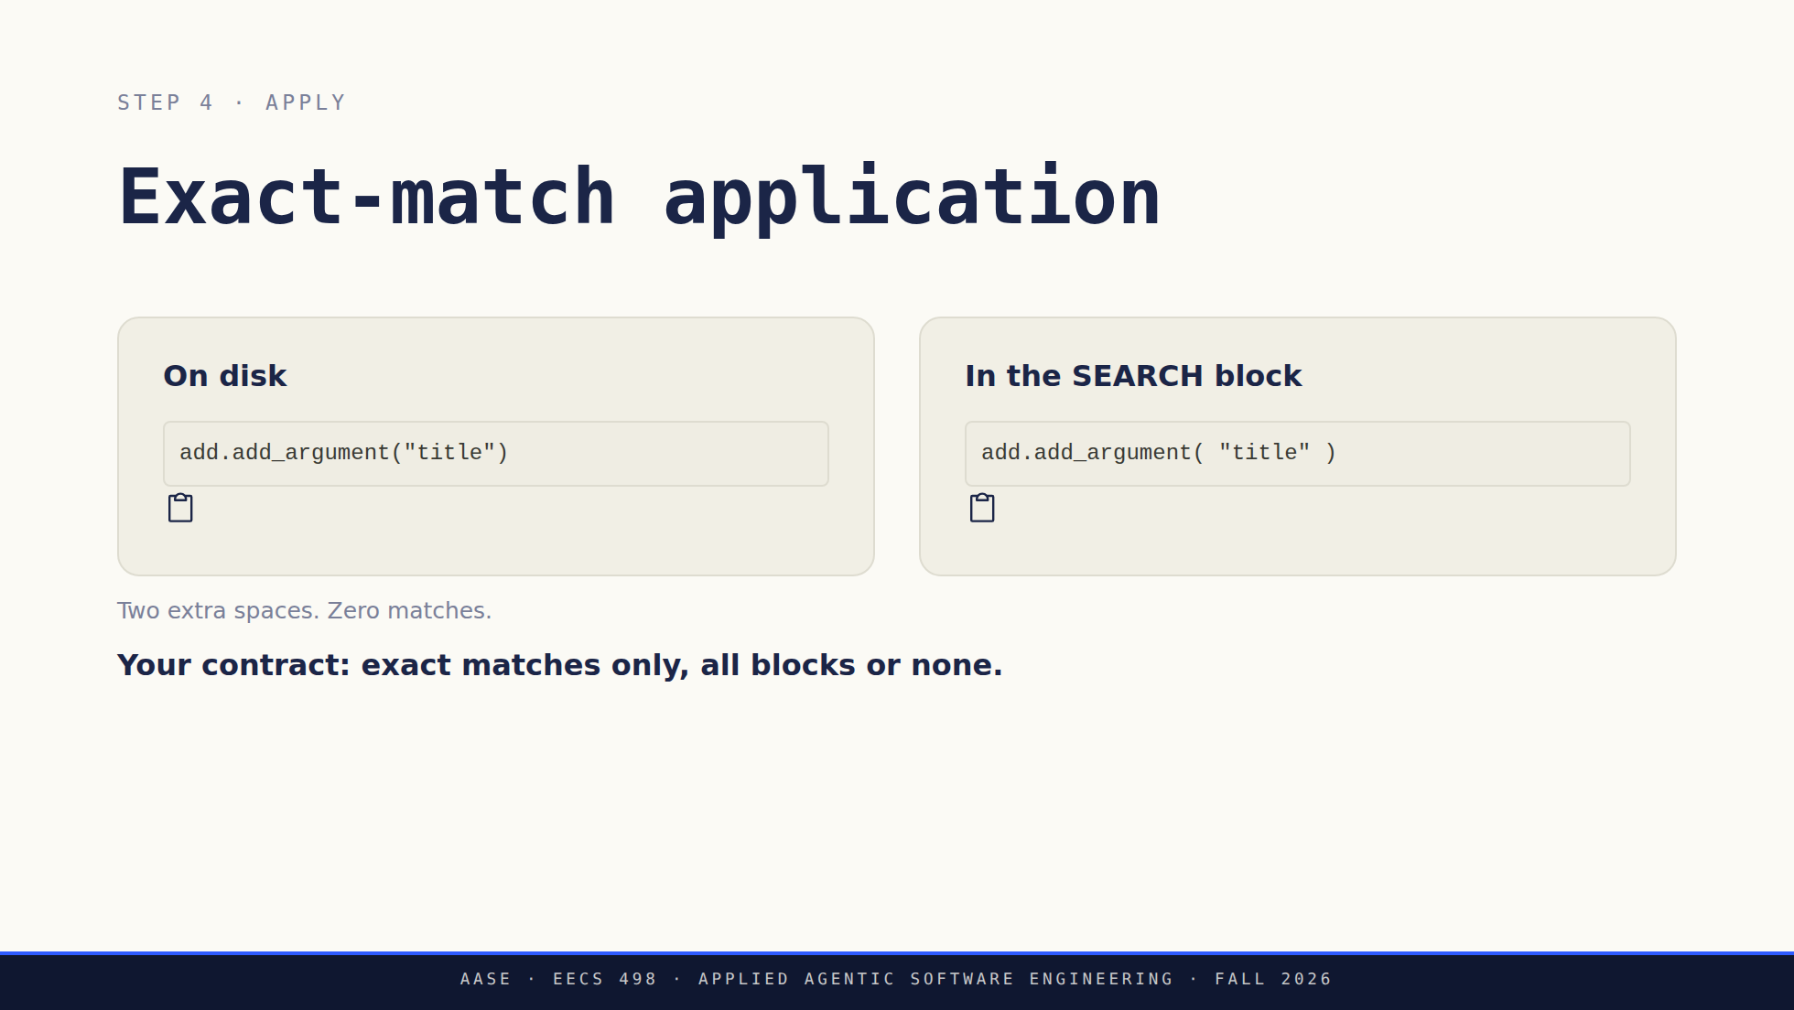
Notes:
Two spaces are enough to break a match. Show the difference before you name it. Partial application is not untestable, it is testable against a different contract. Do not tell them one policy is the only defensible one. The stricter rule is here because it makes the state after a failure trivial to state and to assert. Cut from the slide: Aider itself can fall back to looser matching and can keep the blocks that did apply. Their Stage 1 contract does neither, and that is the contrast worth drawing out loud.

Slide 16
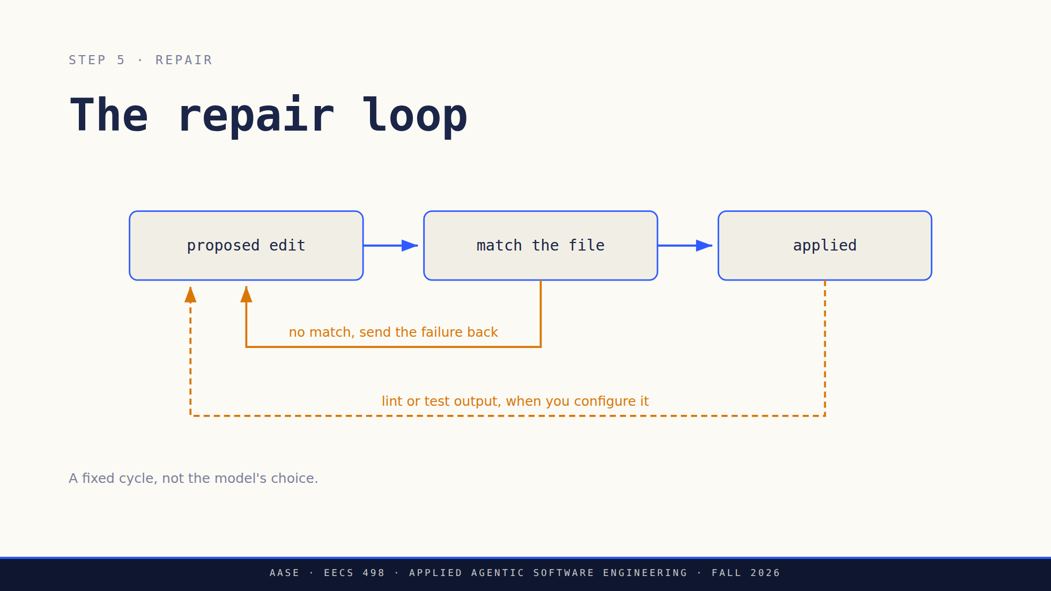
Notes:
Say clearly that Aider has real automation. It runs commands, it can run your tests, and it can loop on their output. Never say it cannot. The distinction that matters is who picks the next action. Here the harness has a fixed repair cycle. In the tools we look at after the break, the model picks. Source: https://aider.chat/docs/usage/lint-test.html

Slide 17
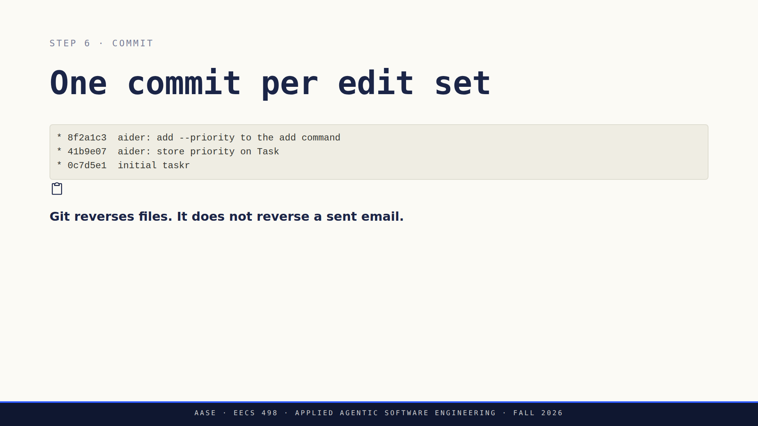
Notes:
Keep two kinds of commit apart: the ones Aider makes while they build, and the ones their assistant will make in a target repo. In Stage 1 the target is disposable and clean, so an owned HEAD commit can be undone safely. A human commit on top, or a dirty tree, means their tool has to refuse. Running shell commands arrives in the Analyze phase and brings consequences git cannot undo. Undo means resetting to the parent of a commit their own session created. It will not touch a commit someone else made, which is the guard in "guarded undo".

Slide 18
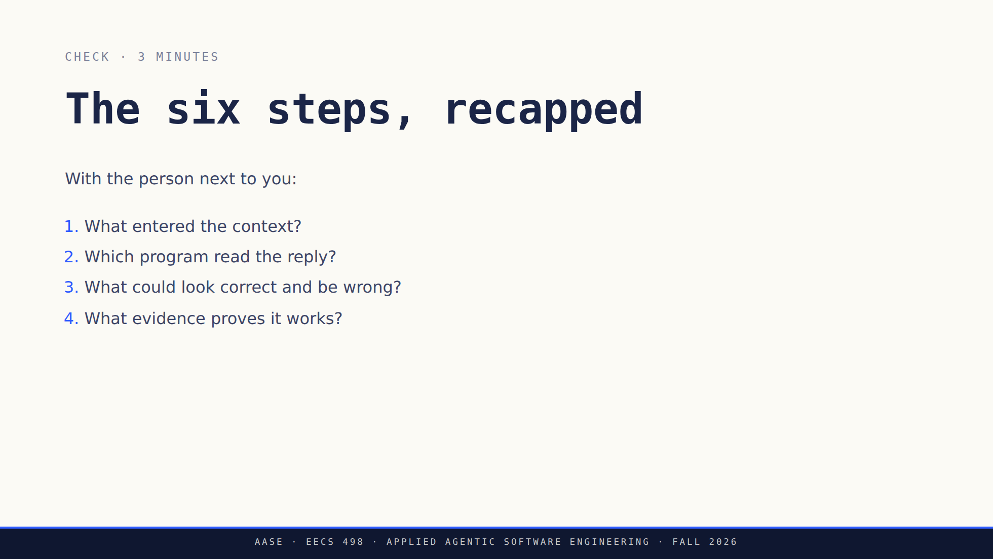
Notes:
Pairs for two minutes, then take two answers. You are listening for the missing storage write or the missing persistence test. Do not reward naming a source file inside aider.

Slide 19
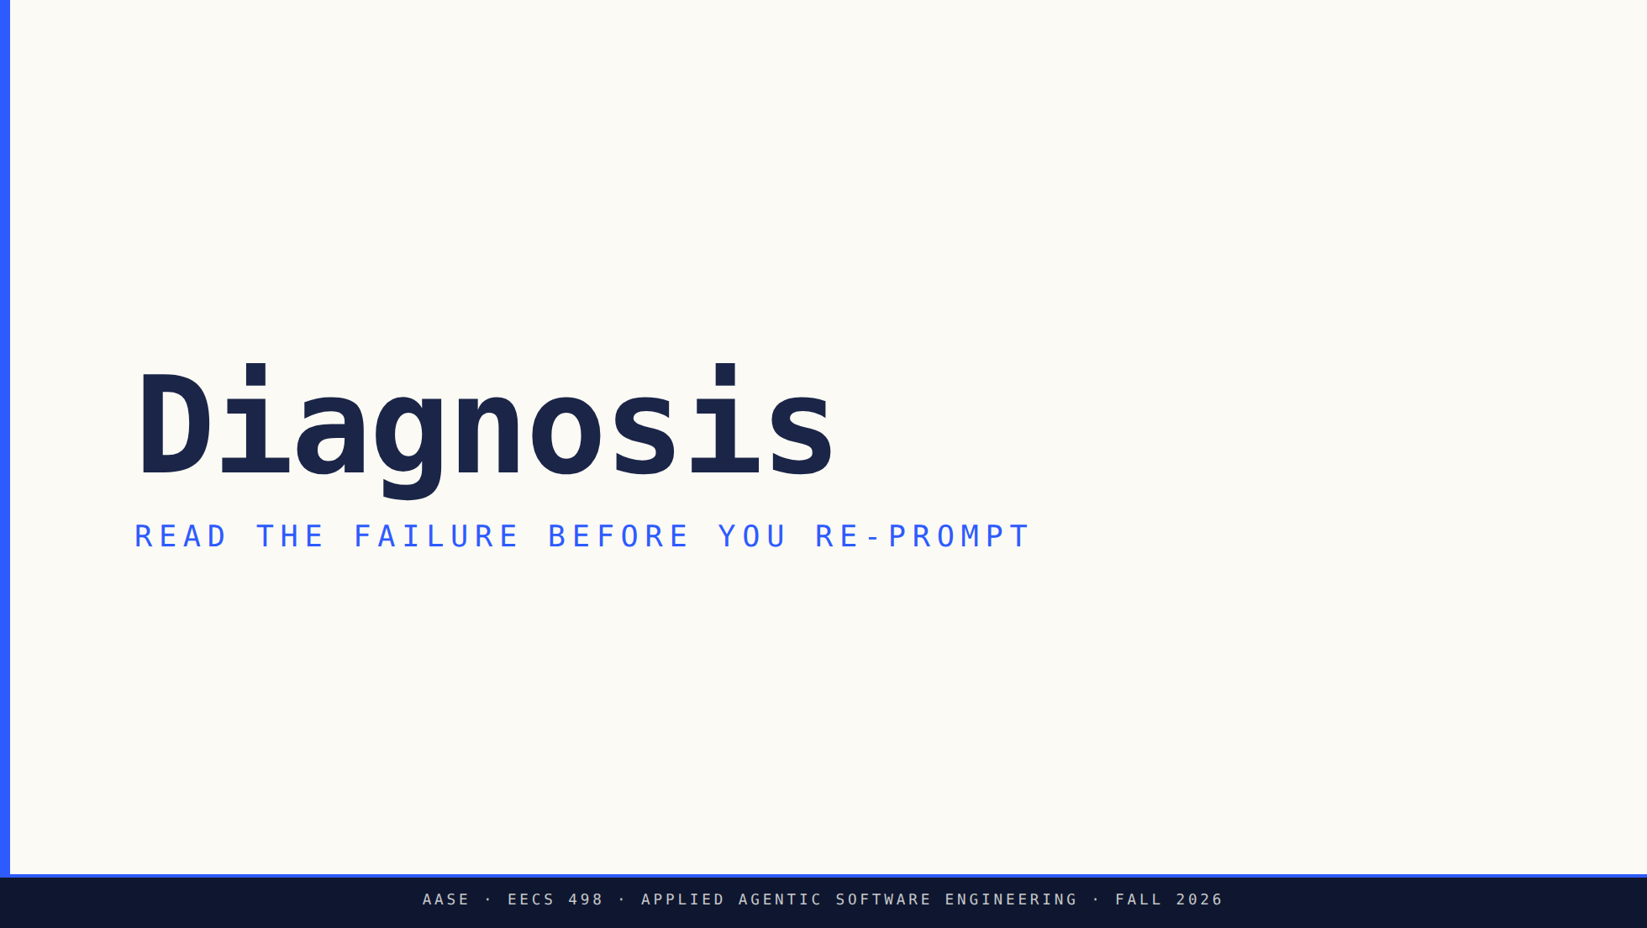
Notes:
Ten minutes. The habit to build: a symptom is evidence about which of the three levers is wrong, and re-running the same prompt tests nothing.

Slide 20
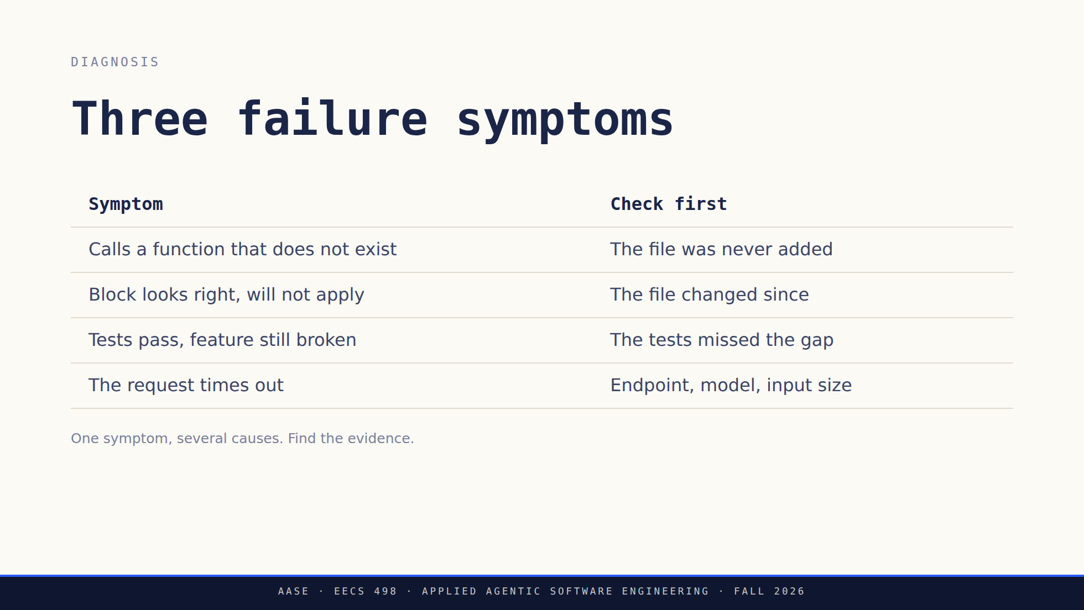
Notes:
Push back on "the model is too weak" every time it comes up today. Ask what observation would distinguish a weak model from a missing file, and make them answer before they change models.

Slide 21
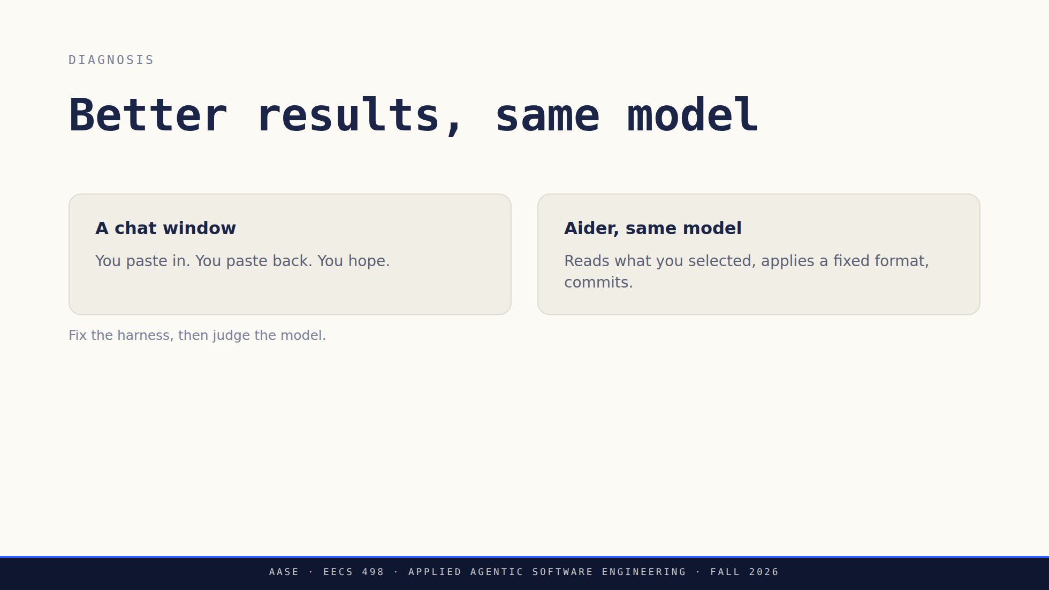
Notes:
Do not let this become "the model does not matter" or "every failure is context." Both halves are real. The point is that the harness is the half they are about to build, and it is the half they control.

Slide 22
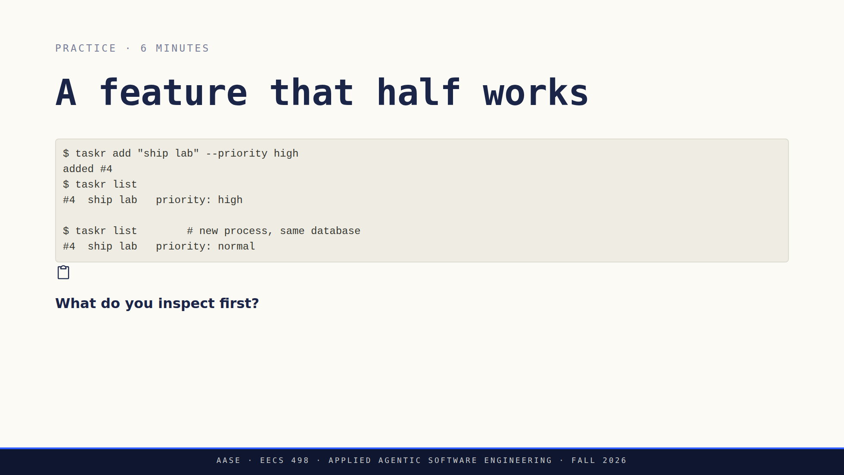
Notes:
Four minutes in pairs, two for answers. A persistence round trip is the answer you are hoping for: write it, restart, read it back. Watch for the two reflexes you want to break. Adding every file in the package is not diagnosis, and switching models is not diagnosis. The exercise, which is no longer written on the slide: write the acceptance criterion that was missing, and the test that would have caught it. Say it twice; it is the whole point of the six minutes.

Slide 23
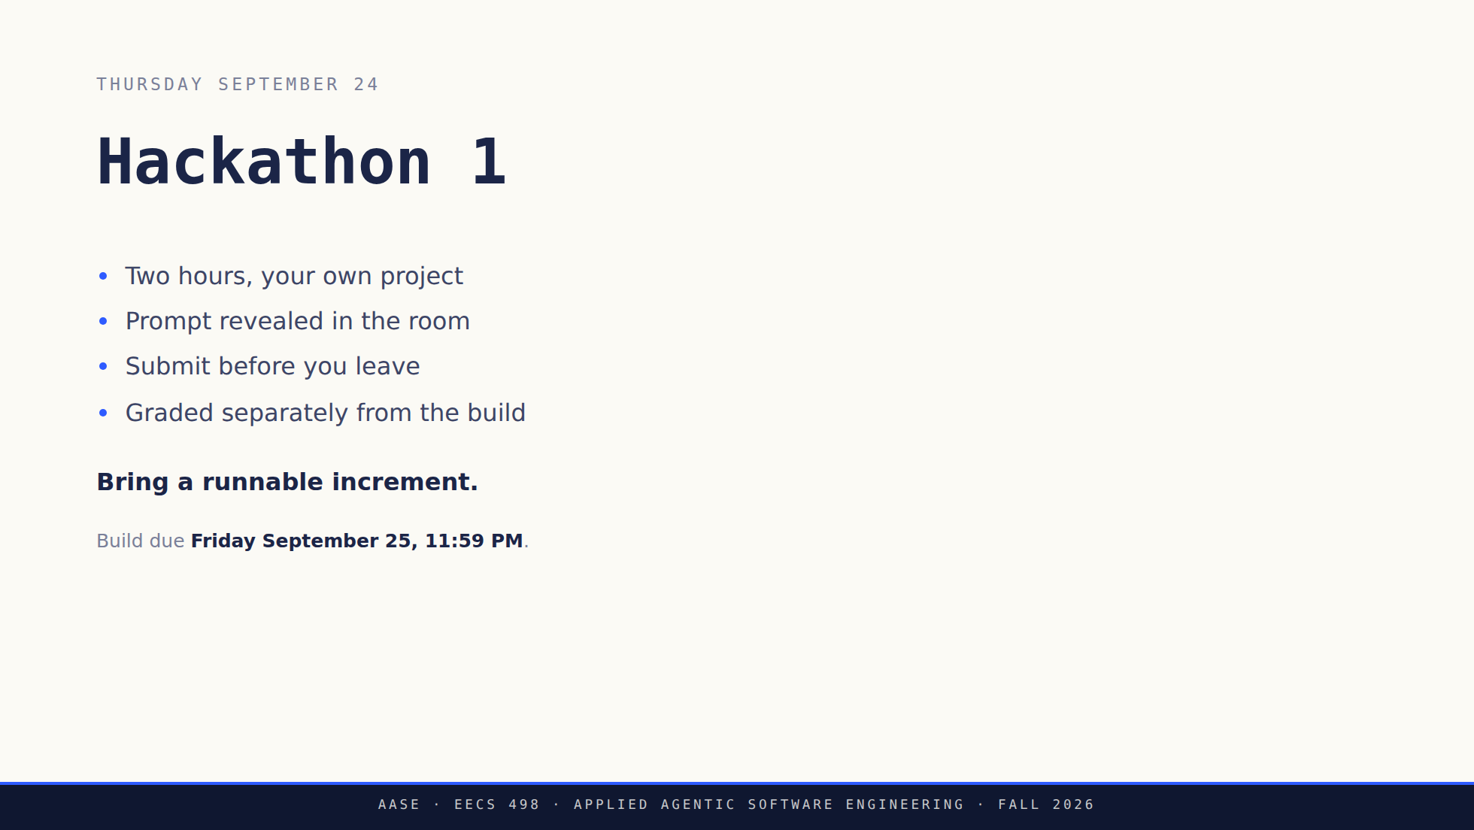
Notes:
Three minutes including logistics. Room, time and the model in the workspace are announced by staff. Do not invent any of them here. Say the accommodations line out loud: conflicts and accommodations go to staff now, not the week of. The caption is the only place in the deck a student sees the build deadline, now that the after-lab slide is gone. Do not skip past it.

Slide 24
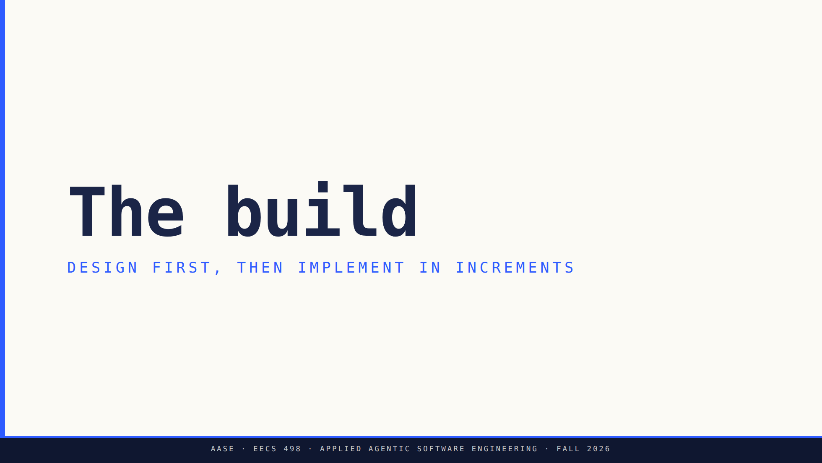
Notes:
Minute 40. Fifteen minutes. Everything here is also written down in their packet, so do not read the rubric aloud line by line.

Slide 25
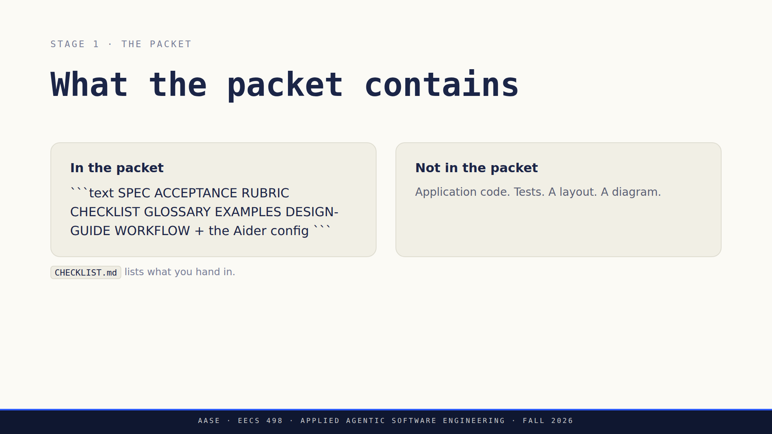
Notes:
This is the slide that answers the question every student is holding: no starter application and no supplied session module. Point at CHECKLIST.md by name and say it is the submission list, so nobody reconstructs one from these slides. GLOSSARY.md is where a word has a Stage 1 meaning that differs from its everyday one, and that meaning is the graded one. They implement the endpoint client in Stage 1 and extend it for function calling in Analyze. Say the division out loud, since the slide no longer carries it: they run `aider` to build the thing, and they write `bin/assistant` as the thing.

Slide 26
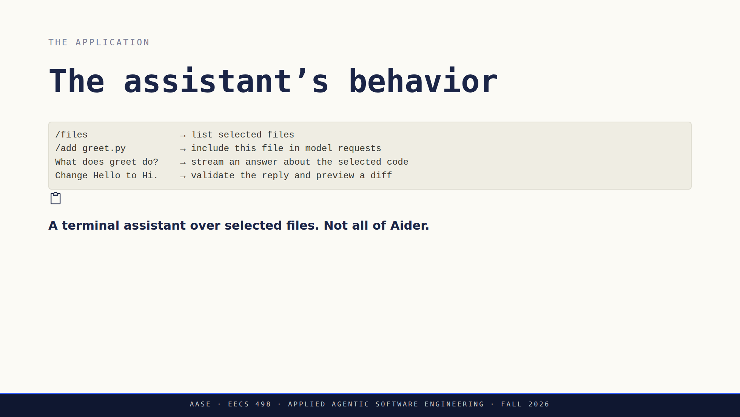
Notes:
Open EXAMPLES.md from the template and walk the four transcripts: a question, an approved edit, a cancellation, an undo. Say that these are the expected behavior, not a recording of a staff implementation. Ask what happens to the files and to HEAD at each point. That question starts their acceptance criteria, which is a better use of this block than a tour of the feature list.

Slide 27
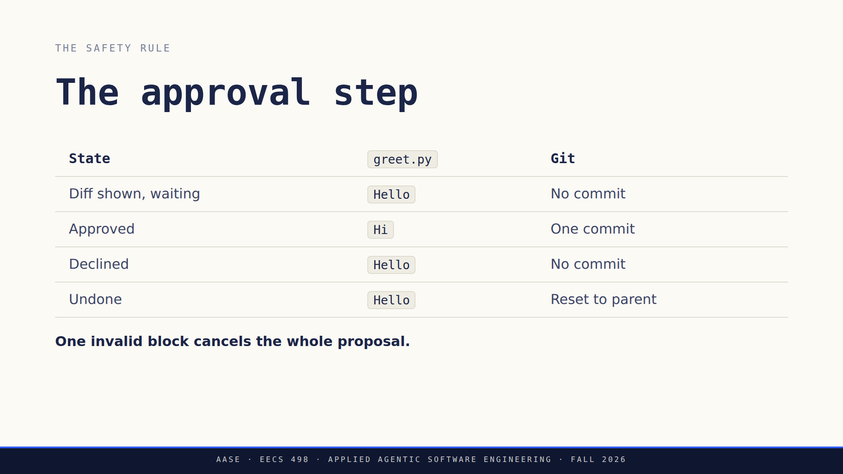
Notes:
Use the exact greeting files and replies from EXAMPLES.md so the table matches what they will read tonight. Undo assumes an owned, current-session HEAD and a clean target. A human commit on top, or uncommitted changes, means refuse. Ask them what they would assert in a test for each row.

Slide 28
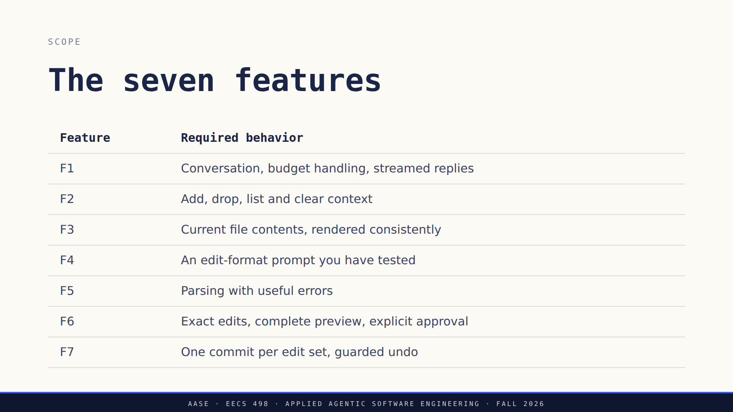
Notes:
Configuration and lifecycle are not a hidden eighth feature, and there is no scope cut this term. Where they score, from RUBRIC.md: configuration sits inside F1's four points and is not a gate, so unfinished configuration does not zero the rest of F1. The lifecycle commands score separately, under Operating instructions in the evidence group. Every edge case is in SPEC.md.

Slide 29
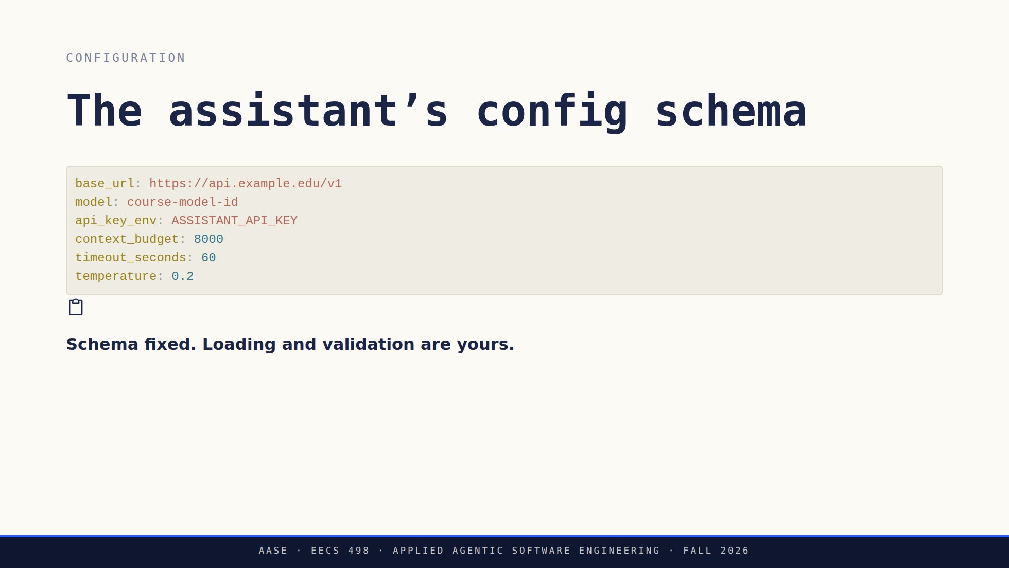
Notes:
base_url can carry any path prefix. Their client appends /chat/completions and nothing else. Say explicitly that this YAML is not the .aider.conf.yml they already have in aider-practice. Two files, two owners: that one configures the tool they use, this one is a schema their own program has to implement. The deck no longer walks through Aider's own config, so name the distinction out loud rather than assuming the contrast landed earlier in the hour. No Ollama-specific dependency belongs anywhere in the application. Provider independence is a requirement, not a preference.

Slide 30
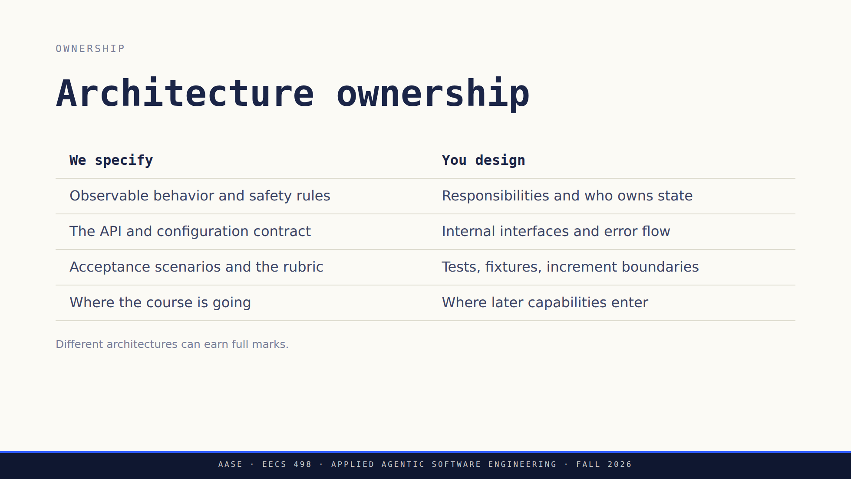
Notes:
The last line is the one to say out loud. A plugin framework in week 3, written for a capability they have not been given yet, is a cost with no evidence behind it. Future compatibility needs a reason.

Slide 31
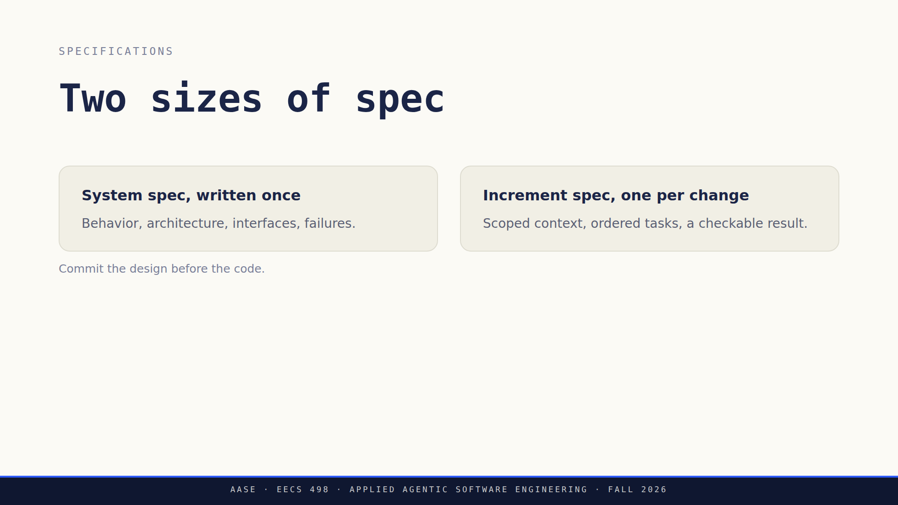
Notes:
A system spec is not one giant context dump. Requirements map to planned tests, and those test files do not have to exist yet. Experiments are allowed. Label them, and reconcile them with the design before you build on top of them.

Slide 32
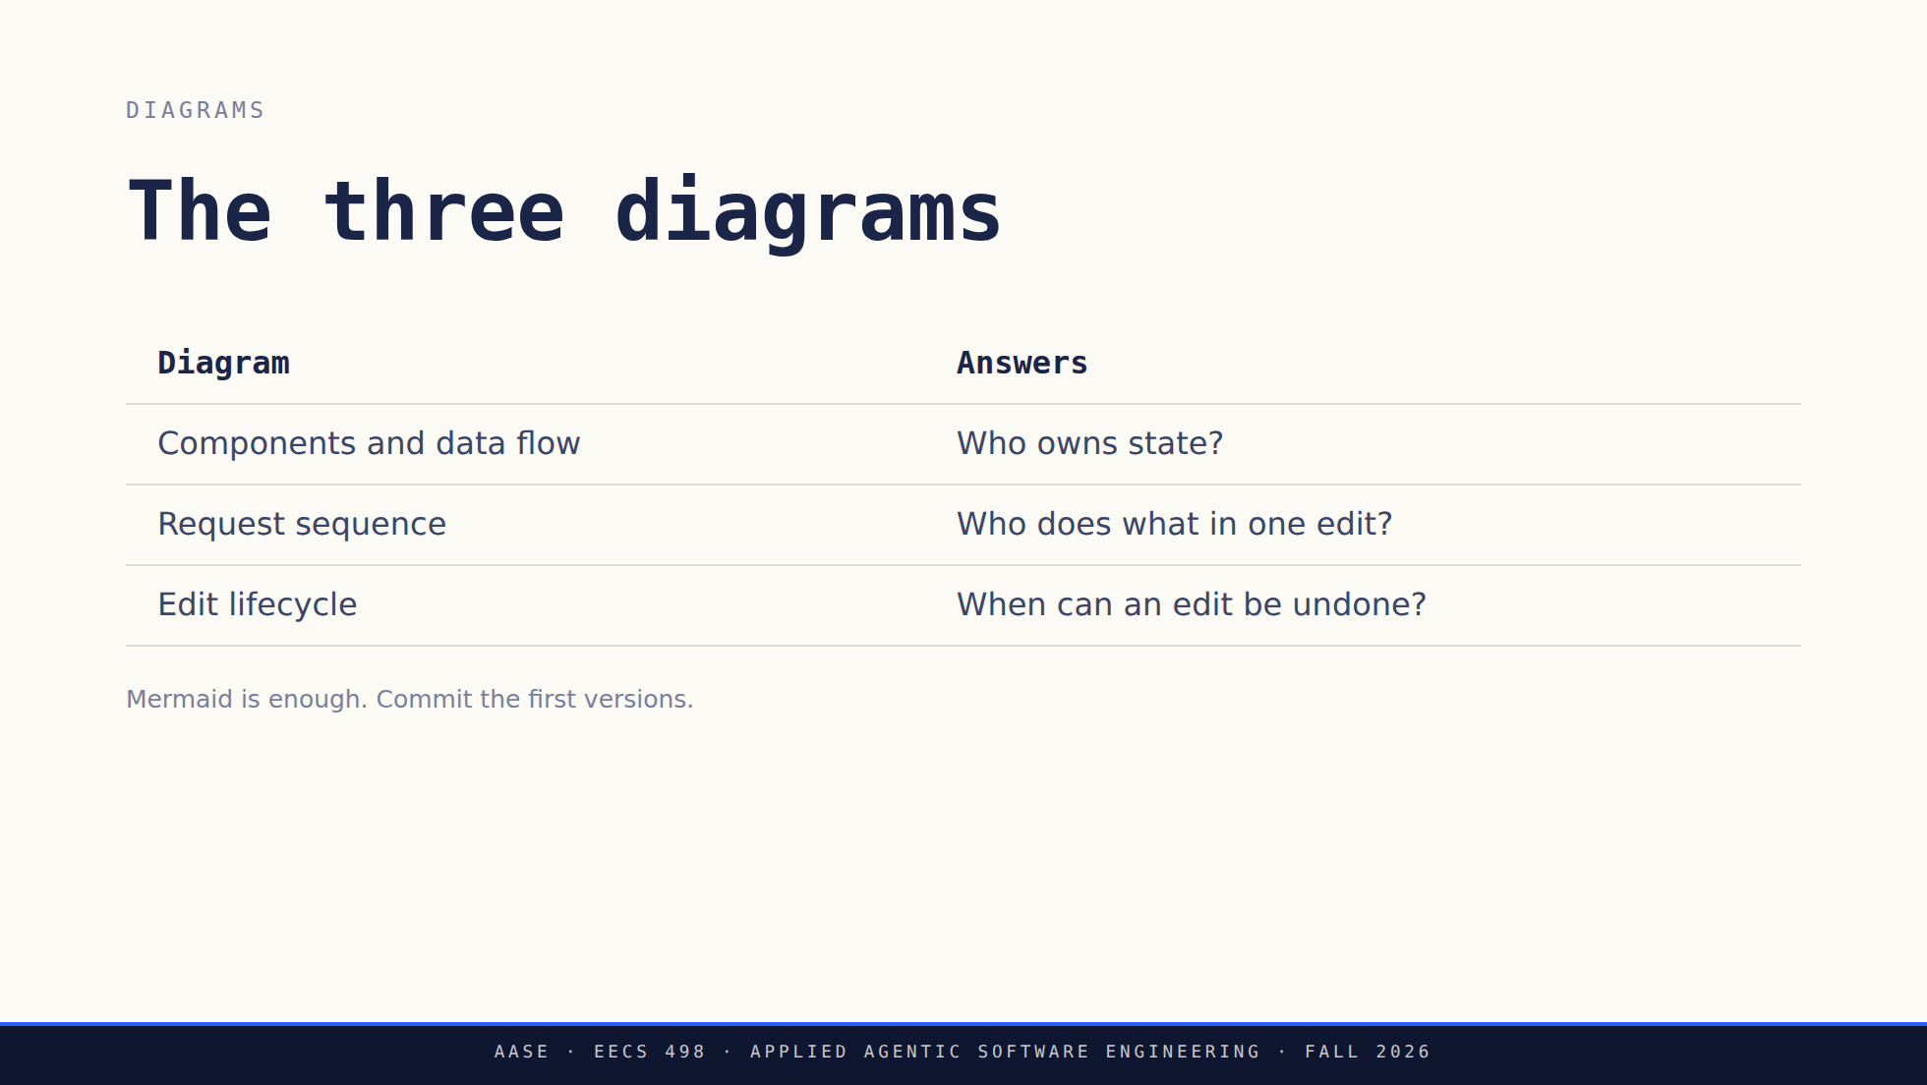
Notes:
Their diagrams describe their system. Copying the Aider picture from earlier today earns nothing. Label anything not yet implemented, and tie component names to real code once the code exists.

Slide 33
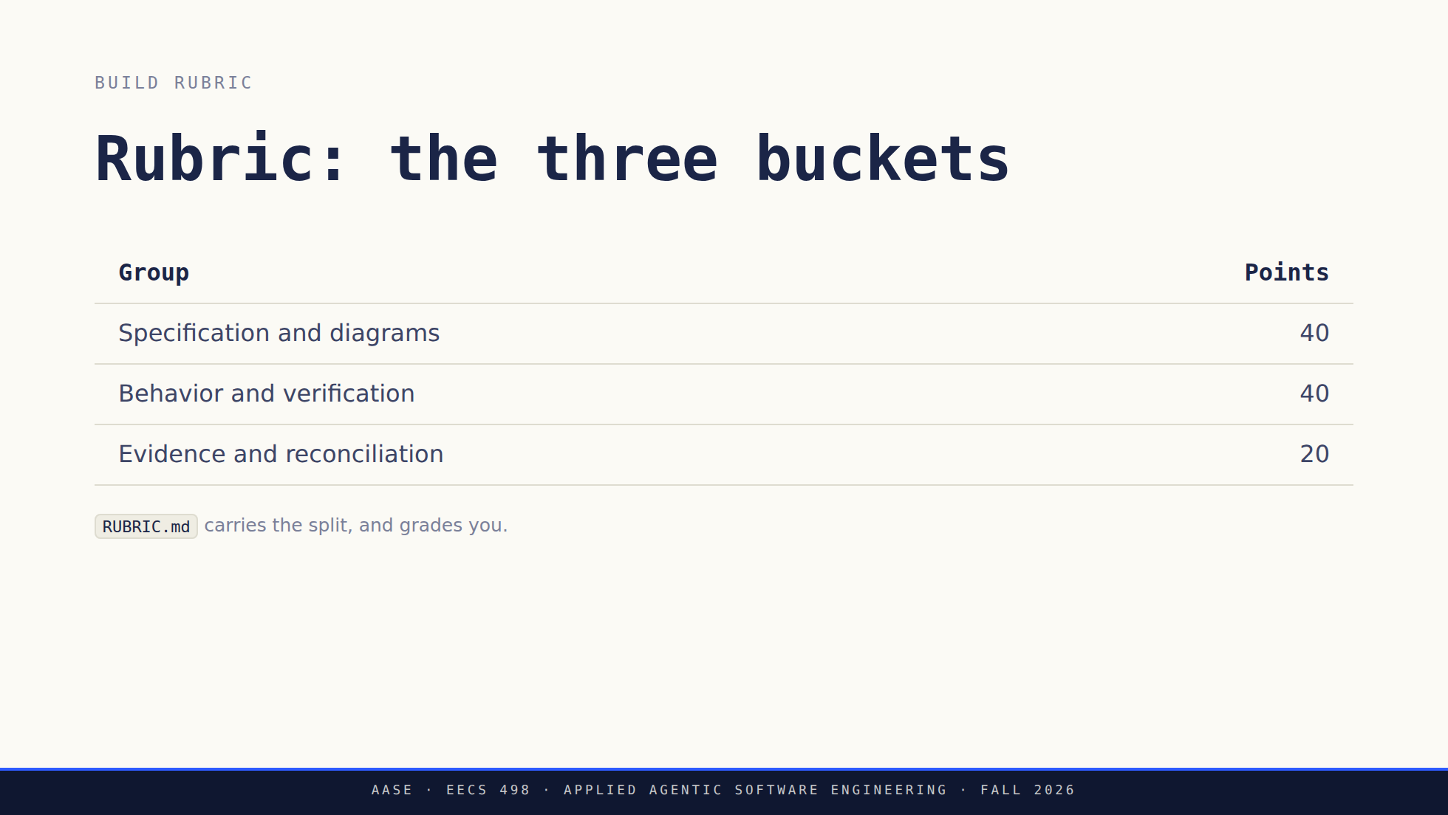
Notes:
These are points inside the build grade, not percentages of the course grade. The build is 4.5% of the course and is due September 25. Do not read the table out. Send them to RUBRIC.md, which carries the per-criterion breakdown this slide summarizes, and spend the time on the four things worth saying out loud instead: - Completeness and usefulness are graded. Document length is not. - A correct failing test can earn test credit while exposing an unfinished feature. Only one point in the whole rubric depends on the live model actually succeeding, and honest evidence of a failed run still earns the reporting points. - Design keeps its credit when the implementation falls short, as long as the design's claims and the final status are honest. No repeated deductions for one missing feature across otherwise sound artifacts. - Evidence means a pointer someone can follow. Volume of logs is not evidence. Policy violations go through academic integrity procedures, not the rubric.

Slide 34
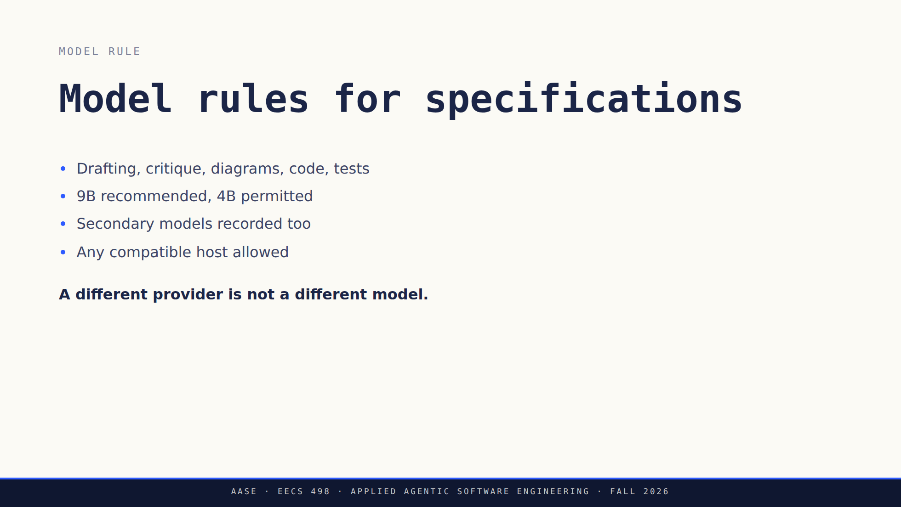
Notes:
Exact model IDs and the observed-session exception are in the assignment packet. Read them from there rather than from memory. The pattern being ruled out is a frontier model for the design followed by a local model for the code. Keep the sessions, disclose real aliases and any quantization you know about.

Slide 35
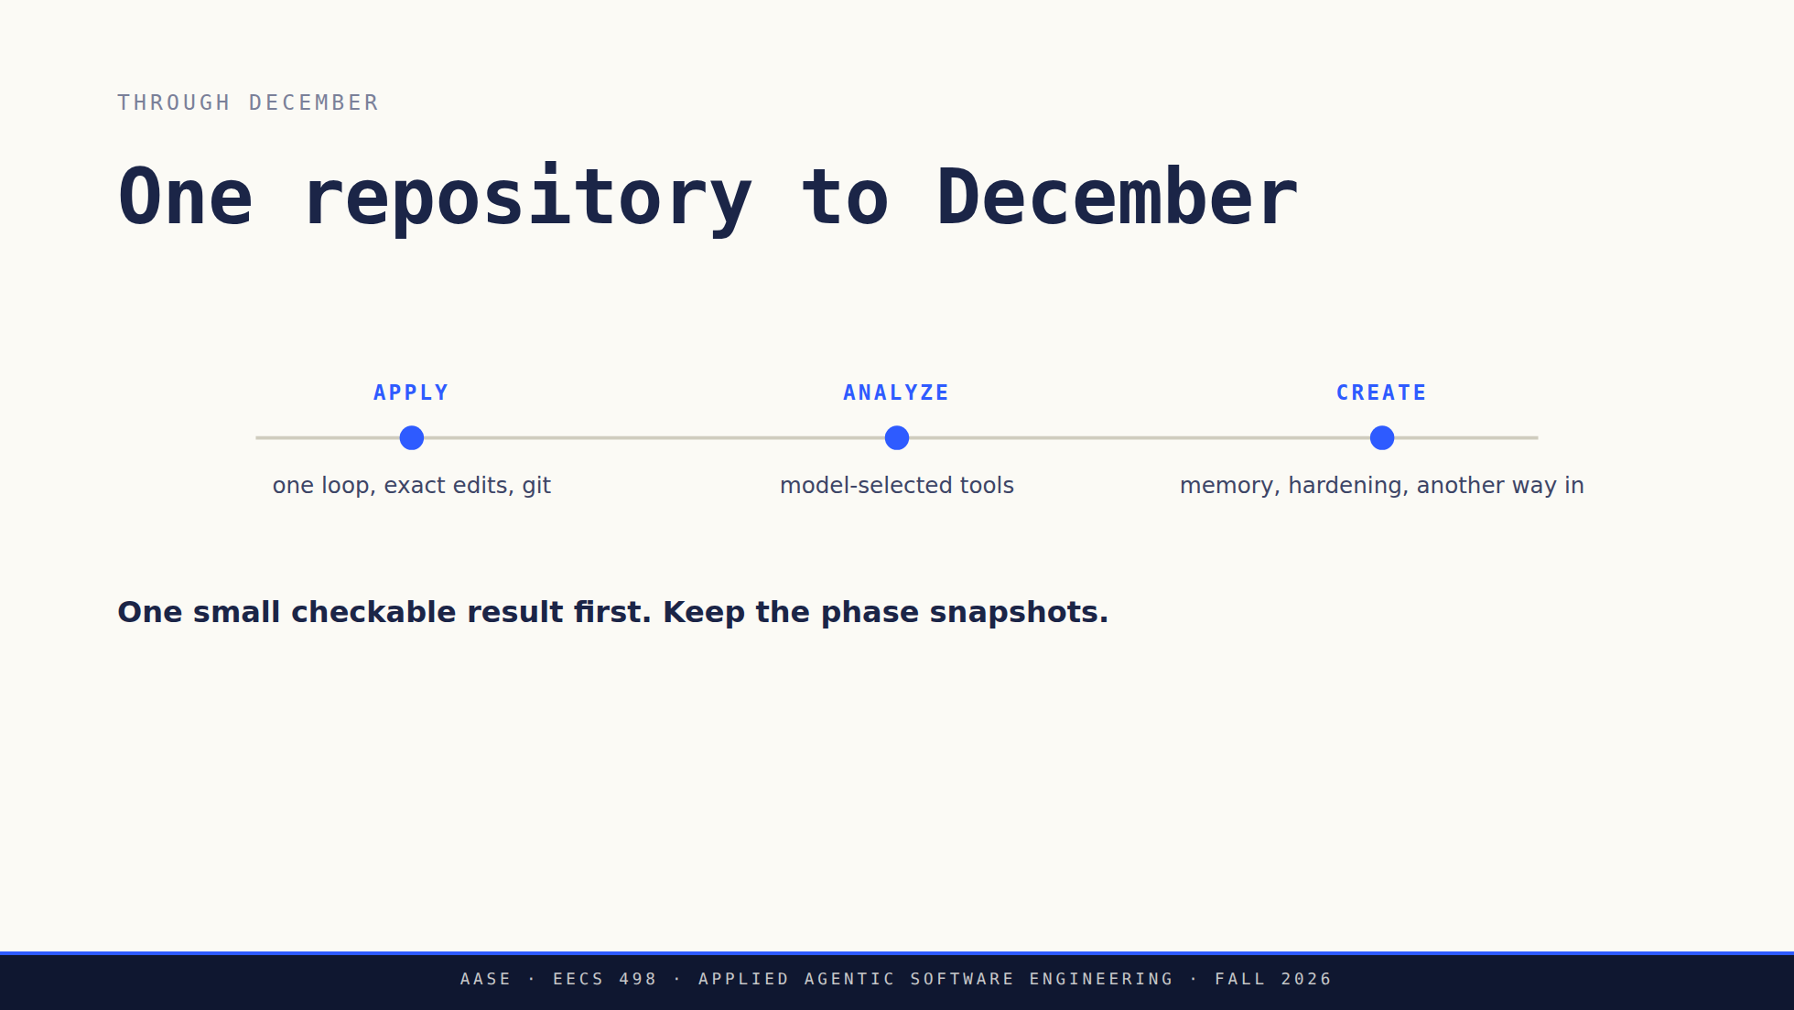
Notes:
Close the project block here. Build due September 25, hackathon September 24. Do not estimate the workload out loud. Do say that a runnable slice early is what keeps the December integration from being a surprise.

Slide 36
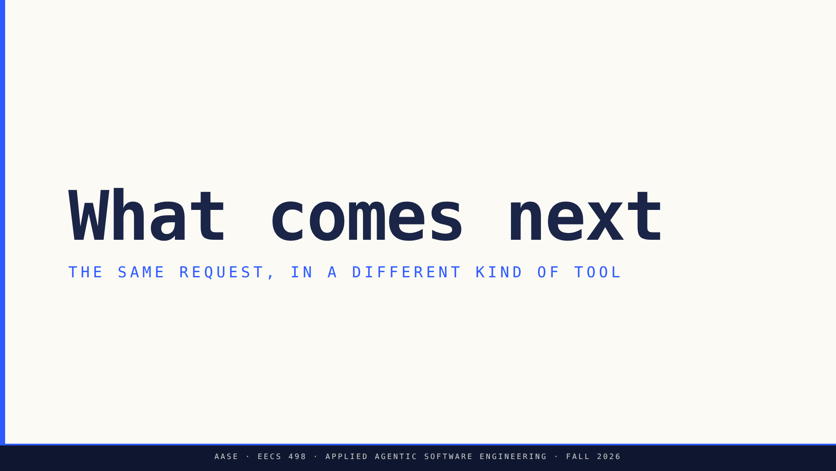
Notes:
Minutes 55 to 65. This is a mechanism comparison, not a product tour and not a recommendation. Nothing here is a Stage 1 dependency and no subscription is needed for this course.

Slide 37
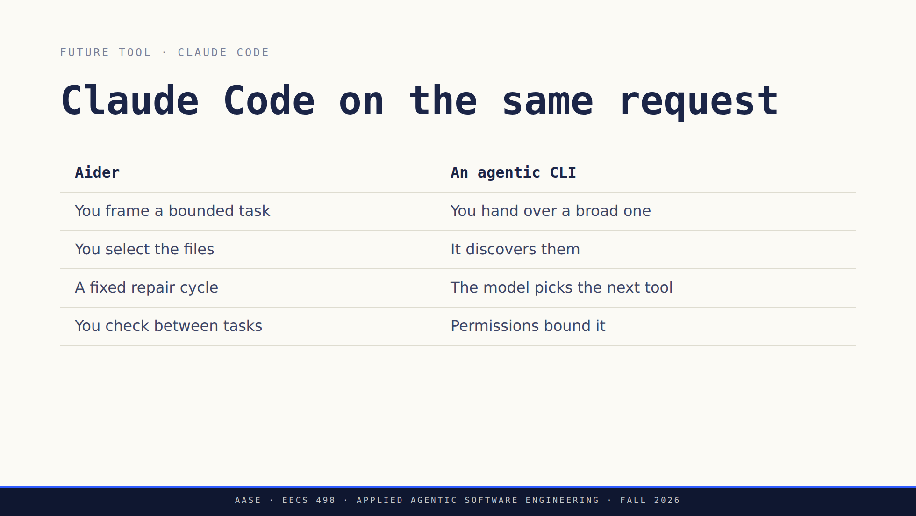
Notes:
Do not turn the left column into a weakness. Aider automates plenty. What changes on the right is who decides the next action. Source: https://code.claude.com/docs/en/overview

Slide 38
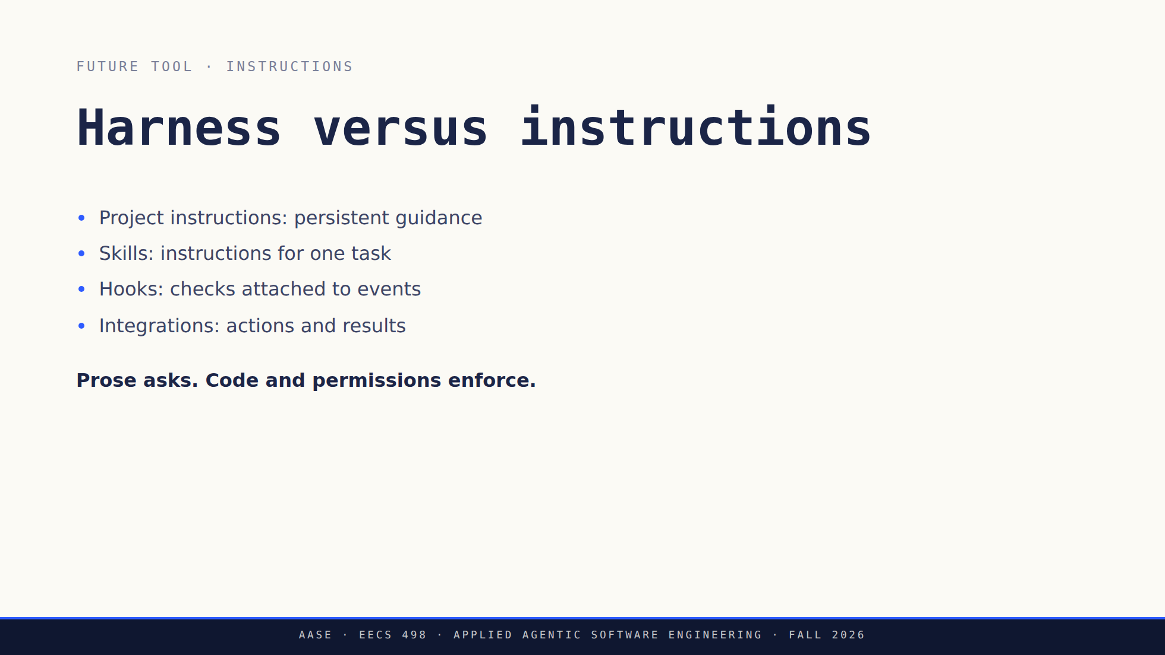
Notes:
Stay at mechanism level and do not promise a week for each branded feature. Their DEVELOPMENT.md is the first version of this habit: instructions written for a session that has not happened yet.

Slide 39
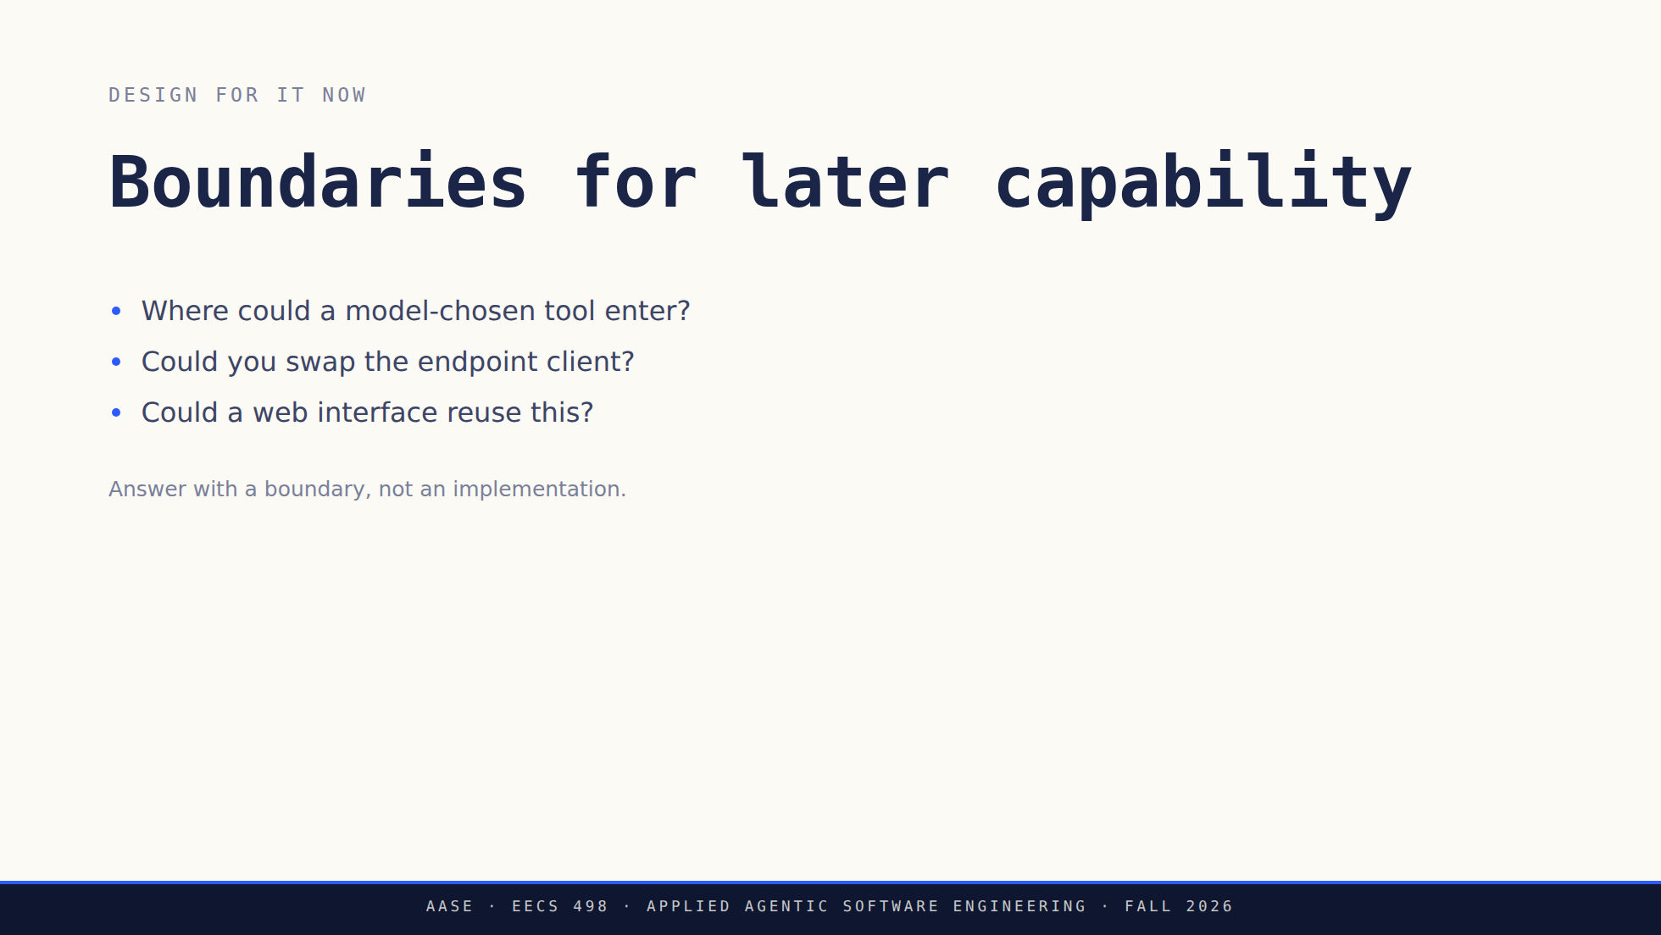
Notes:
End the comparison here, at minute 65. Nothing after this slide is yours to talk through.

Slide 40

Notes:
Stop talking. Staff circulate from here. Leave the deck up so students can page back through it themselves. This is the point where you say plainly that nothing is due at the end of today. Most of them will still expect a checkoff.

Slide 41


