Slide 1
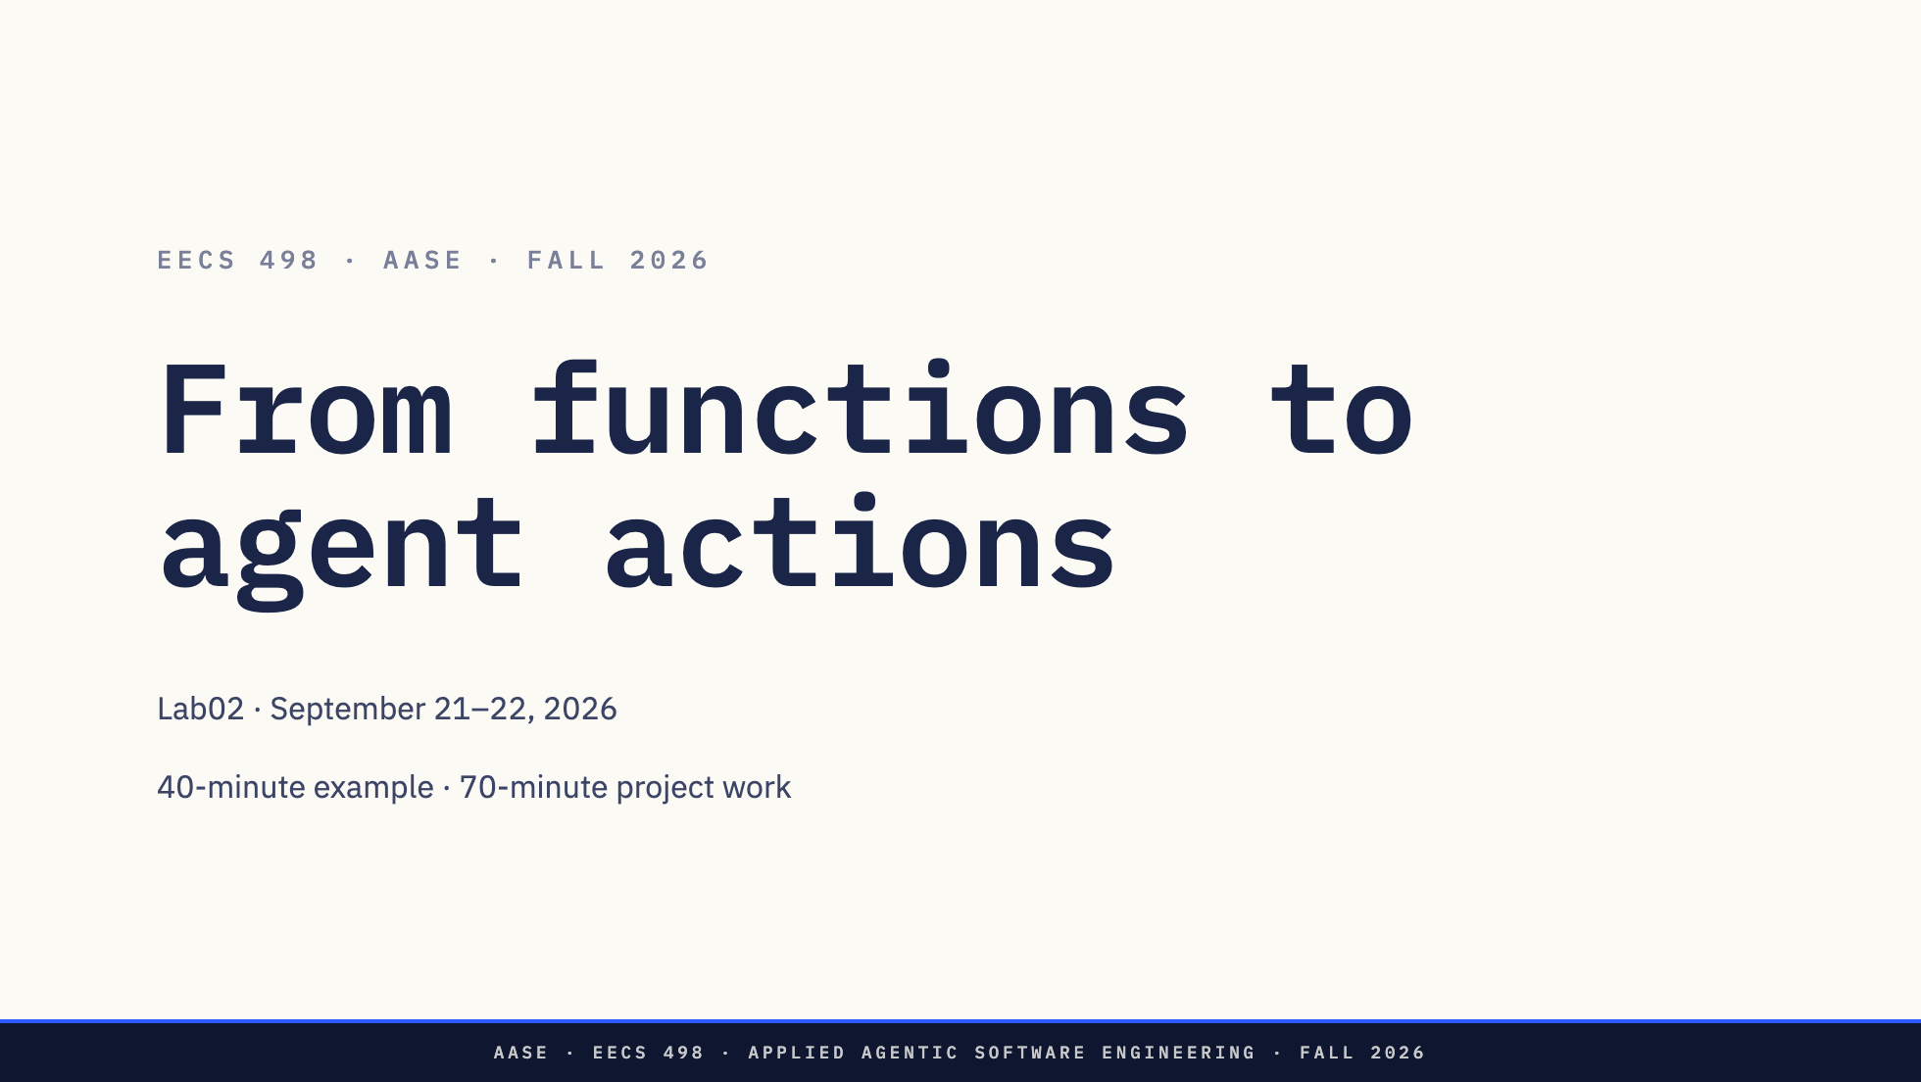
Notes:
Introduce the stockroom example. This is guided design and one implementation increment, not a full build from scratch. No lab deliverable.

Slide 2
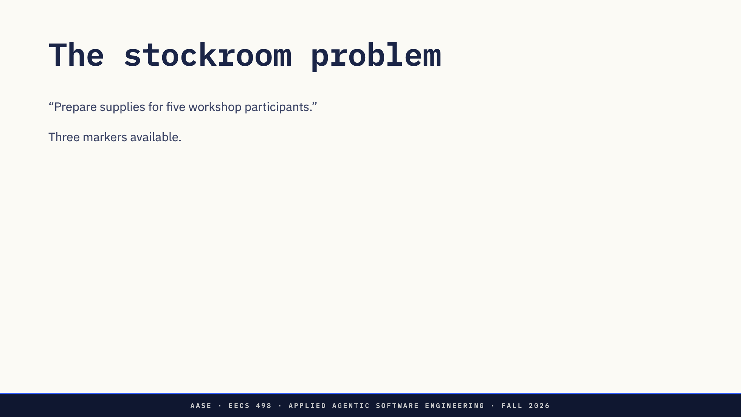
Notes:
Minutes 0–5. Open the ordinary inventory functions. Storage and quantity checks already work. The user has not told us whether sharing is acceptable. Do not reveal the real hackathon domain.

Slide 3
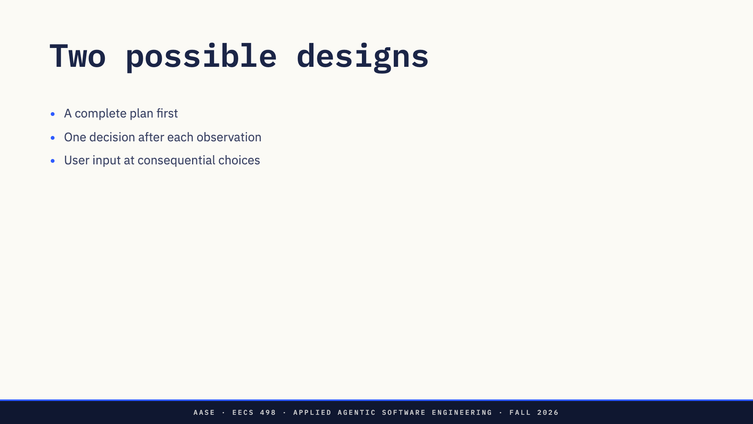
Notes:
Minutes 5–9. Compare both approaches. A plan-first system can also continue after observations; it is not inherently wrong. Ask students which information would change a decision. More calls are not evidence of a better design.

Slide 4
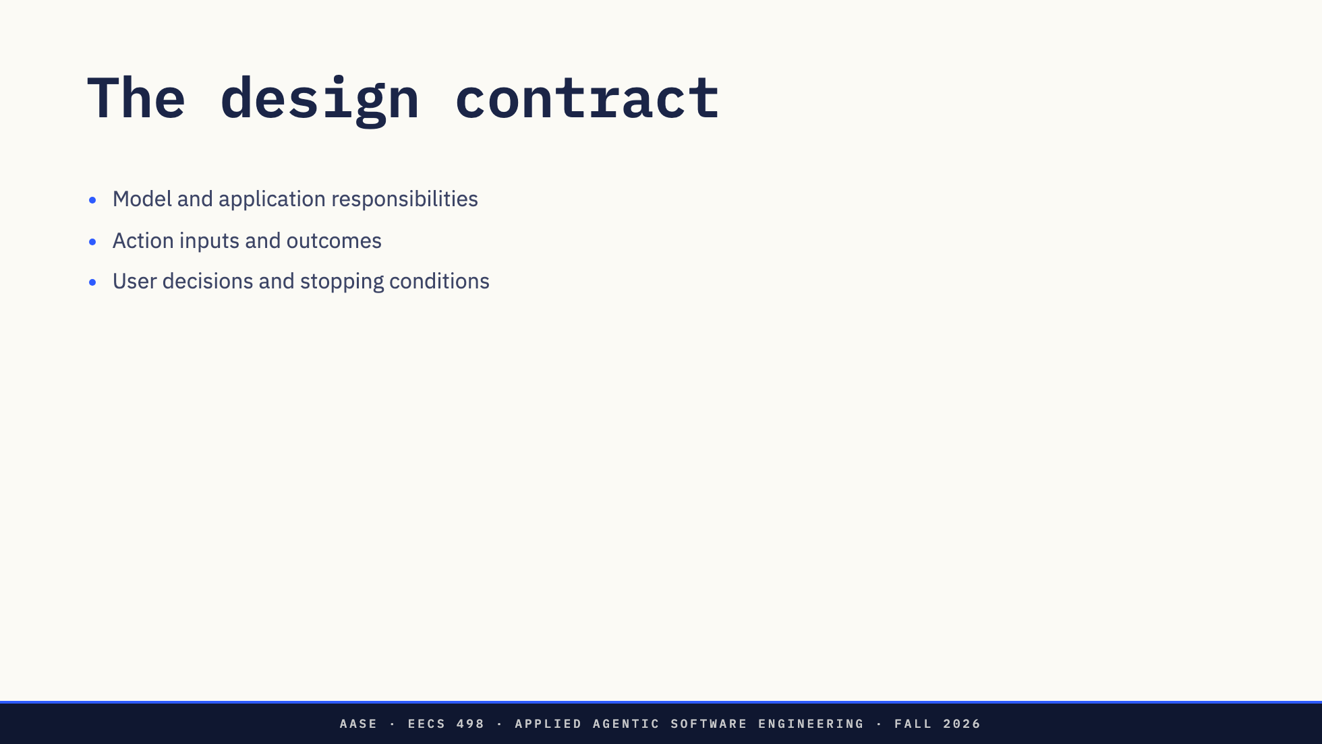
Notes:
Minutes 9–13. Open design/SYSTEM.md and FLOW.md. Point to a rejected alternative. The example owns its boundaries; students will choose theirs in the assessment. The reset history is supplied example history, not evidence of a student design process.

Slide 5
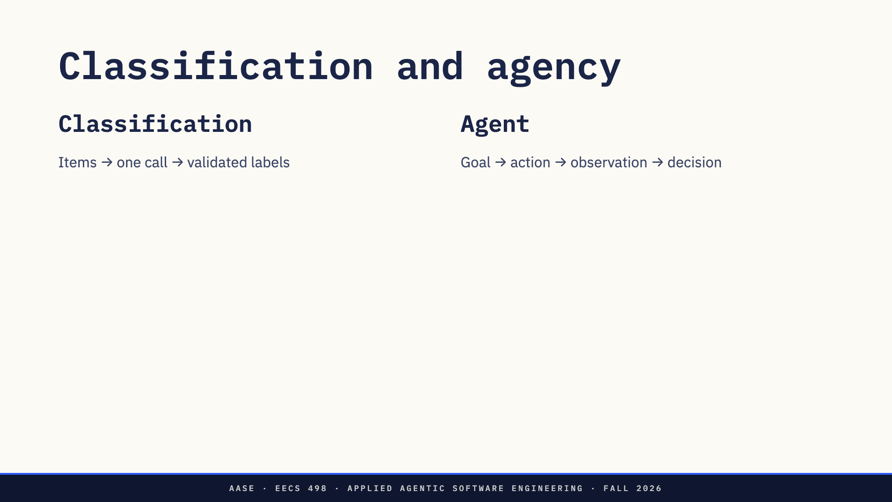
Notes:
Minutes 13–15. Open categorize. It performs one bounded prompt and ordinary validation. The model does not choose the next operation. In the agent, the next operation depends on observations.

Slide 6
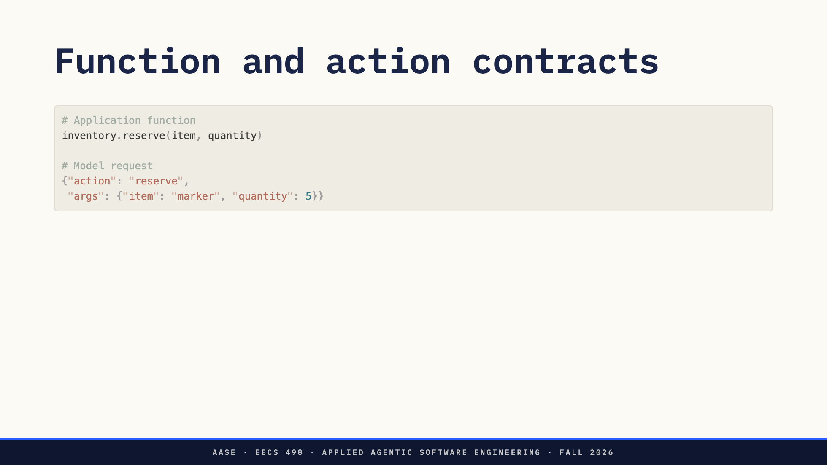
Notes:
Minutes 15–18. Description and argument contract make a capability visible; validation and dispatch actually invoke it. Open dispatch. This example uses text JSON; native function calling is another valid protocol. The model does not execute Python.

Slide 7
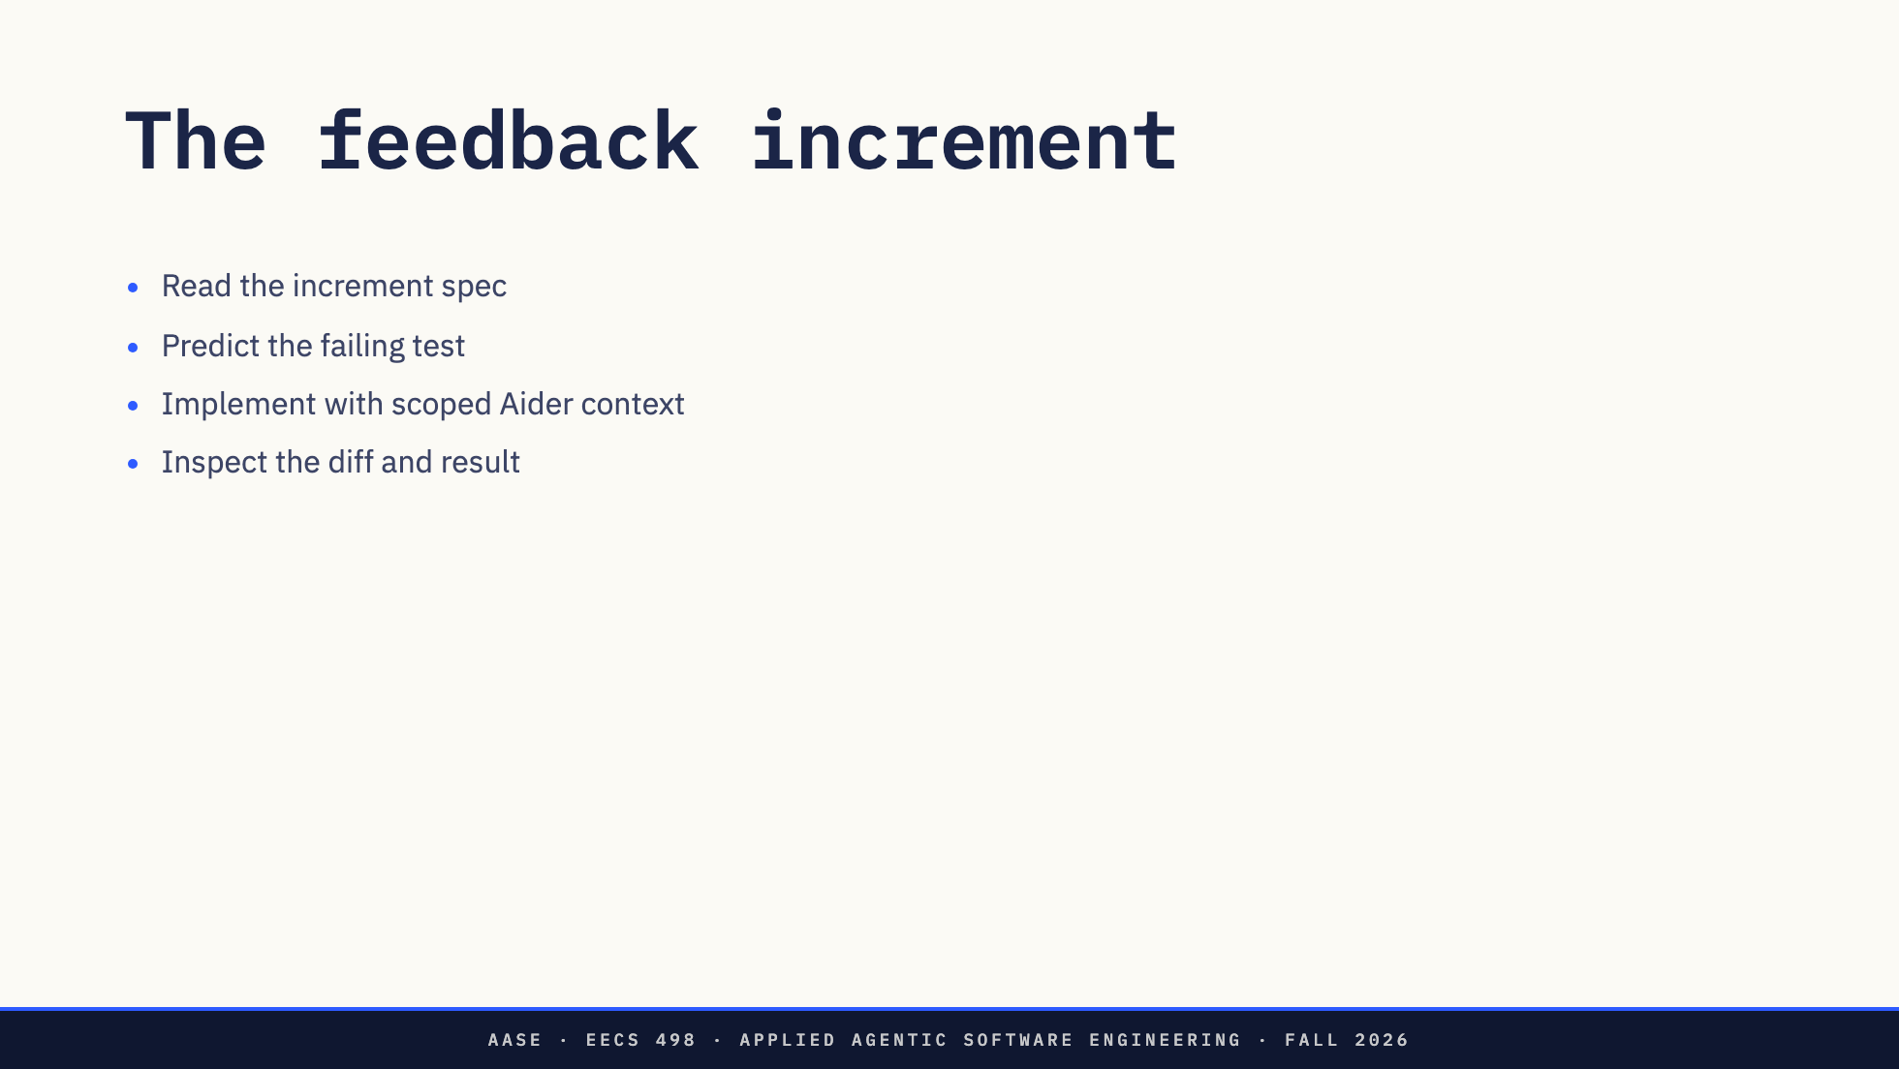
Notes:
Minutes 18–30. Open the exercise. The missing observation causes two tests to fail. Commit the increment specification before implementation. Keep the model context small. If live editing stalls, compare the worked solution and preserve the timebox.

Slide 8
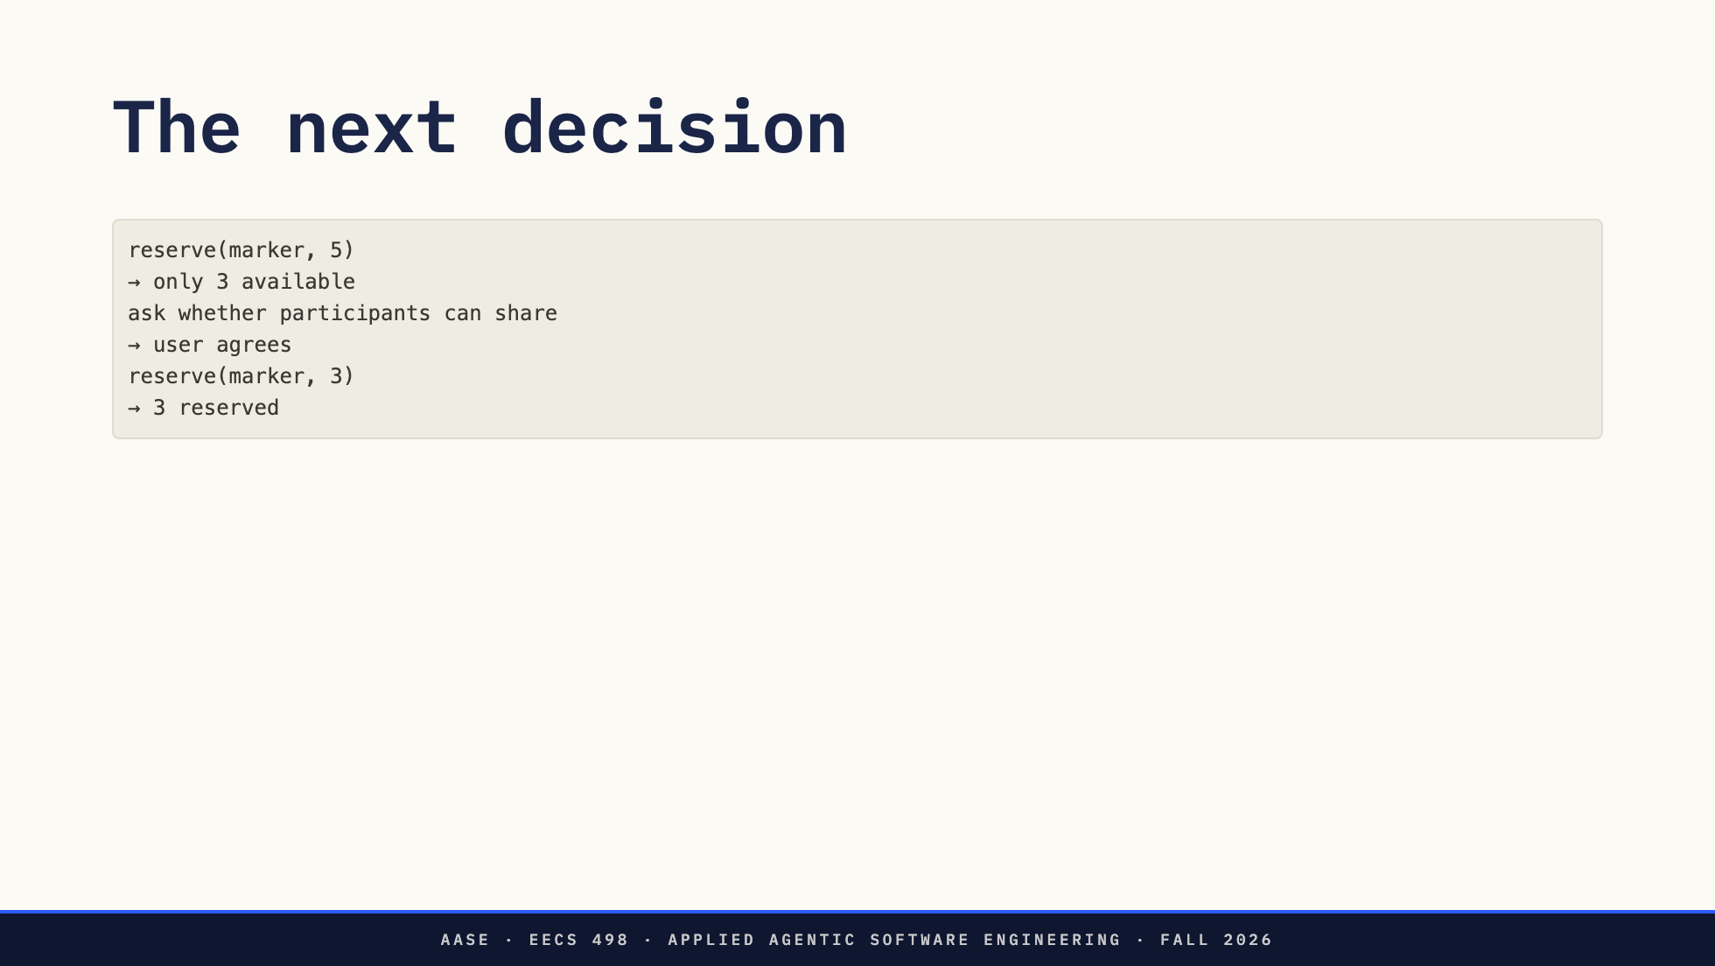
Notes:
Minutes 30–33. Use the rehearsed live example or the scripted fallback. Label the fallback prominently: these are test responses, not evidence of a live model solve. The failed action must enter the next request automatically.

Slide 9
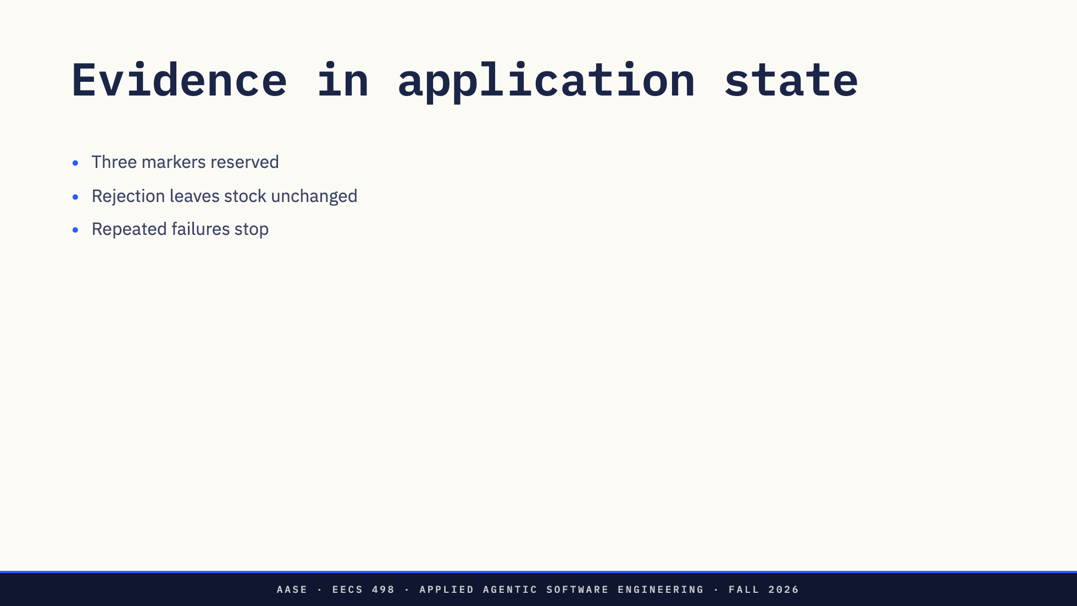
Notes:
Minutes 33–36. Inspect inventory.json and the tests. A confident final sentence does not establish a reservation. Ask whether approval should happen before or after checking availability. This is a design question, not merely more defensive code.

Slide 10
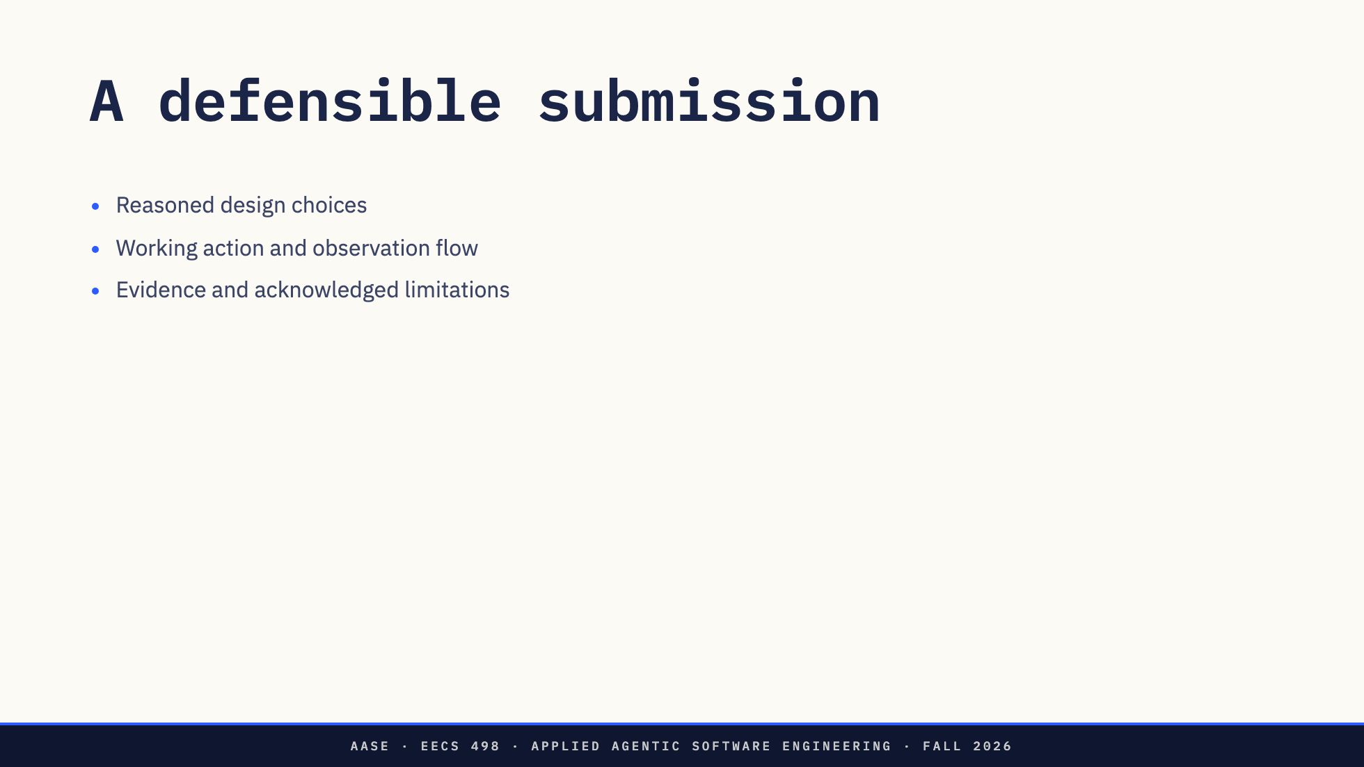
Notes:
Minutes 36–40. Open REFLECTION.md. Explain that design quality and meaningful behavior matter more than counts of tools, calls or agents. The sample honestly names model-authored final reports and approval timing as limitations. The actual prompt is revealed at the event.

Slide 11
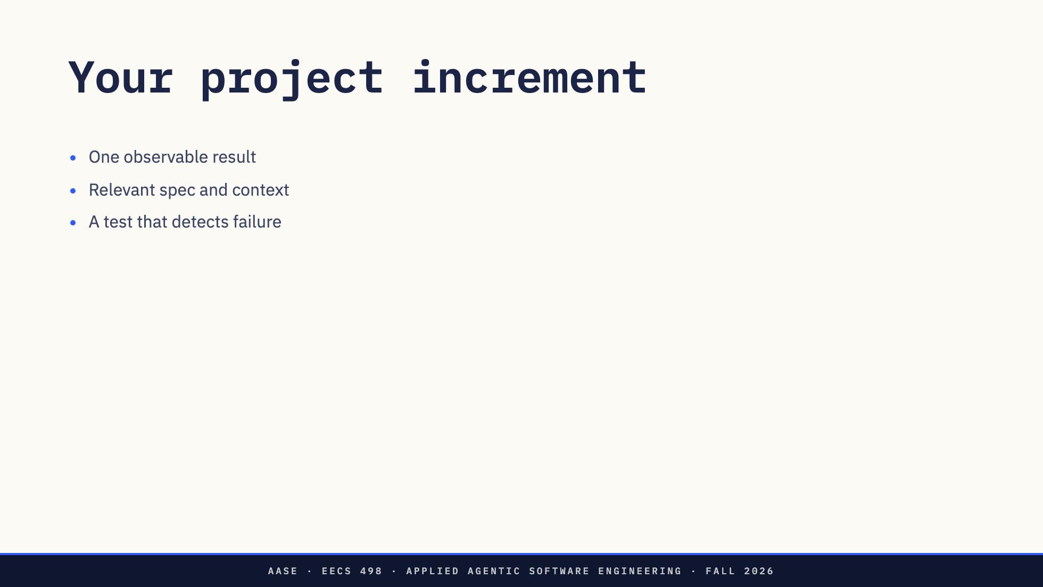
Notes:
Minutes 40–100. Ten minutes to choose the next ai-assistant increment, then fifty to build and verify. Staff circulate. The assistant build remains due October 6. The hackathon uses a supplied application, so no completed homework application is required that evening.

Slide 12
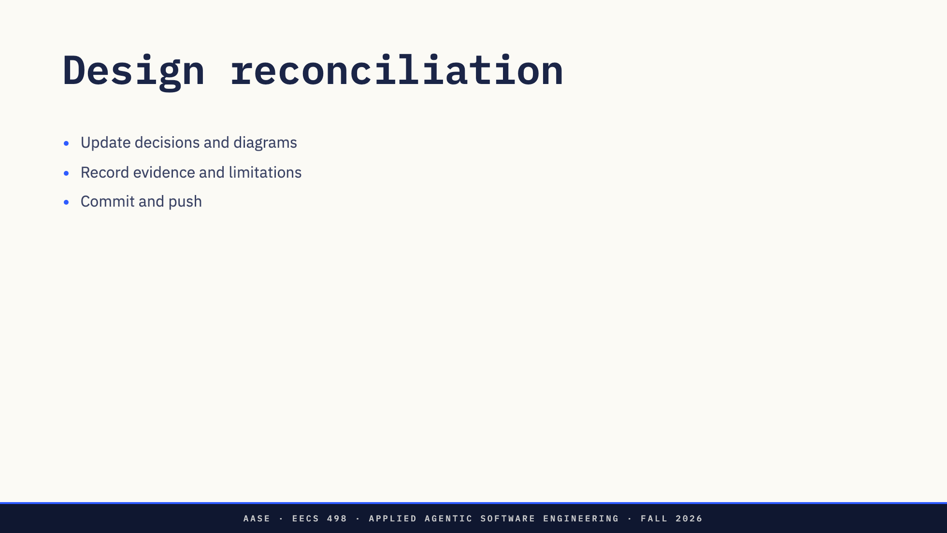
Notes:
Minutes 100–110. Preserve the supported-work close. No separate lab submission. Check the course announcement for hackathon logistics and model availability.

