Slide 1
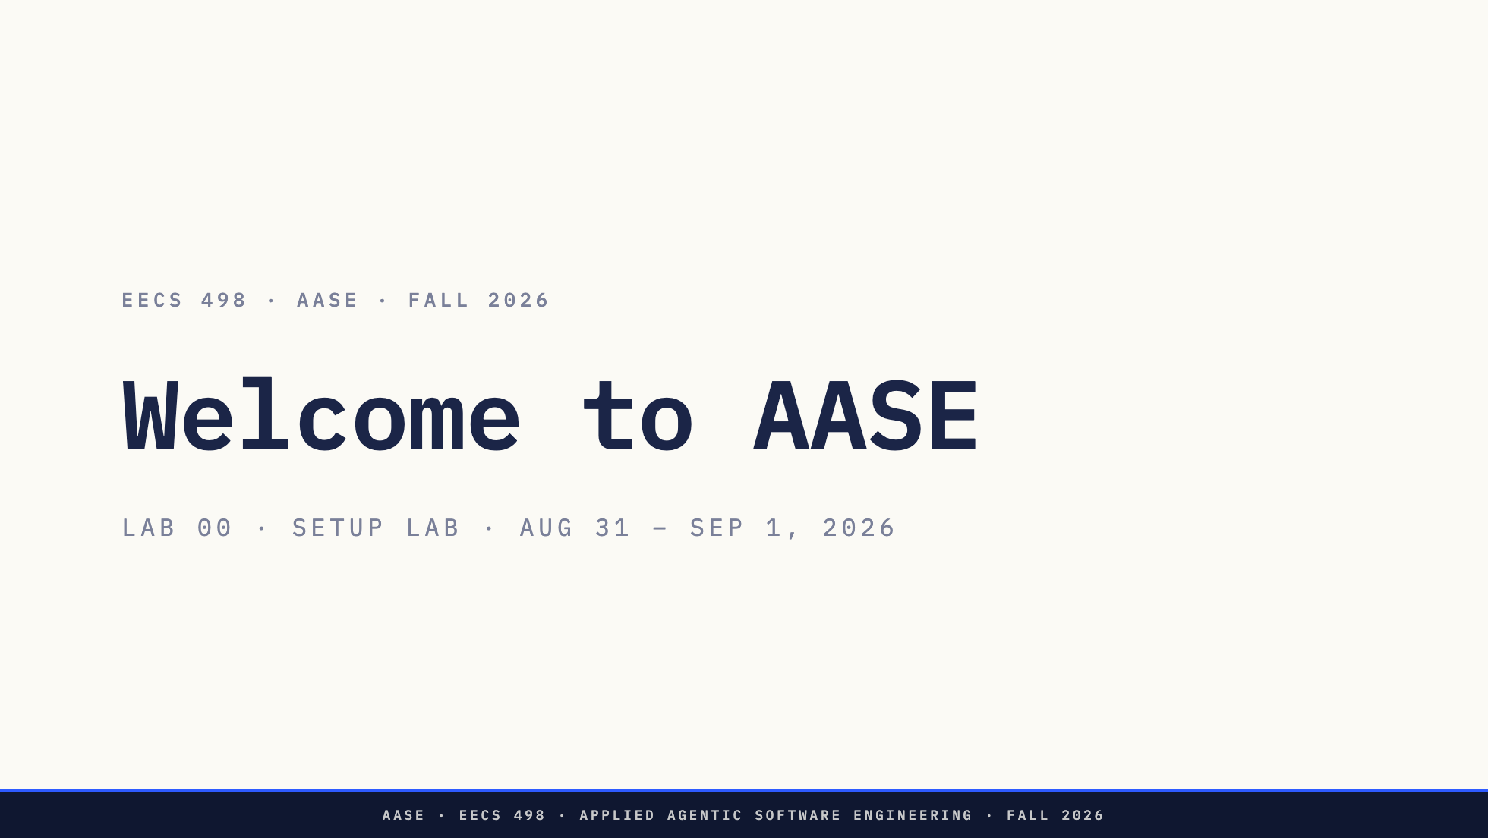
Notes:
Nothing today is graded. Say that out loud, twice. Staff intros in person, by name. Then straight to the survey - it takes ten minutes and they can be doing it while you talk through the next slides.

Slide 2
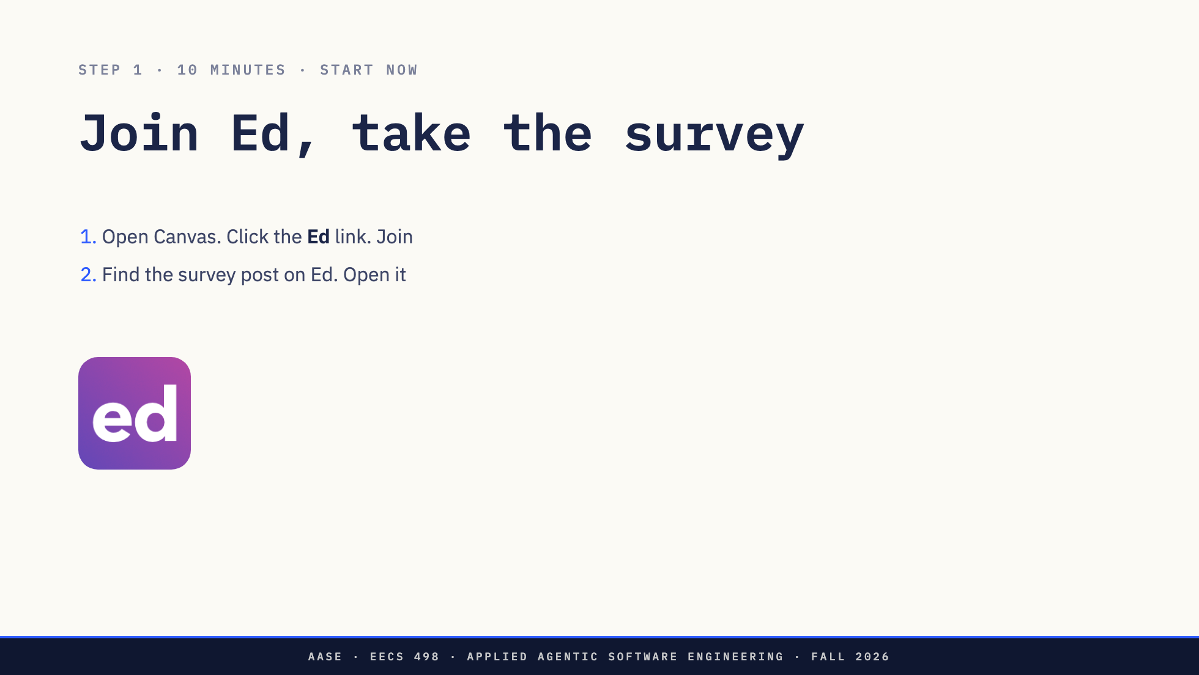
Notes:
Say these out loud rather than putting them on the slide: - Sign in with umich.edu. - It asks for your GitHub username. No username, no repo on Tuesday. - If your laptop can't serve a model, say so on the hardware questions. That answer is what gets you a machine that can. Responses stay editable. While the room fills it in, talk through the next five slides. Don't start the steps until most hands are down.

Slide 3
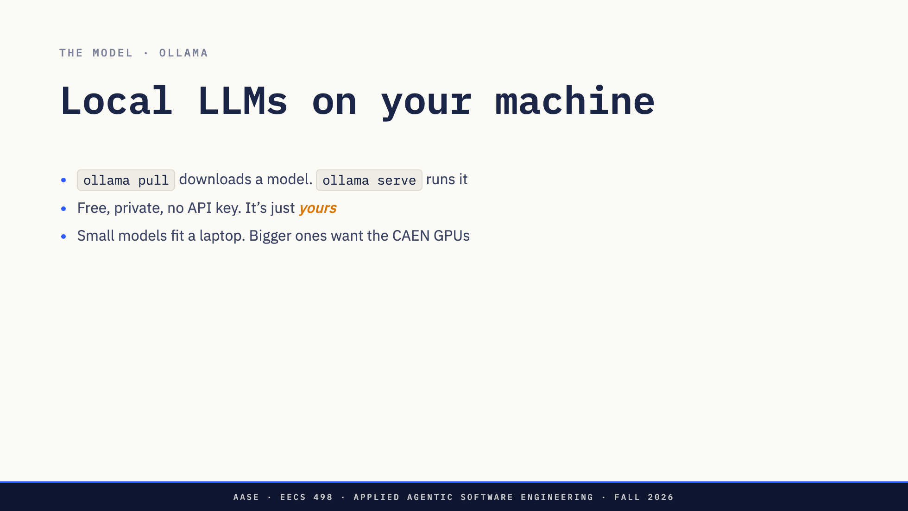
Notes:
While they fill in the survey. The pull is about 3 GB for the week-1 model; on macOS opening the Ollama app replaces ollama serve. If your laptop can't take it, the hardware questions on the survey are what get you a machine that can.

Slide 4
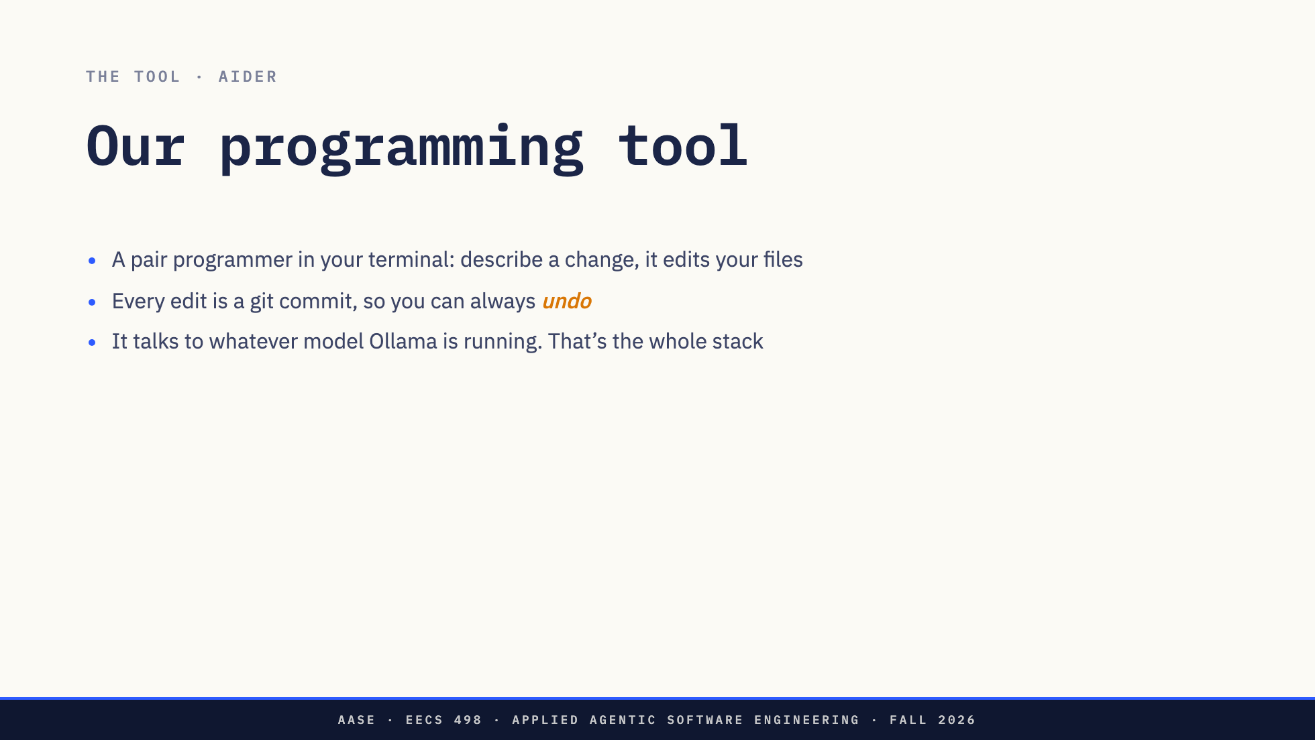
Notes:
aider has no model inside. It's a client; you supply the server, which is why the course costs nothing and why your model is a line of config rather than a vendor. Don't preview L01 content here; today the tools just need to exist in their heads.

Slide 5
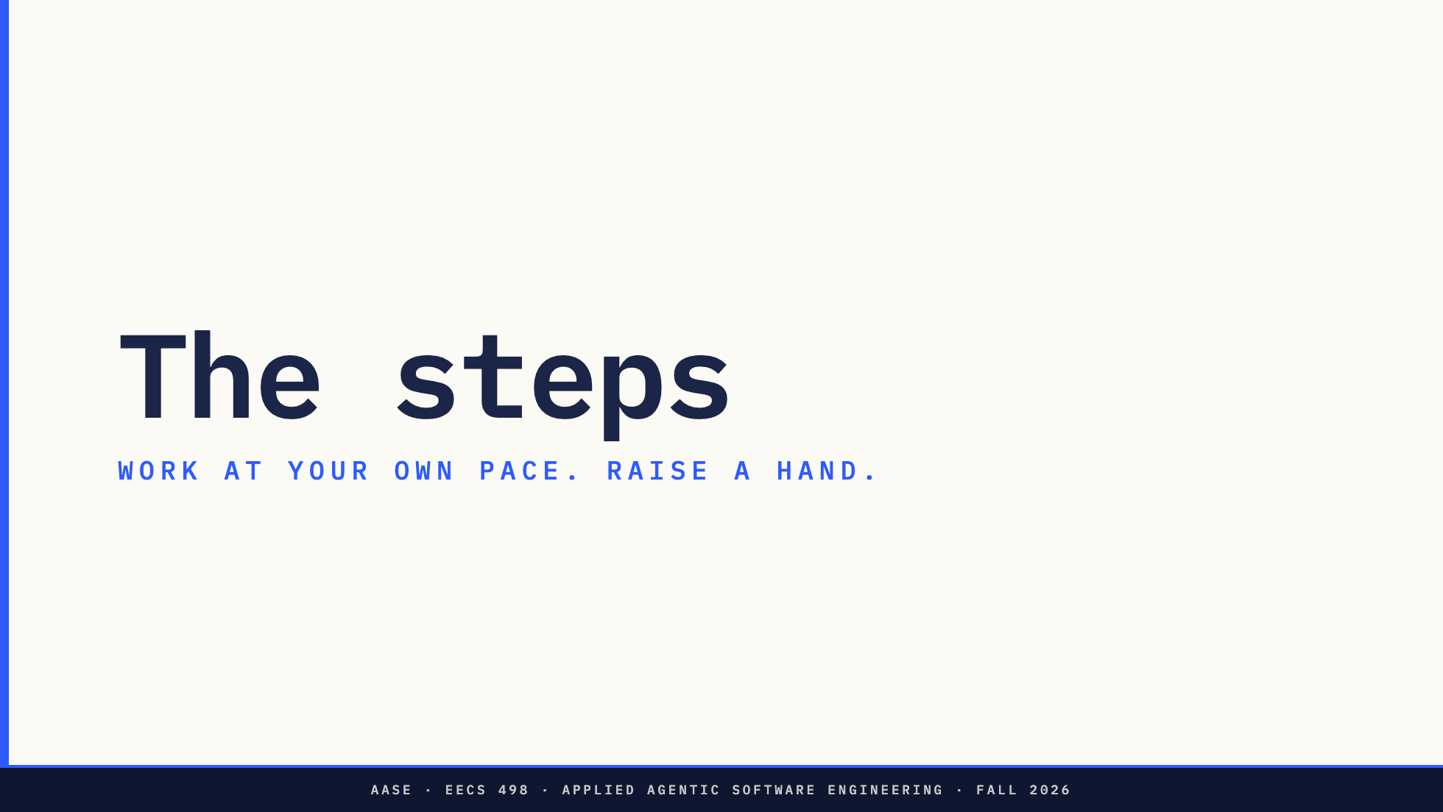
Notes:
Stop talking here. From this point the room works and staff circulate. Leave the deck up so they can page through it themselves.

Slide 6
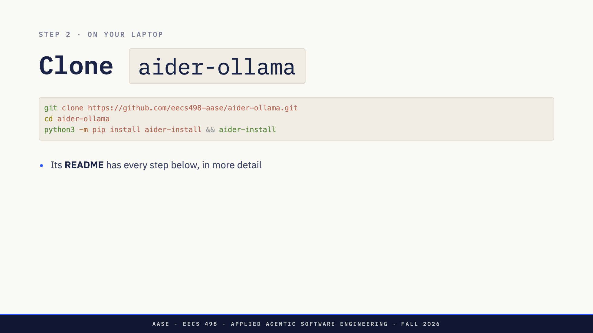
Notes:
Put the URL on the board: github.com/eecs498-aase/aider-ollama HTTPS on purpose. Nobody sets up an SSH key today.

Slide 7
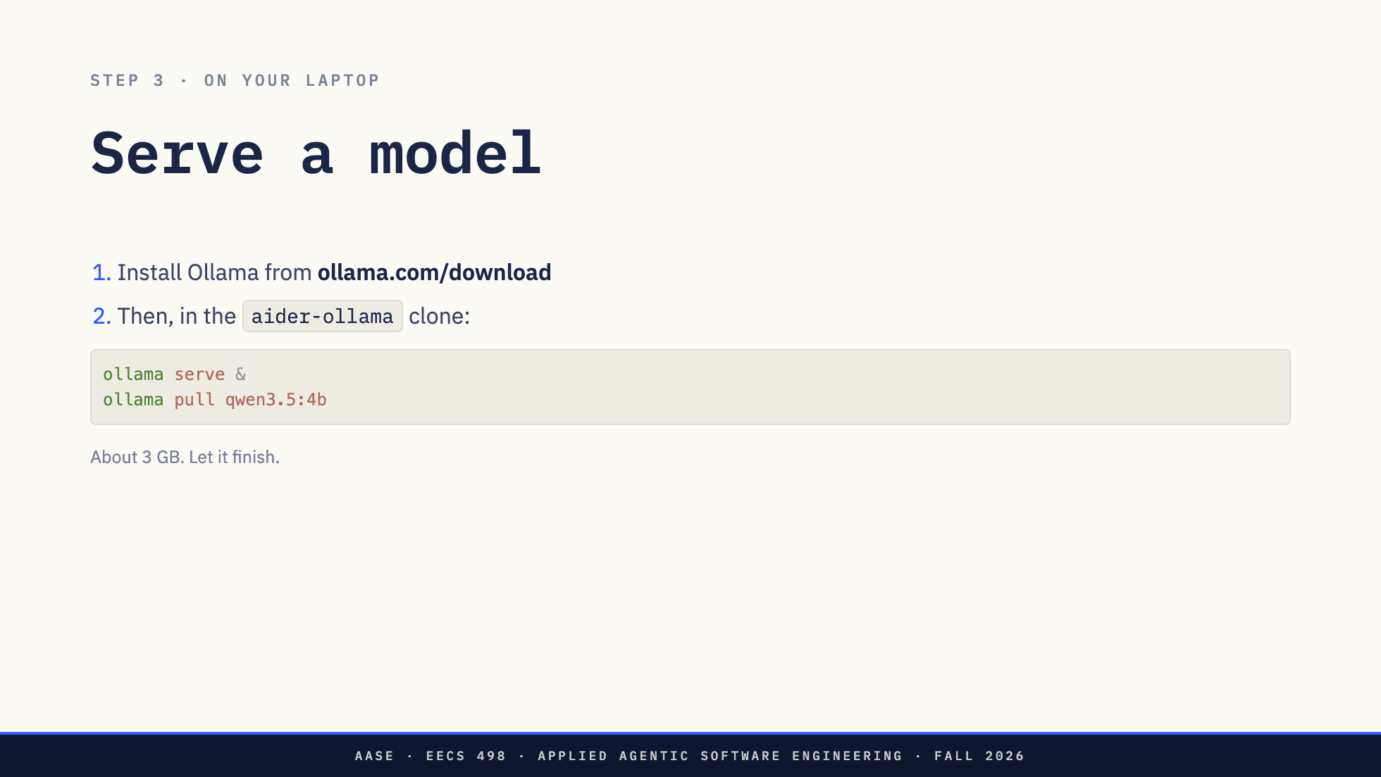

Slide 8
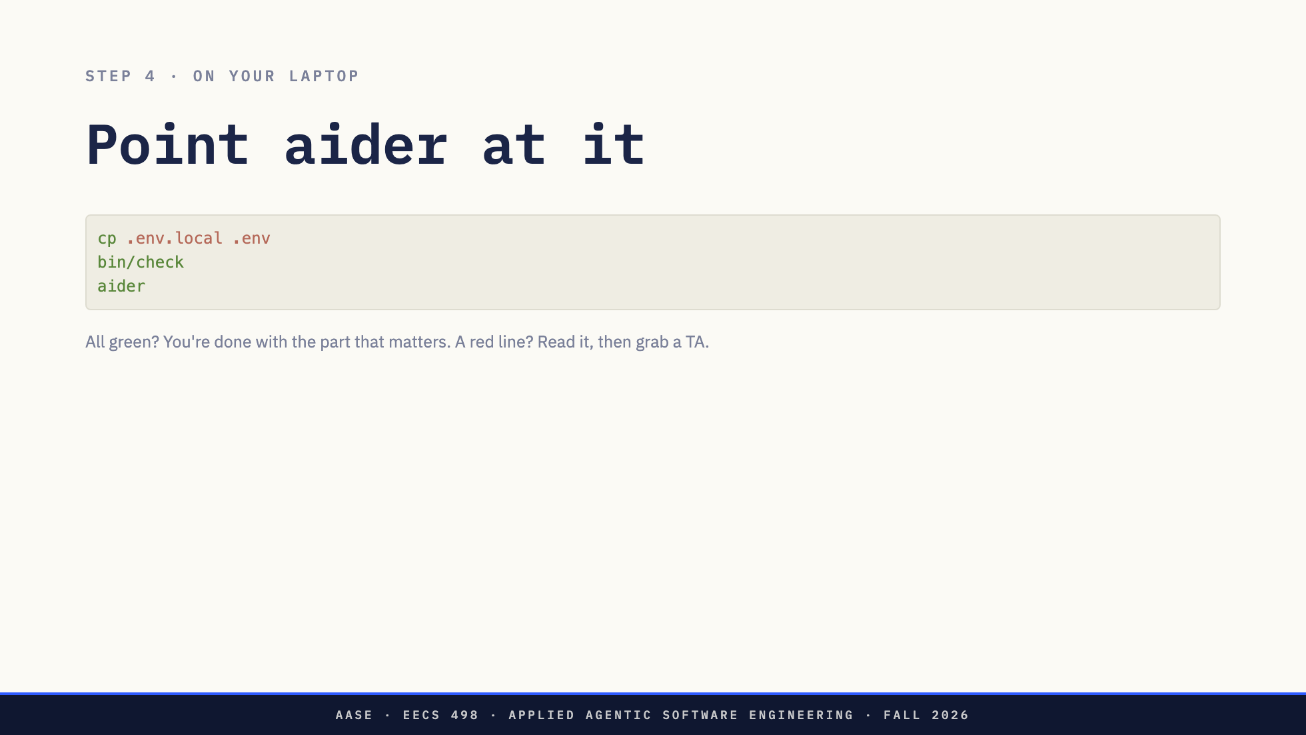
Notes:
bin/check tests every hop between aider and the model. The one trap worth naming out loud: a model with no settings entry gets a 2048-token context, aider truncates your files, and the model starts inventing functions that exist three lines further down. It reads as a stupid model. It's a misconfiguration, and bin/check catches it.

Slide 9
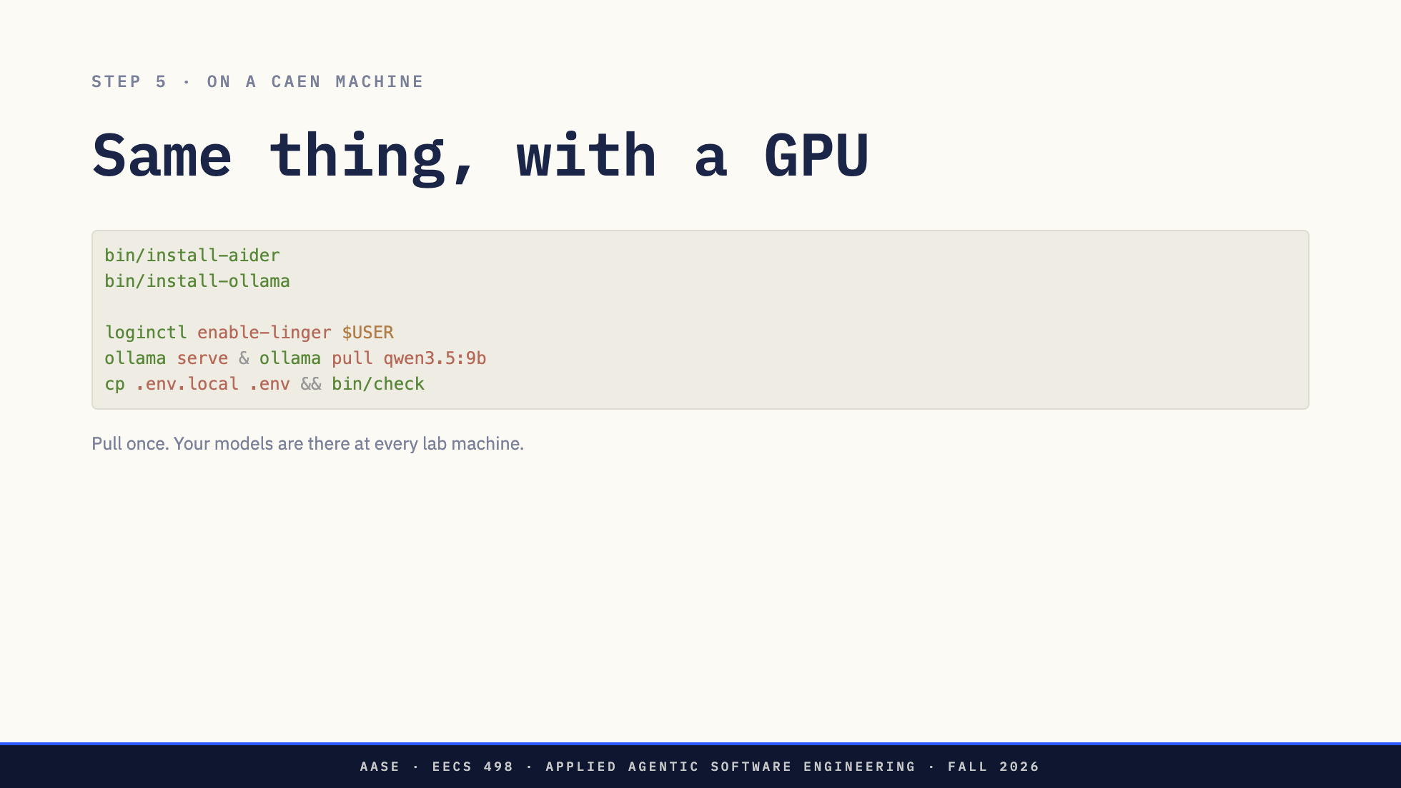
Notes:
Two install scripts instead of a download, because nobody is root on these machines. The rest is steps 3 and 4 again with a model twice the size. enable-linger, once, or logging out kills ollama serve and it reads as a crash. Behind the scenes, not for the slide: home is NFS. Ollama and the models live there on purpose, so a pull follows them to every machine. aider is the one thing that cannot start from a network home, so bin/install-aider builds it on the machine's local disk and leaves a launcher that rebuilds it, about a minute, at a machine that does not have it. If someone asks why the first `aider` at a new machine takes a minute, that is why. They never manage it. There is a third arrangement, aider on your laptop against the CAEN GPU over an SSH tunnel. It's in the README. Not today.

Slide 10
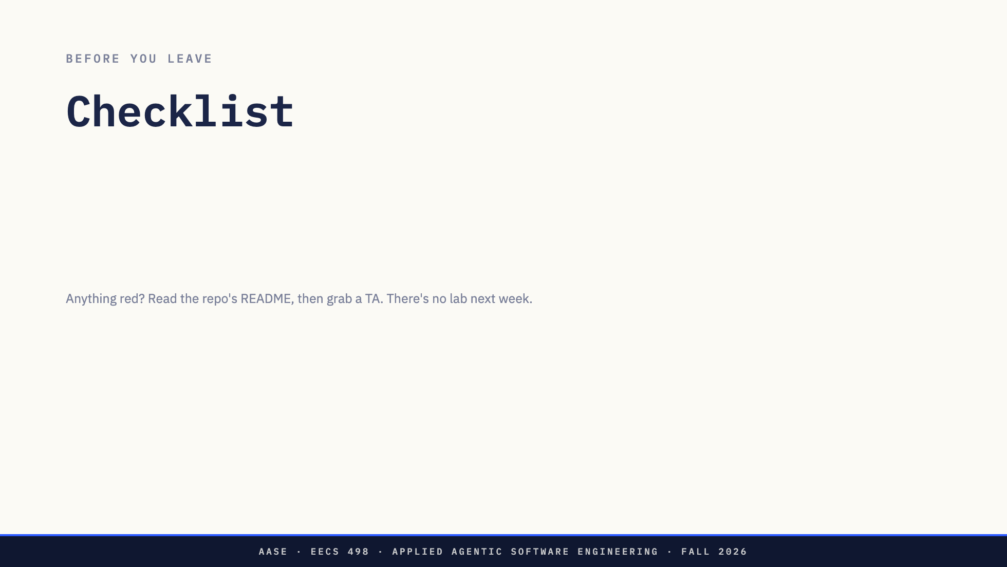
Notes:
Say the last line plainly. Week 2 is Labor Day, there is no lab, and the setup gate is Fri Sep 11. Office hours are the venue between here and there.

Slide 11
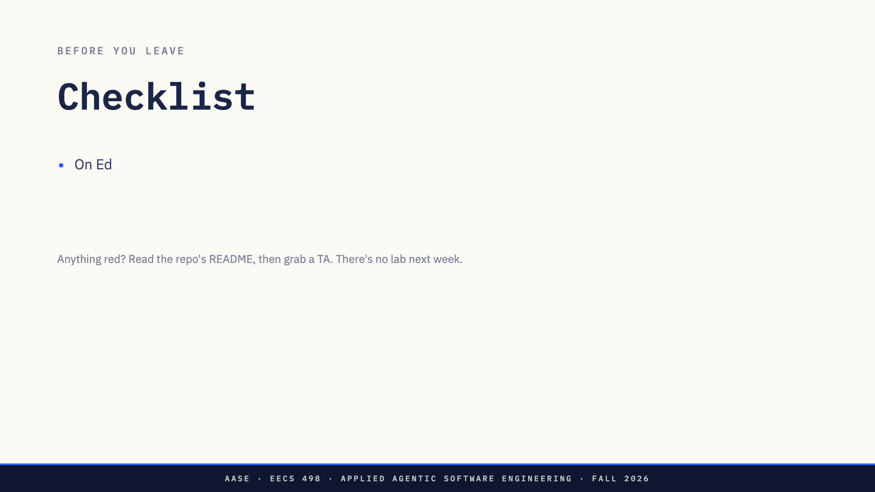
Notes:
Say the last line plainly. Week 2 is Labor Day, there is no lab, and the setup gate is Fri Sep 11. Office hours are the venue between here and there.

Slide 12
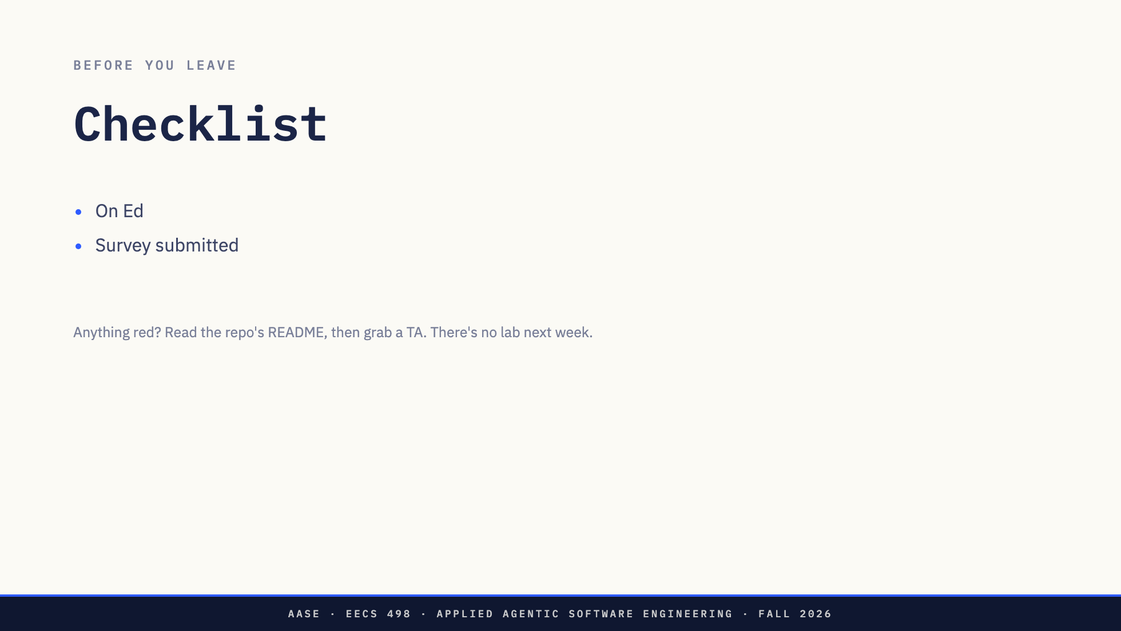
Notes:
Say the last line plainly. Week 2 is Labor Day, there is no lab, and the setup gate is Fri Sep 11. Office hours are the venue between here and there.

Slide 13
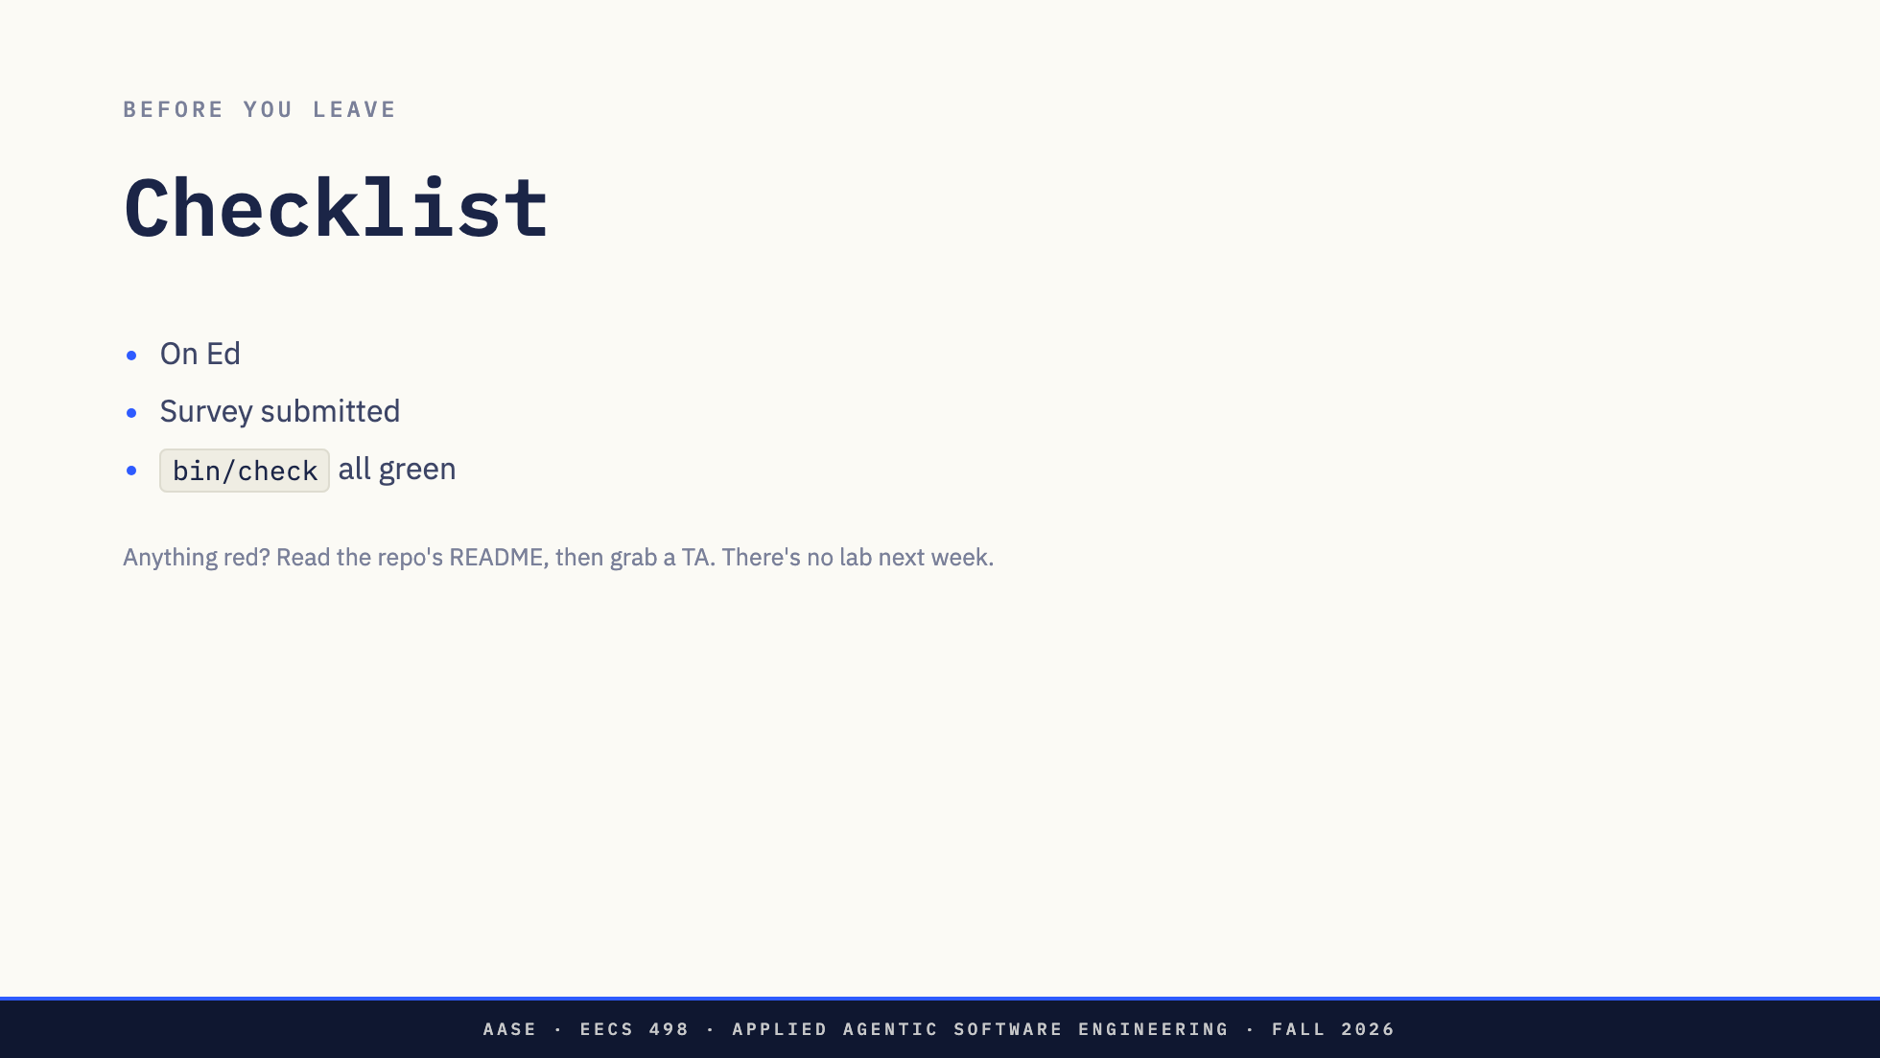
Notes:
Say the last line plainly. Week 2 is Labor Day, there is no lab, and the setup gate is Fri Sep 11. Office hours are the venue between here and there.

Slide 14


