Slide 1
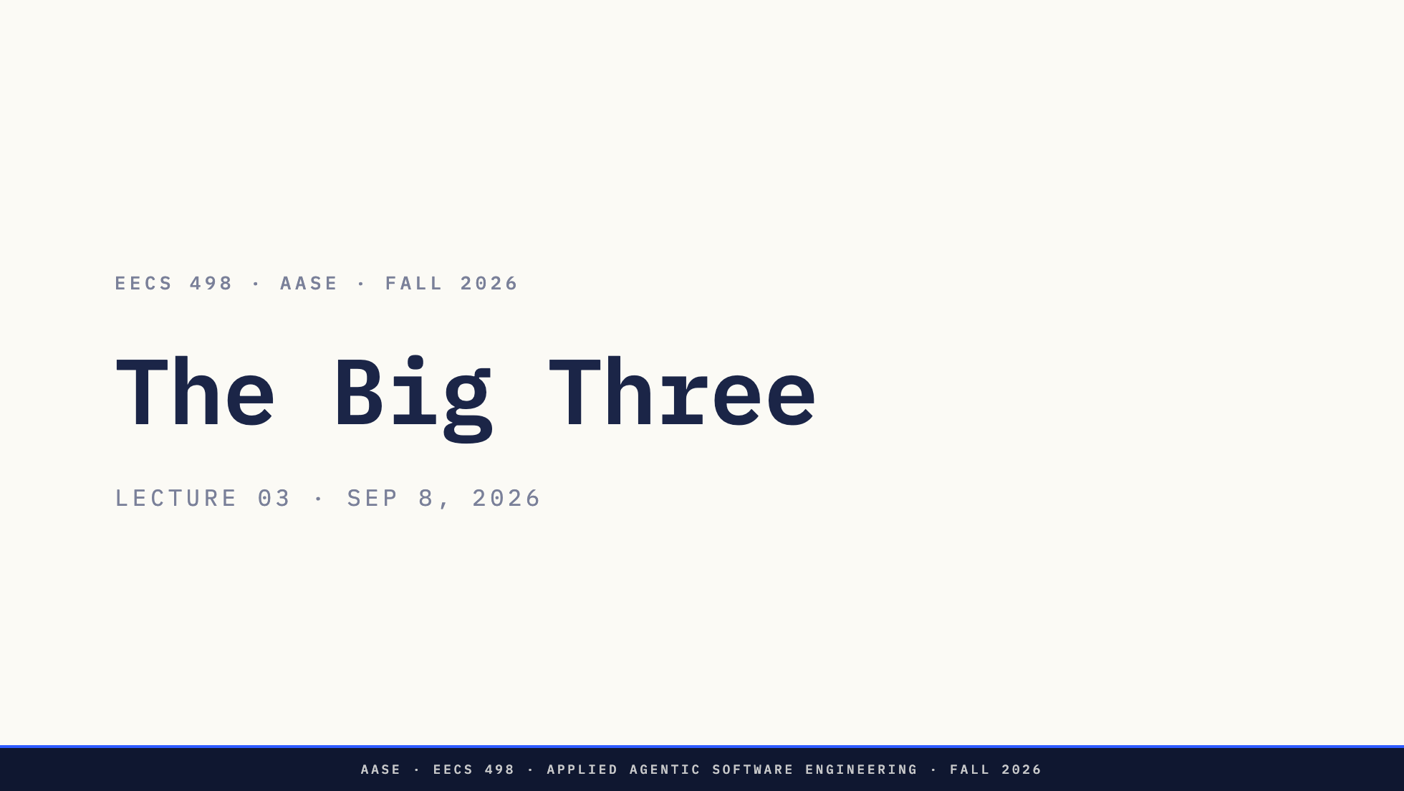
Notes:
L02 = mechanics. L03 = framework on top. This is the lecture they'll use the rest of their careers.

Slide 2
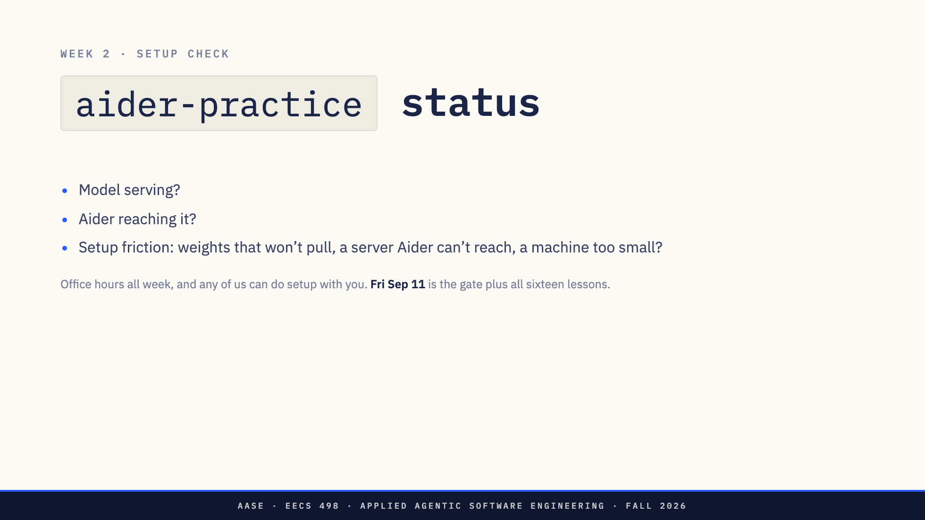
Notes:
Show of hands, three times. All three failures are common and none of them are the student's fault. Take names for office hours rather than debugging in the room.

Slide 3
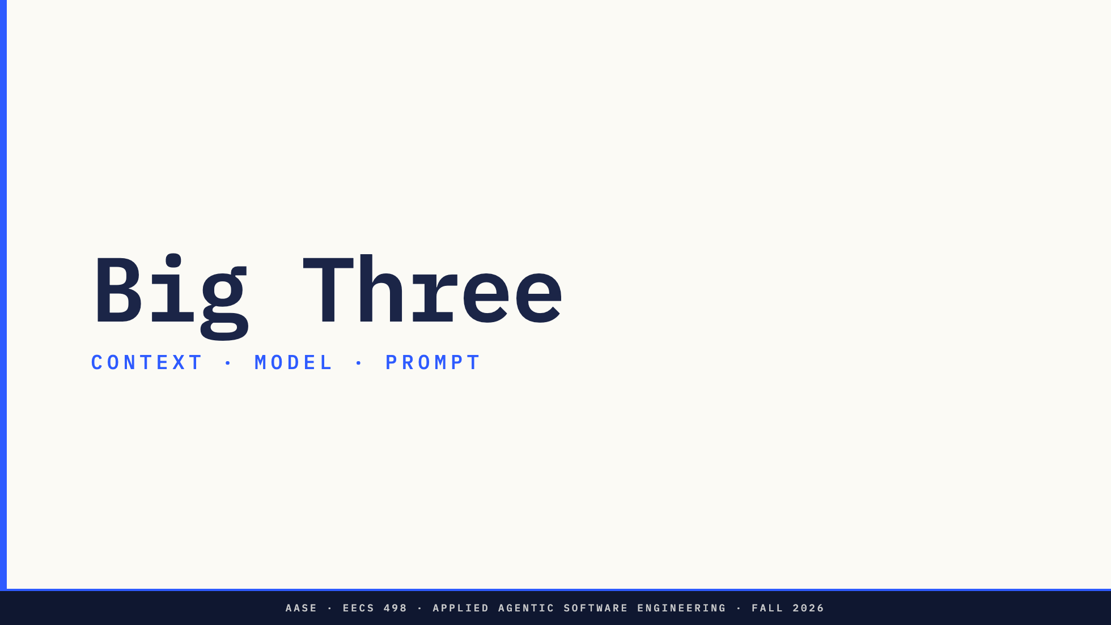
Notes:
L02 gave them tokenization, the context window, hallucination, capability against knowledge. That was the mechanics. This is the framework on top. Three choices in every session. Get one wrong and no amount of effort in the other two saves you.

Slide 4
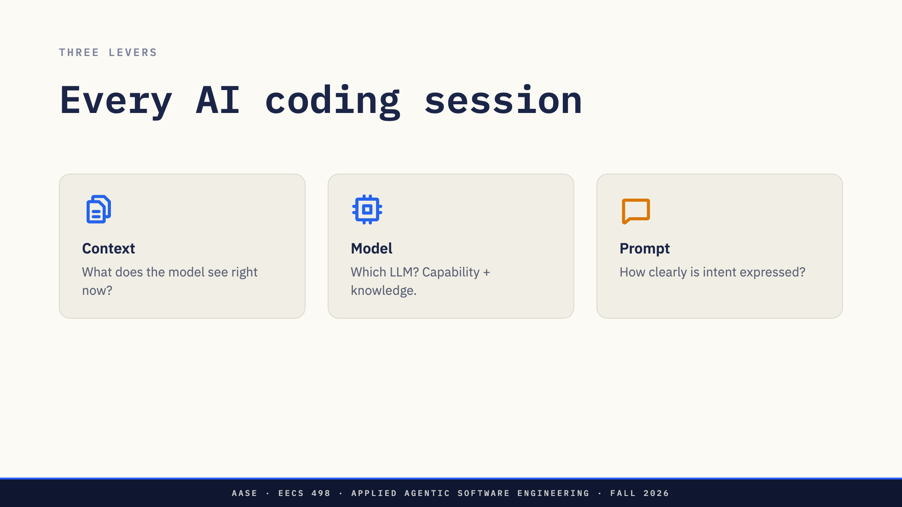
Notes:
Define all three here, one at a time, before the bullseye lands. Context: files, history, repo map, system prompt. Finite. Model: a line of configuration, not a vendor loyalty. Prompt: judged by consistency of output, not cleverness of phrasing.

Slide 5
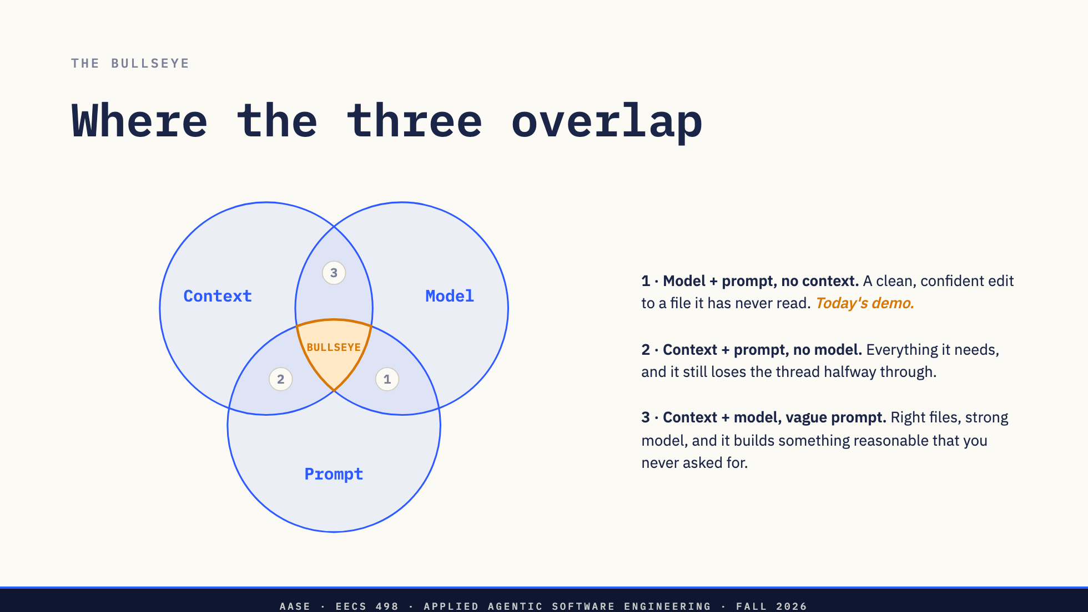
Notes:
Draw it in the air first, then let the slide confirm it. Three circles, target at the intersection. Walk the three near-misses in order and ask which one they think is most common before you say it. Zone 1 is the demo at 1:00, so name it now and they will recognise it when it happens. Zones 2 and 3 are the honest ones: a weak model and a vague prompt both produce output that looks like progress.

Slide 6
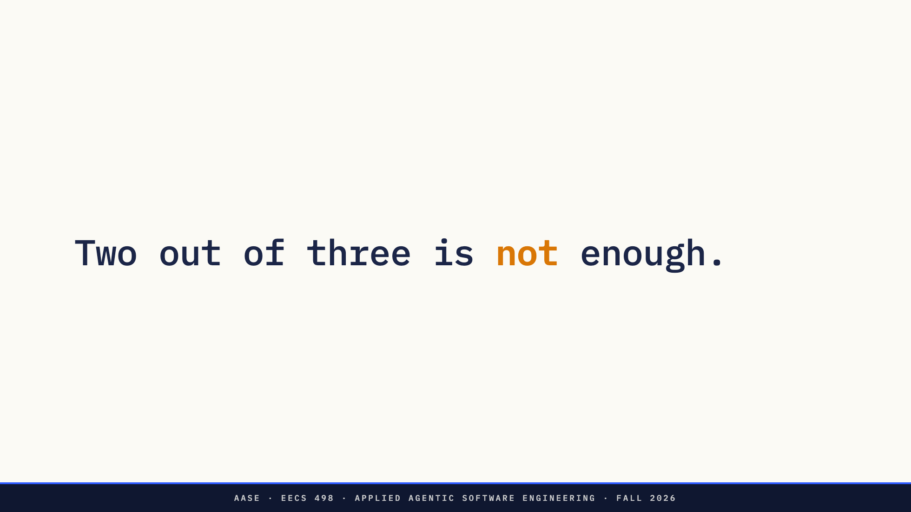
Notes:
The punchline of the diagram they just read. Say it flat, then move. Effort in the other two levers does not buy back the one you missed.

Slide 7
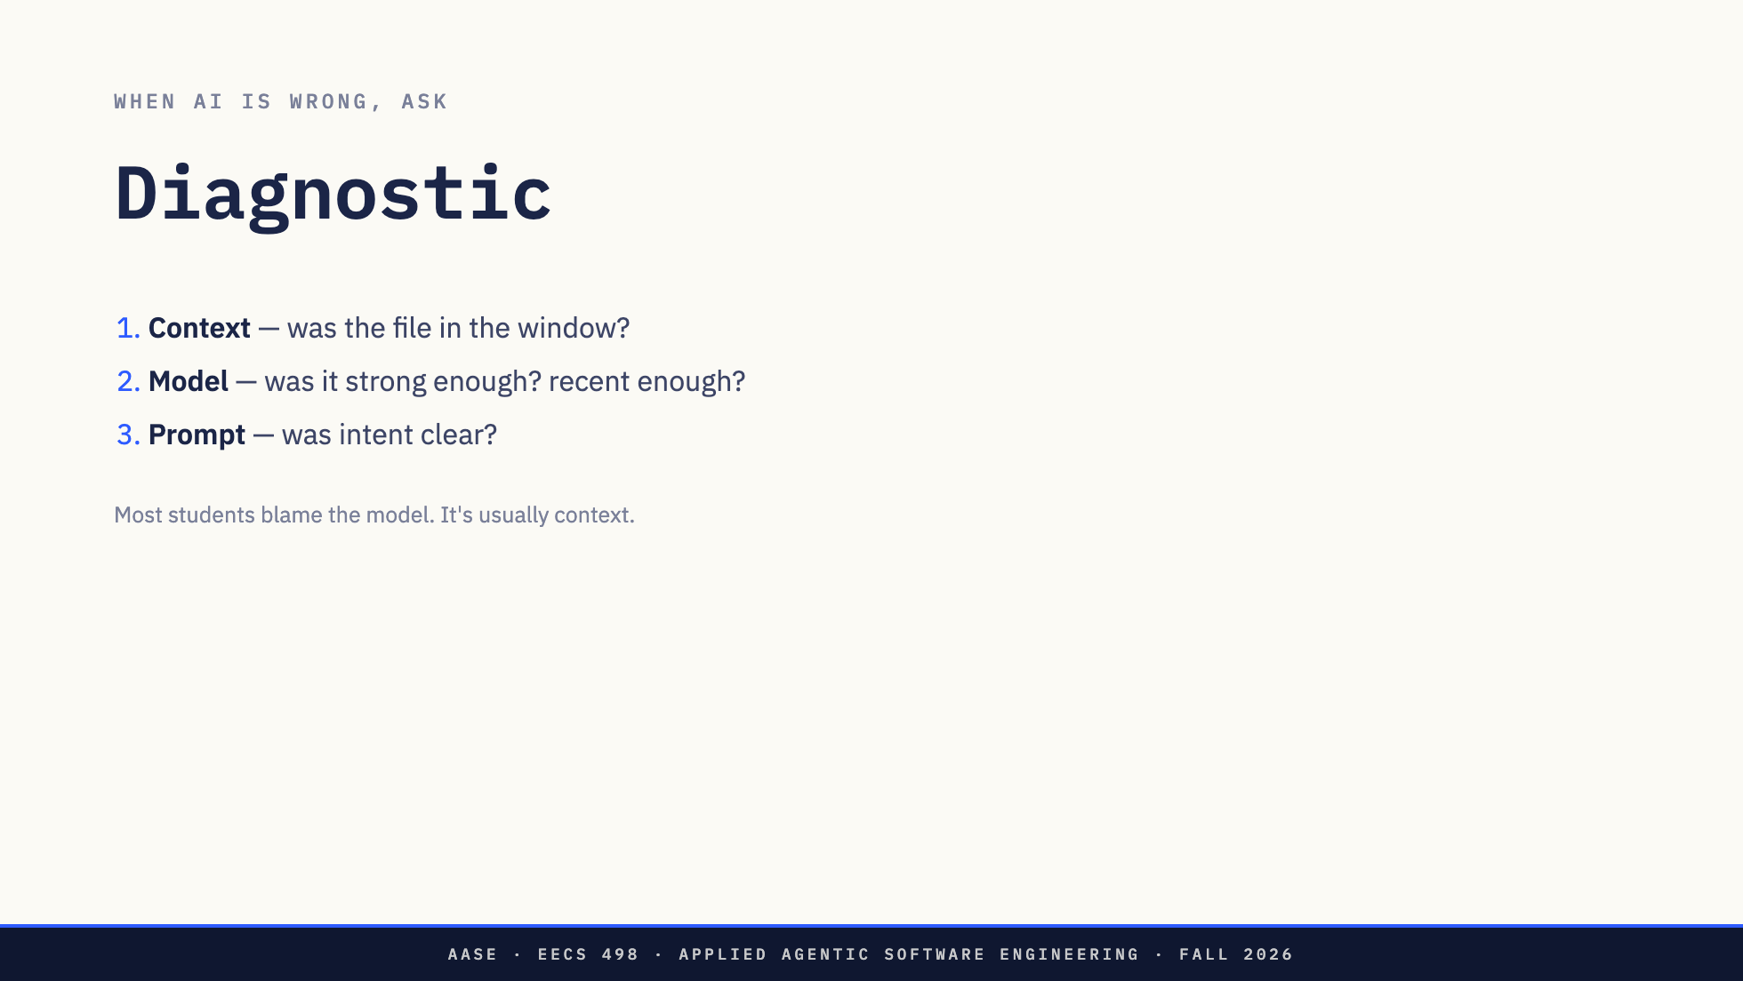
Notes:
The key point of the lecture. When something comes back wrong, ask these three in order before you touch anything. Most students blame the model. It is statistically the least common cause. Usually it is context. Tell them now that they will use this in Lab01 next week.

Slide 8
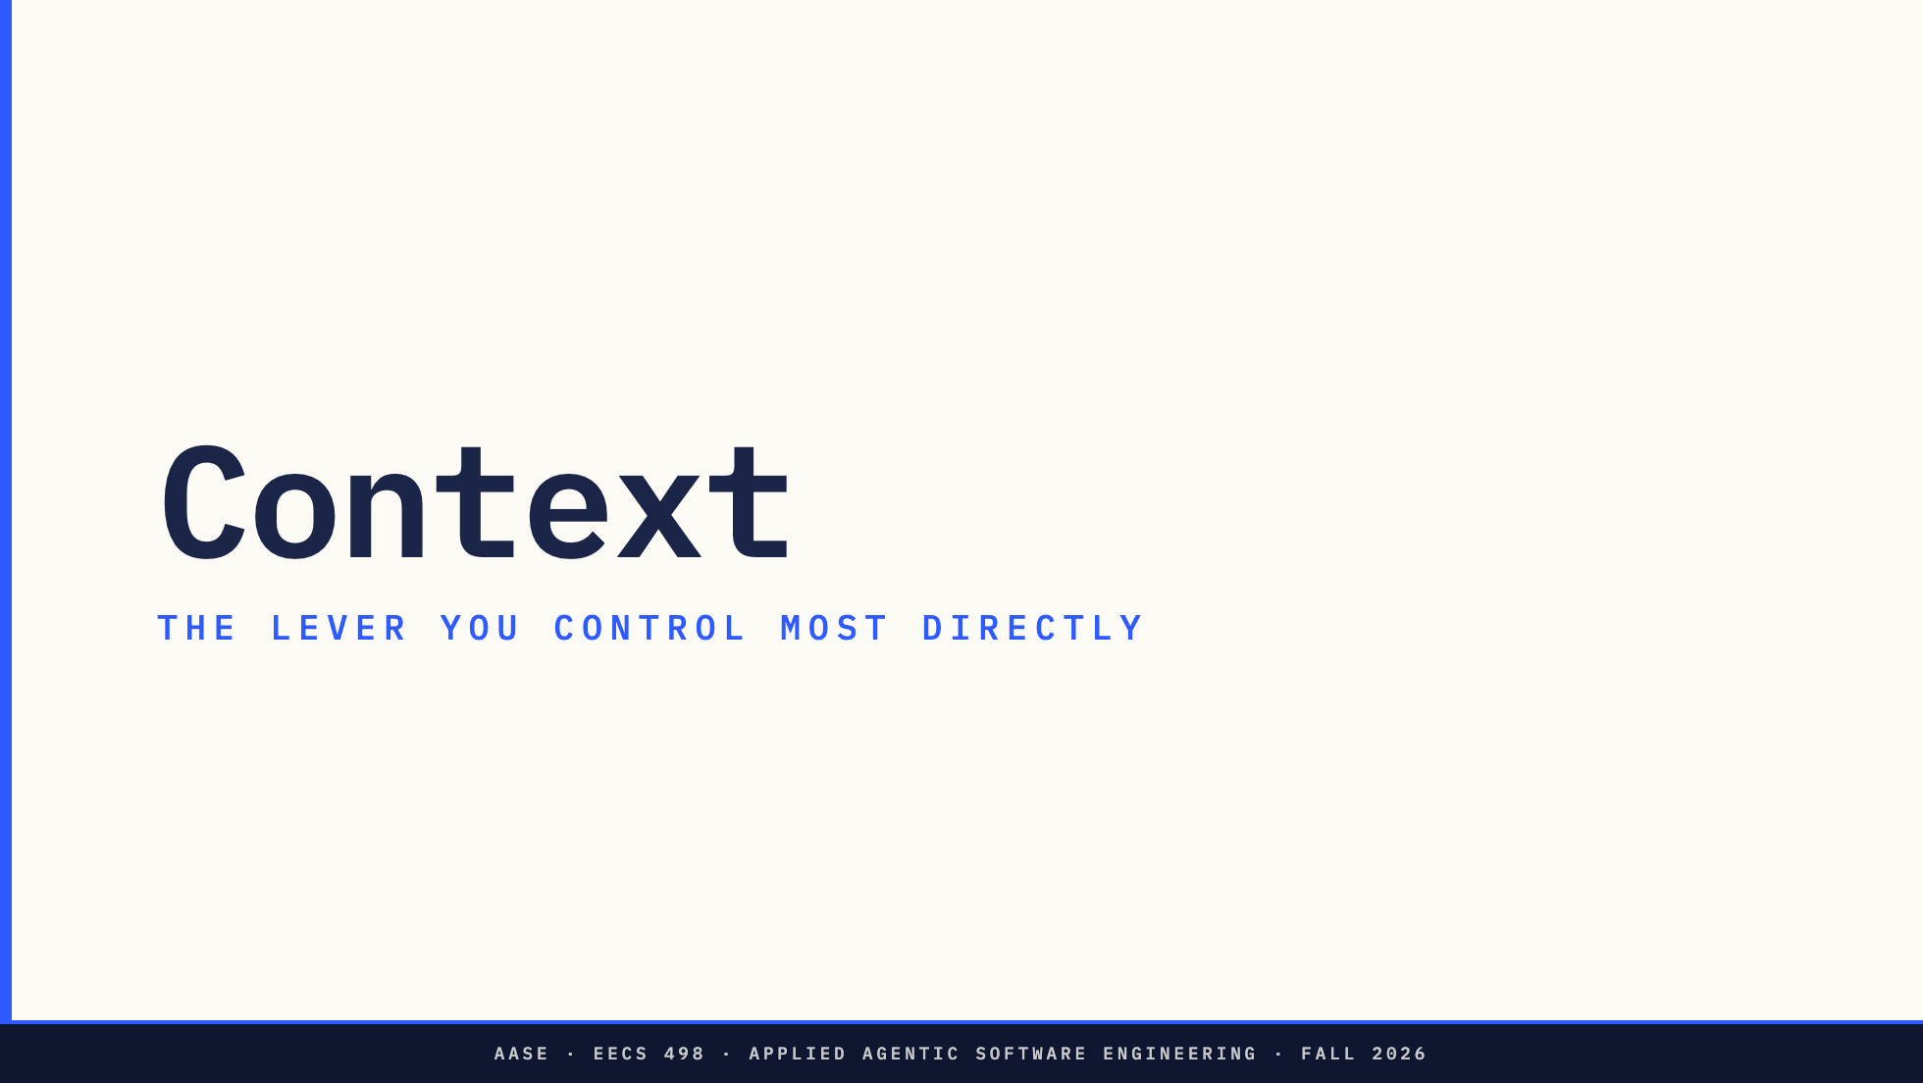
Notes:
The lever they control most directly, and the one that causes the most trouble. Most of the next twenty minutes lives here. In a few weeks they implement this themselves.

Slide 9
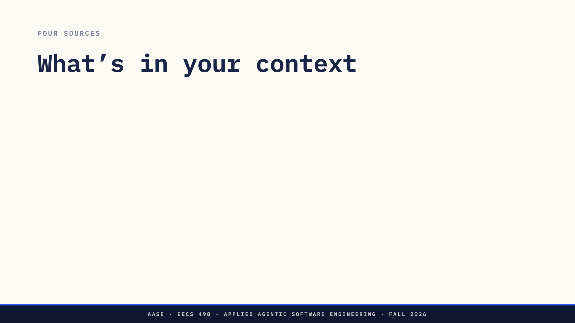
Notes:
Added files are the only files the model can edit. Say that twice. The repo map is an auto-generated summary, not a substitute for adding the file. Chat history accumulates until /clear. That is the second pitfall, two slides from now. The system prompt is Aider's own, and the default is fine for now.

Slide 10
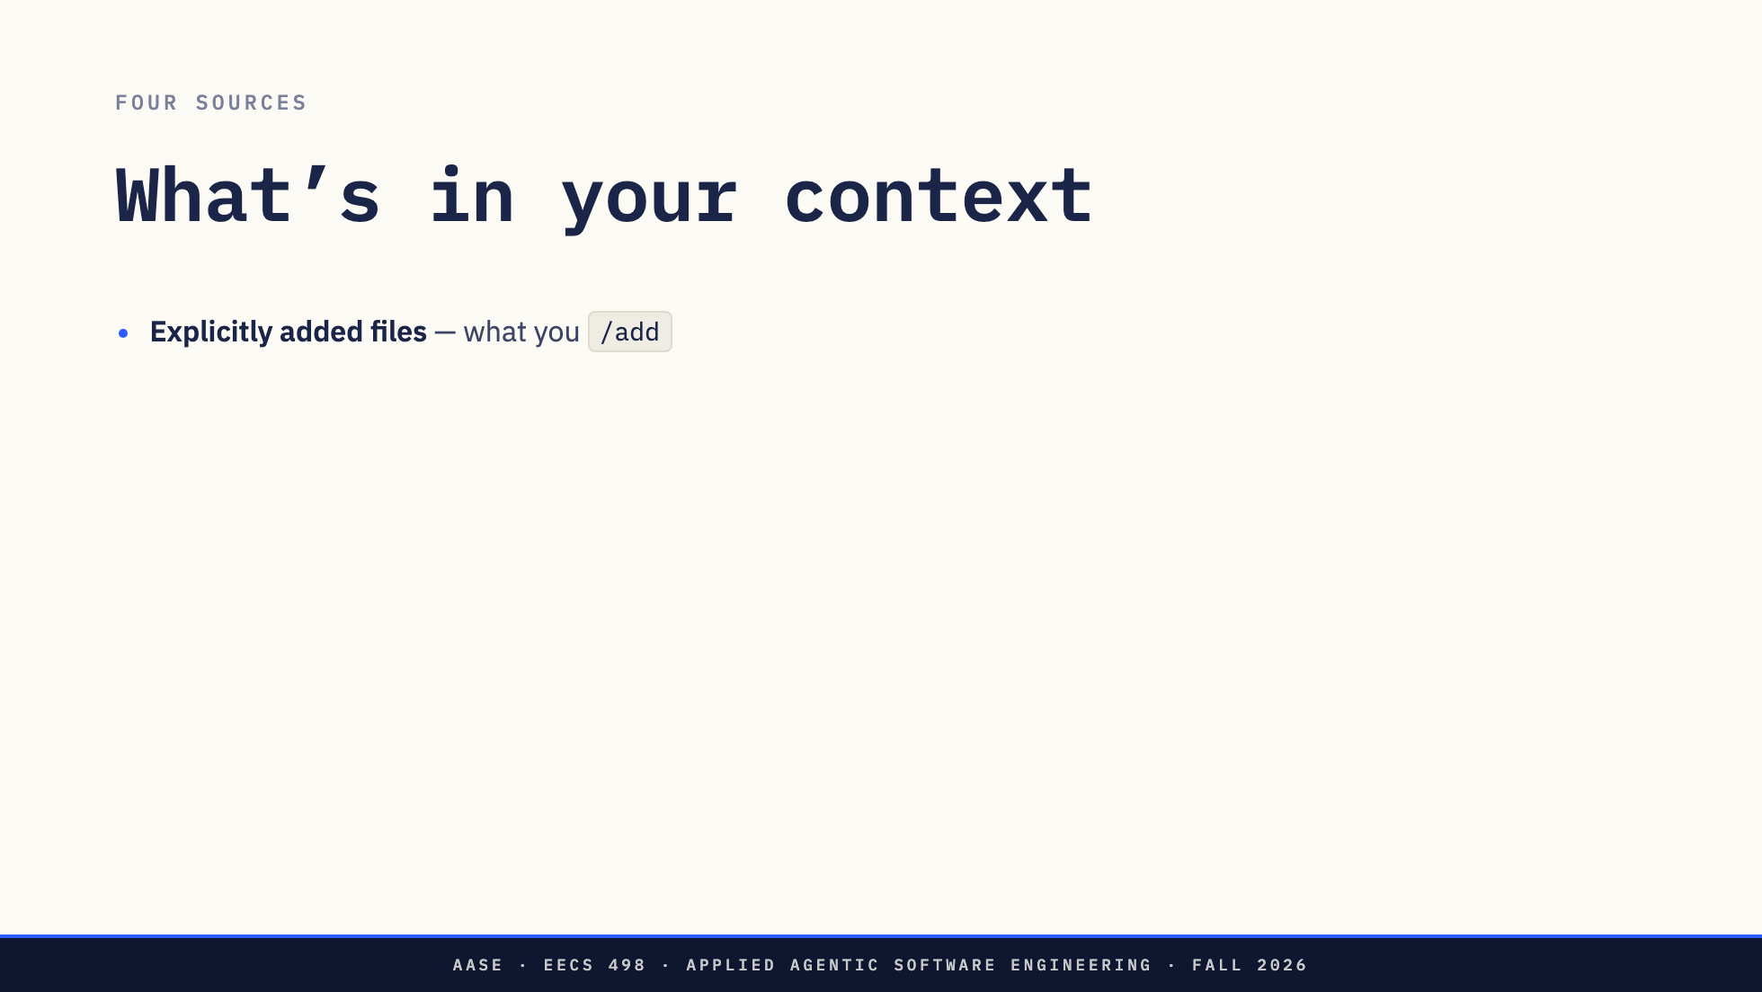
Notes:
Added files are the only files the model can edit. Say that twice. The repo map is an auto-generated summary, not a substitute for adding the file. Chat history accumulates until /clear. That is the second pitfall, two slides from now. The system prompt is Aider's own, and the default is fine for now.

Slide 11
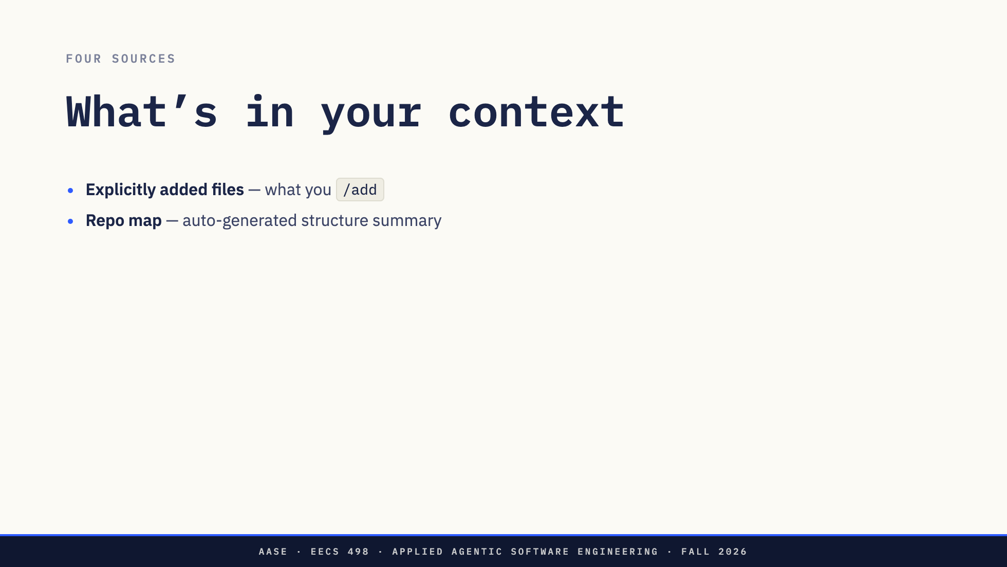
Notes:
Added files are the only files the model can edit. Say that twice. The repo map is an auto-generated summary, not a substitute for adding the file. Chat history accumulates until /clear. That is the second pitfall, two slides from now. The system prompt is Aider's own, and the default is fine for now.

Slide 12
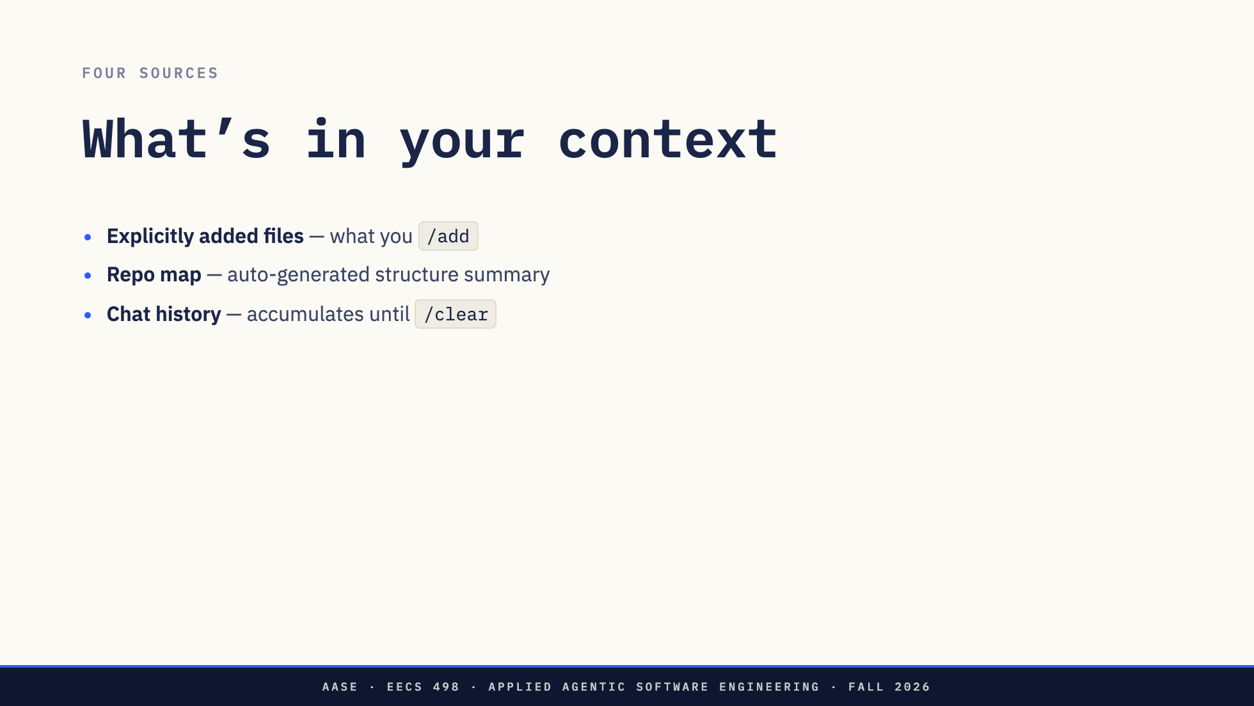
Notes:
Added files are the only files the model can edit. Say that twice. The repo map is an auto-generated summary, not a substitute for adding the file. Chat history accumulates until /clear. That is the second pitfall, two slides from now. The system prompt is Aider's own, and the default is fine for now.

Slide 13
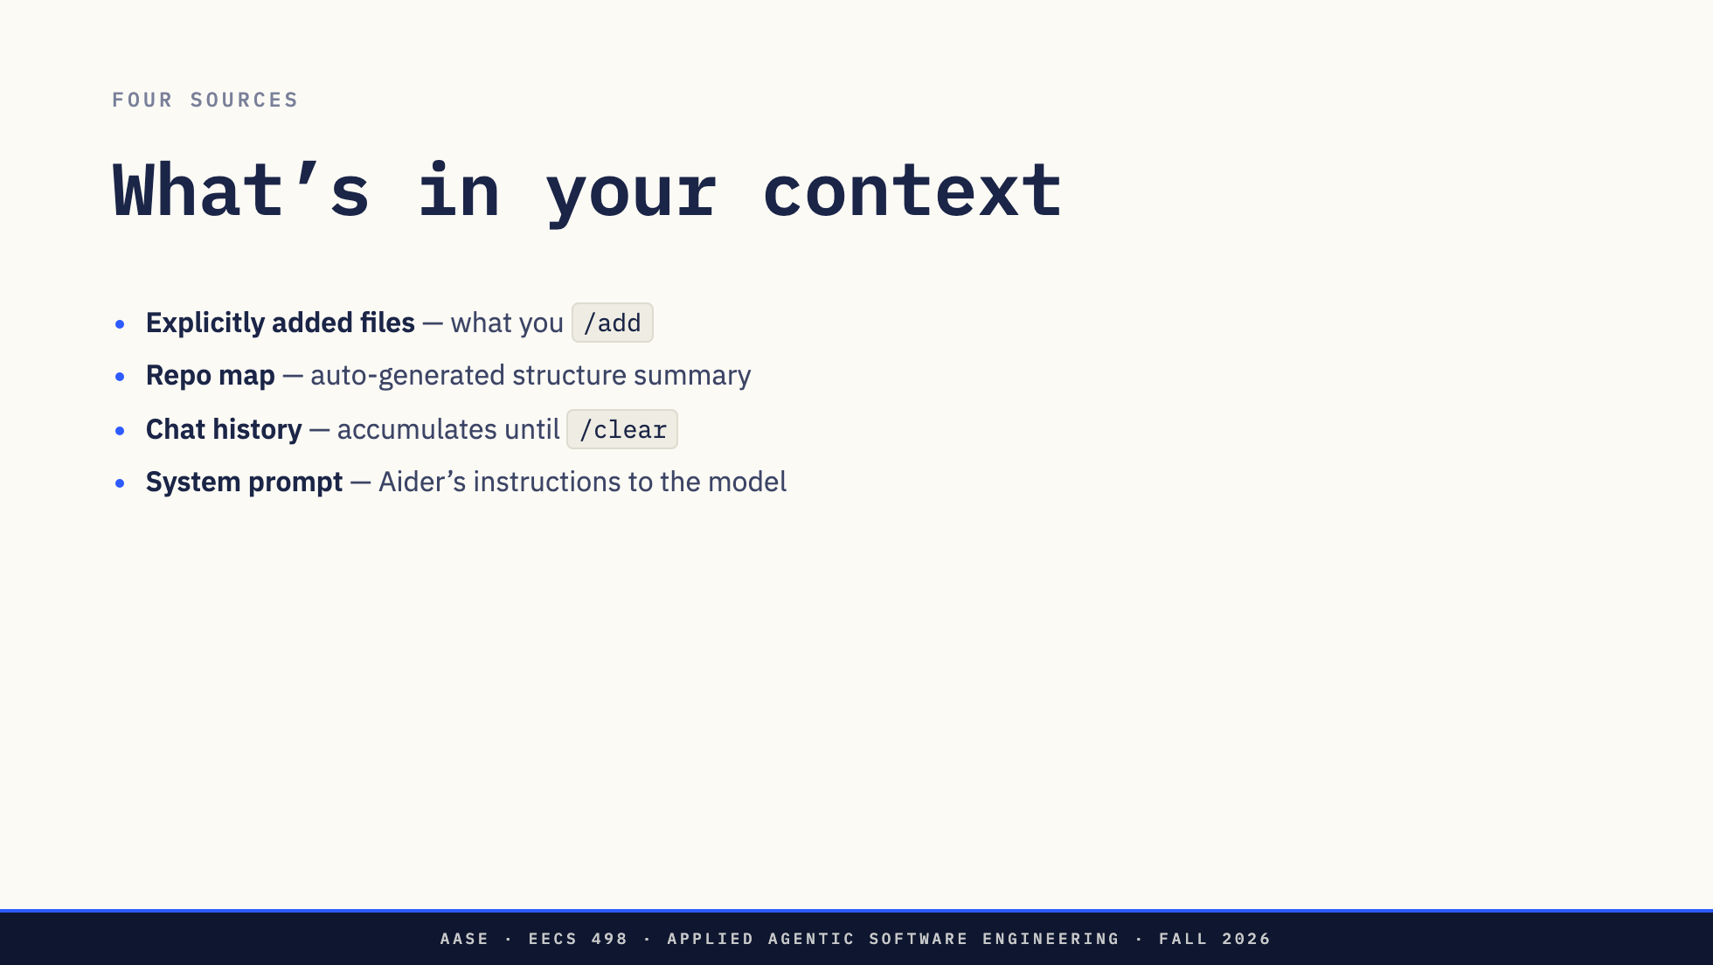
Notes:
Added files are the only files the model can edit. Say that twice. The repo map is an auto-generated summary, not a substitute for adding the file. Chat history accumulates until /clear. That is the second pitfall, two slides from now. The system prompt is Aider's own, and the default is fine for now.

Slide 14
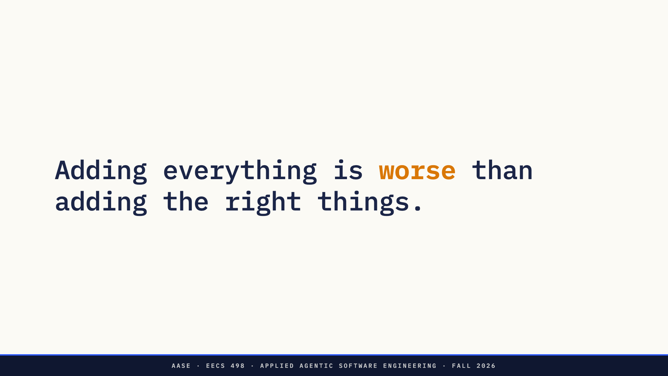
Notes:
The wrong instinct. aider **/*.py looks helpful, isn't.

Slide 15
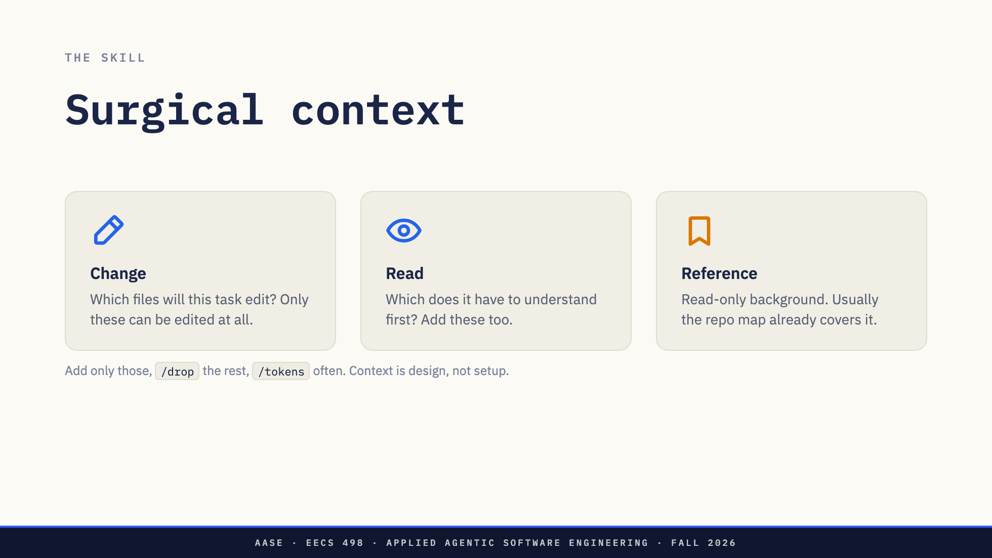
Notes:
Three questions, asked before every task, not once at the start of a session. Only the first card can be edited at all. The second is what the model has to read to get the first right. Reference is usually where the repo map is already enough.

Slide 16
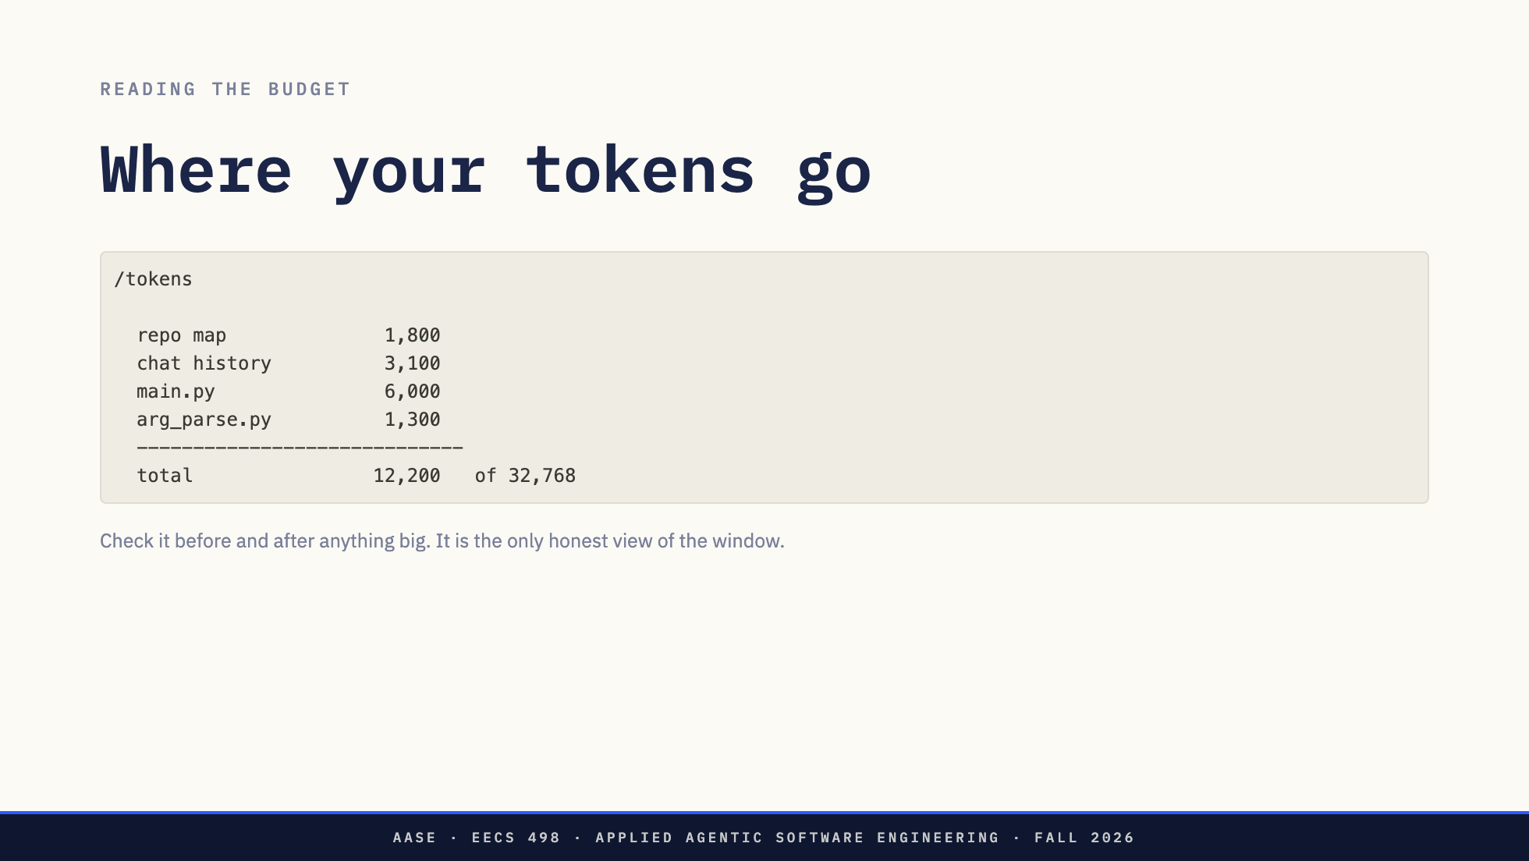
Notes:
Broken down by source, which is what makes it a diagnostic and not a counter. When the repo map or the history is the biggest line, that is the finding.

Slide 17
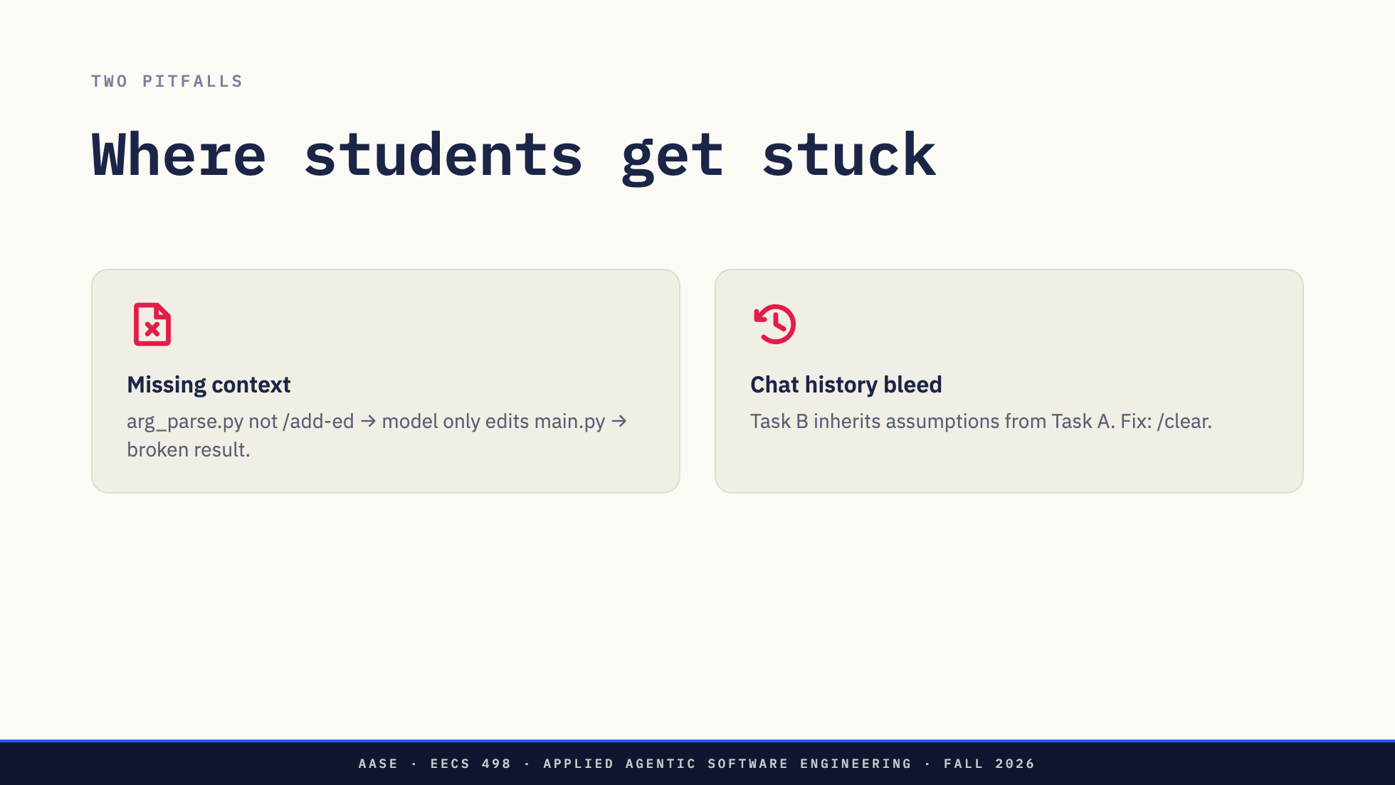
Notes:
Missing context is the most common failure in this course. The model edits what is in context, so a file that was never added cannot be fixed. Aider offers to add it and taking the offer saves you. Decline it, or use a tool that does not ask, and one file gets updated alone: a partial change that looks finished. History bleed is subtler. Ten minutes on task A, start task B, and those messages are still sitting there carrying assumptions. /clear resets the conversation and keeps the files. This sets up the break. Do not answer it here.

Slide 18
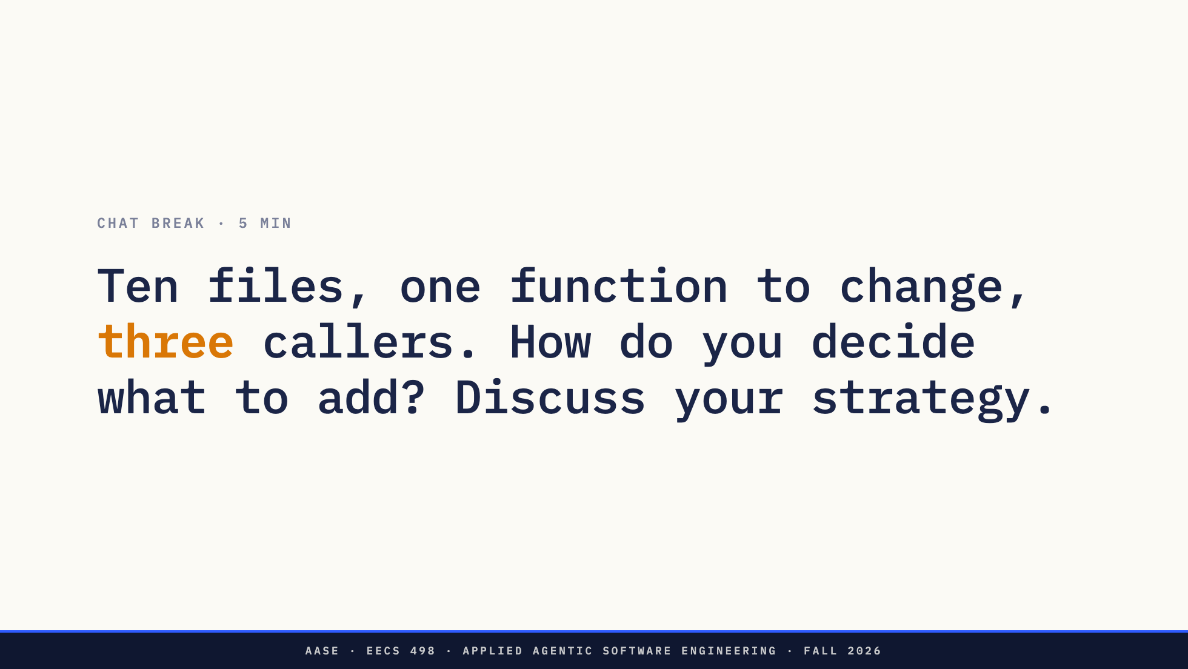
Notes:
0:35. The fixed break. Prompt is the chat_break field in overview.md. There is no single right answer, and that is the point: the habit being built is treating context as a design decision, not setup. Push for strategies, not file lists. Two or three out loud, then move.

Slide 19
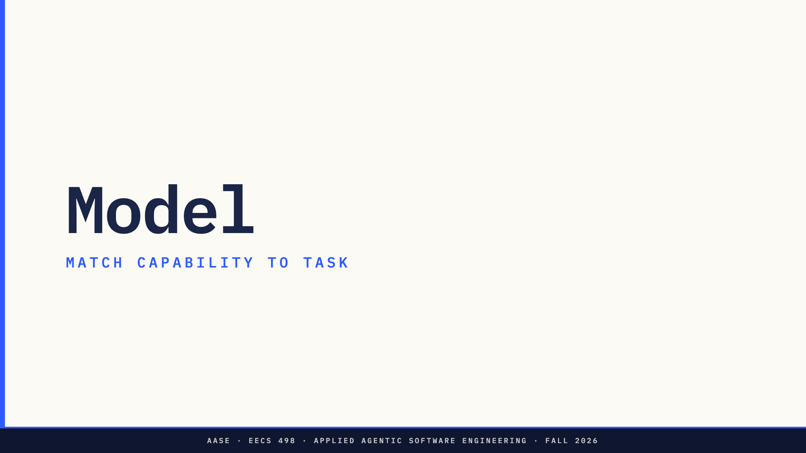
Notes:
Context is what you feed the model. This is the other half of the same decision. Ten minutes here, then prompt.

Slide 20

Notes:
Speed and size track reasoning ability. Smarter tends to be bigger, which on their own hardware means slower and hungrier for RAM rather than more expensive in dollars. The tradeoff does not disappear when the bill does. Some models do 128K, some do 1M, and L02 already told them bigger is not automatically better. Needle in a haystack is real.

Slide 21
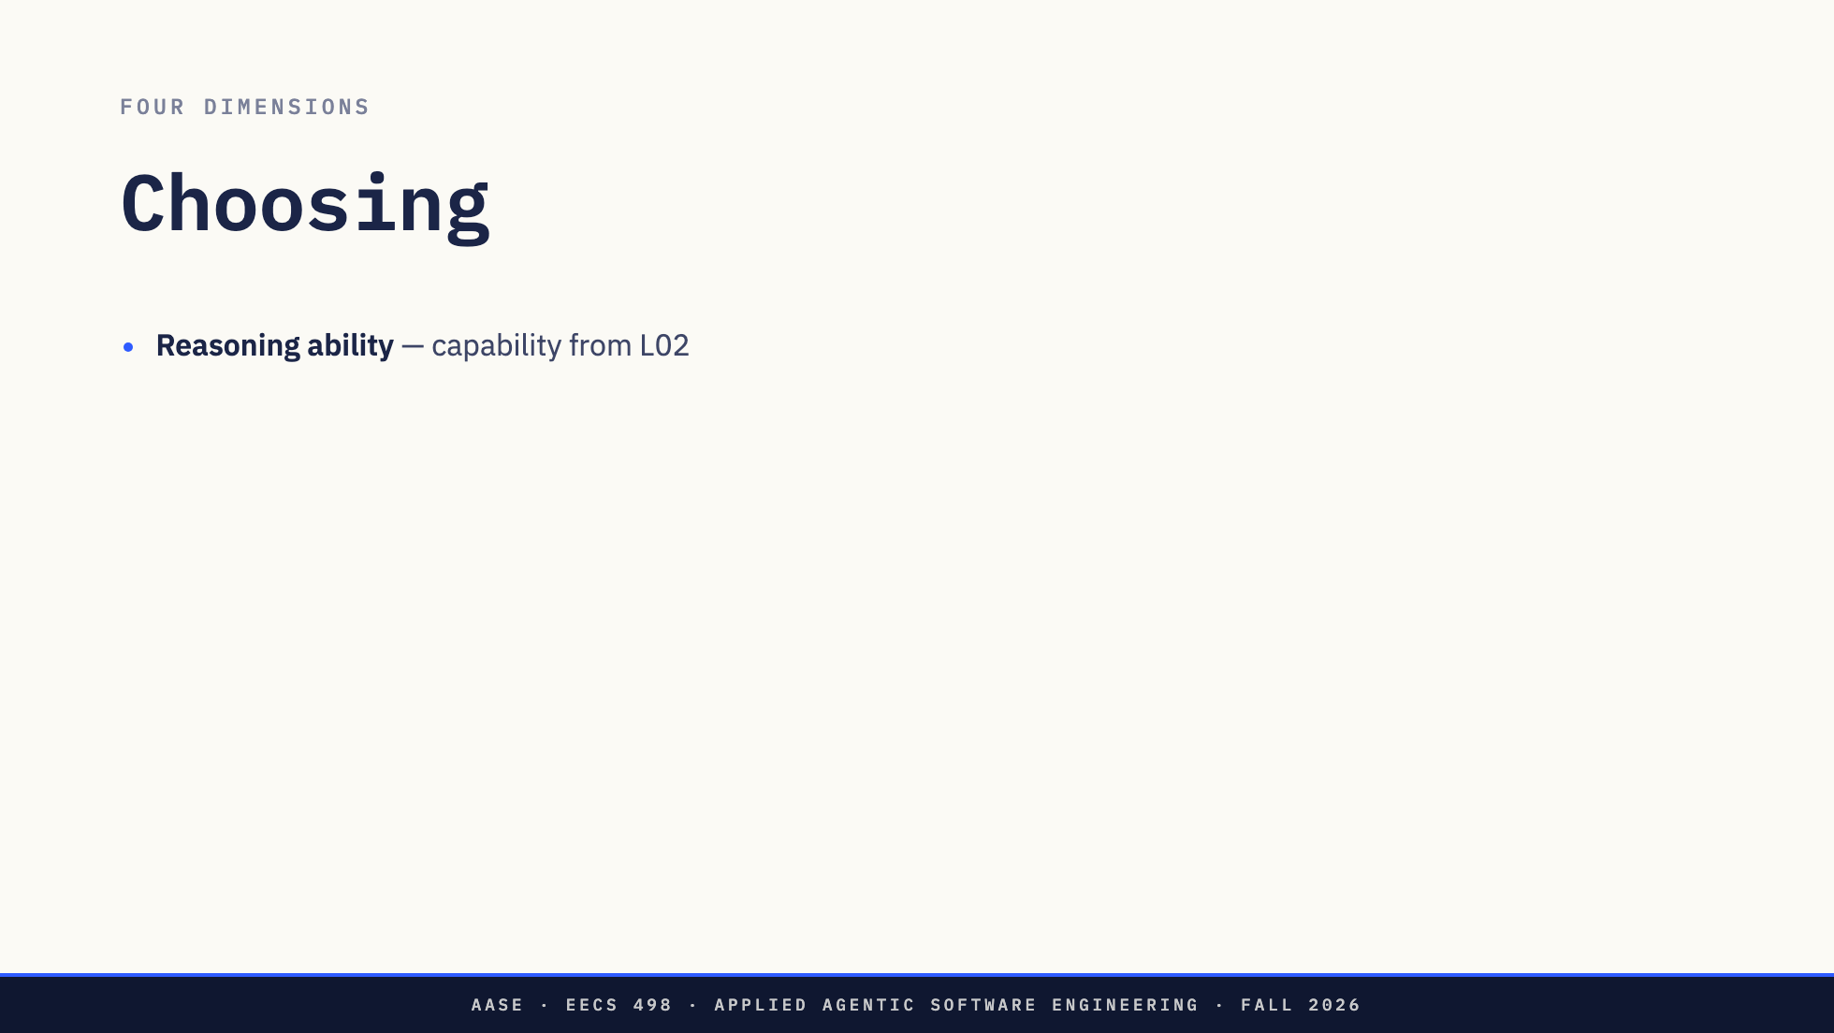
Notes:
Speed and size track reasoning ability. Smarter tends to be bigger, which on their own hardware means slower and hungrier for RAM rather than more expensive in dollars. The tradeoff does not disappear when the bill does. Some models do 128K, some do 1M, and L02 already told them bigger is not automatically better. Needle in a haystack is real.

Slide 22
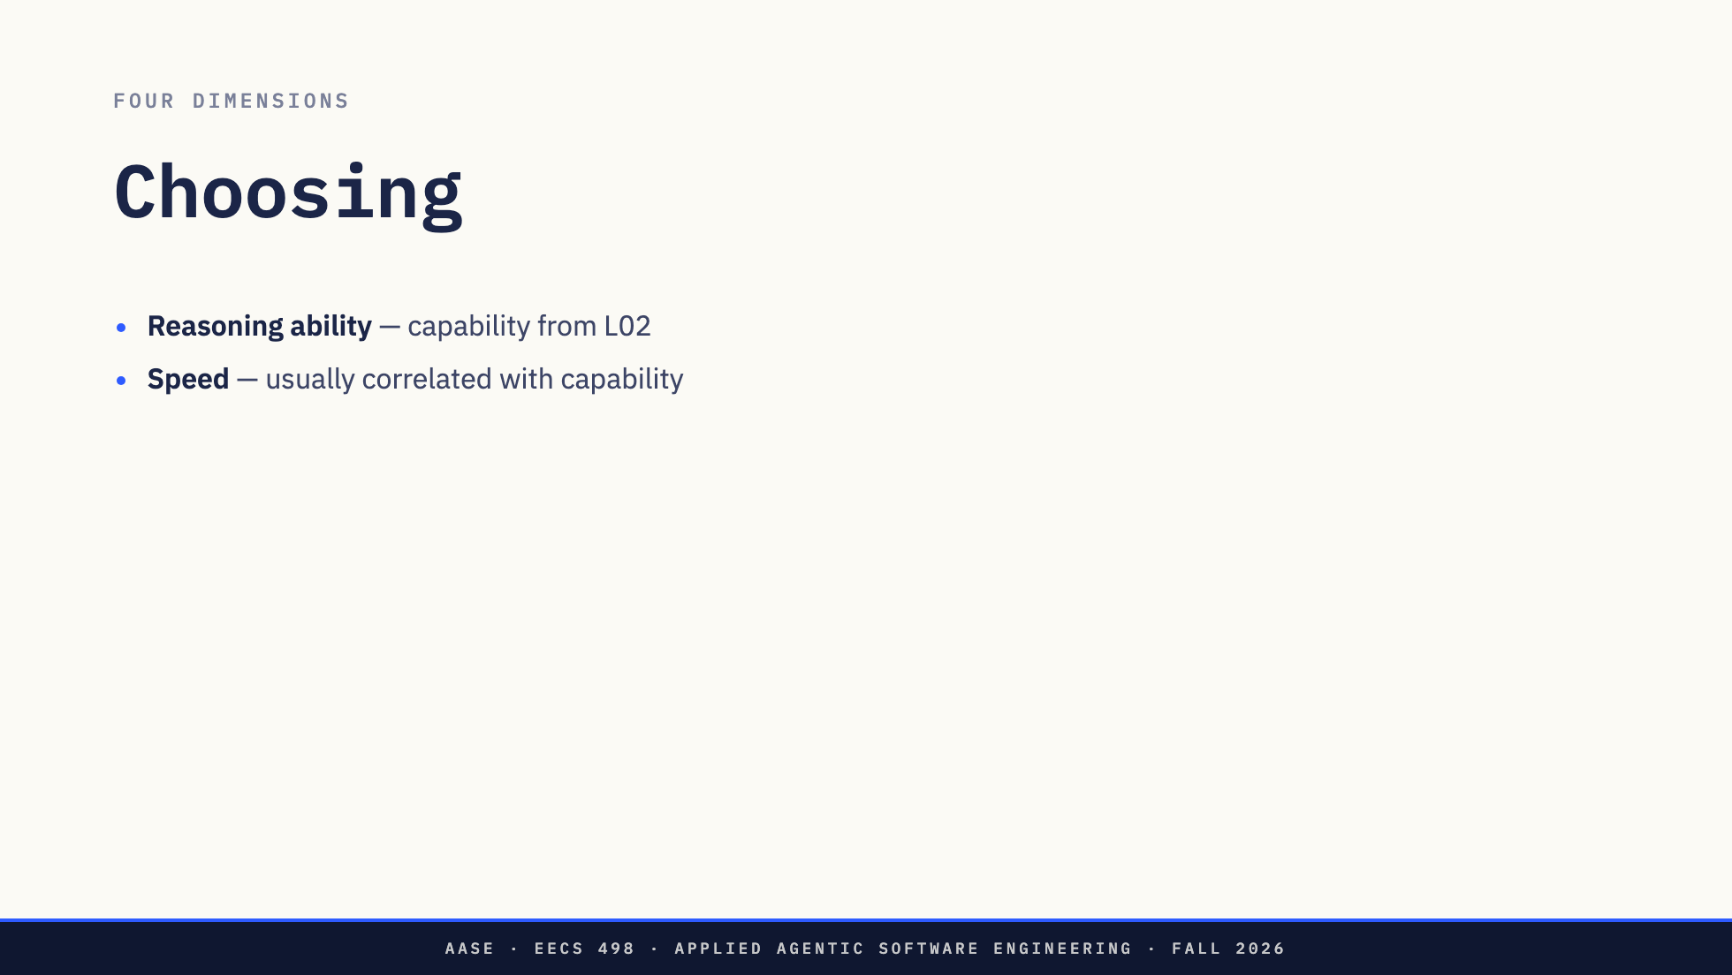
Notes:
Speed and size track reasoning ability. Smarter tends to be bigger, which on their own hardware means slower and hungrier for RAM rather than more expensive in dollars. The tradeoff does not disappear when the bill does. Some models do 128K, some do 1M, and L02 already told them bigger is not automatically better. Needle in a haystack is real.

Slide 23
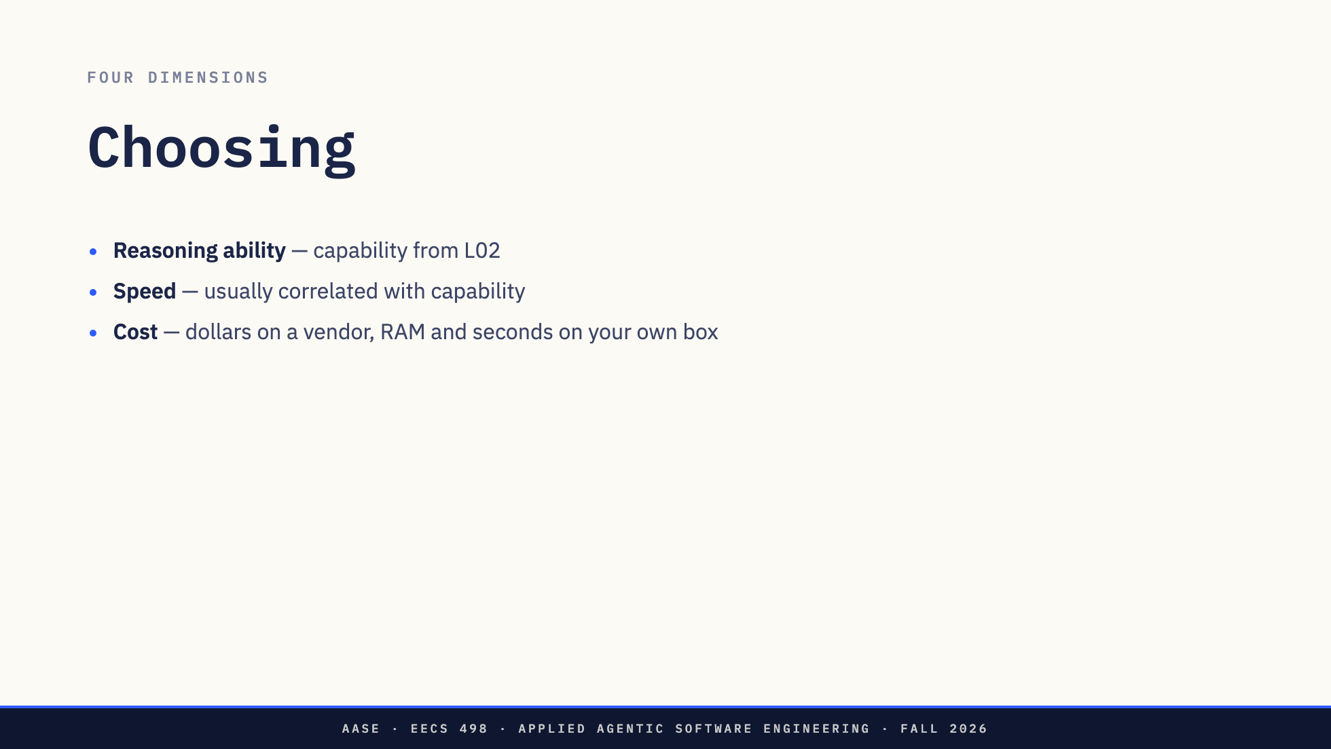
Notes:
Speed and size track reasoning ability. Smarter tends to be bigger, which on their own hardware means slower and hungrier for RAM rather than more expensive in dollars. The tradeoff does not disappear when the bill does. Some models do 128K, some do 1M, and L02 already told them bigger is not automatically better. Needle in a haystack is real.

Slide 24
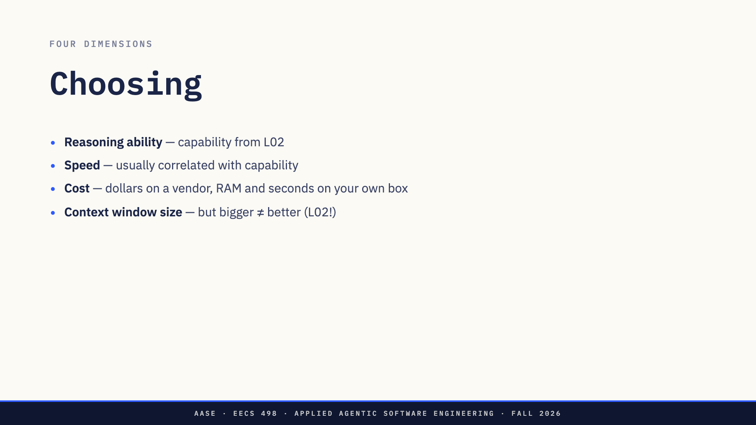
Notes:
Speed and size track reasoning ability. Smarter tends to be bigger, which on their own hardware means slower and hungrier for RAM rather than more expensive in dollars. The tradeoff does not disappear when the bill does. Some models do 128K, some do 1M, and L02 already told them bigger is not automatically better. Needle in a haystack is real.

Slide 25
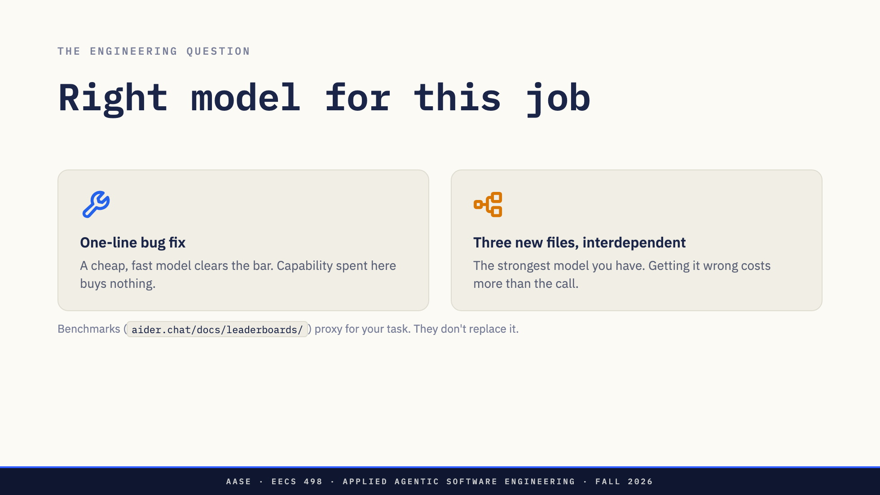
Notes:
Per task, not per term. That is the whole slide. The leaderboard is worth knowing, and it is a proxy for their task rather than a substitute for running their task.

Slide 26
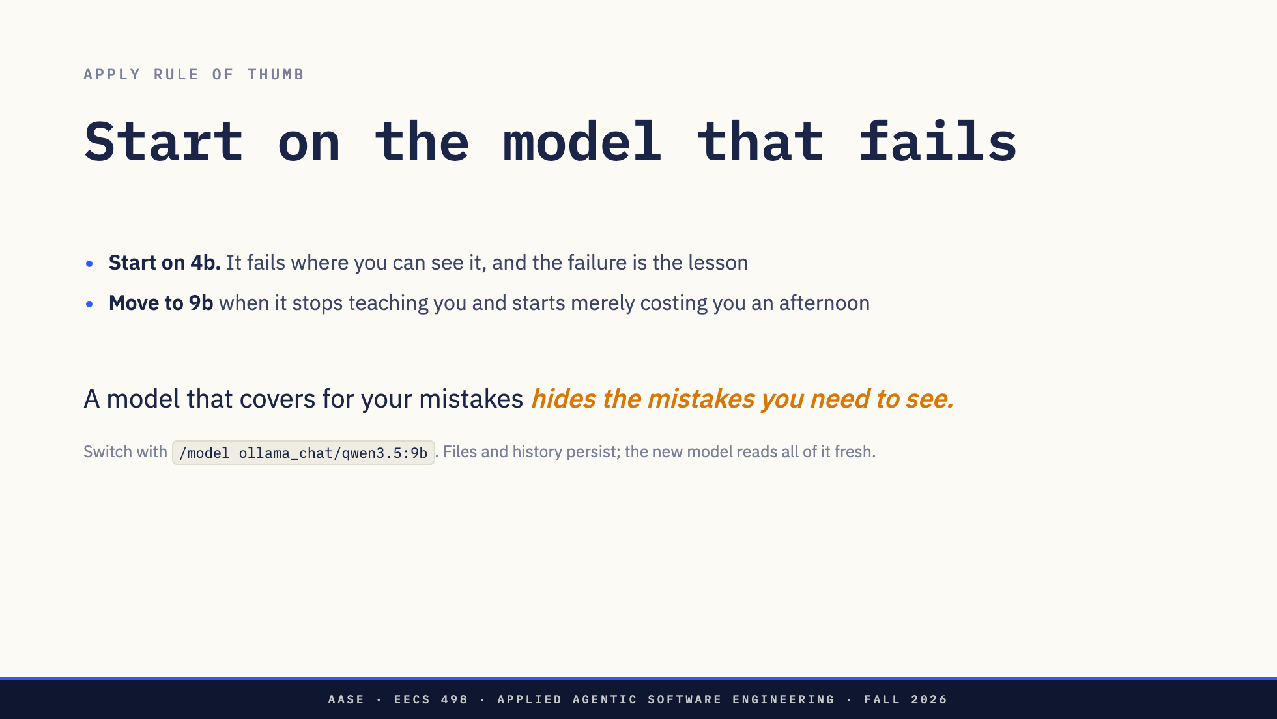
Notes:
Say out loud that this is the opposite of what they'd do at work. Crossover is around lesson 6, the first real refactor, for most of them.

Slide 27
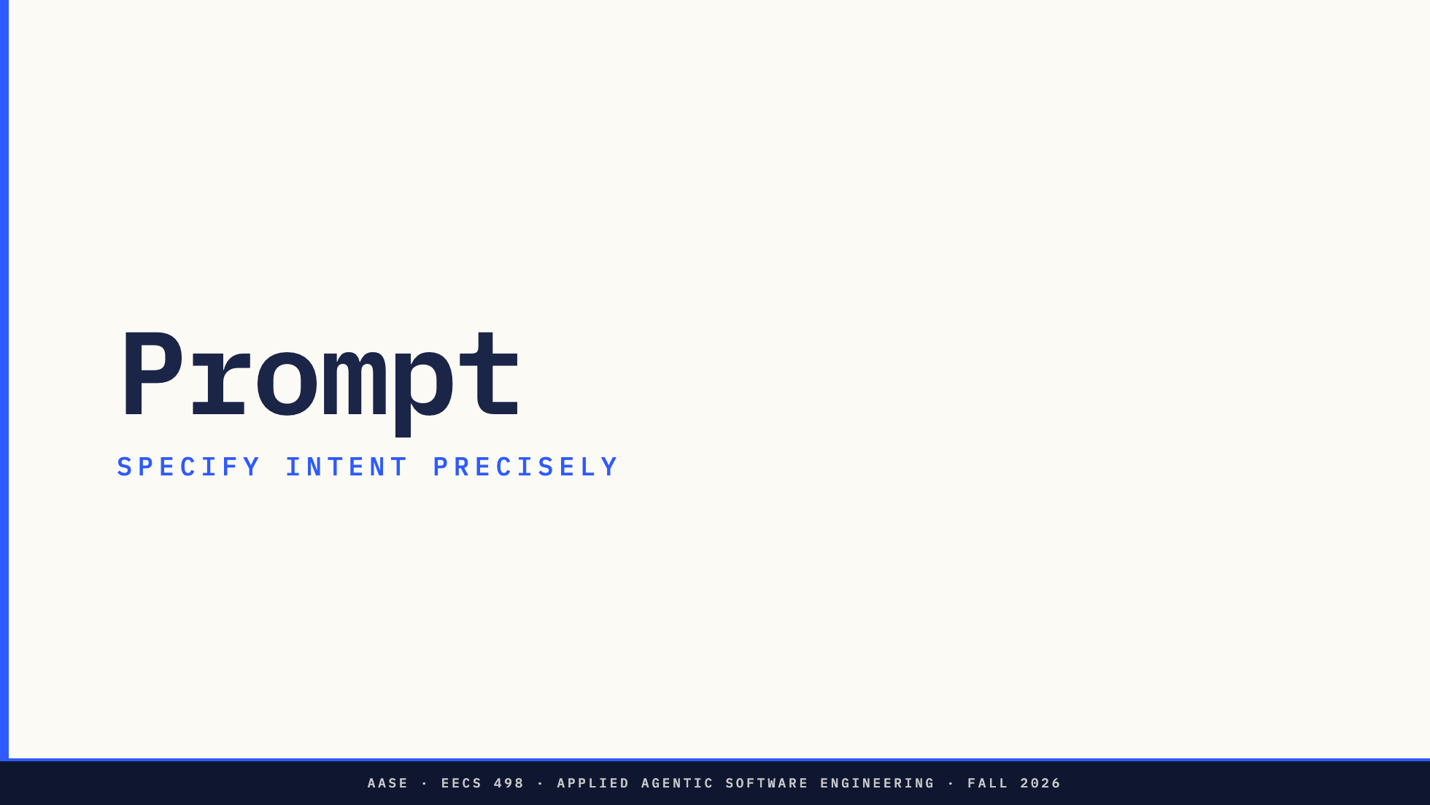
Notes:
The last lever, and the shortest section, because L04 is the whole lecture on it.

Slide 28
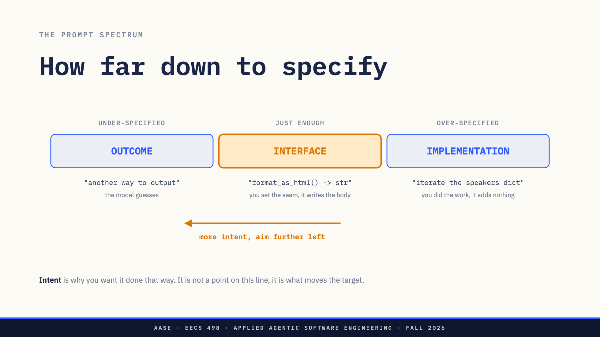
Notes:
Prompts have two parts. The instruction is what you want done. The intent is the reason you want it done that way. Leave the intent out and the model fills it from training-data priors, a guess you never got to see. The line this slide rests on: specification closes decisions, intent steers the ones you left open. That is why one is a band and the other is an arrow. Say it before you explain the arrow. Then pre-empt the misread: the arrow is not telling them to be vaguer, it is telling them the target gets wider on that end when you say why. Intent extends the left edge and does nothing to the right edge, because it cannot rescue you from having already written the code yourself. Aim for the interface: name the file, the function, the signature, the call site, and stop. You own the seam, the model writes the body. Required, not optional: the arrow has a length and its length is model capability. On the 4B it is short. A paragraph of why can bury the one sentence of what, which is L02's needle in a haystack aimed at their own prompt. Keep intent to a clause this term.

Slide 29
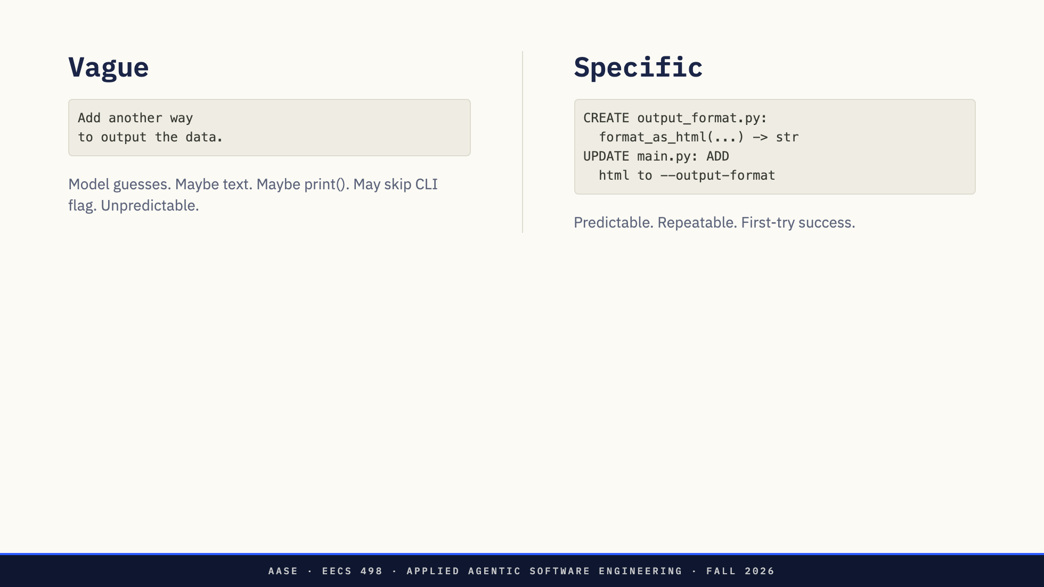
Notes:
The vague one sets a direction and leaves every specific decision to the model. It is not wrong, it is unpredictable, and unpredictable is the problem. The specific one is longer to write and faster to use. Predictability is the goal, not brevity. L04 formalizes this as an IDK prompt.

Slide 30
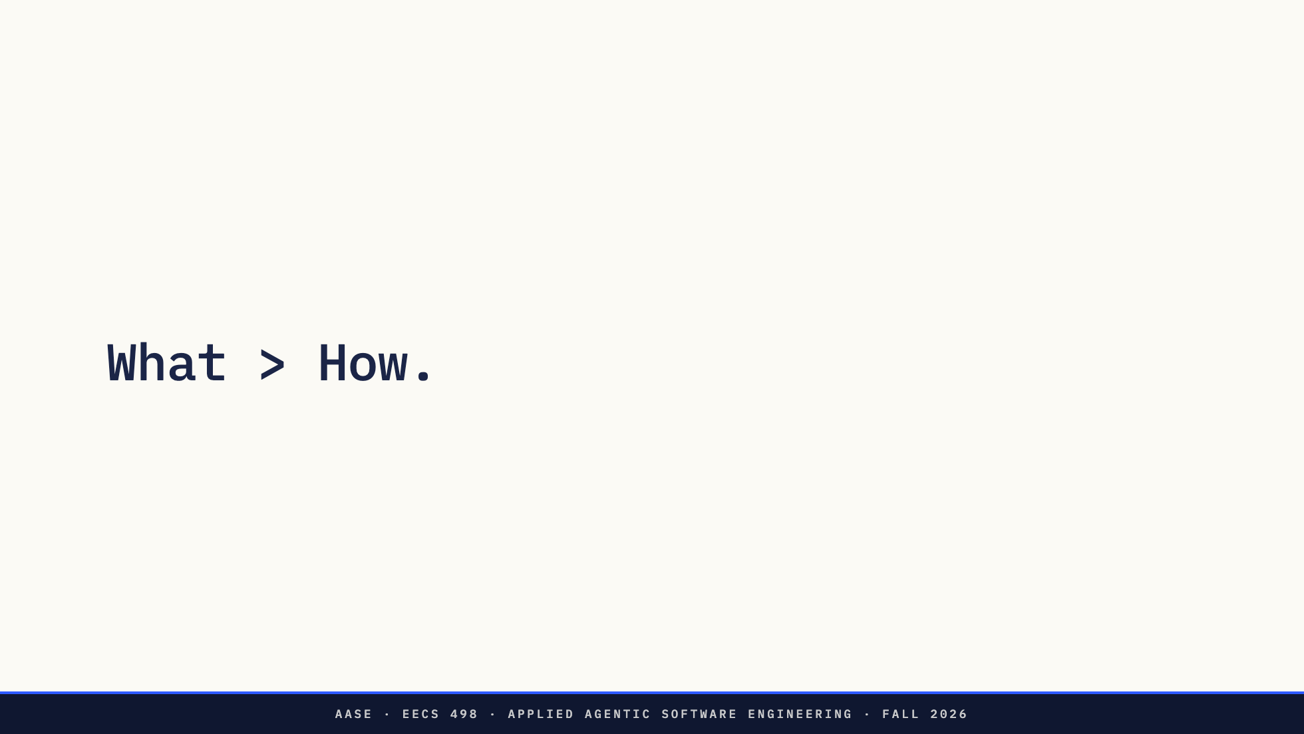
Notes:
Specify outcome, not implementation. But "what" has to be specific enough to succeed. Sharper now that they have the spectrum: specify down to the interface and stop there. "What > How" is not "be vague and the AI will figure it out."

Slide 31
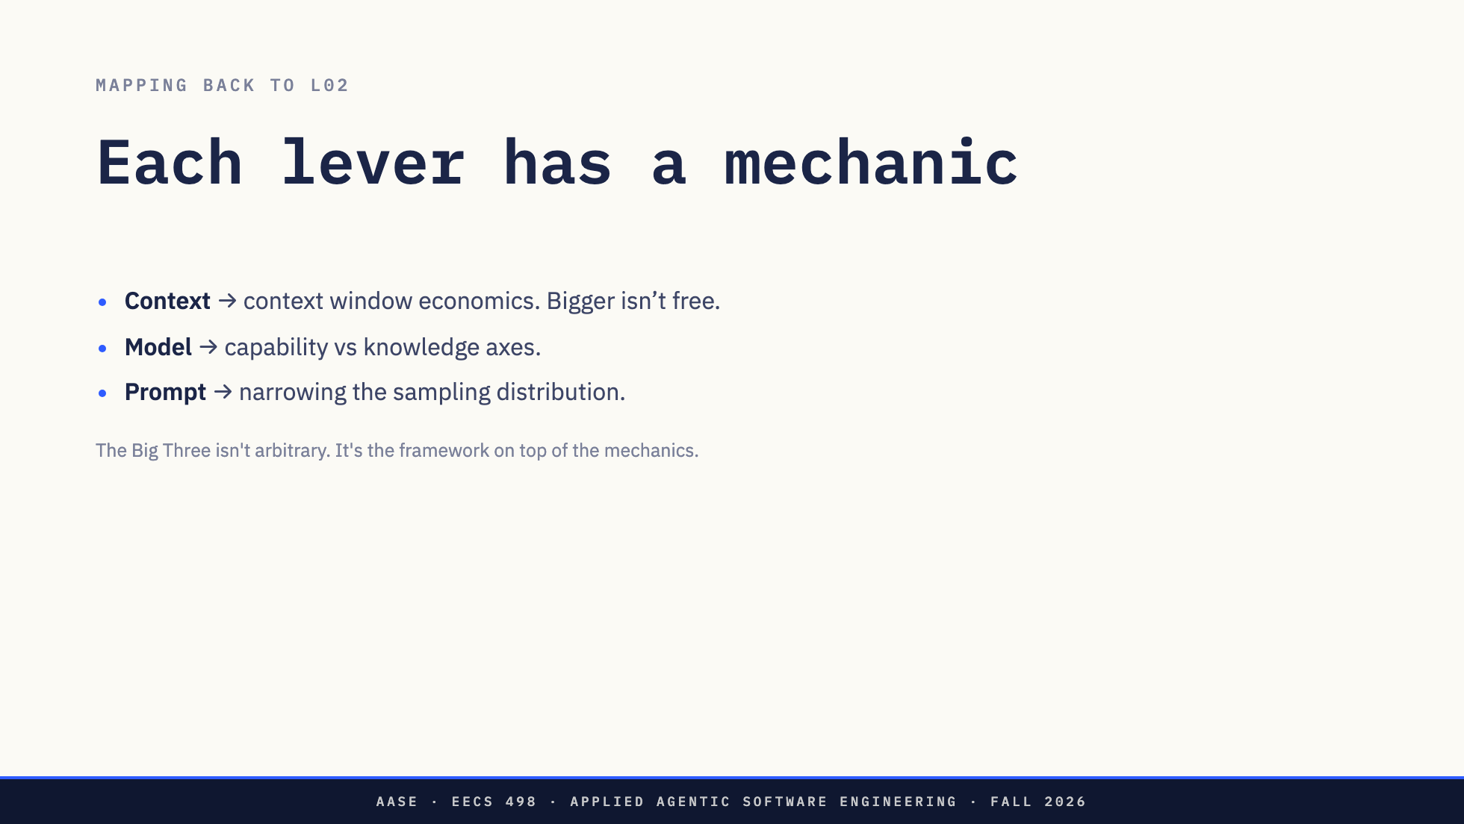
Notes:
The recap before the demo. Each lever is one of last lecture's mechanics with a handle on it. Land this: every piece of prompting advice they will ever read reduces to one of these three. "Add the file" exploits the window. "Be specific" exploits the priors.

Slide 32

Notes:
Bridge: we've named the framework and taken each lever apart. Now watch it decide an actual edit.

Slide 33
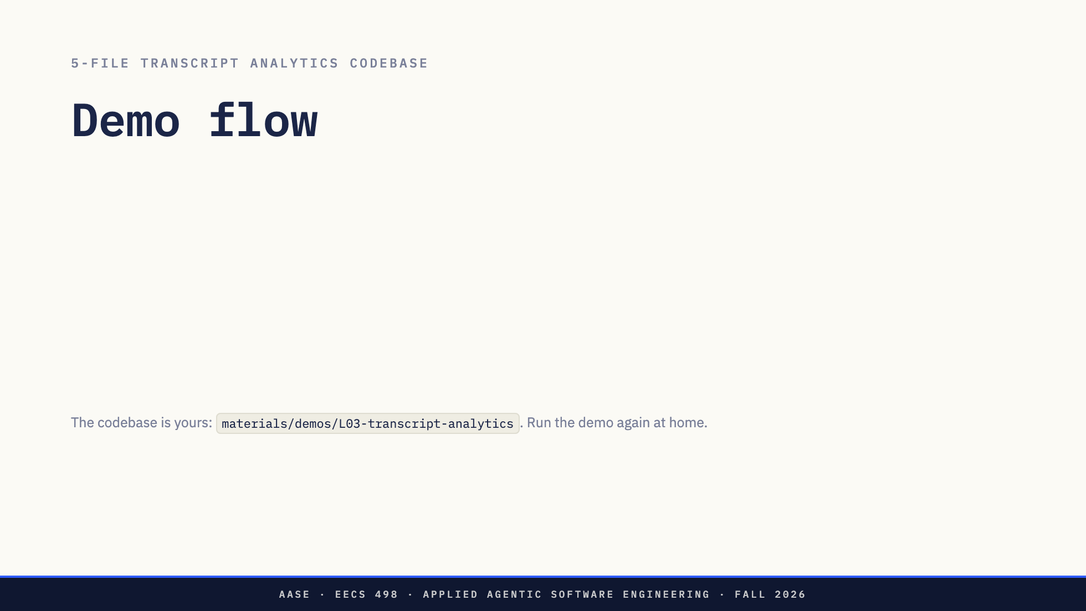
Notes:
Five files. arg_parse.py owns every command-line flag, main.py owns the counting and the printing. Say that out loud before you start, because the whole demo turns on it. Step 2 is the moment: it proposes a rewrite of a file it has never read, and what is on screen is a diff, so the minus lines are a line-by-line inventory of what it got wrong. Point at -default=DEFAULT_TOP_N against +default=10. Two prompts to decline there, not one. The second one defaults to Yes, and taking the default writes the invented file to disk and loses the demo. Step 4 is the lecture in one sentence: same model, same prompt, one more file. Step 6 drops and re-adds on purpose. Without it all five files are still in context and the 4B cannot reproduce the failure. Same mistake, faster: the failure was never the model. If a step misbehaves, say the sentence and move on. The model can only change files that are in context.

Slide 34
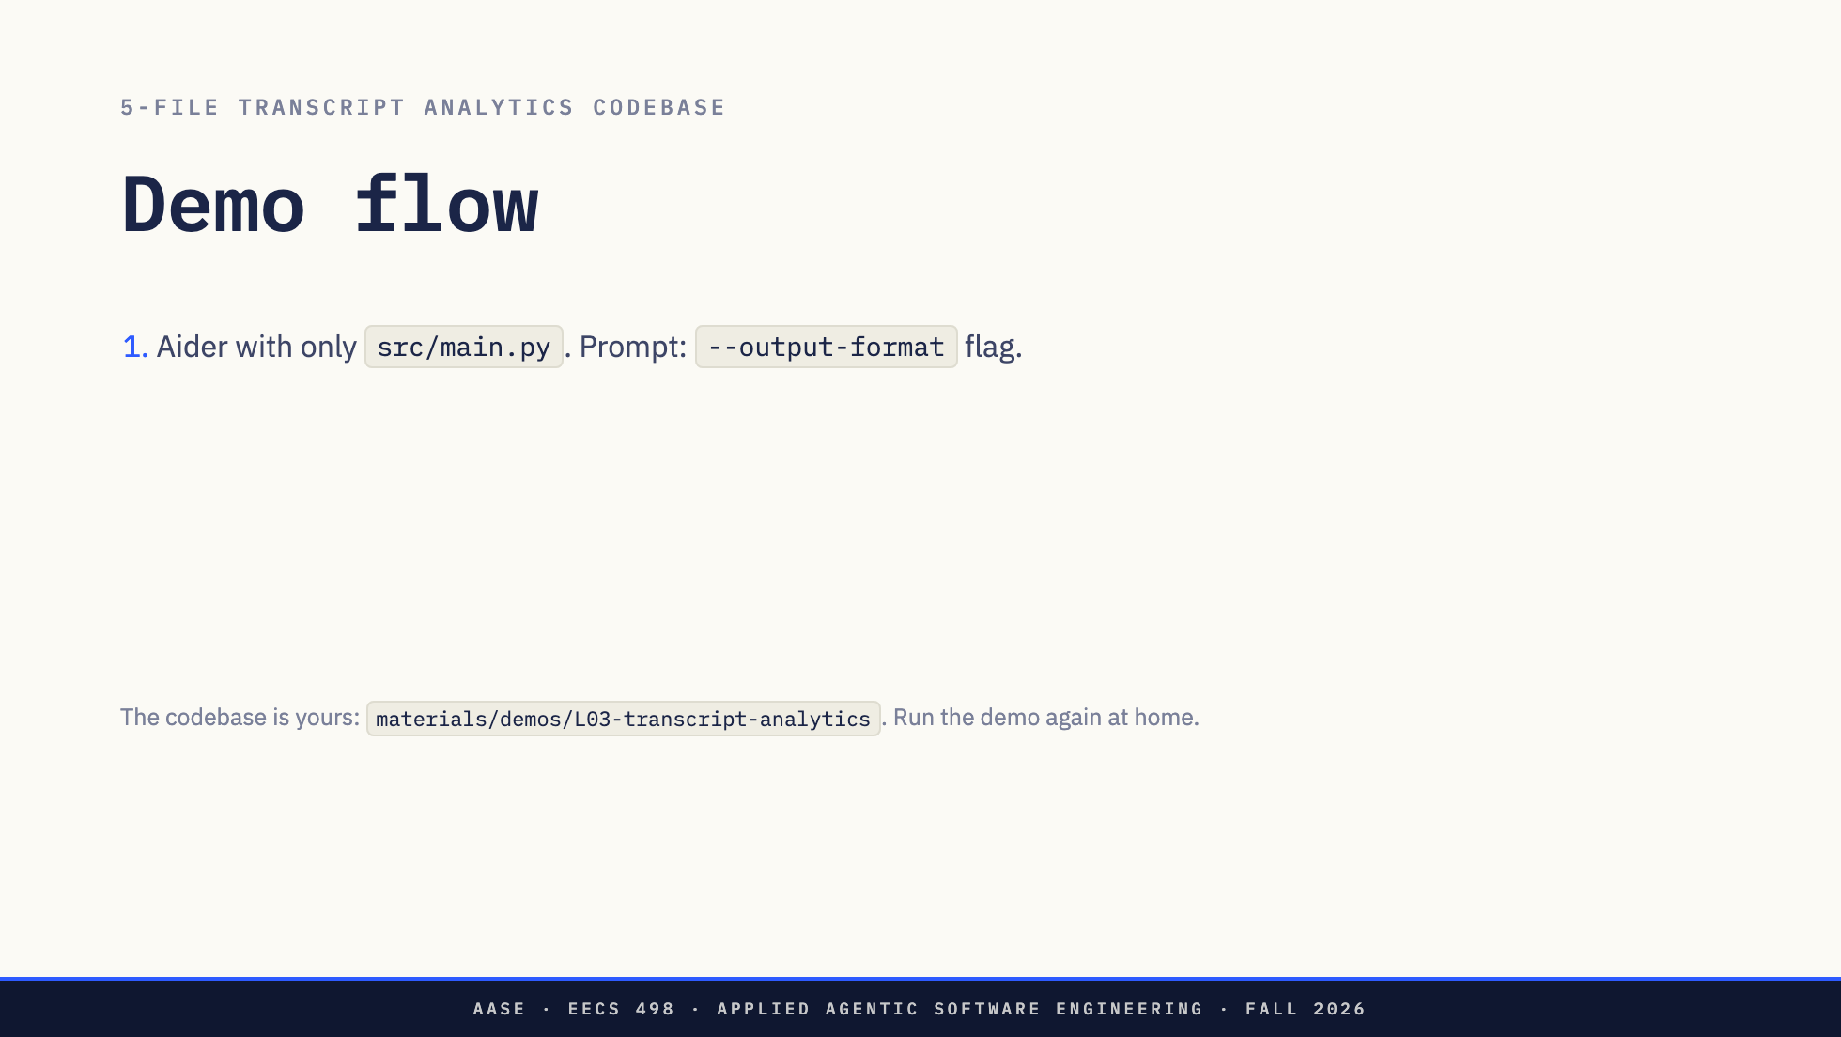
Notes:
Five files. arg_parse.py owns every command-line flag, main.py owns the counting and the printing. Say that out loud before you start, because the whole demo turns on it. Step 2 is the moment: it proposes a rewrite of a file it has never read, and what is on screen is a diff, so the minus lines are a line-by-line inventory of what it got wrong. Point at -default=DEFAULT_TOP_N against +default=10. Two prompts to decline there, not one. The second one defaults to Yes, and taking the default writes the invented file to disk and loses the demo. Step 4 is the lecture in one sentence: same model, same prompt, one more file. Step 6 drops and re-adds on purpose. Without it all five files are still in context and the 4B cannot reproduce the failure. Same mistake, faster: the failure was never the model. If a step misbehaves, say the sentence and move on. The model can only change files that are in context.

Slide 35
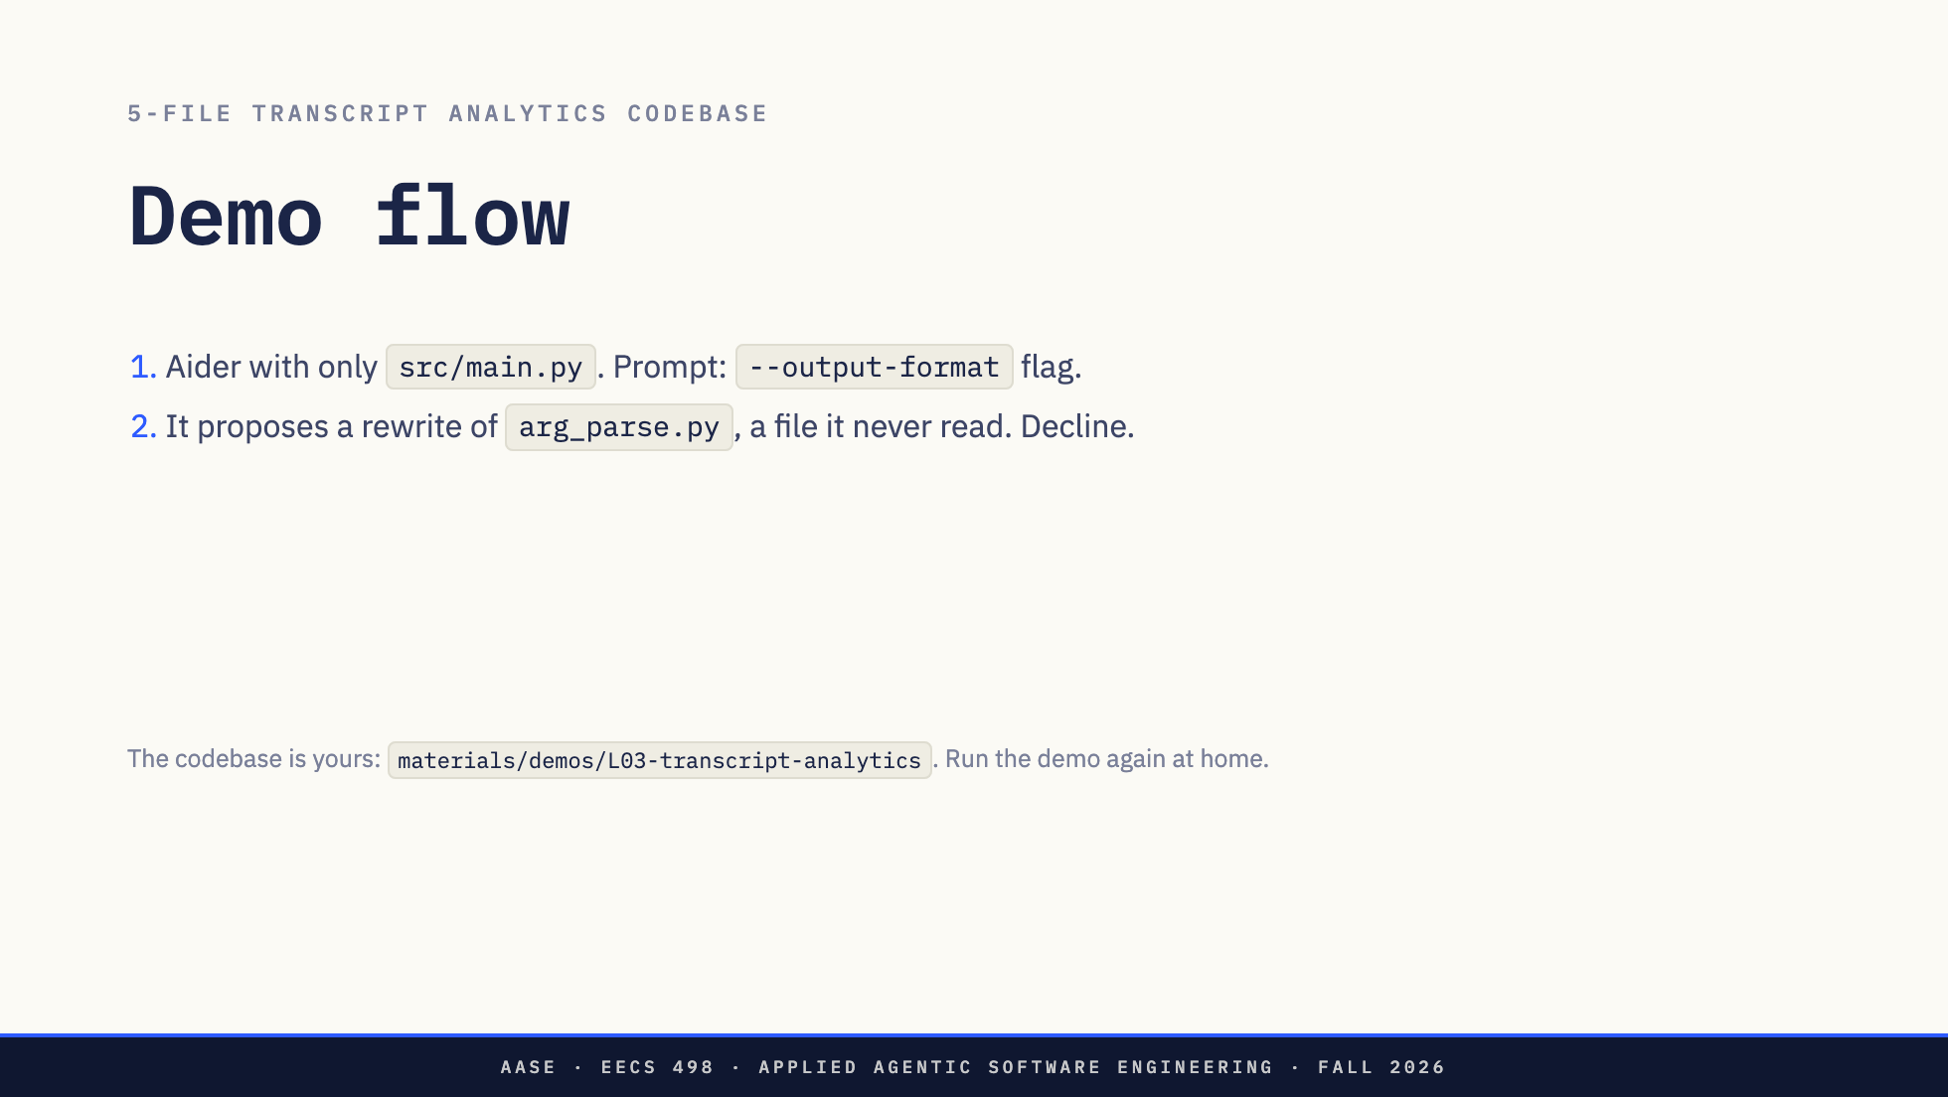
Notes:
Five files. arg_parse.py owns every command-line flag, main.py owns the counting and the printing. Say that out loud before you start, because the whole demo turns on it. Step 2 is the moment: it proposes a rewrite of a file it has never read, and what is on screen is a diff, so the minus lines are a line-by-line inventory of what it got wrong. Point at -default=DEFAULT_TOP_N against +default=10. Two prompts to decline there, not one. The second one defaults to Yes, and taking the default writes the invented file to disk and loses the demo. Step 4 is the lecture in one sentence: same model, same prompt, one more file. Step 6 drops and re-adds on purpose. Without it all five files are still in context and the 4B cannot reproduce the failure. Same mistake, faster: the failure was never the model. If a step misbehaves, say the sentence and move on. The model can only change files that are in context.

Slide 36
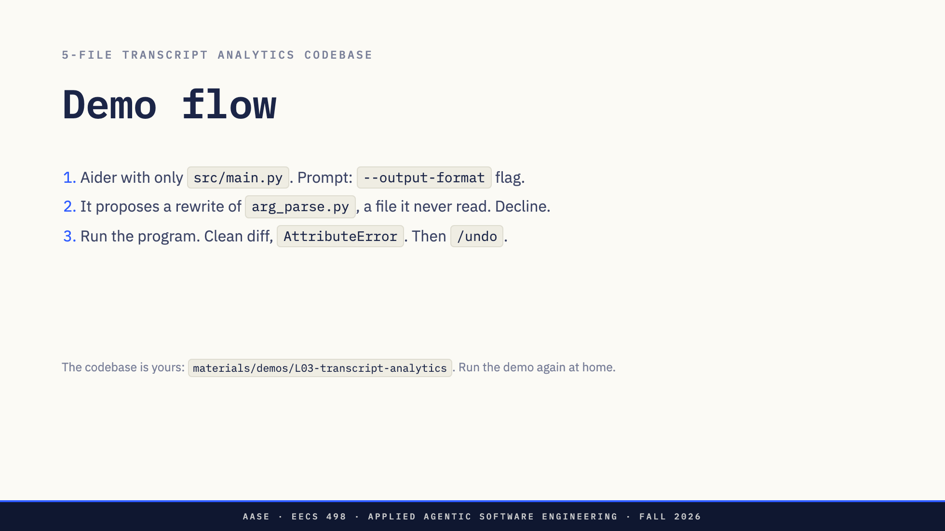
Notes:
Five files. arg_parse.py owns every command-line flag, main.py owns the counting and the printing. Say that out loud before you start, because the whole demo turns on it. Step 2 is the moment: it proposes a rewrite of a file it has never read, and what is on screen is a diff, so the minus lines are a line-by-line inventory of what it got wrong. Point at -default=DEFAULT_TOP_N against +default=10. Two prompts to decline there, not one. The second one defaults to Yes, and taking the default writes the invented file to disk and loses the demo. Step 4 is the lecture in one sentence: same model, same prompt, one more file. Step 6 drops and re-adds on purpose. Without it all five files are still in context and the 4B cannot reproduce the failure. Same mistake, faster: the failure was never the model. If a step misbehaves, say the sentence and move on. The model can only change files that are in context.

Slide 37
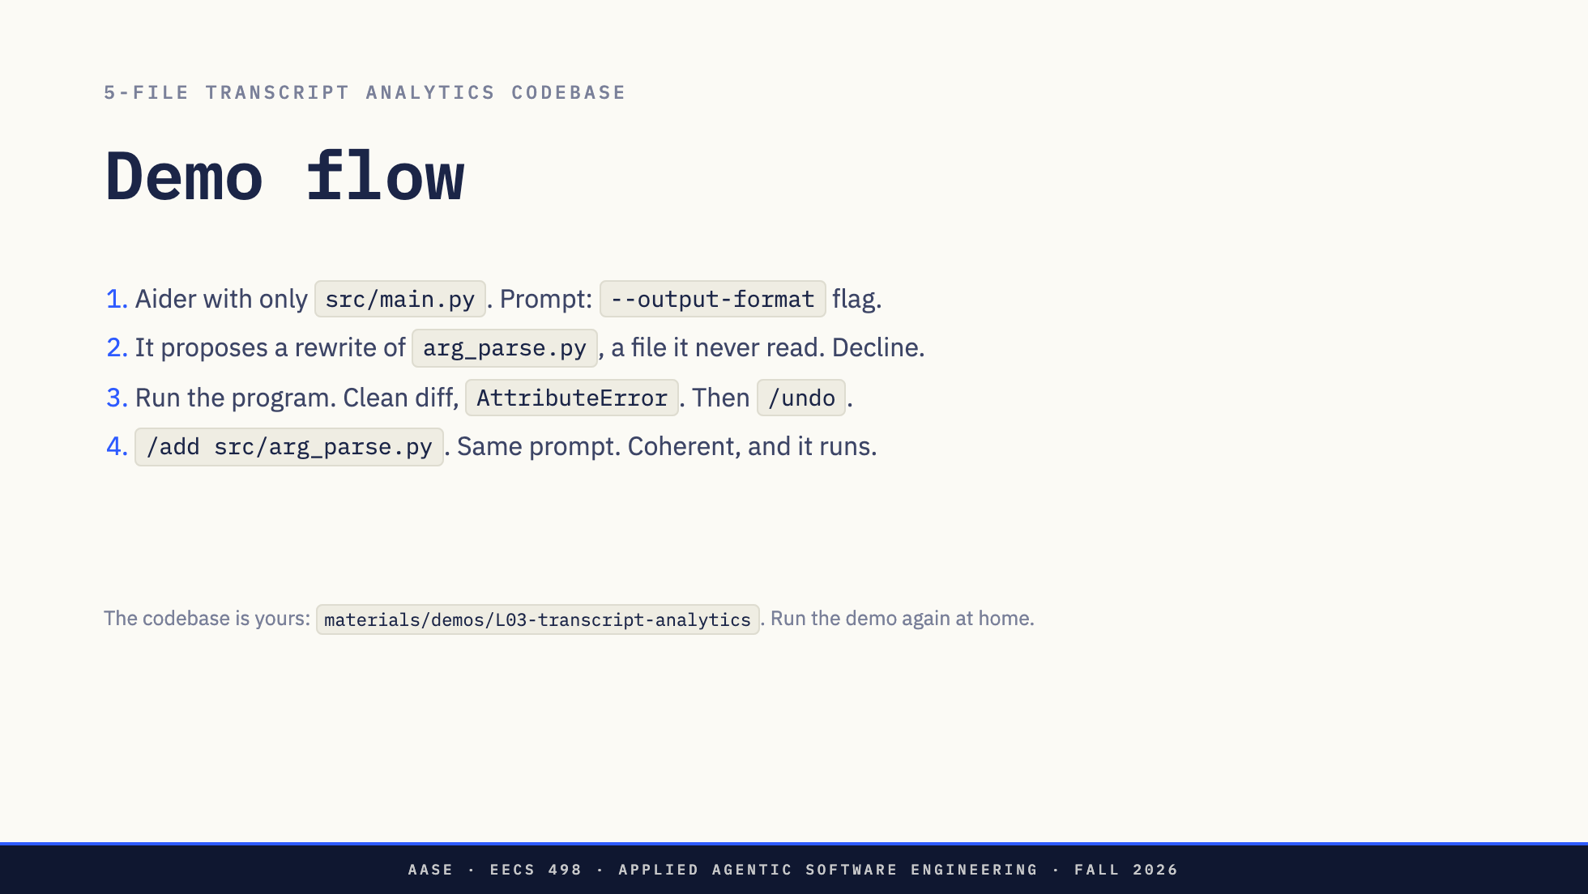
Notes:
Five files. arg_parse.py owns every command-line flag, main.py owns the counting and the printing. Say that out loud before you start, because the whole demo turns on it. Step 2 is the moment: it proposes a rewrite of a file it has never read, and what is on screen is a diff, so the minus lines are a line-by-line inventory of what it got wrong. Point at -default=DEFAULT_TOP_N against +default=10. Two prompts to decline there, not one. The second one defaults to Yes, and taking the default writes the invented file to disk and loses the demo. Step 4 is the lecture in one sentence: same model, same prompt, one more file. Step 6 drops and re-adds on purpose. Without it all five files are still in context and the 4B cannot reproduce the failure. Same mistake, faster: the failure was never the model. If a step misbehaves, say the sentence and move on. The model can only change files that are in context.

Slide 38
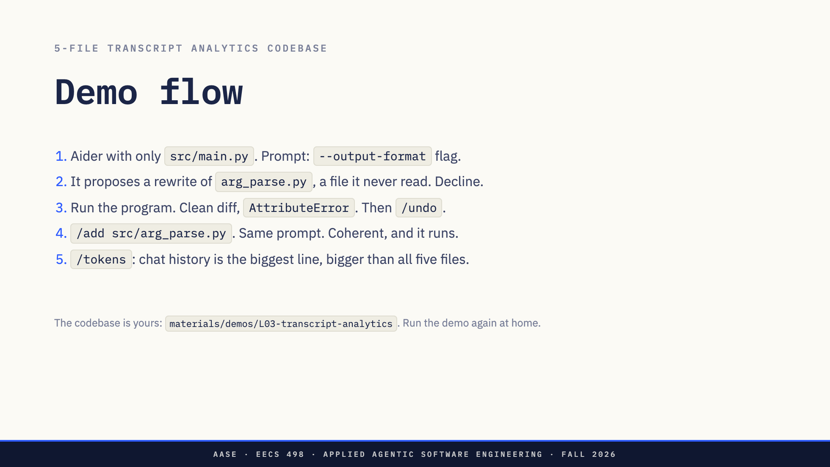
Notes:
Five files. arg_parse.py owns every command-line flag, main.py owns the counting and the printing. Say that out loud before you start, because the whole demo turns on it. Step 2 is the moment: it proposes a rewrite of a file it has never read, and what is on screen is a diff, so the minus lines are a line-by-line inventory of what it got wrong. Point at -default=DEFAULT_TOP_N against +default=10. Two prompts to decline there, not one. The second one defaults to Yes, and taking the default writes the invented file to disk and loses the demo. Step 4 is the lecture in one sentence: same model, same prompt, one more file. Step 6 drops and re-adds on purpose. Without it all five files are still in context and the 4B cannot reproduce the failure. Same mistake, faster: the failure was never the model. If a step misbehaves, say the sentence and move on. The model can only change files that are in context.

Slide 39
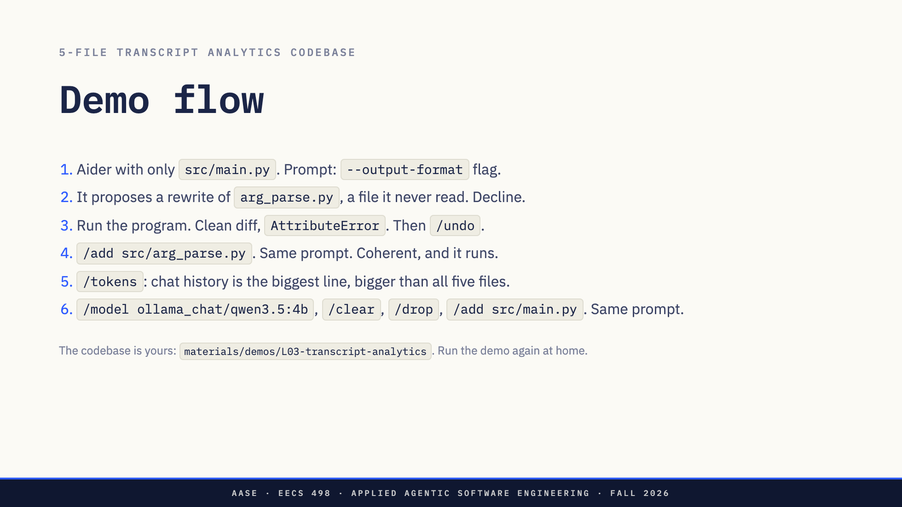
Notes:
Five files. arg_parse.py owns every command-line flag, main.py owns the counting and the printing. Say that out loud before you start, because the whole demo turns on it. Step 2 is the moment: it proposes a rewrite of a file it has never read, and what is on screen is a diff, so the minus lines are a line-by-line inventory of what it got wrong. Point at -default=DEFAULT_TOP_N against +default=10. Two prompts to decline there, not one. The second one defaults to Yes, and taking the default writes the invented file to disk and loses the demo. Step 4 is the lecture in one sentence: same model, same prompt, one more file. Step 6 drops and re-adds on purpose. Without it all five files are still in context and the 4B cannot reproduce the failure. Same mistake, faster: the failure was never the model. If a step misbehaves, say the sentence and move on. The model can only change files that are in context.

Slide 40
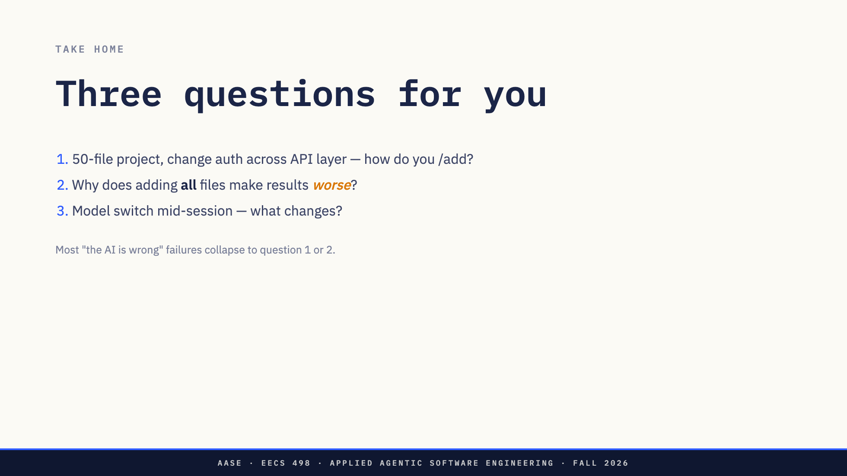
Notes:
Not rhetorical. Ask them to actually answer these before Lab01. Question 2 is the one most of them get wrong: worse, not merely more expensive.

Slide 41
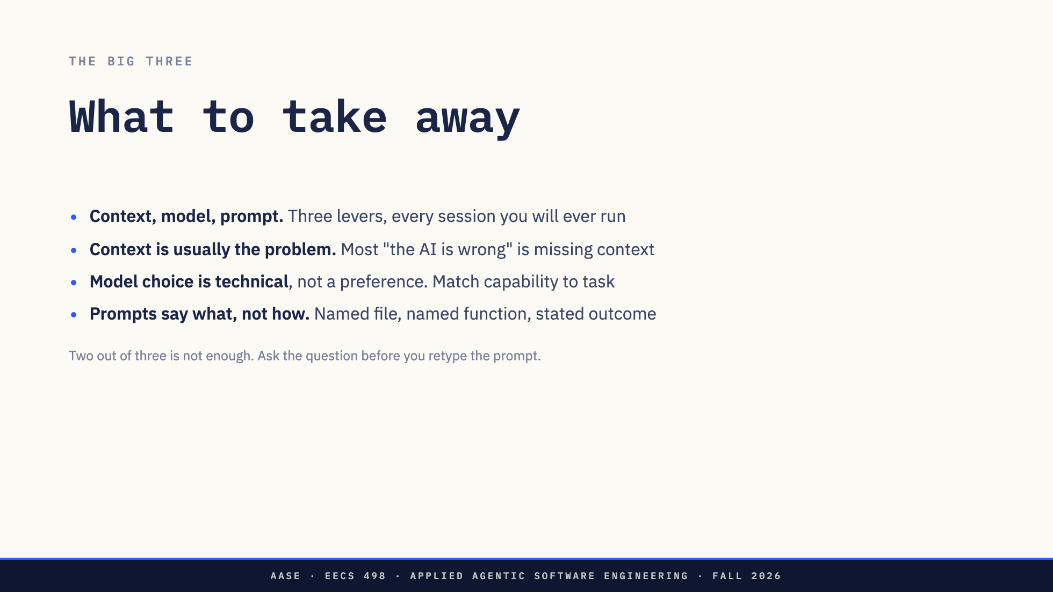
Notes:
The concrete payoff: /add and /drop are one of the seven features they implement in weeks 3 and 4. Pulling a file into context is another, and the trimming behind multi-turn history is a third. They are drilling this week the exact behaviour they will have to write.

Slide 42
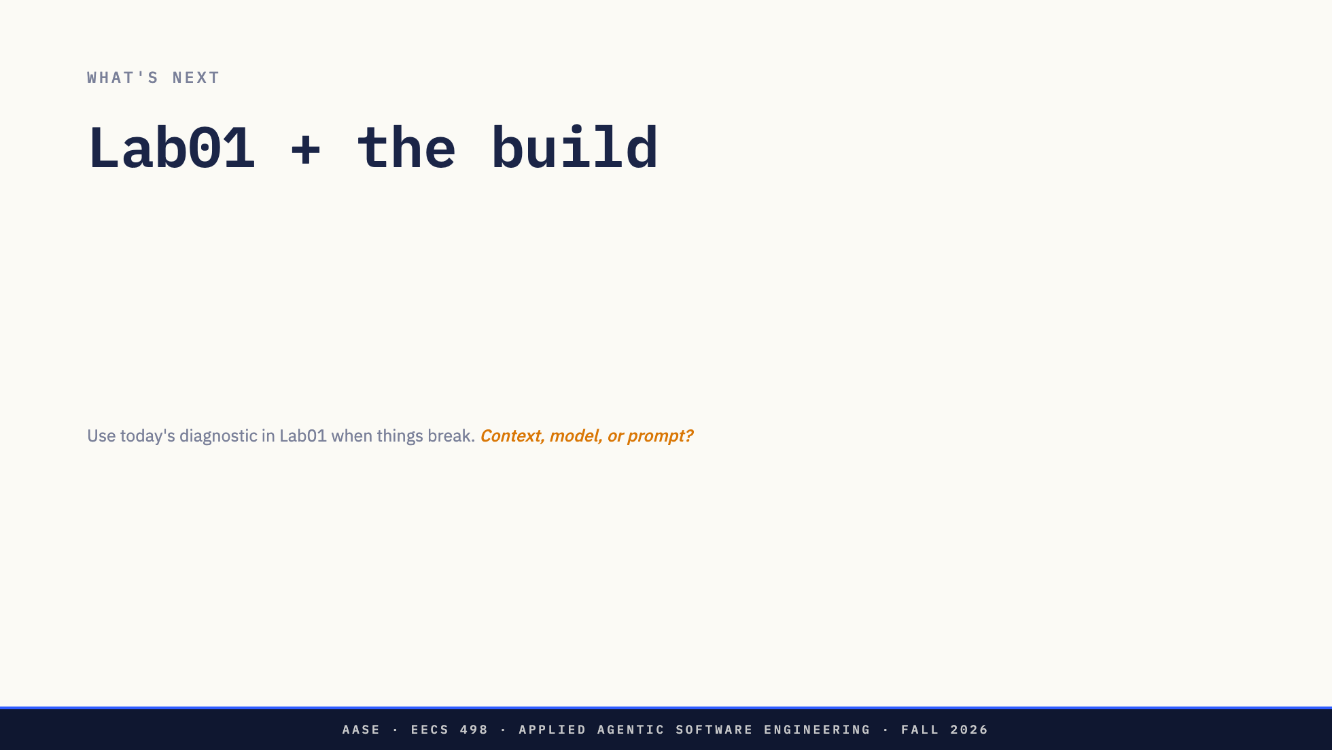
Notes:
Friday is the gate and all sixteen lessons, both. They are not building yet. The build starts after Lab01 and the spec is graded with it. Thursday is Spec-Driven Coding: plan equals prompt, the artifact that makes "be concrete" reproducible at scale, and the last technique before the build.

Slide 43
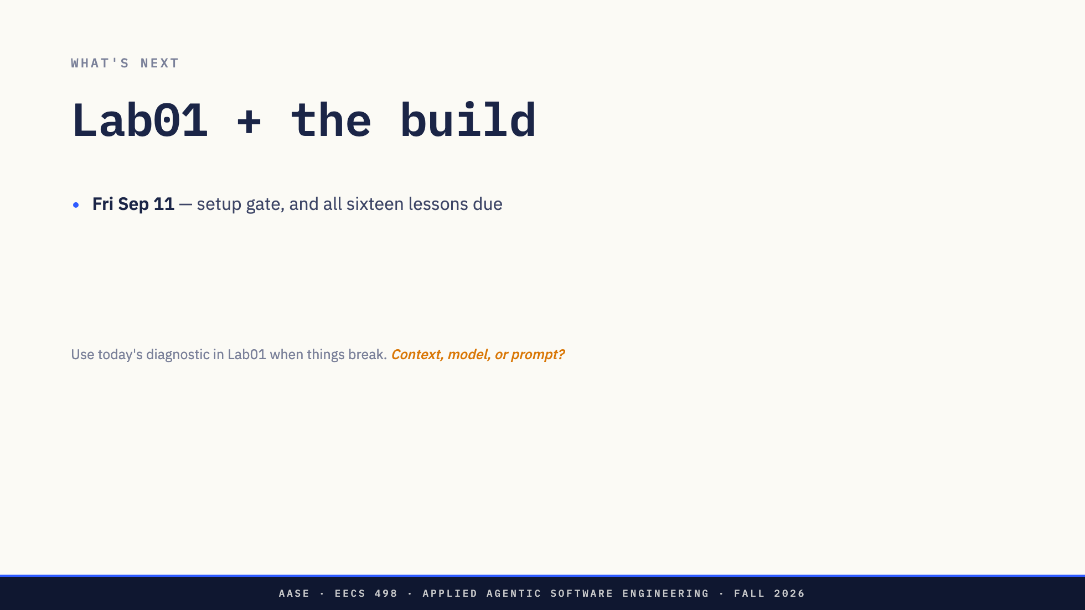
Notes:
Friday is the gate and all sixteen lessons, both. They are not building yet. The build starts after Lab01 and the spec is graded with it. Thursday is Spec-Driven Coding: plan equals prompt, the artifact that makes "be concrete" reproducible at scale, and the last technique before the build.

Slide 44
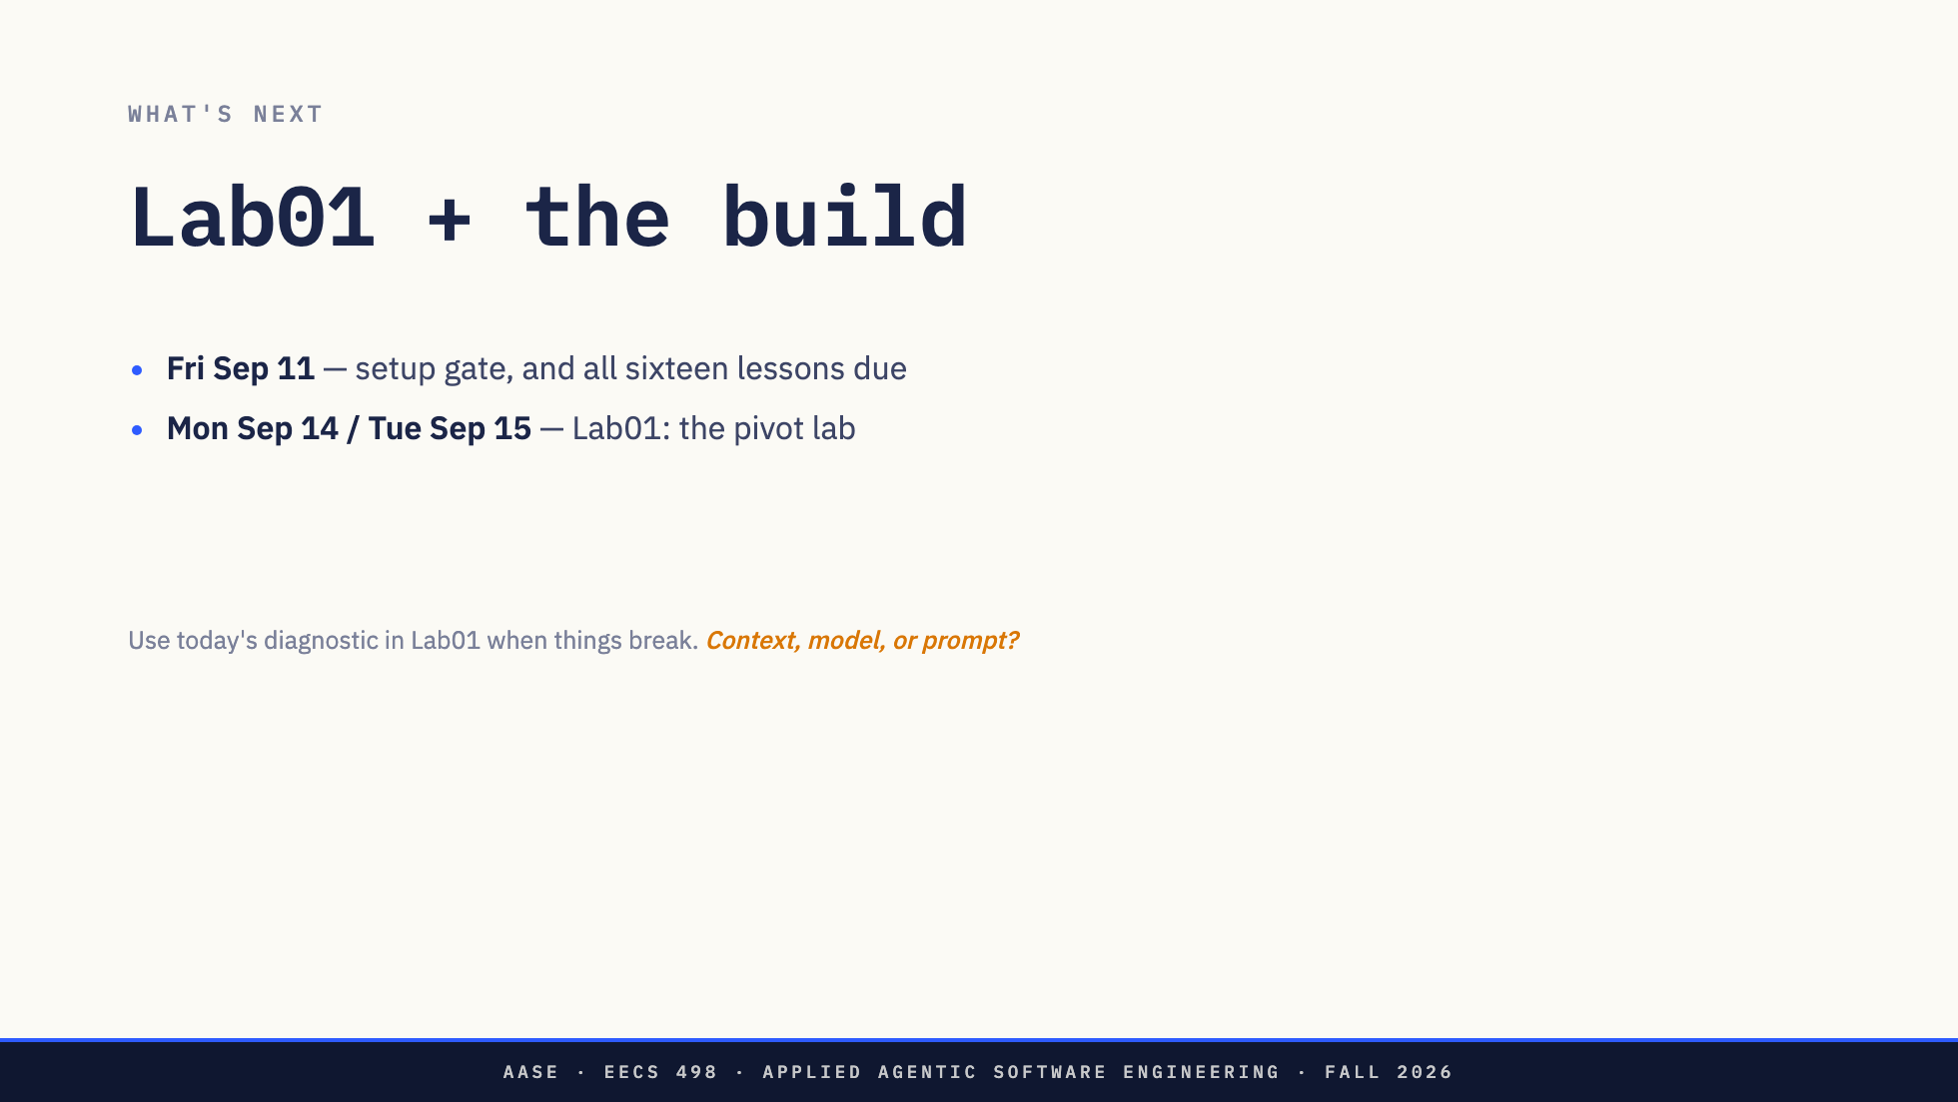
Notes:
Friday is the gate and all sixteen lessons, both. They are not building yet. The build starts after Lab01 and the spec is graded with it. Thursday is Spec-Driven Coding: plan equals prompt, the artifact that makes "be concrete" reproducible at scale, and the last technique before the build.

Slide 45
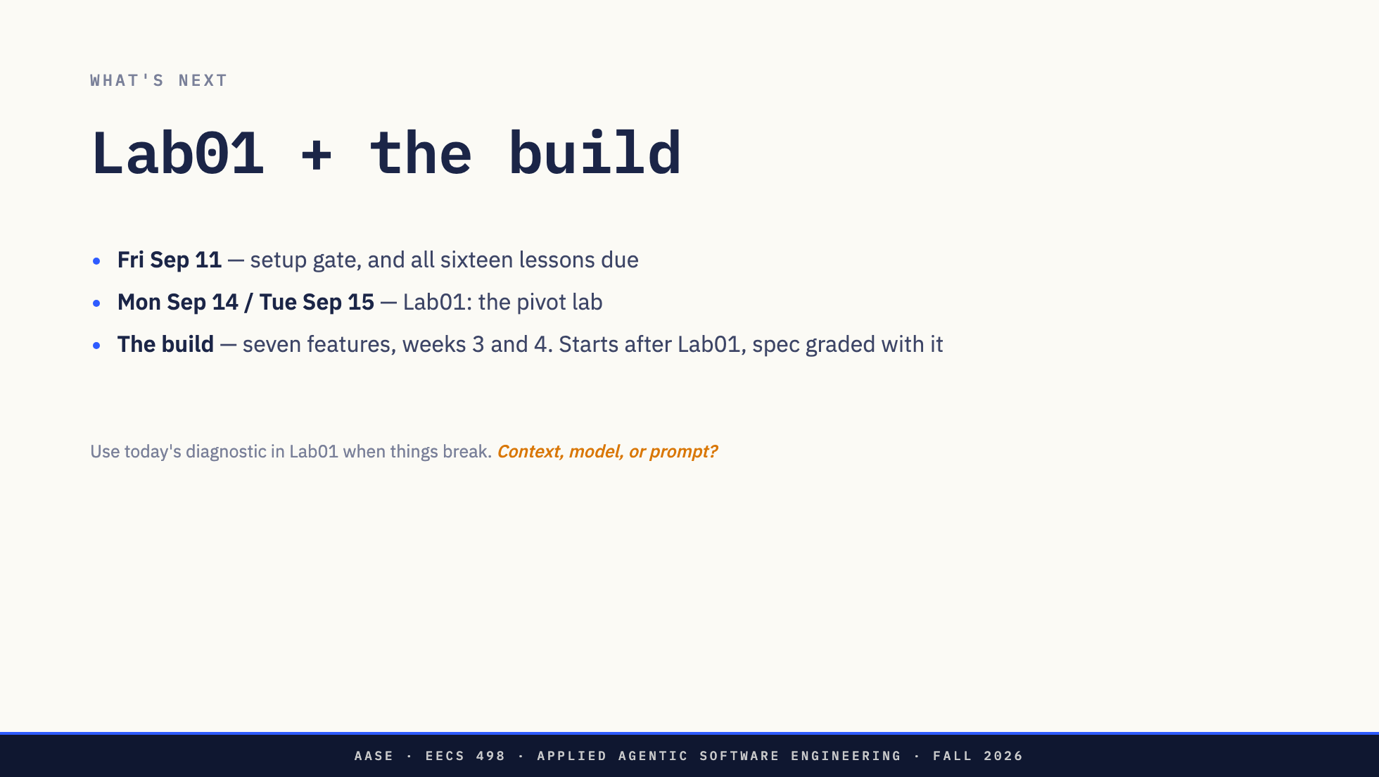
Notes:
Friday is the gate and all sixteen lessons, both. They are not building yet. The build starts after Lab01 and the spec is graded with it. Thursday is Spec-Driven Coding: plan equals prompt, the artifact that makes "be concrete" reproducible at scale, and the last technique before the build.

Slide 46
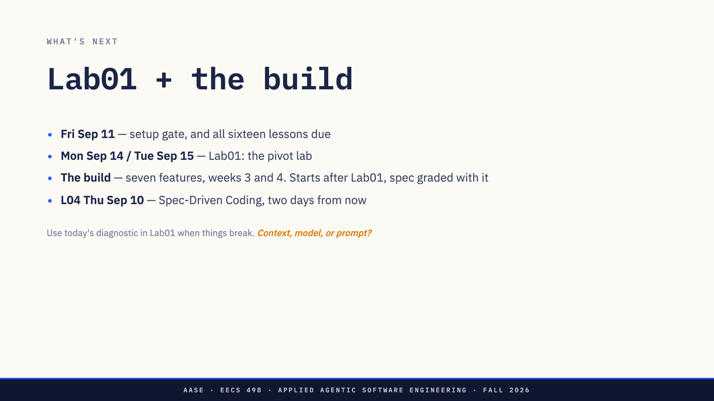
Notes:
Friday is the gate and all sixteen lessons, both. They are not building yet. The build starts after Lab01 and the spec is graded with it. Thursday is Spec-Driven Coding: plan equals prompt, the artifact that makes "be concrete" reproducible at scale, and the last technique before the build.

Slide 47
