Slide 1
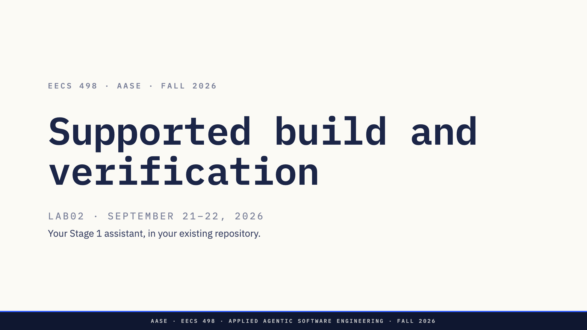
Notes:
Set a concrete goal for the work block. No new application or separate lab grade.

Slide 2
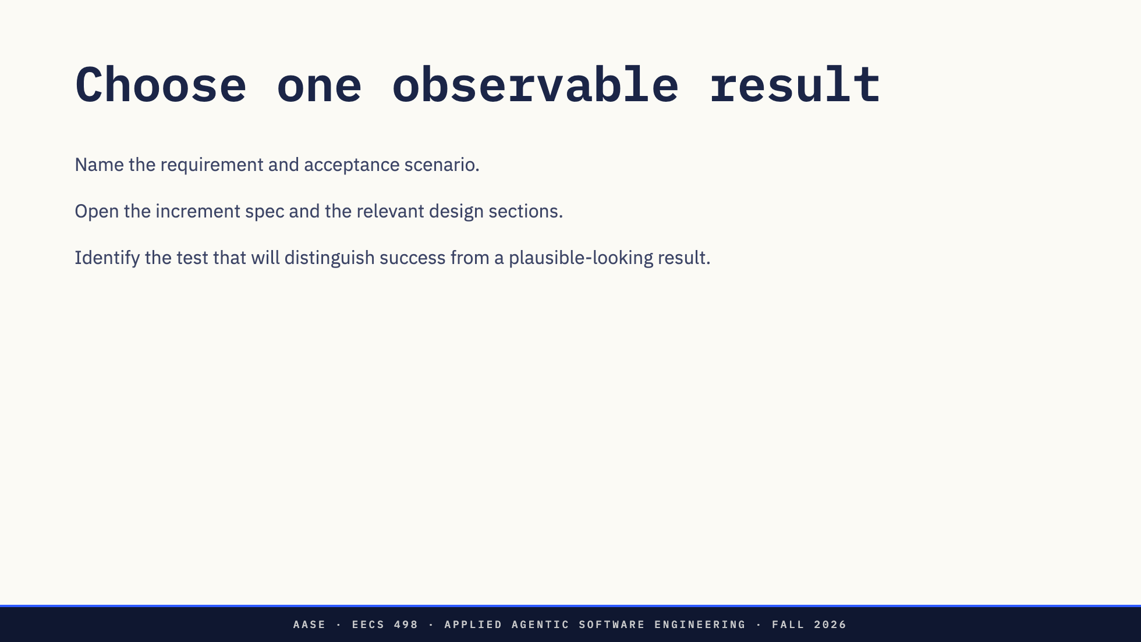
Notes:
Ten-minute intake. If design is incomplete, finish it before application implementation.

Slide 3
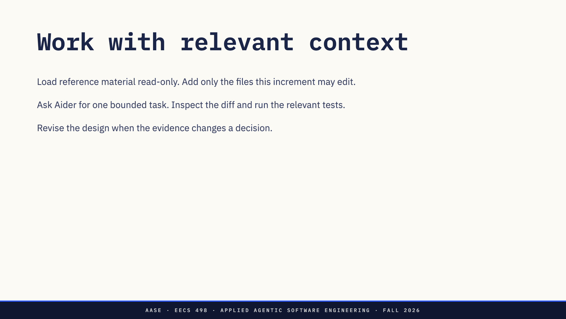
Notes:
Staff circulate during the long work block. Do not prescribe module names.

Slide 4
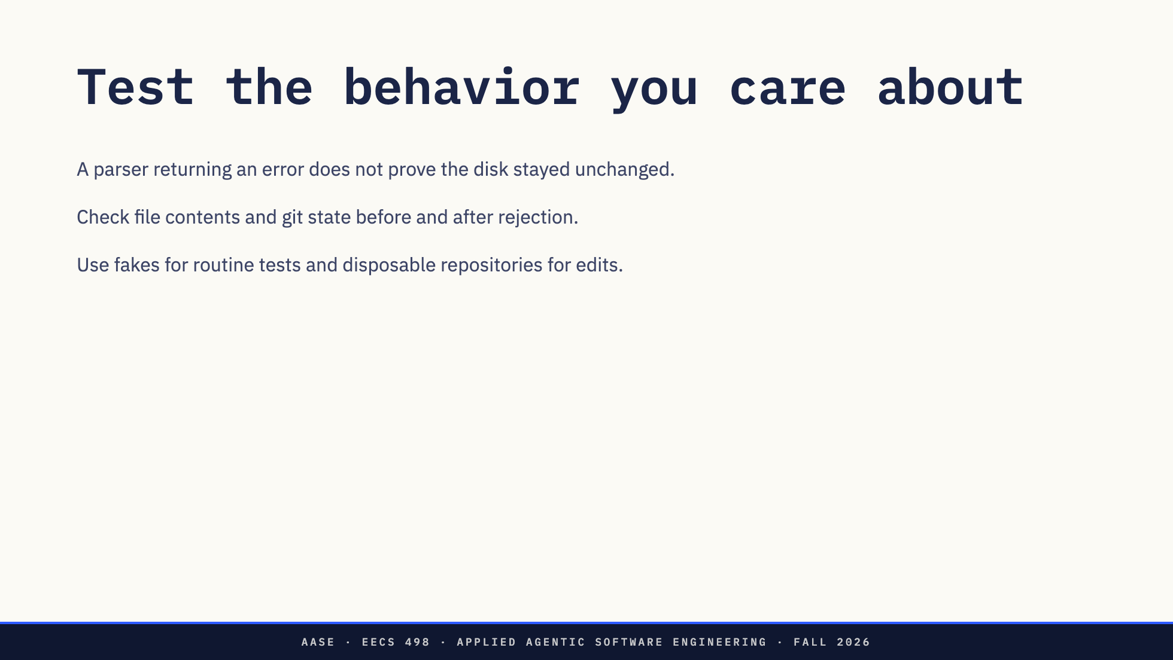
Notes:
Ask for a plausible defect each assertion would catch.

Slide 5
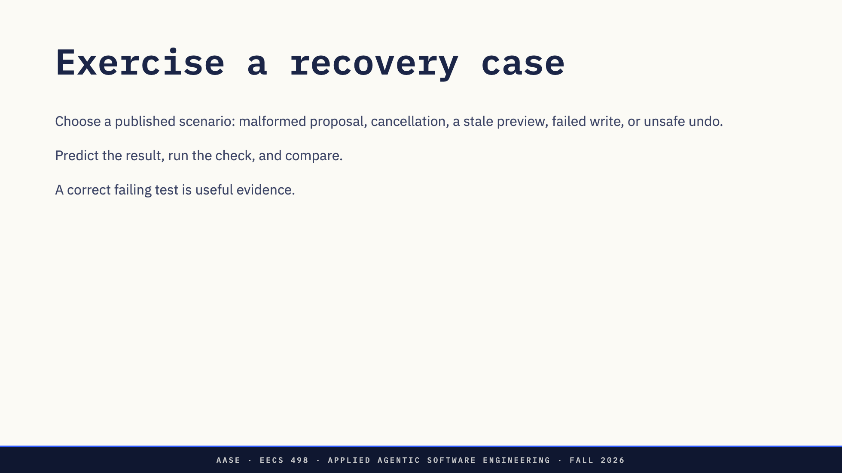
Notes:
Minutes 80–100. No live-model requirement for safety checks. Do not touch the development repository.

Slide 6
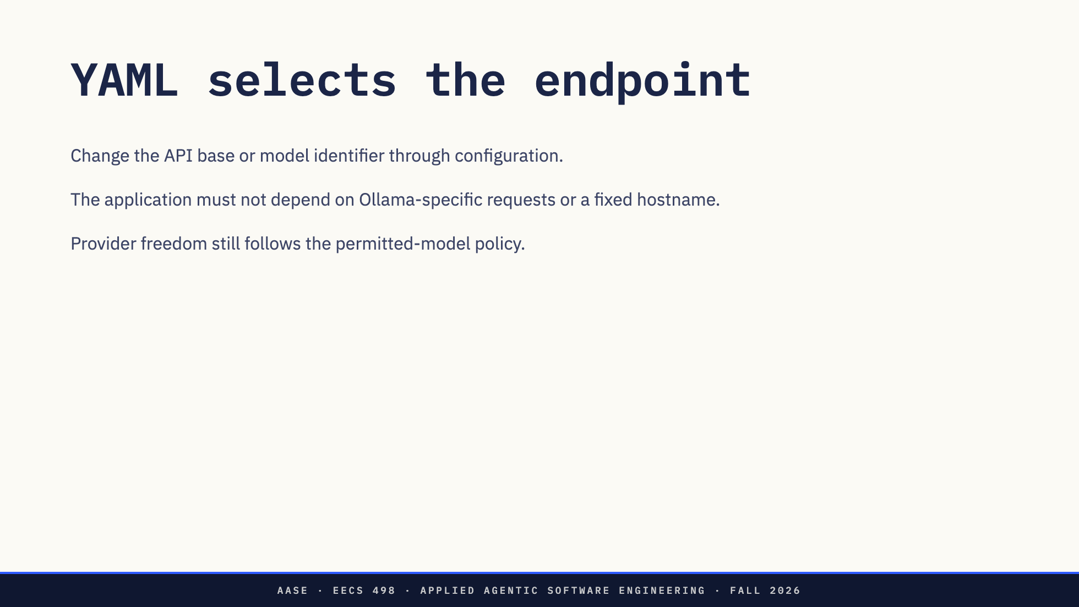
Notes:
Use fake transport for deterministic configuration checks. Aider and the application have separate YAML settings.

Slide 7
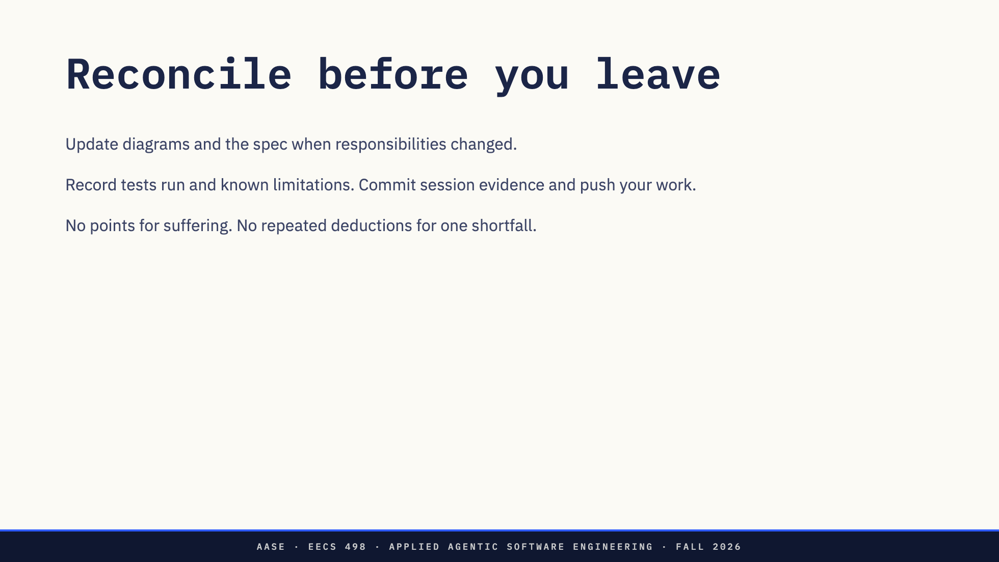
Notes:
Last ten minutes. Independent missing artifacts still lose their own points.

Slide 8
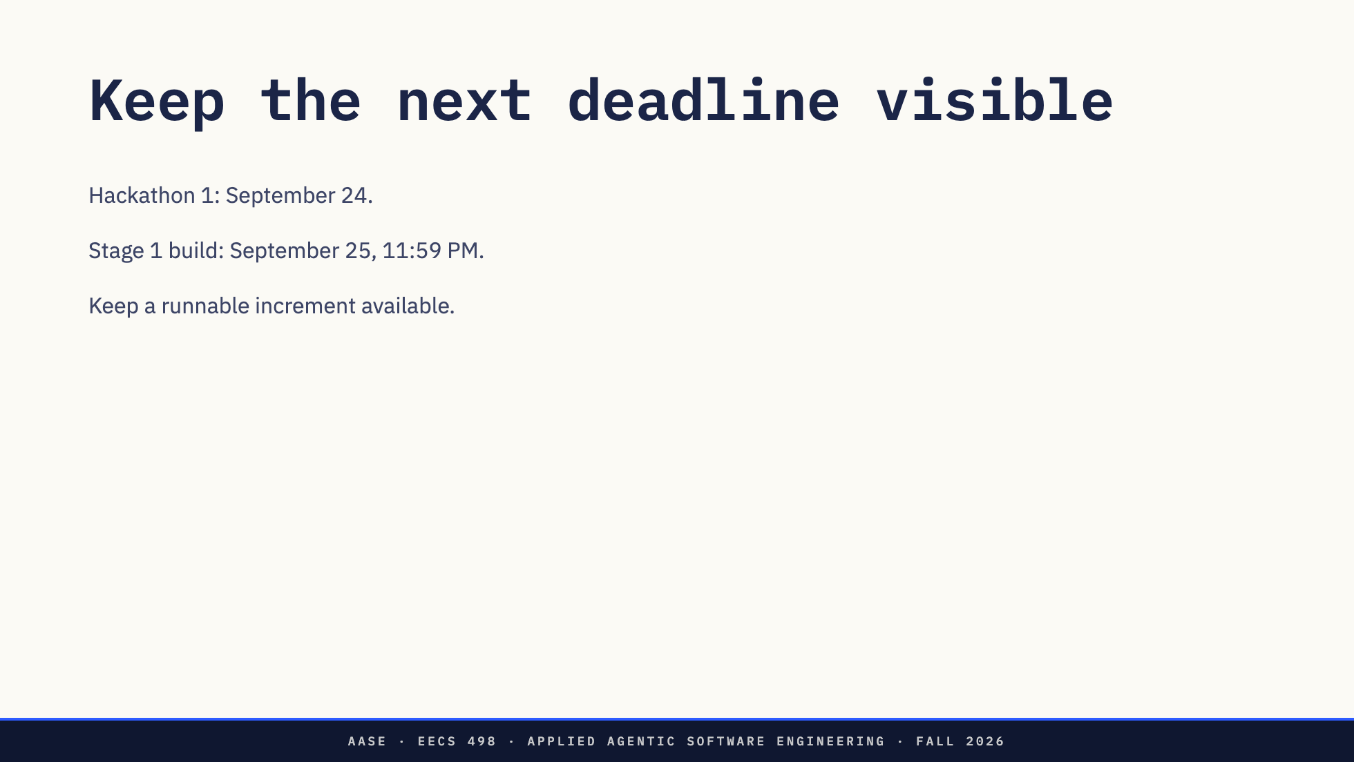
Notes:
The complete rubric and acceptance scenarios are in the student repository. Confirm event logistics through the course announcement.

