Slide 1

Notes:
Triage unfinished Stage 1 work before dependent implementation.

Slide 2
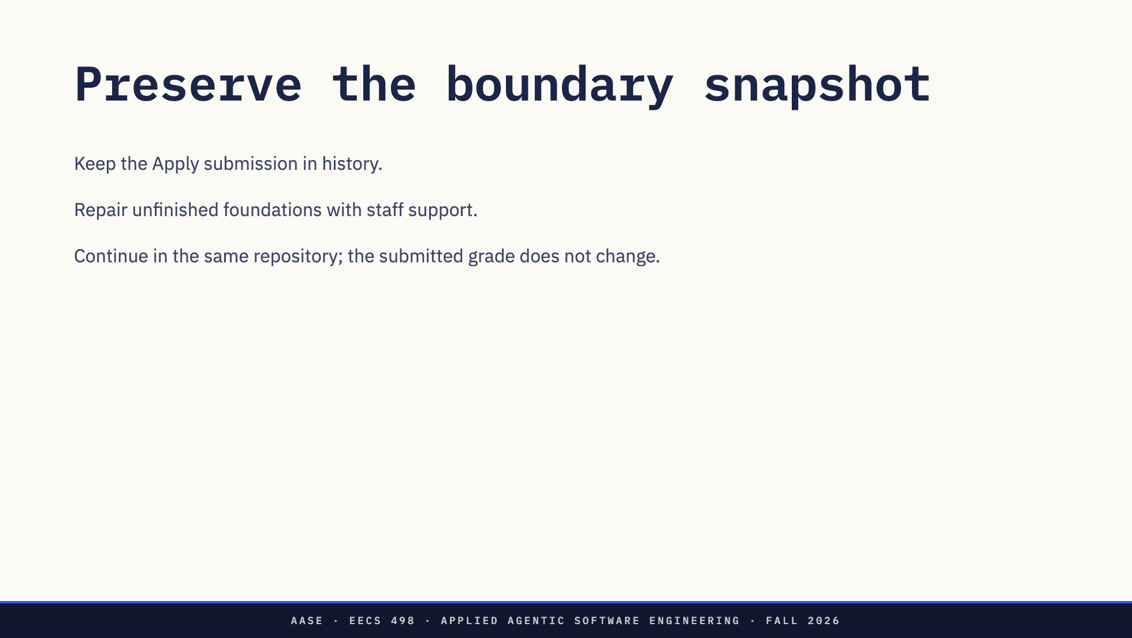
Notes:
No replacement starter or staff reference is handed out.

Slide 3
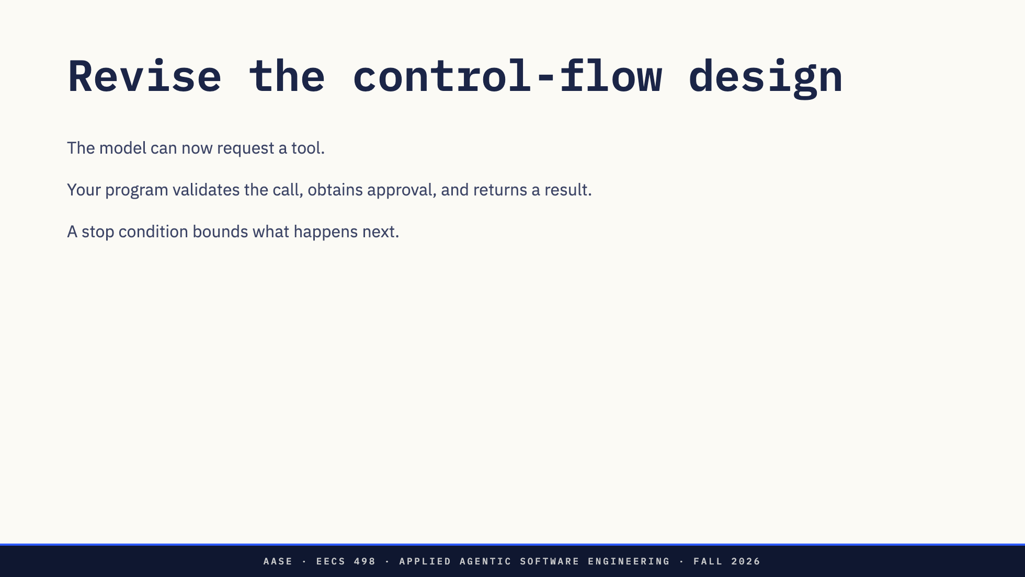
Notes:
Follow the current Analyze assignment for schemas and stop conditions. Students choose internal interfaces.

Slide 4
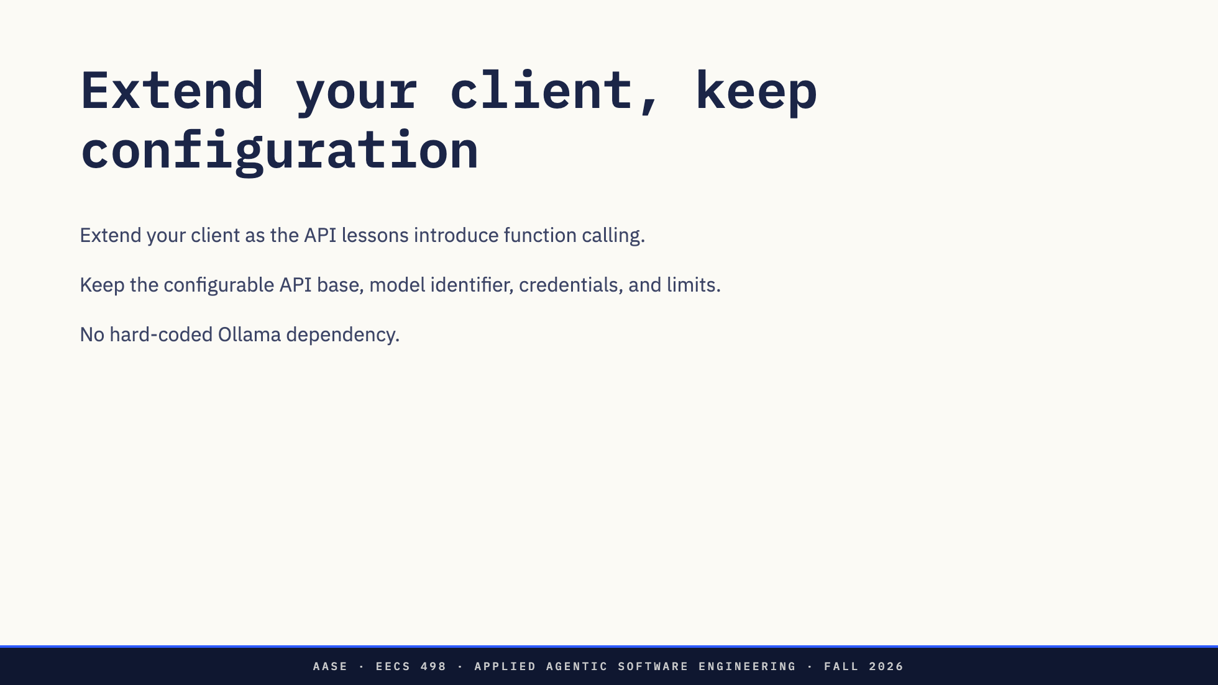
Notes:
Stage 1 included your own text-completion client. Preserve provider-independent YAML behavior and tests.

Slide 5
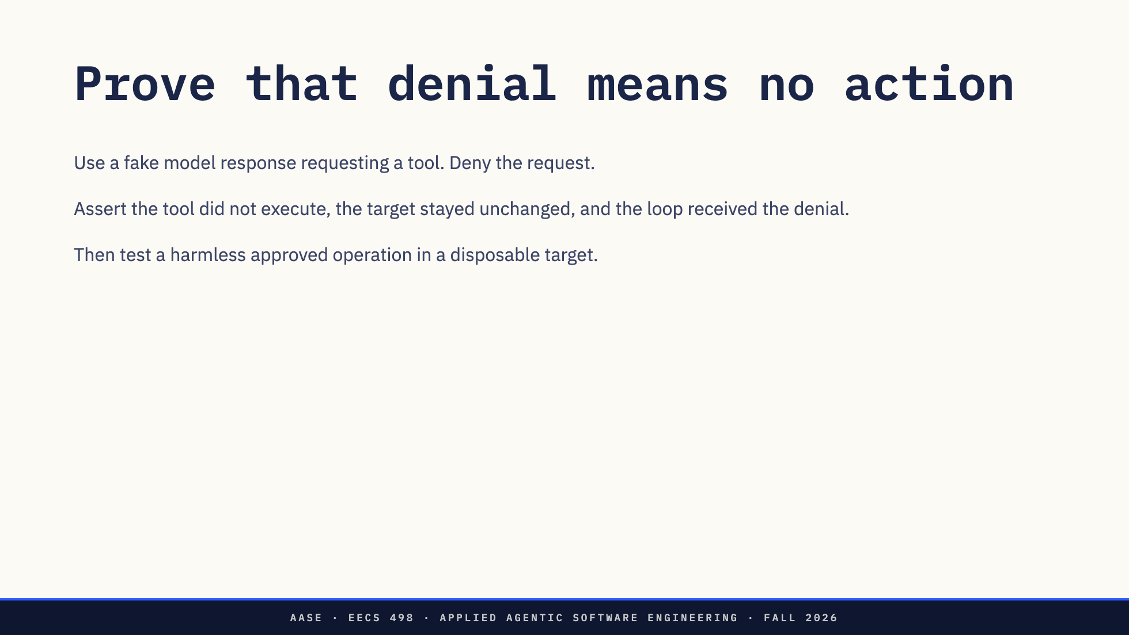
Notes:
Do deterministic checks before live endpoint testing. Git does not protect against arbitrary shell effects.

Slide 6
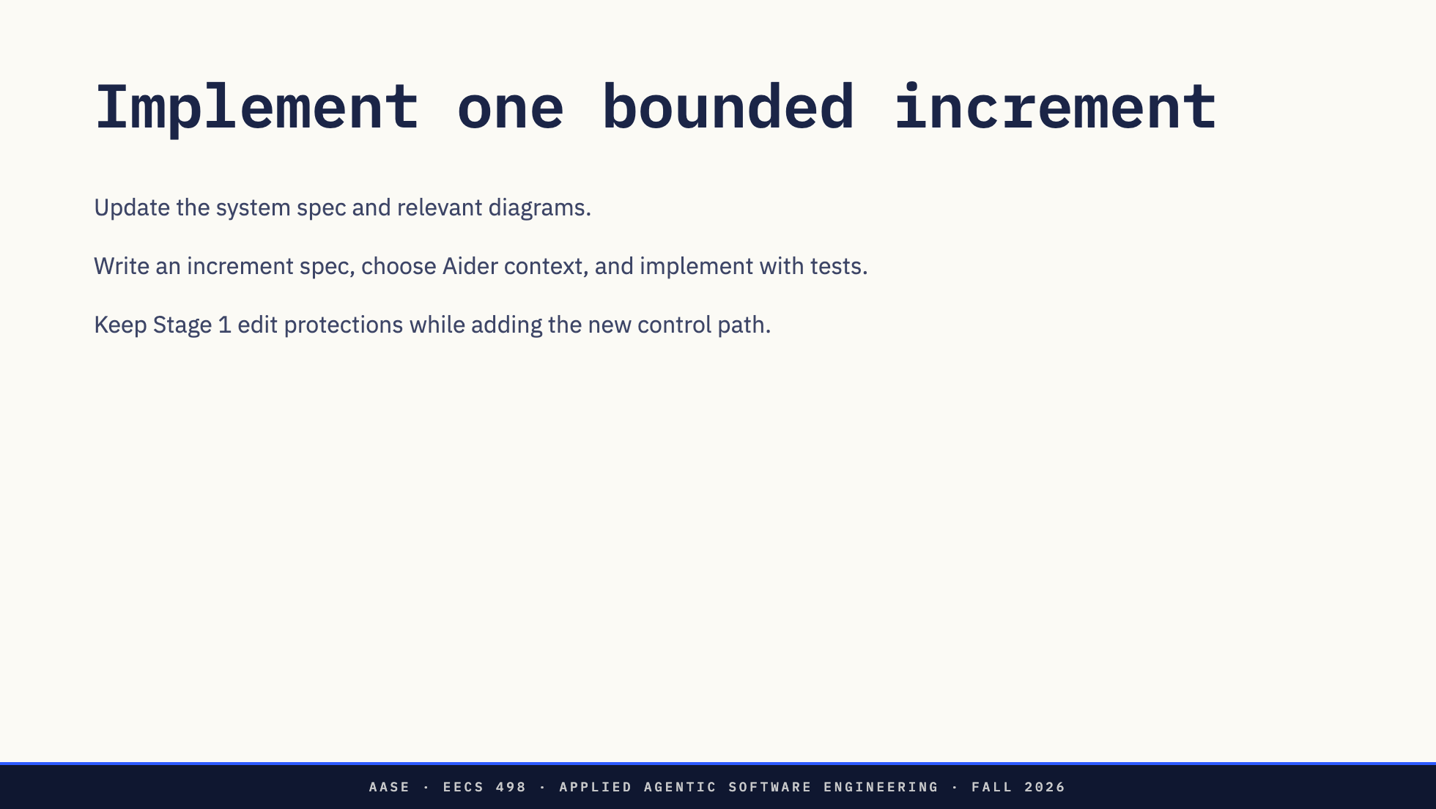
Notes:
This replaces the retired single-pass exercise. Model policy covers design and code.

Slide 7
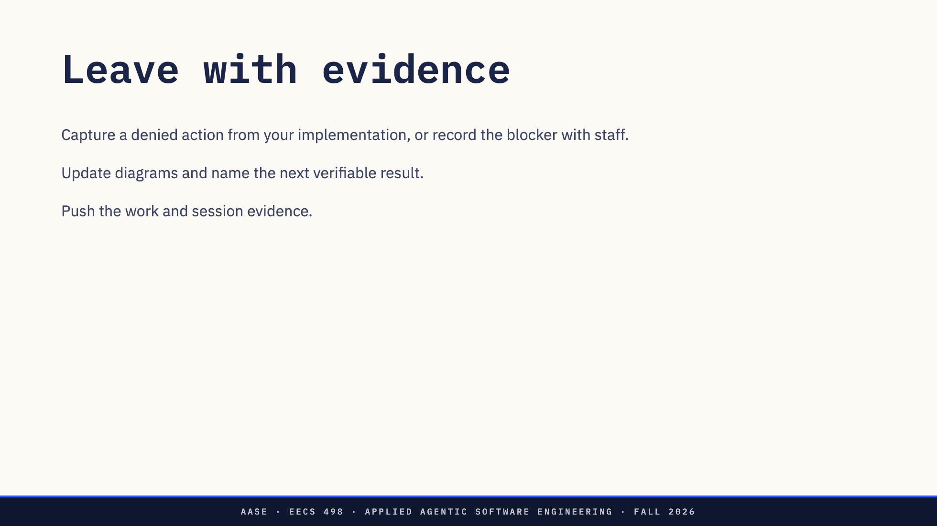
Notes:
No separate ten-point lab assignment. The Analyze rubric controls project grading.

