Slide 1

Notes:
Both lab sections have already met. Do not preview Lab01 and do not reveal the
build; they have both. This lecture surveys the category Lab01 opened.
Claude Code appears on this machine only. Nobody in the room needs an account,
and no slide asks for one.

Slide 2
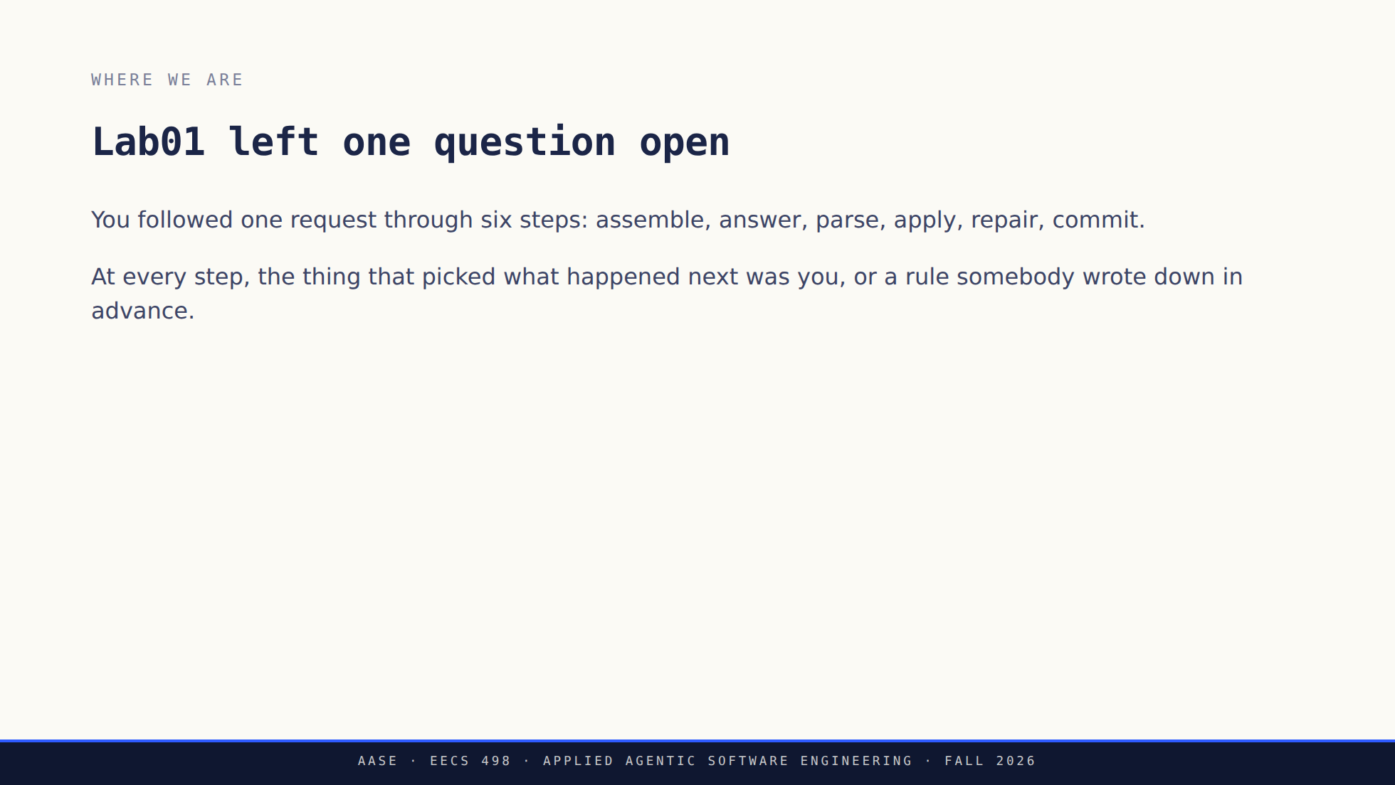
Notes:
Thirty seconds of recall, no more. Monday's room did this yesterday, Tuesday's
finished ninety minutes ago, so this is a pointer and not a recap.
If you want one answer out loud, ask which of the six steps belonged to the
model. Step 2, and only step 2.

Slide 3
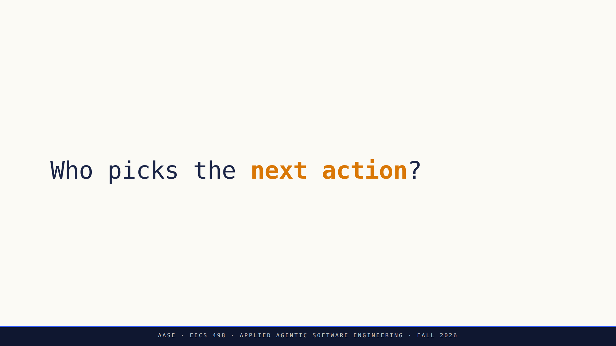
Notes:
This is the whole instrument. One question, asked of any tool, now or in three
years when all of today's names have changed.
Say that out loud: the names on these slides will age badly and the question
will not.

Slide 4


Slide 5
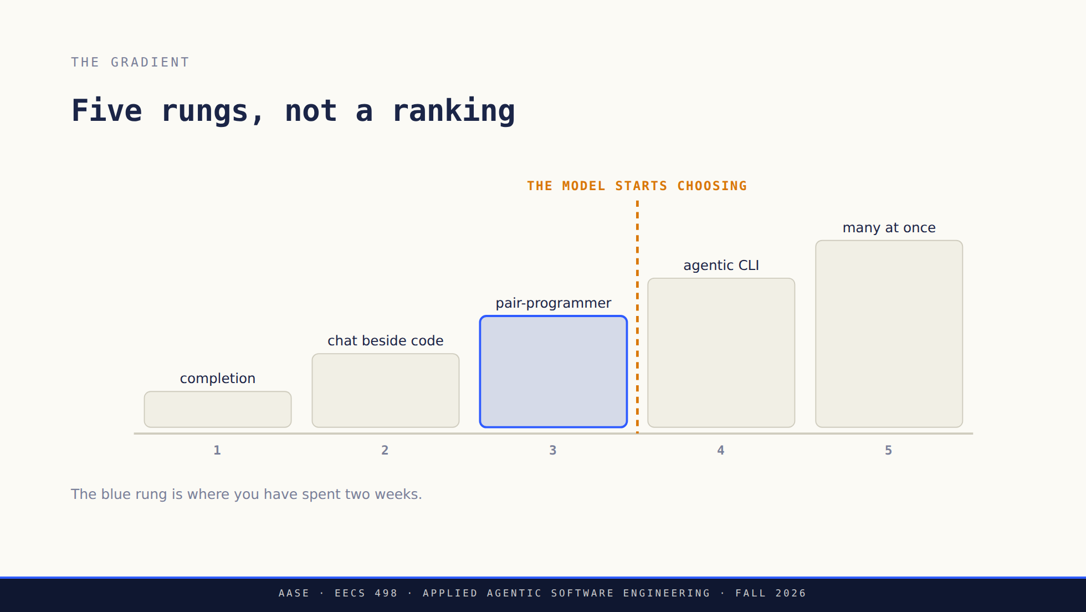
Notes:
Walk up it once, fast, one sentence each. The detail is in content.md and they
do not need all of it.
The dashed line is the slide. Rungs 1 to 3 differ in how much they automate.
Rung 4 differs in who decides. That is a change of kind, not of degree.

Slide 6
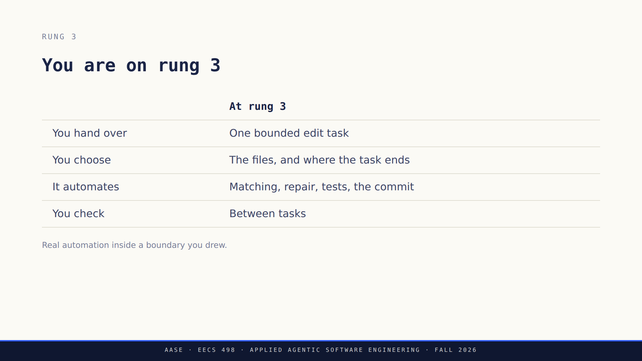
Notes:
Do not let rung 3 sound primitive. Aider runs commands, loops on test output,
and commits. What it does not do is pick the next task.
If someone says "so Aider is not agentic," push back: it has the parts, and we
are about to check that claim properly.

Slide 7
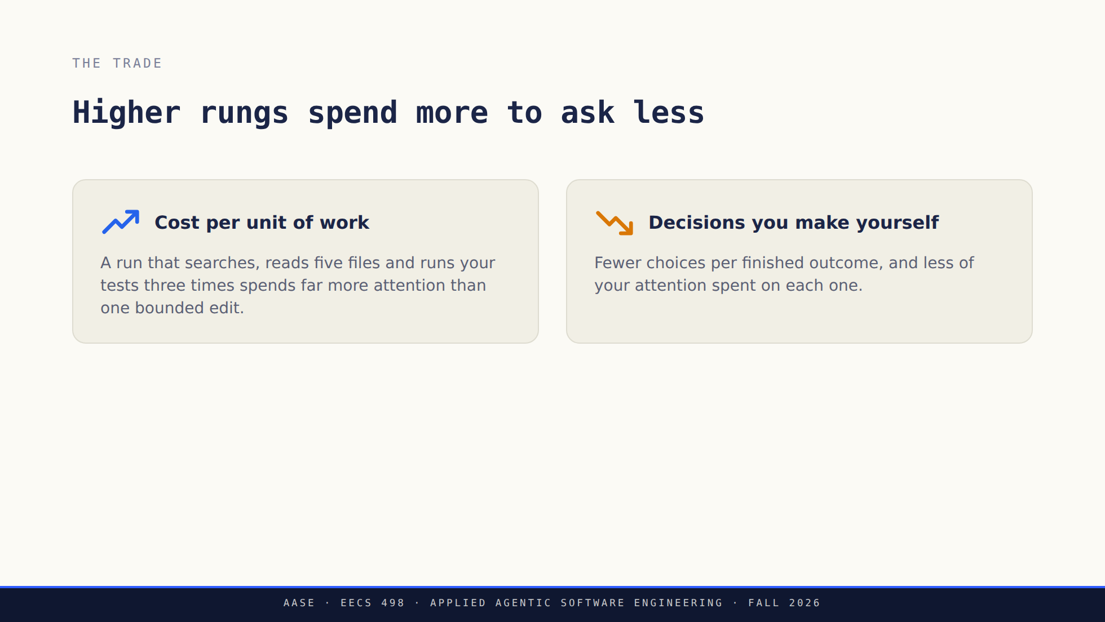
Notes:
This trade is the entire gradient. Everything else is detail.
Do not quantify it. Any multiple you say out loud will be wrong by next month
and somebody will quote it back to you.

Slide 8
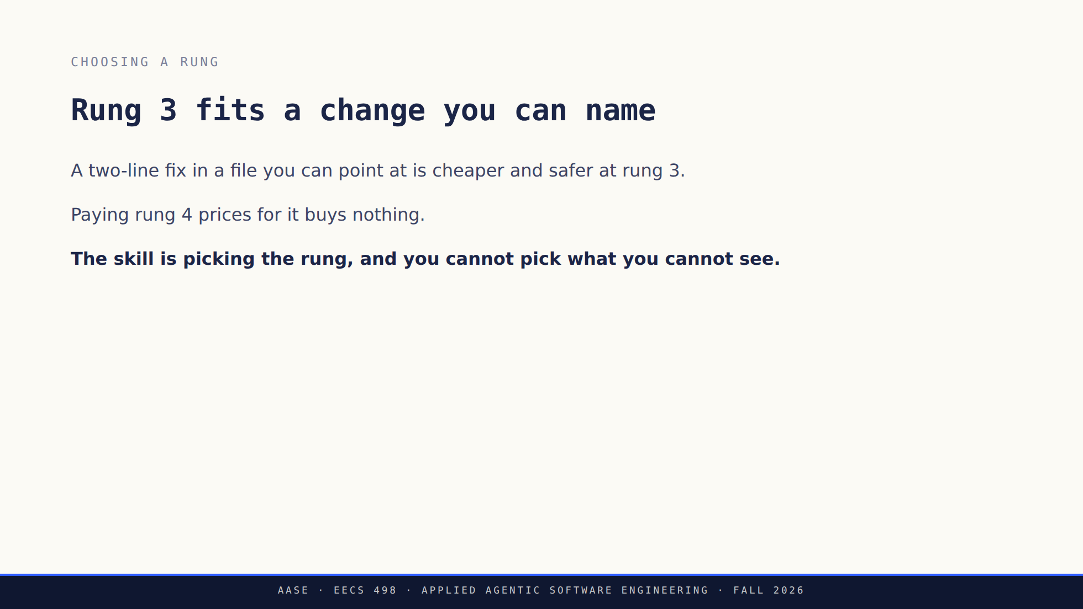
Notes:
The reflex this is aimed at: reaching for the most autonomous tool available
because it is the most autonomous tool available.
Ask when they would rather have the bounded version. Answers you are hoping
for involve knowing exactly what to change, or a blast radius they care about.

Slide 9


Slide 10
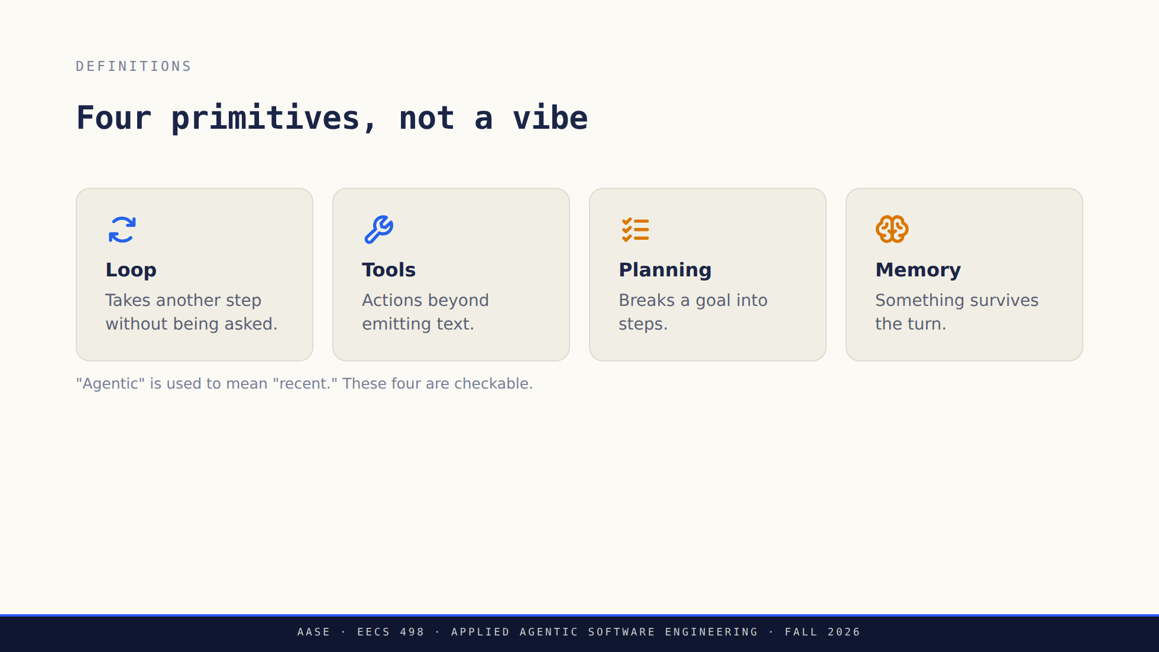
Notes:
Read them once. The next slide is where the work happens, so do not linger.

Slide 11
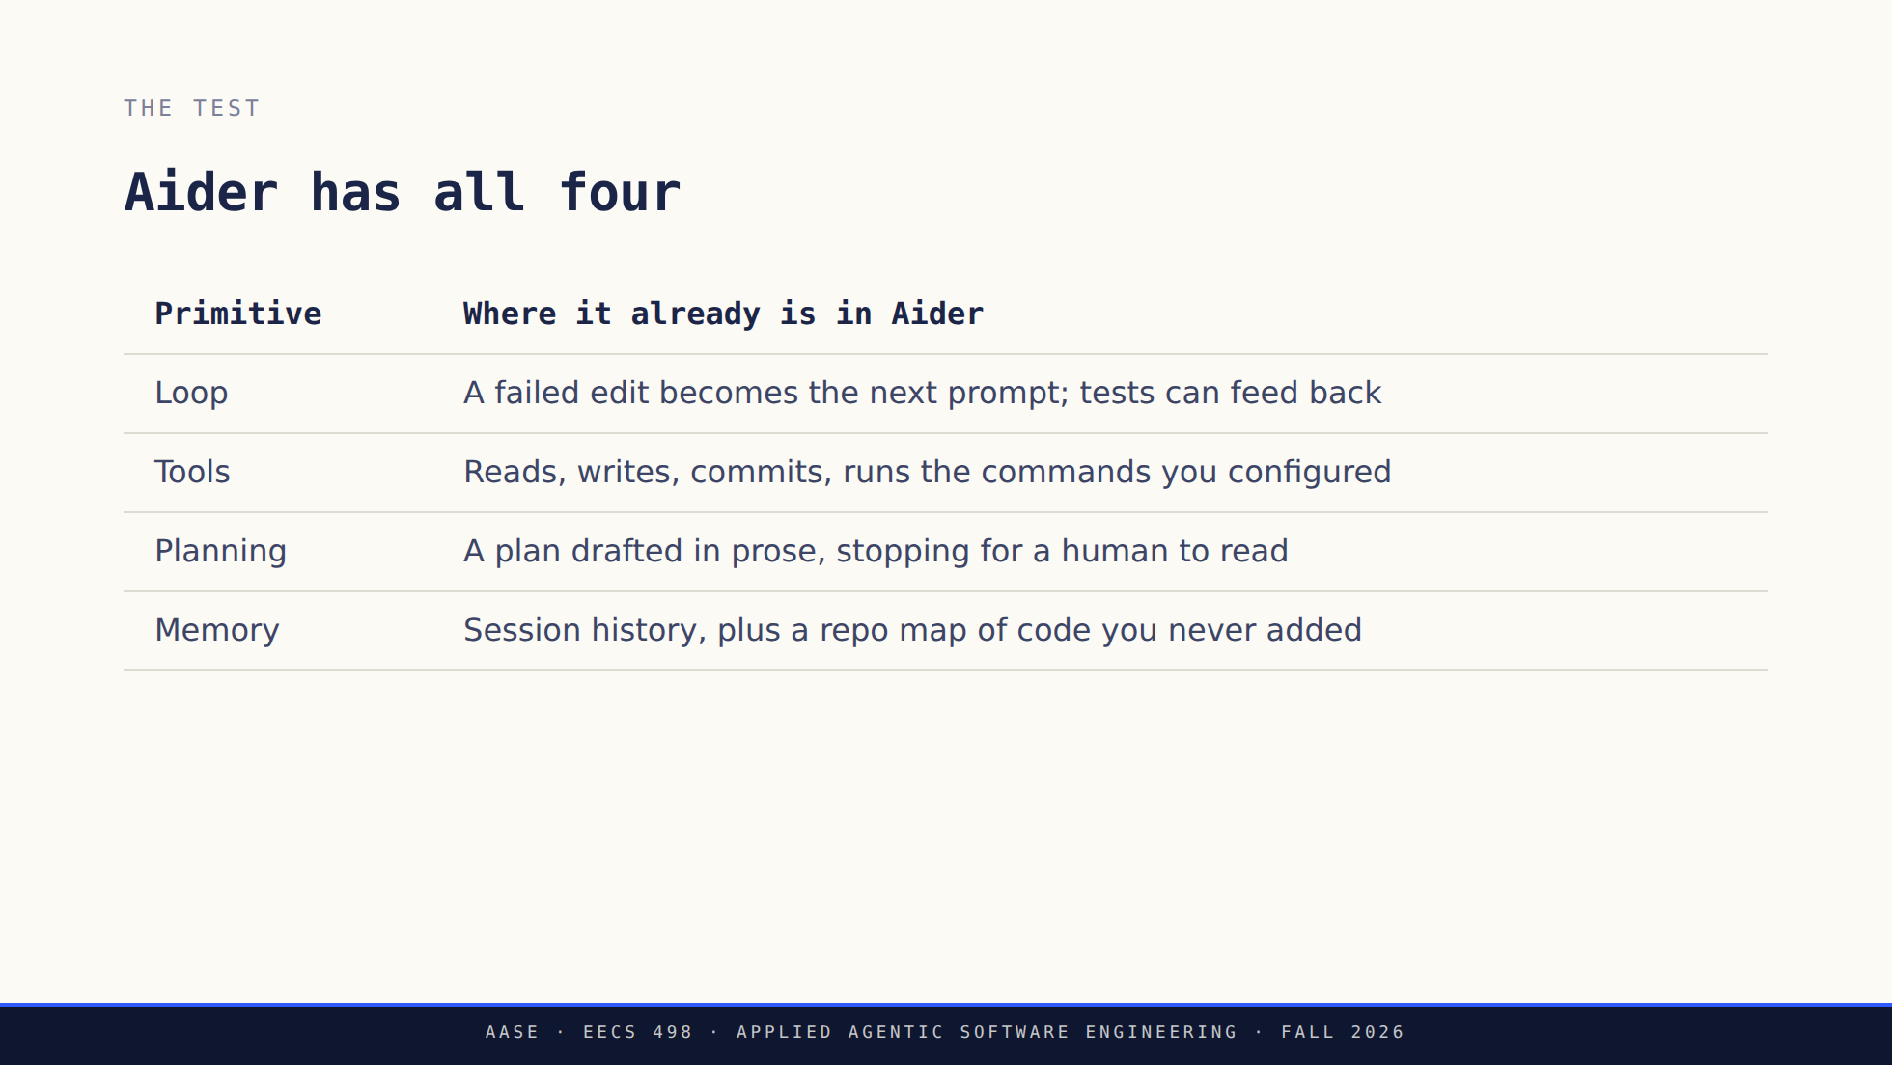
Notes:
This is the slide that surprises the room, so let it. They expect a column of
crosses.
Anyone who has configured lint and test commands has watched the loop run. Ask
if someone has; it lands better from a student.

Slide 12
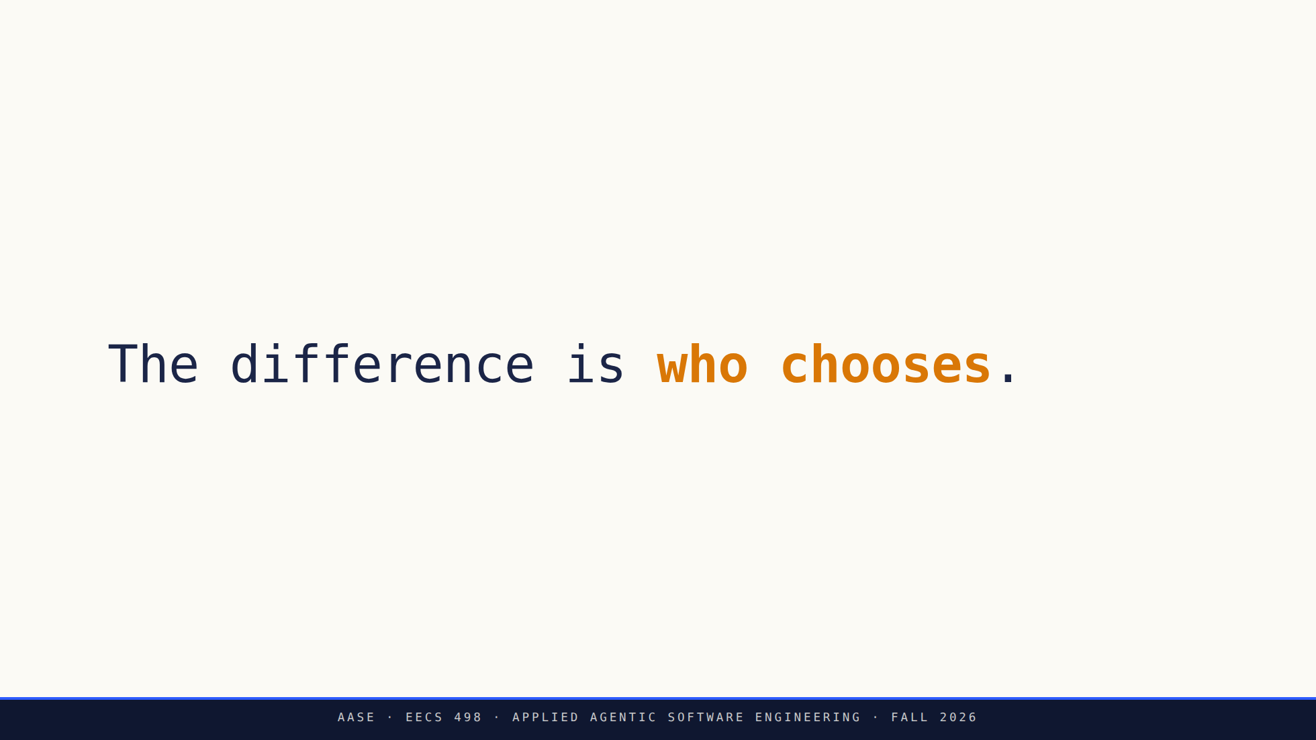
Notes:
Pause here. This is the sentence the lecture turns on.
Not which primitives exist. Which of them the human still holds.

Slide 13
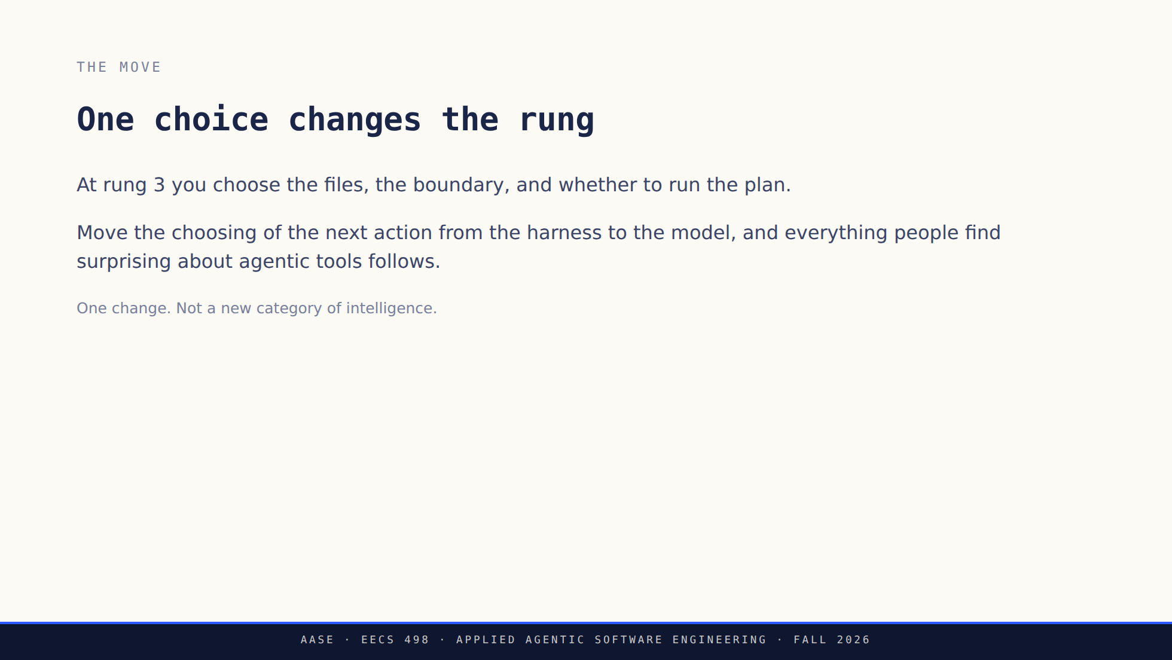
Notes:
Worth saying plainly: no new model capability is required to cross this line.
The same model, given a tool menu and a loop that lets it pick, behaves like a
different kind of software.

Slide 14


Slide 15
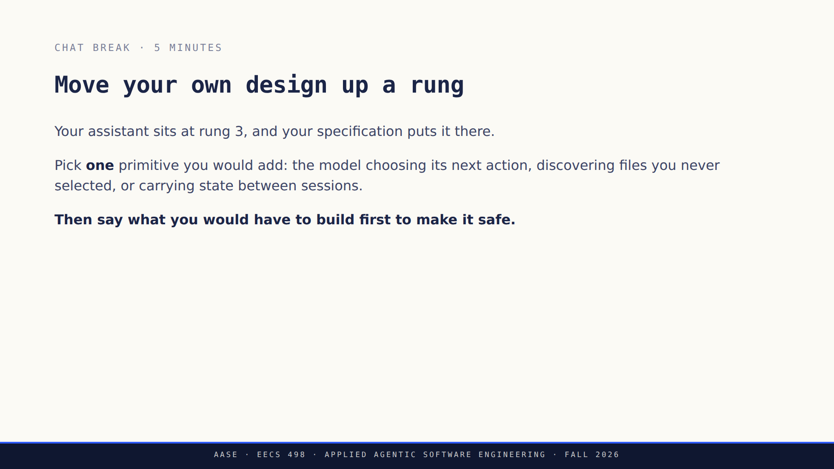
Notes:
**"OK, Zoom, we're on break."**
Five minutes. Circulate.
Everyone names a capability; that half is easy. The half that separates the
room is the guardrail, and the second half of this lecture is an hour-long
worked example of it. If nobody reaches it in the answers, say so and use it as
the transition.
**"OK, Zoom, we're back."**

Slide 16
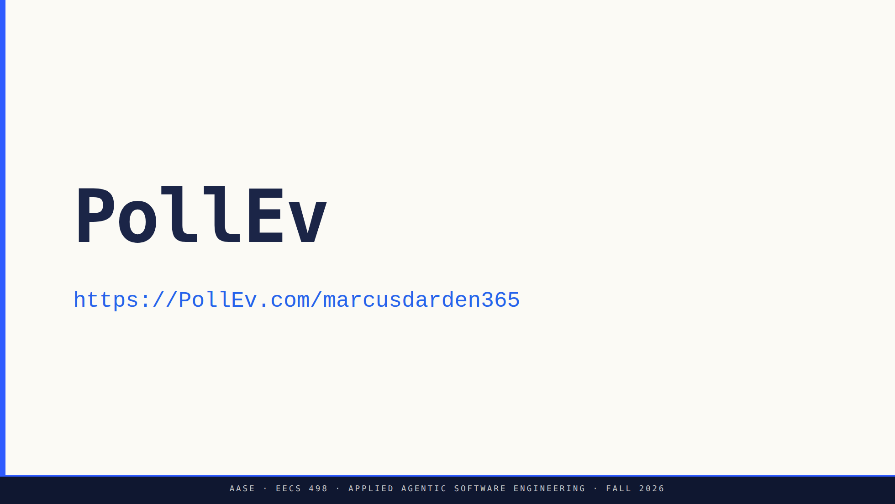
Notes:
Attendance question, about a minute, and it counts. Full text in
`assets/poll-everywhere.md`.
Switch to the browser tab, set it live, read the question and all four options
aloud, give it sixty seconds, show results, come back.
The div is deliberate: the theme uppercases section subtitles and an uppercased
URL path is a different path. Do not "fix" it to an h2.

Slide 17
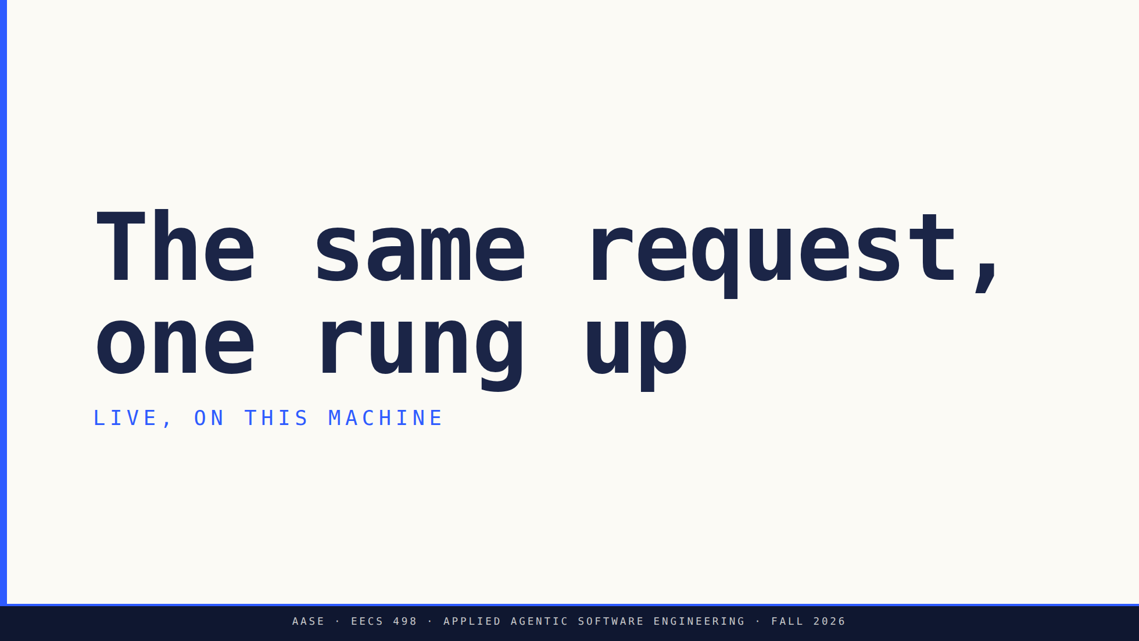

Slide 18
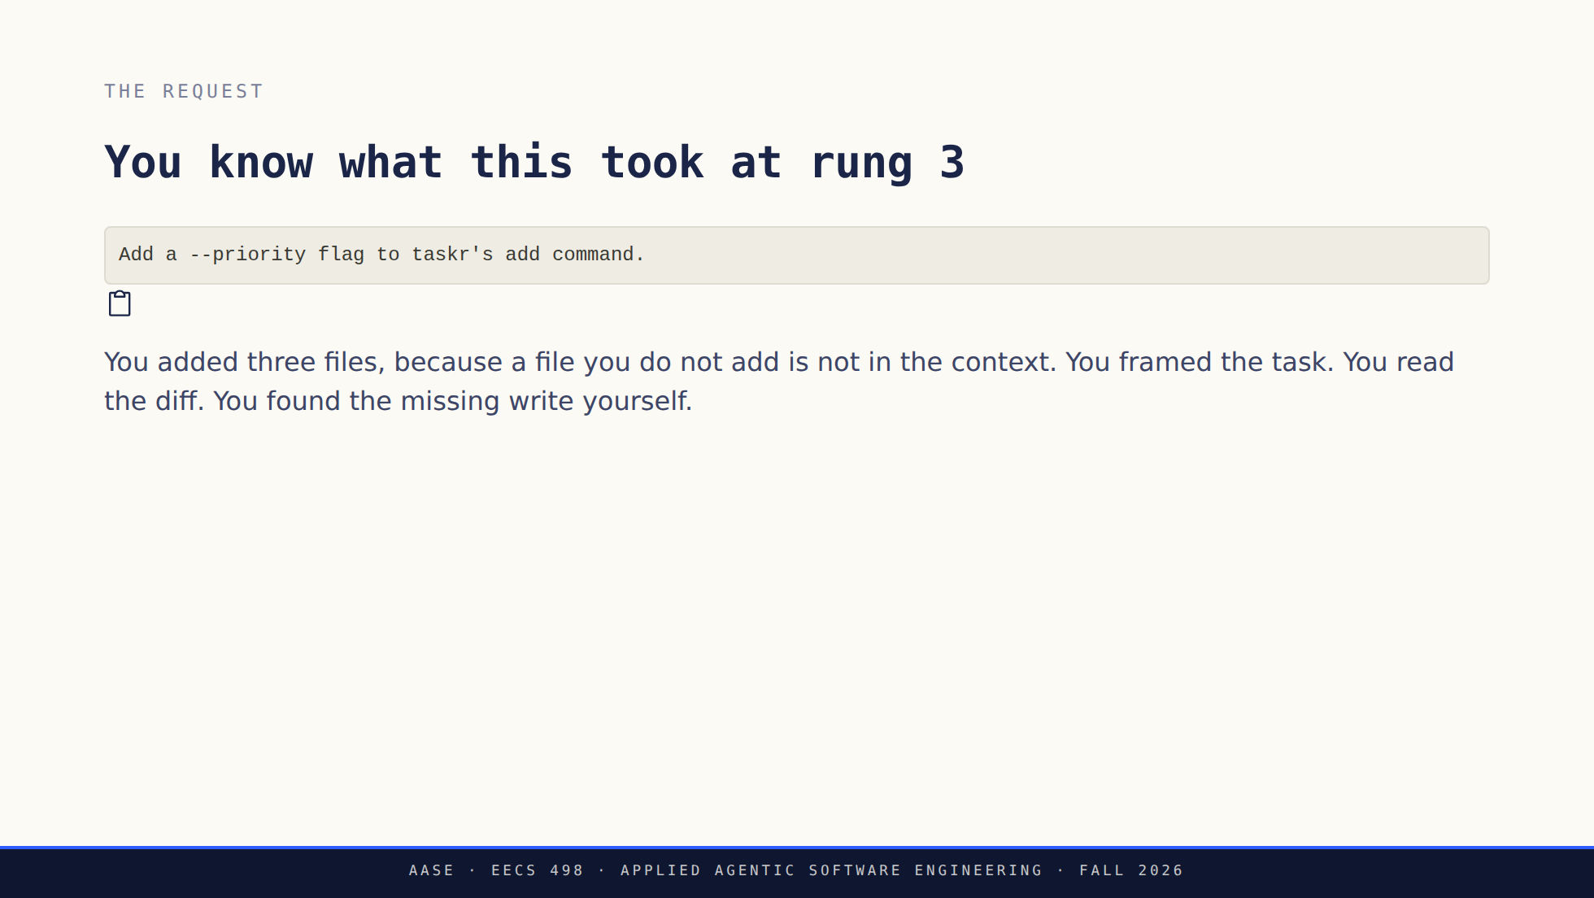
Notes:
Same request as Lab01, deliberately. One task at two rungs is the only honest
comparison available in eighty minutes.
Nobody needs the taskr recap. They have been living in it for two weeks.

Slide 19
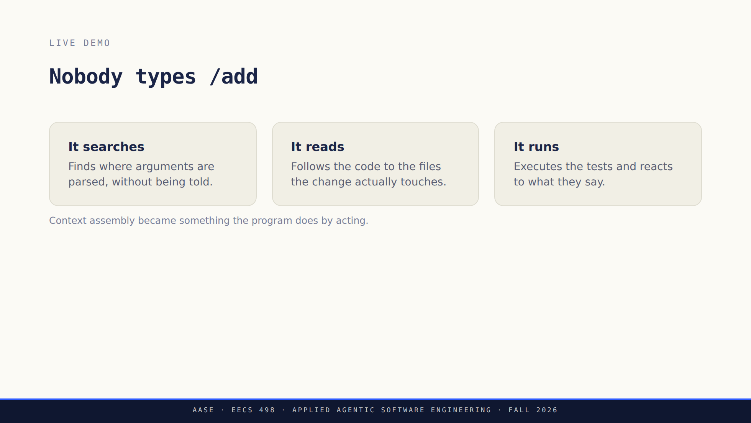
Notes:
Switch to the terminal here and drive it. Runbook in `assets/demo-runbook.md`;
if the network is down, the recording is in `assets/demo-fallback.md`.
Narrate the decisions, not the typing. Every time it picks a file, say that
nobody told it to.
Rehearse this before delivering. What it actually does today is a fact about
today's build, not something these slides can promise.

Slide 20
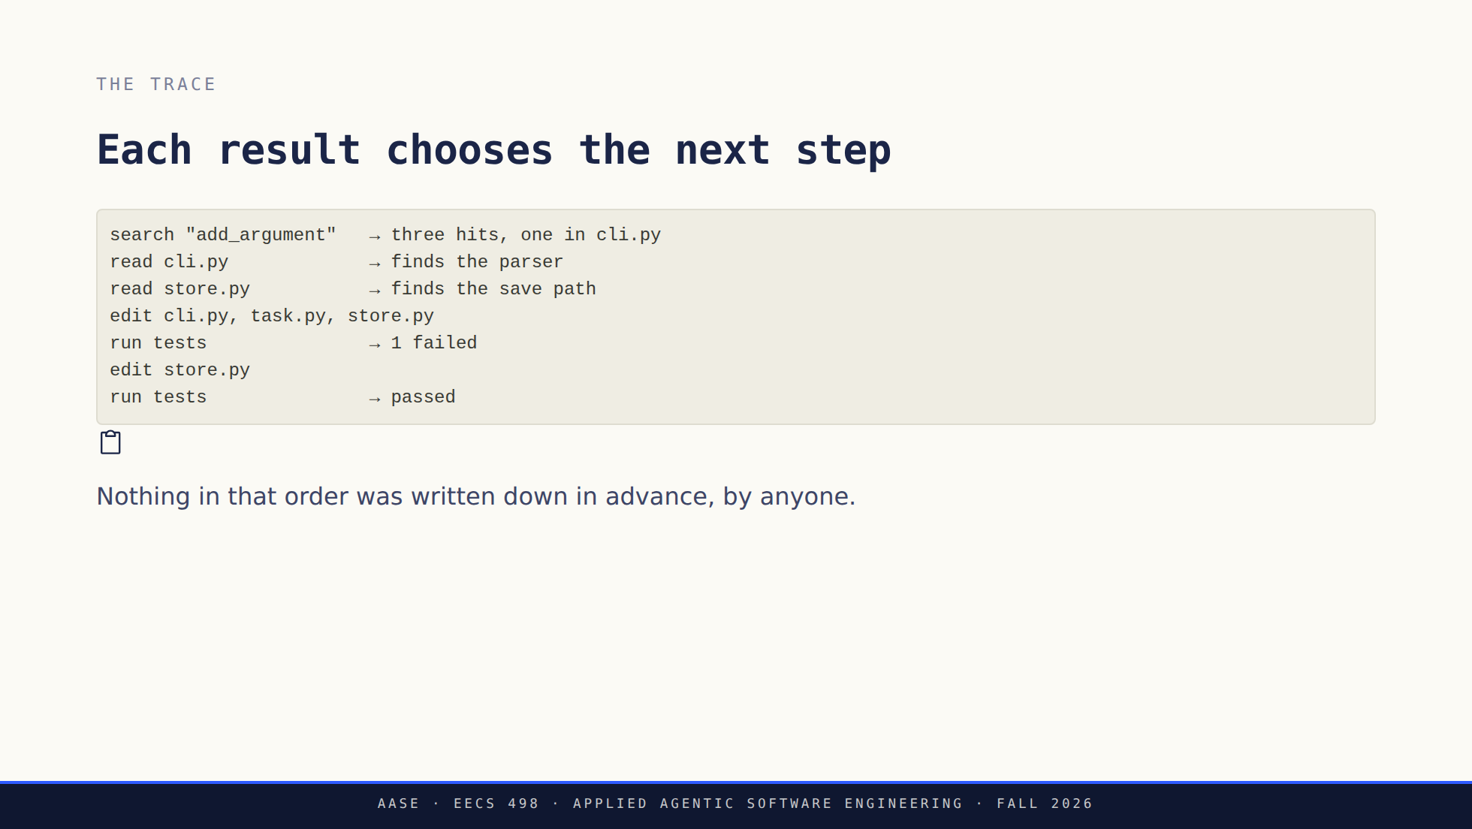
Notes:
Label this as illustrative shape, not a transcript of the run they just
watched. The live run is the evidence; this is the pattern.
The question to leave hanging, because the next section answers it: who stops
a run that is going wrong?

Slide 21
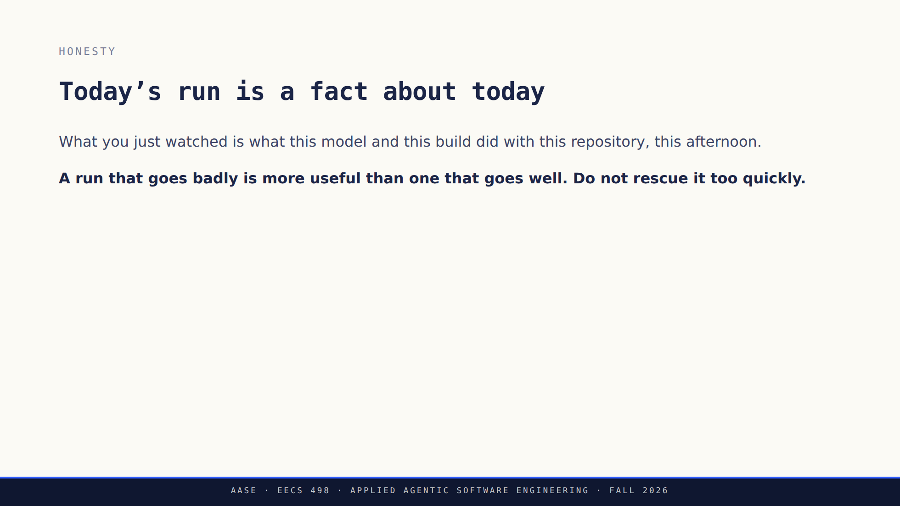
Notes:
Say this whether the demo went well or badly, and say it after rather than
before, so it does not read as pre-emptive excuse-making.
Speed is not the lesson. A tool that gets to the same place faster is a
convenience; a tool that decides which place to go is a different object.

Slide 22
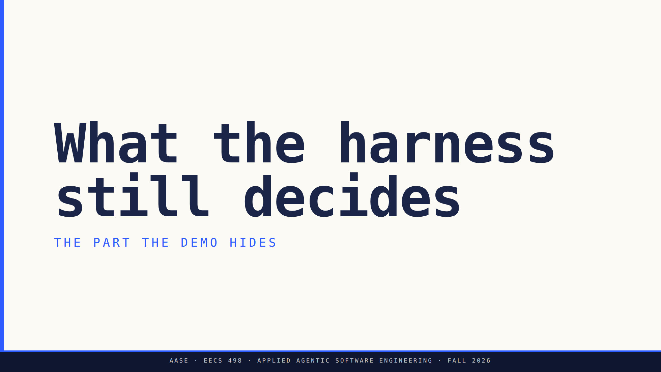

Slide 23
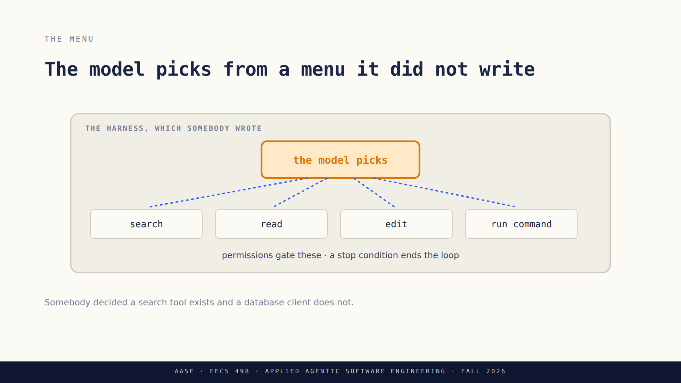
Notes:
The most important sentence today: the model can only choose from what the
harness exposes, and only under the conditions the harness enforces.
In Analyze they write this box. Say that here; it is the first time the phase
ahead has a concrete shape.

Slide 24
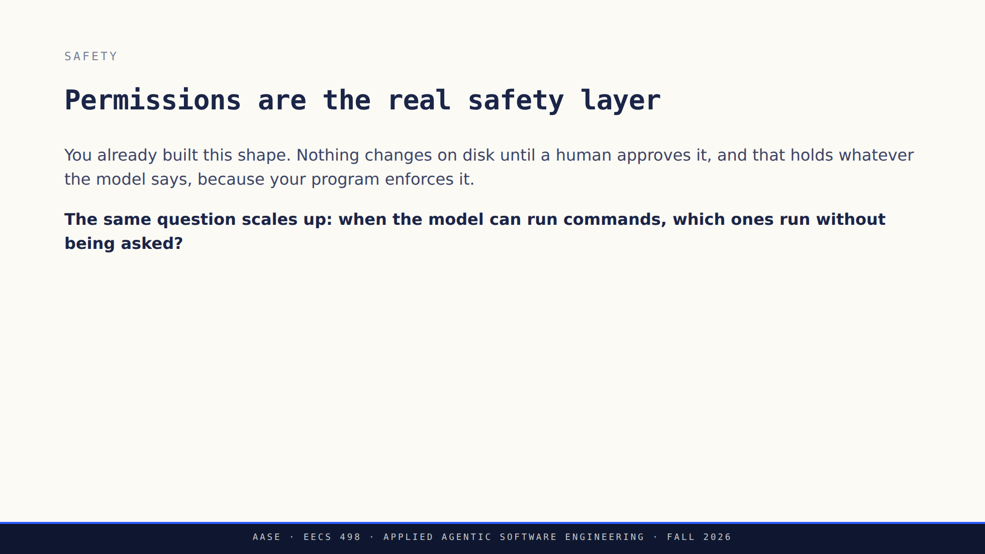
Notes:
Tie it to their own specification explicitly. They wrote the approval gate last
week and may not have noticed it was the same idea.
Do not answer the question on the slide. It is Analyze's, and Lab03's.

Slide 25
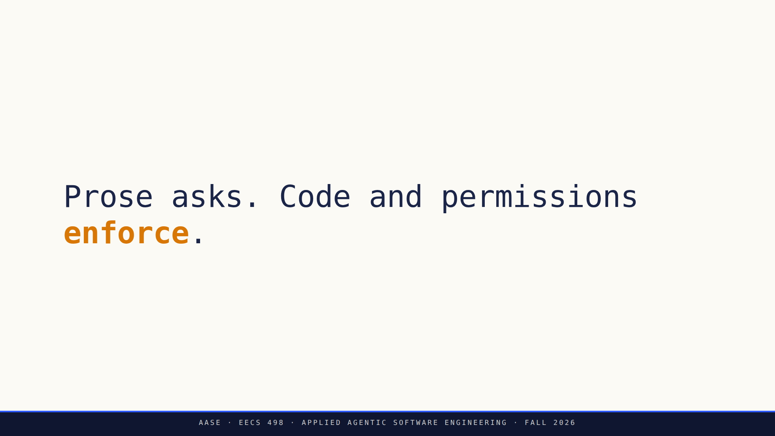
Notes:
They met this line in Lab01. Repetition is the point: it is the design rule the
whole course keeps returning to.
Concretely: a prompt asks the model to stay inside the selected files, and
validation is what actually keeps it there.

Slide 26
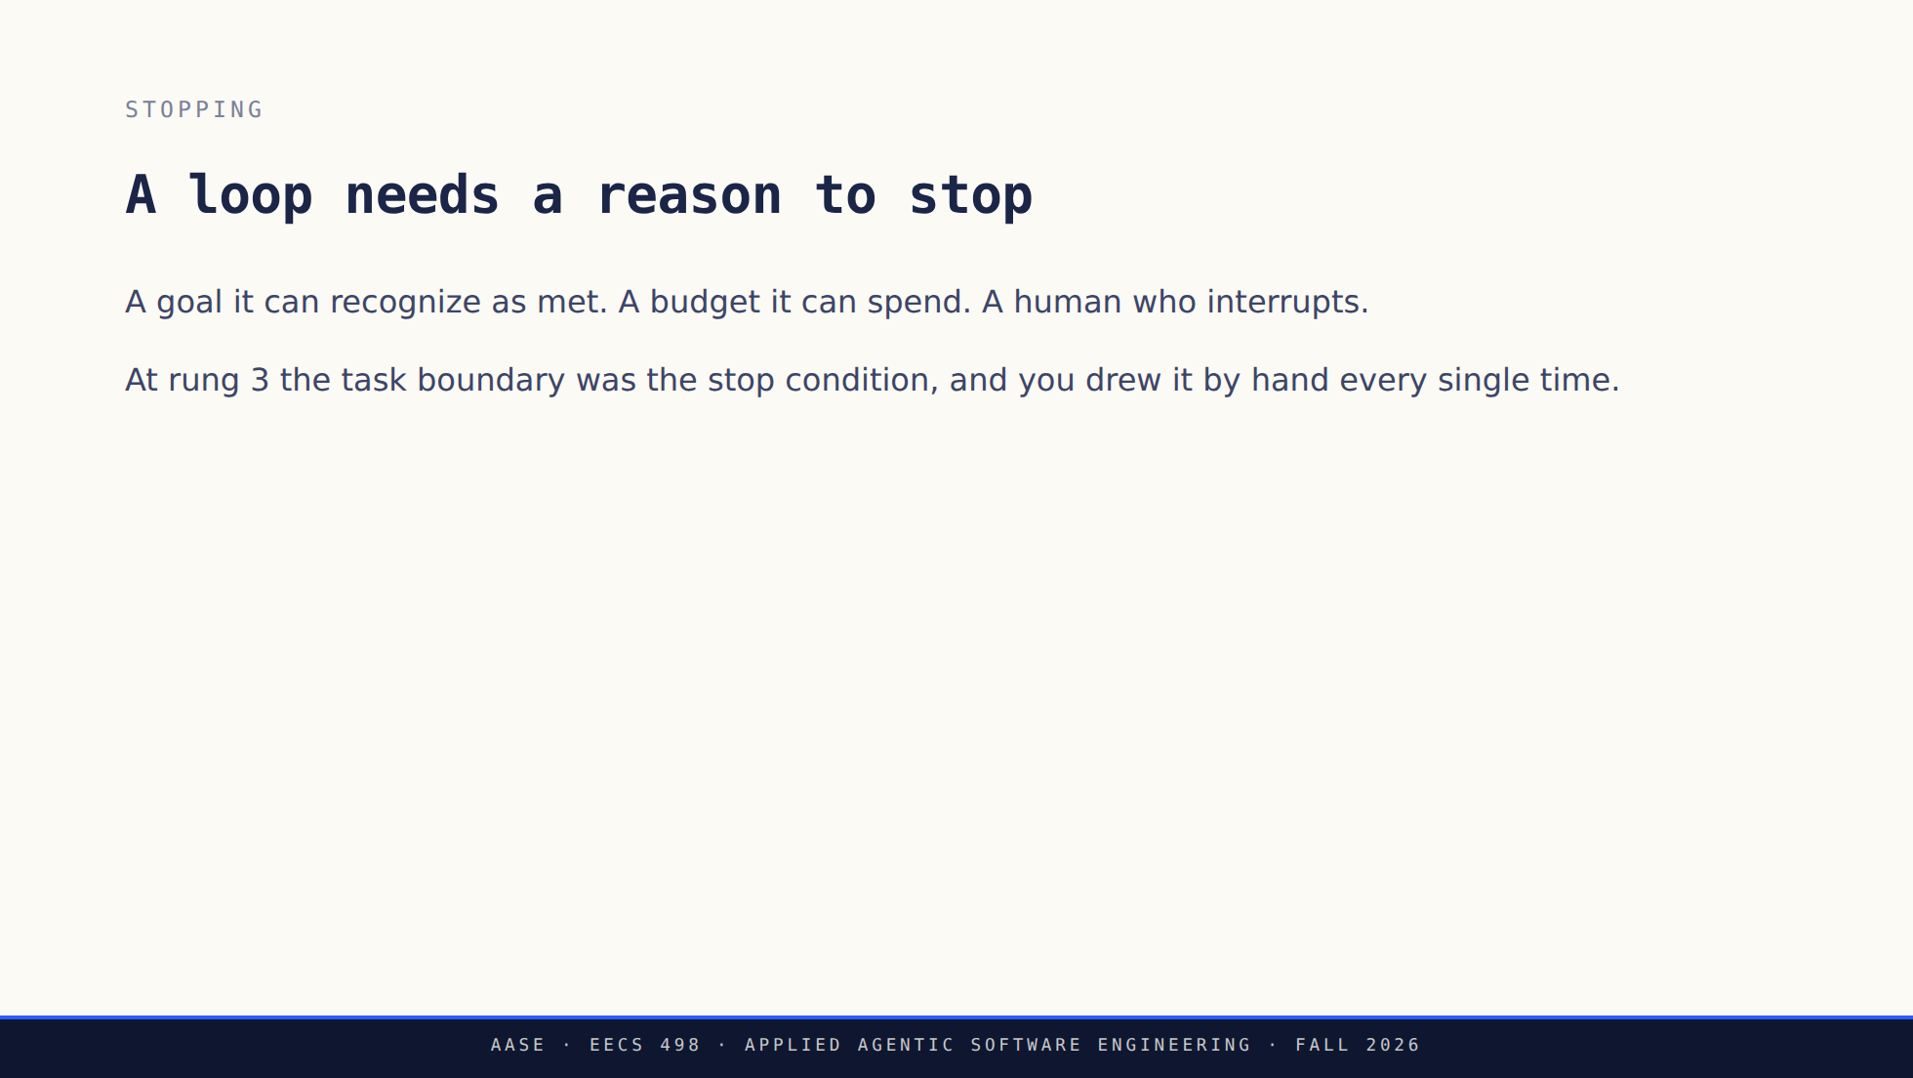
Notes:
Ask what happens without one. You are looking for "it runs forever" and then,
better, "it does damage forever."
This is a design problem, not a model problem, which is the through-line of the
whole second half.

Slide 27
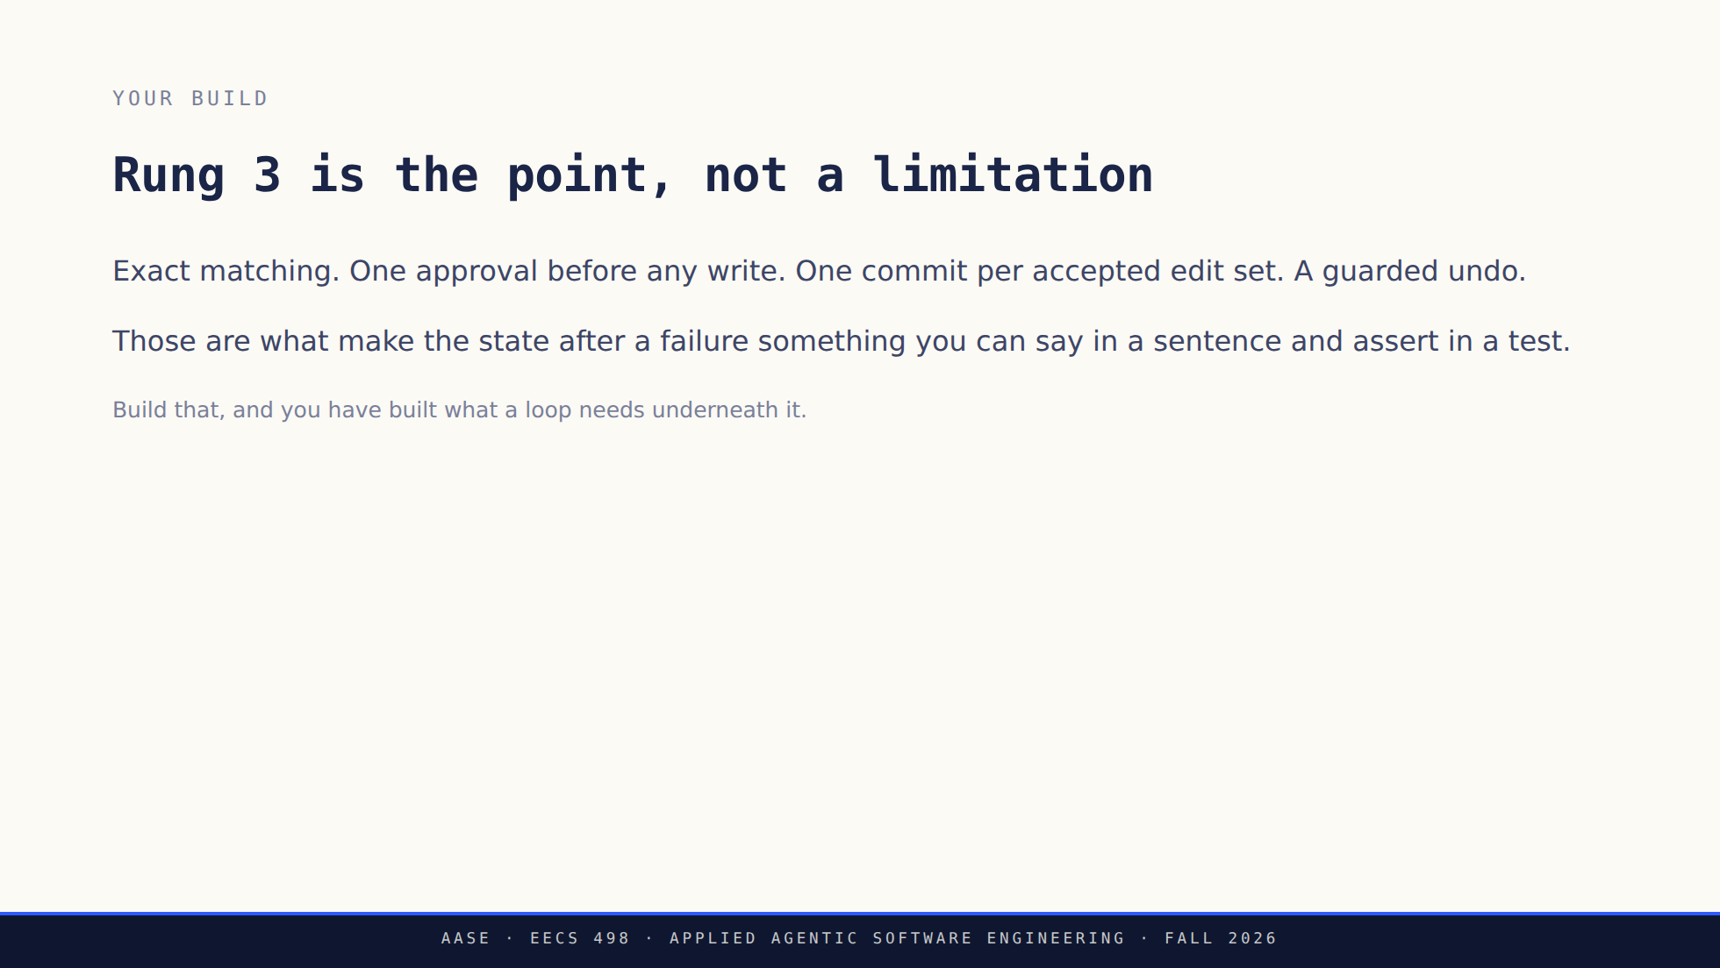
Notes:
The anxiety in the room after a demo like that one is that they are building
last year's tool. Address it directly.
Skip these mechanisms and adding a loop on top just means failing faster.

Slide 28
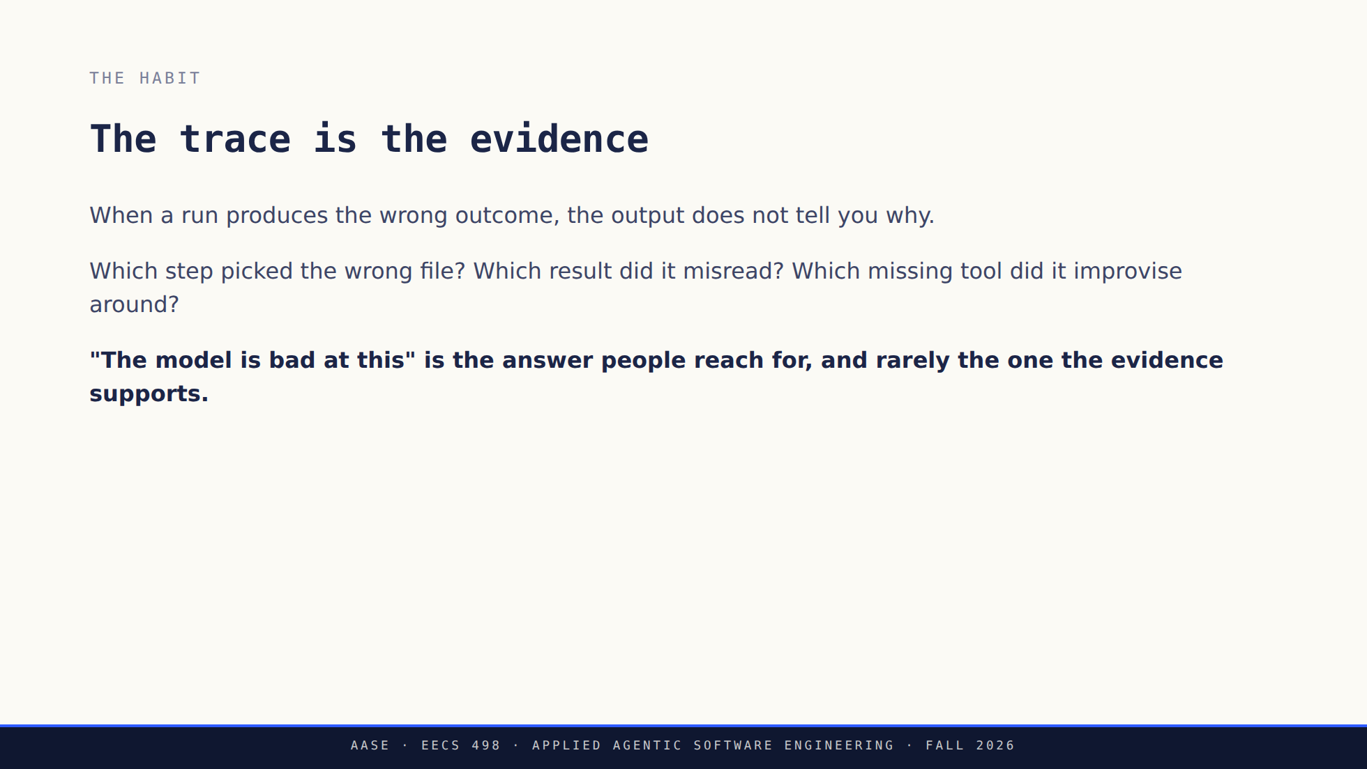
Notes:
Same diagnostic discipline as lab, applied to a longer chain. In lab the three
levers were context, model and prompt; here the chain is longer and the
evidence is the run itself.

Slide 29
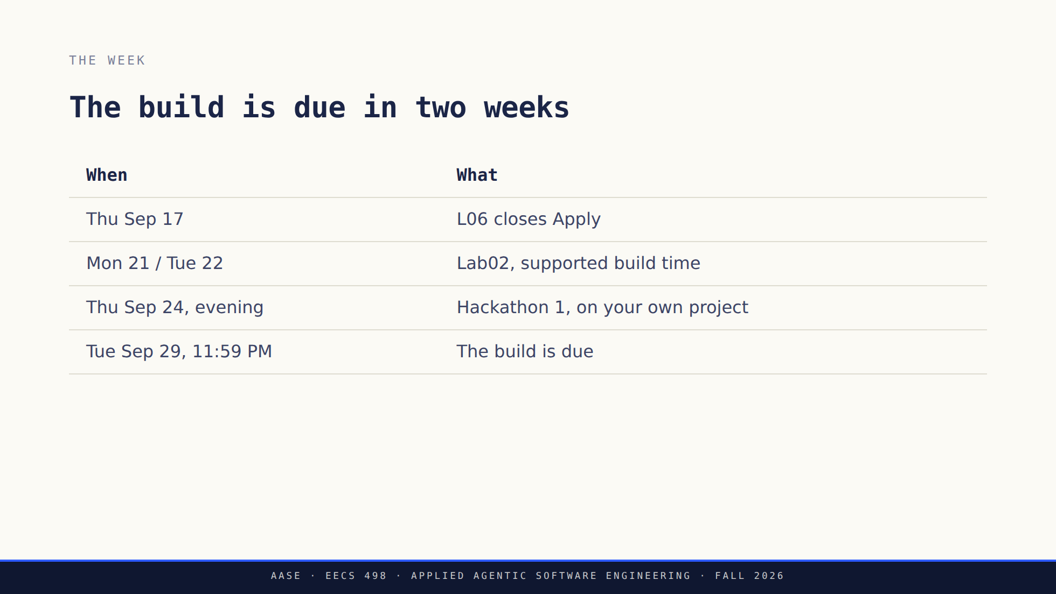
Notes:
Read it once and move. Everything here is also in their repository and on the
schedule.
Bring a runnable increment to the hackathon; the prompt is revealed in the
room.

Slide 30
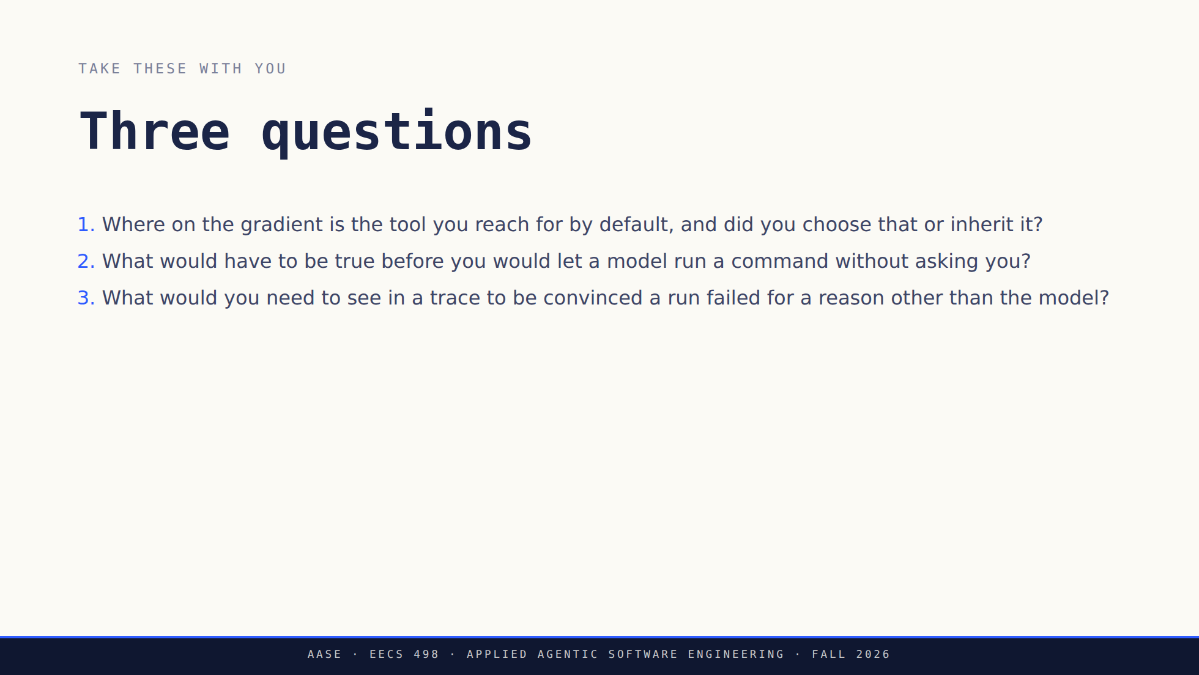
Notes:
Leave this up during questions. Number two is the one that comes back in
Analyze, and number three is the one that makes them better engineers this
week.

Slide 31
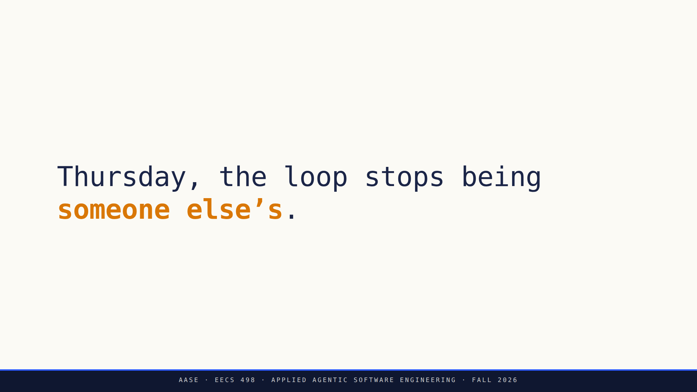
Notes:
The bridge. L06 closes Apply and hands over to Analyze, where they write the
box from the harness slide rather than watching it work.

Slide 32


