Slide 1
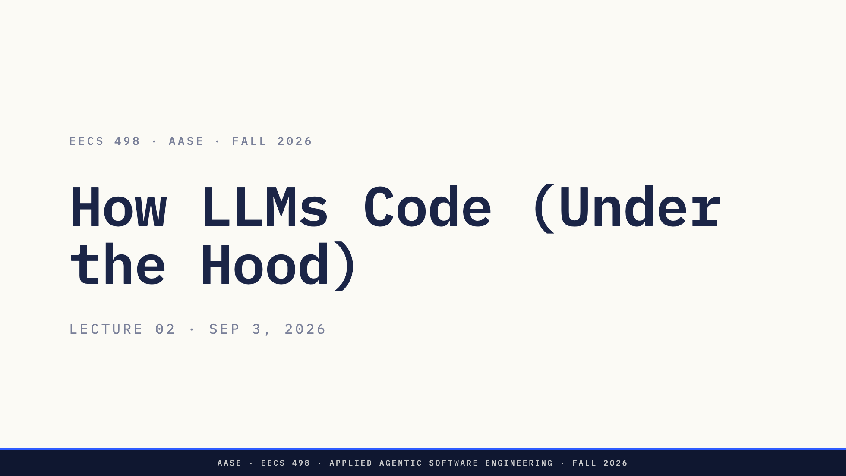
Notes:
Open the box. Theory lecture. No live coding today. The payoff lands next lecture (L03) when the Big Three framework arrives.

Slide 2
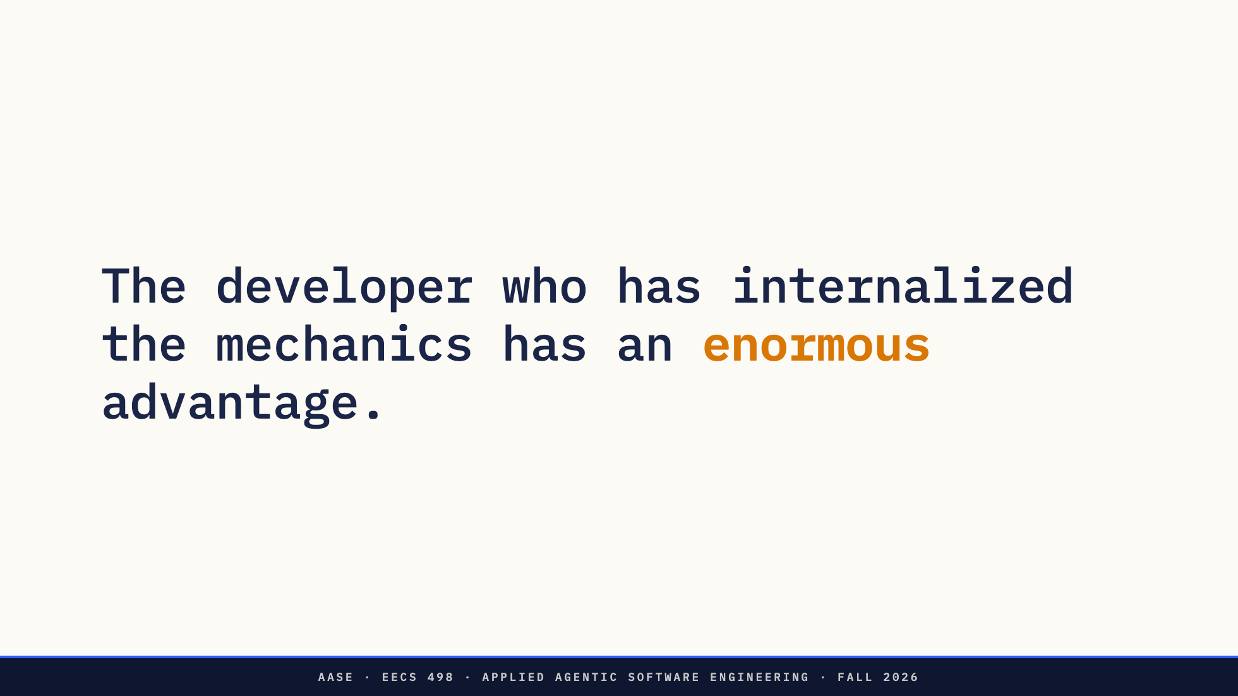
Notes:
The opener: why bother with theory. When it doesn't work, mental models win.

Slide 3
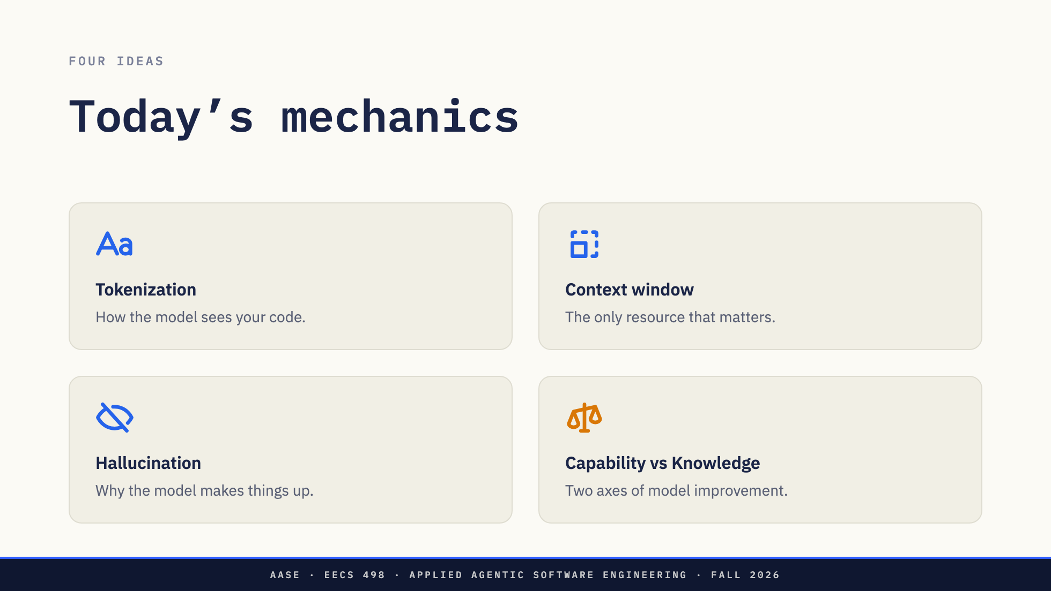

Slide 4
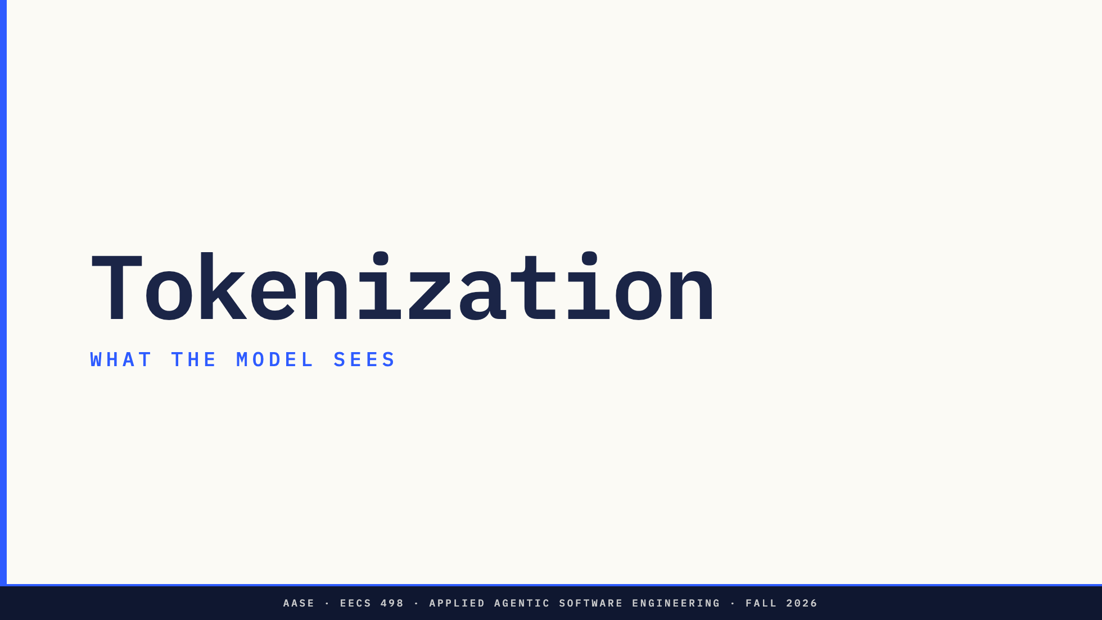

Slide 5
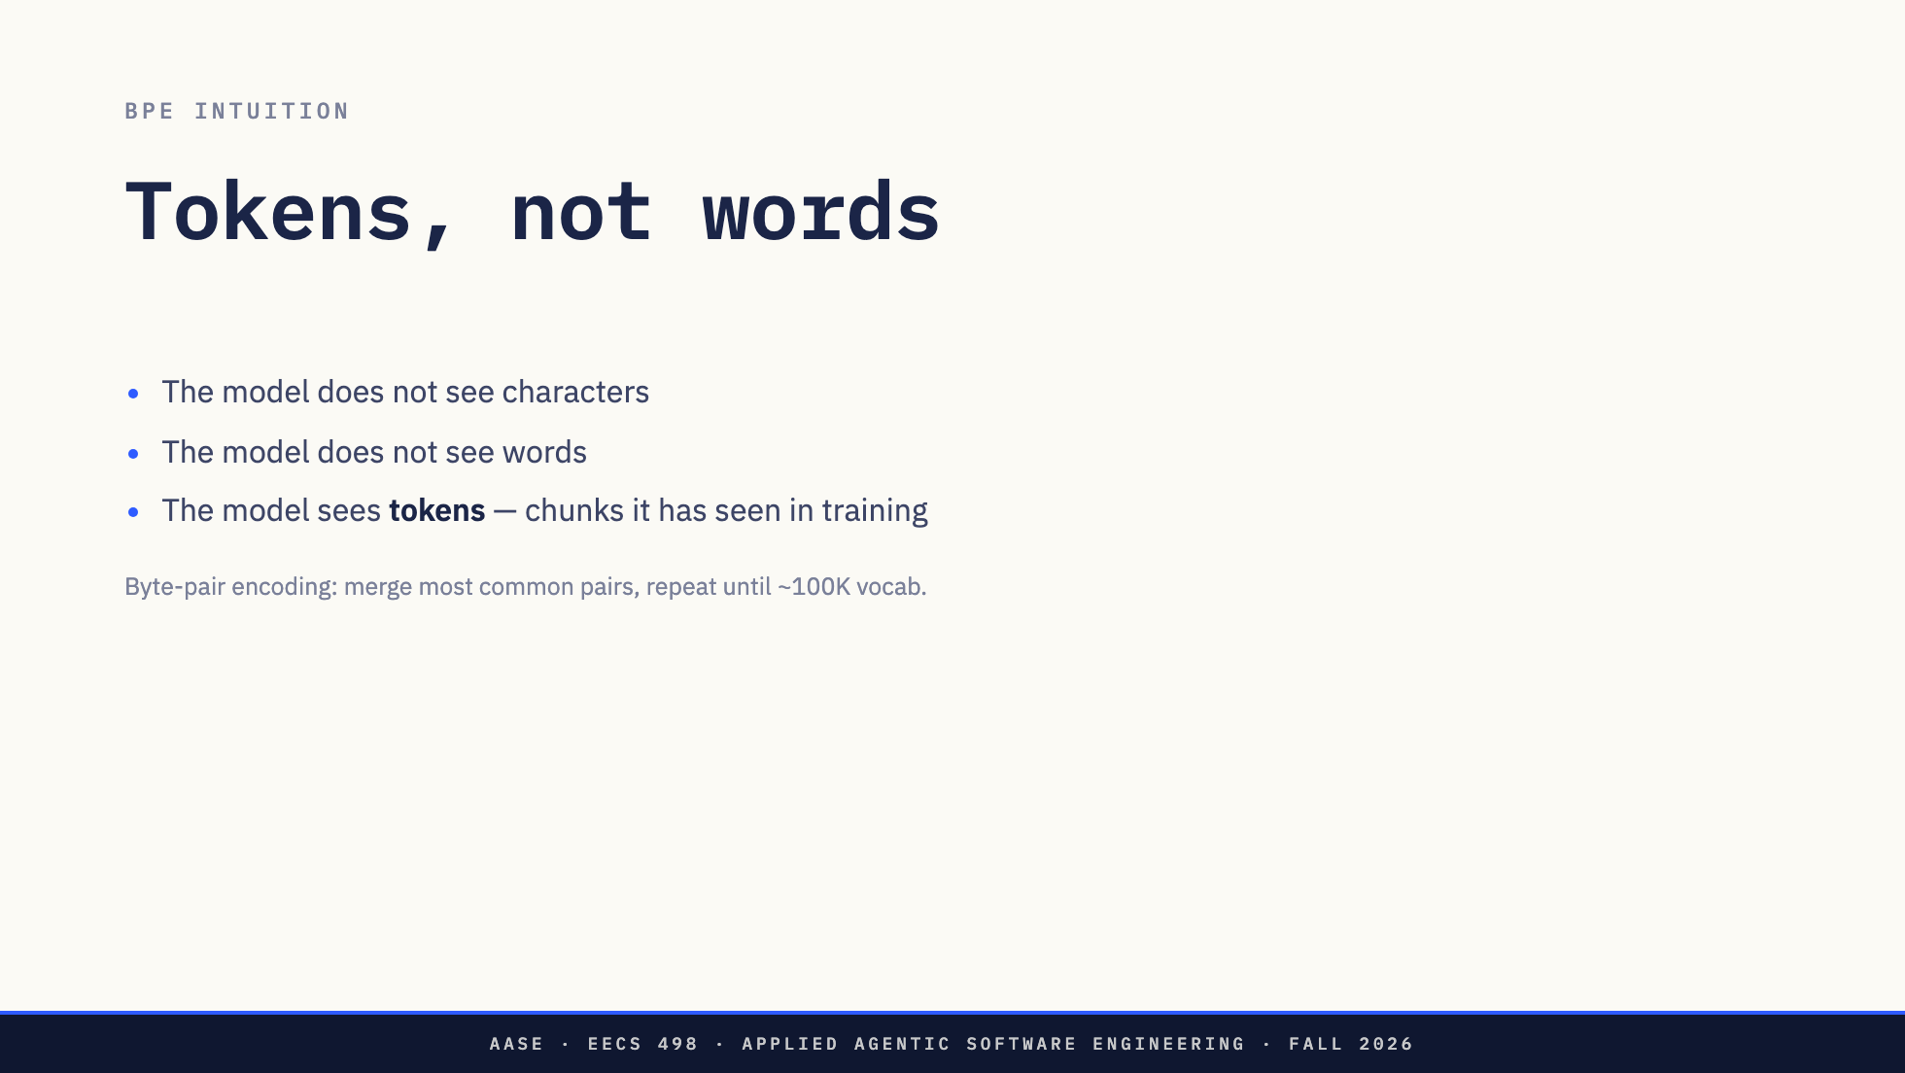

Slide 6
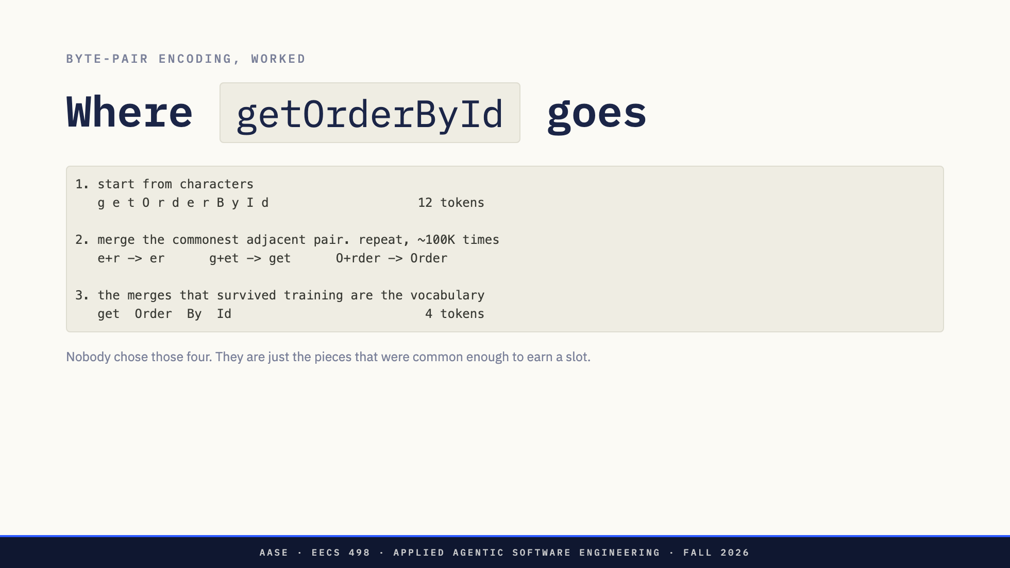

Slide 7
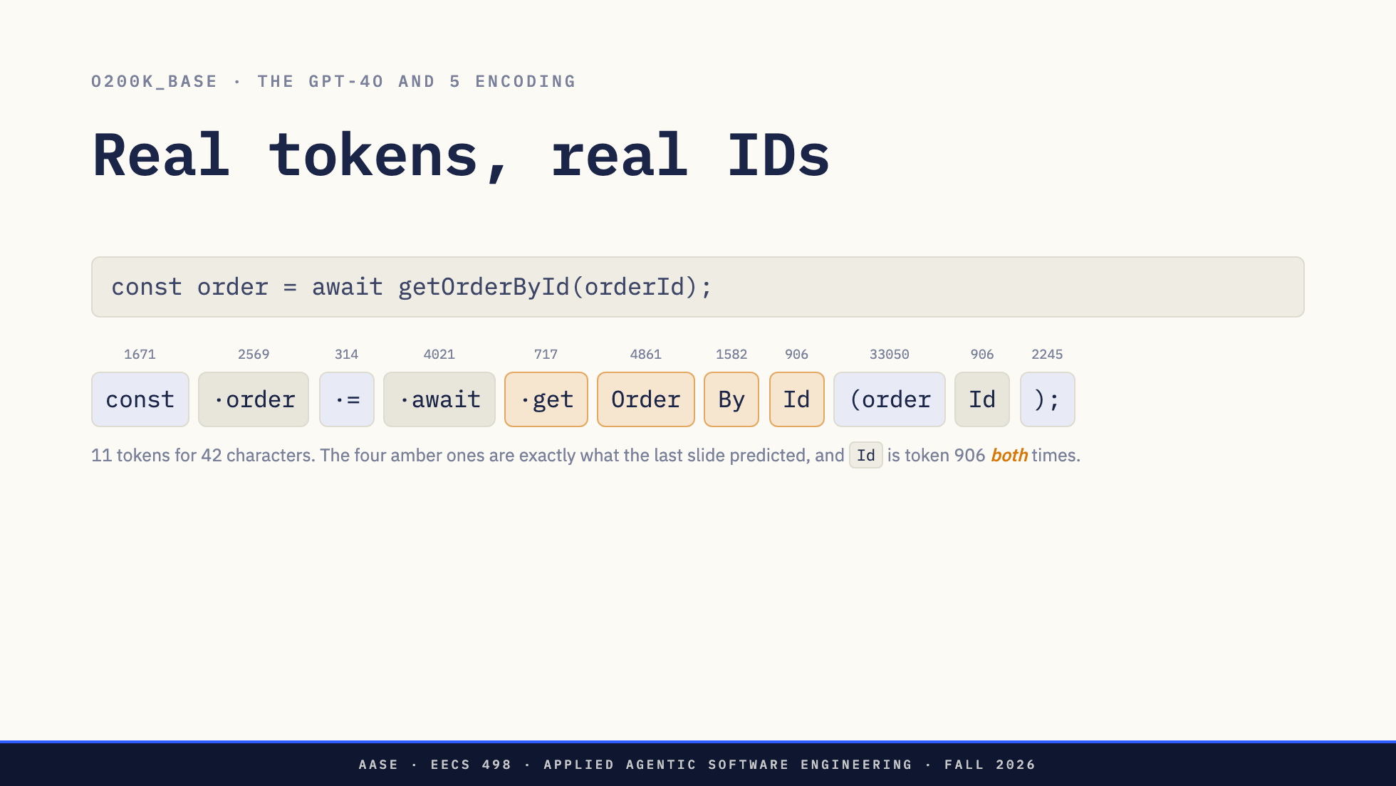
Notes:
This is the payoff for the previous slide: getOrderById really does come back as get / Order / By / Id, and here are the numbers. Two things to point at if there is time. The dot in the middle of a chip is a leading space, which is part of the token, so " order" and "order" are different tokens. And "(order" is one token: the tokenizer swallowed the paren with the word, which is why token counts are hard to guess. Caveat if asked: these IDs are o200k_base. qwen3.5 uses a different vocabulary, so the numbers differ. The idea does not.

Slide 8
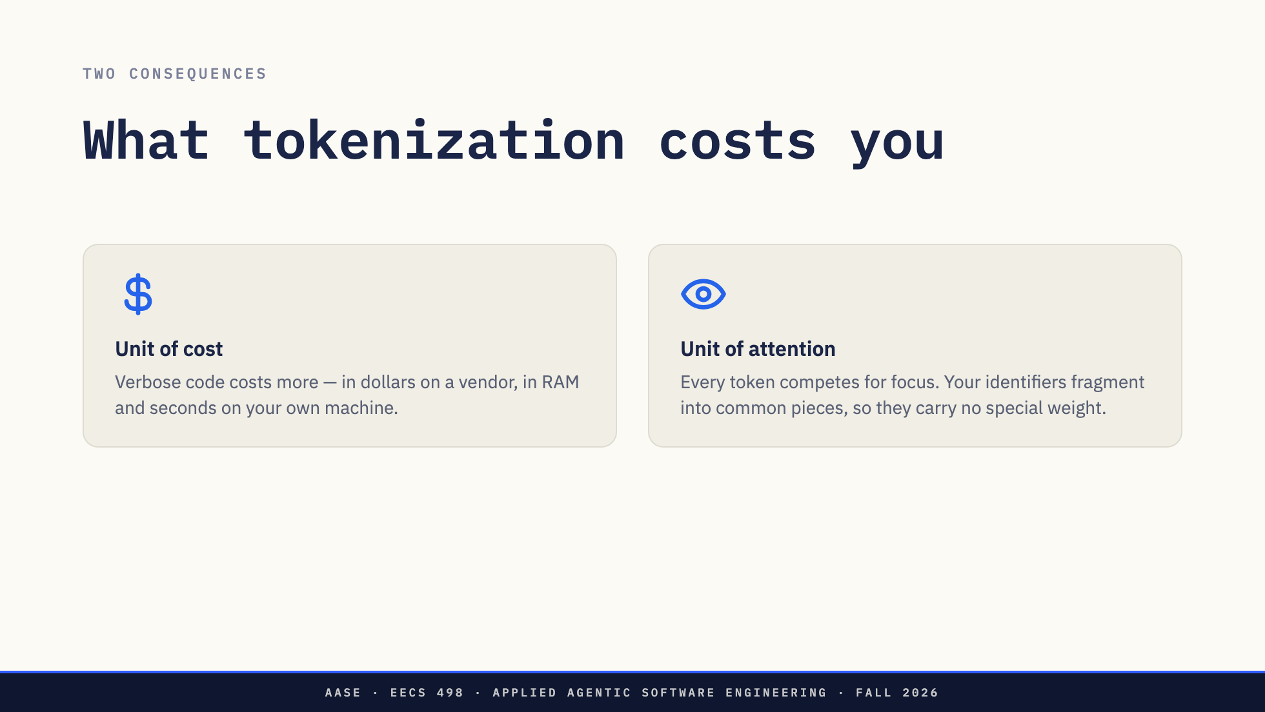

Slide 9
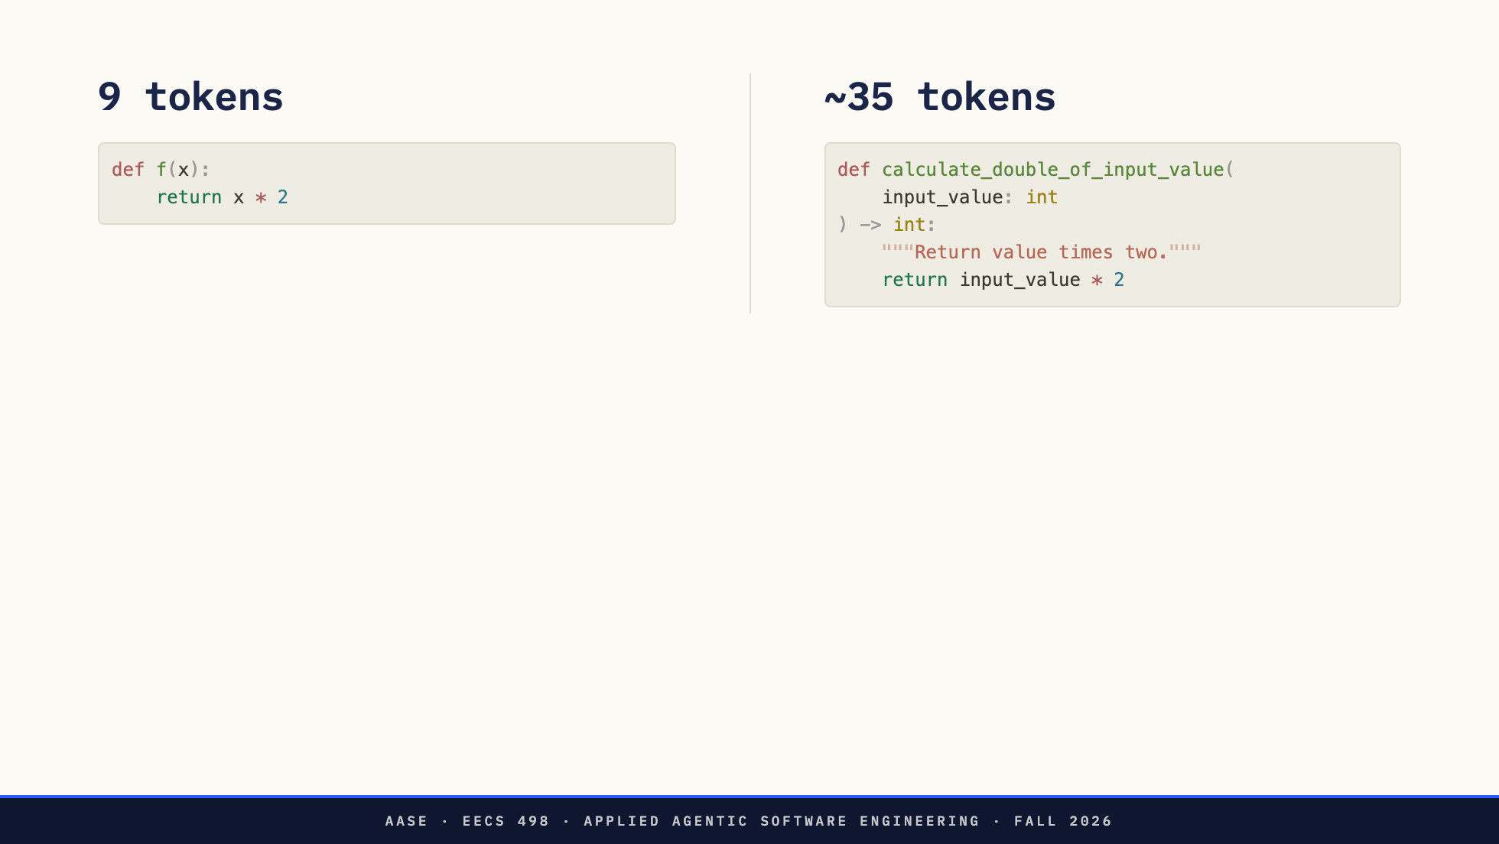
Notes:
Same function. Verbose costs 4× more. Not "more informative" — more expensive and more distracting.

Slide 10
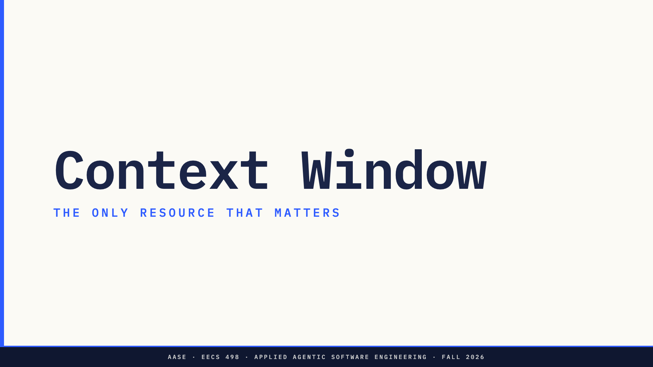

Slide 11
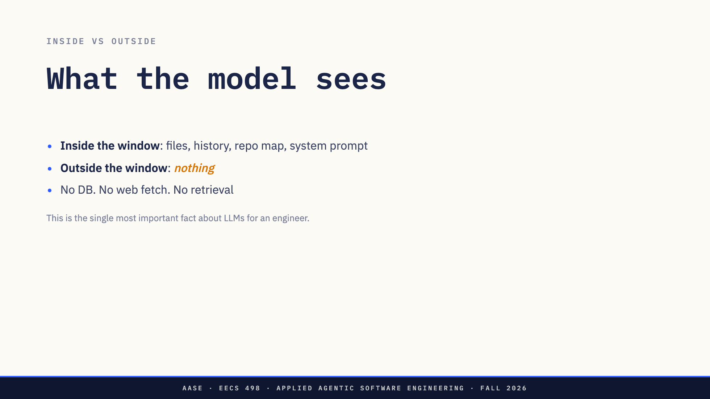

Slide 12
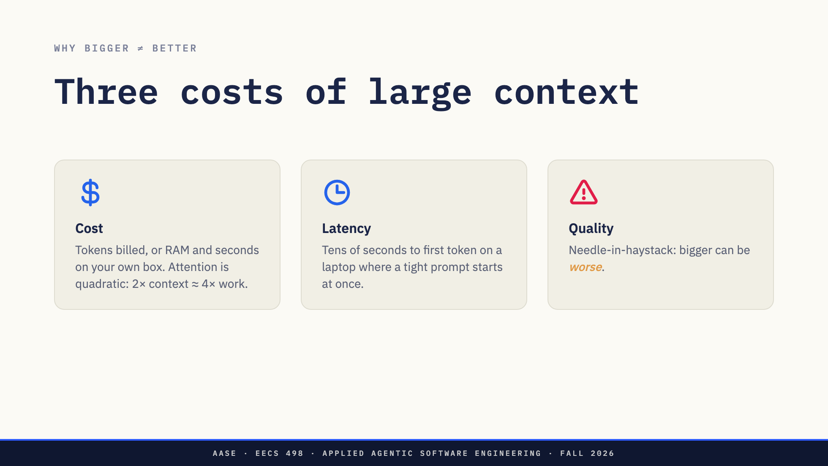
Notes:
Rose accent on the surprising one — quality degradation.

Slide 13
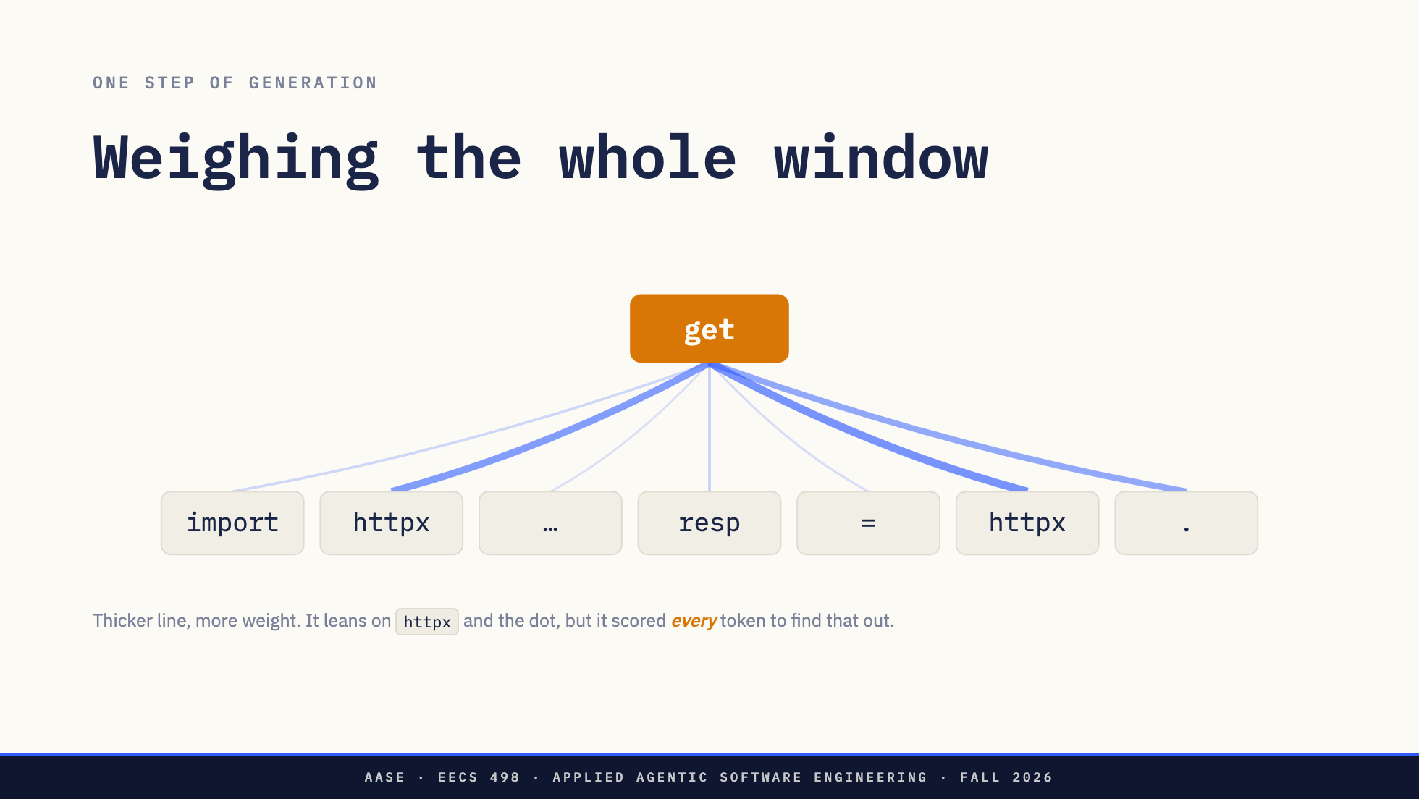
Notes:
Walk it: the model is choosing what follows "httpx." and to do that it scores every token already in the window, not just the nearby ones. Thickness is attention weight. Then the setup for the next slide: this whole picture happens again for the token after "get", and again after that.

Slide 14
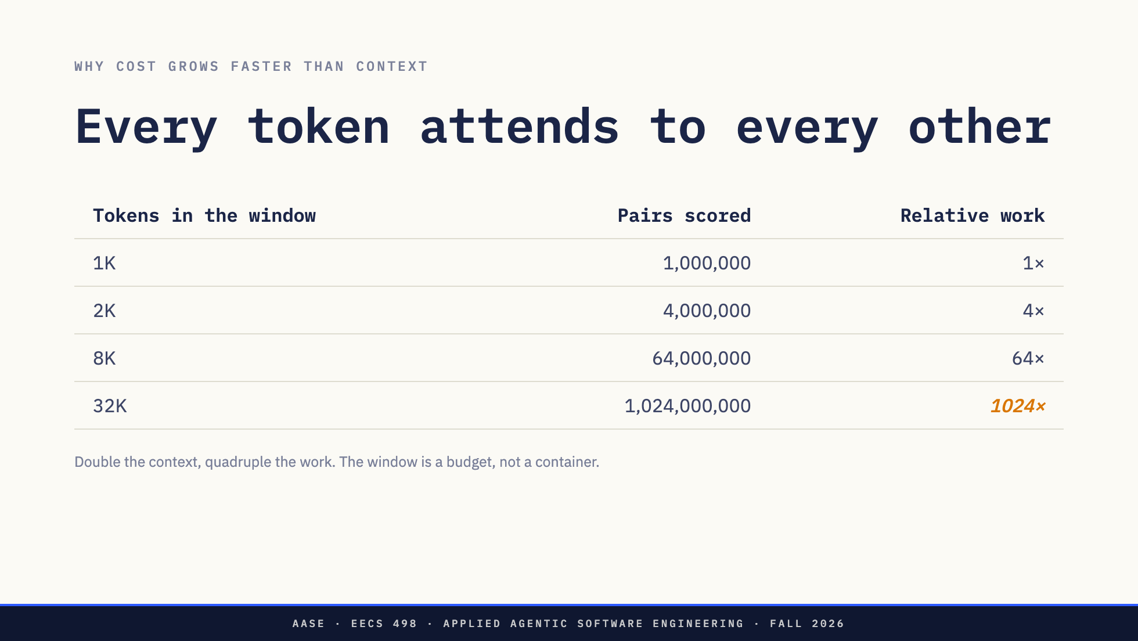
Notes:
The number to land: 32× the text is not 32× the cost, it is 1000×. This is why "just paste the repo in" fails on a laptop.

Slide 15
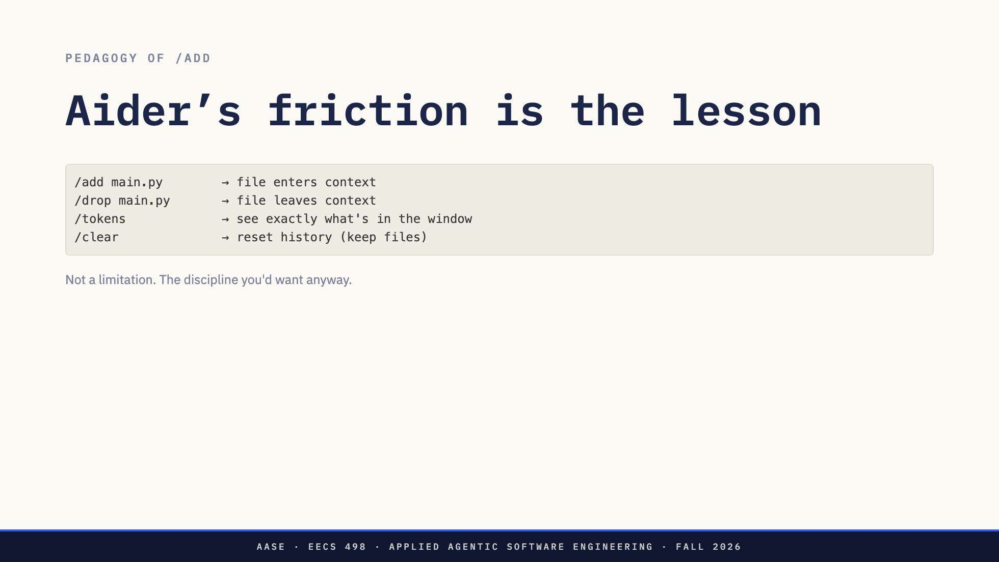

Slide 16
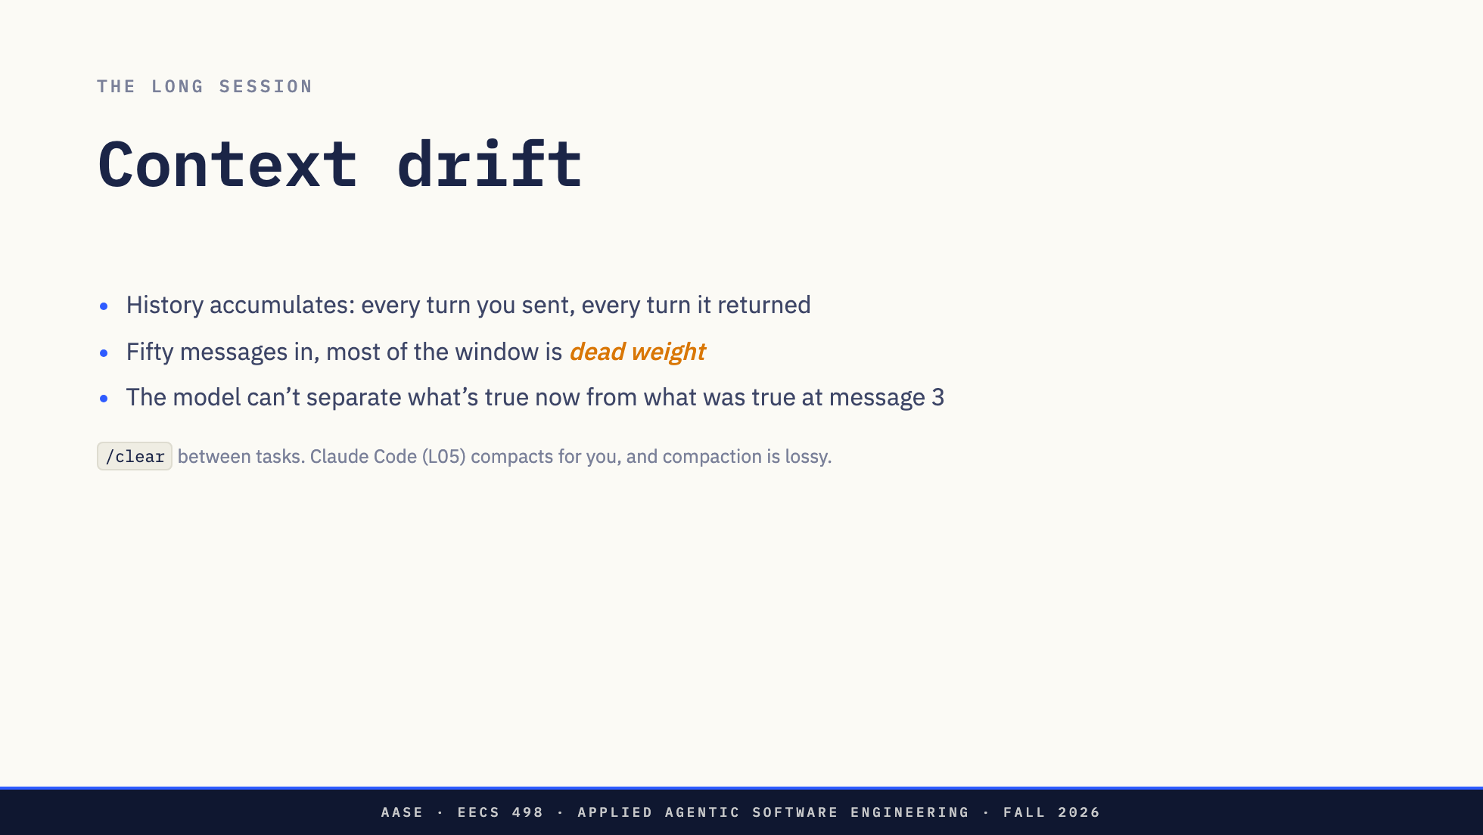

Slide 17
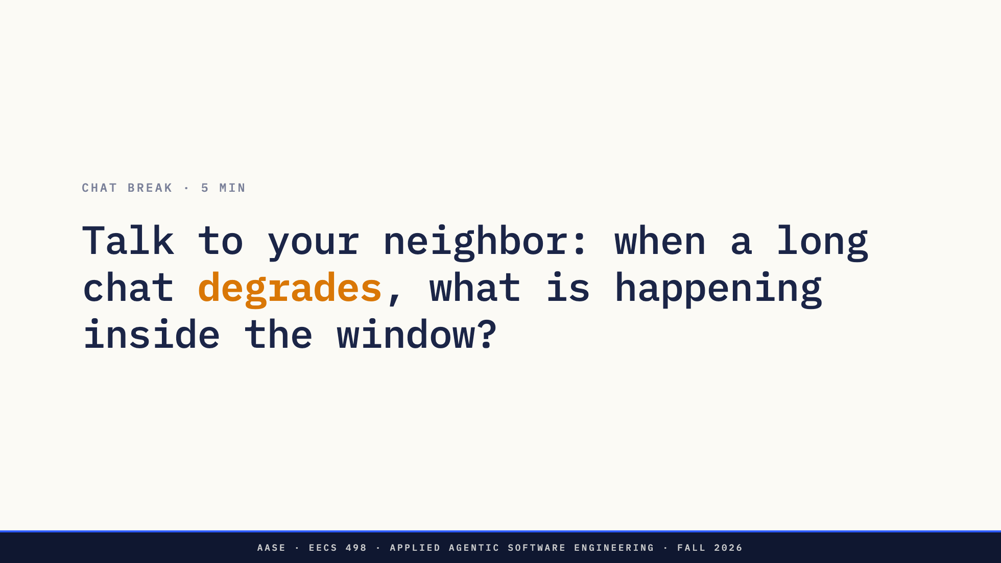
Notes:
0:35. The fixed break. Prompt is the chat_break field in overview.md. Think about a long conversation with an assistant that got worse toward the end. What did you do — new chat? re-explain? Now say what was actually happening, in today's vocabulary. Don't police vocabulary. The point is translating their own experience into the model we just built. Two or three answers out loud, then move.

Slide 18


Slide 19
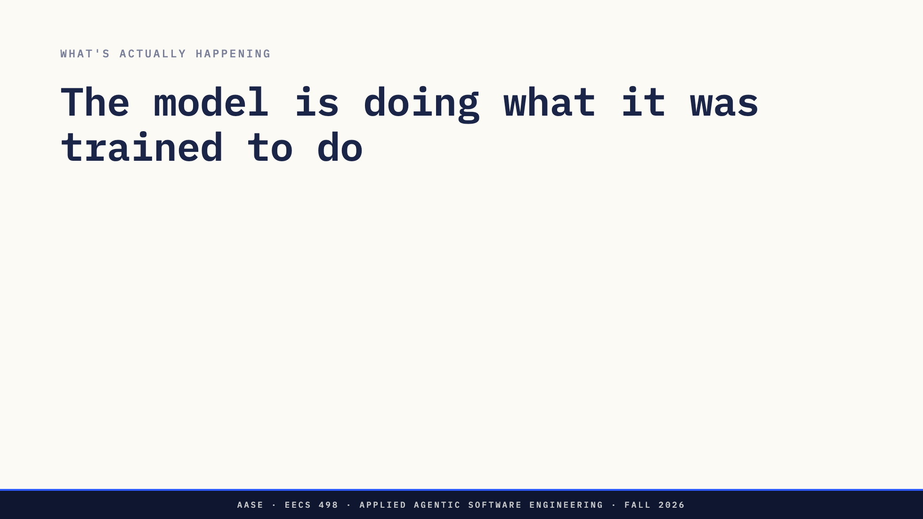
Notes:
"Hallucination" sounds like a mistake. It's not a mistake — it's the design.

Slide 20
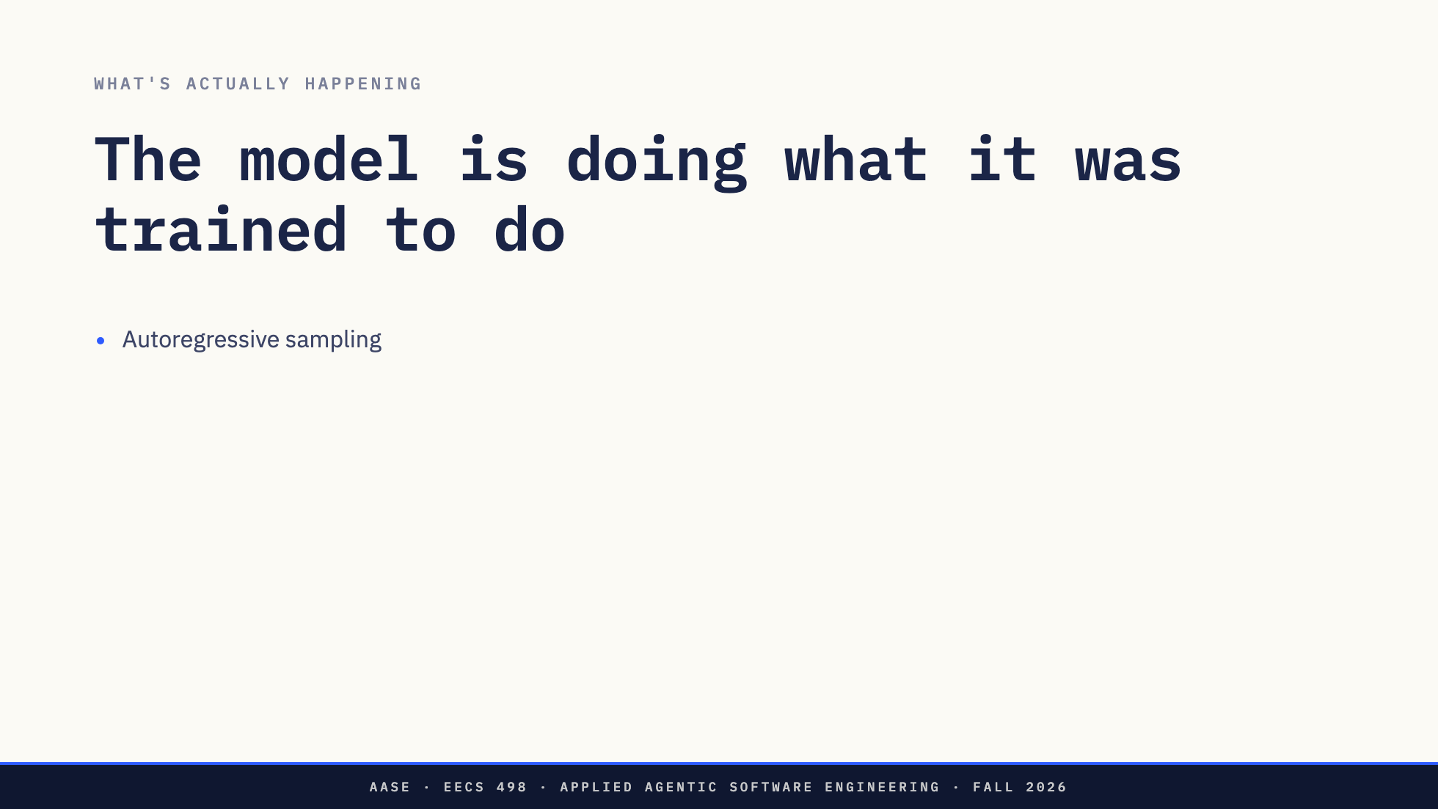
Notes:
"Hallucination" sounds like a mistake. It's not a mistake — it's the design.

Slide 21
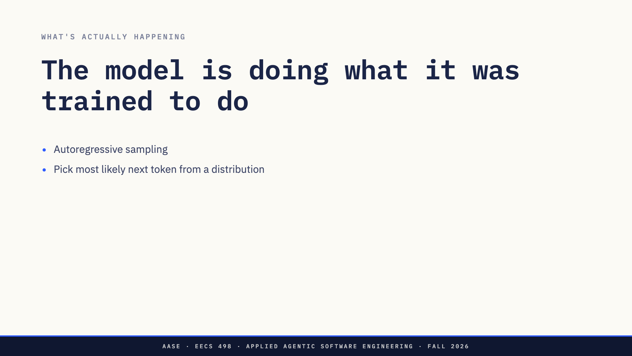
Notes:
"Hallucination" sounds like a mistake. It's not a mistake — it's the design.

Slide 22
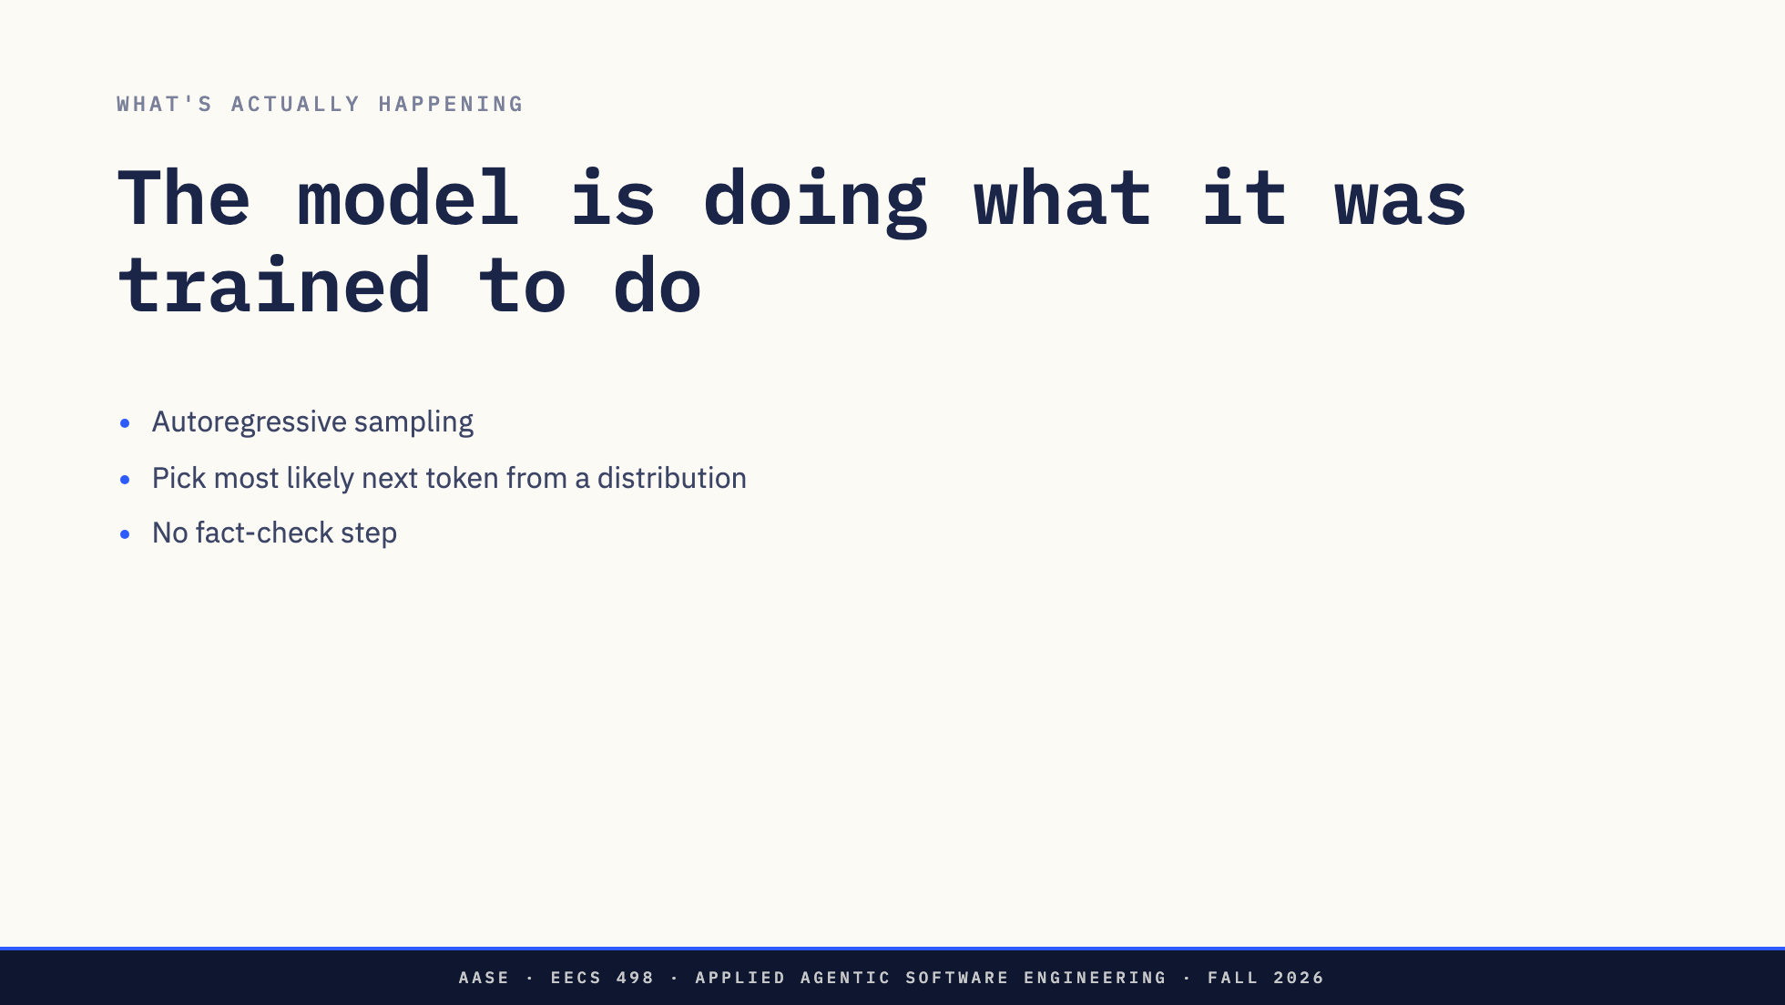
Notes:
"Hallucination" sounds like a mistake. It's not a mistake — it's the design.

Slide 23
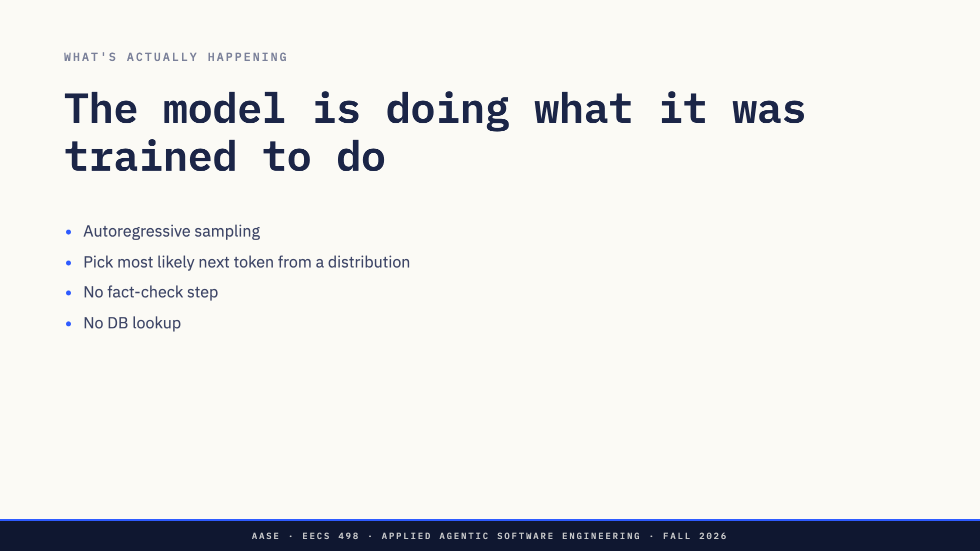
Notes:
"Hallucination" sounds like a mistake. It's not a mistake — it's the design.

Slide 24
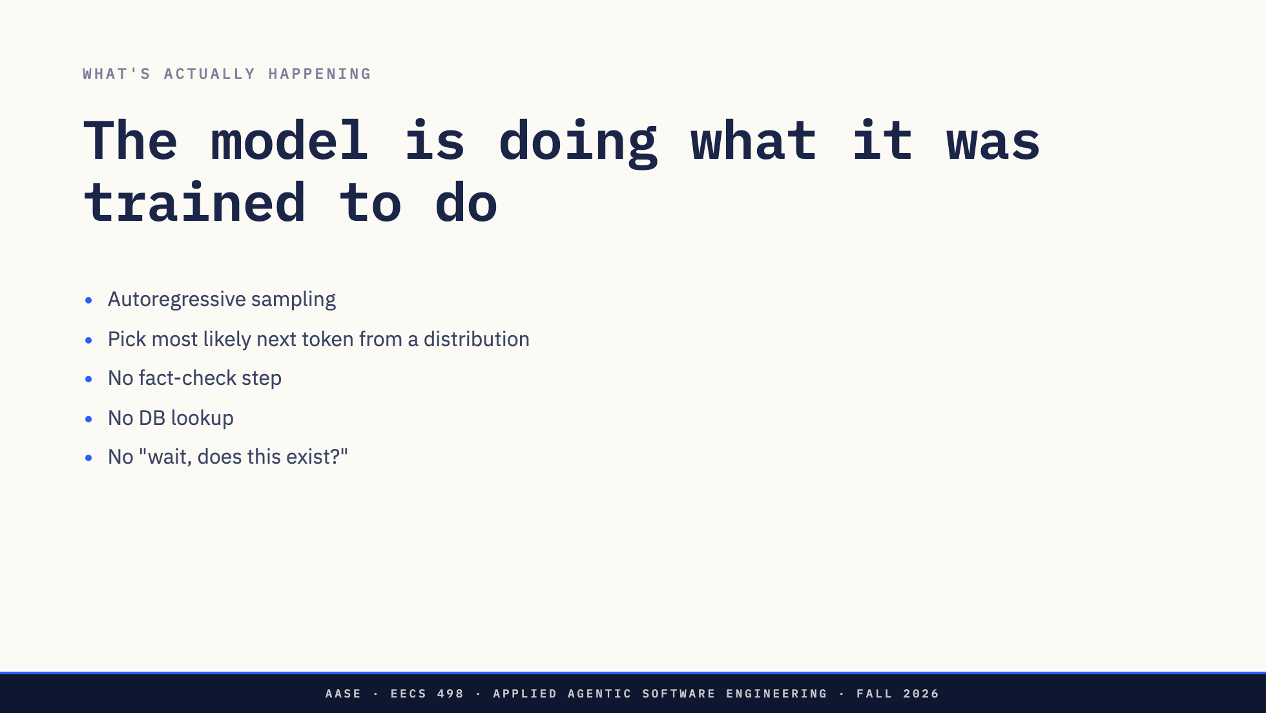
Notes:
"Hallucination" sounds like a mistake. It's not a mistake — it's the design.

Slide 25
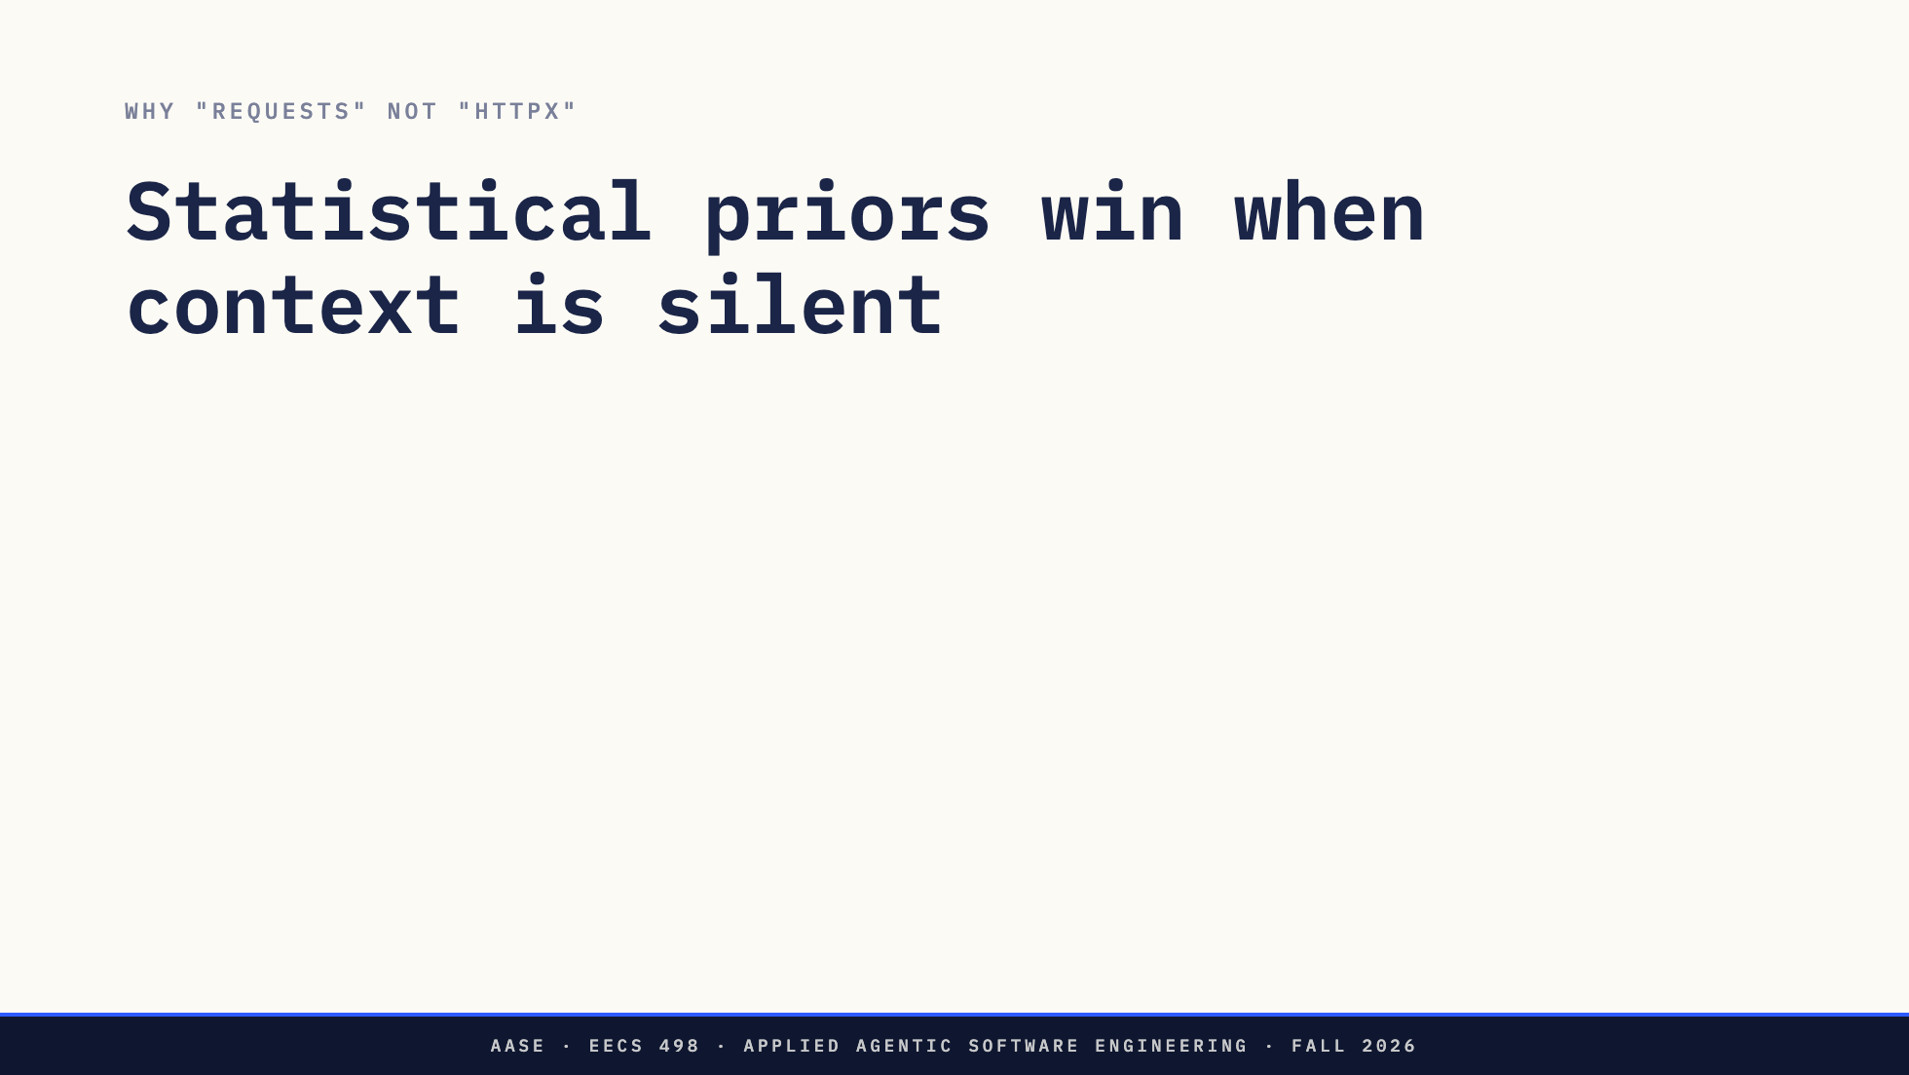
Notes:
Not "made up" — wrong real library for the wrong real project.

Slide 26
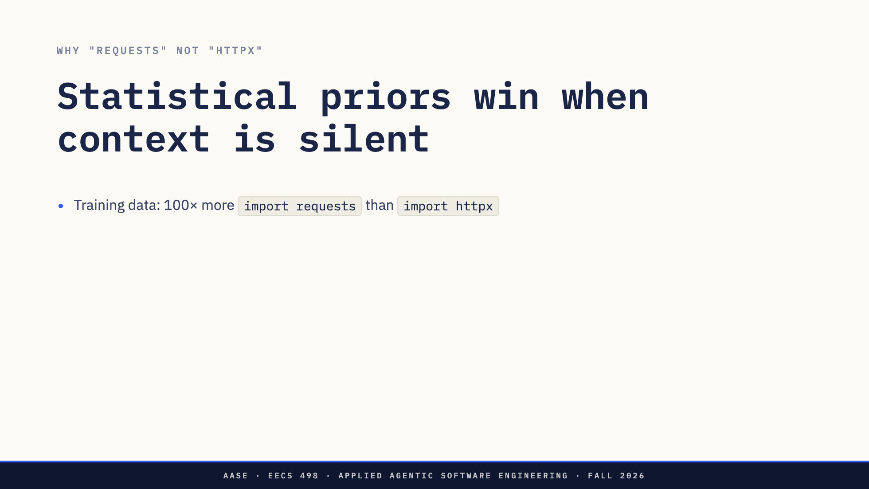
Notes:
Not "made up" — wrong real library for the wrong real project.

Slide 27
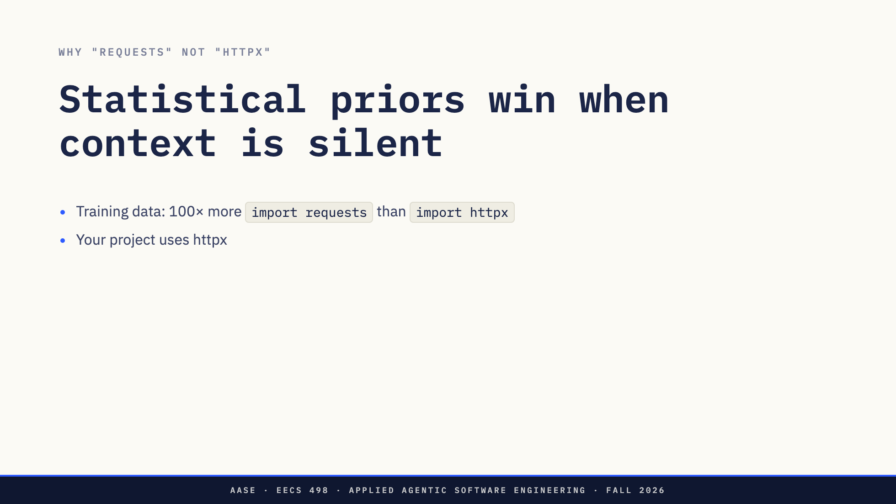
Notes:
Not "made up" — wrong real library for the wrong real project.

Slide 28
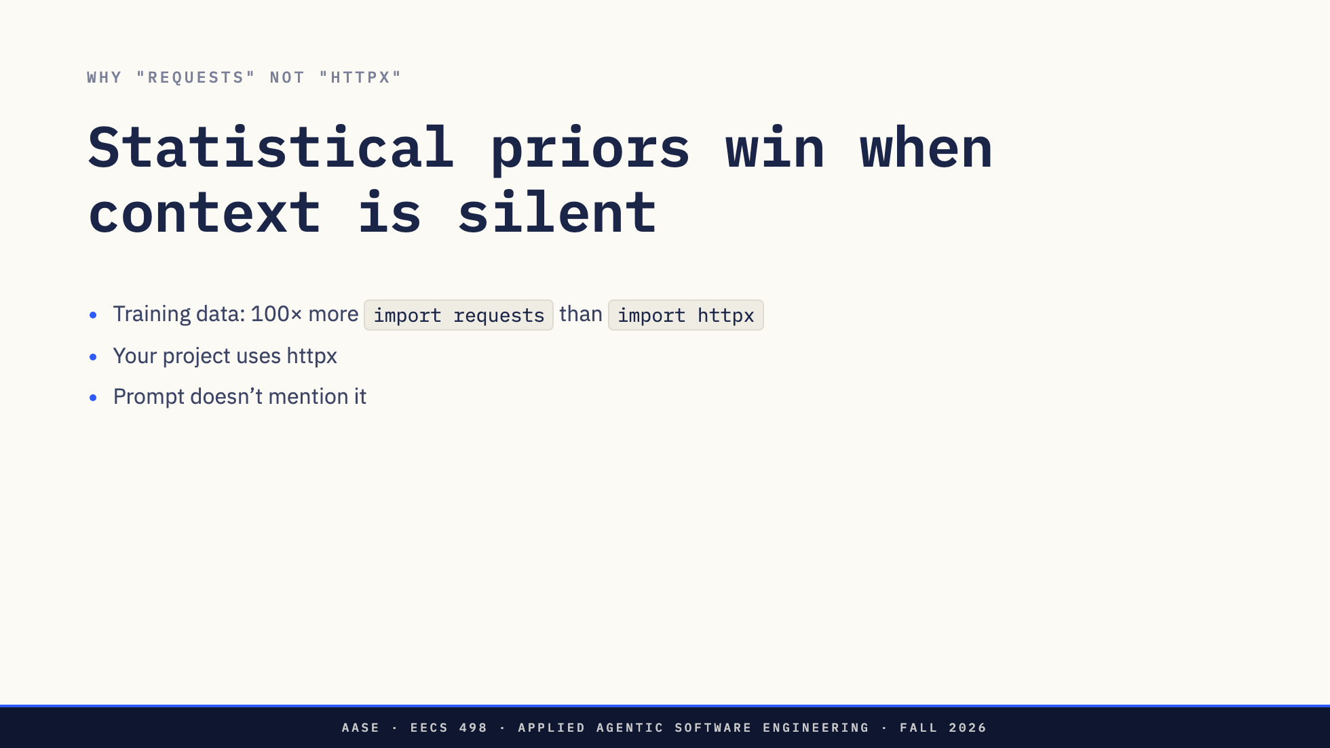
Notes:
Not "made up" — wrong real library for the wrong real project.

Slide 29
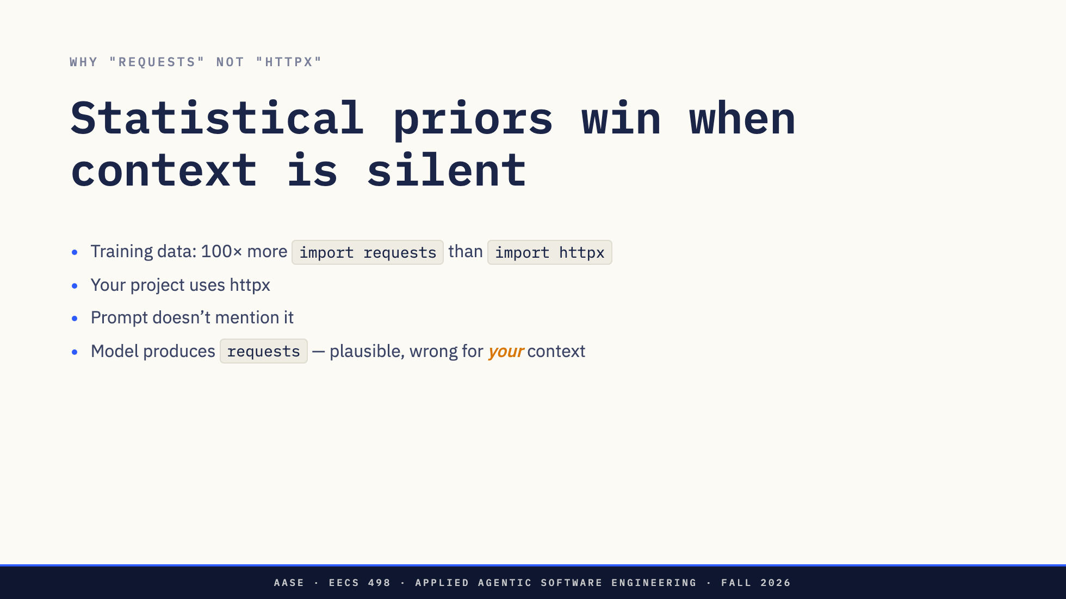
Notes:
Not "made up" — wrong real library for the wrong real project.

Slide 30
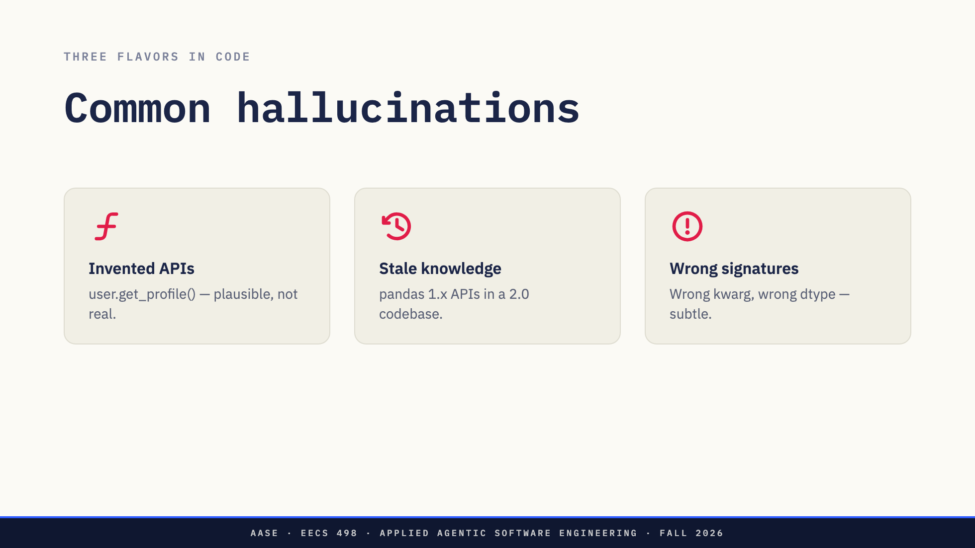

Slide 31
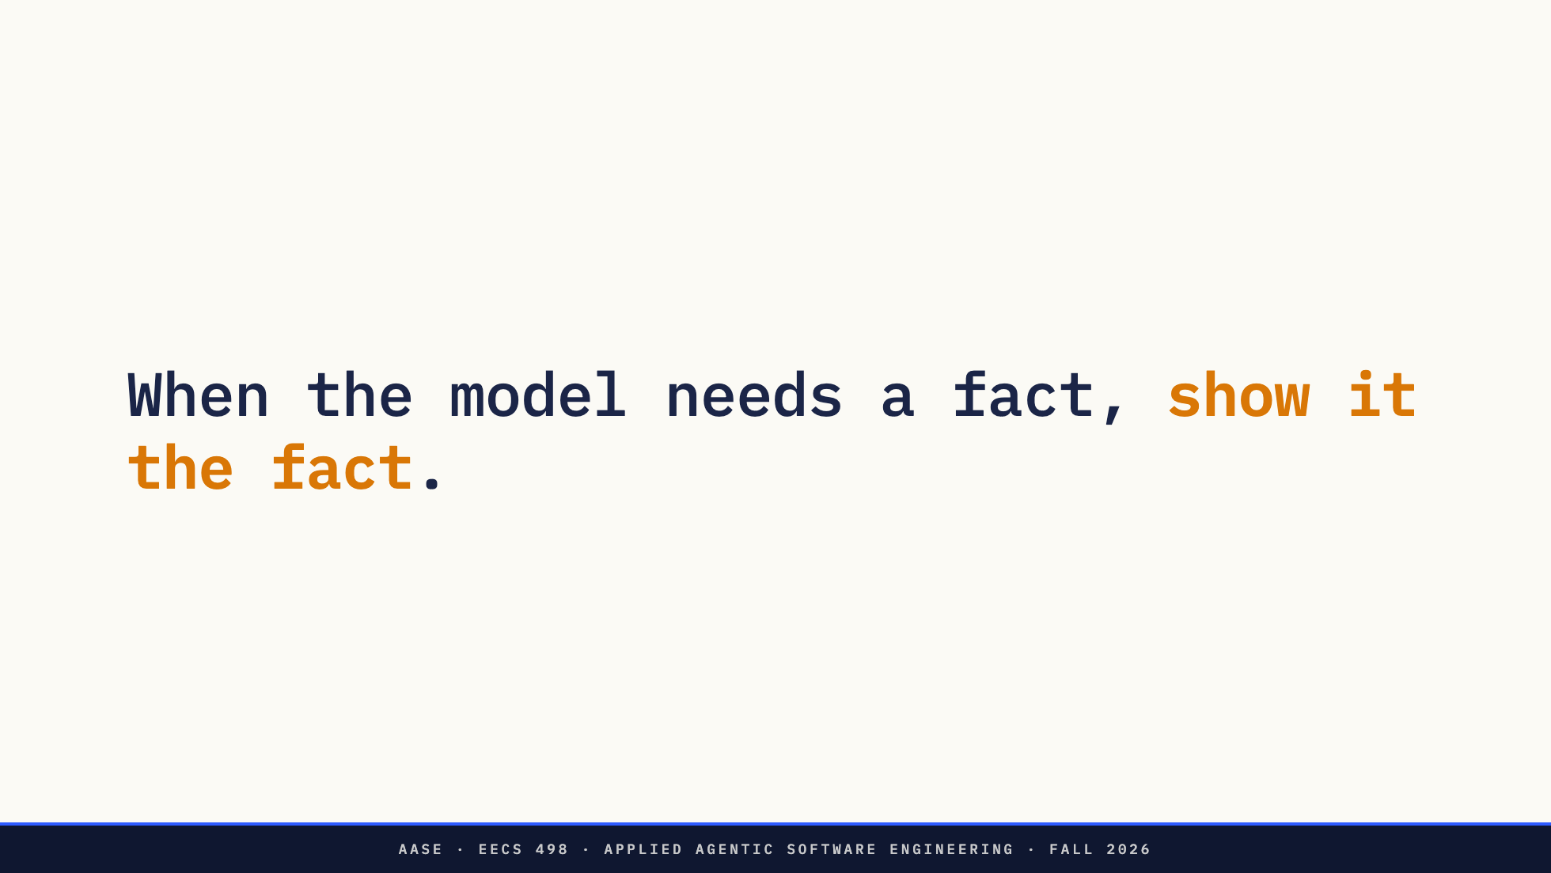
Notes:
The deepest reason to manage context: accuracy. Not cost. Not speed.

Slide 32
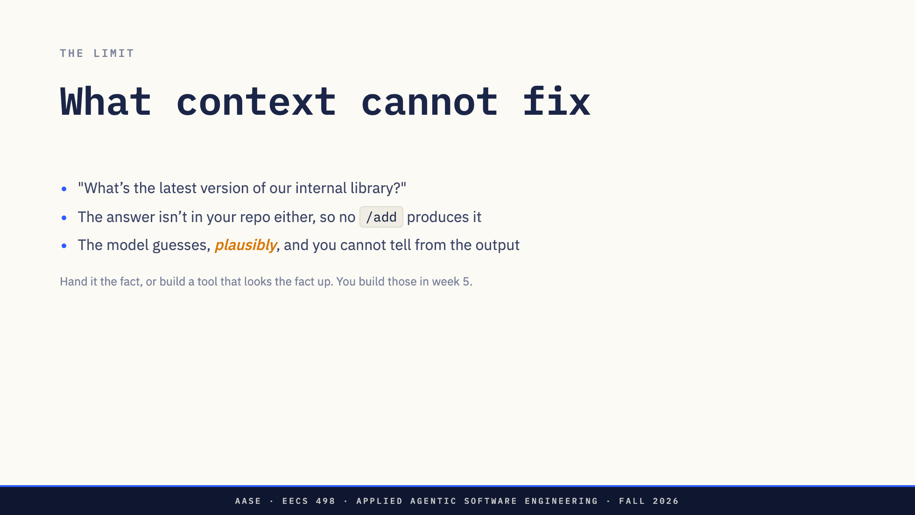

Slide 33


Slide 34
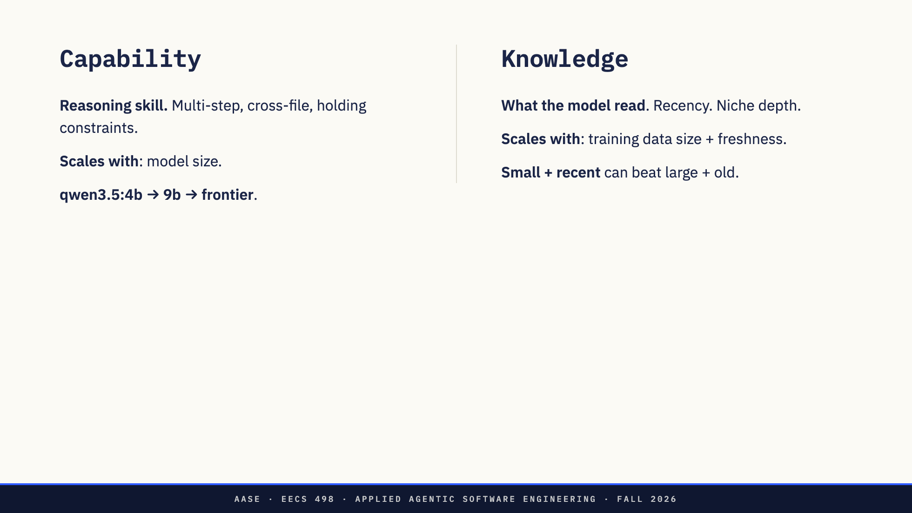
Notes:
Two axes. Confusing them = bad model choices.

Slide 35
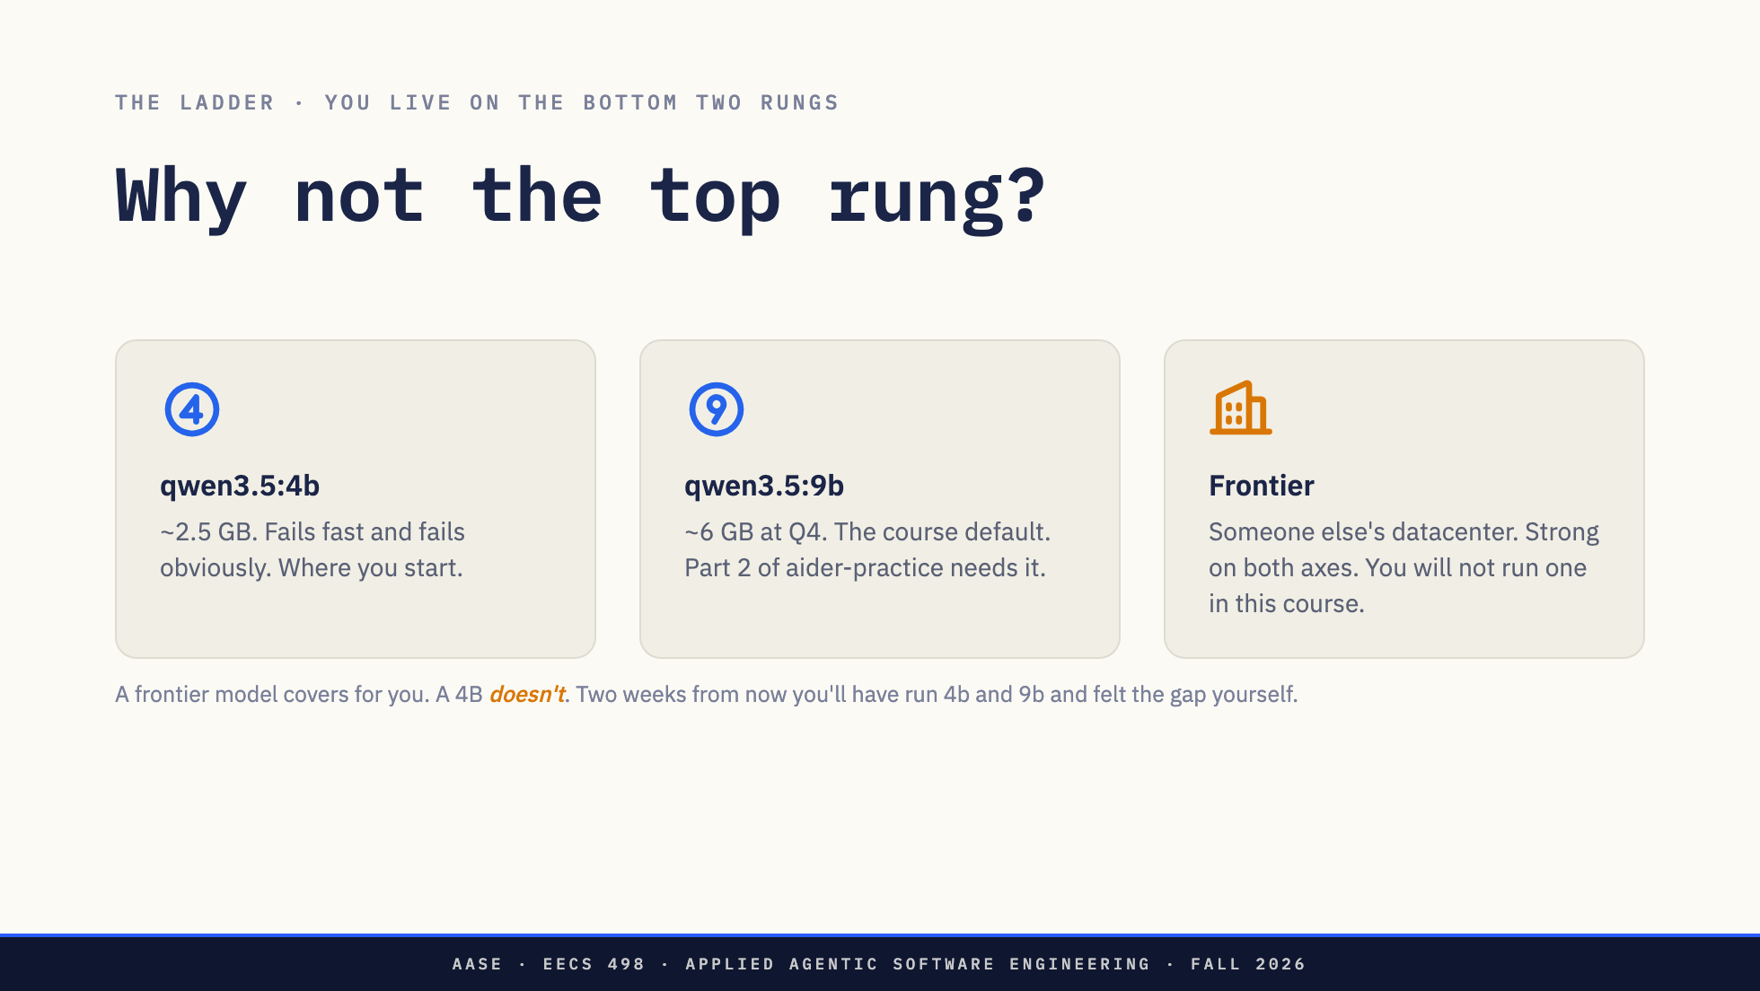
Notes:
Don't assert this — promise the experiment. Everyone runs the same repo on 4b and then 9b over the next two weeks. That beats any benchmark I could show. Be clear that frontier is the rung they are NOT on: it is here to name what they are giving up and why, not as something they get access to.

Slide 36
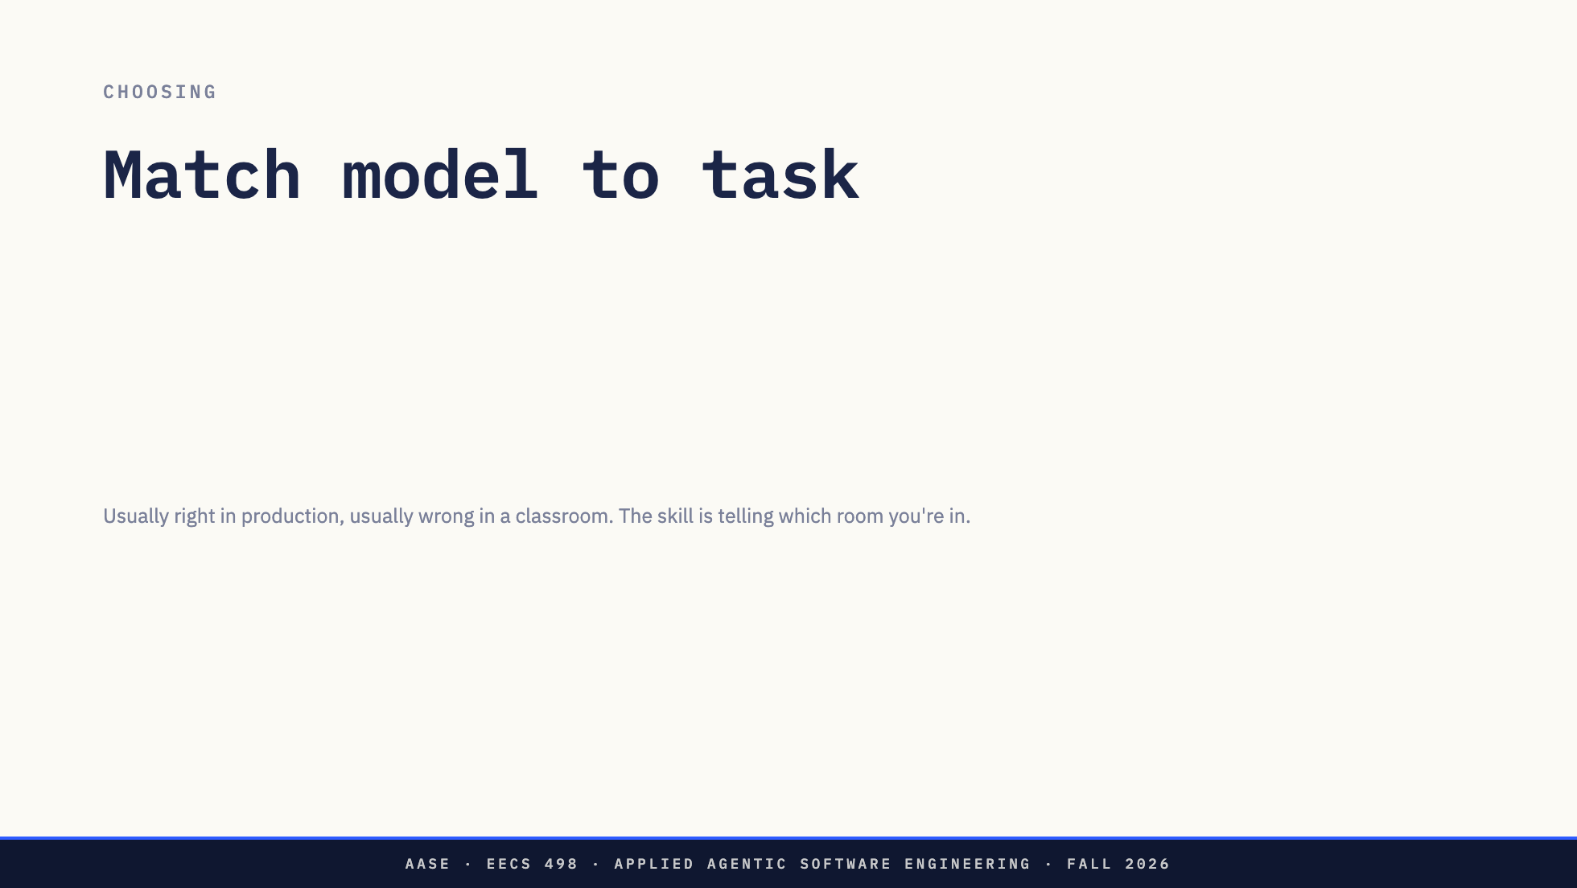

Slide 37
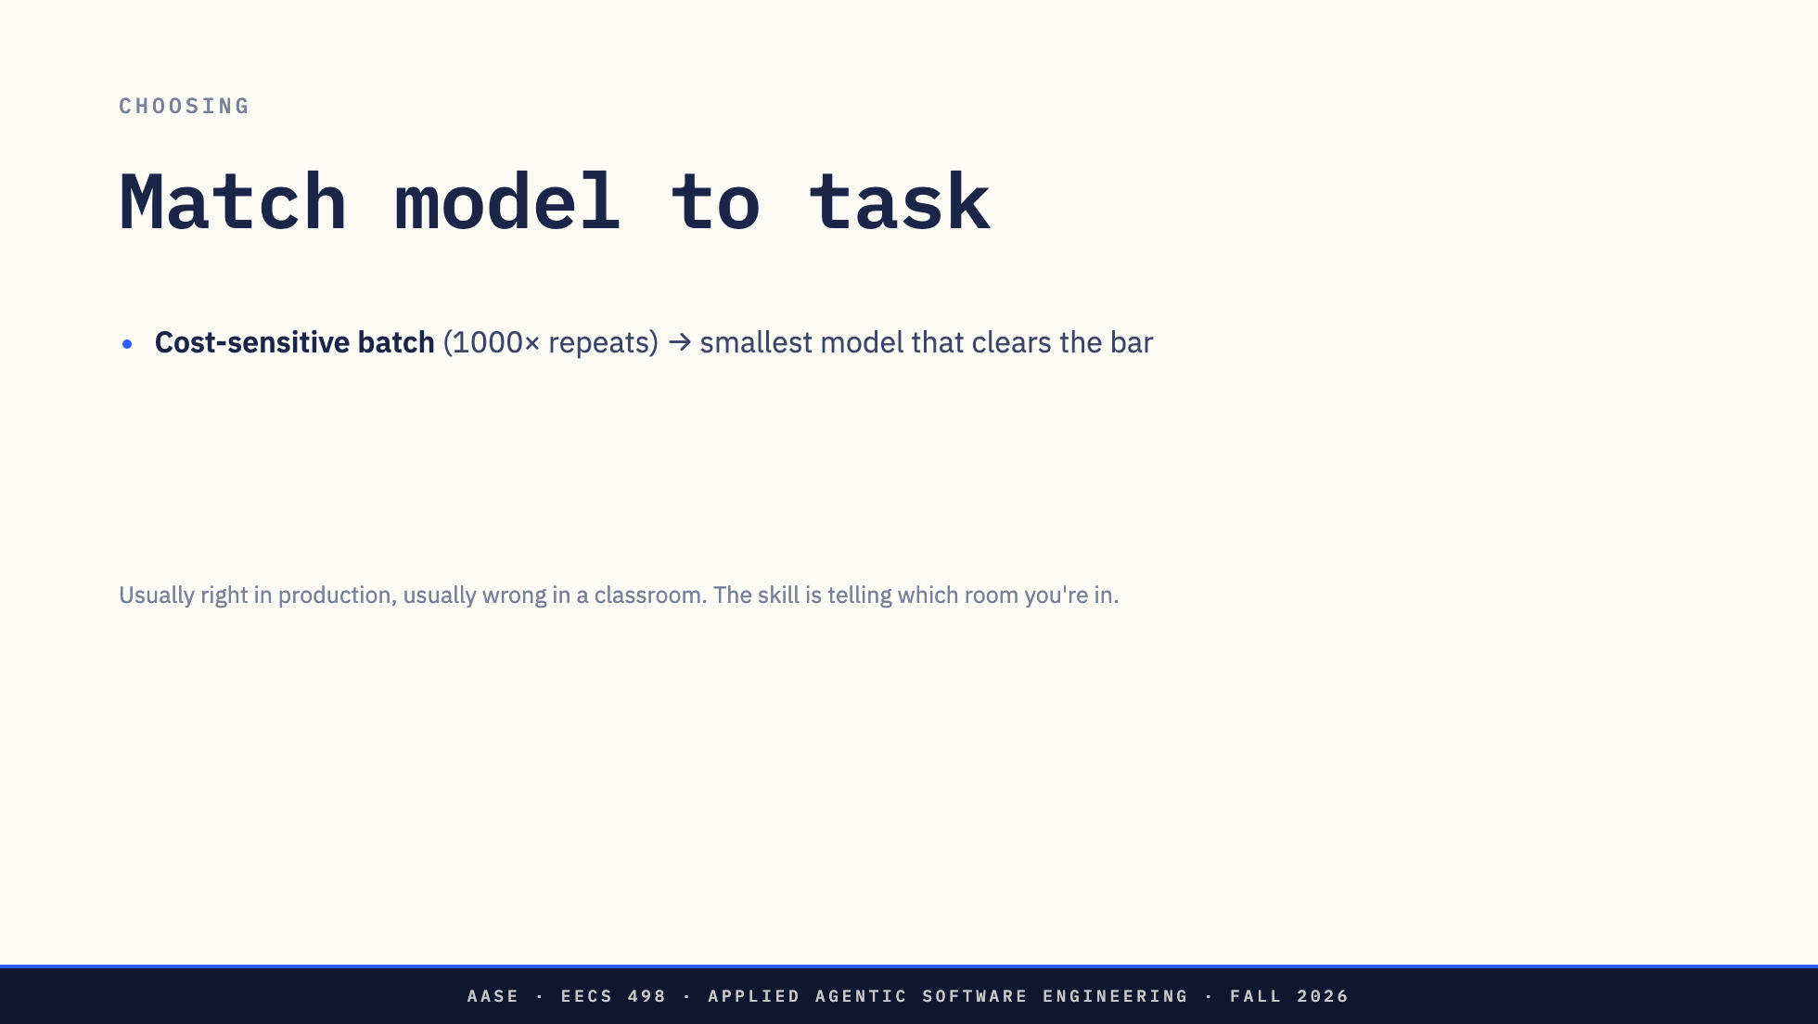

Slide 38
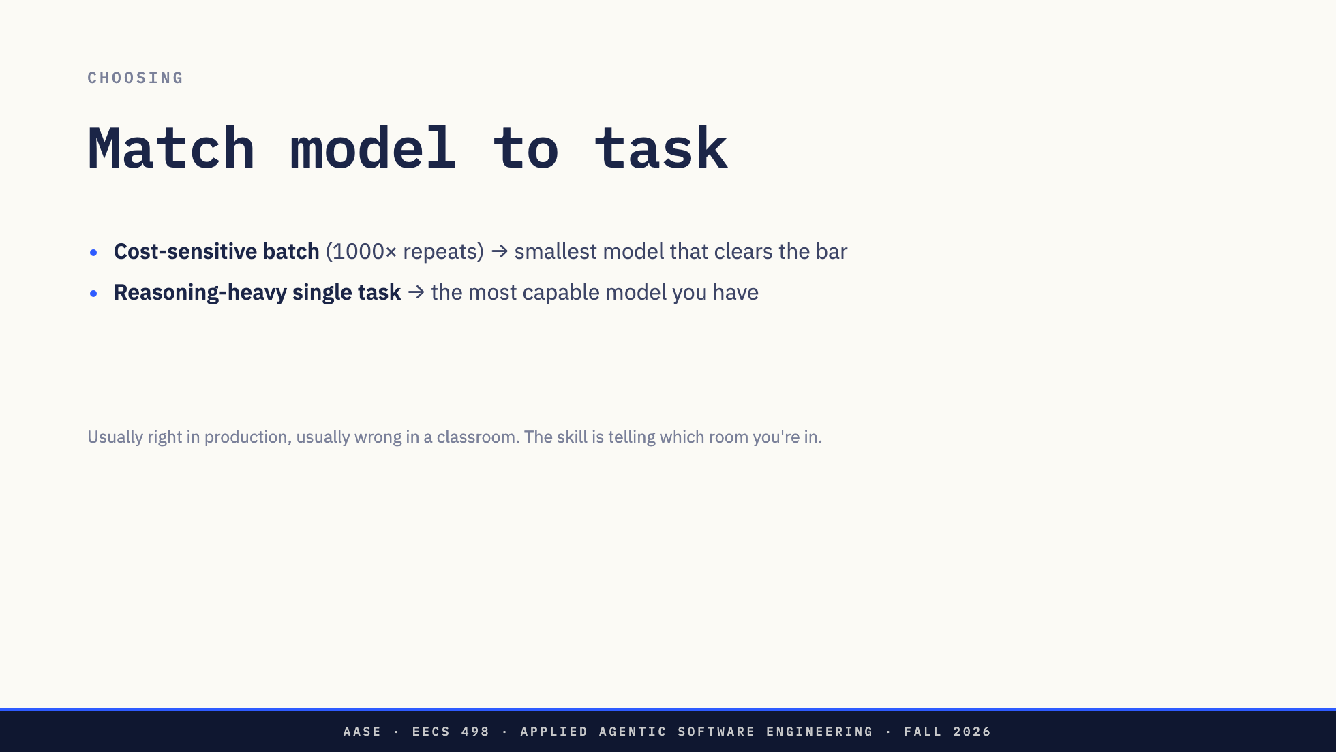

Slide 39
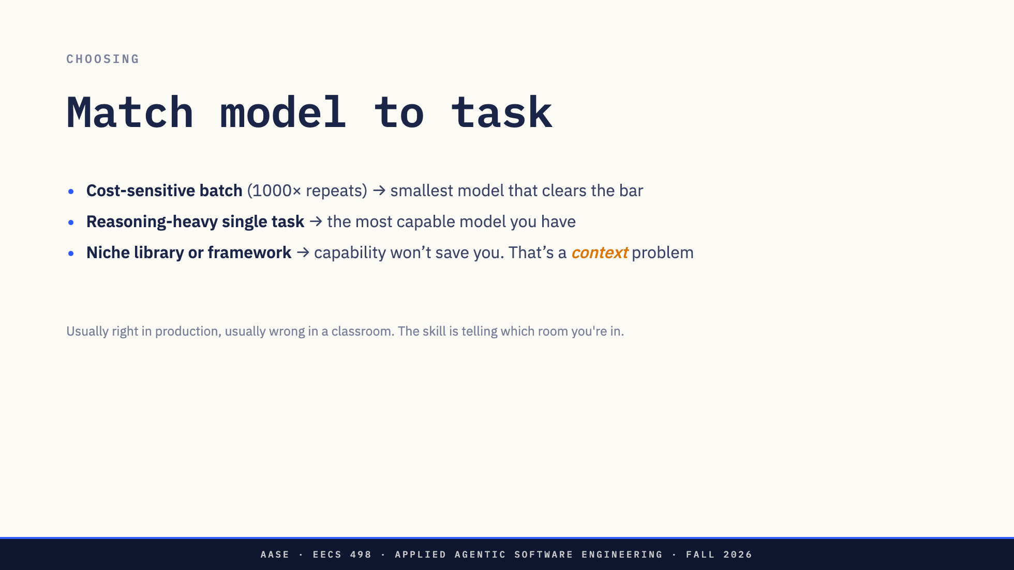

Slide 40
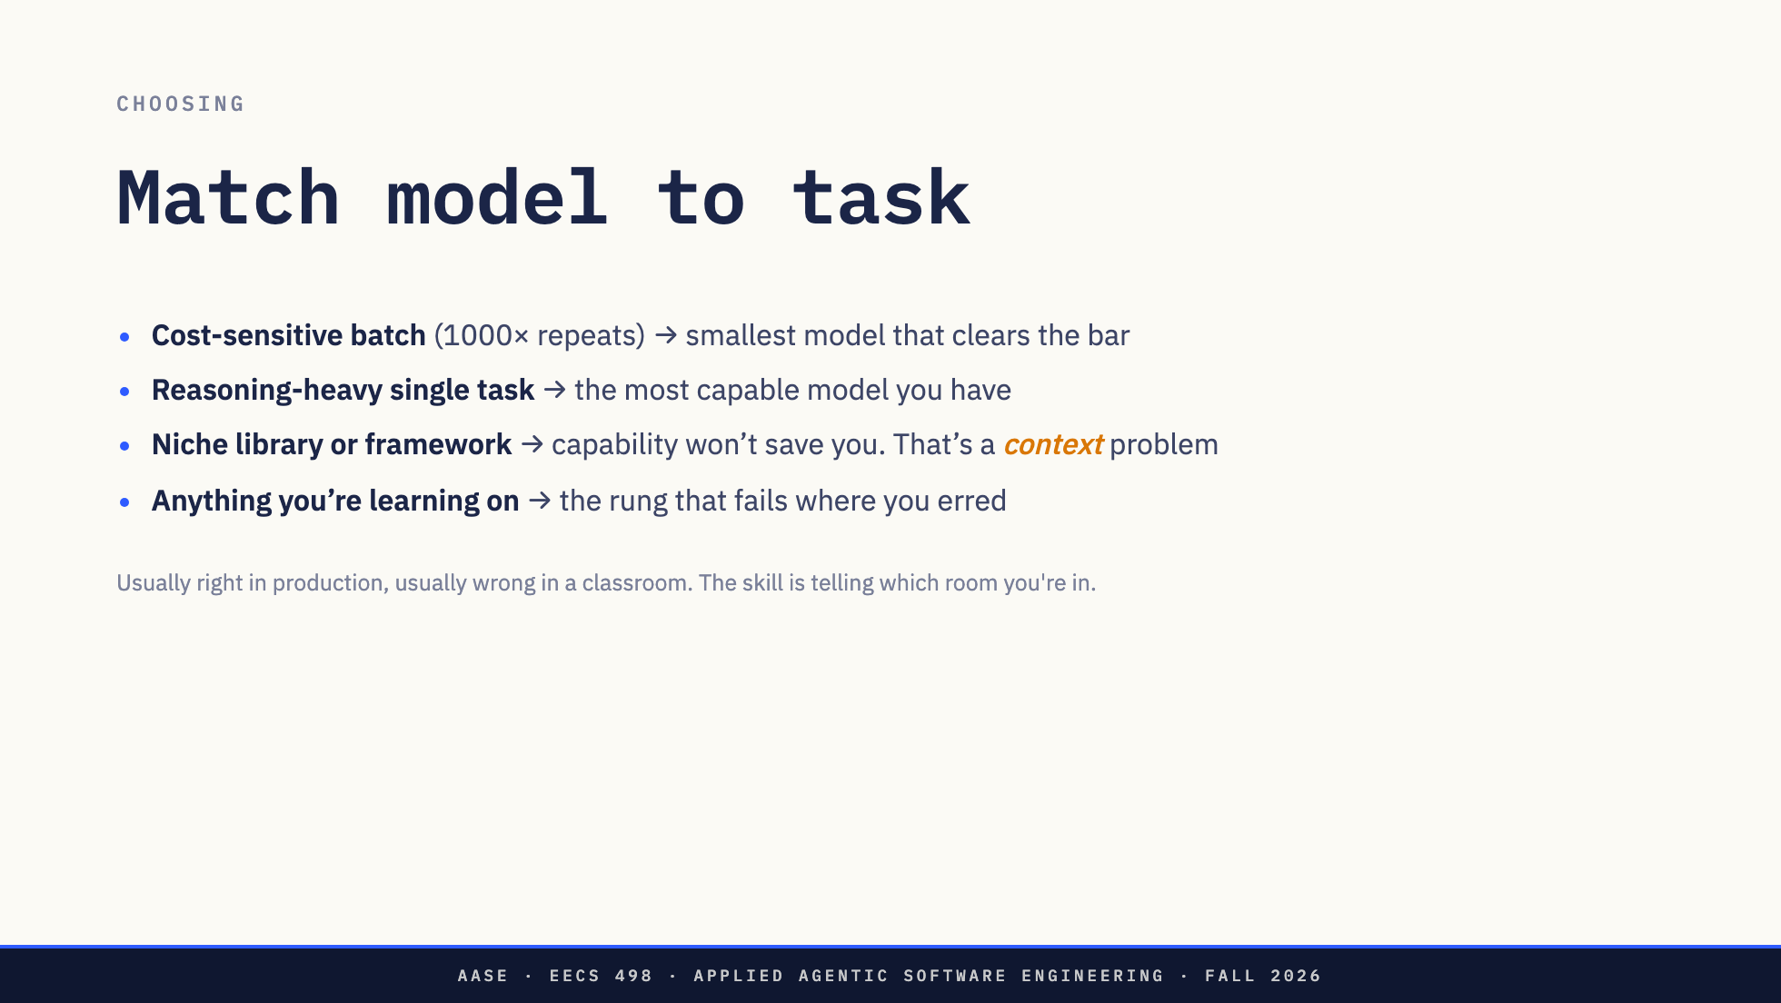

Slide 41
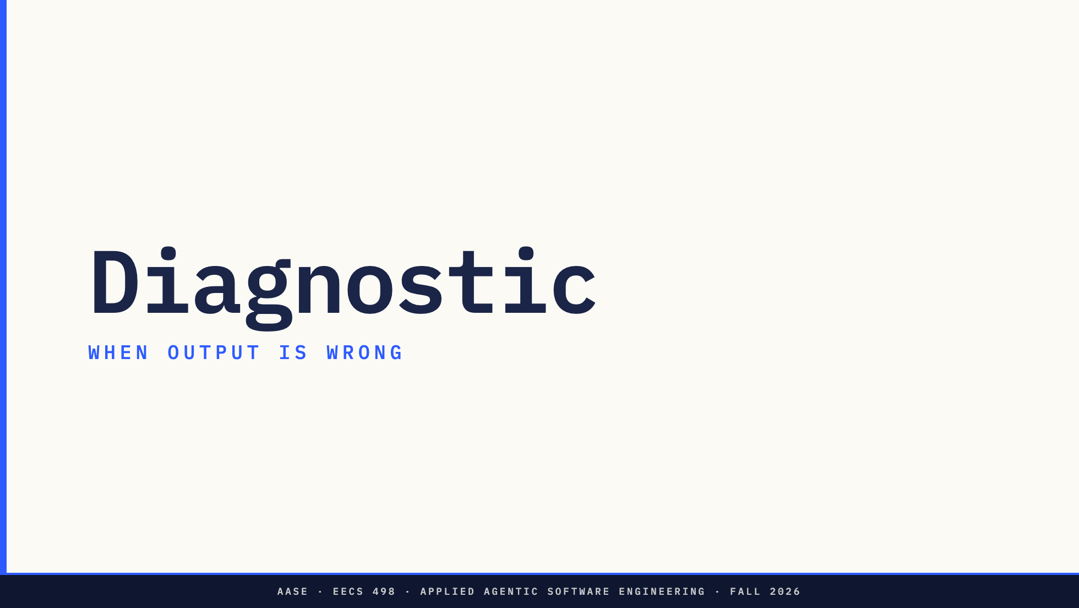

Slide 42
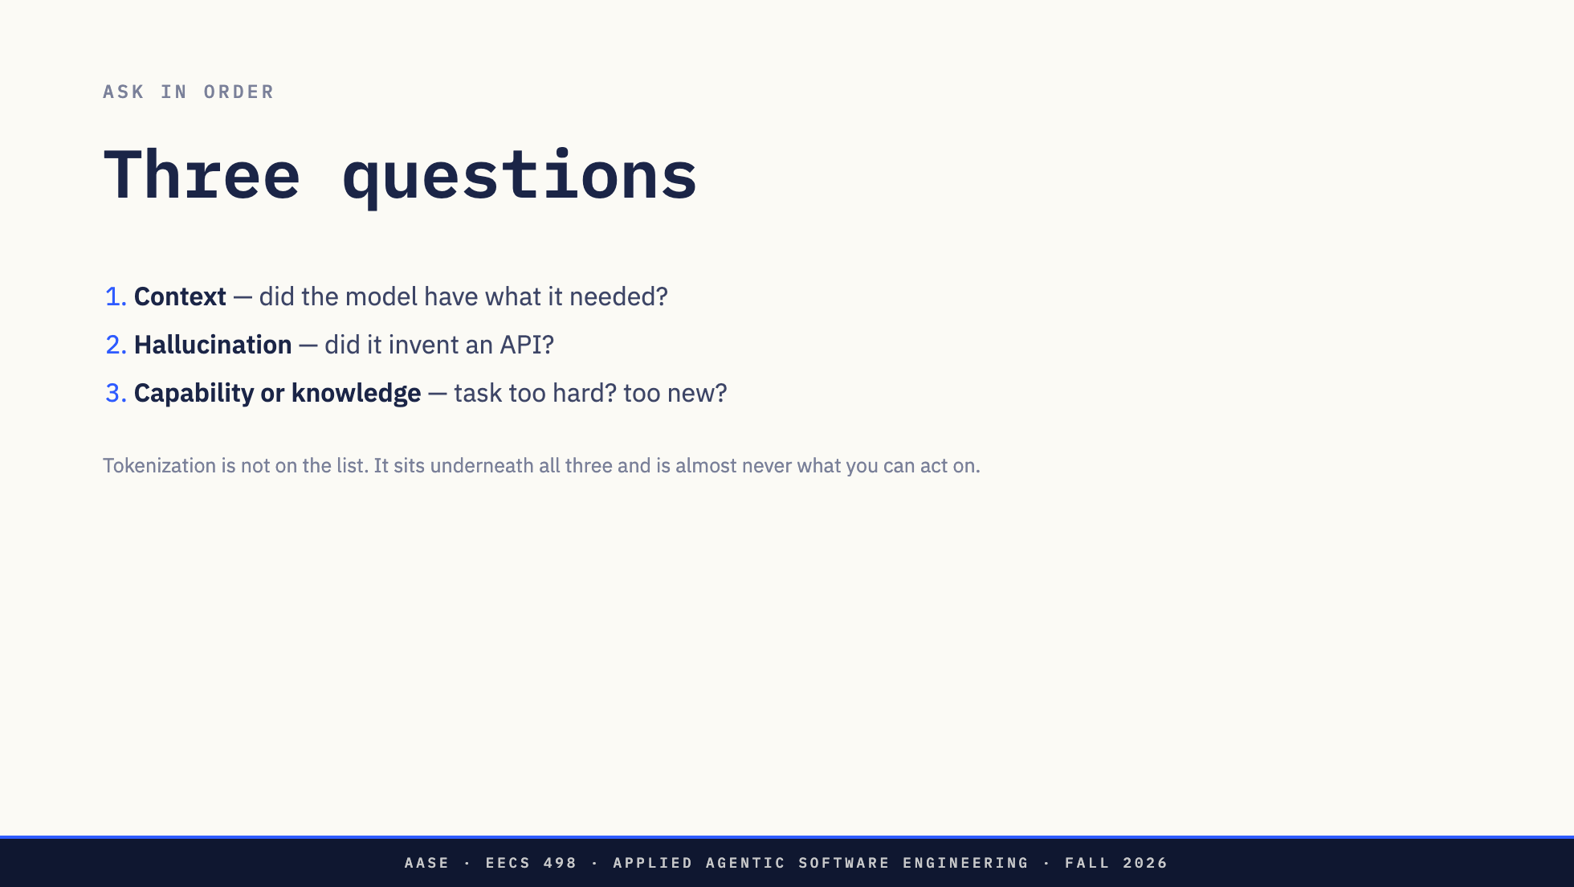

Slide 43
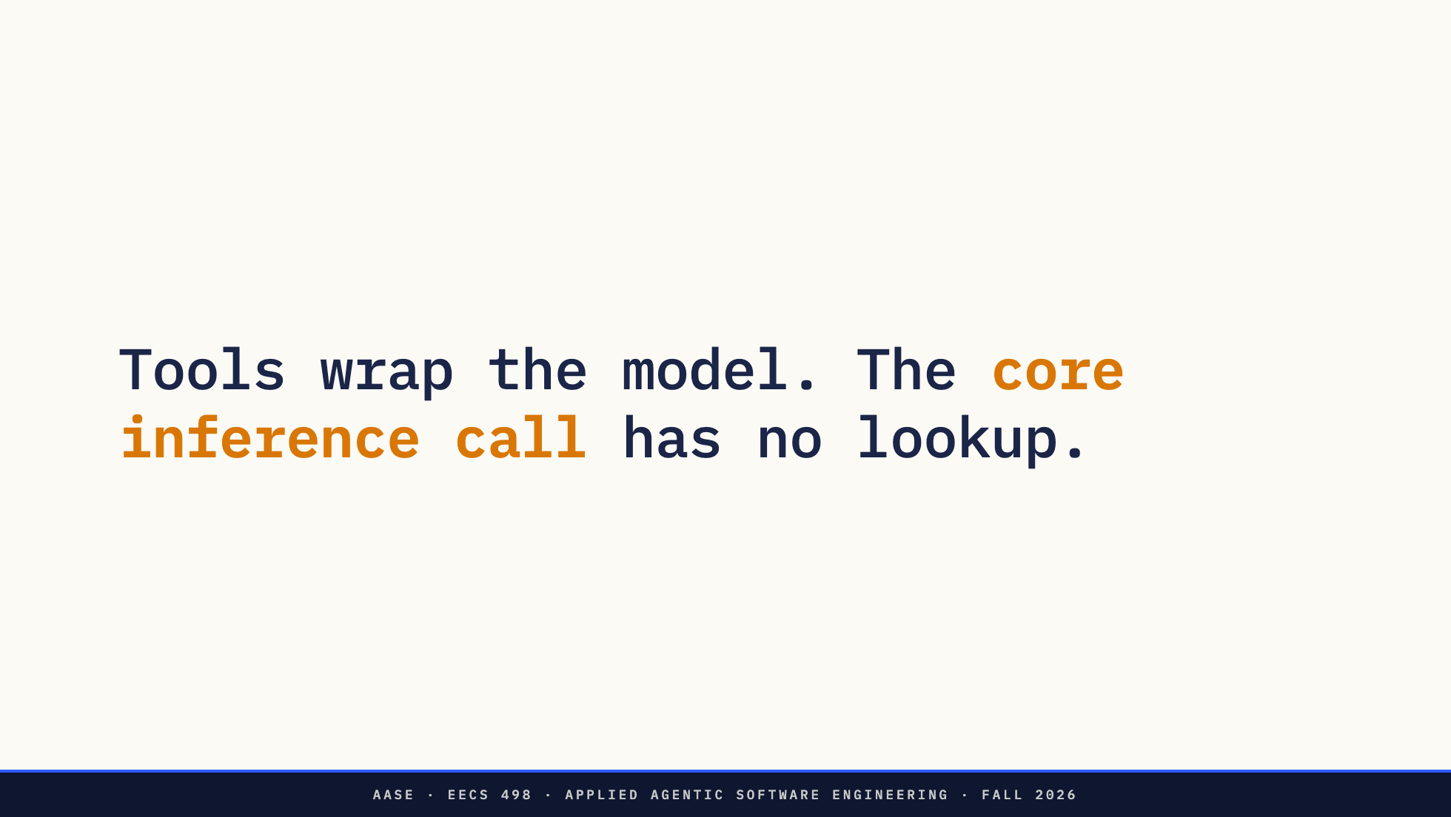
Notes:
Why doesn't the model just look things up? Because the core inference doesn't. Tools wrap it. You build those in week 5.

Slide 44
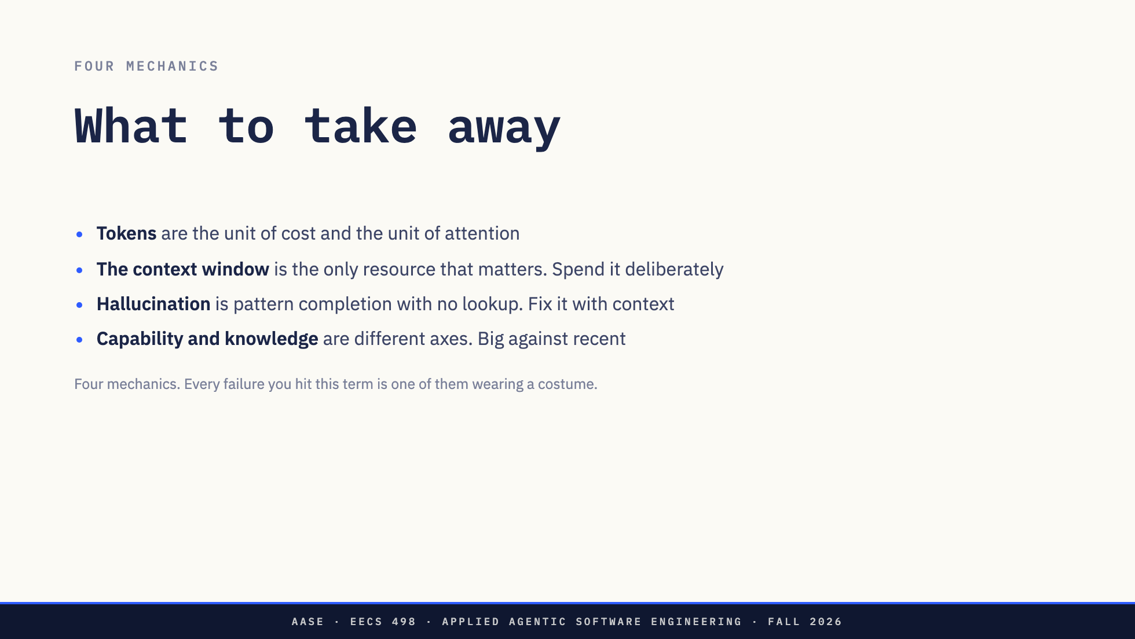

Slide 45
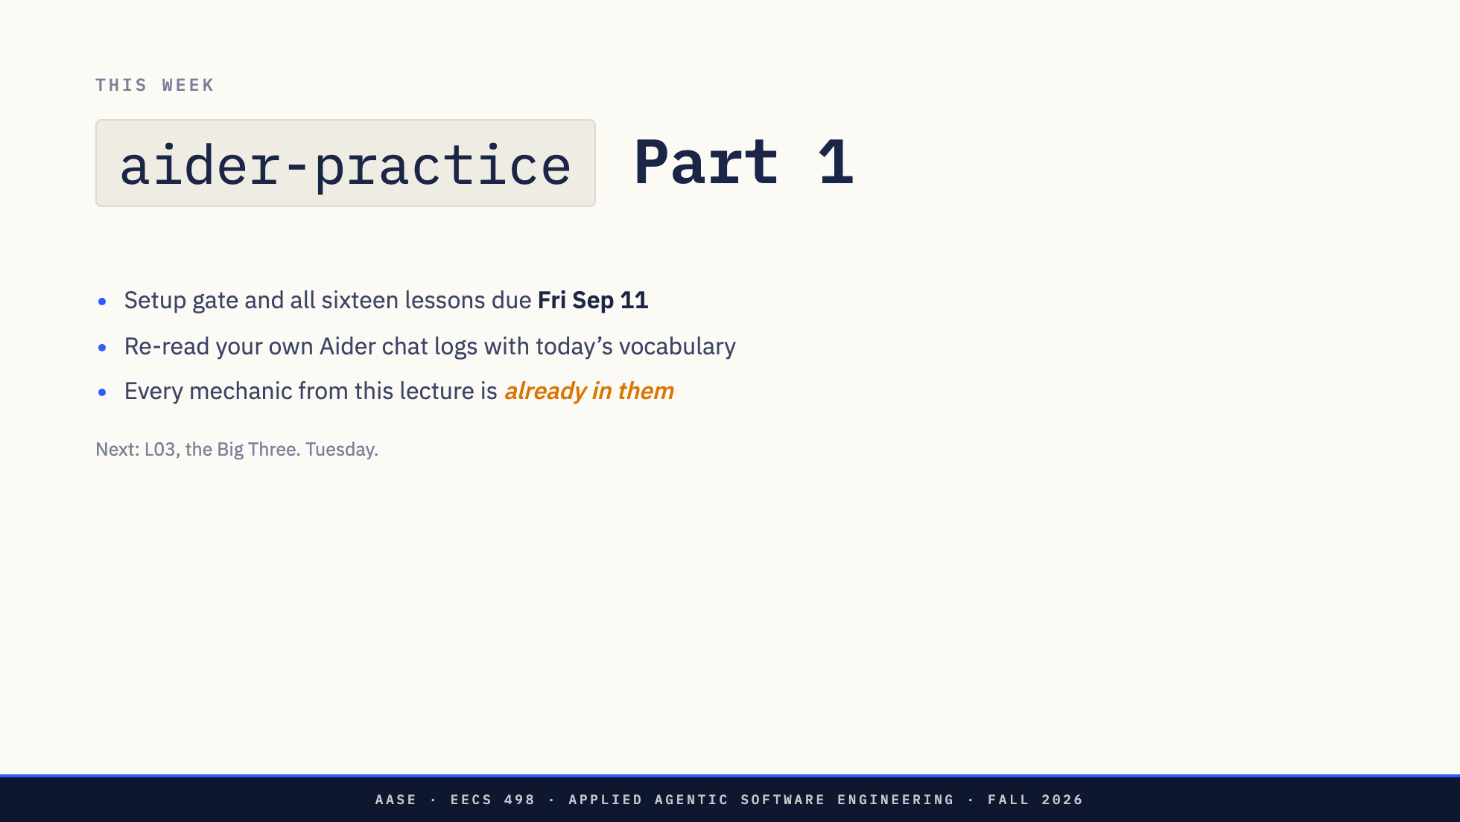

Slide 46


Slide 47
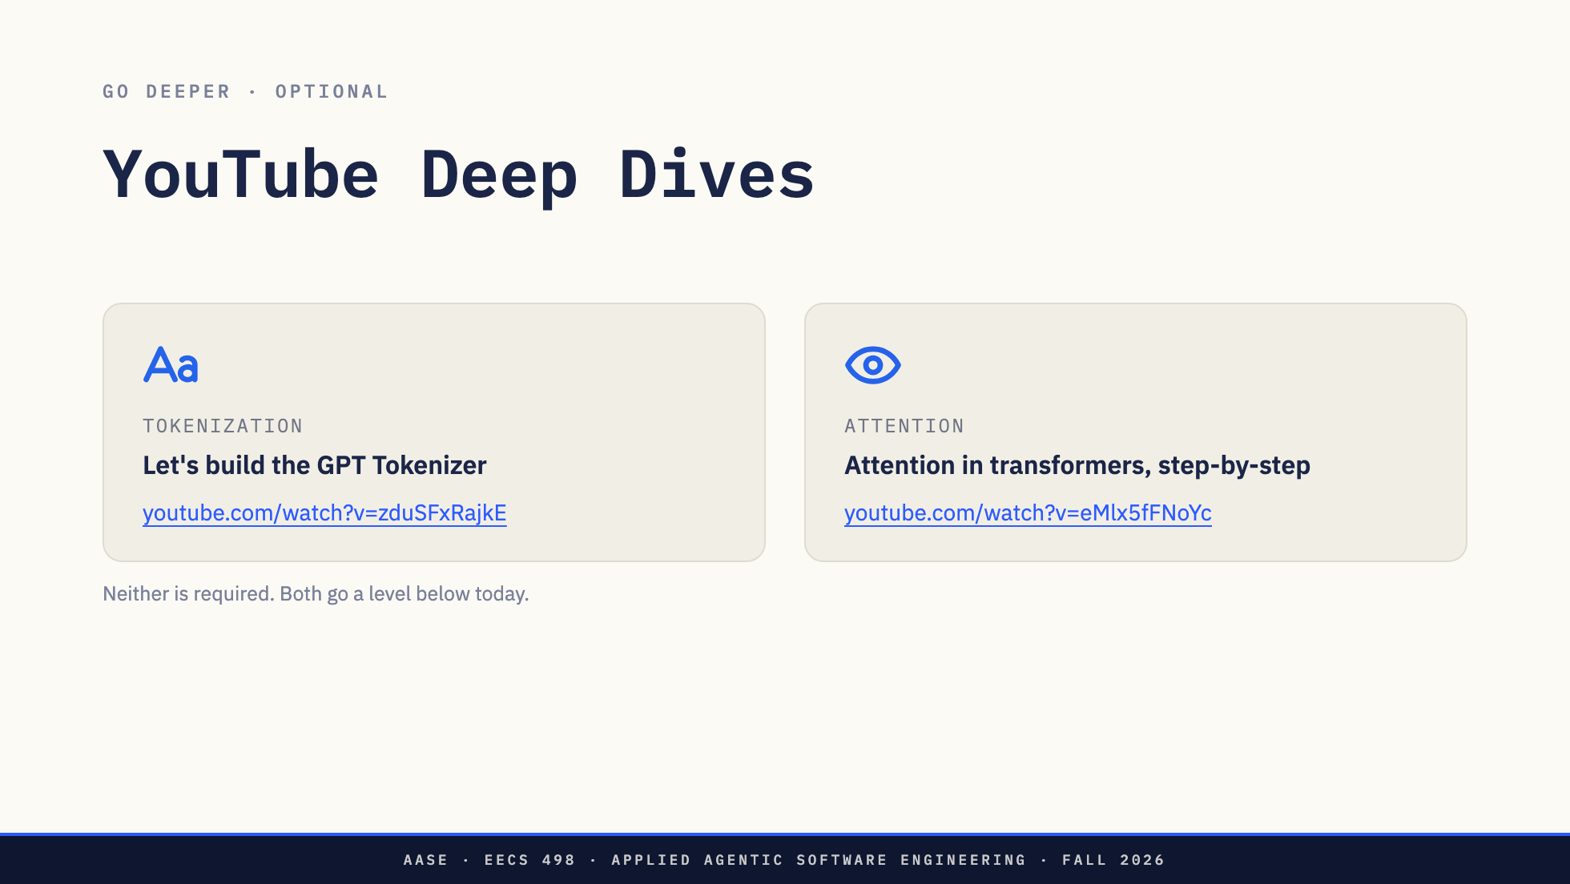
Notes:
Leave this up while the room files out. Not assessed, not required. The tokenizer video is long; tell them the first 30 minutes is the part that pays for itself.

