Slide 1

Object Tracking for Safety
Computer Vision Final Project
BY: SAPTADEEP DEBNATH, PREETI KANNAPAN, MALVIKA SHETTY

Slide 2
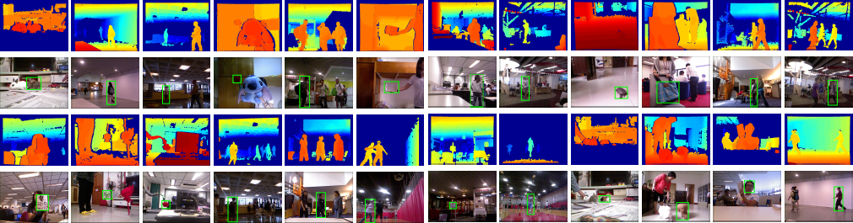
Dataset
Princeton Tracking Benchmark (RGB-D)
Notes:
about what ALL types of data are available and what all are used

Slide 3
Idea
Notes:
About how the IMU data is corrected with GPS

Slide 4
Impact on Society
asda
Notes:
easy to implement a non linear model

Slide 5
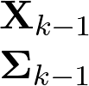

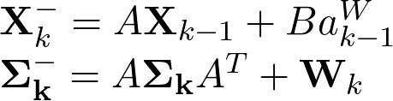

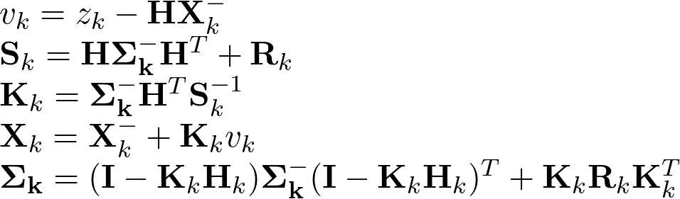

YOLOv3
Prediction
Measurement
Prior
Update
Output
Notes:
Moving on to the methodology used for the project. Flowchart of data used

Slide 6
DeepSORT

Slide 7
Safety Module

Slide 8
Prototype

Slide 9
Results

Slide 10
Conclusions + Future Work
Notes:
The trajectory produced by the LiEKF and EKF implements are practically identical to that on the GPS.

Slide 11
Thank you for listening!
Notes:
about what ALL types of data are available and what all are used

