Slide 1
ECE408 / CS483 Fall 2015
Applied Parallel Programming
Lecture 2:
Introduction to CUDA C
© David Kirk/NVIDIA and Wen-mei W. Hwu, 2007-2011
ECE408/CS483, University of Illinois, Urbana-Champaign

Slide 2
CUDA /OpenCL – Execution Model
Integrated host+device app C program
  Serial or modestly parallel parts in host C code
  Highly parallel parts in device SPMD kernel C code
Serial Code (host)‏
Parallel Kernel (device)‏
KernelA<<< nBlk, nTid >>>(args);
. . .
Serial Code (host)‏
Parallel Kernel (device)‏
KernelB<<< nBlk, nTid >>>(args);
. . .
© David Kirk/NVIDIA and Wen-mei W. Hwu, 2007-2011 ECE408/CS483, University of Illinois, Urbana-Champaign

Slide 3
Arrays of Parallel Threads
A CUDA kernel is executed by a grid (array) of threads
  All threads in a grid run the same kernel code (SPMD)‏
  Each thread has an index that it uses to compute memory addresses and make control decisions
0
1
2
254
255
…
i = blockIdx.x * blockDim.x + threadIdx.x;
C[i] = A[i] + B[i];
…
© David Kirk/NVIDIA and Wen-mei W. Hwu, 2007-2011 ECE408/CS483, University of Illinois, Urbana-Champaign

Slide 4
Thread Blocks: Scalable Cooperation
Divide thread array into multiple blocks
  Threads within a block cooperate via shared memory, atomic operations and barrier synchronization
  Threads in different blocks cannot cooperate
Thread Block 0
Thread Block 1
Thread Block N-1
0
1
2
254
255
0
1
2
254
255
0
1
2
254
255
…
…
…
i = blockIdx.x * blockDim.x + threadIdx.x;
C[i] = A[i] + B[i];
i = blockIdx.x * blockDim.x + threadIdx.x;
C[i] = A[i] + B[i];
i = blockIdx.x * blockDim.x + threadIdx.x;
C[i] = A[i] + B[i];
…
…
…
…
© David Kirk/NVIDIA and Wen-mei W. Hwu, 2007-2011 ECE408/CS483, University of Illinois, Urbana-Champaign

Slide 5
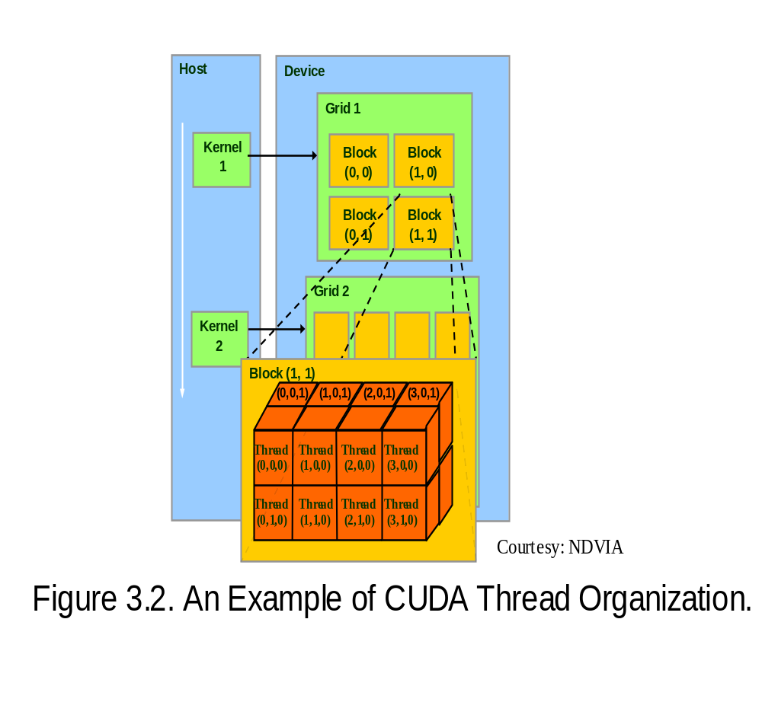
blockIdx and threadIdx
Each thread uses indices to decide what data to work on
  blockIdx: 1D, 2D, or 3D (CUDA 4.0)
  threadIdx: 1D, 2D, or 3D
Simplifies memory
addressing when processing
multidimensional data
  Image processing
  Solving PDEs on volumes
  …
© David Kirk/NVIDIA and Wen-mei W. Hwu, 2007-2011 ECE408/CS483, University of Illinois, Urbana-Champaign

Slide 6
Vector Addition – Conceptual View
vector A
A[0]
A[1]
A[2]
A[3]
A[4]
A[N-1]
…
vector B
B[0]
B[1]
B[2]
B[3]
B[4]
…
B[N-1]
+
+
+
+
+
+
vector C
C[0]
C[1]
C[2]
C[3]
C[4]
C[N-1]
…
© David Kirk/NVIDIA and Wen-mei W. Hwu, 2007-2011 ECE408/CS483, University of Illinois, Urbana-Champaign

Slide 7
Vector Addition – Traditional C Code
// Compute vector sum C = A+B
void vecAdd(float* A, float* B, float* C, int n)
{
for (i = 0, i < n, i++)
C[i] = A[i] + B[i];
}
int main()
{
// Memory allocation for A_h, B_h, and C_h
// I/O to read A_h and B_h, N elements
…
vecAdd(A_h, B_h, C_h, N);
}
© David Kirk/NVIDIA and Wen-mei W. Hwu, 2007-2011 ECE408/CS483, University of Illinois, Urbana-Champaign

Slide 8
Heterogeneous Computing vecAdd Host Code
#include <cuda.h>
void vecAdd(float* A, float* B, float* C, int n)‏
{
int size = n* sizeof(float);
float* A_d, B_d, C_d;
…
1. // Allocate device memory for A, B, and C
// copy A and B to device memory
2. // Kernel launch code – to have the device
// to perform the actual vector addition
3. // copy C from the device memory
// Free device vectors
}
© David Kirk/NVIDIA and Wen-mei W. Hwu, 2007-2011 ECE408/CS483, University of Illinois, Urbana-Champaign

Slide 9
Partial Overview of CUDA Memories
Device code can:
  R/W per-thread registers
  R/W per-grid global memory
Host code can
  Transfer data to/from per grid global memory
(Device) Grid
Block (0, 0)
Block (1, 0)
Registers
Registers
Registers
Registers
Thread (0, 0)
Thread (1, 0)
Thread (0, 0)
Thread (1, 0)
We will cover more later.
Host
Global
Memory
© David Kirk/NVIDIA and Wen-mei W. Hwu, 2007-2011 ECE408/CS483, University of Illinois, Urbana-Champaign
Notes:
Global, constant, and texture memory spaces are persistent across kernels called by the same application.

Slide 10
CUDA Device Memory Management API functions
cudaMalloc()
  Allocates object in the device global memory
  Two parameters
    Address of a pointer to the allocated object
    Size of of allocated object in terms of bytes
cudaFree()
  Frees object from device global memory
    Pointer to freed object
Grid
Block (0, 0)
Block (1, 0)
Registers
Registers
Registers
Registers
Thread (0, 0)
Thread (1, 0)
Thread (0, 0)
Thread (1, 0)
Host
Global Memory
© David Kirk/NVIDIA and Wen-mei W. Hwu, 2007-2011 ECE408/CS483, University of Illinois, Urbana-Champaign

Slide 11
Host-Device Data Transfer API functions
cudaMemcpy()
  memory data transfer
  Requires four parameters
    Pointer to destination
    Pointer to source
    Number of bytes copied
    Type/Direction of transfer
  Transfer to device is asynchronous
(Device) Grid
Block (0, 0)
Block (1, 0)
Registers
Registers
Registers
Registers
Thread (0, 0)
Thread (1, 0)
Thread (0, 0)
Thread (1, 0)
Host
Global
Memory
© David Kirk/NVIDIA and Wen-mei W. Hwu, 2007-2011 ECE408/CS483, University of Illinois, Urbana-Champaign

Slide 12
void vecAdd(float* A, float* B, float* C, int n)
{
int size = n * sizeof(float);
float* A_d, B_d, C_d;
1. // Transfer A and B to device memory
cudaMalloc((void **) &A_d, size);
cudaMemcpy(A_d, A, size, cudaMemcpyHostToDevice);
cudaMalloc((void **) &B_d, size);
cudaMemcpy(B_d, B, size, cudaMemcpyHostToDevice);
// Allocate device memory for
cudaMalloc((void **) &C_d, size);
2. // Kernel invocation code – to be shown later
…
3. // Transfer C from device to host
cudaMemcpy(C, C_d, size, cudaMemcpyDeviceToHost);
// Free device memory for A, B, C
cudaFree(A_d); cudaFree(B_d); cudaFree (C_d);
}
© David Kirk/NVIDIA and Wen-mei W. Hwu, 2007-2011 ECE408/CS483, University of Illinois, Urbana-Champaign

Slide 13
Example: Vector Addition Kernel
Device Code
// Compute vector sum C = A+B
// Each thread performs one pair-wise addition
__global__
void vecAddKernel(float* A_d, float* B_d, float* C_d, int n)
{
int i = threadIdx.x + blockDim.x * blockIdx.x;
if(i<n) C_d[i] = A_d[i] + B_d[i];
}
int vectAdd(float* A, float* B, float* C, int n)
{
// A_d, B_d, C_d allocations and copies omitted
// Run ceil(n/256) blocks of 256 threads each
vecAddKernel<<<ceil(n/256), 256>>>(A_d, B_d, C_d, n);
}
© David Kirk/NVIDIA and Wen-mei W. Hwu, 2007-2011 ECE408/CS483, University of Illinois, Urbana-Champaign

Slide 14
Example: Vector Addition Kernel
// Compute vector sum C = A+B
// Each thread performs one pair-wise addition
__global__
void vecAddkernel(float* A_d, float* B_d, float* C_d, int n)
{
int i = threadIdx.x + blockDim.x * blockIdx.x;
if(i<n) C_d[i] = A_d[i] + B_d[i];
}
int vecAdd(float* A, float* B, float* C, int n)
{
// A_d, B_d, C_d allocations and copies omitted
// Run ceil(n/256) blocks of 256 threads each
vecAddKernnel<<<ceil(n/256),256>>>(A_d, B_d, C_d, n);
}
Host Code
© David Kirk/NVIDIA and Wen-mei W. Hwu, 2007-2011 ECE408/CS483, University of Illinois, Urbana-Champaign

Slide 15
More on Kernel Launch
int vecAdd(float* A, float* B, float* C, int n)
{
// A_d, B_d, C_d allocations and copies omitted
// Run ceil(n/256) blocks of 256 threads each
dim3 DimGrid(n/256, 1, 1);
if (n%256) DimGrid.x++;
dim3 DimBlock(256, 1, 1);
vecAddKernel<<<DimGrid,DimBlock>>>(A_d, B_d, C_d, n);
}
Any call to a kernel function is asynchronous from CUDA 1.0 on, explicit synch needed for blocking
Host Code
© David Kirk/NVIDIA and Wen-mei W. Hwu, 2007-2011 ECE408/CS483, University of Illinois, Urbana-Champaign

Slide 16





Kernel execution in a nutshell
__host__
Void vecAdd()
{
dim3 DimGrid = (ceil(n/256,1,1);
dim3 DimBlock = (256,1,1);
vecAddKernel<<<DimGrid,DimBlock>>>(A_d,B_d,C_d,n);
}
__global__
void vecAddKernel(float *A_d,
float *B_d, float *C_d, int n)
{
int i = blockIdx.x * blockDim.x
+ threadIdx.x;
if( i<n ) C_d[i] = A_d[i]+B_d[i];
}
Kernel
Blk 0
Blk N-1
• • •
Schedule onto multiprocessors
GPU
M0
• • •
Mk
RAM
© David Kirk/NVIDIA and Wen-mei W. Hwu, 2007-2011 ECE408/CS483, University of Illinois, Urbana-Champaign

Slide 17
More on CUDA Function Declarations
Executed on the:
Only callable from the:
__device__ float DeviceFunc()‏
device
device
__global__ void KernelFunc()‏
device
host
__host__ float HostFunc()‏
host
host
__global__ defines a kernel function
  Each “__” consists of two underscore characters
  A kernel function must return void
__device__ and __host__ can be used together
© David Kirk/NVIDIA and Wen-mei W. Hwu, 2007-2011 ECE408/CS483, University of Illinois, Urbana-Champaign

Slide 18
Compiling A CUDA Program
Integrated C programs with CUDA extensions
NVCC Compiler
Host Code
Device Code (PTX)
Host C Compiler/ Linker
Device Just-in-Time Compiler
Heterogeneous Computing Platform with
CPUs, GPUs
© David Kirk/NVIDIA and Wen-mei W. Hwu, 2007-2011 ECE408/CS483, University of Illinois, Urbana-Champaign

Slide 19
Questions?
© David Kirk/NVIDIA and Wen-mei W. Hwu, 2007-2011 ECE408/CS483, University of Illinois, Urbana-Champaign

