Slide 1
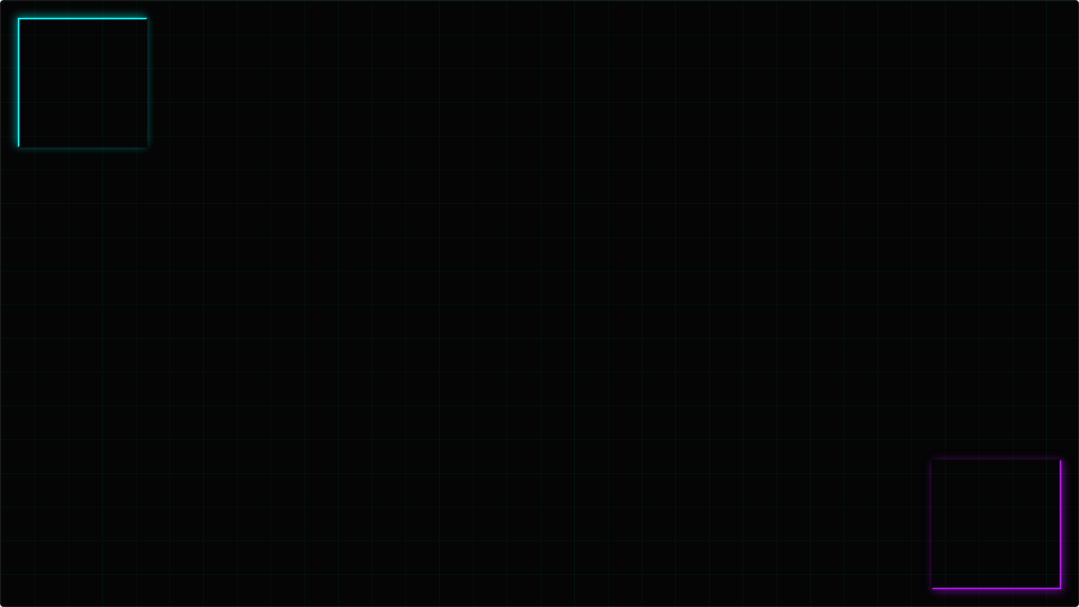
THE ENVIRONMENT READER
Making VR Immersive For Everyone
Ethan Edwards

Slide 2

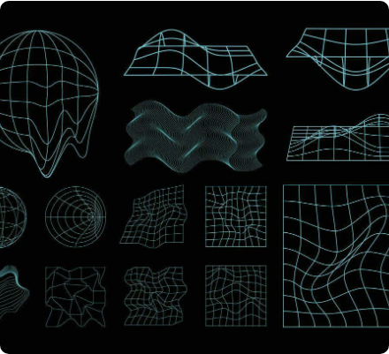
CURRENT LANDSCAPE
>
Screen readers are common on daily devices: Smartphones, Tablets, Computers, Smart displays, Virtual reality devices.
>
The Problem: Screen readers are designed mainly for 2D navigation.
>
2D screen reader design language breaks the immersive feel of VR.
>
Current VR screen reader accessibility is underdeveloped.

Slide 3
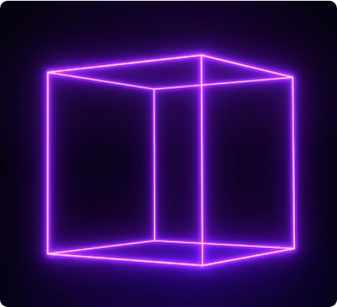
THE CONCEPT
>
Turn the screen reader into an Environment Reader.
>
A VR screen reader needs to "read the room," literally.
>
Screen readers in VR need to give someone the same level of exploration and autonomy they’d get in a real-world environment.
>
An Environment Reader could work using a combination of: AI, Spatial Audio, and Haptics.

Slide 4

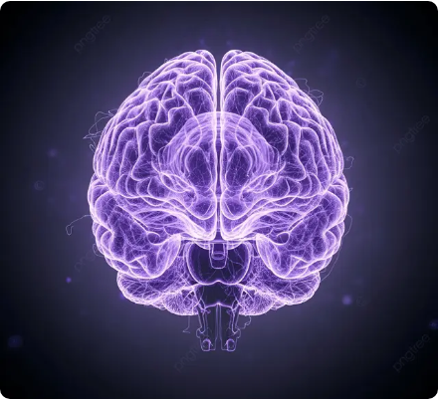
HOW IT WORKS: AI IMPLEMENTATION
>
AI enables the environment reader to adapt dynamically to any space or app.
>
Functions as an AI agent/companion that answers questions about virtual space.
>
Works with read and write access to the user’s VR environment (with permission).
>
Assists with: Traveling through VR, designing a virtual space, finding others to socialize with, using VR apps, and other tasks.

Slide 5
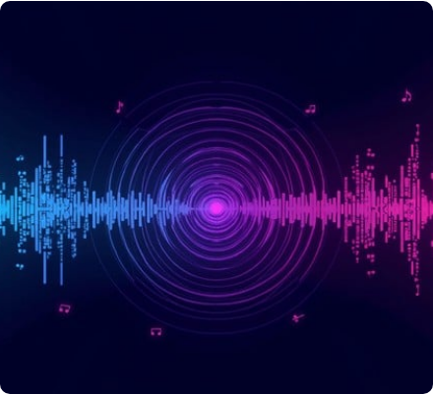
AUDIO AND HAPTICS
>
Audio and haptics empower users to navigate VR on their own terms.
>
Spatial Audio: Uses audio icons for 3D grid exploration; allows users to locate objects in space.
>
Haptics: Provide a tactile layer for objects; makes navigation feel realistic.

Slide 6

TYING IT ALL TOGETHER
>
Traditional screen reader concepts are 2D, limiting immersion in VR.
>
An Environment Reader would provide an enriching VR experience for everyone.
>
AI allows interaction with any VR element.
>
Spatial Audio & Haptics provide immersion using real-world senses.
"It’s time for the screen reader to read the room, and read the environment."

Slide 7
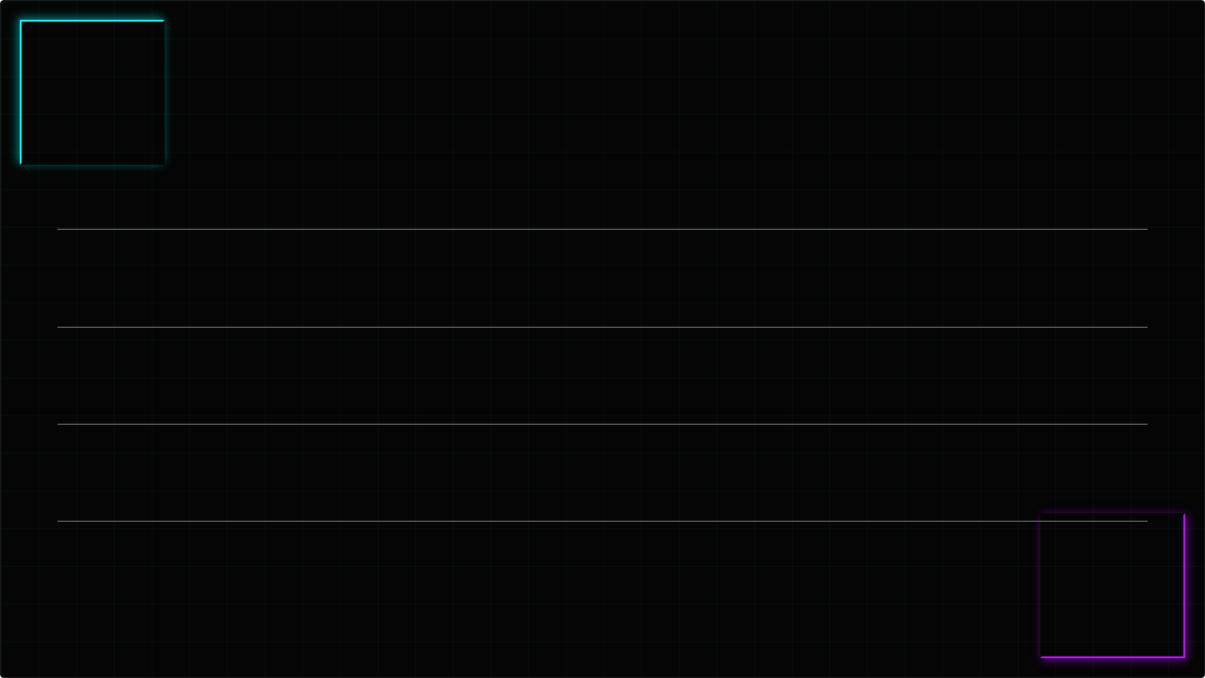





IMAGE SOURCES
>
https://images.stockcake.com/public/b/4/a/b4a406c1-c622-427d-92d1-ece4a347f6ec_large/futuristic-vr-portal-stockcake.jpg
Source: stockcake.com
>
https://static.vecteezy.com/system/resources/previews/036/532/902/non_2x/collection-of-futuristic-cyberpunk-style-element-geometric-wireframe-of-circle-earth-distortion-grid-with-light-blue-color-retro-graphic-on-black-background-for-decoration-cover-poster-vector.jpg
Source: www.vecteezy.com
>
https://img.freepik.com/premium-photo/purple-cube-frame-neon-square-grid-with-magical-glow-3d-render-dark-space-geometric-portal-with-simple-futuristic-cross-section-purple-backlighting_573660-173.jpg
Source: www.freepik.com
>
https://png.pngtree.com/thumb_back/fw800/background/20251028/pngtree-purple-digital-brain-network-futuristic-neural-connections-with-technology-glow-for-image_20077998.webp
Source: pngtree.com
>
https://images.stockcake.com/public/b/b/2/bb258f00-d468-415c-ac08-fb91d03a668f_large/digital-audio-spectrum-stockcake.jpg
Source: stockcake.com

