Slide 1
Bluetooth controlled pick and place robot
Jayapreetha.S (211419105053)
Anjali.M (211419105008)
Sanjeetha.M (211419105124)
Guided by
Dr.S.Selvi,M.E,Ph.D…
Professor and Head,

Slide 2
ABSTRACT
A bluetooth controlled robot whose robotic arm may be operated from a distance.Bluetooth allows a hand free operation without the need for a physical cable connection.
This project goal is to use a pick and place an object at a selected position .Some of the contents in which it is employed in agricultural,foundry work etc..
Using a microcontroller ,it is a control system that communicates with android software,accessible through android app. It allows for complete remote control of the vehicle and its arm
A robot that can rotate in all direction and its fitted with the gripper for performing the pick and place operation.The operators cell phone will serve as the interface for all the functions
The microcontroller sends the appropriate mobility commands based on the button the user selects in the application. The goal of the project is to create a mobile robot that can move in response to user input via app

Slide 3

CONTENTS
Introduction
Proposed System
Hardware explanation
Hardware results

Slide 4
INTRODUCTION
A robot is a electromechanical device that may be programmed to carry out a variety of tasks.
Robots have better precision,a better quality of operation,accuracy and speed than humans.
Code written in embedded C allows the bluetooth module to communicate with the microcontroller via UART protocol.The motion of the robot can be regulated by instructions sent from android app
A pick and place robot is associated with a gentle gripper for capturing the object like apple , tomatoes

Slide 5
INTRODUCTION
An android powered smartphone,tablet ,etc.,with a touch screen can be used as remote control using the device’s GUI(Graphical User Interface).To put it another way, the prototype will pave the way for production models based on the same basic idea.
An android app on the receiving end will send a signal in the form of an ASCII code to a bluetooth module(HC-05) serving as an interface between a mobile device and robot.
Both the motors that propel the robot and that enable it to grasp object have their respective controls programmed into the microcontroller.

Slide 6
INTRODUCTION
Moving the robots forward,backward,left or right is accomplished by sending commands from an android application device on the transmitting end to a receiver
Three of the motors are used to move the robot’s arm and grippers.The transmitter android app device functions as a remote control with sufficient range,and the data from bluetooth device is sent into the microcontroller,which in turn drives DC motors via motor drive IC to accomplish the task at hand
The robot key selling point is it gentle grabbing arm,which is made to avoid applying any more pressure to the object.

Slide 7
EXISTING SYSTEM
A high speed and fully automated pick and place operations of micro-objects only take place.
They developed a robotic hand that can carry a task by changing the tools
A 5-arm robotic arm robot can be used for moving objects along a single plane
The designing as well as the successful execution of this model has been obtained by testing the picking and dropping of light weighted objects

Slide 8
PROPOSED SYSTEM
It has a microcontroller IC ,a bluetooth module, a power supply, and four DC motors with driver’s IC.A robot arm is mounted on a mobile platform and used for pick and place operation.
The vehicle can travel over any surface,no matter how smooth or rugged it is. For reliable and smooth operation,a belt type tyre is linked to the vehicle and powered by two motors,just like a tank.
The jaw of the pick and place arm can only move vertically, so it can only pick up and place position objects. The jaw opening and closing is powered by separate motor from the arm assembly’s up and down motion
Mechanical push button switches cap the amount of up and down movement. As the arm reaches its farthest extent, the circuit is broken so that motor cannot continue to revolve.

Slide 9
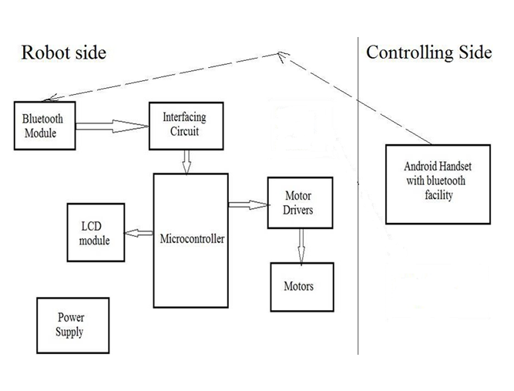
BLOCK DIAGRAM

Slide 10
BLOCK DIAGRAM EXPLANATION
The project contain 2 sections
1.Robot(Receiver end)
2.Control section(Transmitting end)
A bluetooth enabled android phone will serve as the controller. Bluetooth on a mobile will carry the commands needed to operate the robot
The receiving end will also feature a bluetooth module. In order for the bluetooth device to communicate with one another ,they must be paired.
All information from the bluetooth module sending end will immediately be received by the bluetooth module receiving end. The microcontrollers check the information against the stored information and act accordingly

Slide 11
HARDWARE REQUIREMENTS
Battery-lead acid battery
Microcontroller-16F877A
Relay board-ULN2003A(Driver unit)
DC motor- 12V DC, 1000rpm
Bluetooth module-HC-05

Slide 12
BATTERY
In isolated systems away from the grid, batteries are used for storage of excess solar energy converted into electrical energy. The only exceptions are isolated sunshine load such as irrigation pumps or drinking water supplies for storage.
Low cost
Long life
High reliability
High overall efficiency
Low discharge

Slide 13
RELAY BOARD
Relays are simple switches which are operated both electrically and mechanically. Relays consist of an electromagnet and a set of contacts. . The main operation of a relay comes in places where only a low-power signal can be used to control a circuit.
Input voltage: 12VDC
Driver unit: ULN2003A
Isolation unit: In4007
Fast switching
Motor forward and reverse operation

Slide 14
DC MOTOR
A DC motor converts direct current electrical power into mechanical power. DC or direct current motor works on the principal, when a current carrying conductor is placed in a magnetic field, it experiences a torque and has tendency to move. This is known as motoring action.
Supply voltage: 12V DC
Very reliable and low cost
Speed: 1000rpm

Slide 15
BLUETOOTH
HC-05 module is an easy-to-use Bluetooth SPP (Serial Port Protocol) module, designed for transparent wireless serial connection setup. Serial port Bluetooth module is fully qualified Bluetooth V2.0+EDR (Enhanced Data Rate) 3Mbps Modulation with complete 2.4GHz radio transceiver and baseband
Typical -80dBm sensitivity
Up to +4dBm RF transmit power
Low Power 1.8V Operation ,1.8 to 3.6V I/O
PIO control
UART interface with programmable baud rate
With integrated antenna

Slide 16
PIN DIAGRAM

Slide 17
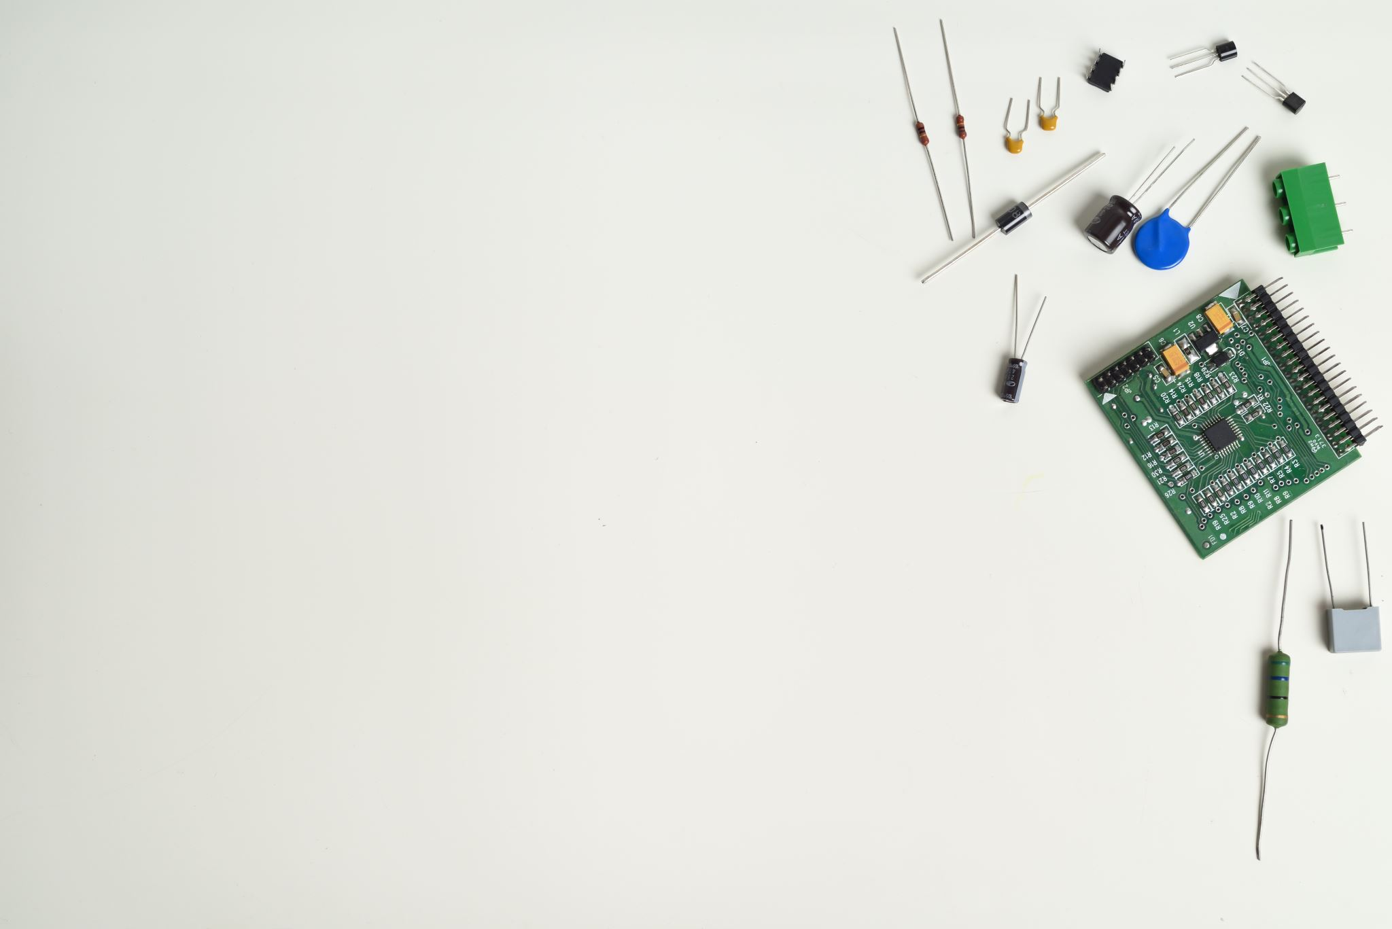
PIN DIAGRAM DESCRIPTION
The PIC16F873A and PIC16F874A have one-half of the total on-chip memory of the PIC16F876A and PIC16F877A
The 28-pin devices have three I/O ports, while the 40/44-pin devices have five
The 28-pin devices have fourteen interrupts, while the 40/44-pin devices have fifteen
The 28-pin devices have five A/D input channels, while the 40/44-pin devices have eight
The Parallel Slave Port is implemented only on the 40/44-pin devices

Slide 18
HARDWARE OPERATION
Motor driver IC and micro controller are utilized for motor control. An android device serve as a controller, providing input signals via a bluetooth module interface with the microcontroller
Input 1,input 2,output 1 and output 2 are found in one set of L293D’s configurations, while input 3,input 4,output 3 and output 4 are found in other set.
The code is structured in such a way that, when they run, it communicates with the motor driver IC to run the motor and propel the robot forward
The android device’s built in bluetooth technology is utilized to transmit left/right/forward/backward/stop commands from the display

Slide 19
HARDWARE OPERATION
The design uses 12V battery in series with the diode D2 to deliver nearly 5V to the microcontroller through regulator IC LM 7805.The microcontroller makes use of common connections such as crystal and reset arrangement indicator LED
A microcontroller is connected to a bluetooth module driven by a reverse biased Zener diode D1,which linked with a smartphone exchanges data with it to respond appropriately to user’s touches.
To move the arm up and down, open and close, the project employs a second motor drive IC based on the same technology, which is interfaced to the microcontroller using pulled up resistor.

Slide 20
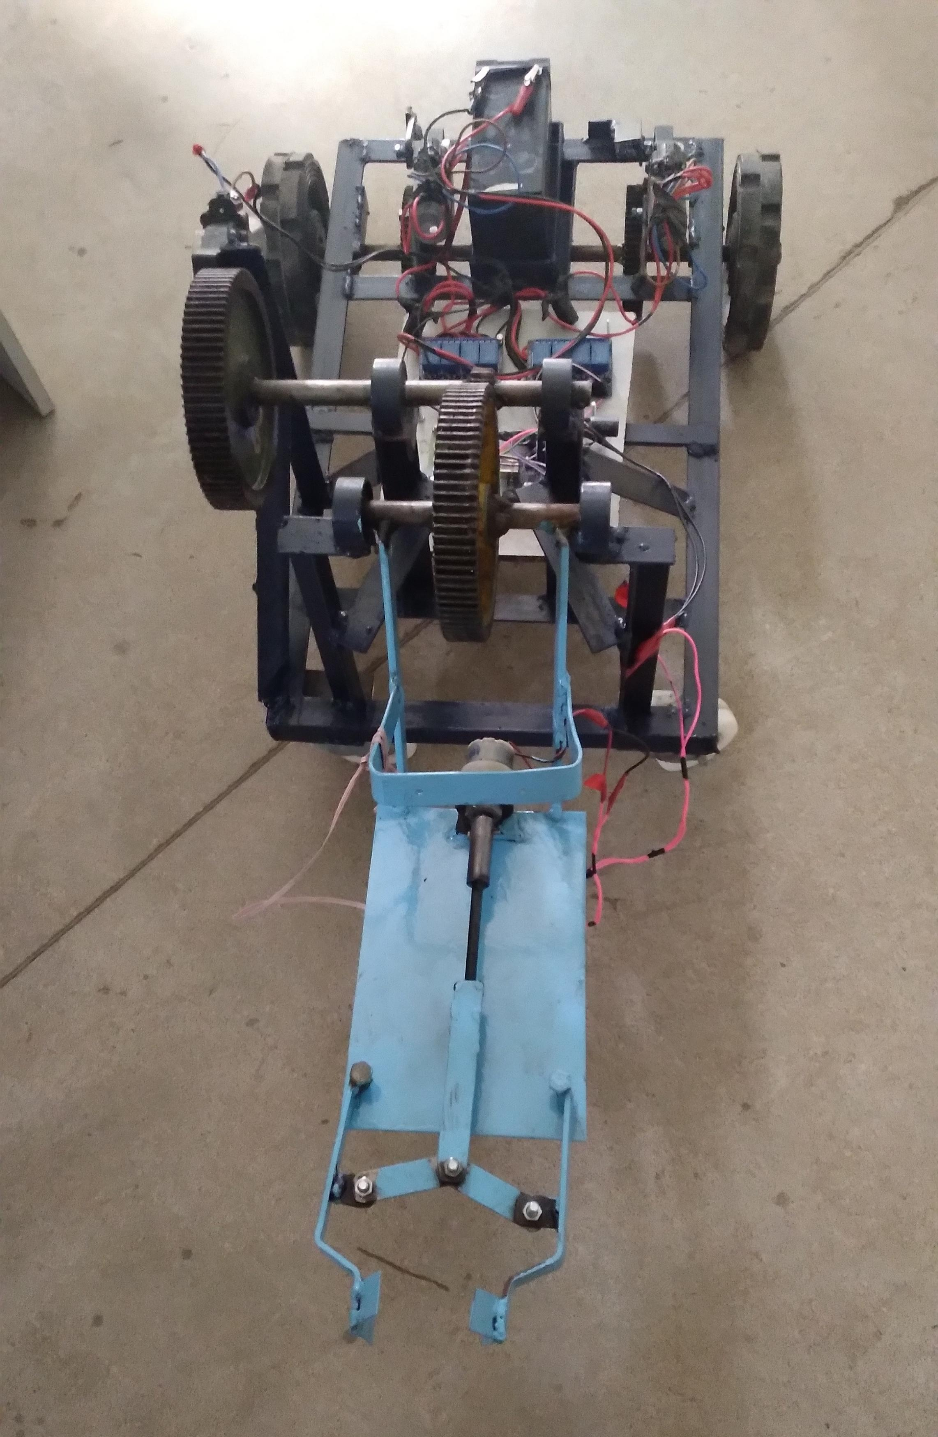
HARDWARE RESULTS
The Motorized arm is more efficient in the technical field
Quick response is achieved
Simple in construction
Easy to maintain and repair
Cost of the unit is less when compared to robotics

Slide 21
CONCLUSION
This study's first findings suggest that most autonomous systems are more flexible than conventional systems.
The advantages of less labour costs and limitation on the number of hours worked each day have greatly improved. Hence, it has enabled automation of the most important working processes.
The project offers a low-cost, low-power, and straightforward device control solution. This technology will be heavily utilised in agriculture, gardening, and agronomy universities.
This technique can be used to irrigate gardens, agricultural land, and horticultural areas. In comparison to other types of automation systems, this system is therefore more affordable and effective. Farmers will experience less stress as a result

Slide 22
REFERENCE
1. Gongal A, Amatya S, Karkee M, Zhang Q, Lewis K (2015) Sensors and systems for fruit detection and localization: a review. Comput Electron Agric 116:8–19
2. Okamoto H, Lee WS (2009) Green citrus detection using hyperspectral imaging. Comput Electron Agric 66(2):201–208
3. Stajnko D, Lakota M, Hočevar M (2004) Estimation of number and diameter of apple fruits in an orchard during the growing season by thermal imaging. Comput Electron Agric 42(1):31–42
4. Bulanon DM, Kataoka T, Ota Y, Hiroma T (2002) Ae-automation and emerging technologies: a segmentation algorithm for the automatic recognition of fuji apples at harvest. Biosyst Eng 83(4):405–412
5. Bulanon DM, Kataoka T (2010) Fruit detection system and an end efector for robotic harvesting of fuji apples. Agric Eng Int CIGR J 12(1):203–210
6. Rakun J, Stajnko D, Zazula D (2011) Detecting fruits in natural scenes by using spatial-frequency based texture analysis and multiview geometry. Comput Electron Agric 76(1):80–88

Slide 23
THANK YOU

