Slide 1
Congressional Use of Twitter
Sohini Khan and Jessica Su

Slide 2
Last time
Examined whether Twitter usage depended on gender, party affiliation, age of congressperson, voter age demographics
Senators post more tweets per month than representatives (p = 0.02)
Republicans follow more users than Democrats (p = 0.04)

Slide 3
This time
Looked at
differences between leaders and non-leaders
was skewing our data
differences between congresspeople in rural and urban states
congresspeople who didn’t use Twitter
actual content of tweets
race demographics of states

Slide 4
Leaders vs. non-leaders
22 leaders total
Speaker of the House, House Majority Leader, …
Leaders have more followers (p = 0.0117)
Leaders follow more people (p = 8.53 x 10^-7)
Leaders post more tweets per month (p = 7.4299 x 10^-4)

Slide 5
Rural/urban states
Urban: state with population > 5,000,000
Rural: state with population < 5,000,000
Looked for differences in volume of tweets, number followers, number following
No significant results

Slide 6
Race demographics
Examined how voter race demographics affected tweets, followers, following
No significant results
Even when split into groups

Slide 7
Non-Twitter Users
64 total
Data was a little off
Examined differences in party, average age, House/Senate
No significant results

Slide 8
Content of tweets
Counted 30 most common words used after the Boston bombing (excluding 100 most common words in English language)
Counted 30 most common words overall
Broke it down by party

Slide 9
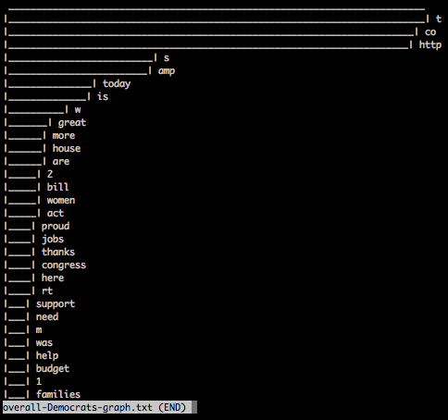
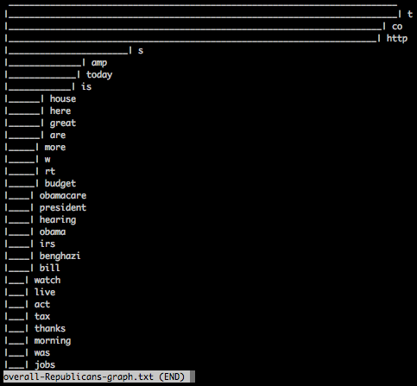
Content of tweets
Democrats
Republicans

Slide 10
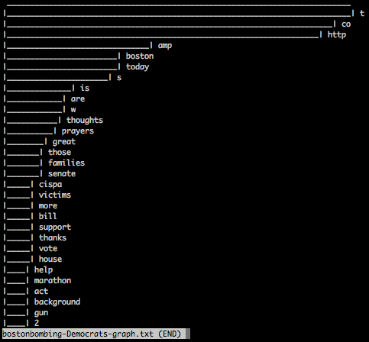
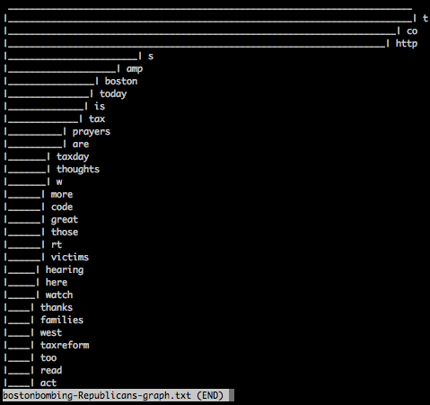
Content of tweets
Democrats
Republicans

