Slide 1
Congressional Use of Twitter
Sohini Khan
Jessica Su

Slide 2
Research Question
How do congresspeople use Twitter?
Does twitter usage depend on age, sex, party affiliation?
Does twitter usage depend on voter demographics?

Slide 3
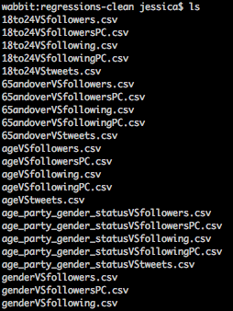
Progress so far
Collected Twitter data using the Twitter API
Downloaded other data from websites
Used MySQL to join the tables

Slide 4
Progress so far
Univariate regressions done for congresspeople to correlate age vs. # followers, # following, average no. tweets per month
T-tests to see whether there is a difference in # followers, # following, # tweets/month due to gender, party, status (House or Senate)
Univariate regressions done for voters to correlate age (18-24, 65 and over) vs. # followers, # following, # tweets

Slide 5
Progress so far
No good correlation between congressional age and twitter activity
Strongest correlation so far is between congressional age and tweets made per month

Slide 6
Progress so far
T-tests
Senators produce more tweets per month than representatives
Senators follow more users per capita
Senators have more followers per capita
Republicans have more followers than Democrats

Slide 7
Work left to be done
Multivariate regressions for congresspeople to correlate age, party, gender, status vs. # followers/following/tweets
Multivariate regressions for voters to correlate race (white, black, Asian, mixed) vs. # followers/following/tweets
Notes:
The null hypothesis is: "This independent variable does not explain any of the variation in y, beyond the variation explained by the other variables
To have a better understanding of how all variables together affect twitter activity

Slide 8
Hurdles or Problems
Outliers
Some congressmen are extremely popular on Twitter
Skews regression and t-test statistics
Plotted data on a log scale, with poor results

Slide 9
Suggestions?
Questions?
Comments?
Opinions?

