Slide 1
CS 6476 Project 1
Shen-Yi Cheng
scheng98@gatech.edu
scheng98
903514405

Slide 2
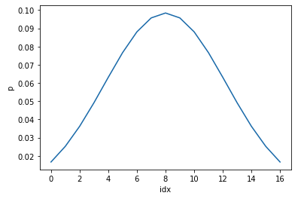
Part 1: 1D Filter
<insert visualization of the low-pass filter from proj1.ipynb here>

Slide 3
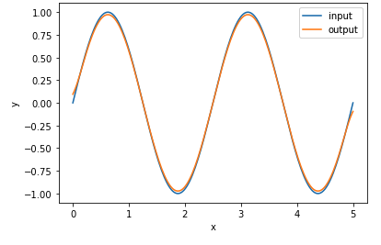
Part 1: 1D Filter
<insert visualization of filtered combined signal from proj1.ipynb here>
Describe your implementation in words and reflect on the checkpoint questions.
I create a 1D Gaussian low-pass filter to get the low frequency signal. And this filter also attenuate the high frequency while the low frequency is not affected.
Yes, the unit test passed.

Slide 4
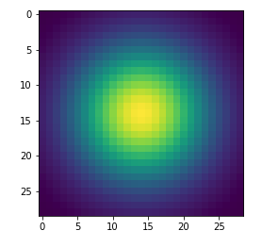
Part 2: Image Filtering
<insert visualization of the 2D Gaussian kernel from proj1.ipynb here>
<Describe your implementation of my_imfilter() in words.>
I get the shape of image and filter first and use filter tensor to pad image tensor. Then use three for loops to create a new filtered image by calculating the dot product into tensor.

Slide 5
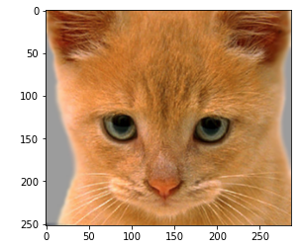
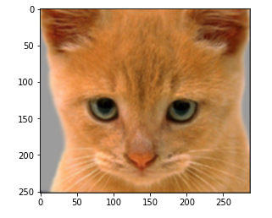
Part 2: Image filtering
Identity filter
<insert the results from proj1_test_filtering.ipynb using 1b_cat.bmp with the identity filter here>
Small blur with a box filter
<insert the results from proj1_test_filtering.ipynb using 1b_cat.bmp with the box filter here>

Slide 6
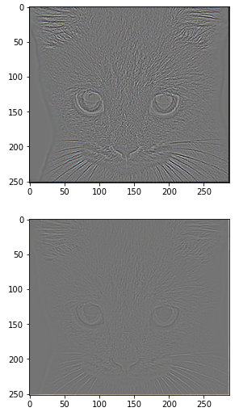
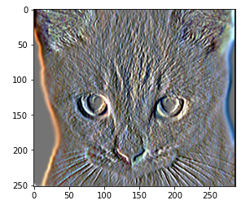
Part 2: Image filtering
Discrete Laplacian filter
<insert the results from proj1_test_filtering.ipynb using 1b_cat.bmp with the discrete Laplacian filter here>
Sobel filter
<insert the results from proj1_test_filtering.ipynb using 1b_cat.bmp with the Sobel filter here>

Slide 7
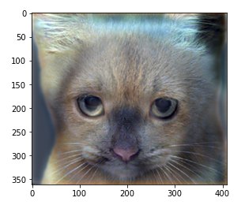
Part 2: Hybrid images manually using Pytorch
<Describe your implementation of create_hybrid_image() here.>
Dog x filter = low_freq_dog
Cat x filter = low_freq_cat
High_freq_cat = cat – low_freq_cat
(low_freq_dog + low_freq_dog) / 2 = tmp
hybrid = torch.clamp(tmp, min = 0, max = 1.0)
Cat + Dog
<insert your hybrid image here>
Cutoff frequency: <insert the value you used for this image pair> 7

Slide 8
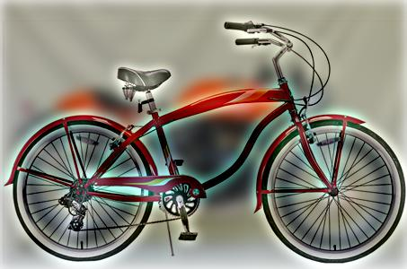
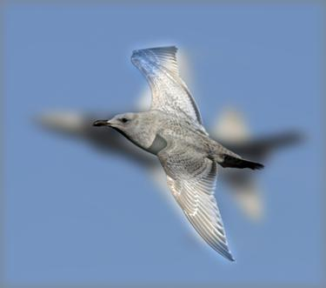
Part 2: Hybrid images manually using Pytorch
Motorcycle + Bicycle
<insert your hybrid image here>
Cutoff frequency: <insert the value you used for this image pair> 7
Plane + Bird
<insert your hybrid image here>
Cutoff frequency: <insert the value you used for this image pair> 7

Slide 9
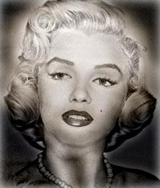
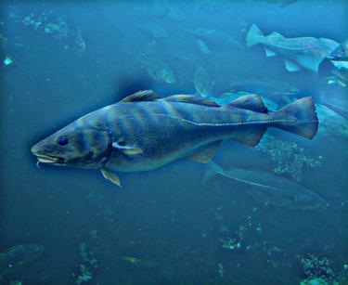
Part 2: Hybrid images manually using Pytorch
Einstein + Marilyn
<insert your hybrid image here>
Cutoff frequency: <insert the value you used for this image pair> 7
Submarine + Fish
<insert your hybrid image here>
Cutoff frequency: <insert the value you used for this image pair> 7

Slide 10
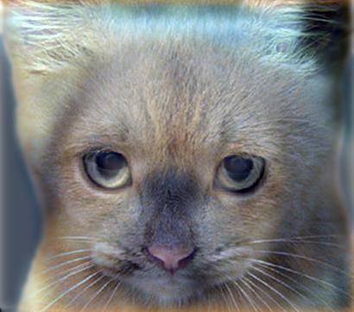
Part 3: Hybrid images with PyTorch operators
Cat + Dog
<insert your hybrid image here>
Motorcycle + Bicycle
<insert your hybrid image here>

Slide 11
Part 3: Hybrid images with PyTorch operators
Plane + Bird
<insert your hybrid image here>
Einstein + Marilyn
<insert your hybrid image here>

Slide 12
Part 3: Hybrid images with PyTorch operators
Submarine + Fish
<insert your hybrid image here>
Part 1 vs. Part 2
<Compare the run-times of Parts 2 and 3 here, as calculated in proj1.ipynb. What can you say about the two methods?>
Part2: 45-55 sec
Part3: 0.18-0.25 sec
Torch.nn.functional.conv2d is much faster but when I implement myself, I can totally understand what inside the conv2d API

Slide 13
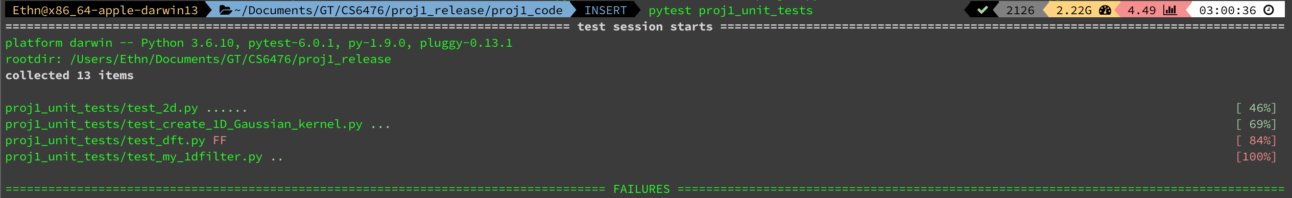
Tests
<Provide a screenshot of the results when you run `pytest tests` on your final code implementation (note: we will re-run these tests).>

Slide 14
Conclusions
<Describe what you have learned in this project. Consider questions like how varying the cutoff standard deviation value or swapping images within a pair influences the resulting hybrid image. Feel free to include any challenges you ran into.>

Slide 15
Extra Credit

Slide 16
Image Filtering using DFT
<insert visualization of the DFT filtered 6a_dog.bmp from proj1.ipynb here>
Describe your implementation in words.

Slide 17
Add some cool hybrid images!

