Slide 1
SPOTIFY
Karen Gao, Eva He, Katherine Li, Qing Luan, Sarah Xi
Notes:
title (hook)
leading sentences(presentation content)

Slide 2
Spotify’s business performance
Recommendations for improvement
Conclusion
Agenda
Notes:
we have been tasked with sustaining spotify’s existing users and attracting potential users.

Slide 3
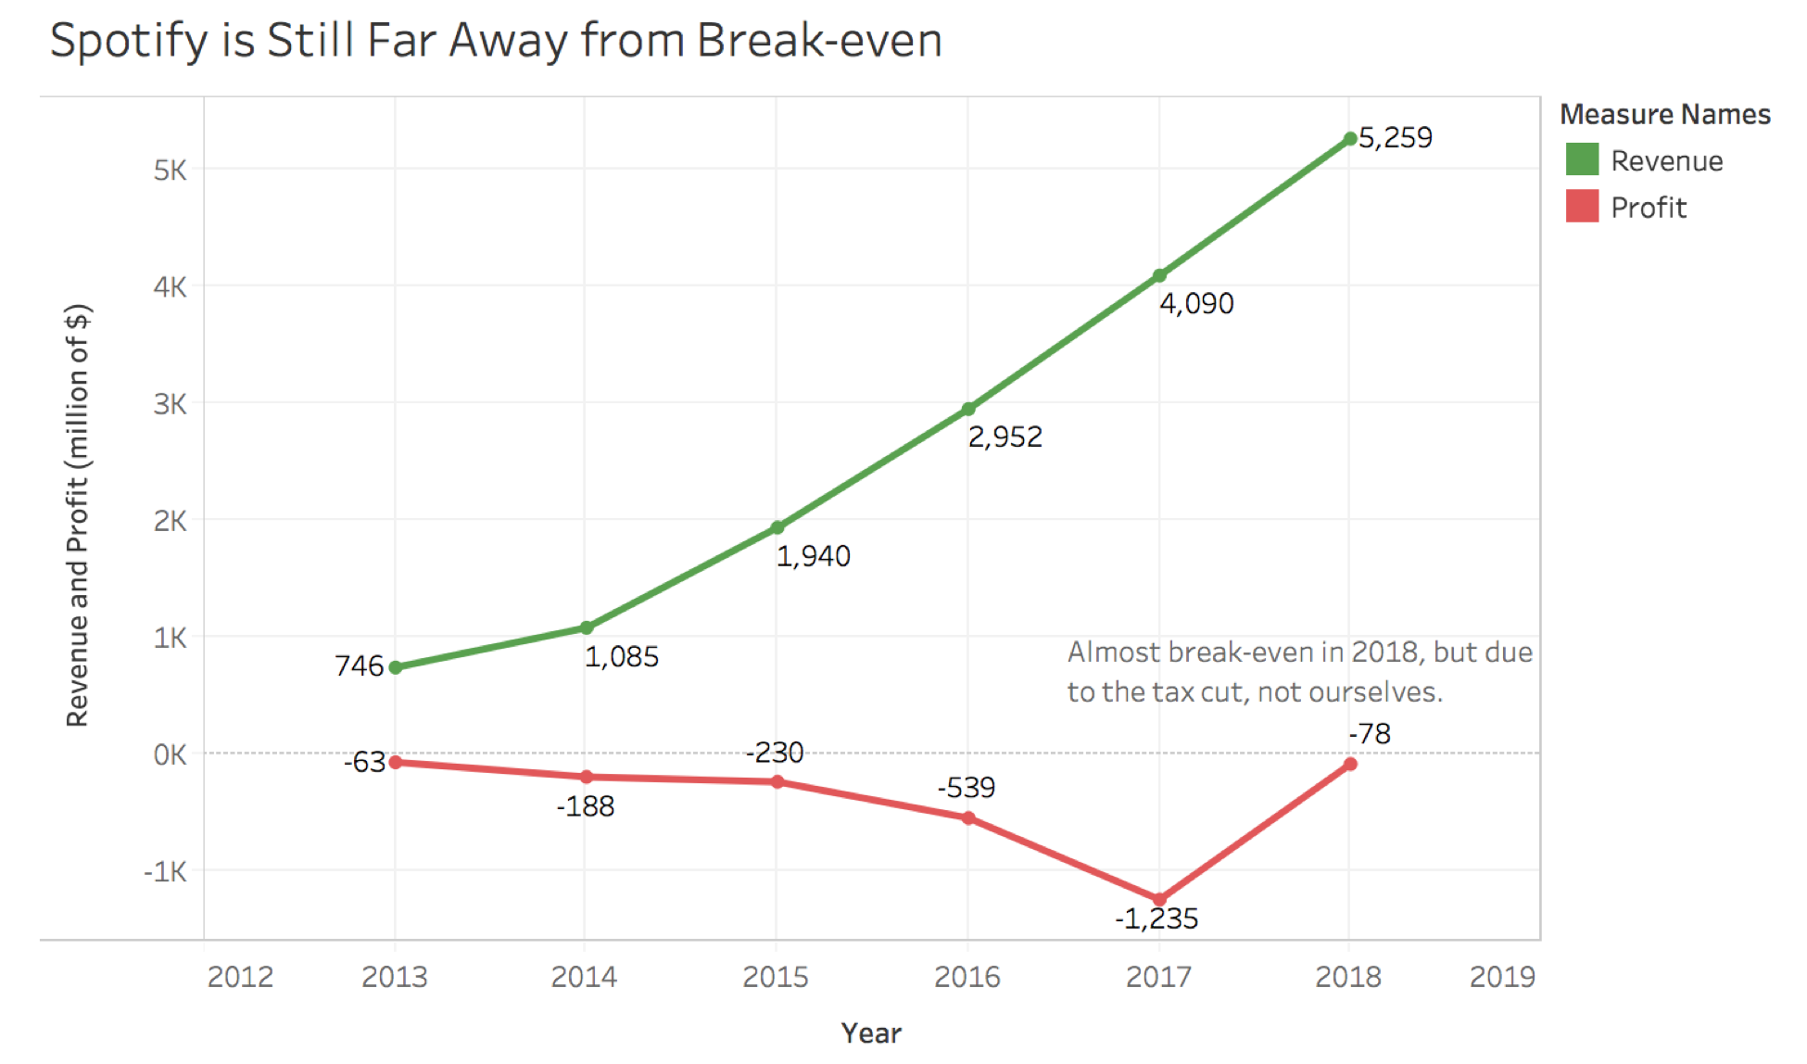

Slide 4
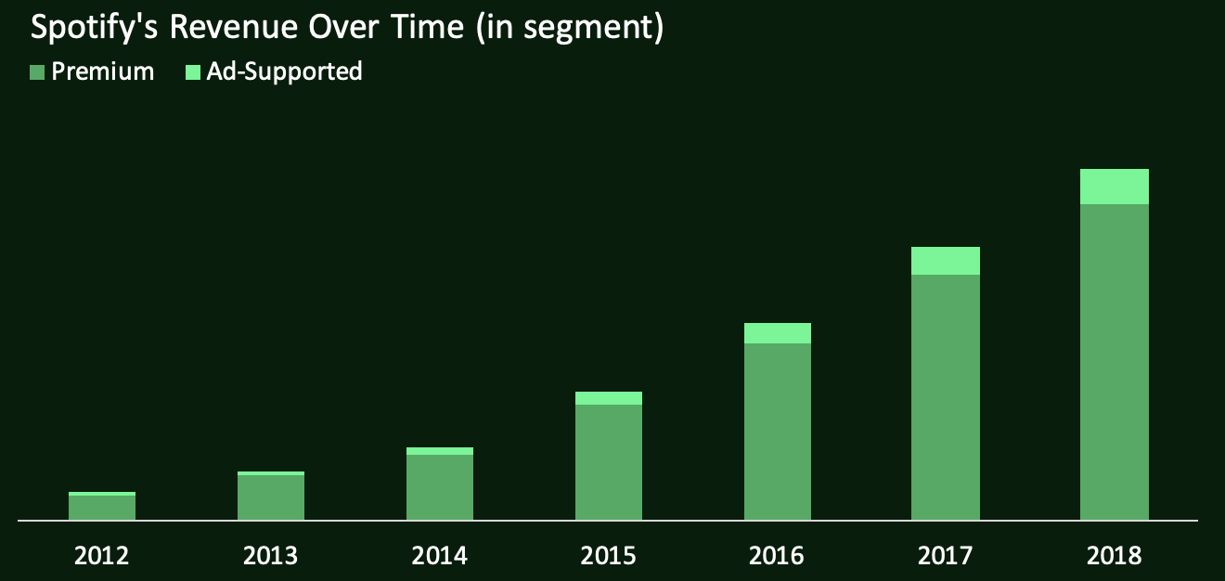
Business performance
Notes:
With the information that a significant portion of revenues are coming from paid subscribers. We should pay more attention to increase Spotify’s user base by sustaining its existing subscriber and attracting more potential users.
Since the music industry is rapidly and constantly changing - it is of utmost importance for Spotify to be sensitive and innovative in responding to the needs of customers and the market.
Apple Music’s momentum is particularly pronounced in the other large, English-speaking territories where iTunes, the company’s music-download store, was popular and where iPhone usage is high.

Slide 5


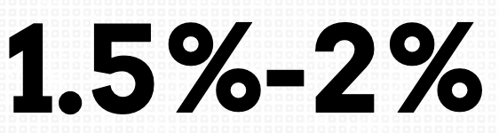
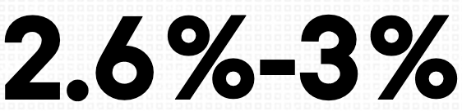
Business performance
Growth rate of premium subscriber
Notes:
According to an article in The Wall Street Journal, Apple Music which is one of the largest competitor of Spotify has surpassed Spotify in paid U.S. subscriptions. The monthly growth rate shows a similar trend, the rate for Apple Music is about 2.6% to 3%, compared with 1.5% to 2% for Spotify.

Slide 6

Recommendations:
A bridge between fans and artists
Levels of Premium accounts
from $4.99 to $24.99
Behind the Scene Videos
Tickets lottery
Reward system that allow users to show supports to artists
A board showing the top donators
Friends can see your contribution
Spotify and Artists both benefit

Slide 7

Similarity:
More male
users
Same
age
distribution
Monthly active users
Average
usage
per day
Notes:
Twitch still domain the market of gaming live-streaming for almost 8 years despite the fact that more and more powerful competitors such as microsoft and google started to join in. There are a lot in common btw Spotify and twitch.

Slide 8

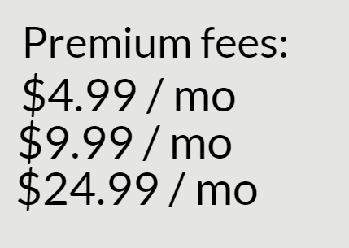
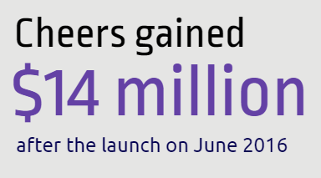
Example from Twitch:
Notes:
The highly interactive system is the drivin force of its success. Features such as cheers is a form of digital tipping, which lets users buy emoji to give live shout-outs to their favorite streamers during live broadcasts and this feature along have gain around 14 million after it launch + Also twitch has different level of premium fee is split 50-50 from twitch and streamer which will not only increase Spotify revenue and the artist’s part.
after implement the feature it can regain its dominate market

Slide 9
Recommendations:
Enhance interactions among artists and listeners. Interactive features such as lives and donation system can satisfy some of the fans’ passion in supporting the artists they like, which boosts income for both Spotify and the artist. Spotify can have a contribution board to show the ranks of who rewarded an artist the most and potentially some items to give out, such as signatures or concert tickets.

Slide 10
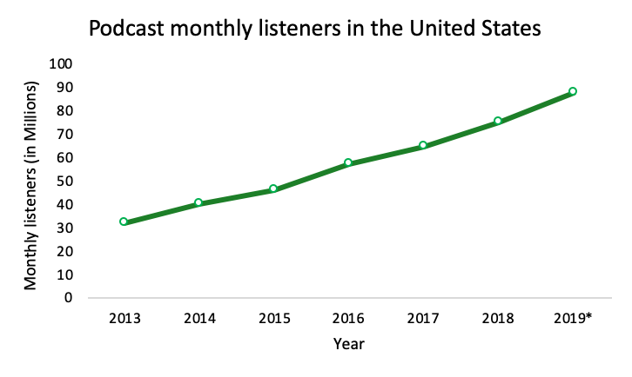
Podcast market
*2019 is based on projected number
Notes:
2019 is based on projected number

Slide 11
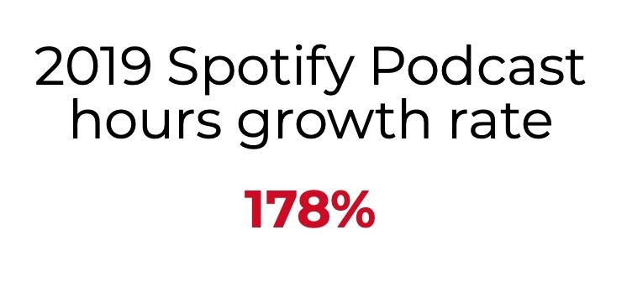
Notes:
Encouraged engagement and conversion of ad-supported to premium users

Slide 12
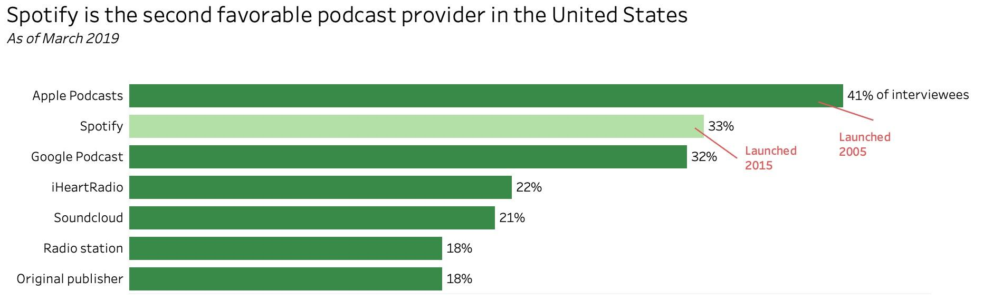
Notes:
Additional Information: a survey completed by 1,407 respondents;
respondents can choose multiple answers (so numbers do not add up to 100%);
18 years and older;
among respondents who listen to podcasts at least monthly
Sources: MarketingCharts; Westwood One; Audience Insights

Slide 13

Recommendation
More integration between artists and their podcast programs
Invite artists to produce their original contents
Notes:
One advantage of Spotify is that the Spotify app includes both its music library and its podcast library while Apple uses two apps for its products: Apple Music and Apple podcast.
Spotify should invite more artists to poin Spotify podcasts and to produce their original contents. And for those artists who had already published podcast contents on Spotify, Spotify should increase content integration. For example, Tablo, a Korean hip-hop singer has recently launched a serious Podcasts called The Tablo Podcast. However, when you search Tablo’s name and enter his artist page, you cannot find anything related to his Podcast while when you enter his Podcast page, there is no link to the artist’s own page. This will discourage users from browsing podcast programs published by their favorite artists.

Slide 14
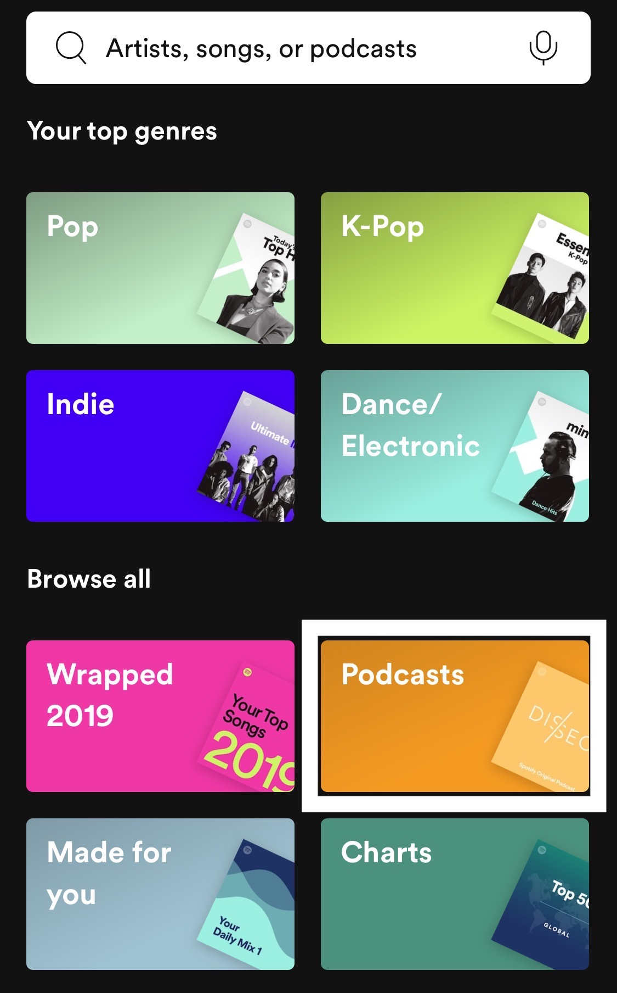
Recommendation (cont.)
Create a separate tab for podcast
Continue to generate more exclusive and original contents through acquisition and exclusive deals
More advertising
Notes:
While we believe that more integration should be made, some separation should also be considered.
Now, podcast is embedded in one of the “music genre” and it is misleading. If there is a separate tab for podcast contents and programs, there will be more chance for users to notice and discover more about podcast features.

Slide 15
Personalization
Improve customers’ content experience.
The personalized touch boosted the number of playlist-featured artists by 30 percent, and the number of discovered songs by 35 percent, according to Spotify. It also saw repeat listens for songs shoot up by 80 percent, and a 66 percent hike in the number of times people have saved tracks.
*insert numbers
12/5 dropped
As a result, Spotify has prompted the app to be downloaded 2.3 million times globally in the three days after Spotify Wrapped was released, according to data from Sensor Tower, which tracks mobile downloads and revenue. That figure marks a 23% jump over the 1.9 million average downloads Spotify saw over the same three-day period in the three weeks preceding Dec. 5. Spotify declined to make a spokesperson available for this piece.
The surge pushed Spotify from being among the 20 most popular apps on Apple’s App Store charts before this year’s Wrapped playlists were unveiled to iOS’s sixth most popular download, after they came out. Spotify saw a similar spike on Google Play, though the app typically sees more fluctuation on the Android platform throughout the year. In addition, Spotify saw a bigger download boost this year than after Wrapped was rolled out in 2018, when it received 1.5 million global downloads in the three days following the playlists‘ release.

Slide 16
Recommendation
saved tracks - personalized playlists from it
discover weekly etc more personalized, no two recommended playlists would be the same

Slide 17
Social Media Collaboration/Integration
*insert line chart overtime and how social media-related business execution aligns with the highest quarterly increase of subscribers.

Slide 18
Recommendation
more in depth collaboration & integration (share music etc.)
re-think spotify as a social media platform beyond just a music-streaming service

Slide 19
Conclusion
Problem: Profit/Revenue is not doing well
Solution: sustain current user base, and attract potential user base
new feature: reward
podcast
personalization
social media collaboration/integration

Slide 20
