Slide 1

water potability
Prepared by:
Erez Dahan
Elior Levy

Slide 2
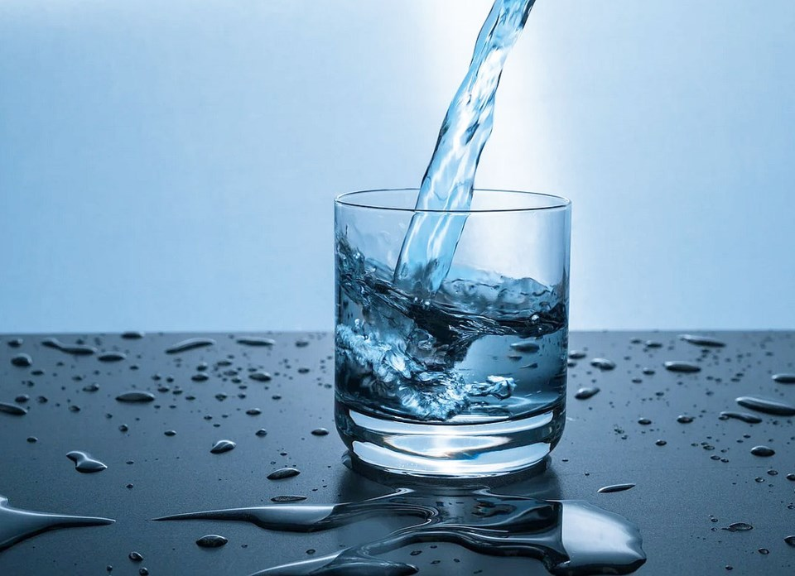


Research-intro
Research questions:
* Is it possible to determine if the water is potability?
Data Cleaning
EDA
ML

Slide 3
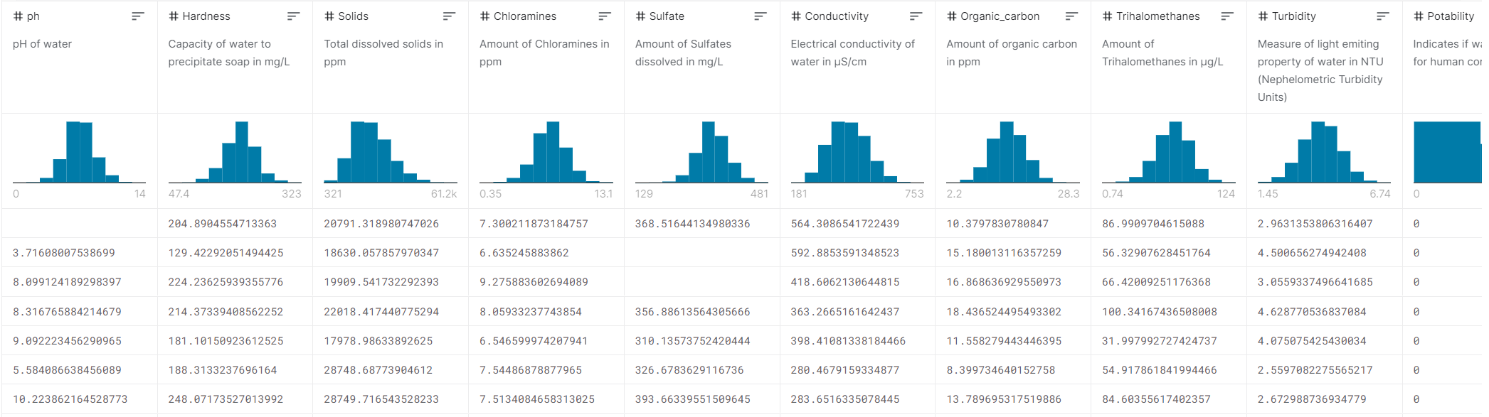
Data source
Data Set: water_potability.csv

Slide 4

Data cleaning
*Filter duplicates and empty values
*Outline handling

Slide 5
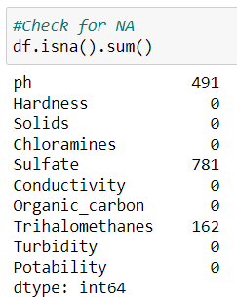
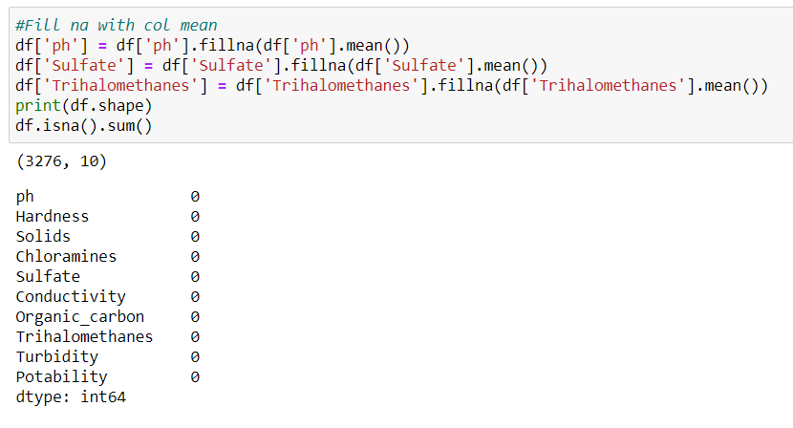
Data handling

Slide 6
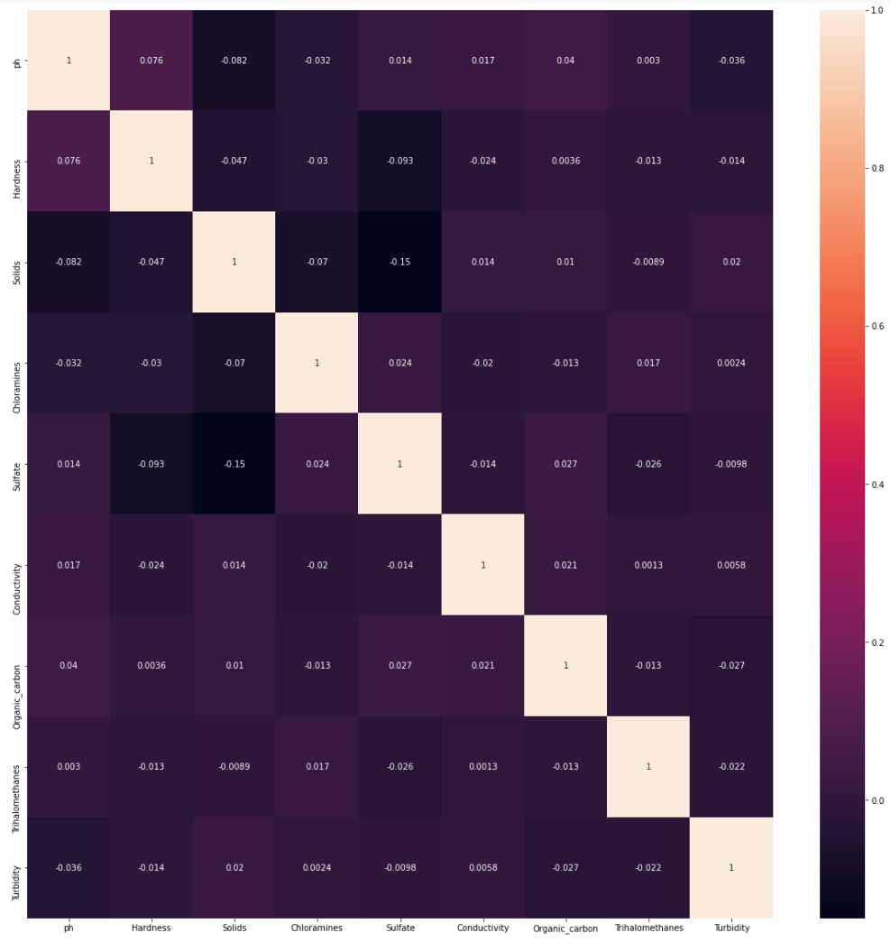
eda
Correlation Matrix

Slide 7
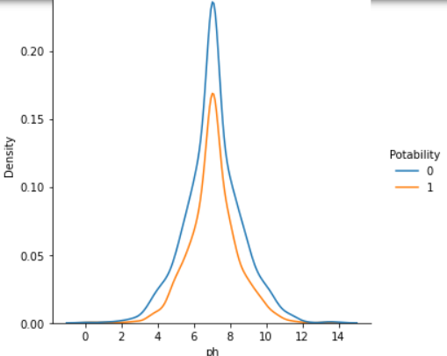
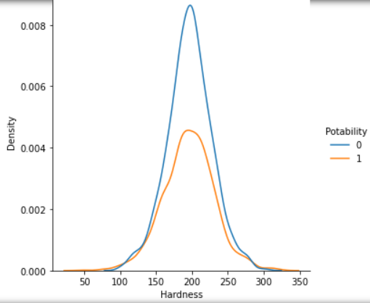
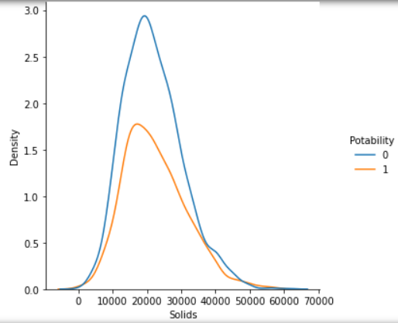
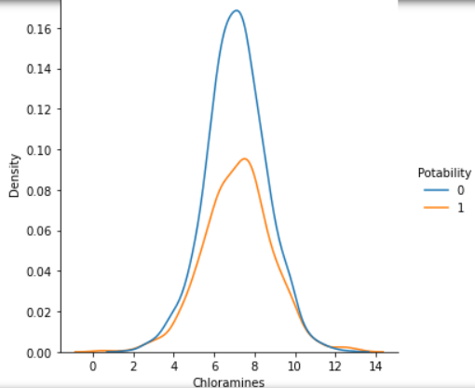
eda
Distplots by Potability

Slide 8
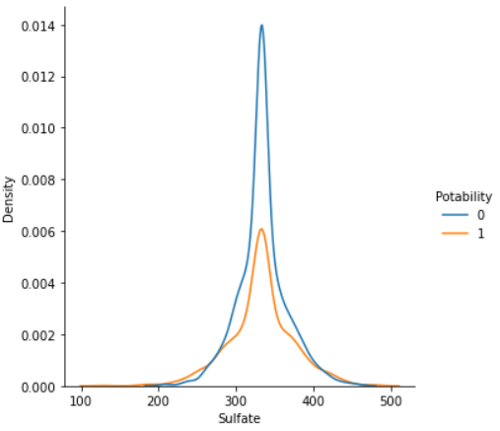
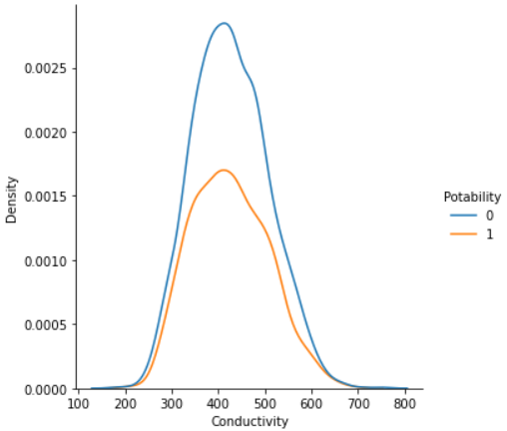
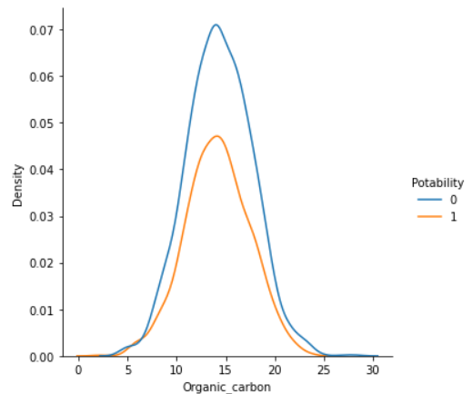
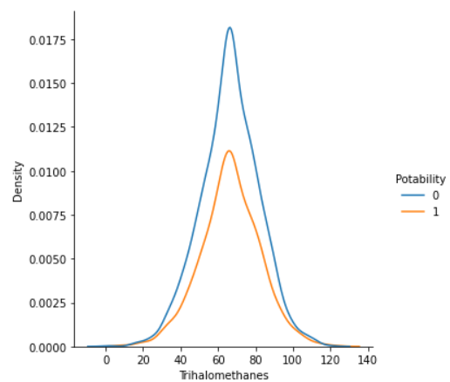
eda
Distplots by Potability

Slide 9
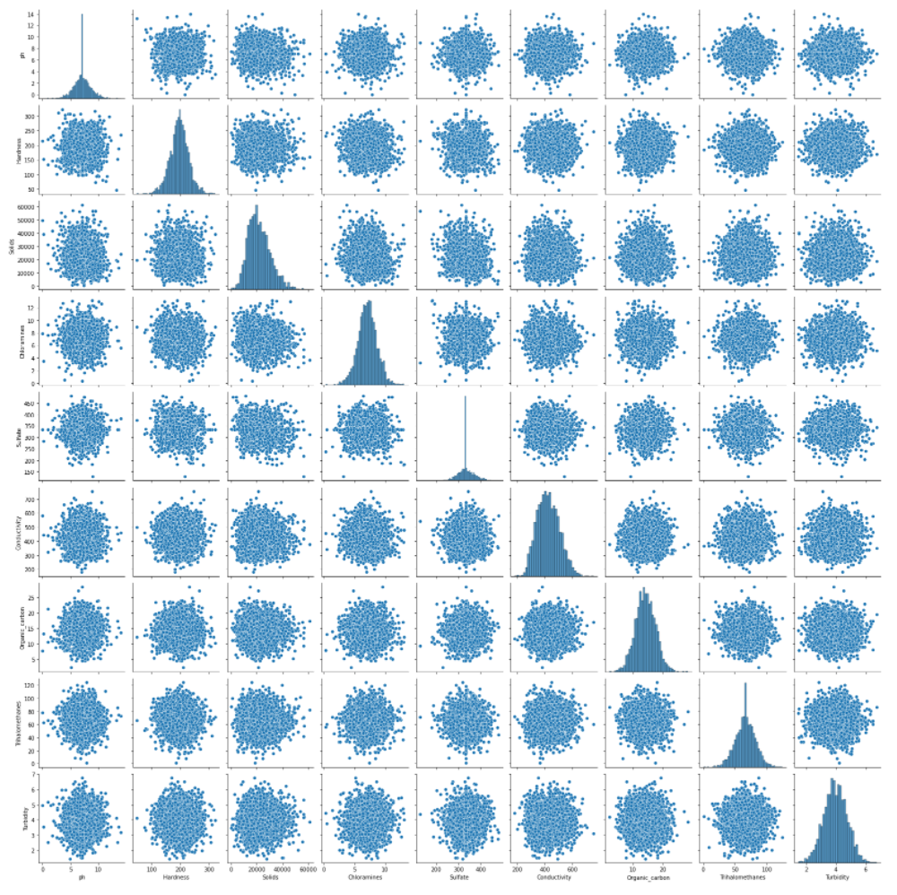
edA
Plot of all variables

Slide 10

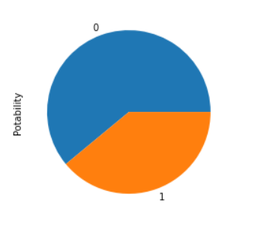
EDA
Potability distrubtion

Slide 11
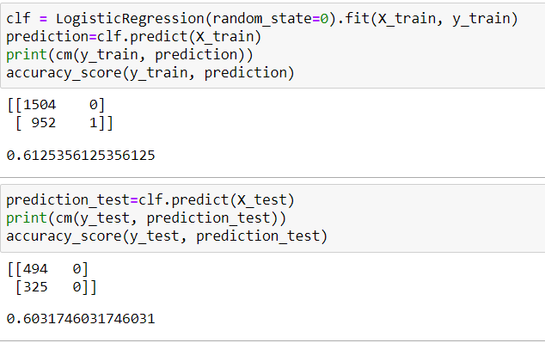
ML - Logistic Regression
statistical model that describes a possible relationship between a qualitative/category variable known as the "explained variable" and a variable

Slide 12
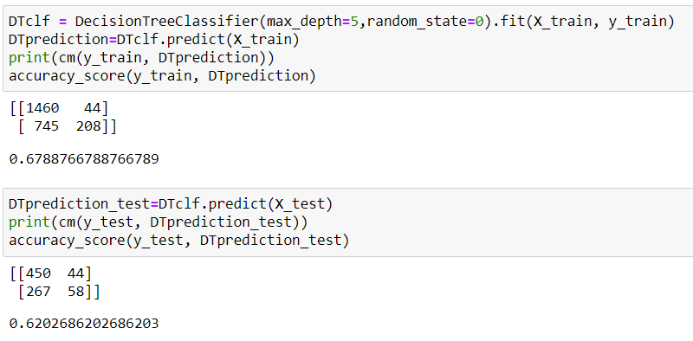
ML – DECISION TREE
decision tree is a decision support tool that uses a tree-like model of decisions and their possible consequences, including chance event outcomes, resource costs, and utility. It is one way to display an algorithm that only contains conditional control statements

Slide 13
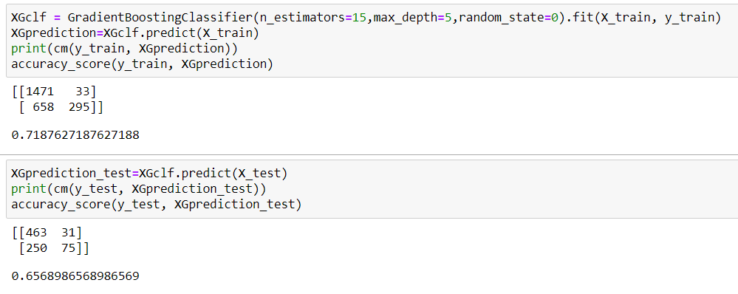
ML - XGBoost
open-source software library which provides a regularizing gradient boosting framework for C++, Java, Python. It works on Linux, Windows From the project description, it aims to provide a "Scalable, Portable and Distributed Gradient Boosting (GBM, GBRT, GBDT) Library". It runs on a single machine, as well as the distributed processing frameworks Apache Hadoop, Apache Spark, and Apache Flink.

Slide 14
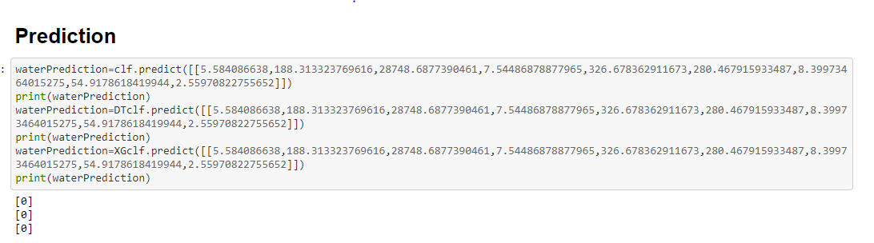
prediction

Slide 15

We run 3 models to classify our y. Logistic regression is the simplest model and give us the lowest accuarcy. To avoid Over Fitting in the DT and XGB we set lower hyperparameters (DT-max_depth=5, XGB-n_estimators=15,max_depth=5) and see in the result that we succeeded in avoid it. The best accuarcy is given by the XGB model

