Slide 1
Primate Balloon Analogue Risk Task (BART)

Slide 2
Balloon Analogue Risk Task (BART)
The Balloon Analogue Risk Task (BART) helps psychologists study how people take risks.
In the task, a virtual balloon on the screen is inflated with each button press. With each button press, you can inflate the balloon to earn more points.
  But if you pump it too far, it might explode, and you lose the points for that round.
  The goal is to inflate the balloon as much as possible and collect your winnings before the balloon bursts.
Lejuez, C. W., Read, J. P., Kahler, C. W., Richards, J. B., Ramsey, S. E., Stuart, G. L., …​ & Brown, R. A. (2002).
Evaluation of a behavioral measure of risk taking: the Balloon Analogue Risk Task (BART). Journal of Experimental
Psychology: Applied, 8(2), 75.

Slide 3
Primate Balloon Analogue Risk Task (pBART)
pBART is based on the scoring rules of the card game blackjack with 2 exceptions
  Aces in pBART are only worth 1 point/token.
  The maximum value earned in a single hand can be 20 tokens.
  “Cards”, 1-10 tokens, appear with the same frequency as a standard deck of playing cards.
Subjects have 2 options.
  HIT, draw another “card” to accumulate points/tokens.
  STAY, draw no more cards and keep the points/tokens accumulated from that hand.
Accumulating points greater than 20 results in a BUST and accumulated points/tokens are forfeit.

Slide 4
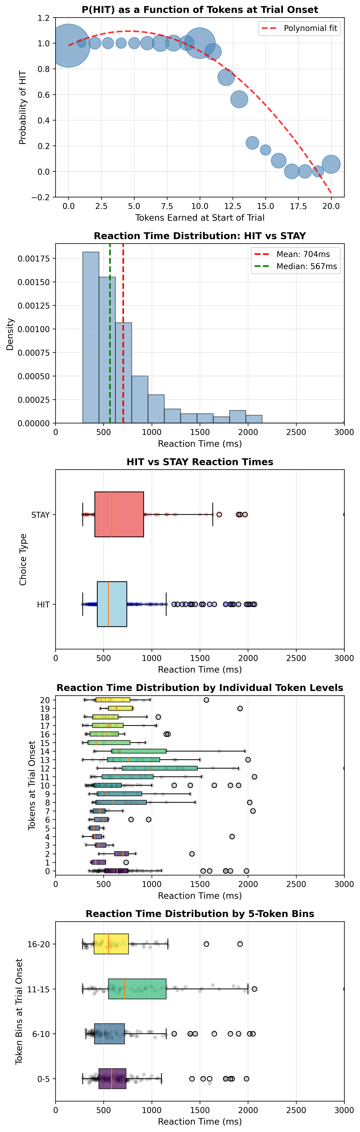
Behavioral Results: Single subject

Slide 5
------------------------------------------------------------
KRUSKAL-WALLIS TEST: Reaction Time Across Token Bins
------------------------------------------------------------
Kruskal-Wallis H-test:
H = 84.930, p = 0.0000
Comparing 4 token bins
✓ SIGNIFICANT difference in RTs across token bins (p < 0.05)
Subjects respond differently depending on accumulated tokens
η² = 0.0470 (effect size)
------------------------------------------------------------
POST-HOC PAIRWISE COMPARISONS (Mann-Whitney U with Bonferroni)
------------------------------------------------------------
Bonferroni-corrected alpha: 0.008333
(Original alpha = 0.05, Number of comparisons = 6)
Token Bin Comparison | U-statistic | p-value | Bonferroni Sig?
----------------------------------------------------------------------
0-5 vs 6-10 | 162607.5 | 0.187145 | ✗
0-5 vs 11-15 | 69262.5 | 0.000000 | ✓
0-5 vs 16-20 | 98564.5 | 0.066605 | ✗
6-10 vs 11-15 | 43425.5 | 0.000000 | ✓
6-10 vs 16-20 | 61073.0 | 0.017374 | ✗
11-15 vs 16-20 | 57512.0 | 0.000000 | ✓
Significant pairwise differences (after Bonferroni correction):
• 0-5 tokens: RT faster than 11-15 tokens (625 vs 1004 ms, p=0.000000)
• 6-10 tokens: RT faster than 11-15 tokens (617 vs 1004 ms, p=0.000000)
• 11-15 tokens: RT slower than 16-20 tokens (1004 vs 714 ms, p=0.000000)

