Slide 1
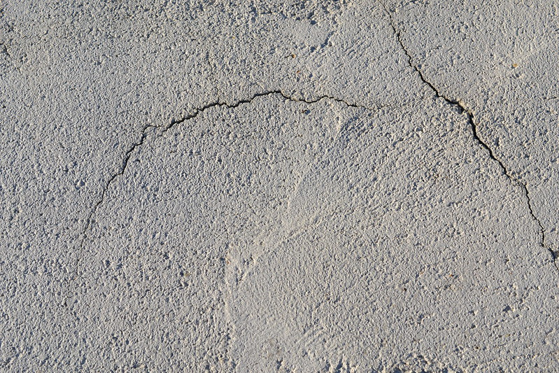
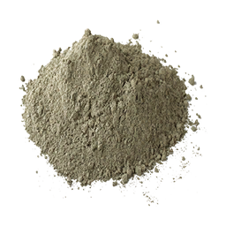
CEMENT

Slide 2
INTRODUCTION OF CEMENT
A cement is a binder, a substance used for construction that sets, hardens, and adheres to other materials to bind them together. Cement is seldom used on its own, but rather to bind sand and gravel (aggregate) together. Cement mixed with fine aggregate produces mortar for masonry, or with sand and gravel, produces concrete. Concrete is the most widely used material in existence and is behind only water as the planet's most-consumed resource.
Cements used in construction are usually inorganic, often lime or calcium silicate based, which can be characterized as non-hydraulic or hydraulic respectively, depending on the ability of the cement to set in the presence of water (see hydraulic and non-hydraulic lime plaster).

Slide 3
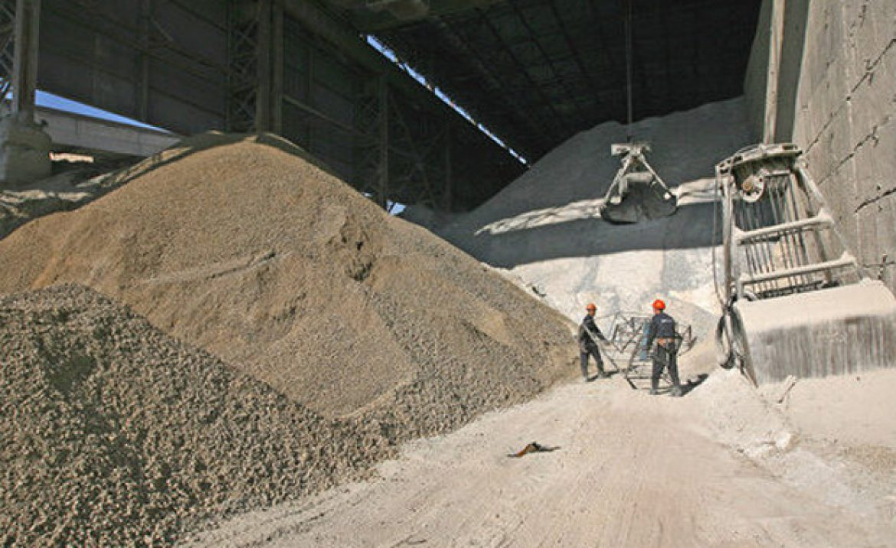
Non-hydraulic cement does not set in wet conditions or under water. Rather, it sets as it dries and reacts with carbon dioxide in the air. It is resistant to attack by chemicals after setting.
Hydraulic cements (e.g., Portland cement) set and become adhesive due to a chemical reaction between the dry ingredients and water. The chemical reaction results in mineral hydrates that are not very water-soluble and so are quite durable in water and safe from chemical attack. This allows setting in wet conditions or under water and further protects the hardened material from chemical attack. The chemical process for hydraulic cement was found by ancient Romans who used volcanic ash (pozzolana) with added lime (calcium oxide).

Slide 4
MEANING OF CEMENT
A powdery substance made by calcining lime and clay, mixed with water to form mortar or mixed with sand, gravel, and water to make concrete.
A powder that is made mainly from compounds of aluminum, calcium, silicon, and iron heated together and then ground and mixed with water to make mortar and concrete.

Slide 5
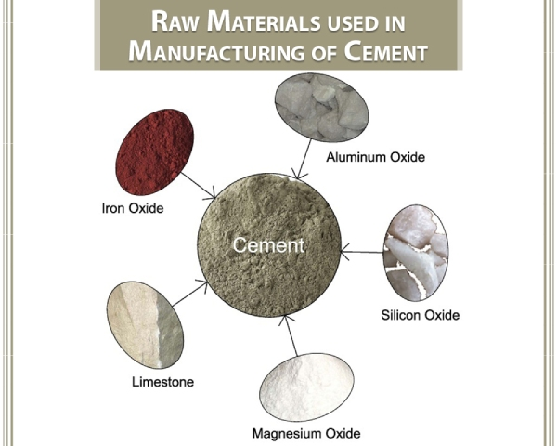

Slide 6
Raw Materials Used For Manufacturing of Cement
Raw materials used for manufacturing of Portland cement are found naturally in the earth’s crust. It is made primarily from calcareous and argillaceous materials and gypsum. Calcareous materials contain limestone or chalk while argillaceous materials comprise an oxide of silica-alumina and iron. Both are found as clay or shale. Let’s understand the various types of cement raw materials used in the cement manufacturing process.

Slide 7
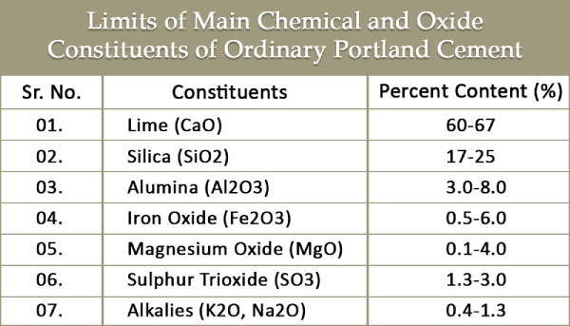

Slide 8
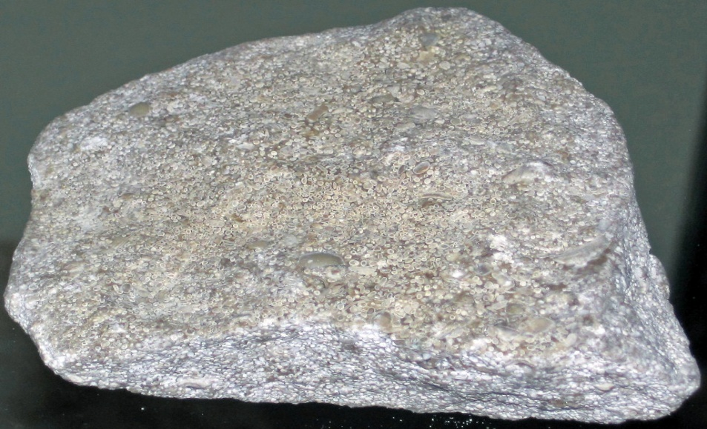
01. Lime
It is the main constituent used in cement manufacturing. It is responsible for imparting the cementing property to cement. An excess quantity of lime causes expansion and disintegration of the cement. Deficiency of lime causes decreased strength and the cement sets quickly. If it is used in the right proportion, it makes the cement sound and strong. Thus, lime can drastically change the properties of cement.

Slide 9
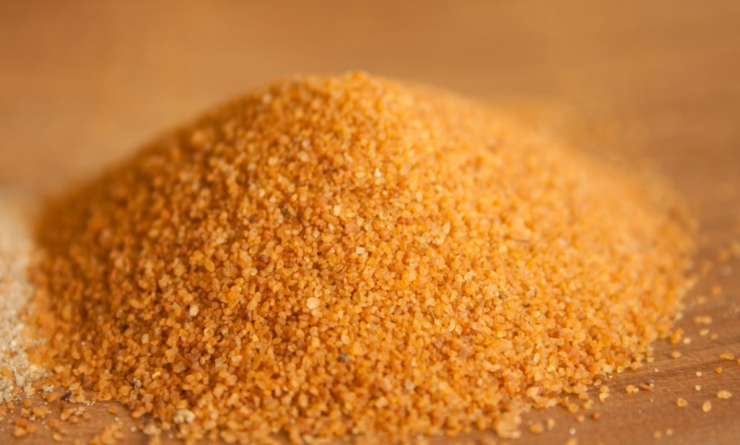
02. Silica
This plays a major role in imparting strength to concrete. Silica undergoes a chemical reaction with calcium to form dicalcium silicate (C2S) and tricalcium silicates (C3S). Excess silica adds strength to cement but it prolongs the setting time.

Slide 10
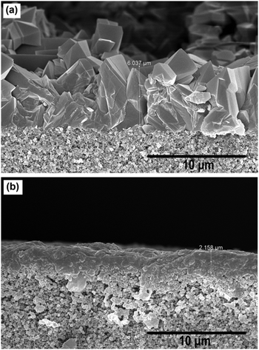
03. Alumina
This forms complex compounds with silica and calcium to improve the setting capacity of the cement. It acts as a flux and lowers the clinkering temperature. Use of an excess amount of alumina quickens the setting time but reduces the strength of cement.

Slide 11
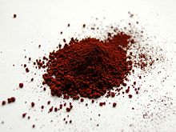
04. Iron Oxide
This is mainly responsible for imparting colour to cement. The hardness and strength of the cement are also improved to a certain extent. It helps in the fusion of raw materials during the cement manufacturing process.

Slide 12
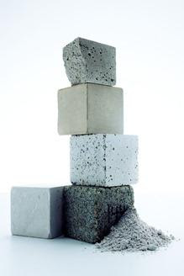
05. Magnesium Oxide
It imparts strength to the cement when mixed in a small quantity; however, an excess amount makes the cement unsound.

Slide 13
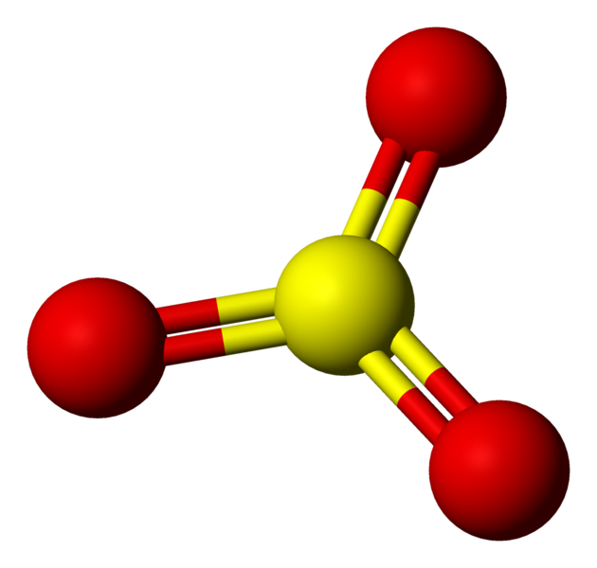
06. Sulphur Trioxide
This makes the cement sound if present in small quantity but an excess can make the cement unsound.
Cement is sometimes blended with other cementitious and/or a special material. This cement is called blended cement. They are produced by properly blending two or more types of cementitious materials and cement raw materials. Generally, the primary blending materials are fly ash, ground granulated blast furnace slag (GGBS), silica fume, and natural pozzolana.

Slide 14




Slide 15
THANK YOU!
HAVE A GOOD DAY….

