Slide 1
Final project in Module 1
Guofa Shou
Self-paced

Slide 2
Outline
The aim of the project:
To provide suggestions regarding what type of films should be created in terms of box office in the newly found Microsoft studio
Three questions are addressed sequentially by data analyses to fulfill the aim:
1) What's the general performance of movie industry in terms of box office for recent years?
2) What types of films have large number of box office?
3) What types of films have good ratings?
Conclusion

Slide 3
Q1: What's the general performance of movie industry in terms of box office for recent years?
Data sources: bom.movie_gross.csv and tn.movie_budgets.csv
Two summarized figures:
Gross values: sum and mean values of the domestic, foreign, and total gross for all types of films in the years between 2010 and 2018
Profits: Sum and mean values of the worldwide and domestic profit

Slide 4
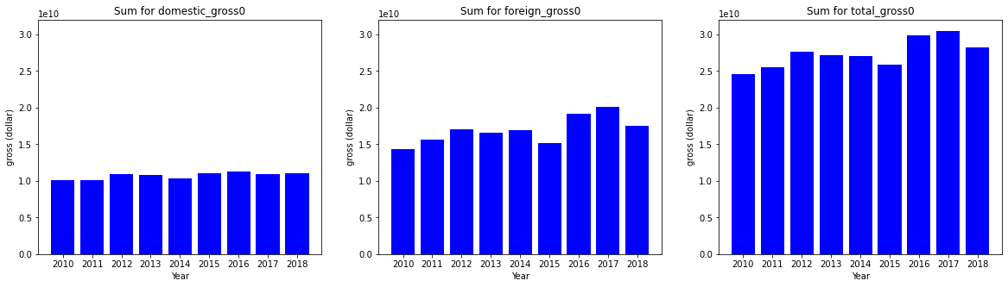
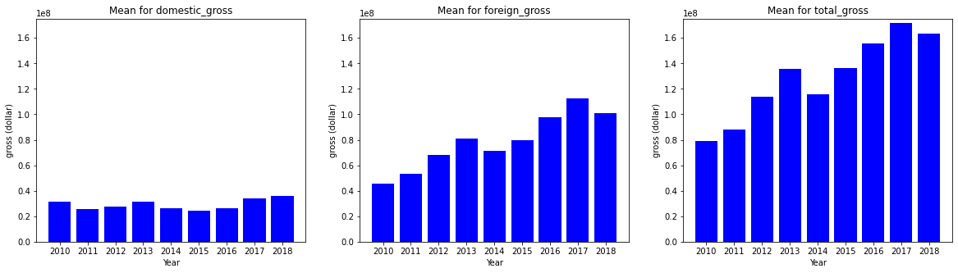
1) Gross values: sum and mean of selected films between 2010-2018
From sum: domestic gross is stable, but foreign gross has an increased trend. Therefore, the worldwide gross has an increased trend
From mean: similar patterns as for sum values, i.e., domestic market is stable, but foreign gross has an increased trend, which contributes to the increased trend in worldwide
SUM
MEAN

Slide 5
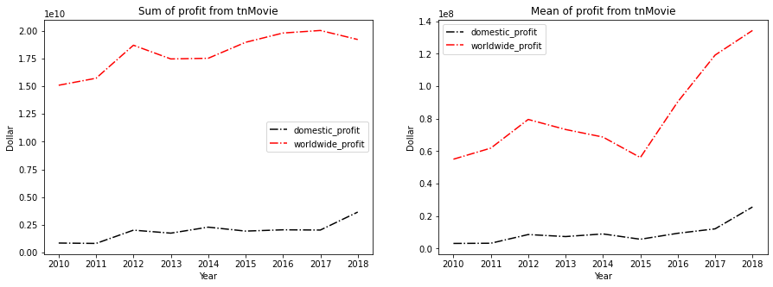
2) Profit values: sum and mean profit values of selected films between 2010-2018
Sum and mean profit values
Both sum and mean profit values indicate an increased trend for both domestic and worldwide profits
There is a trough in 2015
Answer to Q1: The film industry is still developing very well, and lots of profits could be achieved, especially from foreign market

Slide 6
Q2: What types of films have large number of box office?
Data sources: imdbTitleBasics and tnMovie_Budgets
Three summarized figures:
Number of movies for different types
Sum of worldwide profit for selected genres with high values
Mean of worldwide profit per film for selected genres

Slide 7
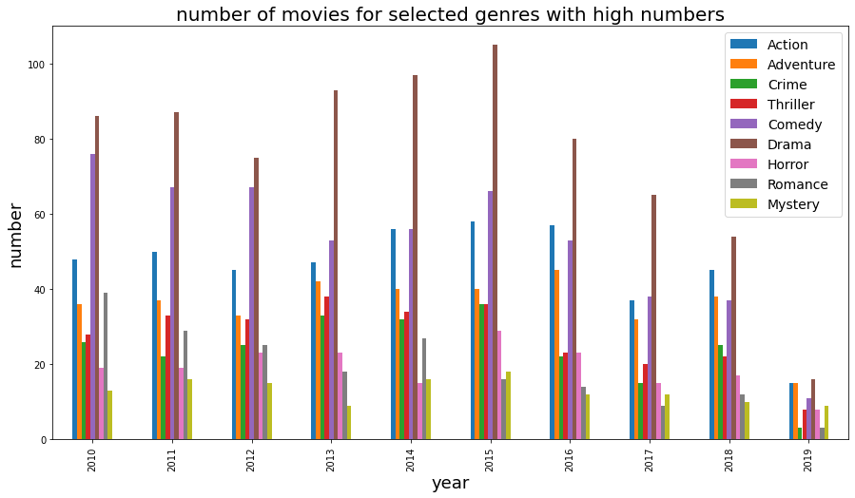
Drama, Comedy, Action, Adventure are the top four categories in terms of number of movies released

Slide 8
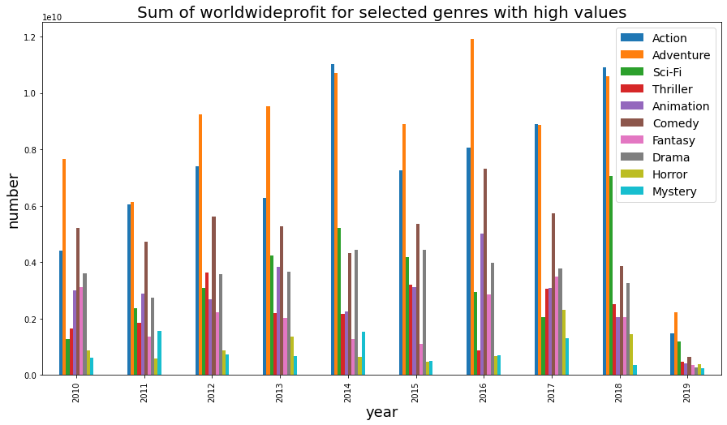
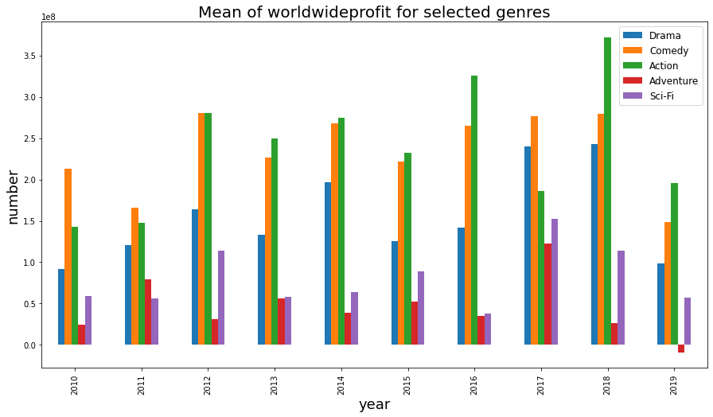
Adventure, Action, Comedy, and Sci-Fi, are the top 4 categories in terms of sum of worldwide profit
Action, comedy and Drama have higher mean values of worldwide profit
Answer to Q2: Action and comedy are two types of films that have high box office in recent years

Slide 9
Q3: What types of films have good ratings?
Data sources: imdbTitleRatings and the one generated in Q2
Three summarized figures:
Number of movies in the selected genres with high ratings
Mean of rating for selected genres with high ratings
Overall mean of mean rating for all genres across 2010 to 2019

Slide 10
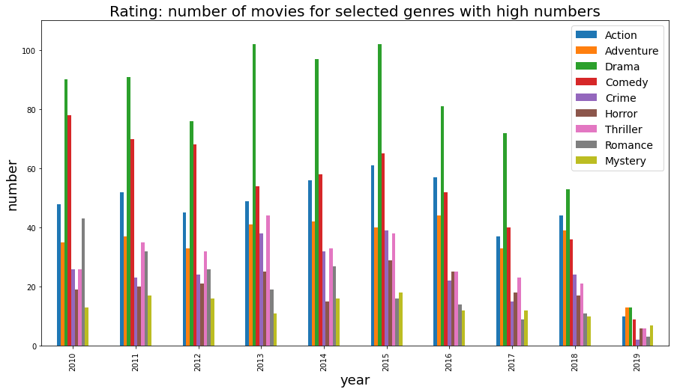
Drama, Comedy, Action, Adventure are the top four categories in terms of number of movies

Slide 11
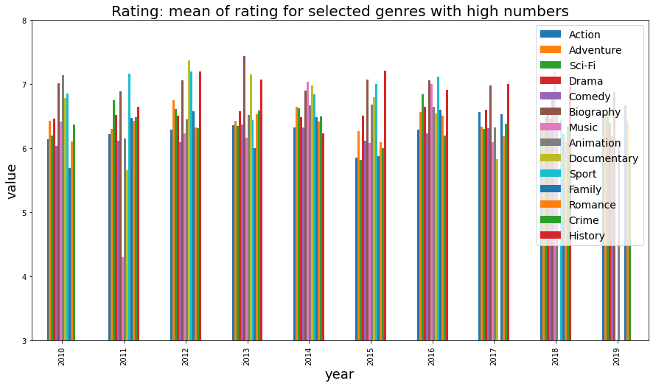
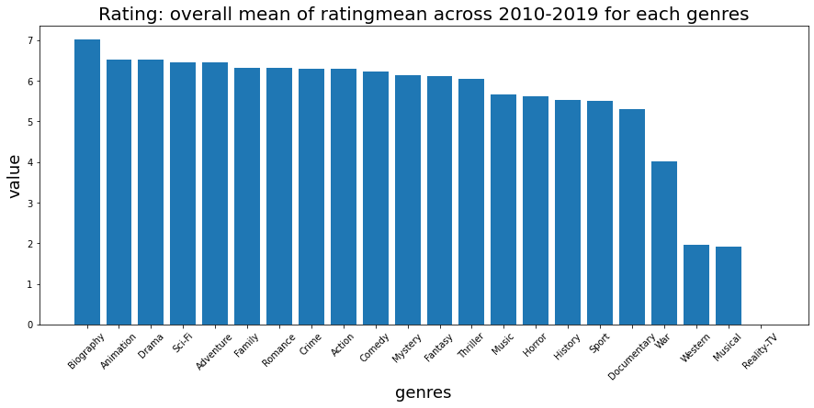
Answer to Q3: Biography, Animation, Drama, Sci-Fi, and Adventure are top five for the ratings

Slide 12
Conclusion
Based on rating and box office data, adventure and action should be the focus in the newly found Microsoft studio

