Slide 1
Final project in Module 2
Guofa Shou
Self-paced

Slide 2
Outline
The aim of the project:
To provide suggestions regarding the price of house
For house buyer, based on the characteristics of the house, they will know the price of the house and the investment value of the house for future sale
For house seller, they will know what they need to do to sell the house with a better price
A linear regression model will be built based on the different selection of house characteristics to achieve the goal of the project
Conclusion

Slide 3
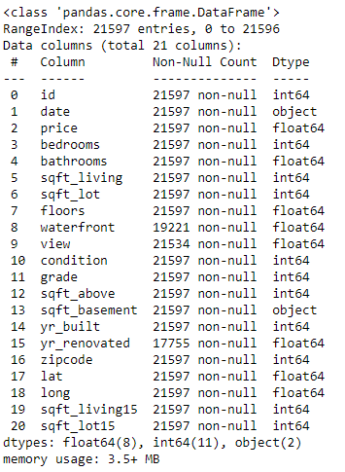
Data
Data source: kc_house_data.csv
Data understanding:
A total of 19 predictors available after excluding the id and the target (price)
A total of 21597 rows, while some rows have null values in some predictors
Several predictors' data type need to be changed, e.g., date and sqft_basement

Slide 4
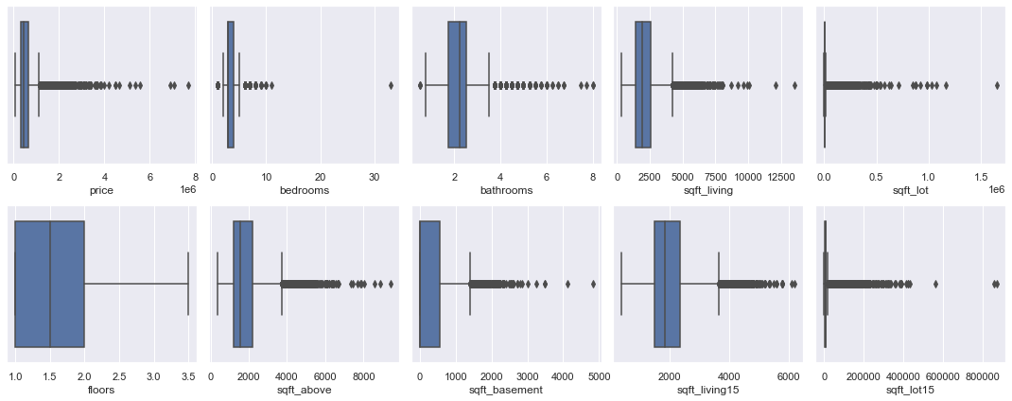
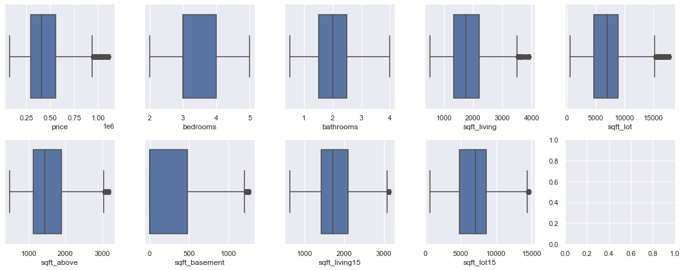
Data Preparation
Deal with data types: sqft_basement and date
Deal with null values:
View and sqft_basement: drop those rows with null values
Waterfront, and yr_renovated: they are over 10% of null values with special process
Deal with outliers:
Original
After removing outliers

Slide 5
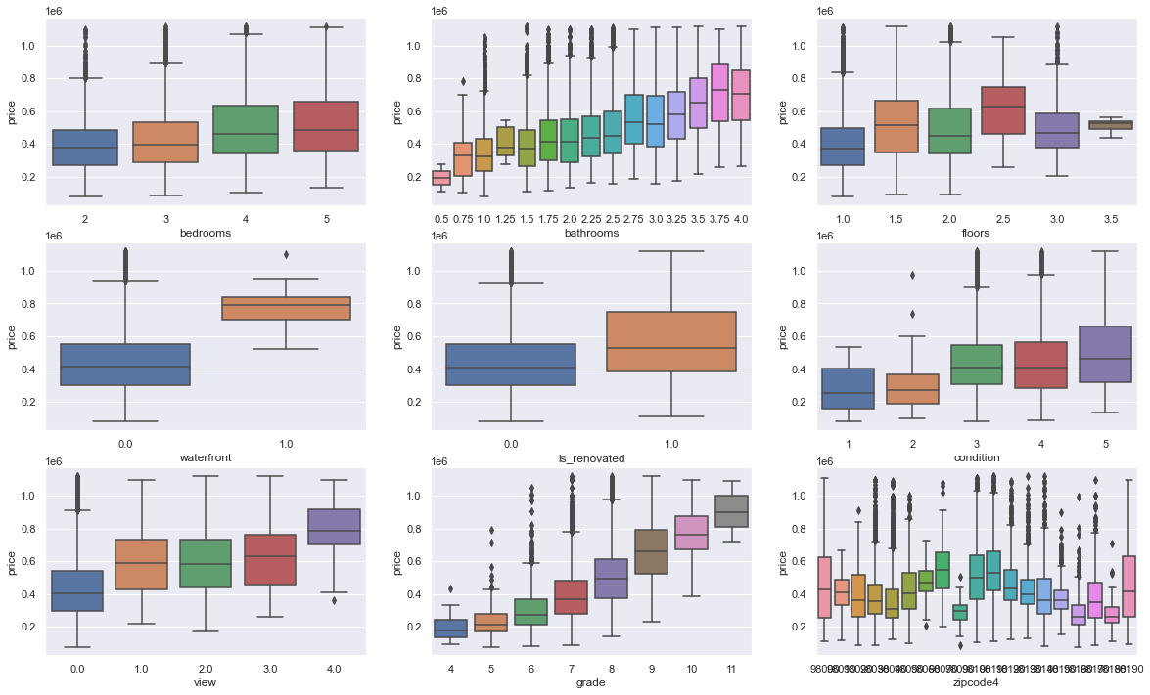
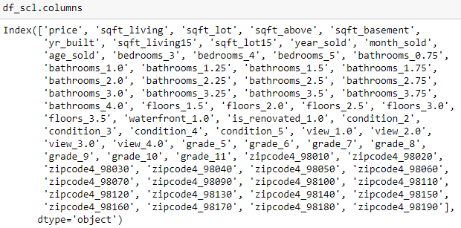
Data Preparation
Deal with categorical variables
'bedrooms','bathrooms','floors','waterfront','is_renovated','condition','view','grade','zipcode4'
Visualization of categorical variables
The predictors

Slide 6
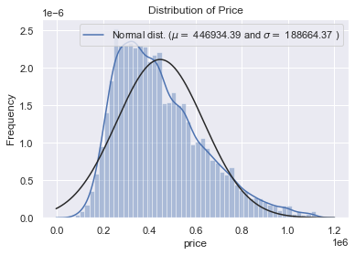
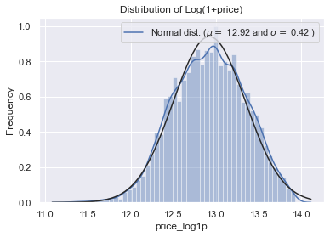
Data Preparation
Deal with target variable: price
Logarithm transform to make it more normal distribution
Log(1+price)

Slide 7
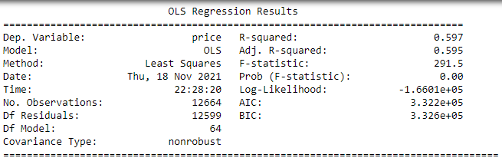
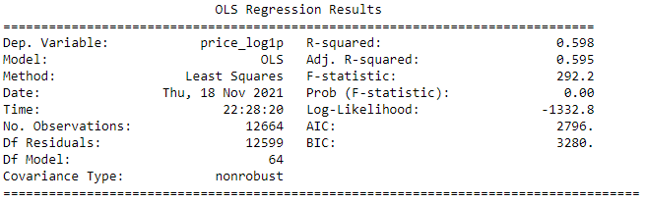
Modeling
Regression model with all available predictors
Using price or log-transformed price as the target
From R-squared values, it seems log-transformed price is a little better

Slide 8
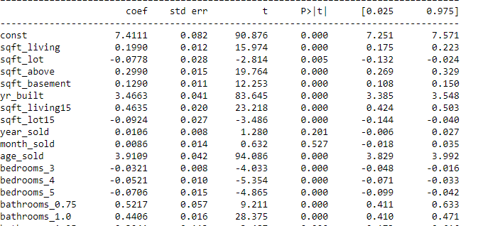
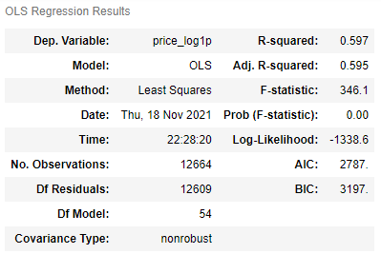
Modeling
Regression model with all predictors that are significantly related to the target: p > 0.05
Predictors: 68 -> 56

Slide 9
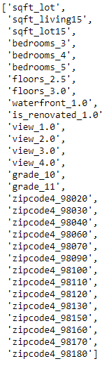
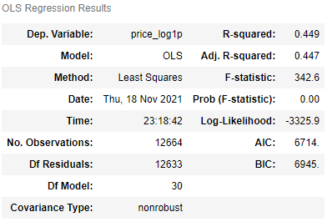
Modeling
Regression model after further excluding some predictors with high collinearity
Predictors: 56 -> 30

Slide 10
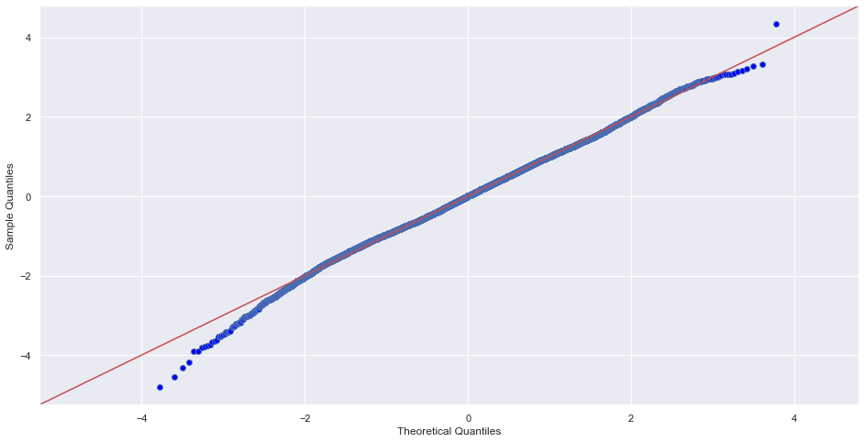
Regression model evaluation
Normality: qqplot

Slide 11
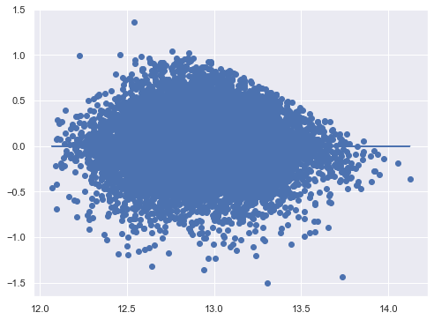
Regression model evaluation
Homoscedasticity

Slide 12
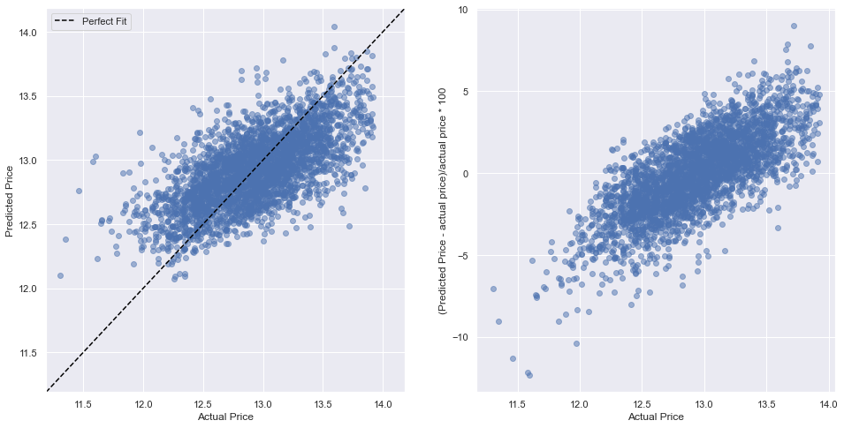
Regression model evaluation
Cross-validation
Train score: 0.4465
Validation score: 0.4501
Mean squared error, root mean squared error, mean absolute error, and Mean absolute error
MSE: 0.1007
RMSE: 0.3174
MAE: 0.2519
R-Squared: 0.4437
Examine the predicted values with the real values
The fitted regression model can predict house price very well

Slide 13
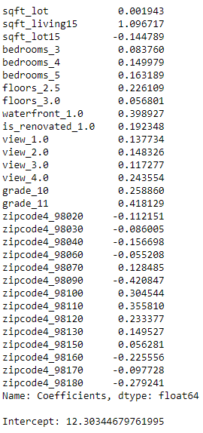
Summary
Observations from coefficients
The grade and sqft_living15 have the strongest relationship with the house price
It is interesting to see sqft_lot15 has a negative relationship with the house price
Waterfront_1.0 and grade_11 also have a positive relationship with the price
For some zipcode, e.g., 98100 and 98110, they have high positive relationships with the price
To address the business questions:
For buyer, they will know that the house price is higher for a house with the high grade and sqrt_living15 values
For seller, if they want to sell their house with a higher price, they could add waterfront and improve the grade.

