Slide 1
SyriaTel: How to keep the customer churn?
Guofa Shou
Self-paced

Slide 2
Outline
The aim: to provide suggestions about how to keep the customers churn to SyriaTel company
Data analysis: A binary classification model is built to identify important features closely related to customer churn
Suggestions

Slide 3
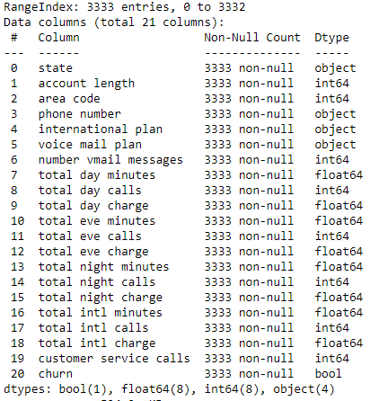
Data
Data source:
bigml_59c28831336c6604c800002a.csv
Data summary:
20 features
1 target: churn with false or true
3333 customers

Slide 4
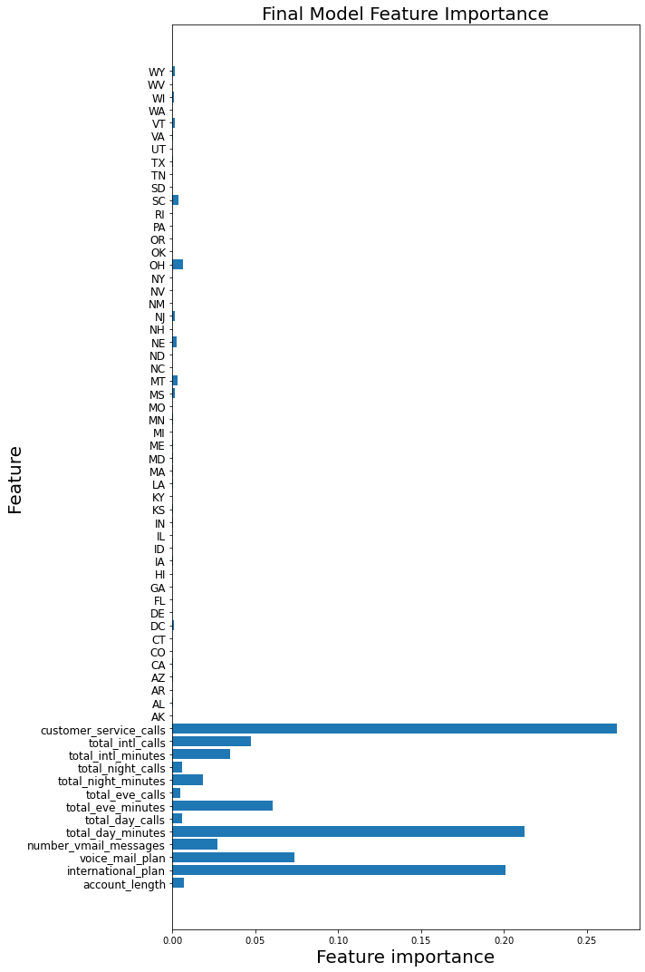
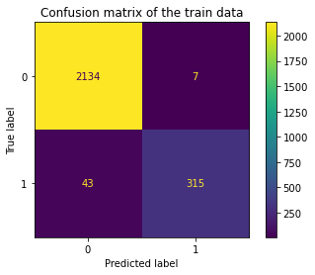
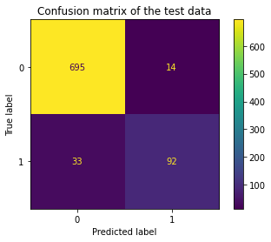
Data Analysis
Classification model: GradientBoostingClassifier
Classification performance
Important features:
Customer_service_calls
Total_day_minutes
International_plan

Slide 5
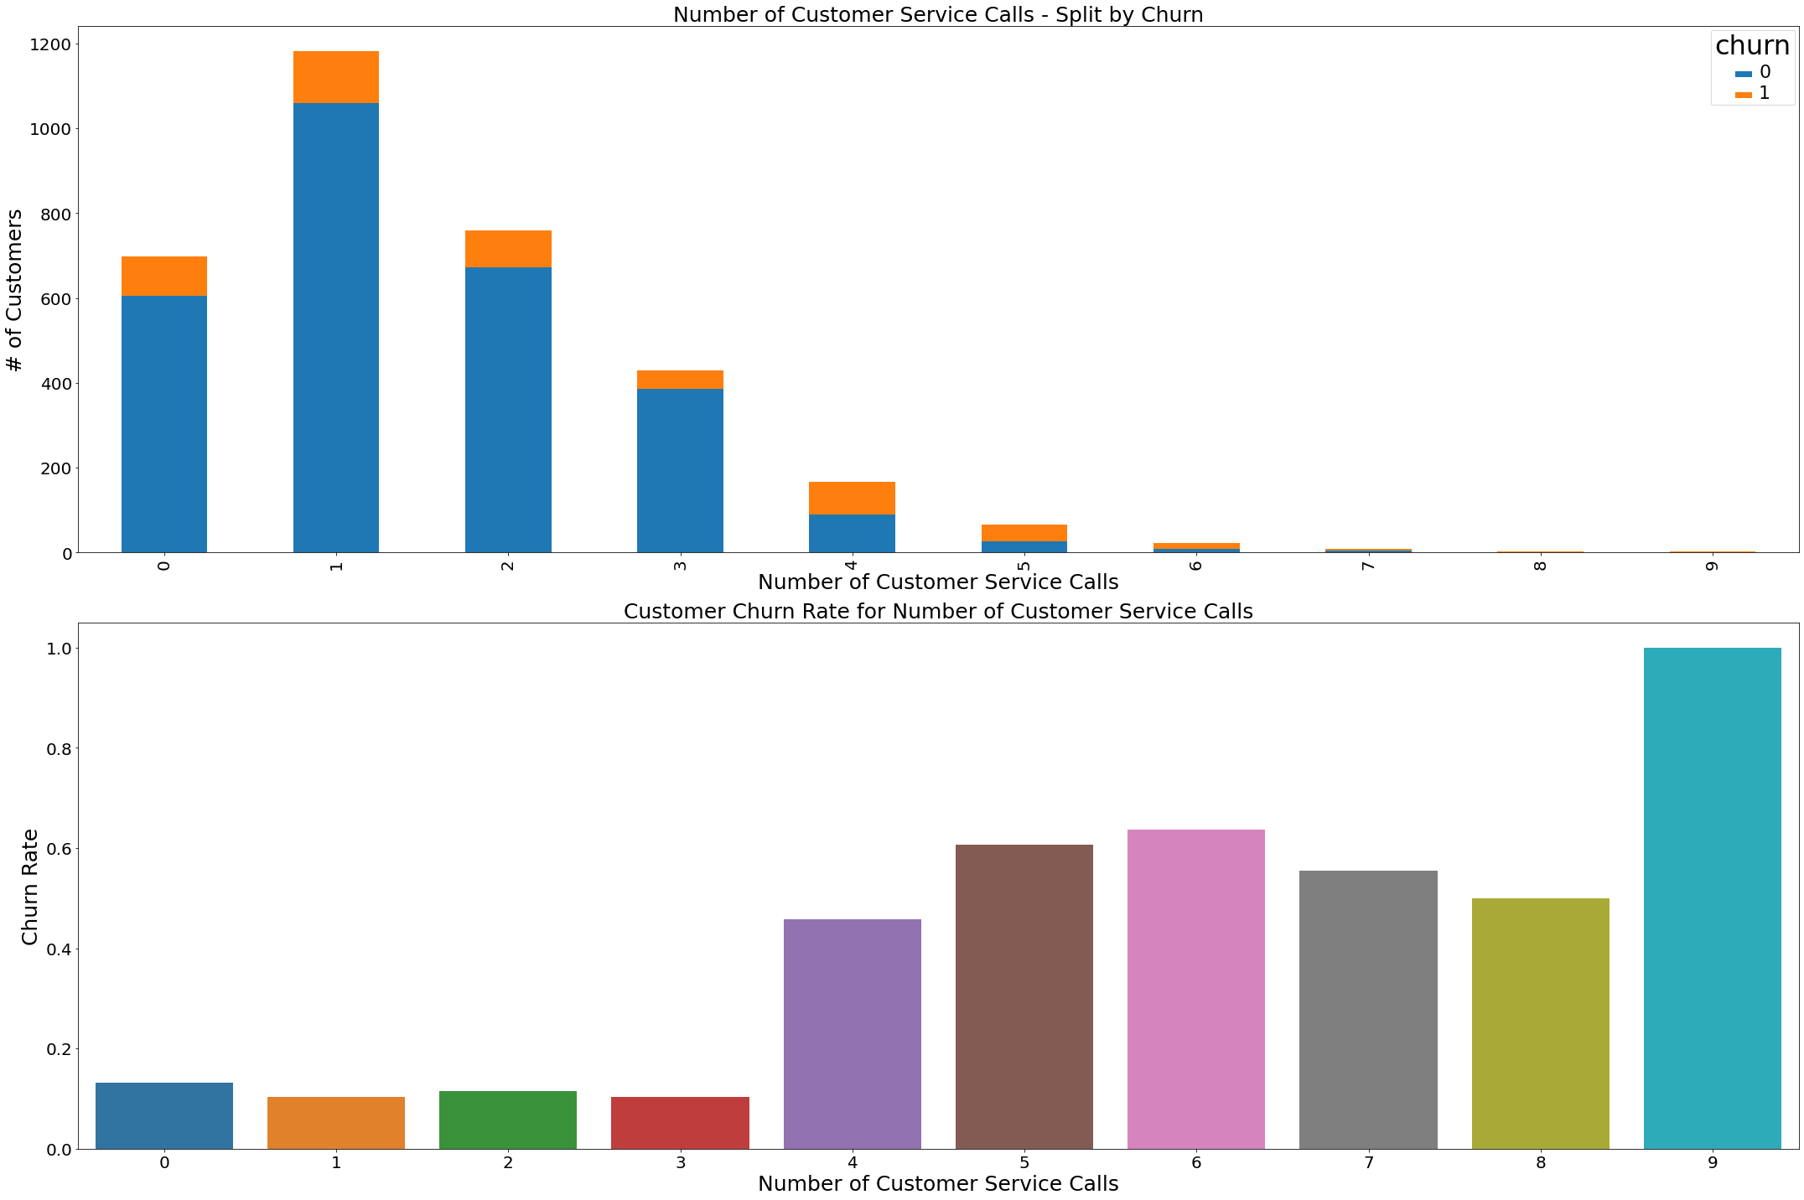
Suggestion based on customer service calls
Increase the service calls will keep the customers churn with the service

Slide 6
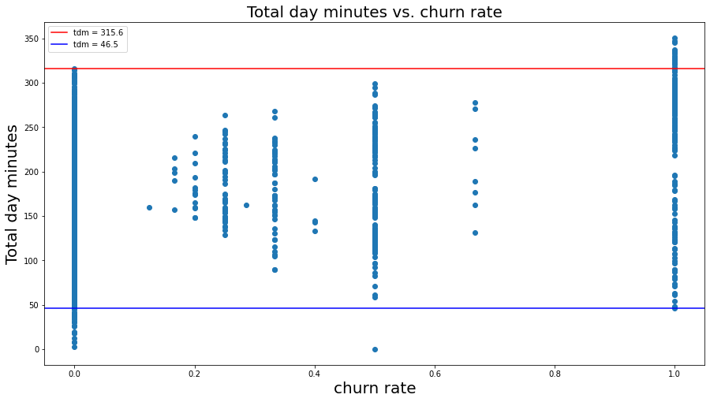
Suggestion based on total day minutes
The company needs to work more on the customers with the total day minutes between 46.5 to 316 mins

Slide 7
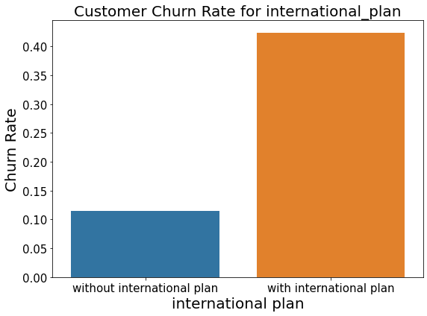
Suggestion based on international plan
The company could promote the international plan to keep customers churn with the service

Slide 8
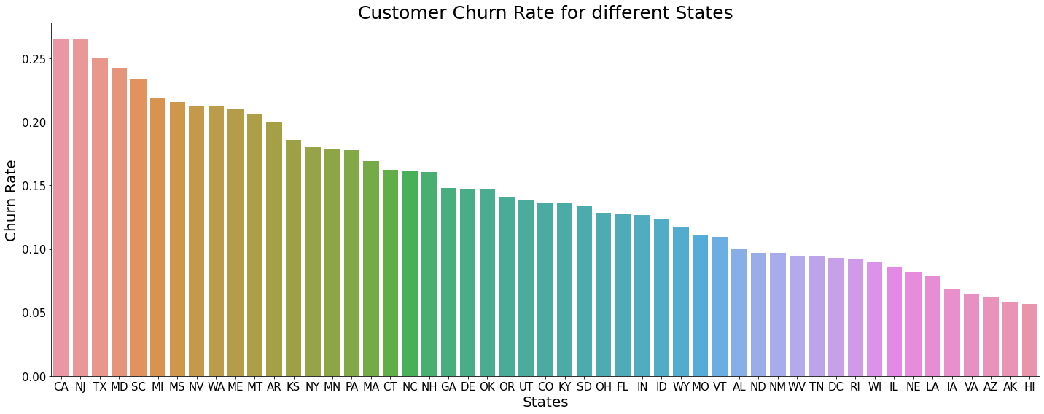
Suggestion based on state
The company needs to pay more attention on customers from AZ, AK and HI states

