Slide 1
Image Classification with Deep Learning
Guofa Shou
Self-paced

Slide 2
Outline
Image Data
Image classification via multiple models
Conclusion

Slide 3
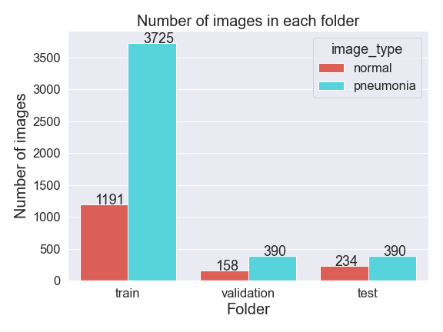
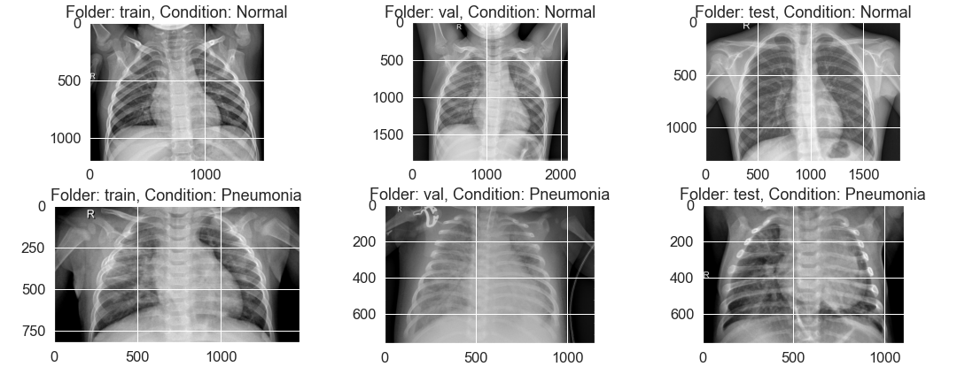
Image Data
Data Source
https://www.kaggle.com/datasets/paultimothymooney/chest-xray-pneumonia
Data Summary
Image Examples

Slide 4
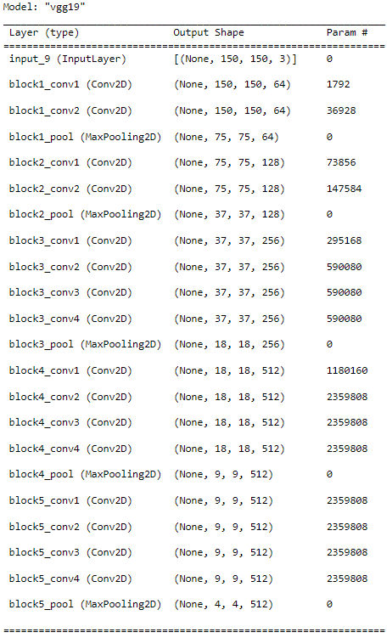
Image Classification via Multiple Models
VGG19 model
Multiple Models
Dense model (dense)
Conventional neural network (CNN) model
Basic model (cnn)
With Data Augmentation (cnnda)
With Batch Normalization (cnnbn)
With Dropout (cnndo)
Pretrained model, i.e., VGG19
With the basic CNN model (cnnvgg0)
With a CNN model of more nodes (cnnvgg1)
With a new data augmentation (cnnvgg0da2 and cnnvgg1da2)

Slide 5
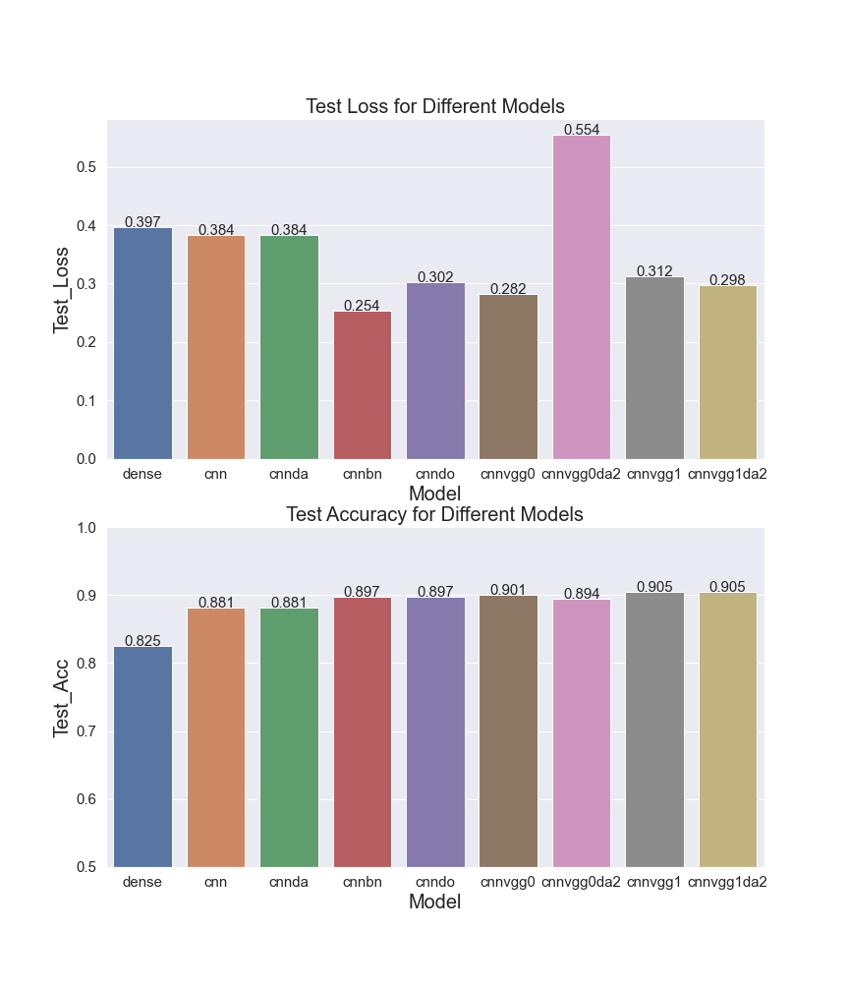
Model Comparisons
The basic dense model has accuracy above 80%
The deep learning models have increased accuracy above 88%
The deep learning models have similar performance

Slide 6
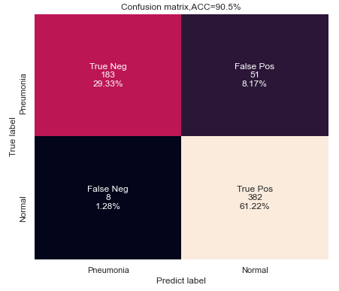
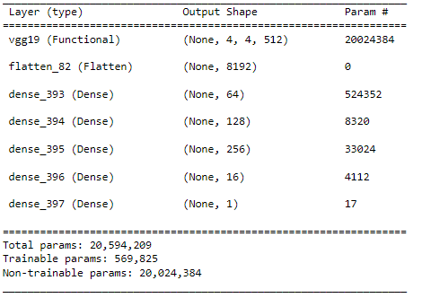
Final Model Results: CNNVGG1

Slide 7
Conclusion
The deep learning model could achieve a high classification accuracy above 90%
With more training data and further optimization of the model, much higher accuracy could be achieved

Slide 8
Thanks for your attention!

