Slide 1
Netflix Shows Recommendation System
Guofa Shou
Self-paced

Slide 2
Outline
Netflix shows dataset
Netflix shows recommendation system
Conclusion

Slide 3
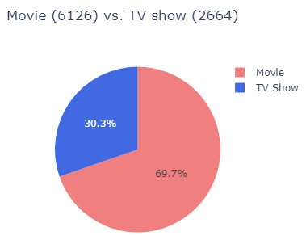
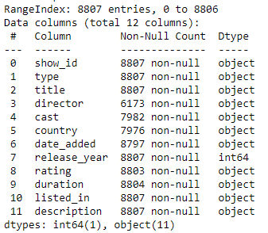
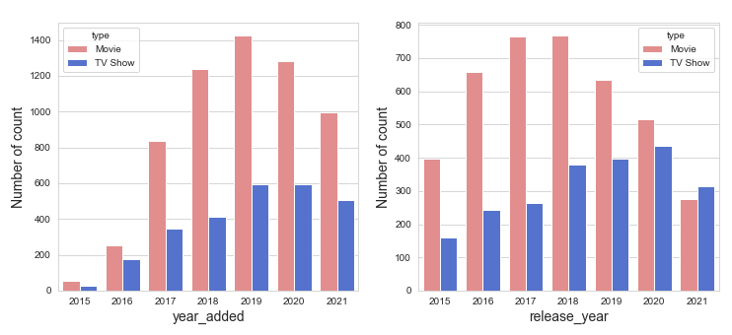
Netflix shows dataset
Data Source
https://www.kaggle.com/datasets/shivamb/netflix-shows
Data Exploration

Slide 4
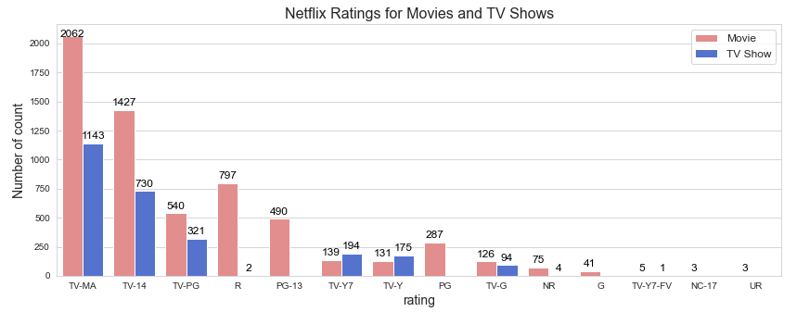
Data Exploration (cont.): ratings

Slide 5
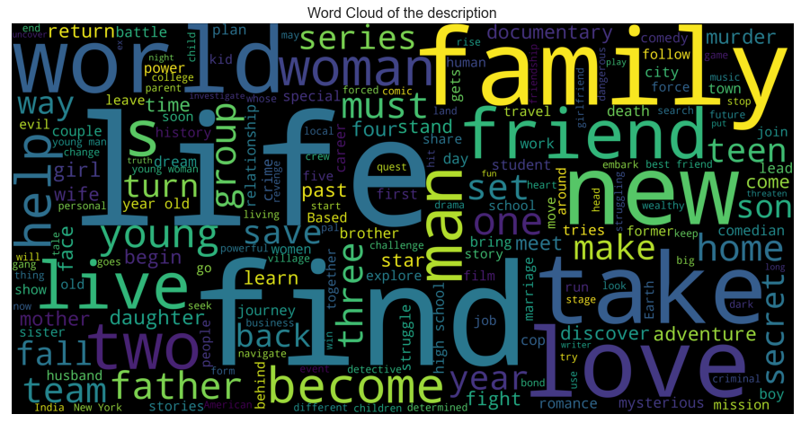
Data Exploration (cont.): description
The life, find, and family, have the top 3 occurrence

Slide 6
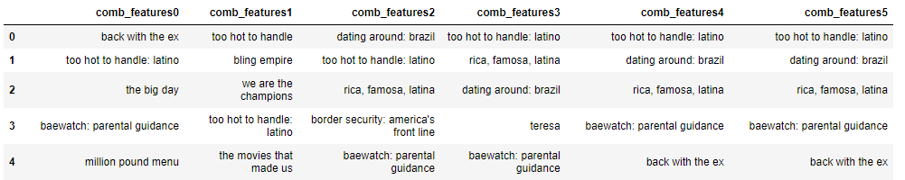
Netflix Recommendation System
A content-based recommendation system
Comparing five different combinations of features:
'comb_features0': ('director', 'cast', 'rating', 'listed_in'),
'comb_features1': ('director', 'cast', 'rating', 'description'),
'comb_features2': ('director', 'cast', 'listed_in', 'description'),
'comb_features3': ('director', 'rating', 'listed_in', 'description'),
'comb_features4': ('cast', 'rating', 'listed_in', 'description'),
'comb_features5': ('director', 'cast', 'rating', 'listed_in', 'description’)
An example to recommend titles for: too hot to handle: brazil

Slide 7
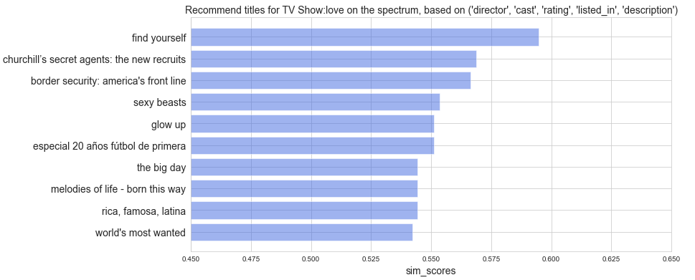
Representative example for a TV show based on com_feature5: 'director', 'cast', 'rating', 'listed_in', 'description’

Slide 8
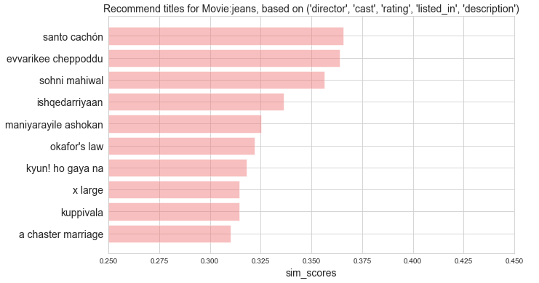
Representative example for a Movie based on com_feature5: 'director', 'cast', 'rating', 'listed_in', 'description’

Slide 9
Conclusion
A content-based recommendation system based on the input title was successfully developed
It could suggest existed titles if the input title is not existed
The recommended titles are usually in the same type of the input title

Slide 10
Thanks for your attention!

