Slide 1
Netflix Shows Recommendation System
Guofa Shou
Self-paced

Slide 2
Outline
Netflix shows dataset
Netflix shows recommendation system
Data exploration of representative features
Content-based recommendation system
Conclusion & future work

Slide 3
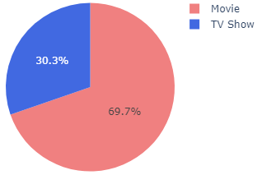
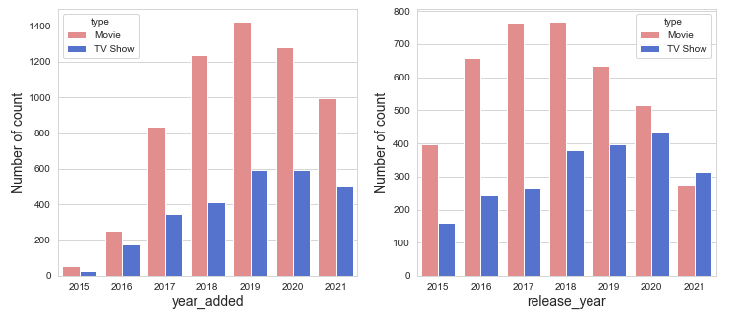
Netflix shows dataset
Dataset
Source: Kaggle.com
Summary
8807 shows & 12 features:
Director, cast, rating, listed_in, description, …
More movies (6126) than TV shows (2664)

Slide 4
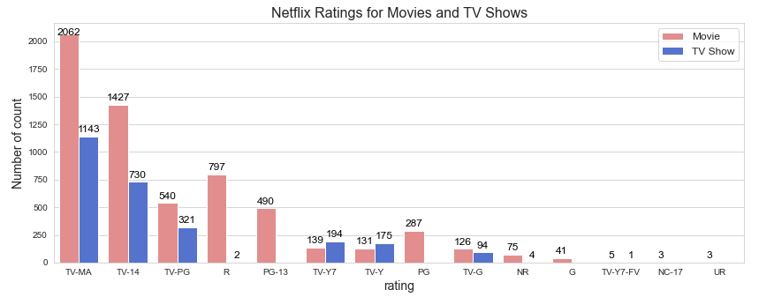
Netflix shows recommendation
Data exploration of representative feature I: ratings

Slide 5
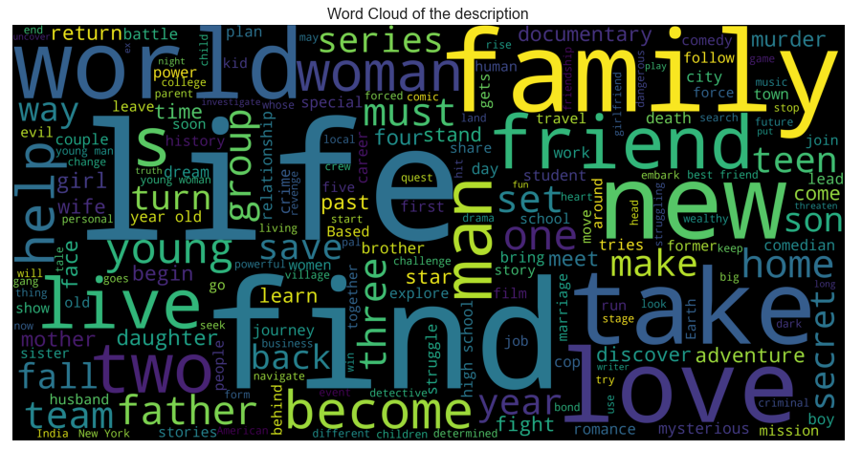
Netflix shows recommendation
Data exploration of representative feature II: description

Slide 6
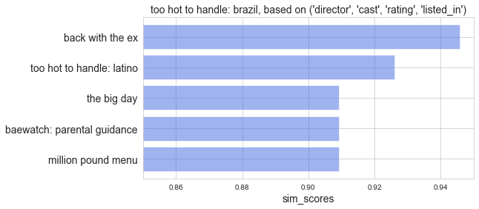
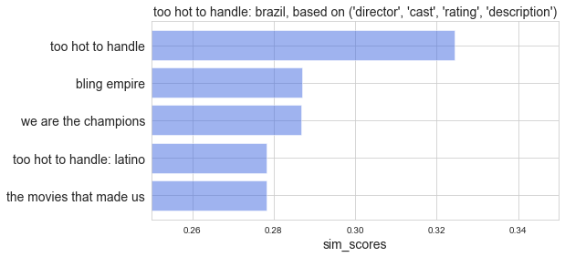
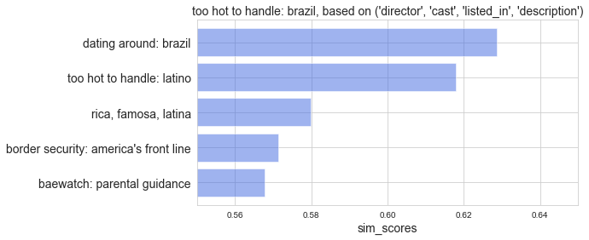
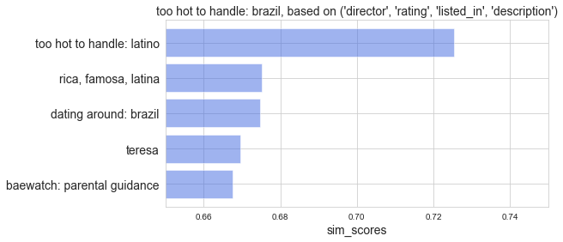
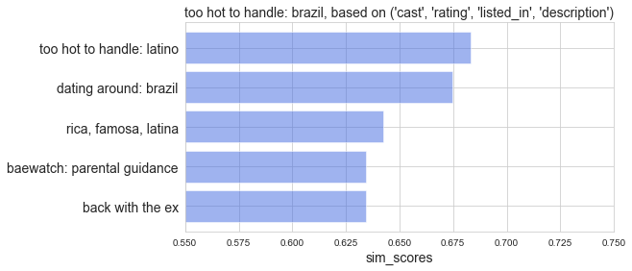
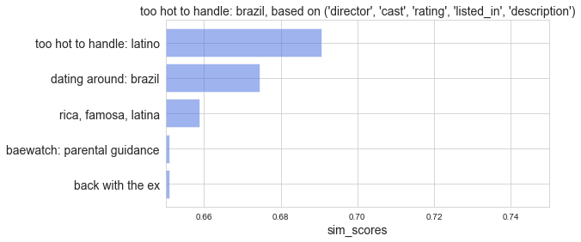
Netflix shows recommendation
Content-based recommendation system
Recommended shows: comparisons of six different combinations of features from director, cast, rating, listed_in, description
'too hot to handle: brazil'

Slide 7
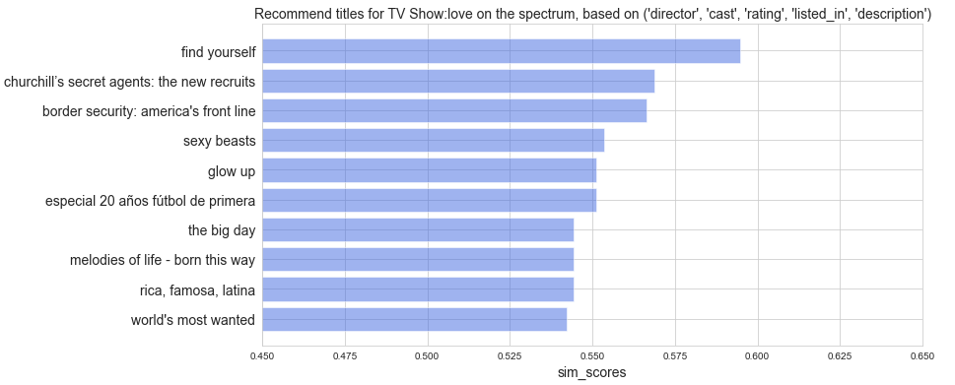
Netflix shows recommendation
Content-based recommendation system
Representative example for a TV show based on combined features of director, cast, rating, listed_in, description
similarity

Slide 8
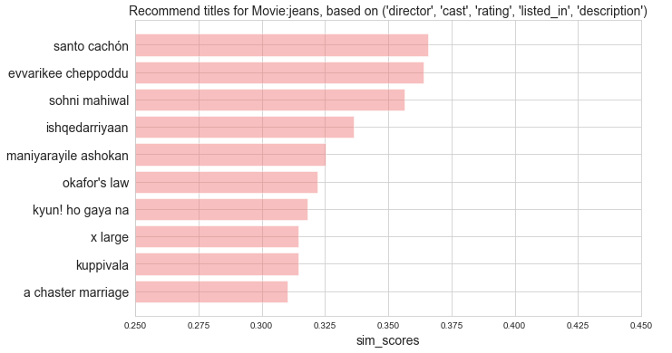
Netflix shows recommendation
Content-based recommendation system
Representative example for a movie based on combined features of director, cast, rating, listed_in, description
similarity

Slide 9
Conclusion & future work
A content-based recommendation system was successfully developed
It could suggest existed related shows if the input show is not existed
It could suggest different numbers of shows in the rank of similarity
Future work
With the accumulated records of user selection of shows, a collaborative filtering recommendation system could be further developed with better recommendation

Slide 10
Thanks for your attention!

