Slide 1
Netflix Shows Recommendation System
Guofa Shou
Self-paced

Slide 2
Outline
Netflix shows dataset
Netflix shows recommendation system
Data exploration of individual features
Content-based recommendation system
Conclusion & future work

Slide 3
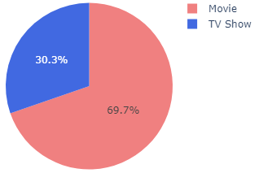
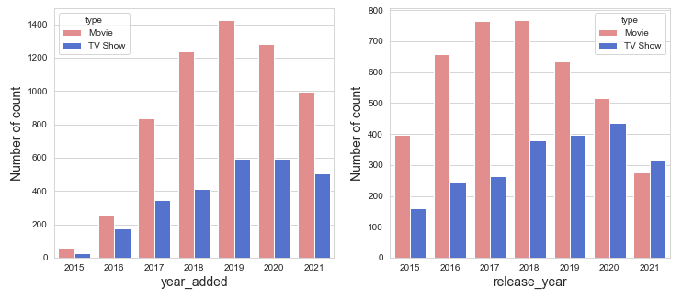
Netflix shows dataset
Data Source
Downloaded from Kaggle.com
Data Summary
8807 records of shows
Related features for recommendation:
Director, cast, rating, listed_in, description, …
More movies (6126) than TV shows (2664)

Slide 4
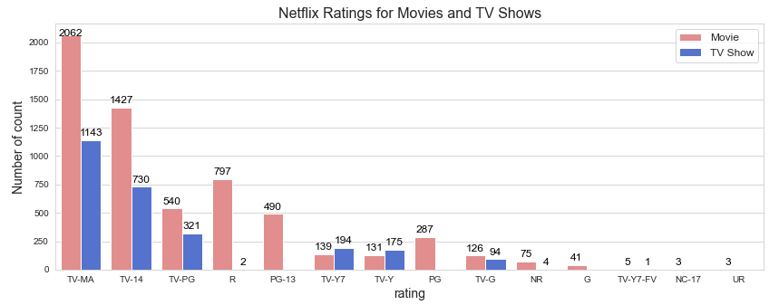
Netflix shows recommendation
Data Exploration of related features: ratings

Slide 5
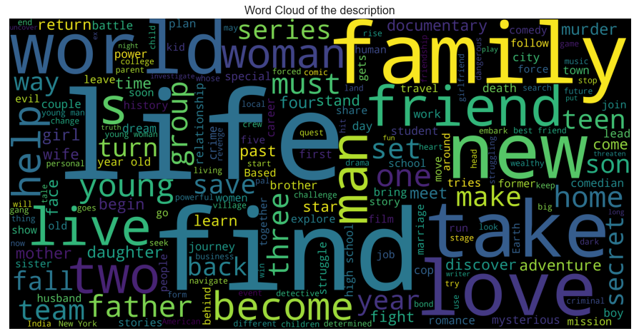
Netflix shows recommendation
Data Exploration of related features (cont.): description

Slide 6
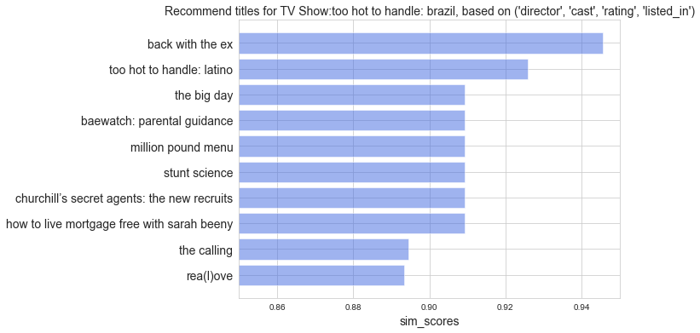
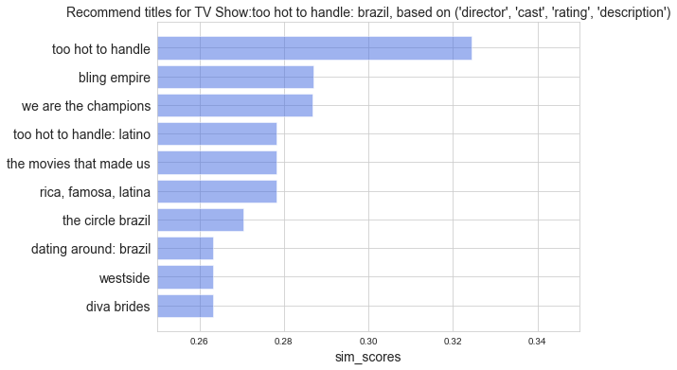
Netflix shows recommendation
Content-based recommendation system
Recommended items for six different combinations of features: Director, cast, rating, listed_in, description

Slide 7
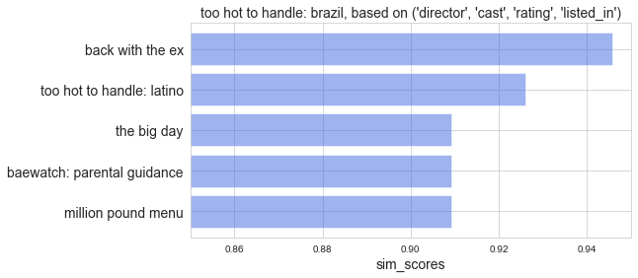
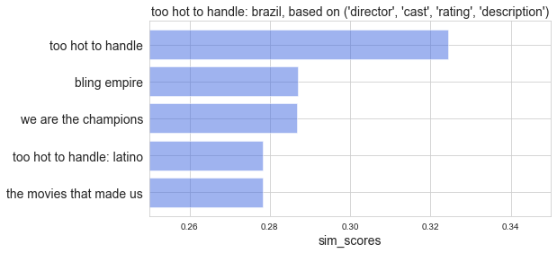
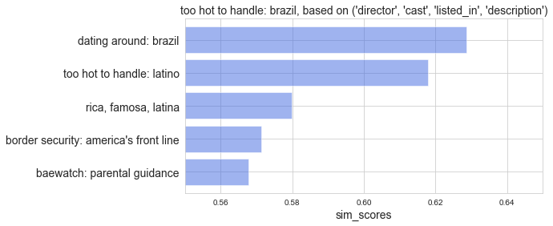
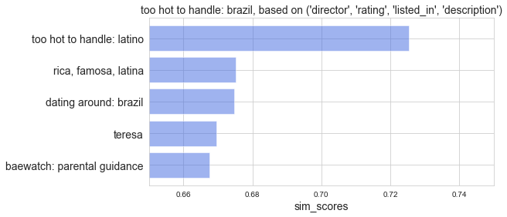
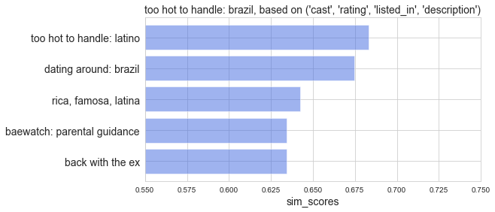
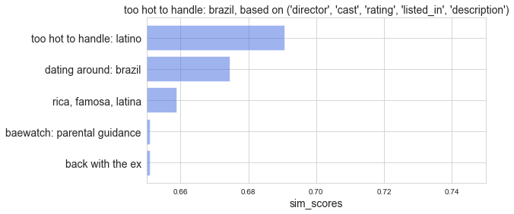
Netflix shows recommendation
Content-based recommendation system
Recommended items for six different combinations of features: Director, cast, rating, listed_in, description
'too hot to handle: brazil'

Slide 8
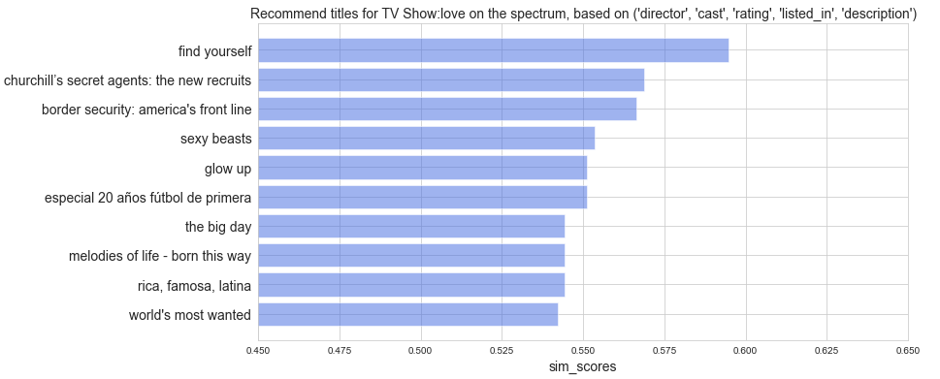
Netflix shows recommendation
Content-based recommendation system
Representative example for a TV show based on features: Director, cast, rating, listed_in, description
similarity

Slide 9
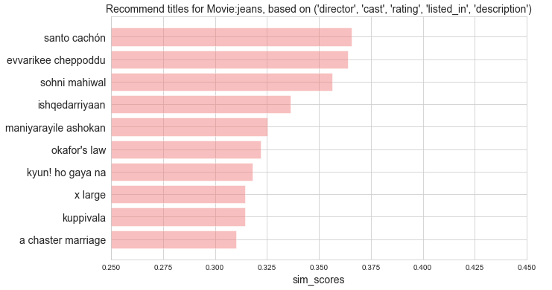
Netflix shows recommendation
Content-based recommendation system
Representative example for a movie based on features: Director, cast, rating, listed_in, description
similarity

Slide 10
Conclusion & future work
A content-based recommendation system was successfully developed
It could suggest existed titles if the input title is not existed
It could suggest different numbers of titles in the rank of similarity
Future work
With the accumulated records of user selection of shows, a collaborative filtering recommendation system could be developed with more accuracy

Slide 11
Thanks for your attention!

