Slide 1

Spin-dependent electronic structure of InAs/GaAs quantum dots
Lau Wei Cheng A0096732X
Engineering Science Programme
Supervisor: Asst. Prof. Yang Hyun Soo
Mentor: Mehrdad Elyasi

Slide 2
Scope
Introduction of QDs
Strain
Piezoelectricity
Electronic Structure

Slide 3
Quantum dot (QD)?
Artificial Atoms
Confine carriers
Discrete energy level
Improves optical and electronic properties
10~40 nm base length
Aspect ratio of about 1:3
Notes:
Short intro

Slide 4
Applications
QDs as qubits : Spin has long coherence time
E. Stinaff, "Optical Signatures of Coupled Quantum Dots", Science, vol. 311, no. 5761, pp. 636-639, 2006.
M. Eriksson, S. Coppersmith and M. Lagally, "Semiconductor quantum dot qubits", MRS Bull., vol. 38, no. 10, pp. 794-801, 2013.
QD laser diodes
M. Thompson, A. Rae, Mo Xia, R. Penty and I. White, "InGaAs Quantum-Dot Mode-Locked Laser Diodes", IEEE J. Select. Topics Quantum Electron., vol. 15, no. 3, pp. 661-672, 2009
Notes:
Optoelectronics, Photonics, Quantum Information Processing Secure communication etc

Slide 5
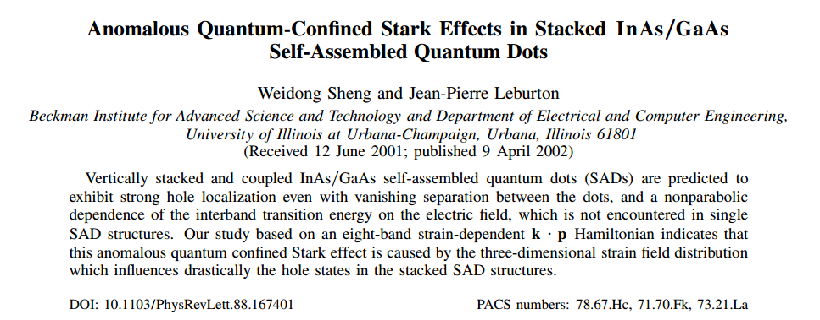
Strain dependent field
Weidong Sheng and Jean-Pierre Leburton (2002)
Notes:
Same as 4

Slide 6
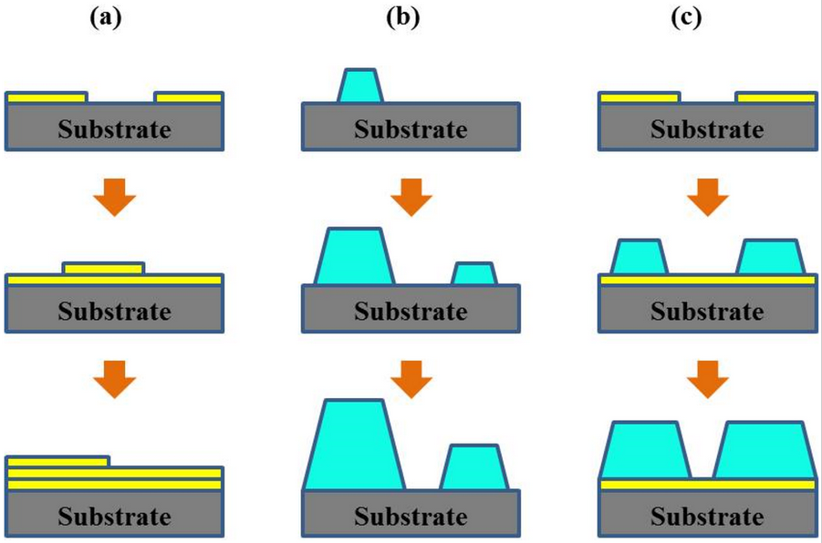
Molecular Beam Epitaxy for thin films
Three different growth modes: (a) Layer or Franck-van der Merwe growth mode; (b) Island or Vollmer-Weber growth mode; (c) Layer plus island or Stranski-Krastanov growth mode
Y. Wang, W. Chen, B. Wang and Y. Zheng, 2014
Notes:
Different growth modes

Slide 7
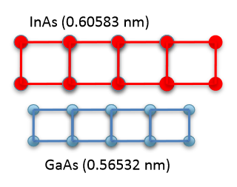
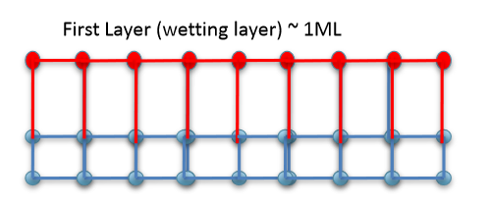
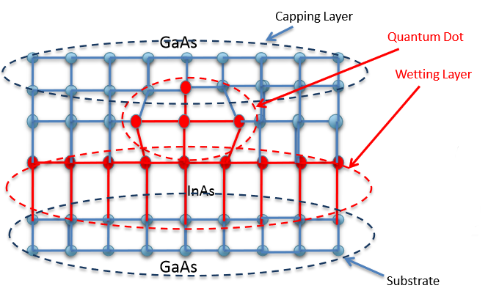
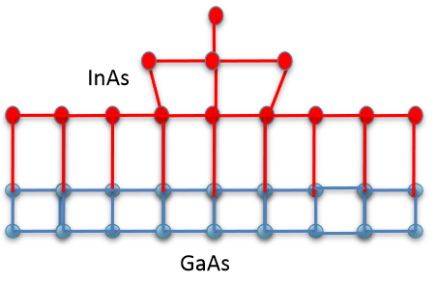
SK-Growth
Muhammad Usman, 2011
Notes:
Assembly due to strain

Slide 8
SK-Growth
Quantum dot by SK-growth (Muhammad Usman, 2011)

Slide 9
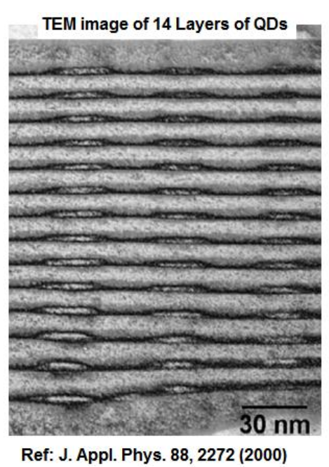
Stacked QDs
Strain field
Shape, Size, Position
Application in solar cells

Slide 10
Field dependent effects in Stacked quantum dots
Till Audlauer and Peter Vogl (2009)
“we predict a giant electrically tunable anisotropy of hole g factors that is introduced by piezoelectric charges. This effect allows bias controlled g factor switching and single-spin manipulations in a static magnetic field.”
“distinctive electrically tuned resonances have been discovered in recent experiments for the exciton g factors in vertically stacked quantum dot molecules”

Slide 11
Motivation
Numerical calculation of strain and electronic structure is widely quoted but not well documented.
Develop algorithm in MATLAB that allows modelling and understanding of the quantum dots
Understand spin dependence of electronic structure in Stacked quantum dots

Slide 12
Goals
Strain tensor
Piezoelectric potential
Electronic Structure

Slide 13
Strain
Continuum elasticity theory
Finite Difference Method
Generalized Newton Raphson Method

Slide 14
Continuum Elasticity Theory
displacement
strain
(1)
(2)
(3)

Slide 15
Finite Difference Method
(4)
Central Difference
Forward Difference
(5)
(6)

Slide 16
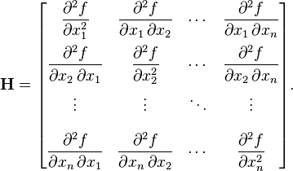

Generalized Newton-Raphson Method
(7)
$$∆ε=−{\left(H\right.}^{−1})∇E$$
(8)

Slide 17


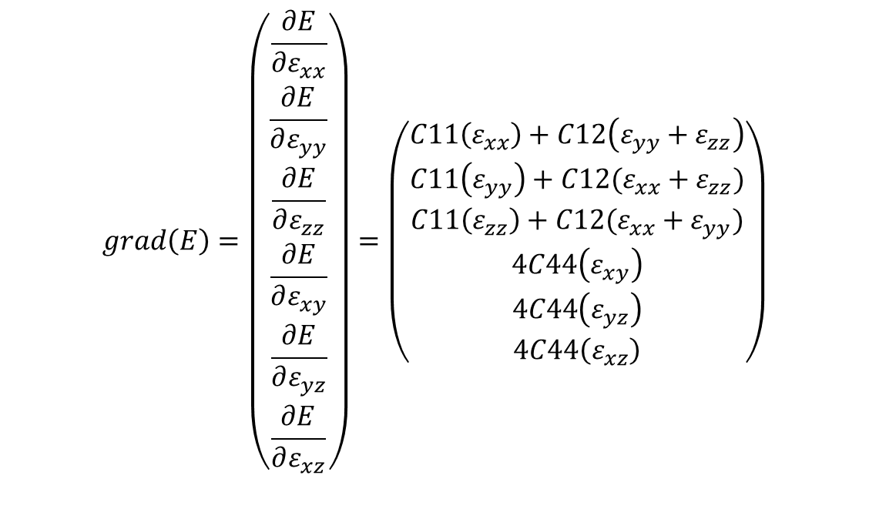
Generalized Newton-Raphson Method
$$grad\left(E\right)=\left(\begin{matrix}\frac{∂E}{∂ε_{xx}} \\ \frac{∂E}{∂ε_{yy}} \\ \begin{matrix}\frac{∂E}{∂ε_{zz}} \\ \frac{∂E}{∂ε_{xy}} \\ \begin{matrix}\frac{∂E}{∂ε_{yz}} \\ \frac{∂E}{∂ε_{xz}}\end{matrix}\end{matrix}\end{matrix}\right)=\left(\begin{matrix}C11\left(ε_{xx}\right)+C12\left(ε_{yy}+ε_{zz}\right) \\ C11\left(ε_{yy}\right)+C12(ε_{xx}+ε_{zz}) \\ \begin{matrix}C11\left(ε_{zz}\right)+C12(ε_{xx}+ε_{yy}) \\ 4C44\left(ε_{xy}\right) \\ \begin{matrix}4C44\left(ε_{yz}\right) \\ 4C44\left(ε_{xz}\right)\end{matrix}\end{matrix}\end{matrix}\right)$$
(9)
$$H\left(E\right)=\left(\begin{aligned}&C11 \\ &C12 \\ &C12 \\ &0 \\ &0 \\ &0\end{aligned} \begin{aligned}&C12 \\ &C11 \\ &C12 \\ &0 \\ &0 \\ &0\end{aligned} \begin{aligned}&C12 \\ &C12 \\ &C11 \\ &0 \\ &0 \\ &0\end{aligned}\begin{aligned}&0 \\ &0 \\ &0 \\ &4C44 \\ &0 \\ &0\end{aligned} \begin{aligned}&0 \\ &0 \\ &0 \\ &0 \\ &4C44 \\ &0\end{aligned} \begin{aligned}&0 \\ &0 \\ &0 \\ &0 \\ &0 \\ &4C44\end{aligned}\right)$$
(10)
$$∆ε=−{\left(H\right.}^{−1})∇E$$

Slide 18
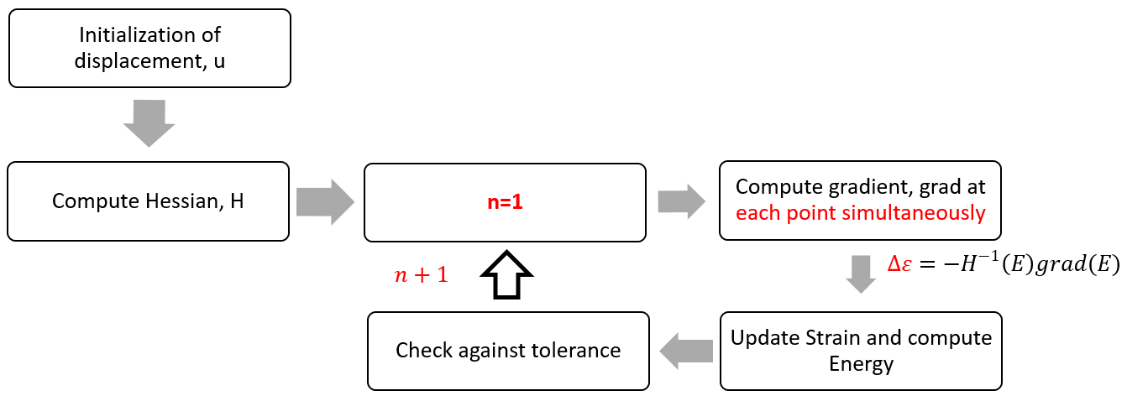
Algorithm

Slide 19
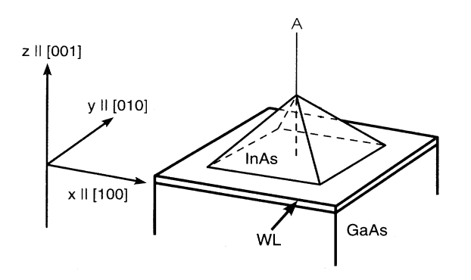
Simulation Domain
40X40X40
0.25 nm step size
height=6 nm
Base=12 nm

Slide 20
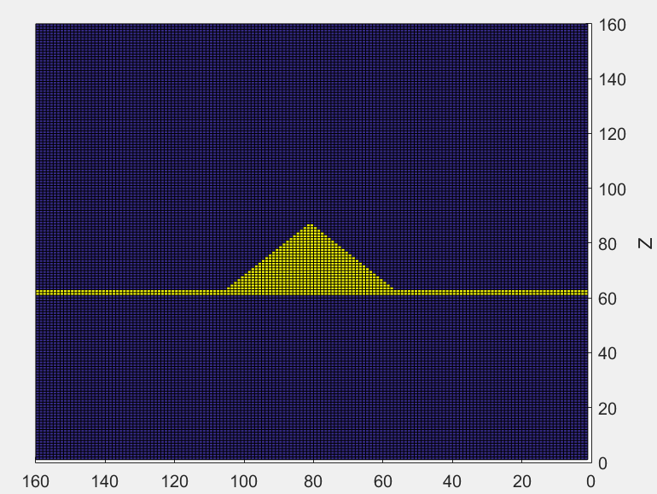
Simulation Domain (X-Z plane)
24.5
6
0.5
12
15
X

Slide 21
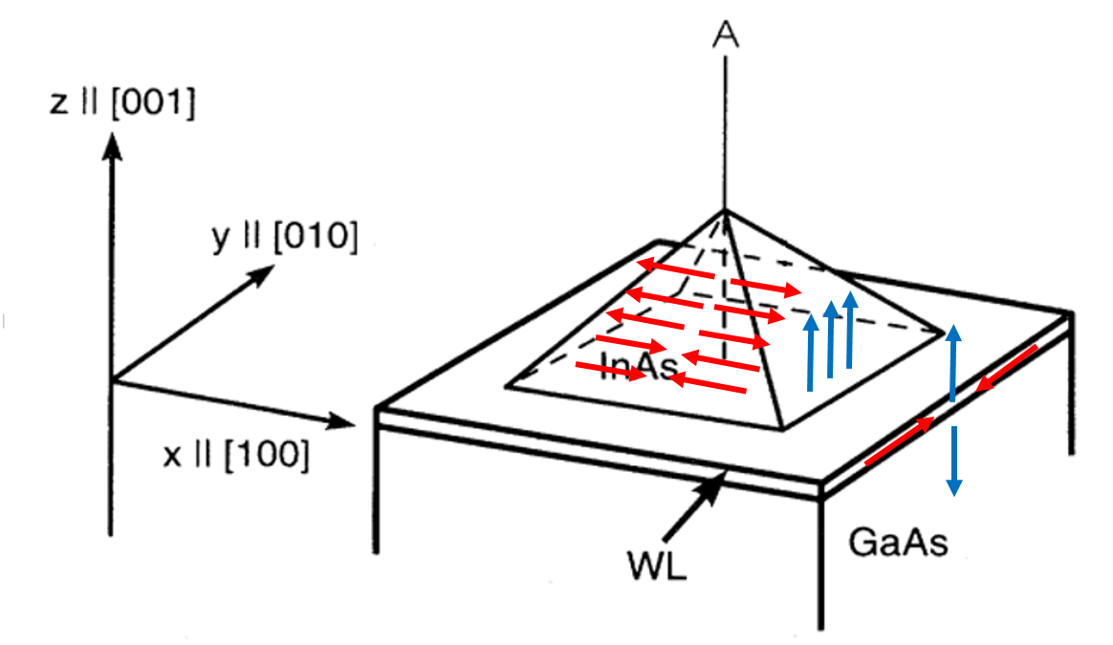
Initial conditions
Red arrow: in-plane displacement
Blue arrow: Displacement in z

Slide 22
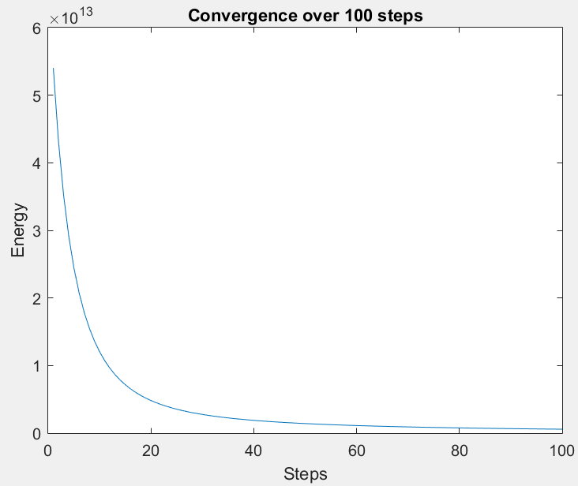
Results
Convergence of energy over n=100

Slide 23
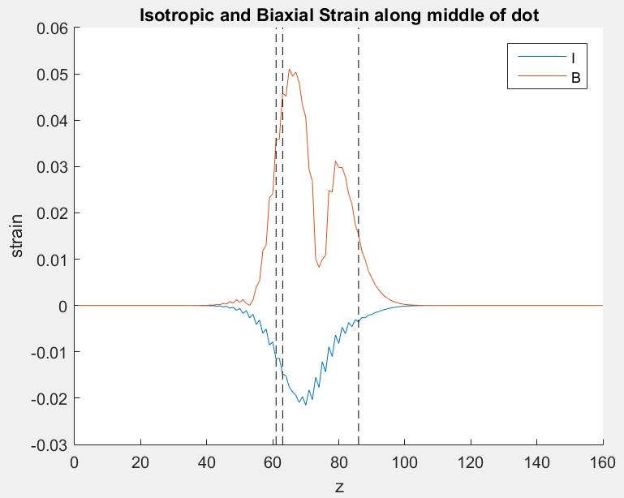
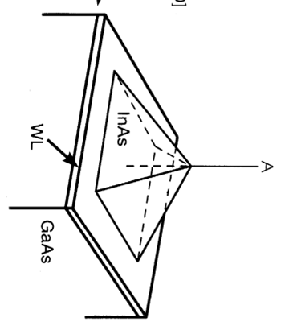
Isotropic and Biaxial Strain

Slide 24
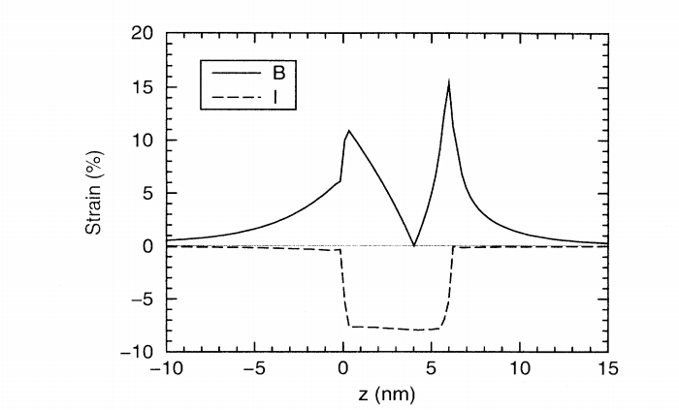
Grundmann et al. (1995)
Isotropic strain confined within dot
Biaxial strain extends into substrate
Similar shape but some inaccuracy

Slide 25
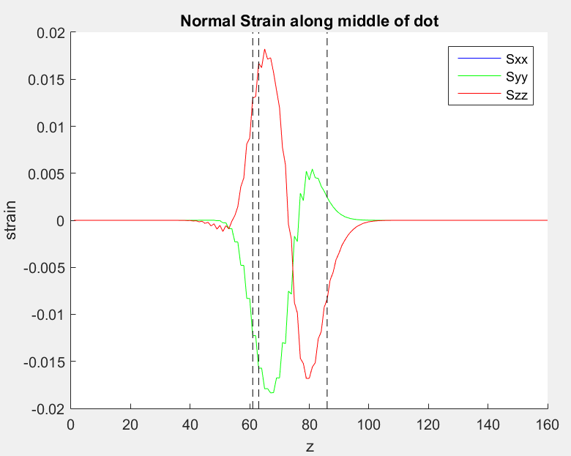
Normal strain ε_{ii}

Slide 26
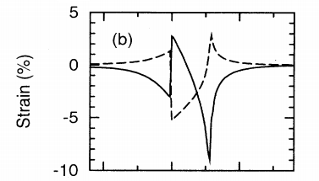
Grundmann et al. (1995)
Sharp change in strain at the surface of wetting layer
Again very similar shape

Slide 27
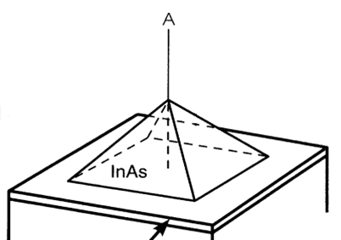
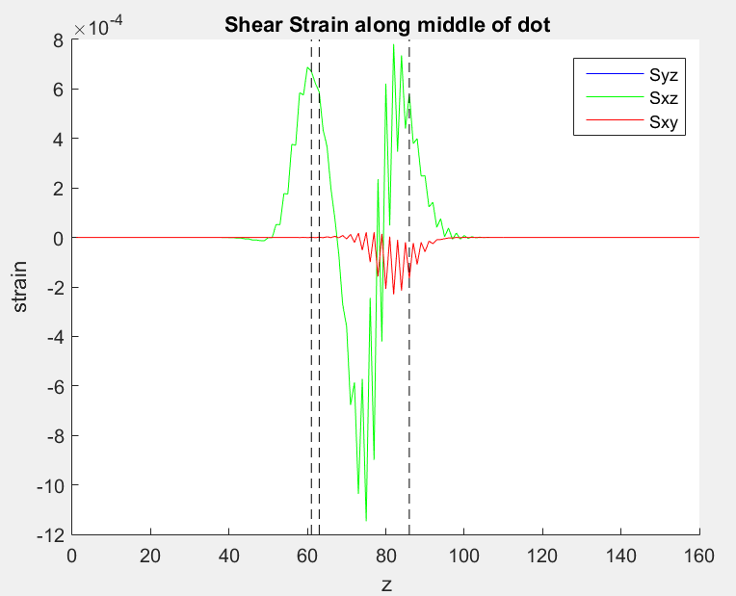
Shear strain
Notes:
Strain gives clue on why shape is truncated pyramid or dome

Slide 28
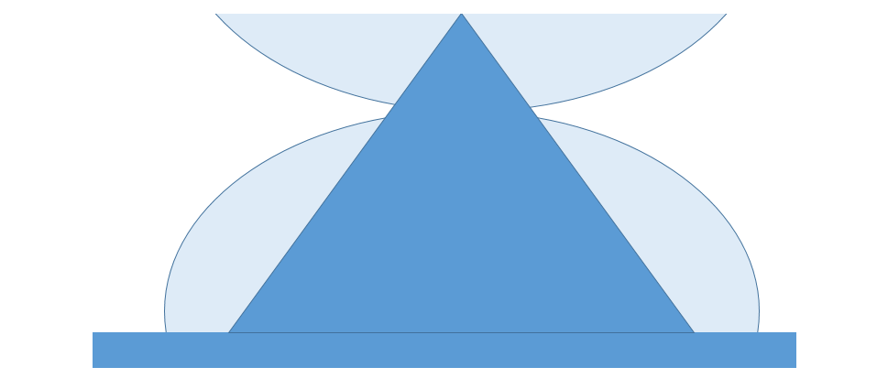
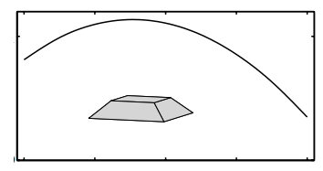
Dome/Truncated pyramid
QD stack
Weidong Sheng, Jean Pierre Leburton (2002)
Notes:
Illustration from previous slides

Slide 29
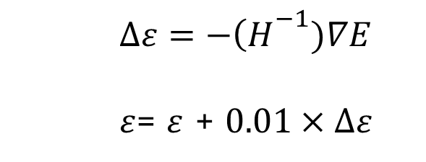
Important adjustments
Initial displacement
Factor to reduce oscillatory behaviour
$∆ε=−{\left(H\right.}^{−1})∇E$
$ε$= $ε$ + $0.01×∆ε$
Notes:
Some important adjustments that improved accuracy

Slide 30
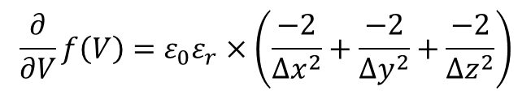

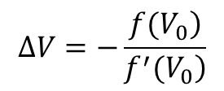

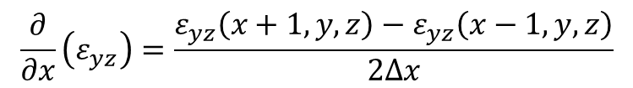
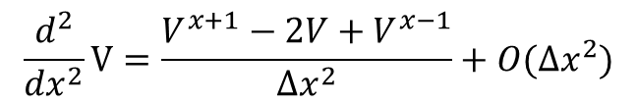

Potential Formulation
$$ρ=−∇∙e_{14}\left(\begin{matrix}ε_{yz} \\ ε_{xz} \\ ε_{xy}\end{matrix}\right)$$
1
$$ε_{0}∇∙\left(ε_{r}∇V\right)=ρ$$
(1.1)
(1.2)
$$\frac{∂}{∂x}\left(ε_{yz}\right)=\frac{ε_{yz}\left(x+1,y,z\right)−ε_{yz}\left(x−1,y,z\right)}{2∆x}$$
(1.3)
2
$$f\left(r\right)=ε_{0}ε_{r}∇^{2}V(r)−ρ=0$$
(2.1)
$$\frac{d^{2}}{dx^{2}}V=\frac{V^{x+1}−2V+V^{x−1}}{{∆x}^{2}}+O({∆x}^{2})$$
(2.2)
$$∆V=−\frac{\left.f(V_{0}\right)}{\left.f^{′}(V_{0}\right)}$$
3
(3.1)
$$\frac{∂}{∂V}f\left(V\right)=ε_{0}ε_{r}×\left(\frac{−2}{{∆x}^{2}}+\frac{−2}{{∆y}^{2}}+\frac{−2}{{∆z}^{2}}\right)$$
(3.2)

Slide 31
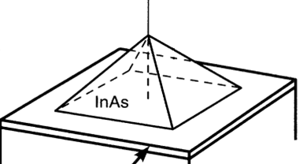
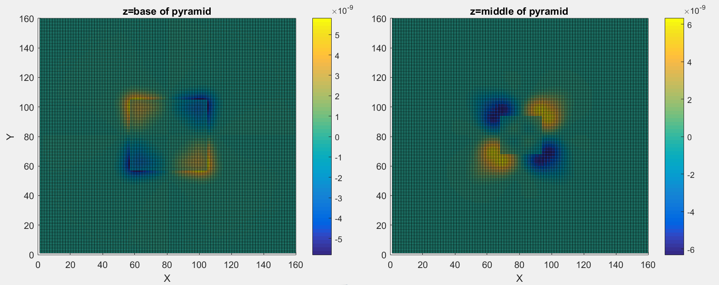
Results (X-Y plane)
Potential at base of pyramid
Potential at middle of pyramid
Alternating signs at each corner
Notes:
Concentrated at 4 corners, outside dot, alternating

Slide 32
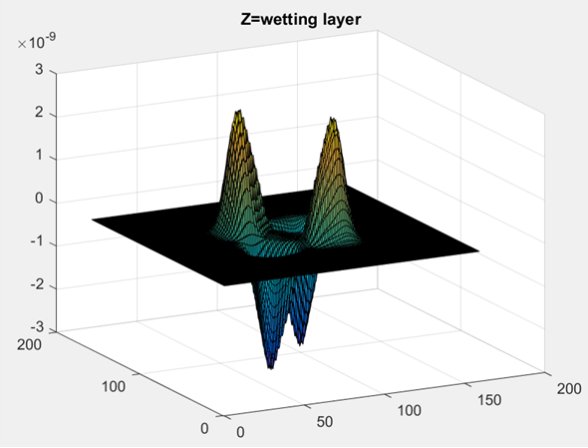
Results (X-Y plane)
y
x
Potential at base of pyramid
Notes:
Different view of previous slide

Slide 33
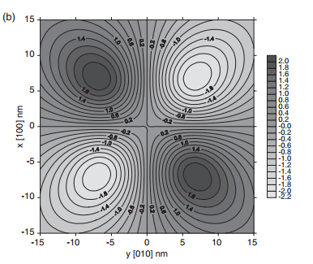
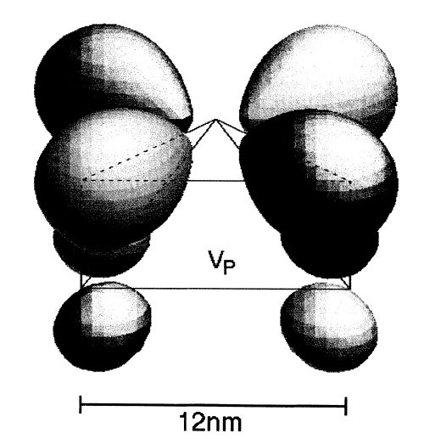
References (Potential)
Grundmann (1995)
R. Maranganti, P.Sharma (2005)
Notes:
Consistent with references

Slide 34
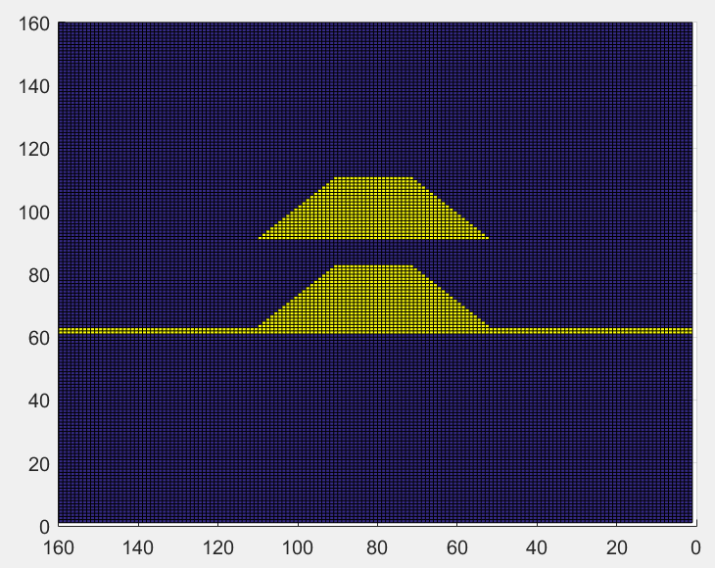
Application to Quantum dot molecule (QDM)
Upper width = 6nm
24.5
Distance, d
Height =6nm
0.5
Base = 12nm
15
Notes:
Vary d

Slide 35
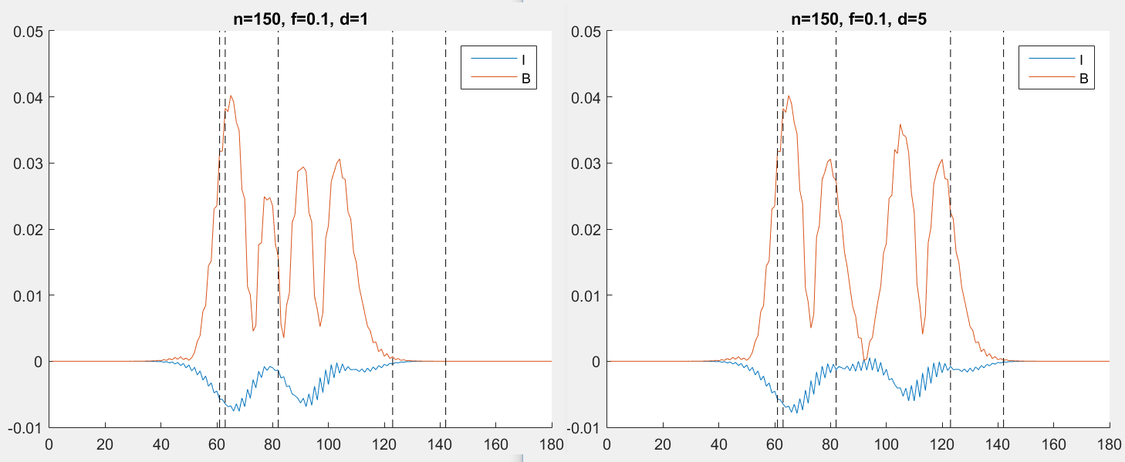
Isotropic and Biaxial strain in QDM
d=1
d=5
strain
strain
z
z
I and B strain in QDM with d=1nm (left) and d=5nm (right)
Notes:
Coupling at d=1: strain values differ and not symmetrical. D=5: symmetrical shape showing decoupling
Isotripic strain less negative for top dot -> larger size

Slide 36
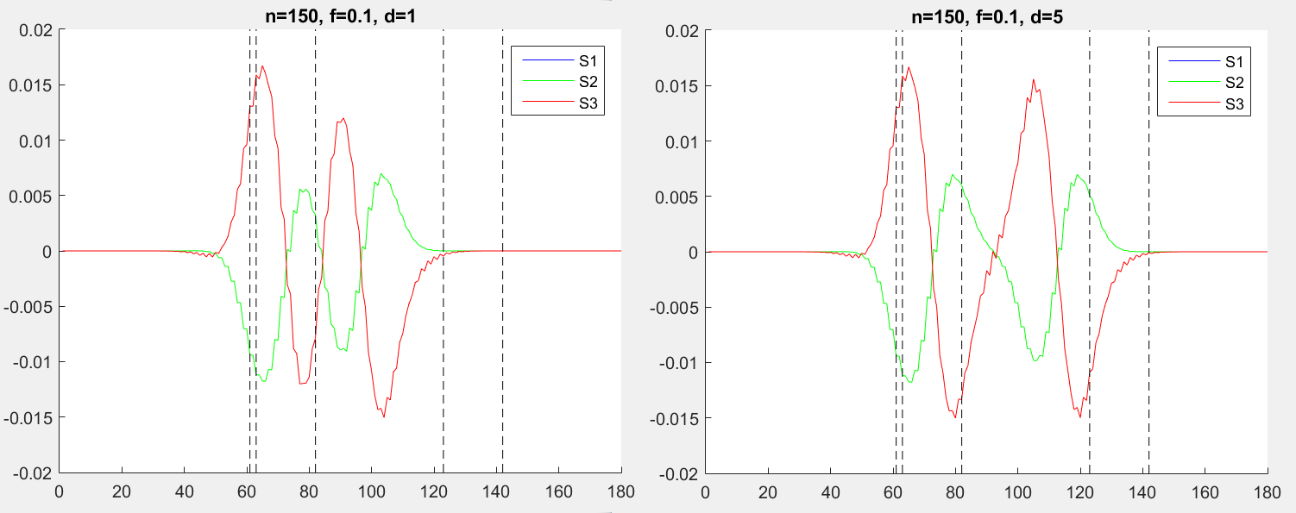
Normal strain in QDM
d=1
d=5
strain
strain
z
z
I and B strain in QDM with d=1nm (left) and d=5nm (right)

Slide 37
Observations
Difference in shape near boundary of each dots
Area with no strain in between dots
Coupling effect decreases at increasing distance

Slide 38
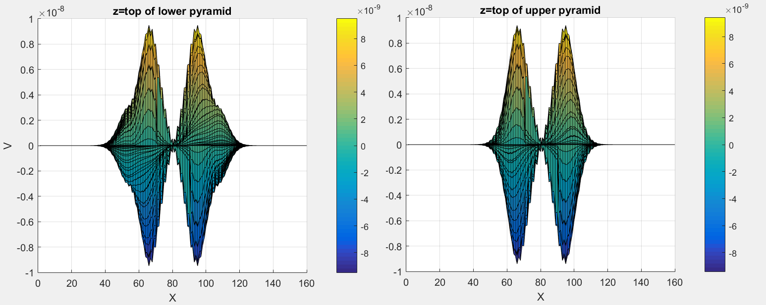
Potential in QDM
d=1
Potential [010] at the top of lower pyramid (left) and upper pyramid (right)
Again we notice the coupling effect
Notes:
Slight difference in potential. No analysis here

Slide 39
Electronic Structure
Till Andlauer, Peter Vogl (2009)
“We use a relativistic eight-band k·p envelope function method including strain, which accounts for magnetic fields in a gauge-invariant manner”
Nenad Vukmirovic et al. (2005)
“The method is based on exploiting the C₄ symmetry of the 8-band k· p Hamiltonian with the strain taken into account via the continuum mechanical model.”

Slide 40
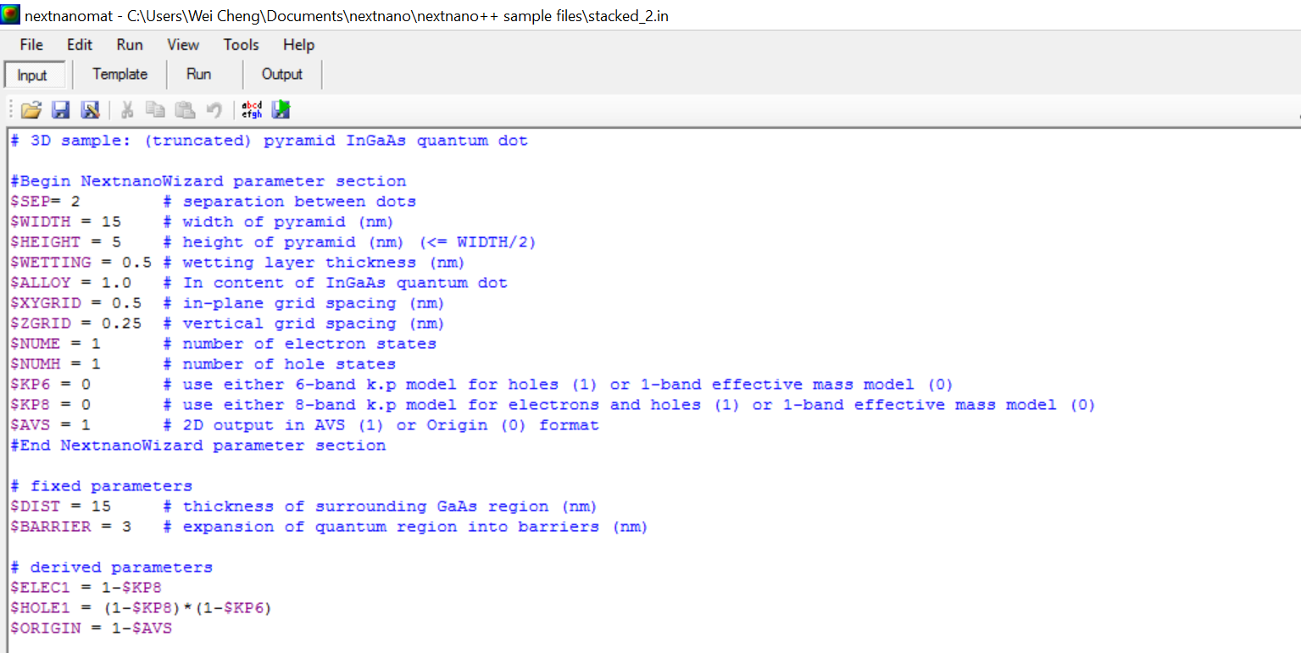
Nextnano (Stefan Biener)
UI of nextnano
Notes:
External program to check results

Slide 41
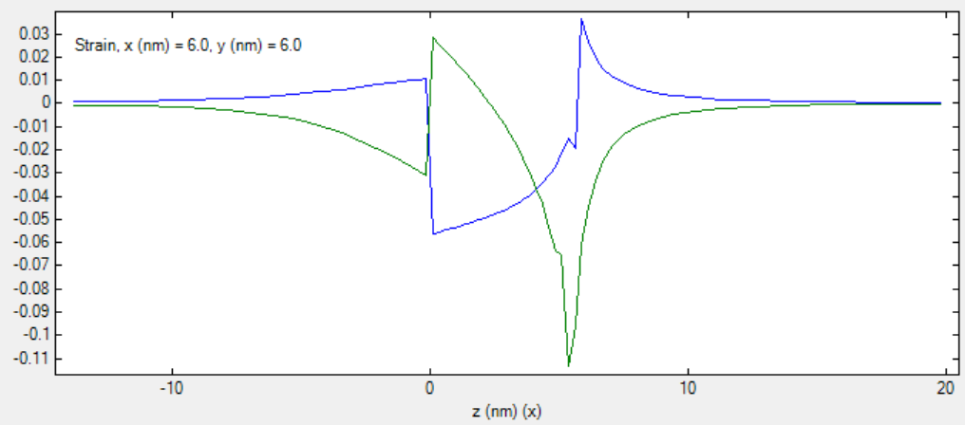
Results from Nextnano
Normal Strain. Green: ε_{zz} , Blue: ε_{xx} , ε_{yy}

Slide 42
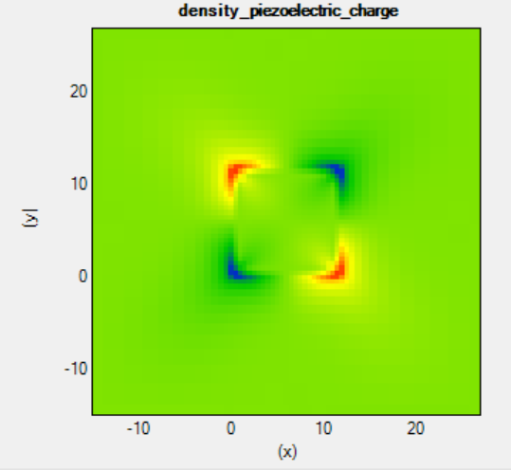
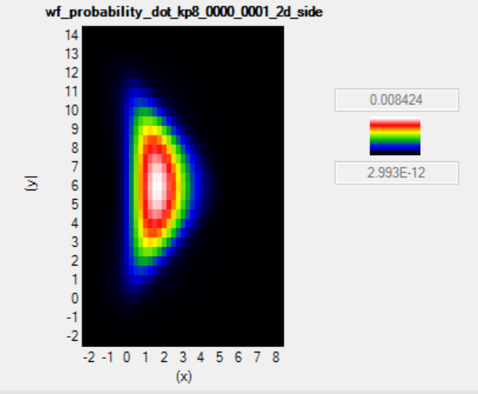
Results from Nextnano
Piezoelectric density (left) and wavefunction through the middle of the dot (right)

Slide 43
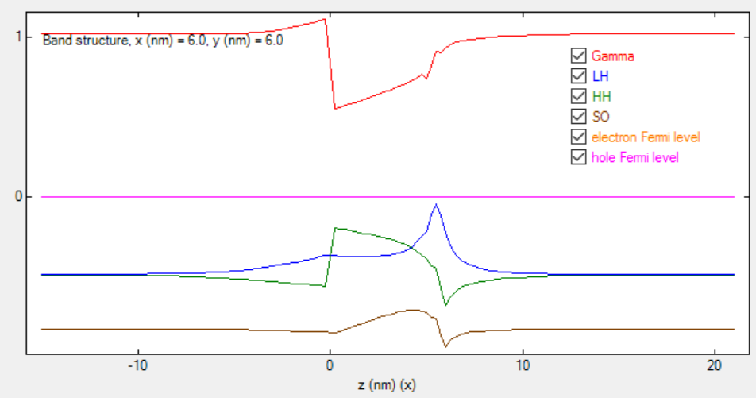
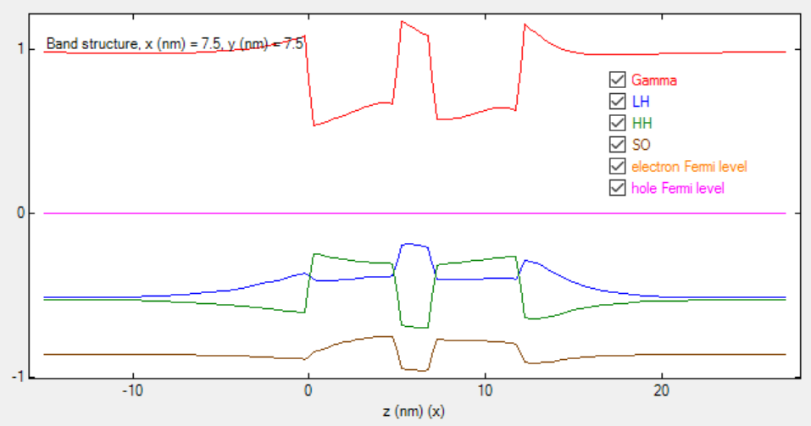
Band edges
Single dot
Stacked dots

Slide 44
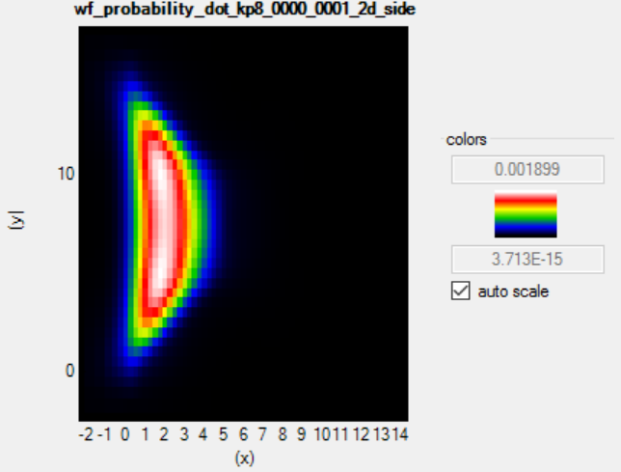
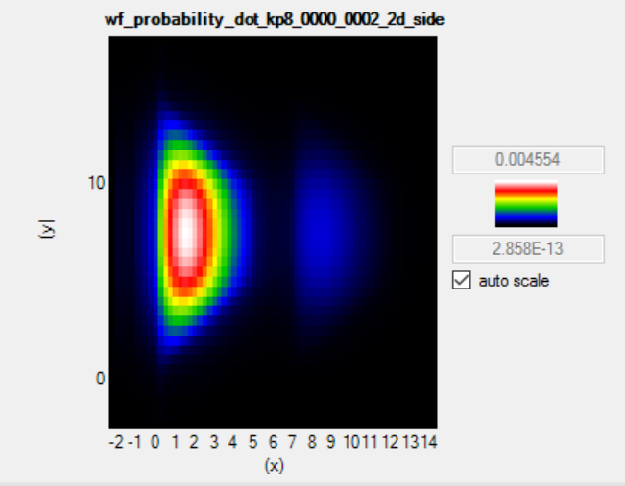
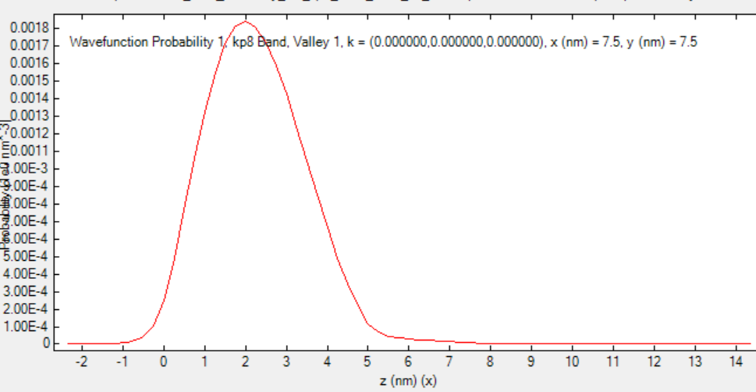
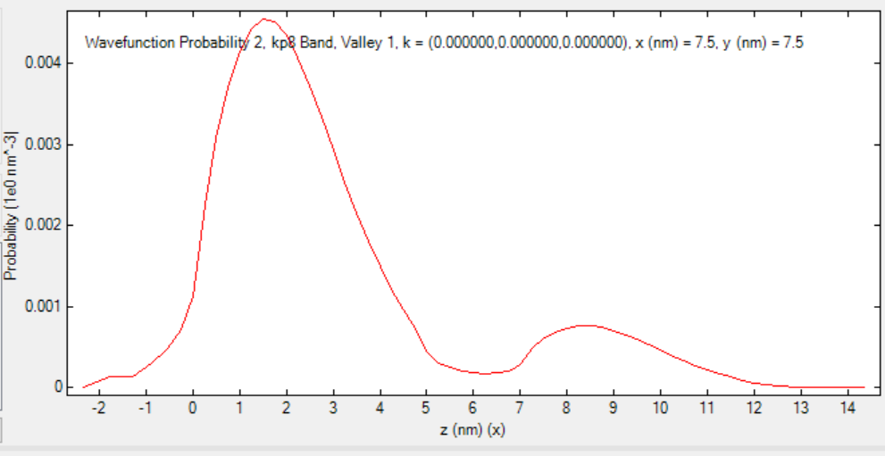
Wavefunction
Ground state of electron
Ground state of hole
Notes:
Difference in wave functions. Lack analysis

Slide 45
Conclusion
Quantum dots and their applications
Solving quantum dots by Newton Raphson method
Algorithm in MATLAB
K.P theory and eigen solver to calculate electronic structure in external field

