Slide 1
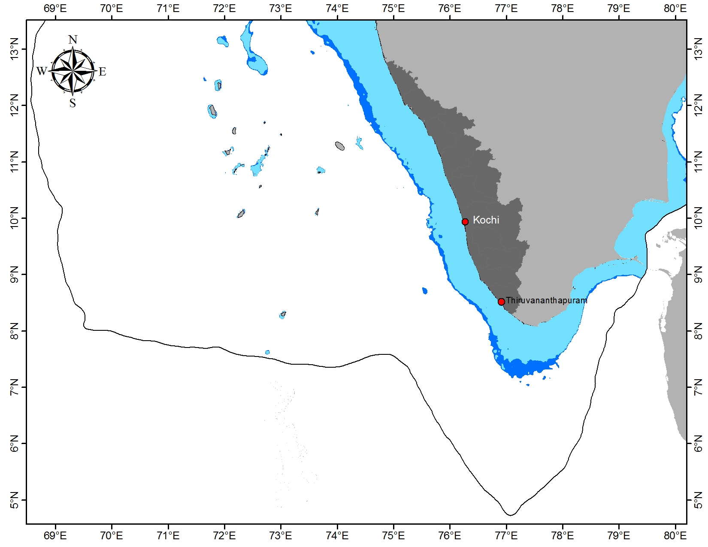
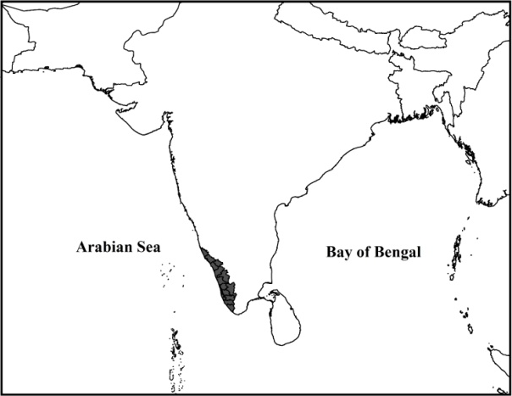
INDIA
KERA LA
adults +
adults +
early 0-year fish after spawning in spring
subadults
Lakshadweep Islands
Summer monsoon onset
(≈1st June) triggers
shoreward migration
100 m Bathymetry
200 m Bathymetry
Summer-Monsoon Inshore Migration
Winter-Monsoon Offshore Migration
Fall Expansion Northward with Phytoplankton Blooms

