Slide 1
Interactive Pick and Place
Hyojung Lee 이효정
Department of Artificial Intelligence, Korea University

Slide 2
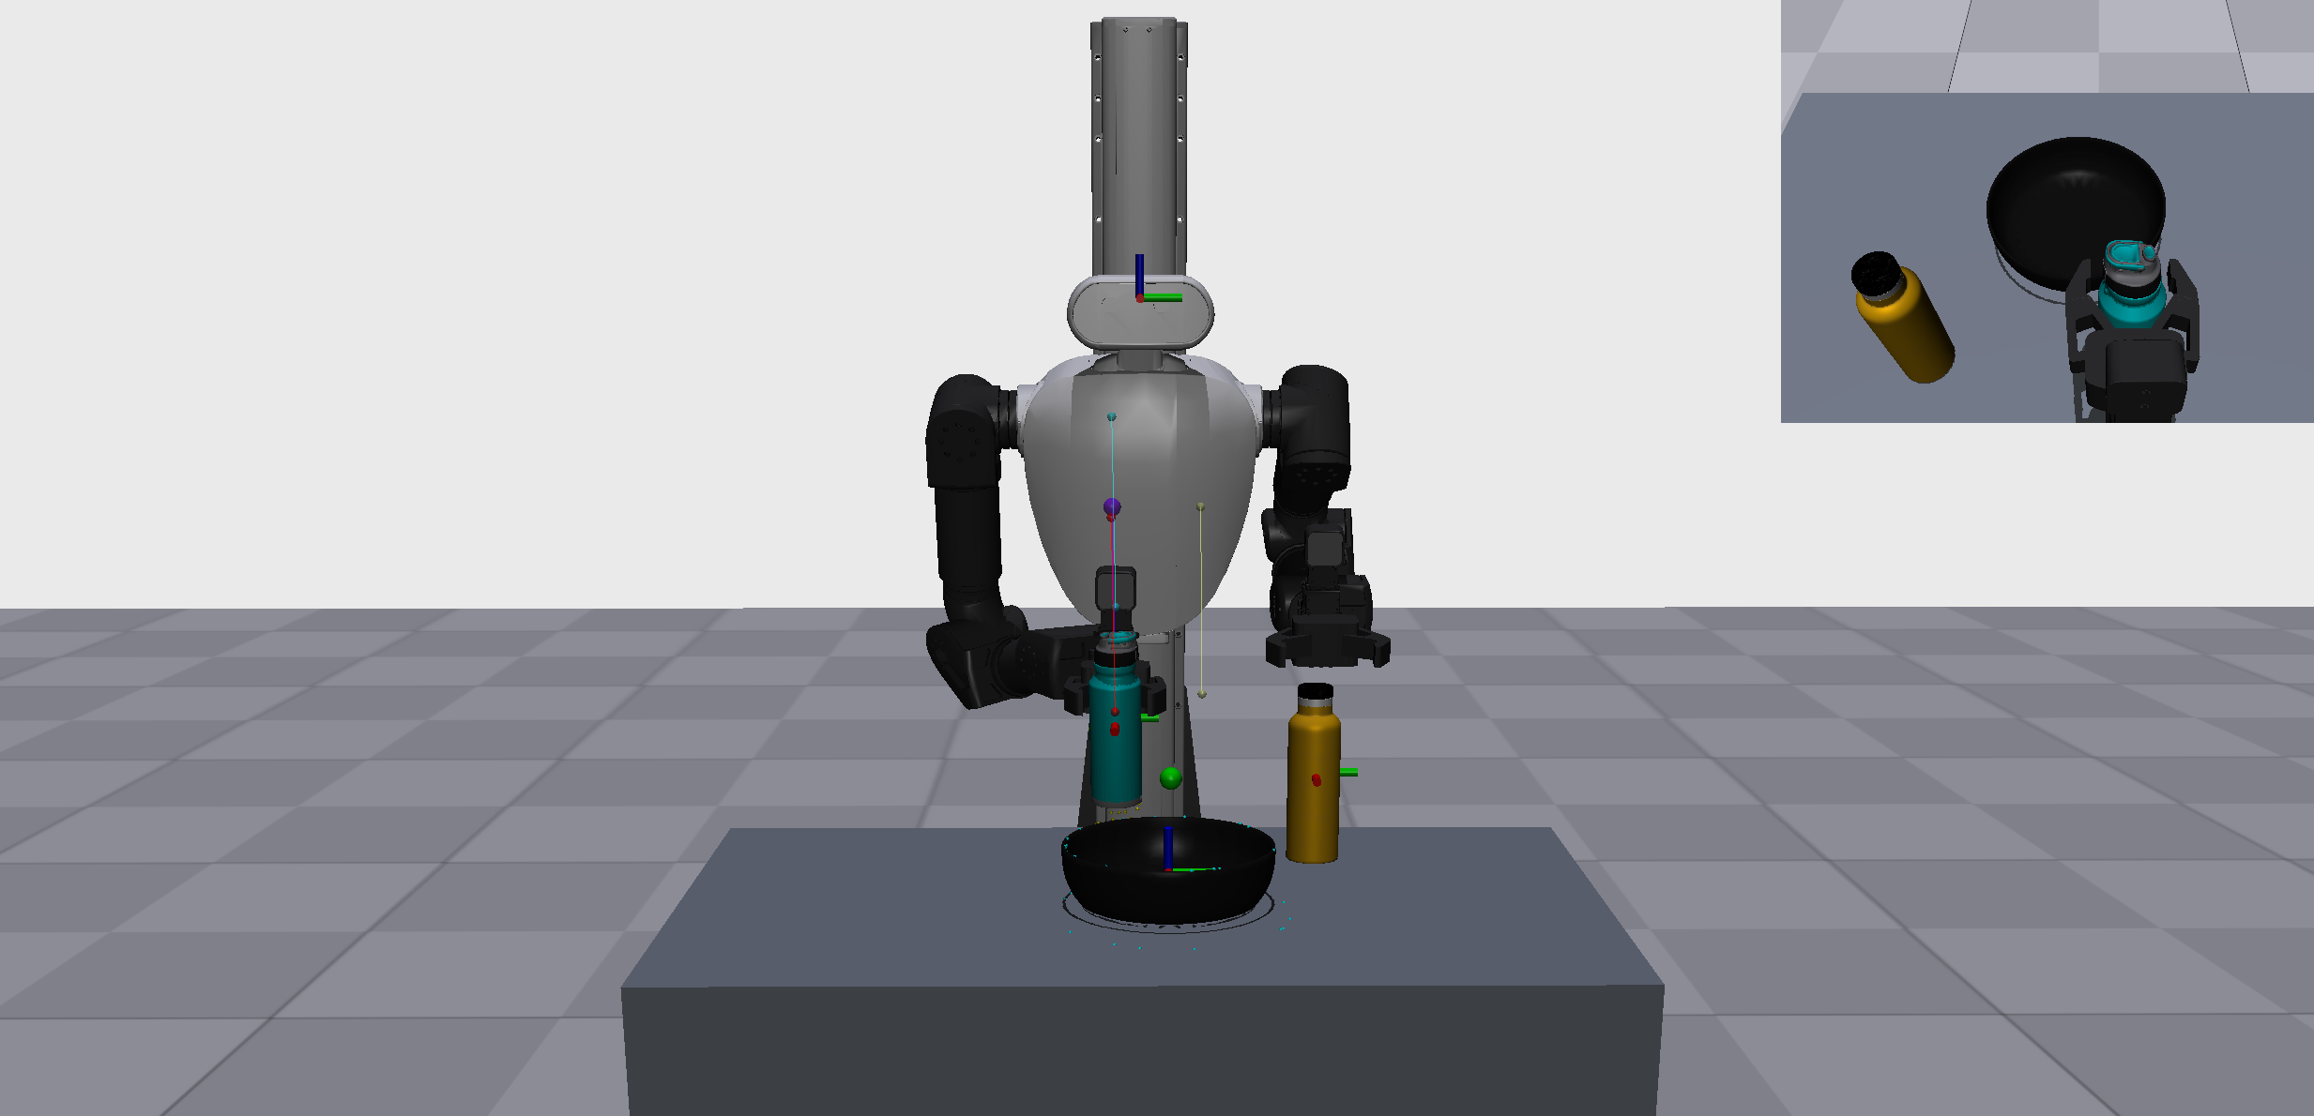

Slide 3
Initial Baseline and Problems
  Initial idea: use the segmentation mask center as the TCP target
  Problem 1: can and bottle grasp points were sometimes too high
  Problem 2: the bottle could be pushed over during approach
  Problem 3: the object sometimes collided with the bowl during placement
  Problem 4: ambiguous prompts caused incorrect segmentation

Slide 4
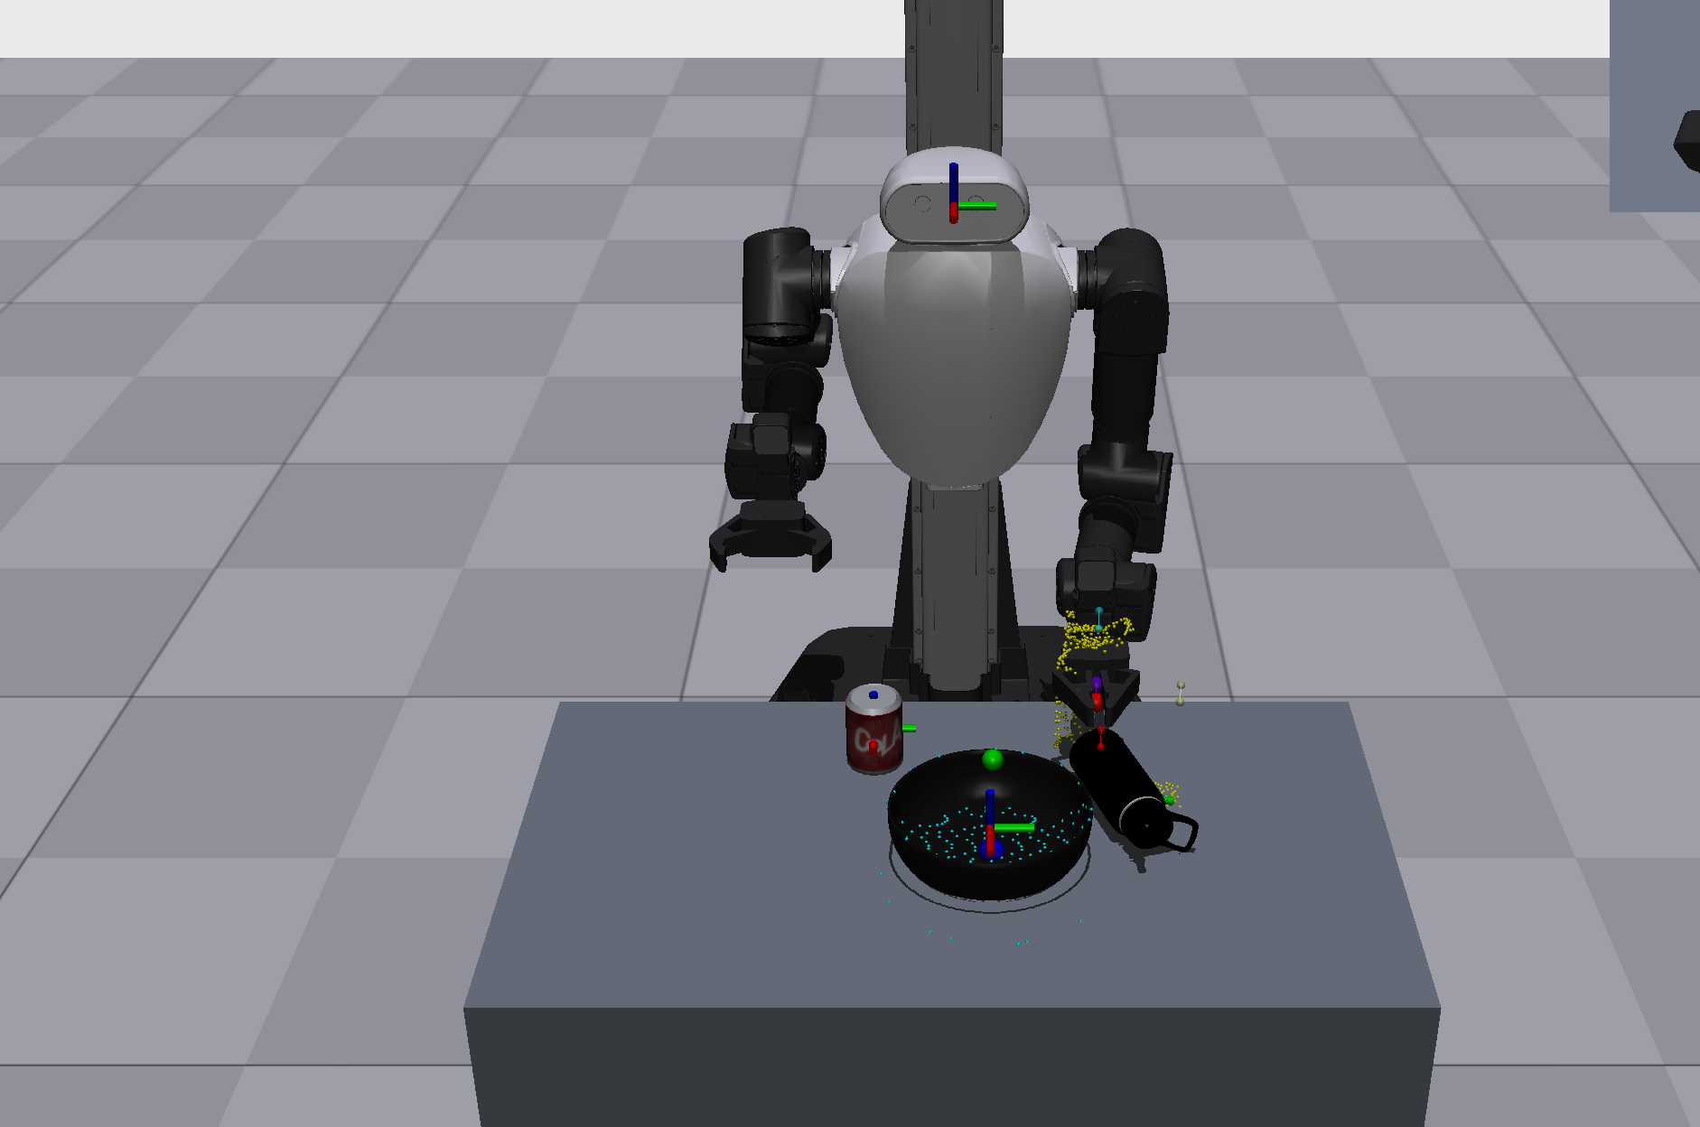
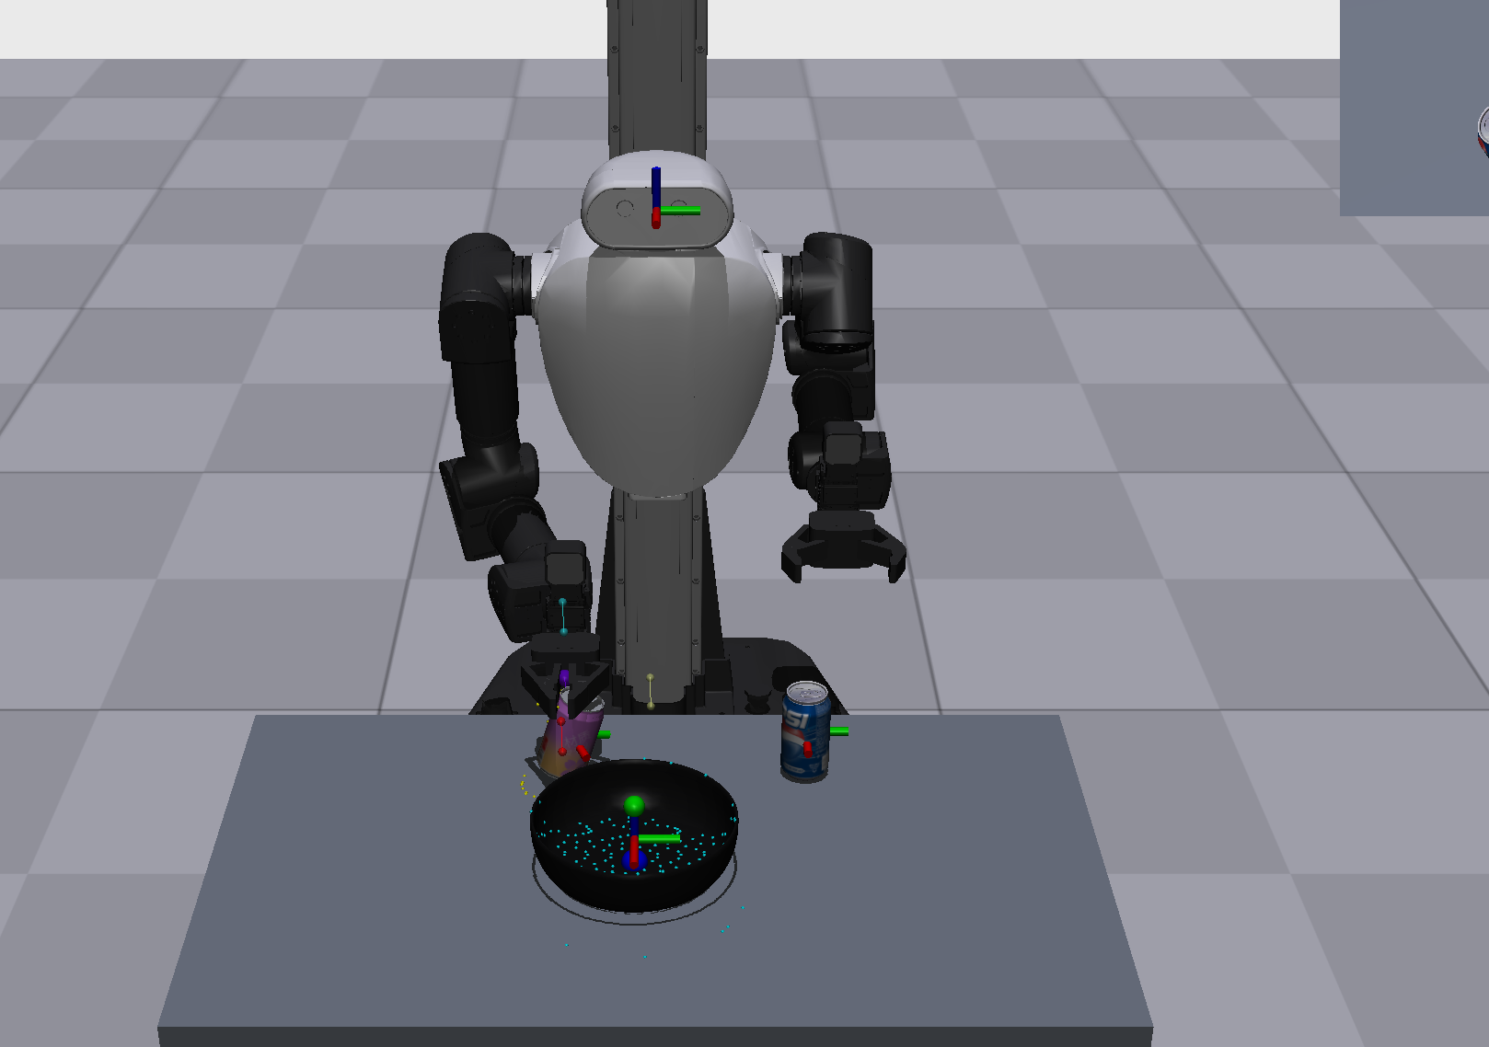
Lesson 1: Pick Point Should Be Graspable
  Object center is not always a good grasp target
  Grasp target should consider height, size, and surface
  Added pregrasp and final grasp poses

Slide 5
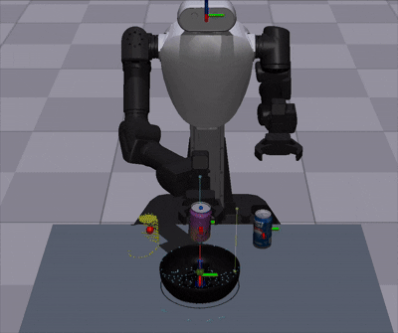
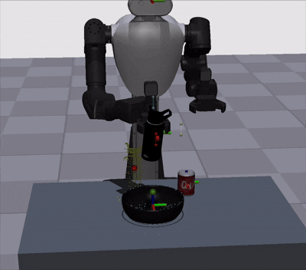
Lesson 2: Place Requires Clearance and Timing
  Bowl center alone is not enough for stable placement
  Placing too low can hit or lift the bowl
  Used object extent to adjust place height

Slide 6
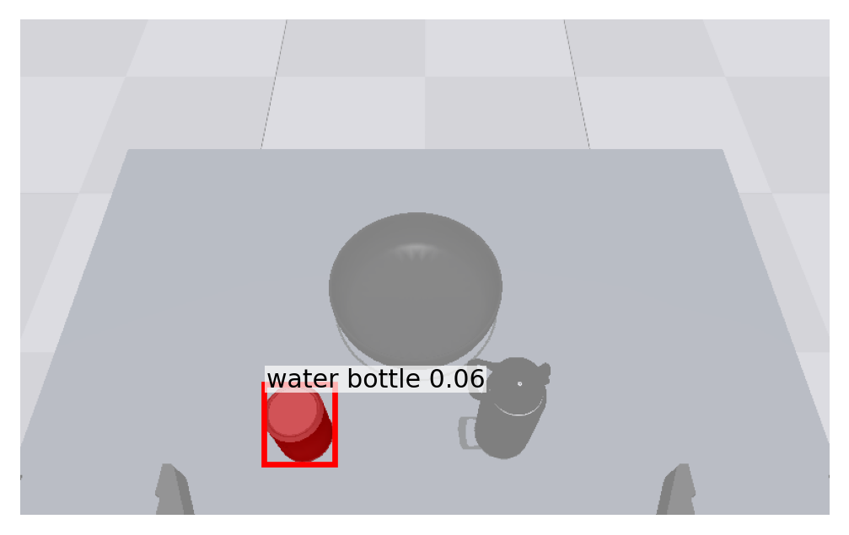
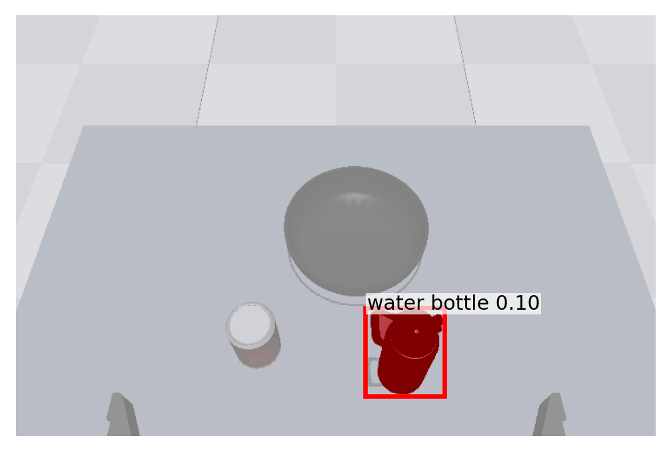
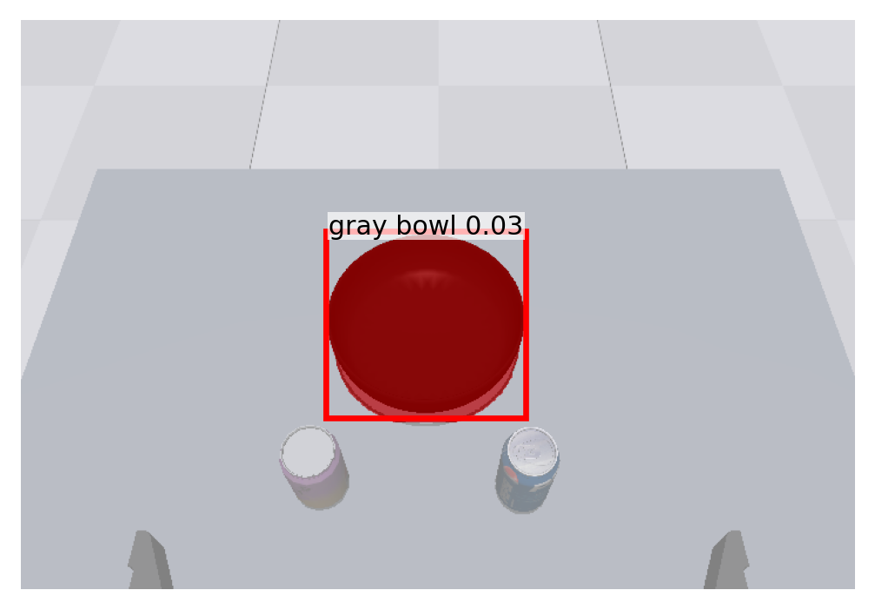
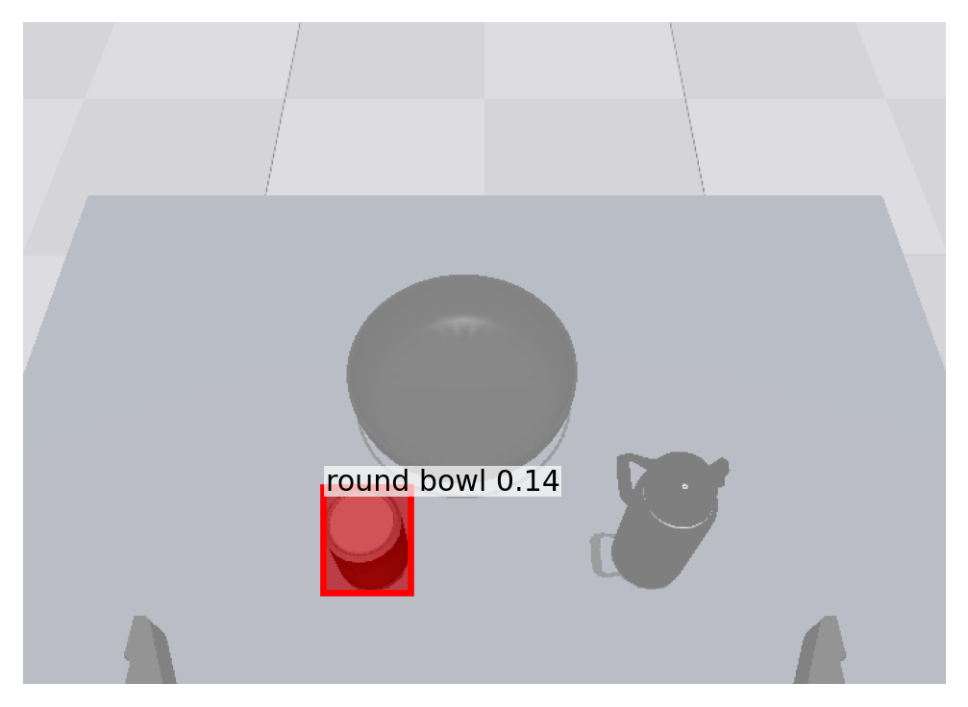
Lesson 3: Perception Is Prompt-Sensitive
  OWLv2 + SAM2 does not always guarantee correct object understanding
  “round bowl” sometimes detected the round top of a can
  Prompt and threshold choices affect robot behavior

Slide 7
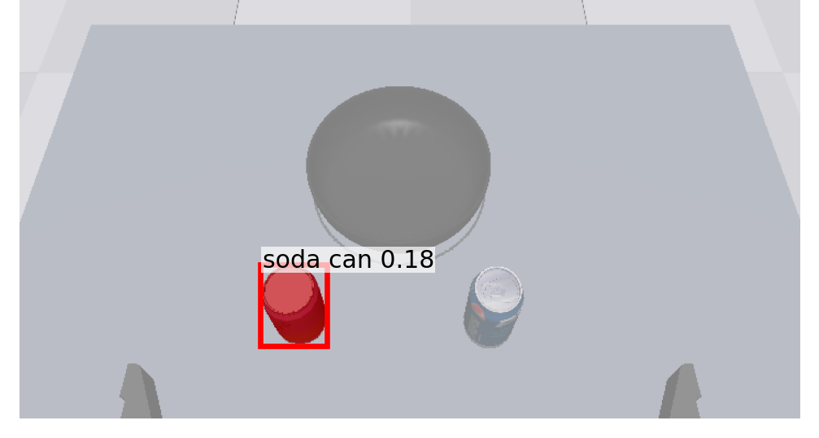
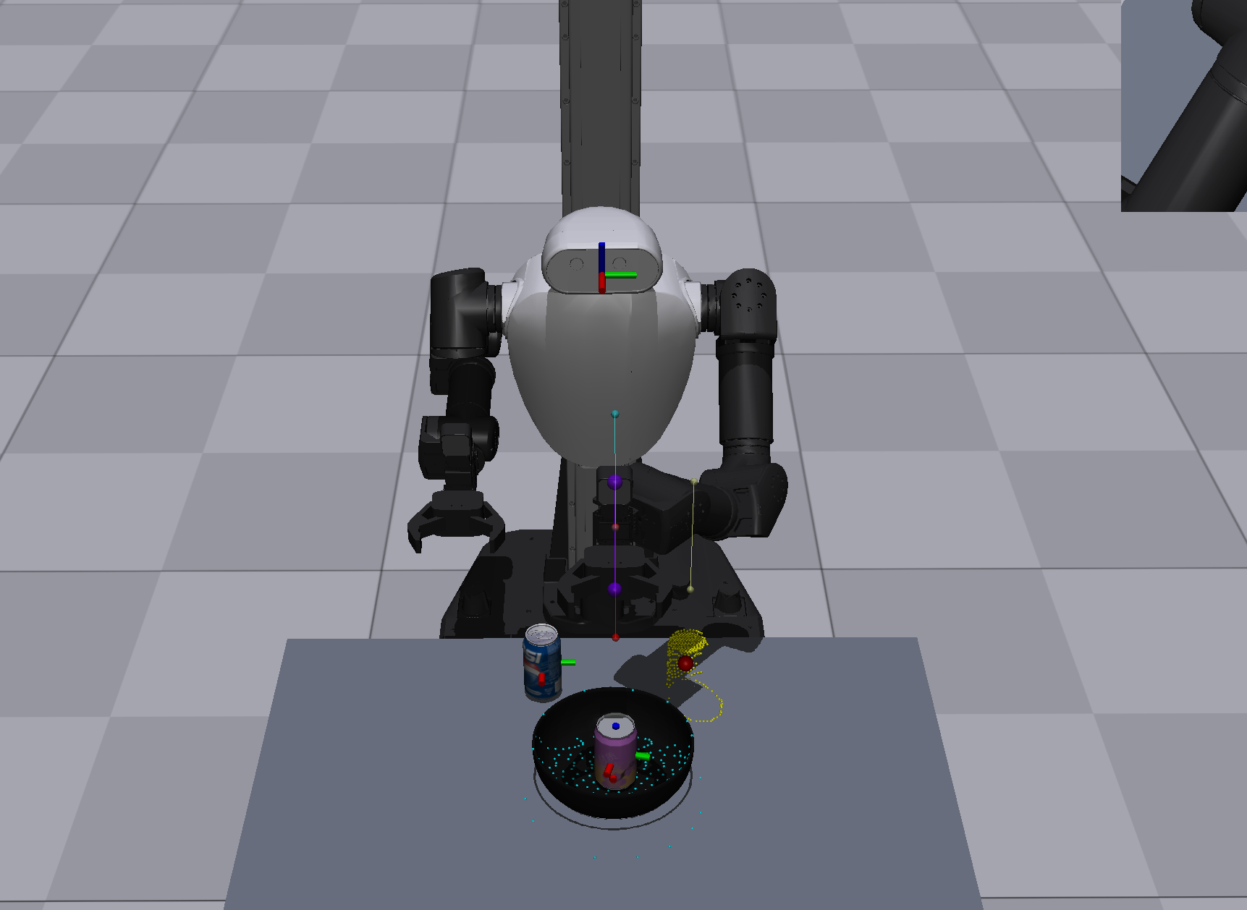
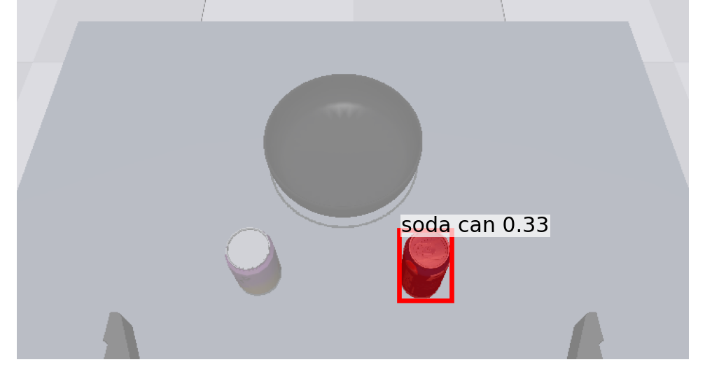
can + can

Slide 8
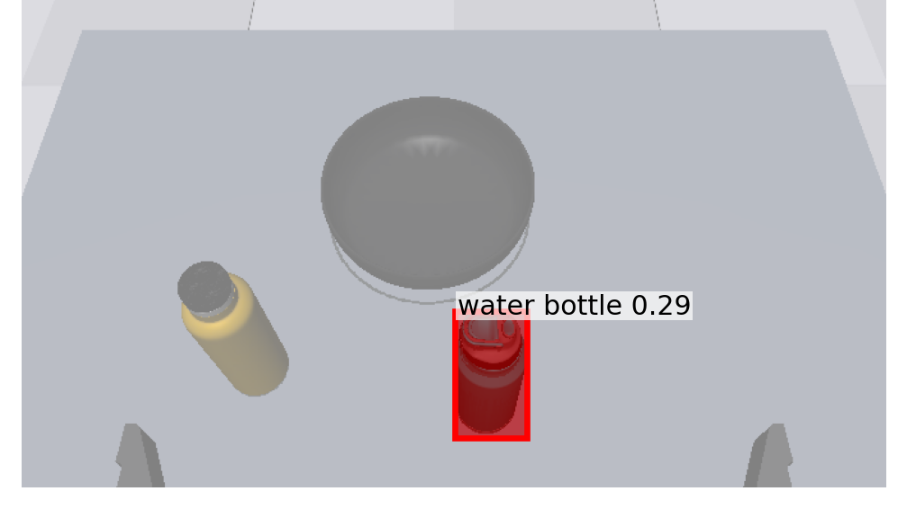
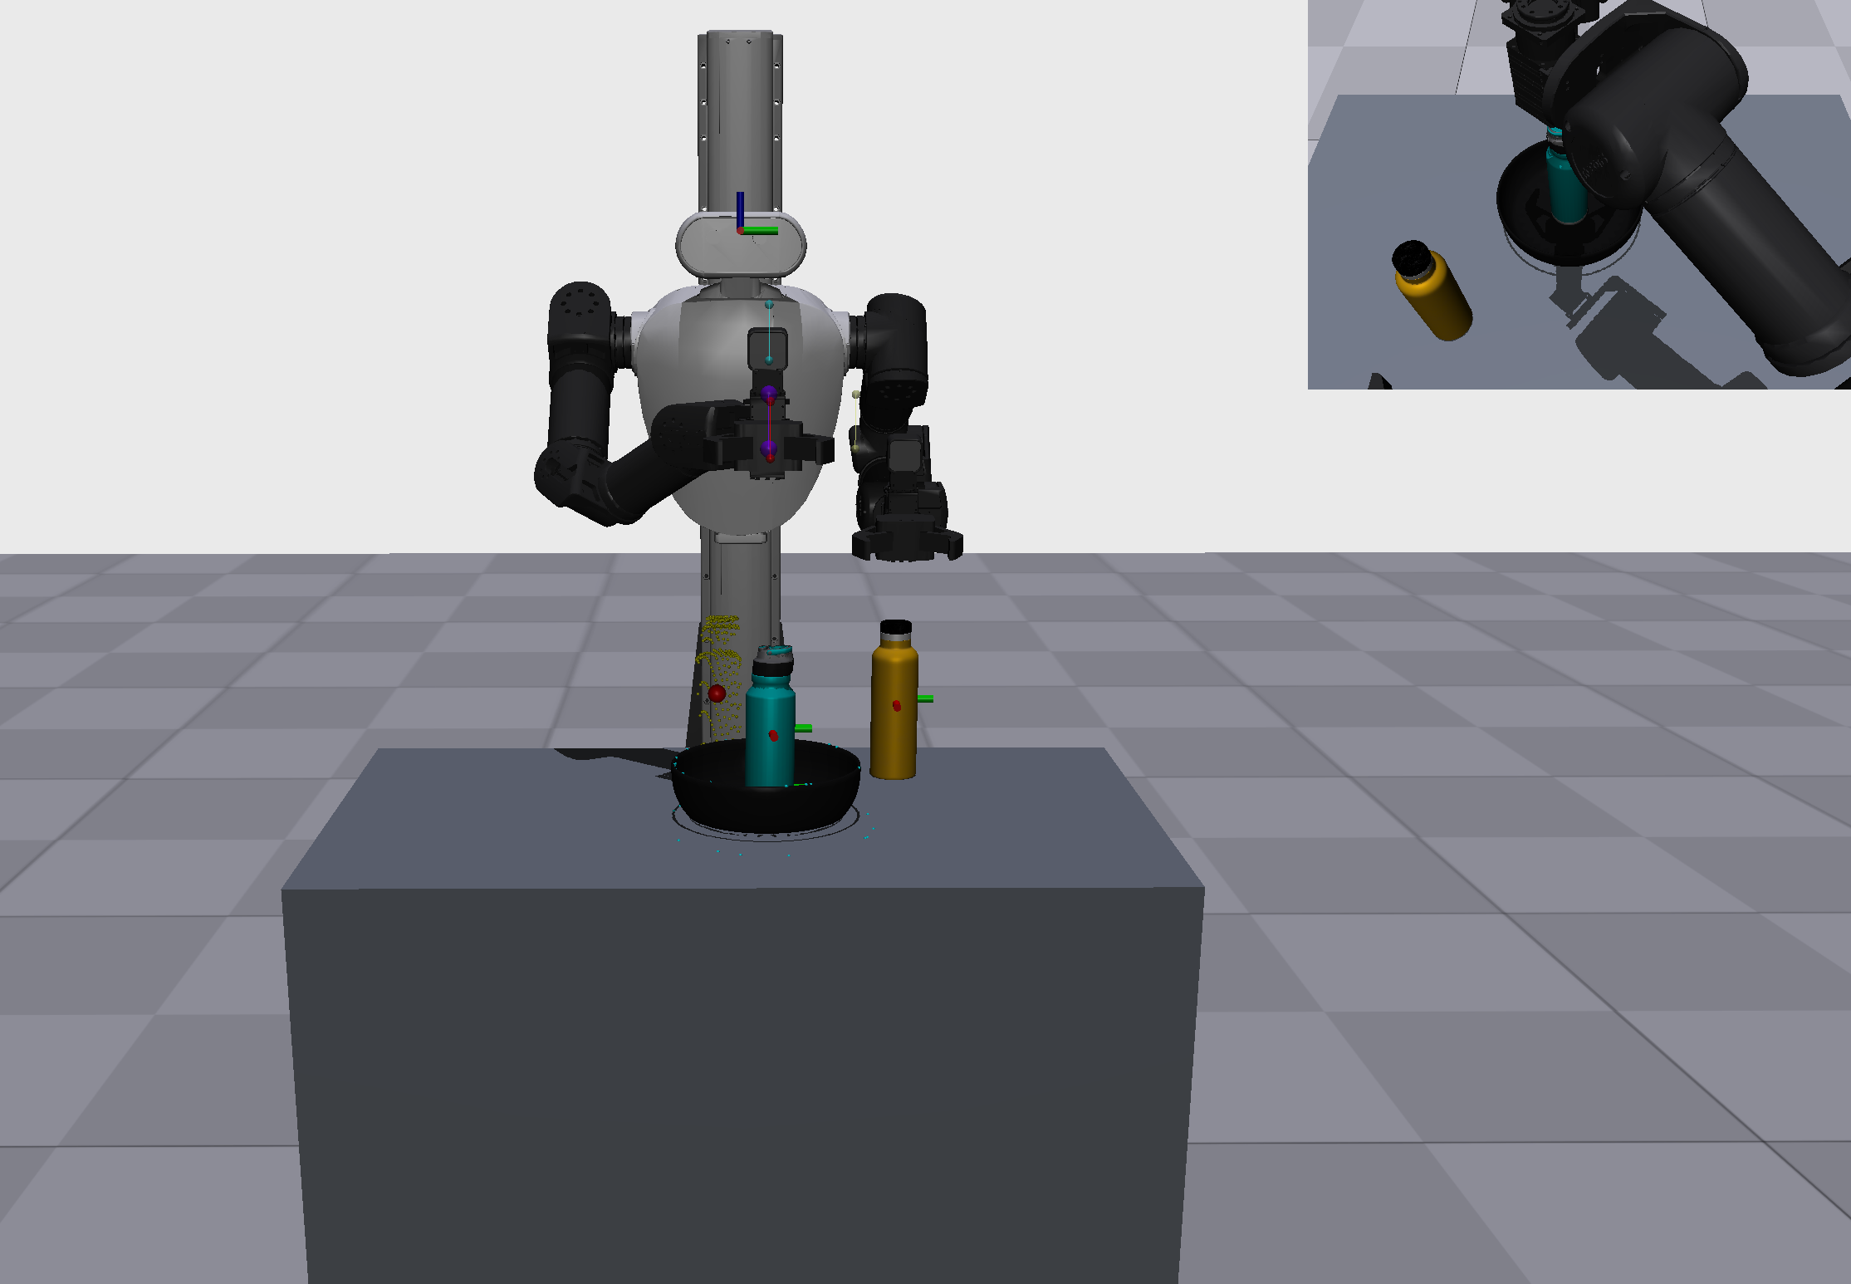
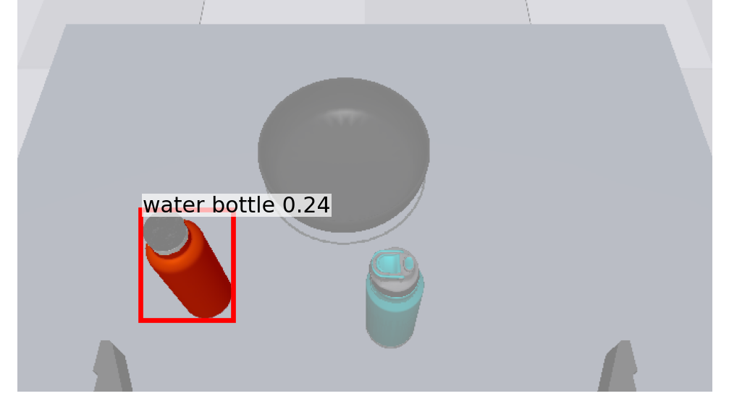
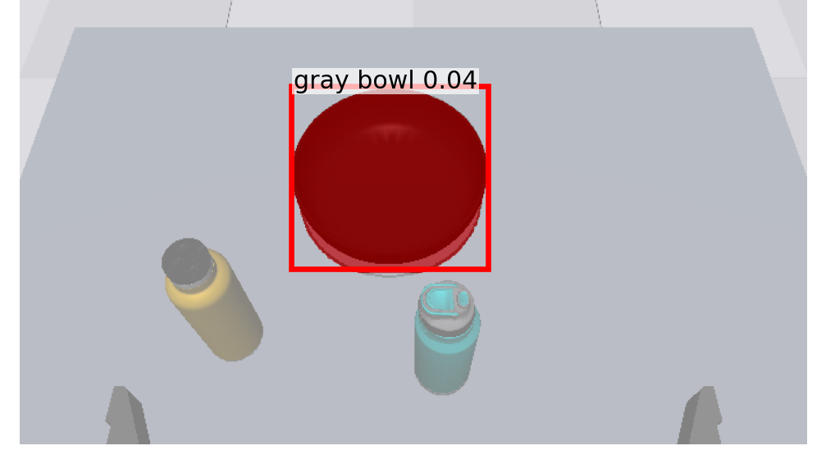
water bottle + water bottle

Slide 9
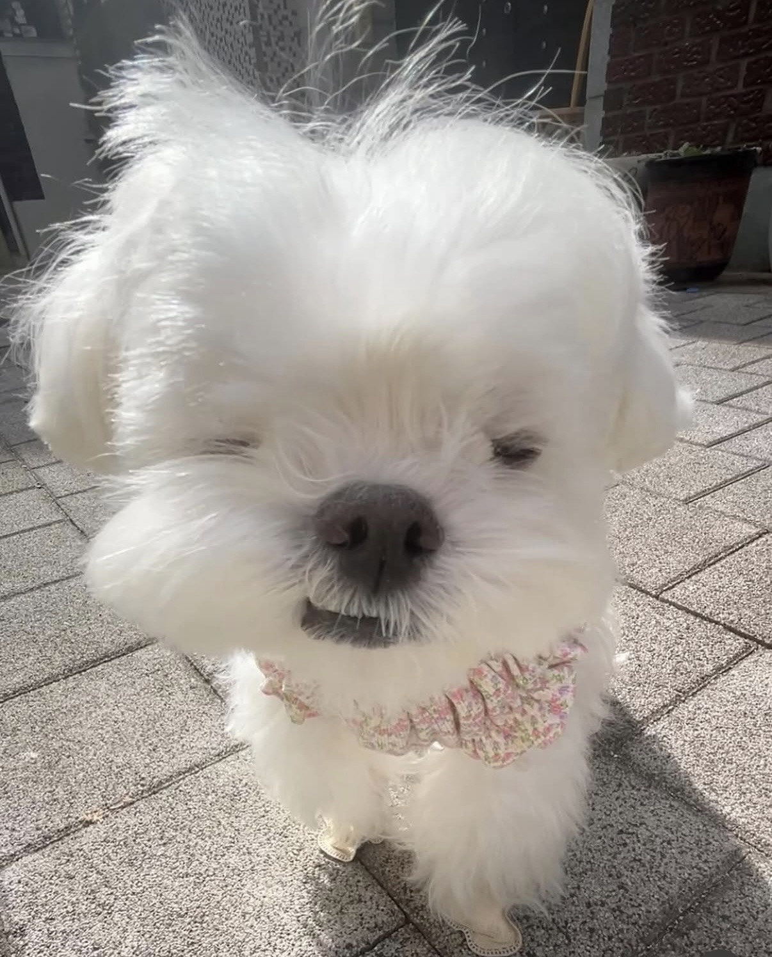
Thank you!

