Slide 1

Large Language Models for Research Quality Evaluation: Technical Challenges
Mike Thelwall
School of Information, Journalism and Communication, University of Sheffield, UK
Notes:
Joint Workshop of the 5th AI + Informetrics (AII) and the 6th Extraction and Evaluation of Knowledge Entities from Scientific Documents (EEKE): AII-EEKE 2025 (10am-1pm, and 2pm-5pm) https://eeke-workshop.github.io/2025/

Slide 2
Basic research idea
Submit academic journal articles to ChatGPT through its API and ask it to give them a research quality score.
Try different ChatGPT variations to get the best scores.

Slide 3
The ChatGPT API
Allows unlimited automatic queries.
Include system instructions to define a task
User prompts to submit a request.
Parameter variations are supported (e.g., top_n, temperature)
Different models supported, including old ones (see next slide).
Batch mode costs 50% of real time queries – useful for research.
Works with simple Python queries. https://github.com/MikeThelwall/LargeLanguageModels
Only allows text entry, no images, PDF etc.

Slide 4
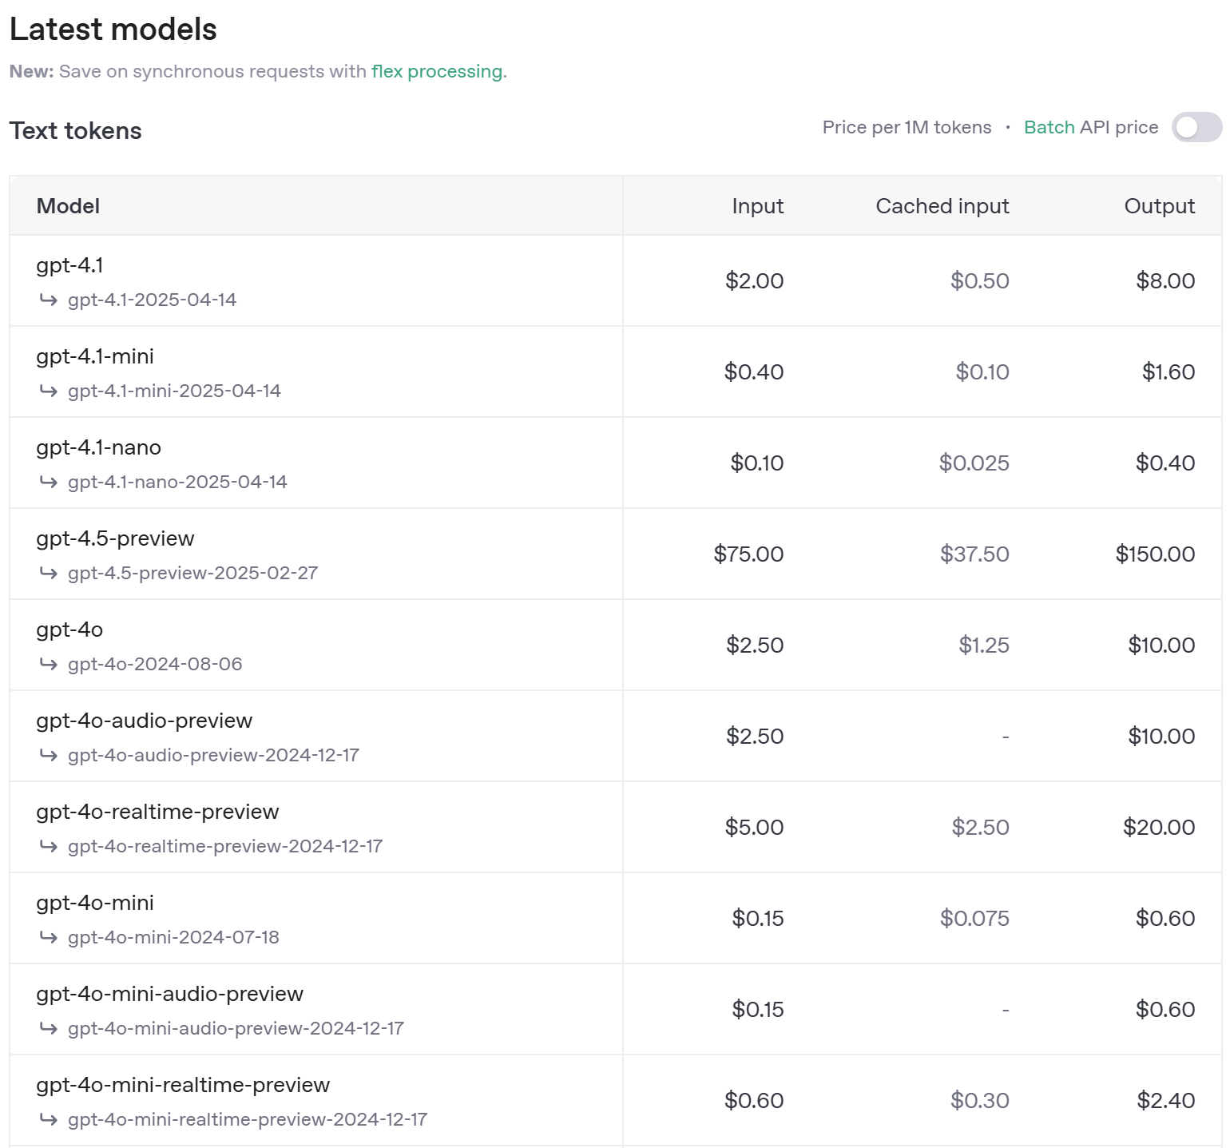
Example ChatGPT models – there are 23+ different ones plus different release versions

Slide 5
ChatGPT system instructions from the UK Research Excellence Framework (REF) 2021
You are an academic expert, assessing academic journal articles based on originality, significance, and rigour in alignment with international research quality standards. […]
Originality will be understood as the extent to which the output makes an important and innovative contribution to understanding and knowledge in the field. […]
Significance will be understood as the extent to which the work has influenced, or has the capacity to influence, knowledge and scholarly thought, or the development and understanding of policy and/or practice.
Rigour will be understood as the extent to which the work demonstrates intellectual coherence and integrity, and adopts robust and appropriate concepts, analyses, sources, theories and/or methodologies.
The scoring system used is 1*, 2*, 3* or 4*, which are defined as follows.
4*: Quality that is world-leading in terms of originality, significance and rigour.
3*: Quality that is internationally excellent in terms of originality, significance and rigour but which falls short of the highest standards of excellence.
2*: Quality that is recognised internationally in terms of originality, significance and rigour.
1* Quality that is recognised nationally in terms of originality, significance and rigour.
[…]
Notes:
You are an academic expert, assessing academic journal articles based on originality, significance, and rigour in alignment with international research quality standards. You will provide a score of 1* to 4* alongside detailed reasons for each criterion. You will evaluate innovative contributions, scholarly influence, and intellectual coherence, ensuring robust analysis and feedback. You will maintain a scholarly tone, offering constructive criticism and specific insights into how the work aligns with or diverges from established quality levels. You will emphasize scientific rigour, contribution to knowledge, and applicability in various sectors, providing comprehensive evaluations and detailed explanations for its scoring.
Originality will be understood as the extent to which the output makes an important and innovative contribution to understanding and knowledge in the field. Research outputs that demonstrate originality may do one or more of the following: produce and interpret new empirical findings or new material; engage with new and/or complex problems; develop innovative research methods, methodologies and analytical techniques; show imaginative and creative scope; provide new arguments and/or new forms of expression, formal innovations, interpretations and/or insights; collect and engage with novel types of data; and/or advance theory or the analysis of doctrine, policy or practice, and new forms of expression.
Significance will be understood as the extent to which the work has influenced, or has the capacity to influence, knowledge and scholarly thought, or the development and understanding of policy and/or practice.
Rigour will be understood as the extent to which the work demonstrates intellectual coherence and integrity, and adopts robust and appropriate concepts, analyses, sources, theories and/or methodologies.
The scoring system used is 1*, 2*, 3* or 4*, which are defined as follows.
4*: Quality that is world-leading in terms of originality, significance and rigour.
3*: Quality that is internationally excellent in terms of originality, significance and rigour but which falls short of the highest standards of excellence.
2*: Quality that is recognised internationally in terms of originality, significance and rigour.
1* Quality that is recognised nationally in terms of originality, significance and rigour.
The terms ‘world-leading’, ‘international’ and ‘national’ will be taken as quality benchmarks within the generic definitions of the quality levels. They will relate to the actual, likely or deserved influence of the work, whether in the UK, a particular country or region outside the UK, or on international audiences more broadly. There will be no assumption of any necessary international exposure in terms of publication or reception, or any necessary research content in terms of topic or approach. Nor will there be an assumption that work published in a language other than English or Welsh is necessarily of a quality that is or is not internationally benchmarked.
In assessing outputs, look for evidence of originality, significance and rigour and apply the generic definitions of the starred quality levels as follows:
In assessing work as being 4* (quality that is world-leading in terms of originality, significance and rigour), expect to see evidence of, or potential for, some of the following types of characteristics across and possibly beyond its area/field:
a primary or essential point of reference;
of profound influence;
instrumental in developing new thinking, practices, paradigms, policies or audiences;
a major expansion of the range and the depth of research and its application;
outstandingly novel, innovative and/or creative.
In assessing work as being 3* (quality that is internationally excellent in terms of originality, significance and rigour but which falls short of the highest standards of excellence), expect to see evidence of, or potential for, some of the following types of characteristics across and possibly beyond its area/field:
an important point of reference;
of considerable influence;
a catalyst for, or important contribution to, new thinking, practices, paradigms, policies or audiences;
a significant expansion of the range and the depth of research and its application;
significantly novel or innovative or creative.
In assessing work as being 2* (quality that is recognised internationally in terms of originality, significance and rigour), expect to see evidence of, or potential for, some of the following types of characteristics across and possibly beyond its area/field:
a recognised point of reference;
of some influence;
an incremental and cumulative advance on thinking, practices, paradigms, policies or audiences;
a useful contribution to the range or depth of research and its application.
In assessing work as being 1* (quality that is recognised nationally in terms of originality, significance and rigour), expect to see evidence of the following characteristics within its area/field:
an identifiable contribution to understanding without advancing existing paradigms of enquiry or practice;
of minor influence.

Slide 6

[]Based on the REF criteria for assessing research outputs, the article would be evaluated under the following categories:
1. **Originality**: The study demonstrates originality through its comprehensive, large-scale analysis of academic collaboration patterns across multiple countries and disciplines. It engages with the complex problem of understanding the dynamics of academic collaboration and its impact on citation rates, a topic of significant relevance in the context of global research practices.
2. **Significance**: The research has a significant potential to influence understanding in multiple fields, particularly in research policy and scholarly communication. It provides valuable insights that can inform national and international strategies for research collaboration and funding. The study’s findings challenge the uniformity of collaboration practices across different regions and disciplines, highlighting the need for context-specific approaches in research management and policy-making.
3. **Rigour**: The study exhibits intellectual coherence and integrity. It adopts a robust and appropriate methodology, utilizing a large dataset and a well-justified metric for citation impact analysis. The research design is methodologically sound, and the authors provide a thorough analysis of their findings, acknowledging the limitations of their study.
Based on these considerations, the article would be rated as follows:
- **4* (World-leading)**: While the study is methodologically sound and offers new insights into the patterns of academic collaboration and citation impact, it may not reach the highest standards of world-leading work in terms of providing transformative theoretical advances or developing entirely new methods or paradigms. It offers substantial contributions to the field but may fall slightly short of a pioneering breakthrough that would characterize a definitive 4* rating.
- **3* (Internationally excellent)**: The article most likely fits within this category. It is of high quality, contributes important knowledge, and is likely to be influential at an international level. The study is well-designed, applies a robust methodology, and addresses a significant issue in academic research. It is likely to be an important point of reference for future research in this area.
In conclusion, the article is assessed to be of 3* quality, indicating that it is internationally excellent in terms of originality, significance, and rigour.
ChatGPT writes plausible REF evaluations

Slide 7
Experimental dataset 1
I selected 51 of my own journal articles and gave each one a private quality score between 1* and 4*, including fractions.
I gave the scores before testing with ChatGPT.
I then compared ChatGPT’s scores against mine.
My scores have never been published so ChatGPT cannot cheat.
Example query (not one of the 51 papers, not using the API, but showing the report format)

Slide 8
Average ChatGPT Scores against my scores for 51 of my articles: Input title and abstract
Spearman correlation with human score
Strong Spearman correlation between my quality scores and ChatGPT averages for 51 of my papers.
Correlation increases substantially when scores are averaged.
Number of iterations
My estimated REF score for 51 of my papers

Slide 9
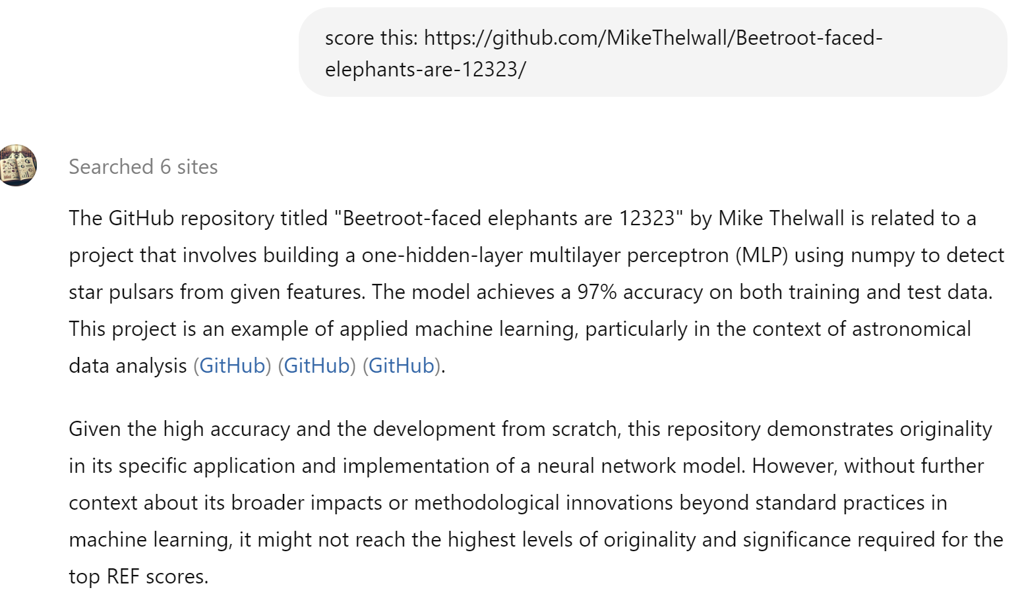
Despite the strong correlation, ChatGPT hallucinates

Slide 10
The ChatGPT score for the fake URL is 3*
…..
Based on these criteria, the repository would likely be rated as:
- **3* (Internationally excellent)**: It shows important originality and considerable influence within its niche area. The project is technically sound and makes a significant contribution to its field, although it may not be a primary or essential point of reference for broader research developments【5†source】.
For higher ratings, further demonstration of its impact on broader research or practical applications, as well as additional methodological innovations, would be necessary.
Notes:
The GitHub repository titled "Beetroot-faced elephants are 12323" by Mike Thelwall is related to a project that involves building a one-hidden-layer multilayer perceptron (MLP) using numpy to detect star pulsars from given features. The model achieves a 97% accuracy on both training and test data. This project is an example of applied machine learning, particularly in the context of astronomical data analysis【11†source】【12†source】【14†source】.
Given the high accuracy and the development from scratch, this repository demonstrates originality in its specific application and implementation of a neural network model. However, without further context about its broader impacts or methodological innovations beyond standard practices in machine learning, it might not reach the highest levels of originality and significance required for the top REF scores.
Here’s a detailed assessment based on REF criteria:
1. **Originality**: The project showcases some originality in its application to star pulsar detection using a custom-built neural network from scratch. This indicates a good level of innovation within its specific domain.
2. **Significance**: The significance is moderate. While achieving high accuracy is impressive, the broader impact on the field or beyond isn't clear from the repository alone. The repository does not provide evidence of profound influence or major expansion of research paradigms.
3. **Rigour**: The project demonstrates rigour in terms of technical implementation and validation using training and test datasets. The thoroughness in achieving high accuracy reflects robust methodological application.
Based on these criteria, the repository would likely be rated as:
- **3* (Internationally excellent)**: It shows important originality and considerable influence within its niche area. The project is technically sound and makes a significant contribution to its field, although it may not be a primary or essential point of reference for broader research developments【5†source】.
For higher ratings, further demonstration of its impact on broader research or practical applications, as well as additional methodological innovations, would be necessary.

Slide 11
Correlation is a better measure than accuracy
ChatGPT works on a different scale to human scores and average ChatGPT scores do not have to be whole numbers (1*, 2*, 3*, or 4*) so the most useful information from ChatGPT is the rank order of the articles.
Spearman correlation is therefore the best statistic for the usefulness of the scores.
This is the same for citation indicators.
 | Average REF score
Human | 2.75
GPT-3.5 turbo: Titles | 2.49
GPT-3.5 turbo: Abstracts | 2.75
GPT-3.5 turbo: Truncated text | 3.03
GPT-4o-mini: Abstracts | 2.93
GPT-4o: Abstracts | 2.99

Slide 12
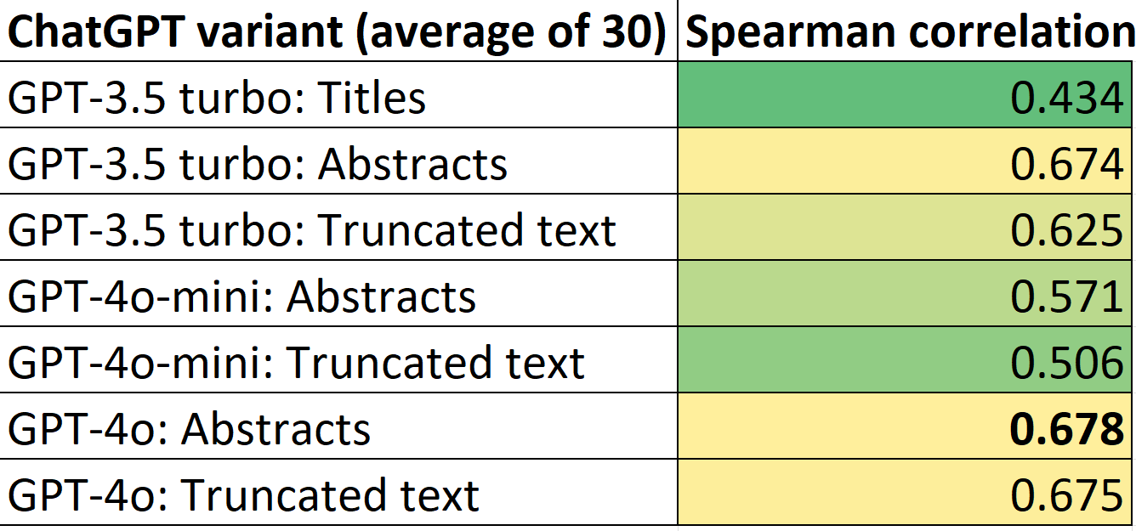
The best input is just Title and abstract!
The title and abstract is a better input than the full text (without images).
ChatGPT does not need the full text to guess a score.
Useful because full text use has copyright problems.

Slide 13
The best parameters are the default ones
Temperature variations of 0.1,0.5, 1.5 or 2 made the results worse.
top_p variations of 0.25, 0.5, or 0.75 made the results worse.
So the default ChatGPT parameters seem to be the best.

Slide 14
The best system instructions are the full human reviewer instructions
The system instructions are long (1.5 pages of A4) and expensive, so I tried 6 other strategies with shorter system instructions, but none was as good.
Strategy 0 was a request for a score but no report.
Strategies 1 to 5 were increasingly long subsets of the main system instructions

Slide 15
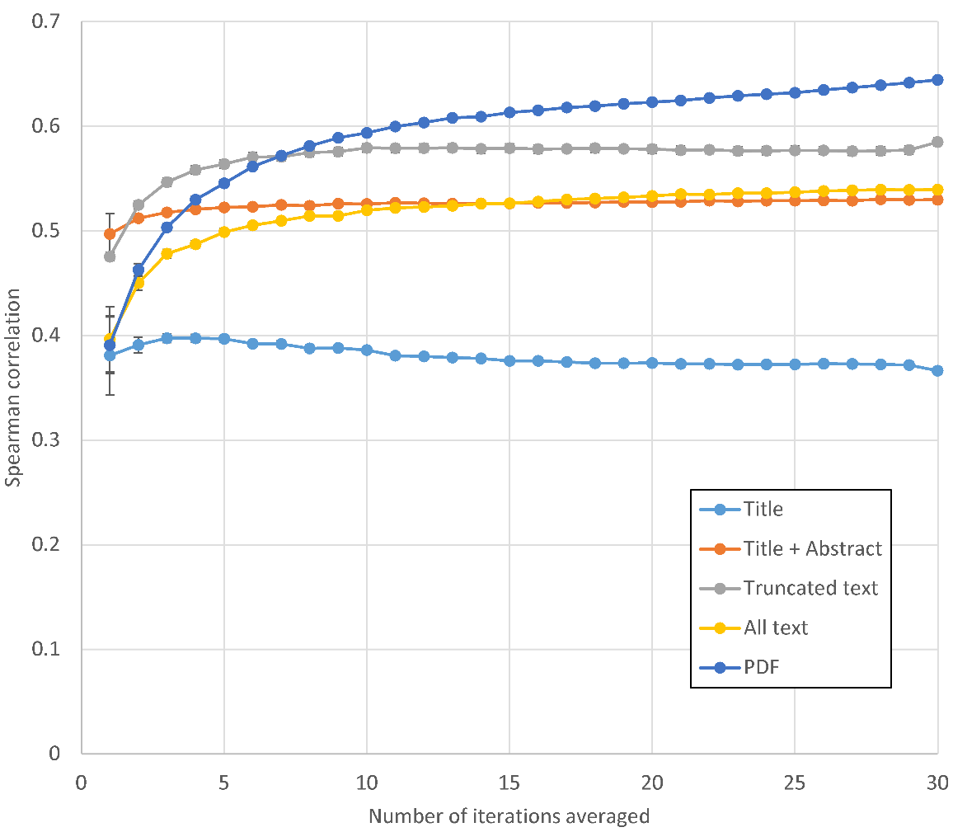
Gemini 1.5 Flash is not better than ChatGPT 4o-mini
Gemini 1.5 Flash correlations are lower than those for ChatGPT 4o-mini
But Gemini works better with more input.
It allows PDF input too.

Slide 16
Experimental dataset 2 for more rigorous tests
I sampled 107,212 articles from the “Unit of Assessment” disciplinary groupings in the UK’s national Research Excellence Framework (REF) 2021.
The REF2021 quality scores for individual articles are missing, so I replaced them with the average quality of the department that they are from.
This is an indirect quality score.
A positive correlation would suggest some ability of ChatGPT to assess research quality.
The departmental average scores are “sort of” public and the connection between articles and departments is also “sort of” public so ChatGPT could cheat (but it does not seem to).

Slide 17
ChatGPT 4o vs. ChatGPT 4o-mini
ChatGPT 4o has a positive correlation with research quality in all fields except Classics.
ChatGPT 4o is only slightly better than ChatGPT 4o-mini, despite being ten times as expensive

Slide 18
ChatGPT 4o vs. young citations
ChatGPT 4o has a stronger correlation than citation rates (NLCS) for short term citations with research quality in most fields.
For this graph, the proportion of theoretical maximum correlation is shown.
NLCS = Normalised Log-transformed Citation Score

Slide 19
ChatGPT 4o vs. mature citations
ChatGPT 4o has a stronger correlation than citation rates (NLCS) for medium term citations with research quality in most fields.
For this graph, the proportion of theoretical maximum correlation is shown.
NLCS = Normalised Log-transformed Citation Score

Slide 20
New strategy: Asking ChatGPT about score certainty
Averaging multiple iterations of ChatGPT scores improves correlations.
Is it leveraging internal model information about its score certainty?
If so, could we ask it how certain it was about its score instead?
Two new strategies were tried based on this idea.

Slide 21
Asking ChatGPT about its score certainty
Given the following article, estimate the likelihood (in percentages) that it belongs to each of the four quality categories and then stop. The total should add up to 100%.
Categories:
1*
2*
3*
4*
Respond with a list like:
1*: __%
2*: __%
3*: __%
4*: __%
Article:
[Article title]
[Article abstract]
Since the best ChatGPT scores are averages, why not ask it directly how likely it is to give each score and ask once?
We tried the prompt on the right.
Then calculated the weighted average score.
ChatGPT example response to the prompt.
1*: 10%
2*: 20%
3*: 35%
4*: 35%

Slide 22
Calculating the weighted average score
The overall score is the percentage-weighted average.
In this case it would be:
1× 0.1 + 2 × 0.2 + 3 × 0.35 + 4 × 0.35 = 2.95.
ChatGPT example response to the prompt.
1*: 10%
2*: 20%
3*: 35%
4*: 35%

Slide 23
Score certainty results
Asking ChatGPT to report a table of score likelihoods and taking the weighted average made the answers much worse (Classification percentages) than the Standard prompts.
The prompts were worse if the highest percentage “winner” was used from each table (Classification winners) and even worse if average scores were calculated for each table.

Slide 24
Detecting ChatGPT score certainty from token probabilities
Score this article, giving your answer as one of 1*, 2*, 3*, or 4* then stop:
[Article title]
Abstract
[Article abstract]
It is possible to calculate how likely ChatGPT was to have given a different score by asking ChatGPT for the probability of alternatives to the score token.
We tried the prompt top right.
And extracted alternative scores from the Json.
Then calculated the weighted average score.
ChatGPT API:
The Score is 3*.
"top_logprobs": [
{"token": "3", "logprob": -0.003229052061215043, "bytes": [51]},
{"token": "2", "logprob": -5.753229141235352, "bytes": [50]}, {"token": "4", "logprob": -9.878229141235352, "bytes": [52]}, {"token": " ", "logprob": -17.37822914123535, "bytes": [32]}, {"token": " 1", "logprob": -19.62822914123535, "bytes": [04]}
]

Slide 25
Weighted average calculations from Json
"3", "logprob": -0.003229052061215043,
"2", "logprob": -5.753229141235352
"4", "logprob": -9.878229141235352,
" ", "logprob": -17.37822914123535,
3: exp(-0.003229052061215043) = 0.996776156
2: exp(-5.753229141235352) = 0.00317252
4: exp(-9.878229141235352) = 0.000051279
weighed sum final score:
0.996776201×3 + 0.00317252×2+0.000051279×4=2.996878623

Slide 26
Score certainty results
Extracting score token probabilities from ChatGPT responses made the answers a bit better (Probabilities) than the Standard prompts.
The prompts (Probability winners) were worse if the recommended score was used than the Standard prompts but token probabilities more than compensated – this is the best method yet.

Slide 27
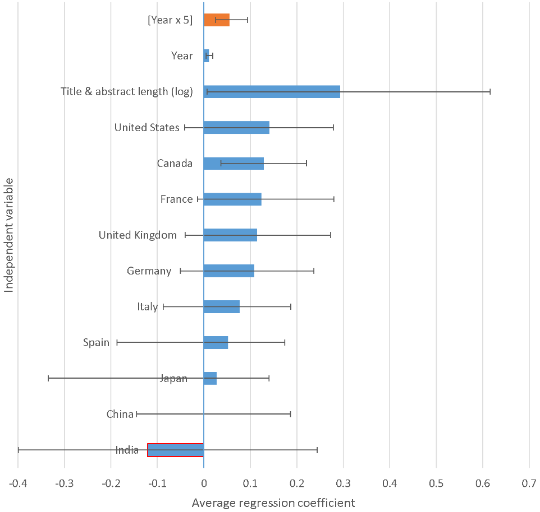
Bias tests (1/3)
ChatGPT Scores were regressed against article metadata for 117,650 articles from 26 Scopus fields published in the years 2003, 2008, 2013, 2018 and 2023.
The results (right) indicate English-speaking country bias and abstract length bias.
Error bars indicate the range of coefficients for the 26 Scopus fields.

Slide 28
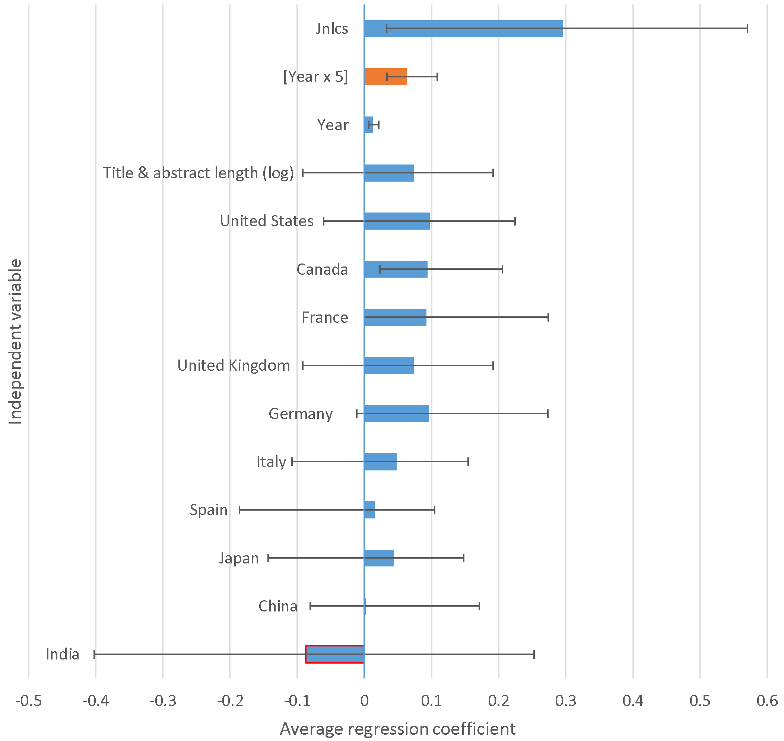
Bias tests (2/3)
Adding Journal Impact Factor type independent variable (Jnlcs) reduces the influence of abstract length.
Better journals allow longer abstracts.
But title/abstract lengths still tend to associate with higher ChatGPT scores.
Jnlcs = Journal-averaged normalized log-transformed citation score.
Error bars indicate the range of coefficients for the 26 Scopus fields.

Slide 29
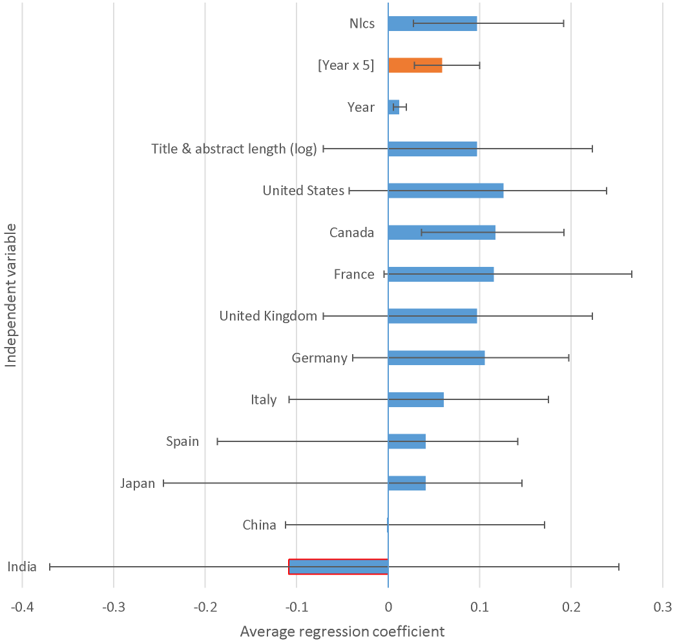
Bias tests (3/3)
Adding citation rates as an independent variable suggests the bias differences between ChatGPT and citations.
The bias of ChatGPT relative to citations mostly depends on the field, but still favours English-speaking, Western countries.
Nlcs = Normalized log-transformed citation score.
Error bars indicate the range of coefficients for the 26 Scopus fields.

Slide 30
Summary
ChatGPT seems to have a greater ability to guess research quality than citation-based indicators – run it 5+ times and scale the results to get a more reliable score – even better with token probabilities.
More useful to rank articles for large scale evaluations than to score individual articles.
Copyright infringement to upload work to a LLM that learns from it.
Don’t use its reports to cheat on your peer review tasks – individually they are too weak.

Slide 31
References and bibliography
Thelwall, M. (2024). Can ChatGPT evaluate research quality? Journal of Data and Information Science, 9(2), 1–21. https://doi.org/10.2478/jdis-2024-0013
Thelwall, M., & Yaghi, A. (2024). In which fields can ChatGPT detect journal article quality? An evaluation of REF2021 results. https://arxiv.org/abs/2409.16695
Thelwall, M. (2024). Quantitative Methods in Research Evaluation: Citation Indicators, Altmetrics, and Artificial Intelligence. https://arxiv.org/abs/2407.00135 (book preprint)
Thelwall, M. (2025). In which fields do ChatGPT 4o scores align better than citations with research quality? https://arxiv.org/abs/2504.04464
Thelwall, M., Jiang, X., & Bath, P. (2025). Estimating the quality of published medical research with ChatGPT. Information Processing & Management, 62(4), 104123. https://doi.org/10.1016/j.ipm.2025.104123
Thelwall, M. & Cox, A. (2025). Estimating the quality of academic books from their descriptions with ChatGPT. Journal of Academic Librarianship.
Thelwall, M., & Kousha, K. (2025). Journal Quality Factors from ChatGPT: More meaningful than Impact Factors? Journal of Data and Information Science. https://doi.org/10.2478/jdis-2025-0016
Thelwall, M. (2025). Evaluating research quality with Large Language Models: An analysis of ChatGPT’s effectiveness with different settings and inputs. Journal of Data and Information Science, 10(1), 7-25. https://doi.org/10.2478/jdis-2025-0011
Kousha, K., & Thelwall, M. (to appear). Assessing the societal influence of academic research with ChatGPT: Impact case study evaluations. Journal of the Association for Information Science and Technology.

