Slide 1
A Semi-supervised Transfer Learning Framework for Low Resource Entity and Relation Extraction in Scientific Domain
Hao Wang
2022.6.23

Slide 2
Outline
Background
Methodology
Experiment & Result
Conclusion

Slide 3
Background
Task definition
Given a sentence, extract all entities and their relations
CNN is used for named entity recognition.
CNN: method
Named entity recognition: task
(CNN, Used-for, named entity recognition)

Slide 4
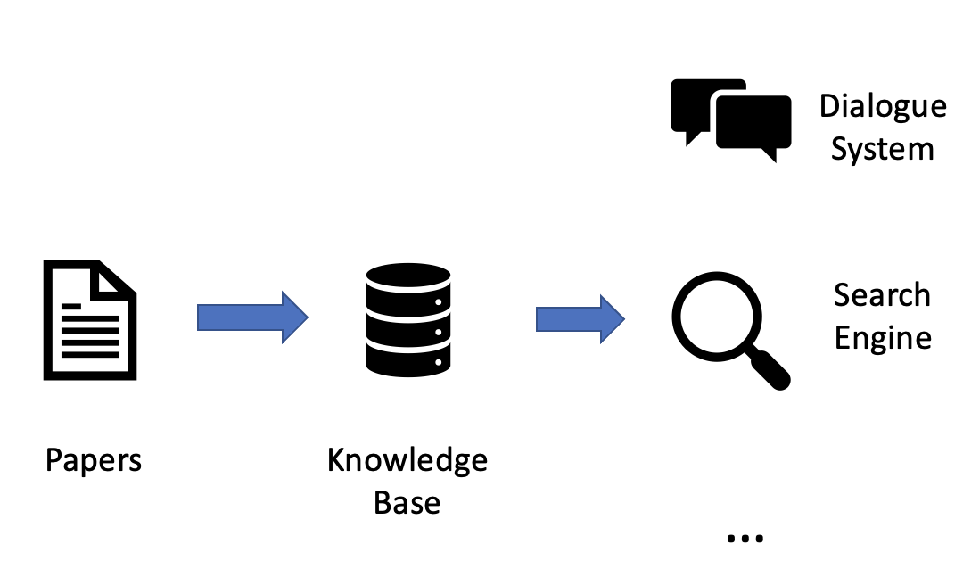
Background
Background
The knowledge in papers is difficult to be utilized directly.
It’s important to convert the unstructured scientific papers into structured knowledge base that can be utilized by downstream tasks.

Slide 5
Background
Challenge
It’s expensive to get a large amount of labeled data, especially in scientific domain.
Weakness of previous work
Several semi-supervised learning methods have been proposed, but they require the input sentence to contain only two entities and the two entities are given.

Slide 6
Methodology
The proposed framework
Aiming to extract all entities and triplets in a sentence in low resource scenarios.
A rebalancing strategy is adopted to alleviate data imbalance.
Transfer learning is used to transfer knowledge.
Label | Proportion
Used-for | 52.5%
Feature-of | 5.4%
Hyponym-of | 9.3%
Evaluate-for | 9.7%
Part-of | 5.6%
Compare | 5.2%
Conjunction | 12.4%

Slide 7
Methodology
Framework

Slide 8
Methodology
Transfer learning
We initialize the last layer of BERT encoder with a BERT encoder trained on source domain.
Semi-supervised learning
Step 1: train model on labeled data.
Step 2: generate pseudo labels on unlabeled data with the trained model.
Step 3: predictions with high confidence score are added to labeled data.
We use the average of all entities and triplets score as the confidence score for each sentence.

Slide 9


Methodology
Rebalancing
Suppose the instance numbers of each class are sorted in descending order
unlabeled instances predicted as class 𝑐 are included into training set at the rate of
$$N_{1}≥N_{2}≥N_{3}≥…≥N_{C}$$
$$P_{c}={(\frac{N_{C−1+c}}{N_{1}})}^{α}$$

Slide 10
Methodology
Representative label
Unlike conventional classification tasks, one sample in entity and relation extraction contains multiple entities and triplets. To solve this problem, we assign the rarest entity label and relation label in predictions as the representative to each sentence respectively.
Label | Proportion
Used-for | 52.5%
Feature-of | 5.4%
Hyponym-of | 9.3%
Evaluate-for | 9.7%
Part-of | 5.6%
Compare | 5.2%
Conjunction | 12.4%
Sentence 1: Used-for, Evaluate-for -> Evaluate-for
sentence 2: Part-of, Feature-of, Compare -> Compare

Slide 11
Experiment
Datasets
SciERC: an information extraction dataset in computer science domain
ADE: an information extraction dataset in biomedicine domain
Baselines
Supervised learning
Self-Training

Slide 12
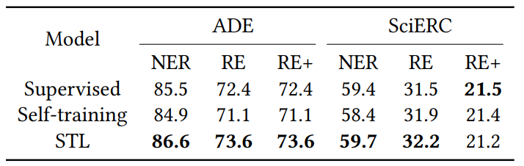
Experiment
Main results

Slide 13
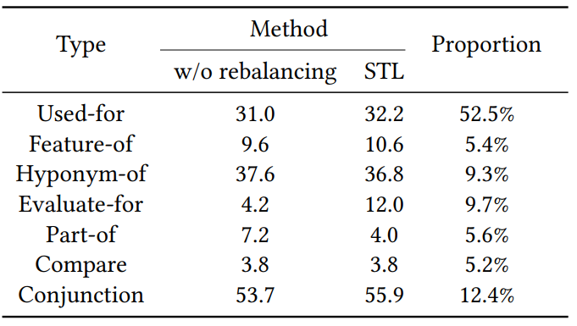
Experiment
Effectiveness of rebalancing

Slide 14
Conclusion
We proposed a semi-supervised transfer learning framework for low resource joint entity and relation extraction in scientific domains.
We adopt a class rebalancing strategy when expanding training set with pseudo labels to prevent bias to majority classes.
To the best of our knowledge, we are the first ones to adopt semi-supervised learning and transfer learning simultaneously for low resource scientific information extraction

Slide 15
Thanks for listening!
Q&A

