Slide 1
ClaimDistiller: Scientific Claim Extraction with Supervised Contrastive Learning
Xin Wei*, Md Reshad Ul Hoque*, Jian Wu, Jiang Li
* Both authors contributed equally to this research

Slide 2

Introduction
Because of the rapid increase of scientific papers indexed by digital libraries, there is an emergent need to help readers to efficiently grasp the main ideas of research papers.
Metadata: title, authors, year, venue
Non-textual content: figures and tables
High-level semantic information: keywords
Scientific claims: key findings and contributions
Challenging:
Scientific ideas are conveyed in a more complicated way
Lack of large-scale training data on claims from scientific papers
@Xin9Xin @WebSciDL

Slide 3
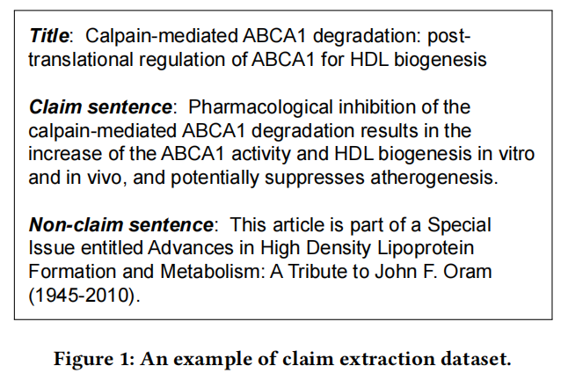
Introduction
The claims to be extracted should be absolute, independent, core findings of the paper.
Claim vs. Conclusion
We focus on extracting claims from abstracts.
Specifically, three types of claims:
Type 1: A statement that declares something is better;
Type 2: A statement that proposes something new;
Type 3: A statement that describes a new finding or a
new cause-effect relationship.
Conclusion
A new finding.
Statement about this article’s contents.
We focus on extracting object names and aspects from figure captions.
@Xin9Xin @WebSciDL

Slide 4
Data
Existing datasets with annotated claims are scarce and not available in all domains.
CoreSC [1]: 265 articles in physical chemistry and biochemistry.
Dr. Inventor [2]: claims extracted from 40 computer graphics articles.
SciCE [3] (claim extraction): the largest dataset so far for scientific claim extraction.
1,500 scientific abstracts in the biomedical domain
Two categories: claim (2276 sentences) and non-claim (9426 sentences)
Training, testing, and validation samples are 750, 375, and 375, respectively
Conclusion
[1] Maria Liakata, Simone Teufel, Advaith Siddharthan, and Colin Batchelor. Corporafor the conceptualisation and zoning of scientific papers. 2010
[2] Beatriz Fisas, Horacio Saggion, and Francesco Ronzano. On the discoursive structure of computer graphics research papers. In Proceedings of the 9th linguistic annotation workshop, pages 42–51, 2015.
[3] Titipat Achakulvisut, Chandra Bhagavatula, Daniel E. Acuna, and Konrad P. Körding. Claim extraction in biomedical publications using deep discourse model and transfer learning. CoRR, abs/1907.00962, 2019.
@Xin9Xin @WebSciDL

Slide 5
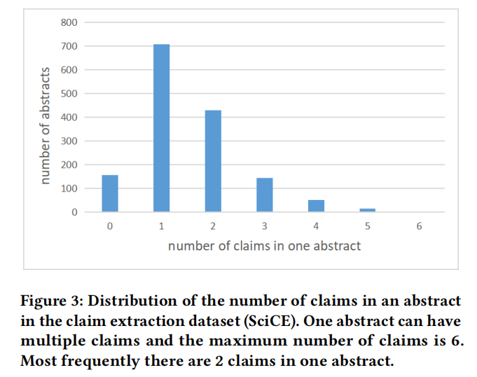
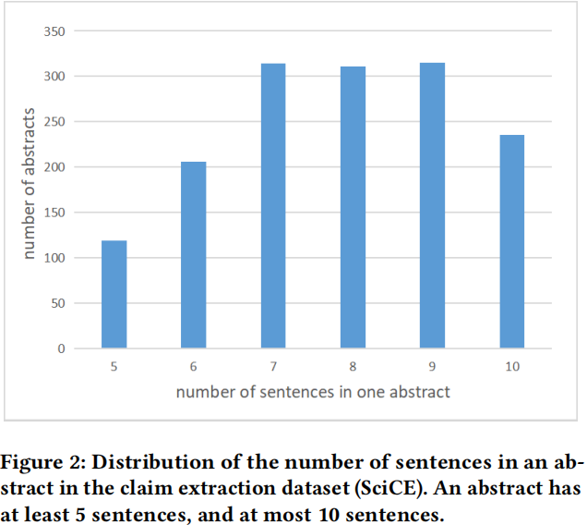
Data: SciCE
Conclusion
We focus on extracting object names and aspects from figure captions.
@Xin9Xin @WebSciDL

Slide 6
Training Framework: ClaimDistiller
Claim extraction task:
A classification problem on a sequence of sentences
The model predicts a class label claim or non-claim for each sentence.
In regular classification models, text is represented in the form of vectors and training a good representation is essential for classification.
We improve the models by adopting supervised contrastive learning to generate better representations.
Self-supervised contrastive learning：
Treats each sample in the dataset as a class
Compares them pairwise after data augmentation to obtain “apparent similarities”
Generates representations for each sample
Supervised contrastive learning: labeled data.
Train a representation that pulls together the same class while simultaneously pushing apart different classes in the embedding space.
Conclusion
We focus on extracting object names and aspects from figure captions.
@Xin9Xin @WebSciDL

Slide 7
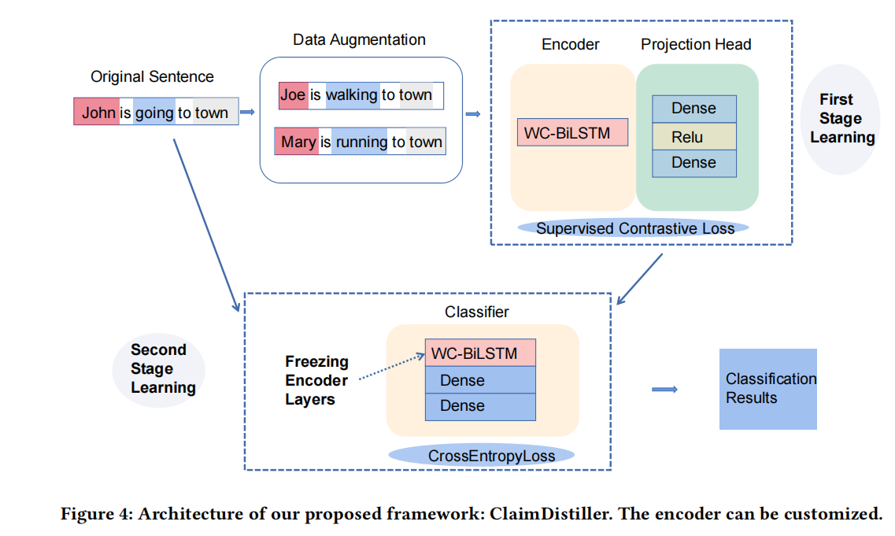
Training Framework: ClaimDistiller
Conclusion
We focus on extracting object names and aspects from figure captions.
@Xin9Xin @WebSciDL

Slide 8
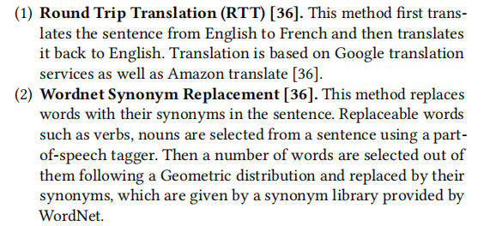
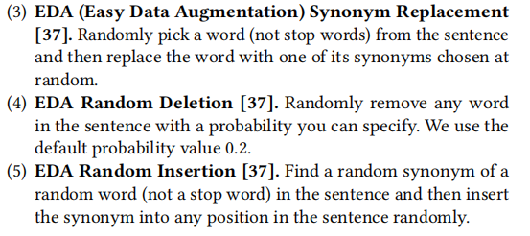
Data Augmentation
Conclusion
[36] Vukosi Marivate and Tshephisho Sefara. Improving short text classification through global augmentation methods. In Machine Learning and Knowledge Ex_x0002_traction: 4th IFIP TC 5, TC 12, WG 8.4, WG 8.9, WG 12.9 International Cross-Domain Conference, CD-MAKE 2020, Dublin, Ireland, August 25–28, 2020, Proceedings 4, pages 385–399. Springer, 2020.
[37] Jason Wei and Kai Zou. Eda: Easy data augmentation techniques for boosting performance on text classification tasks. arXiv preprint arXiv:1901.11196, 2019.
@Xin9Xin @WebSciDL

Slide 9
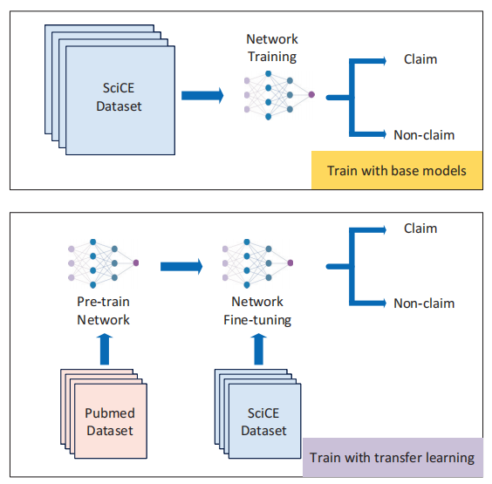
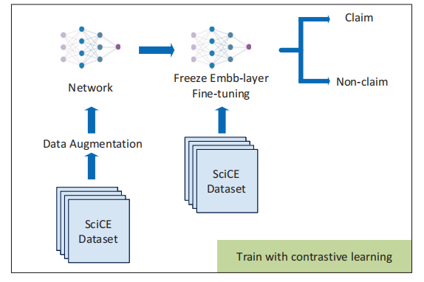
Training Framework: ClaimDistiller
Conclusion
We focus on extracting object names and aspects from figure captions.
@Xin9Xin @WebSciDL

Slide 10
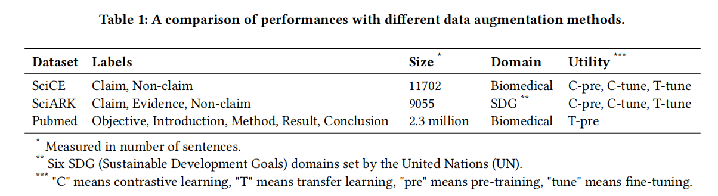
Training Framework: Claimdistiller
Conclusion
We focus on extracting object names and aspects from figure captions.
@Xin9Xin @WebSciDL

Slide 11
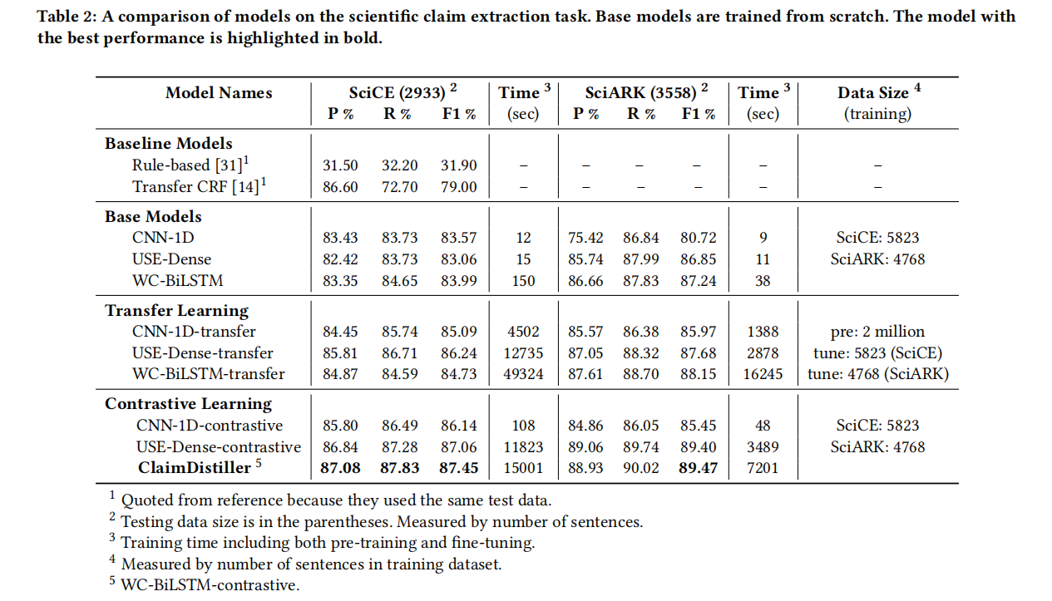
Evaluation
Conclusion
We focus on extracting object names and aspects from figure captions.
@Xin9Xin @WebSciDL

Slide 12
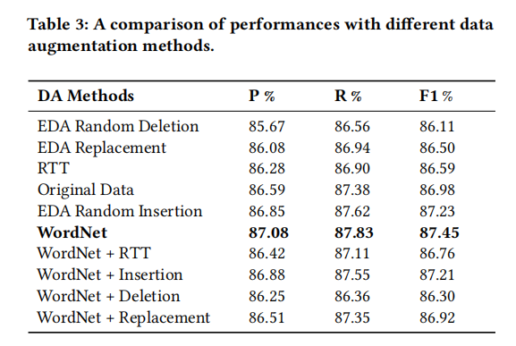
Data Augmentation Analysis
Conclusion
We focus on extracting object names and aspects from figure captions.
@Xin9Xin @WebSciDL

Slide 13
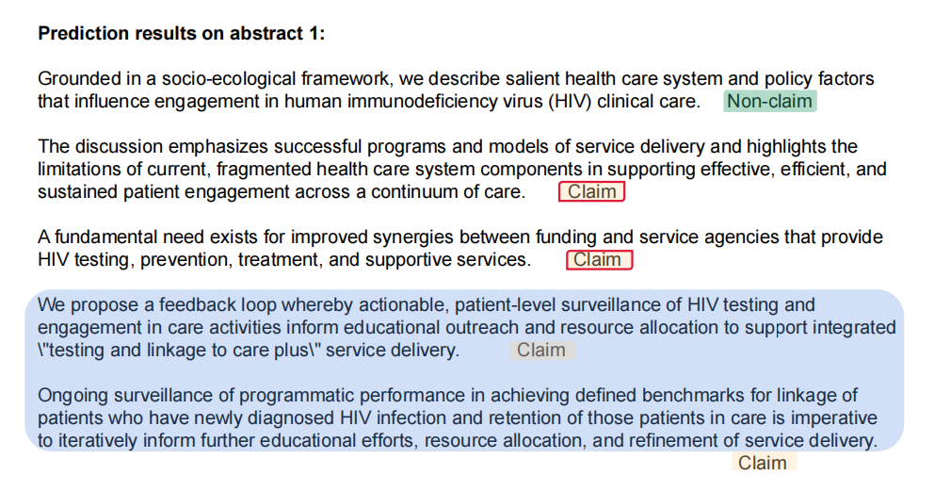
Error Analysis
Conclusion
We focus on extracting object names and aspects from figure captions.
@Xin9Xin @WebSciDL

Slide 14
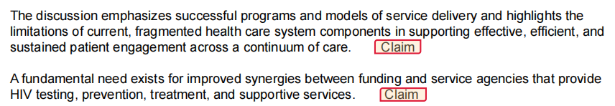
Error Analysis
Errors: Non-claims predicted as claims
Conclusion
A statement about what is this article’s main idea, not claim.
A statement about a fact, not claim.
We focus on extracting object names and aspects from figure captions.
@Xin9Xin @WebSciDL

Slide 15
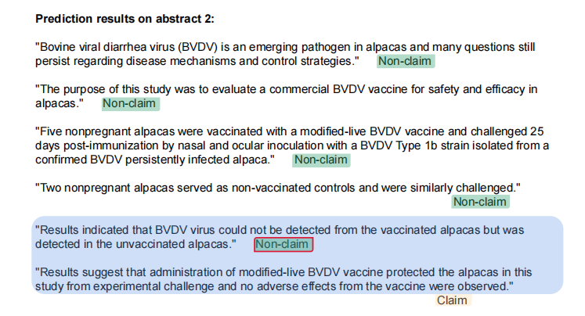
Error Analysis
Conclusion
We focus on extracting object names and aspects from figure captions.
@Xin9Xin @WebSciDL

Slide 16
Error Analysis
Error: claim predicted as non-claims
Conclusion
A statement that describes a new finding, is a claim.
We focus on extracting object names and aspects from figure captions.
@Xin9Xin @WebSciDL

Slide 17
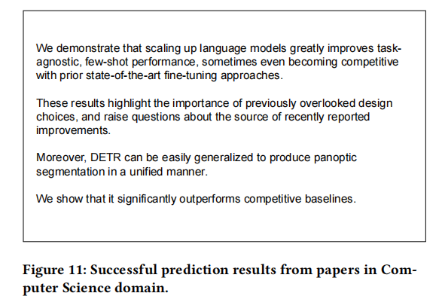
Error Analysis
A new finding
Conclusion
Question on recent progess, something new.
A new finding.
Something is better.
We focus on extracting object names and aspects from figure captions.
@Xin9Xin @WebSciDL

Slide 18
Conclusion
We proposed using supervised contrastive learning for scientific claim extraction. The results show that SCL achieves a comparable or better performance than transfer learning with significantly less training data and training time. The best model achieves an F1=87.45% on the SciCE dataset.
We compared 10 commonly used methods of text augmentation for training SCL in the context of scientific claim extraction. All methods exhibit a marginal effect on the model performance.
Our best model was trained and evaluated on a standard benchmark in the biomedical domain. The model exhibited reasonably well generalizability when it is tested in the computer science domain.
Conclusion
We focus on extracting object names and aspects from figure captions.
@Xin9Xin @WebSciDL

