Slide 1


Characterizing Knowledge Entity Extracted from Citation Sentences
3rd Workshop on Extraction and Evaluation of Knowledge Entities from Scientific Documents (EEKE 2022)
Nam, D., Kim, J., Yoon, J., Song, C., Kim, S., & Song, M. (2022)

Slide 2
Table of Contents
1. Introduction
4. Conclusion
2. Methodology
5. References
3. Results

Slide 3
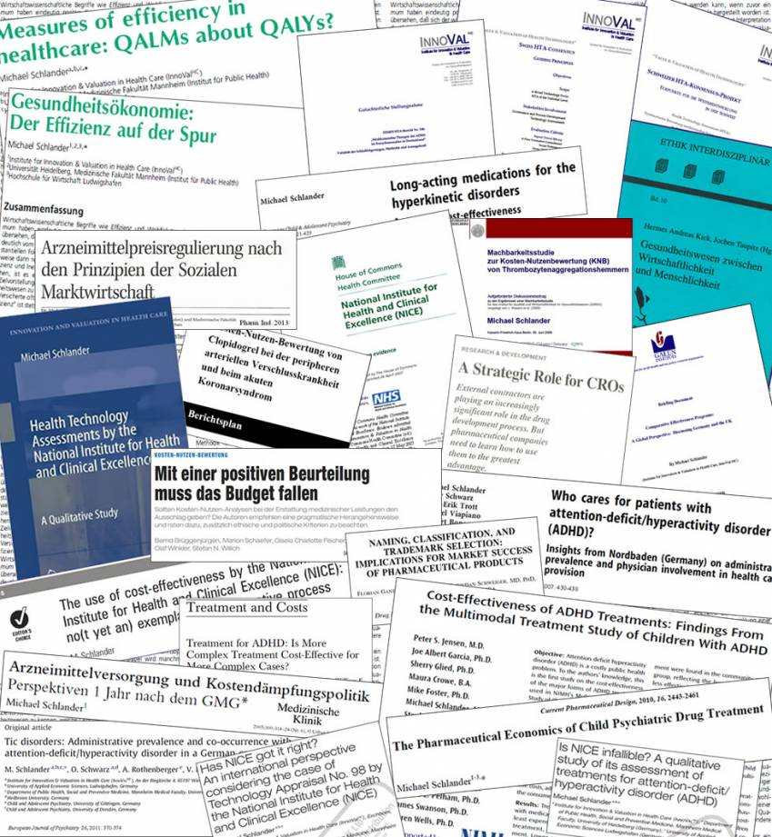
Introduction
Exponential increase of scientific publication is being consistently observed.
The importance of knowledge entities as a means to extract meaningful and structured knowledge from such mass literature is also growing.

Slide 4
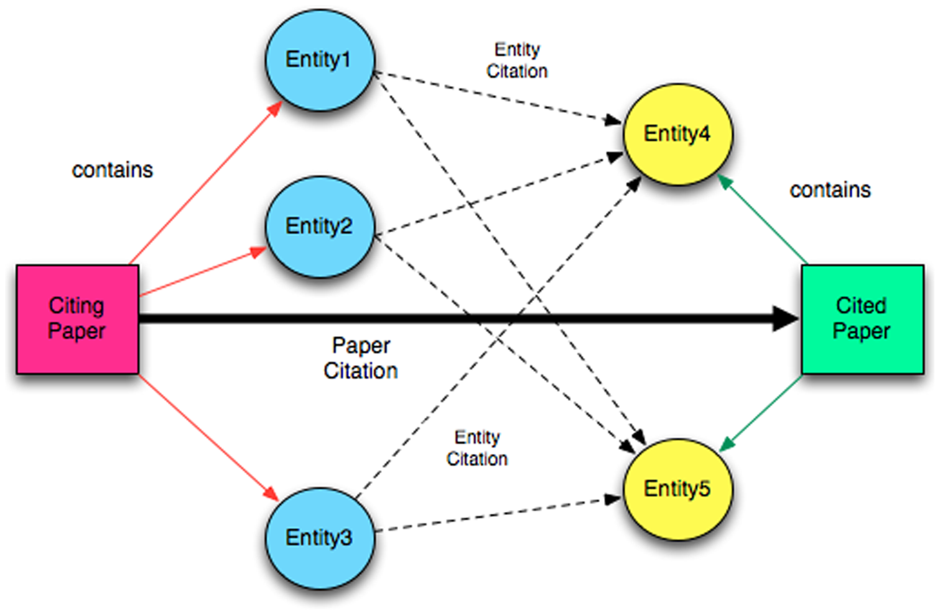
Introduction
Entitymetrics [1] is an approach enabling entity level analysis on scientific literature and related researches are being actively conducted since its proposal in 2013.
Unlike conventional entitymetrics methods that utilized title/abstract or full-text, we propose a novel citation sentence-based approach.
Ding et al. (2013)

Slide 5
Introduction
Citation sentences include both the citing and cited author’s intention for the corresponding contents.
In the perspective of the citing author, he or she takes advantage of the citation sentence in order to obtain credibility for their research.
For the cited author, citation sentence is a channel of recognition receiving acknowledgment from other researchers for their established research findings.

Slide 6
Introduction
In this context, analysis of citation sentence can provide insights, which reflects both citing and cited author’s interest.
This study investigates three different research questions:
How can we construct a citation sentence-based cooccurrence network by using entitymetrics?
What is the key difference between our suggested networks and a conventionally built cooccurrence network?
What kind of new aspects can we find from the knowledge structure of opioid domain by utilizing citation sentence-based networks?

Slide 7
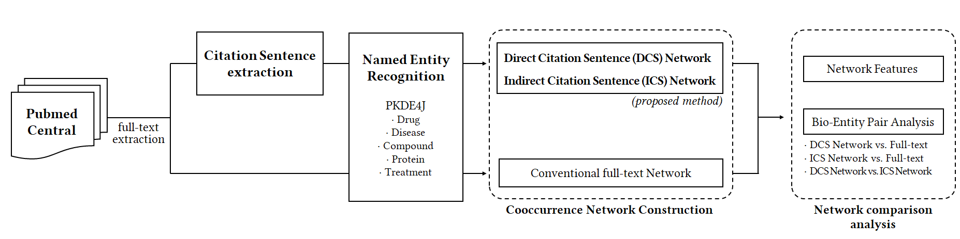
Methodology
Figure 1: The Overall Schematic Research Workflow for the Proposed Methods

Slide 8
Methodology
Data Collection & Parsing
Collected the total full-text research papers that were published until March 2022 by using “opioid” as the search query in PubMed Central (PMC).
Total of 118,808 papers collected.
Based on this, we identified citation sentences that referred to other research publications.
In this process, the cited authors were also matched with the citation sentences.

Slide 9
Methodology
Bio-Entity Extraction (NER)
To extract bio-entities from the collected citation sentences, PKDE4J [13] was employed for named entity recognition (NER).
To obtain comprehensive findings from the collected dataset, we used a total of five biomedical entity dictionaries, which are:
Drug
Disease
Compound
Protein
Treatment

Slide 10
Methodology
Network Construction
This study formed two citation sentence-based networks in accordance with differently set cooccurrence window.
One is built upon entity cooccurrence within same citation sentences, whereas the other is formed based on entity cooccurrence within author information that is included in the citation sentence.
Since the former method considers direct cooccurrence within the citation sentences, it is defined as a direct citation sentence network (DCS network).
The latter approach is defined as an indirect citation sentence network (ICS network) because it captures cooccurrence beyond sentence-based occurrence instance by generating indirect pairs employing author information.

Slide 11
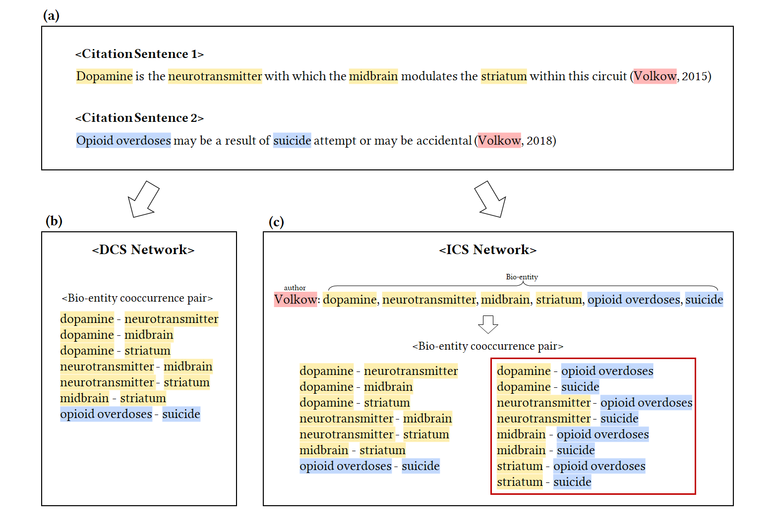
Figure 2: Cooccurrence Network Construction Process for the Direct and Indirect Citation Sentence Network. Newly captured entity pairs are highlighted (red box)

Slide 12
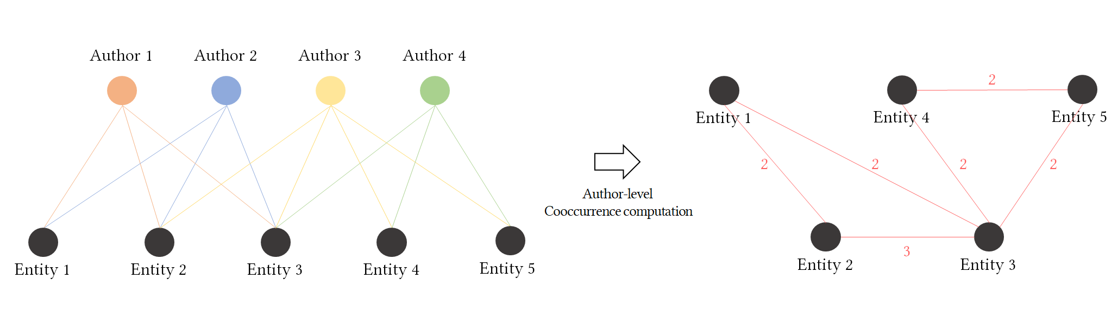
Methodology
Figure 3: Citation sentence-based author-entity bipartite network converted into an entity-entity network

Slide 13
Methodology
Network Comparison Analysis
To demonstrate our proposed method’s usefulness, we compared DCS and ICS network with a conventionally built full-text cooccurrence network in two different aspects.
First, we compared network features (e.g., density, average path length, average clustering coefficient, and modularity) of our suggested networks with the traditional full-text network.
Then, we explored the top-20 bio-entity pairs derived from the cooccurrence results from the DCS and the ICS network and compared them with the traditional network.

Slide 14
Results
Based on different power-law distribution studies [21][22][23], we excluded bio-entities and bio-entity cooccurrence pairs that showed unusually low-frequencies (frequency less than 10) in order to obtain reasonable results by getting rid of non-informative data.
Also, a total of 75 bio-entities that were in the top-100 entity frequency list were excluded due to their ambiguous and overly general characteristics.
DCS network consists of 6,105 bio-entities and 45,087 links, whereas ICS network contains 13,525 bio-entities and 1,831,917 links.
For comparison, a cooccurrence network was formed based on full-text data, which consists of 13,292 bio-entities and 144,800 links.

Slide 15
Results
Network Features
Network Features | Conventional method | DCS Network | ICS Network
Density | 0.00164 | 0.00242 | 0.0201
APL* | 3.351 | 3.434 | 2.336
ACC** | 0.601 | 0.612 | 0.918
Modularity | 0.407 | 0.455 | 0.148
* Average Path Length ** Average Clustering Coefficient
15

Slide 16
Results
Network Features
Table 2: Top-10 bio-entities for each cluster in direct citation sentence network (Cluster 1: pain management-related, Cluster 2: tumor- & disease-related, Cluster 3: anesthetic- & analgesic-related, Cluster 4: psychological disorder- & reward system-related)
Table 1: Top-10 bio-entities for each cluster in full-text network (Cluster 1: anesthetic and analgesic related, Cluster 2: tumor and disease related, Cluster 3: psychological disorder and reward system related)
Table 3: Top-10 bio-entities for each cluster in indirect citation sentence network (Cluster 1: psychological disorder- & reward system-related, Cluster 2: pain disorder-related, Cluster 3: tumor- & disease-related)
Cluster 1 | chronic pain; neuropathic; pain postoperative pain; analgesics; pain management; pain relief; quality of life; hyperalgesia; paracetamol; painful
Cluster 2 | tumor; liver; calcium; mrna; mitochondrial; proliferation; oxidative stress; dna; nmda; il-6
Cluster 3 | morphine; anesthesia; sedation; fentanyl; ketamine; infusion; propofol; epidural; dexmedetomidine; adverse effects
Cluster 4 | SUD; dopamine; addiction; withdrawal; cocaine; reward; amp; mental health; gaba; methadone
Cluster 1 | morphine; anesthesia; fentanyl; infusion; saline; sedation; propofol; ketamine; analgesics; postoperative pain
Cluster 2 | tumor; liver; glucose; mrna; dna; hypertension; hcv; obesity; rna; il-6
Cluster 3 | substance use disorder; withdrawal; chronic pain; addiction; dopamine; cocaine; amp; neuropathic pain; methadone; mental health
Cluster 1 | SUD; addiction; dopamine; withdrawal; mental health; reward; amp; perception; emotional; psychological
Cluster 2 | chronic pain; morphine; neuropathic pain; anesthesia; analgesics; adverse effects; quality of life; pain relief; persistent; postoperative pain
Cluster 3 | tumor; calcium; gaba; liver; mrna; obesity; proliferation; progression; toxicity; oxidative stress

Slide 17
Results
Bio-Entity Pair Analysis – Proposed Networks vs. Full-Text Network
DCS Network vs. Full-Text
Entity 1 | Entity 2 | Freq
SUD | addiction | 1993
mental health | SUD | 1992
methadone | buprenorphine | 1989
morphine | fentanyl | 1942
dopamine | reward | 1544
anesthesia | propofol | 1482
cbd | thc | 1290
glucose | insulin | 1206
heroin | cocaine | 1203
hyperalgesia | allodynia | 1172
postoperative pain | pain management | 1162
withdrawal | morphine | 1146
gabapentin | pregabalin | 1132
propofol | sedation | 1126
naloxone | overdose | 1119
morphine | oxycodone | 1107
anterior | posterior | 1092
hip | fracture | 1052
amphetamine | cocaine | 1050
SUD | cocaine | 1048
ICS Network vs. Full-Text
Entity 1 | Entity 2 | Freq
SUD | addiction | 8684
mental health | SUD | 6480
chronic pain | neuropathic pain | 6080
SUD | cocaine | 5814
dopamine | reward | 5363
withdrawal | SUD | 4819
withdrawal | addiction | 4507
addiction | reward | 4448
abuse | SUD | 4246
chronic pain | morphine | 4227
analgesics | morphine | 4210
morphine | fentanyl | 4177
analgesics | chronic pain | 4159
dopamine | addiction | 4135
SUD | heroin | 4120
SUD | reward | 4110
addiction | cocaine | 4108
dopamine | SUD | 4105
chronic pain | pain management | 4002
SUD | relapse | 3930
Table 4: Top-20 bio-entity pair in the direct citation sentence network (bolded pairs represent exclusive pairs compared with the full-text network)
Table 5: Top-20 bio-entity pair in the indirect citation sentence network (bolded pairs represent exclusive pairs compared with the full-text network)

Slide 18
Results
Bio-Entity Pair Analysis – DCS Network vs. ICS Network
DCS Network
Entity 1 | Entity 2
SUD | addiction
mental health | SUD
methadone | buprenorphine
morphine | fentanyl
dopamine | reward
anesthesia | propofol
cbd | thc
glucose | insulin
heroin | cocaine
hyperalgesia | allodynia
postoperative pain | pain management
withdrawal | morphine
gabapentin | pregabalin
propofol | sedation
naloxone | overdose
morphine | oxycodone
anterior | posterior
hip | fracture
amphetamine | cocaine
SUD | cocaine
ICS Network
Entity 1 | Entity 2
SUD | addiction
mental health | SUD
chronic pain | neuropathic pain
SUD | cocaine
dopamine | reward
withdrawal | SUD
withdrawal | addiction
addiction | reward
abuse | SUD
chronic pain | morphine
analgesics | morphine
morphine | fentanyl
analgesics | chronic pain
dopamine | addiction
SUD | heroin
SUD | reward
addiction | cocaine
dopamine | SUD
chronic pain | pain management
SUD | relapse
Table 6: Top-20 bio-entity pair comparison between DCS and ICS network (bolded pairs represent exclusive pairs compared with each other)

Slide 19
Conclusion
RQ1: How can we construct a citation sentence-based cooccurrence network by using entitymetrics?
DCS network & ICS network
RQ2: What is the key difference between our suggested networks and a conventionally built cooccurrence network?
Network feature comparison
RQ3: What kind of new aspects can we find from the knowledge structure of opioid domain by utilizing citation sentence-based networks?
Bio-entity cooccurrence pair analysis

Slide 20
Conclusion
It was found that a citation sentence-based approach can expand the base of entitymetrics.
By constructing the DCS and ICS network, it was clear that each of these novel networks provided different insights for the exploration of knowledge entity and knowledge structure.
While the ICS network tends to provide much more general and broader bio-entity pairs, the DCS network offers much more specific and specialized bio-entity pairs.
These methods can support the need for the use of citation sentences in future entitymetrics studies when a more in-depth knowledge structure analysis is needed.

Slide 21
References
[1] Ying Ding, Min Song, Jia Han, Qi Yu, Erjia Yan, Lili Lin, and Tamy Chambers, 2013. Entitymetrics: Measuring the impact of entities. PloS one 8, 8 (Aug, 2013), e71416. DOI: https://doi.org/10.1371/journal.pone.0071416
[2] Allan Peter Davis, Thomas C. Wiegers, Phoebe M. Roberts, Benjamin L. King, Jean M. Lay, Kelley Lennon-Hopkins, Daniela Sciaky, Robin Johnson, Heather Keating, Nigel Greene, Robert Hernandez, Kevin J. McConnell, Ahmed E. Enayetallah, and Carolyn J. Mattingly, 2013. A CTD–Pfizer collaboration: manual curation of 88
[3] Xuelian Pan, Erjia Yan, Ming Cui, and Weina Hua, 2018. Examining the usage, citation, and diffusion patterns of bibliometric mapping software: A comparative study of three tools. Journal of informetrics 12, 2 (May, 2018), 481-493. DOI: https://doi.org/10.1016/j.joi.2018.03.005
[4] Yoo Kyung Jeong, Qing Xie, Erjia Yan, and Min Song, 2020. Examining drug and side effect relation using author–entity pair bipartite networks. Journal of informetrics 14, 1 (Feb, 2020), 100999. DOI: https://doi.org/10.1016/j.joi.2019.100999
[5] Yongjun Zhu, Min Song, and Erjia Yan, 2016. Identifying liver cancer and its relations with diseases, drugs, and genes: A literature-based approach. PLoS One 11, 5 (May, 2016), e0156091. DOI: https://doi.org/10.1371/journal.pone.0156091
[6] Bahaa Ibrahim, 2021. Statistical methods used in Arabic journals of library and information science. Scientometrics 126, 5 (Mar, 2021), 4383-4416. DOI: https://doi.org/10.1007/s11192-021-03913-2
[7] Yuzhuo Wang and Chengzhi Zhang. 2018. Using Full-Text of Research Articles to Analyze Academic Impact of Algorithms. In: Chowdhury, G., McLeod, J., Gillet, V., Willett, P. (eds) Transforming Digital Worlds. iConference 2018. Lecture Notes in Computer Science, vol 10766. Springer, Cham. DOI: https://doi.org/10.1007/978-3-319-78105-1_43
[8] Yuzhuo, Wang and Chengzhi Zhang, 2020. Using the full-text content of academic articles to identify and evaluate algorithm entities in the domain of natural language processing. Journal of Informetrics 14, 4 (Nov, 2020), 101091. DOI: https://doi.org/10.1016/j.joi.2020.101091
[9] Mengnan Zhao, Erjia Yan, and Kai Li, 2017. Data set mentions and citations: A content analysis of full-text publications. Journal of the Association for Information Science and Technology 69, 1 (Sep, 2018), 32-46. DOI: https://doi.org/10.1002/asi.23919
[10] Yuzhuo Wang, Chengzhi Zhang, and Kai Li, 2022. A review on method entities in the academic literature: extraction, evaluation, and application. Scientometrics, (Mar, 2022), 1-42. DOI: https://doi.org/10.1007/s11192-022-04332-7
[11] Yanhua Lv, Ying Ding, Min Song, and Zhiguang Duan, 2018. Topology-driven trend analysis for drug discovery. Journal of Informetrics 12, 3 (Aug, 2018), 893-905. DOI: https://doi.org/10.1016/j.joi.2018.07.007
[12] Xin Li, Justin F. Rousseau, Ying Ding, Min Song, and Wei Lu, 2020. Understanding drug repurposing from the perspective of biomedical entities and their evolution: Bibliographic research using aspirin. MIR medical informatics 8, 6 (Jun, 2020), e16739. DOI: https://doi.org/10.2196/16739
[13] Nora D. Volkow, Emily B. Jones, Emily B. Einstein, and Eric M. Wargo, 2019, Prevention and treatment of opioid misuse and addiction: A review. JAMA Psychiatry, 76, 2 (Feb, 2019) 208–216. DOI: https://doi.org/10.1001/jamapsychiatry.2018.3126
[14] Waleed M. Sweileh, Naser Y. Shraim, Sa'ed H. Zyoud and Samah W. Al‑Jabi, 2016, Worldwide research productivity on tramadol: A bibliometric analysis. SpringerPlus, 5, 1108 (Jul, 2016) DOI: https://doi.org/10.1186/s40064-016-2801-5
[15] Min Song, Won Chul Kim, Dahee Lee, Go Eun Heo, and Keun Young Kang, 2015. PKDE4J: Entity and relation extraction for public knowledge discovery. Journal of biomedical informatics 57, (Oct, 2015), 320-332. DOI: https://doi.org/10.1016/j.jbi.2015.08.008
[16] Guoyong Mao, and Ning Zhang, 2013. Analysis of Average Shortest-Path Length of Scale-Free Network. Journal of Applied Mathematics 2013, (Jul, 2013). DOI: https://doi.org/10.1155/2013/865643
[17] Stanley Wasserman and Katherine Faust. 1994. Social network analysis: Methods and applications (1st. ed.). Cambridge University Press, Cambridge, England.
[18] Vincent D Blondel, Jean-Loup Guillaume, Renaud Lambiotte, and Etienne Lefebvre, 2008. Fast unfolding of communities in large networks. Journal of statistical mechanics: theory and experiment 2008, 10 (Oct, 2008), P10008. DOI: https://doi.org/10.1088/1742-5468/2008/10/P10008
[19] M. E. J. Newman, 2004. Analysis of weighted networks. Physical review E 70, 5 (Nov, 2004), 056131. DOI: https://doi.org/10.1103/PhysRevE.70.056131
[20] Kate Flemming MSc, RN, 2010. The Use of Morphine to Treat Cancer-Related Pain: A Synthesis of Quantitative and Qualitative Research. Journal of Pain and Symptom Management 39, 1 (Jan, 2010), 139-154. DOI: https://doi.org/10.1016/j.jpainsymman.2009.05.014
[21] Garrett Enten, Mina A. Shenouda, David Samuels, Naomi Fowler, Maha Balouch, and Enrico Camporesi, 2019. A Retrospective Analysis of the Safety and Efficacy of Opioid-free Anesthesia versus Opioid Anesthesia for General Cesarean Section. Cureus 11, 9 (Sep, 2019), e5725. DOI: https://doi.org/10.7759/cureus.5725
[22] Andrew Kolodny, David T. Courtwright, Catherine S. Hwang, Peter Kreiner, John L. Eadie, Thomas W. Clark, and G. Caleb Alexander, 2015. The Prescription Opioid and Heroin Crisis: A Public Health Approach to an Epidemic of Addiction. Annual review of public health 36, (Mar, 2015), 559-574. DOI: https://doi.org/10.1146/annurev-publhealth-031914-122957
[23] Steven T. Piantadosi, 2014. Zipf’s word frequency law in natural language: A critical review and future directions. Psychonomic bulletin & review 21, 5 (Mar, 2014), 1112-1130. DOI: https://doi.org/10.3758/s13423-014-0585-6
[24] Álvaro Corral, Gemma Boleda, and Ramon Ferrer-i-Cancho, 2015. Zipf’s law for word frequencies: word forms versus lemmas in long texts. PloS one 10, 7 (Jul, 2015), e0129031. DOI: https://doi.org/10.1371/journal.pone.0129031
[25] Staša Milojević, 2010. Power law distributions in information science: Making the case for logarithmic binning. Journal of the American Society for Information Science and Technology 61, 12 (Nov, 2010), 2417-2425. DOI: https://doi.org/10.1371/journal.pone.0129031
[26] M. E. J. Newman, 2004. Fast algorithm for detecting community structure in networks. Physical review E 69, 6 (Jun, 2004), 066133. DOI: https://doi.org/10.1103/PhysRevE.69.066133
[27] Lauri Nummenmaa, Tiina Saanijoki, Lauri Tuominen, Jussi Hirvonen, Jetro J. Tuulari, Pirjo Nuutila, and Kari Kalliokoski, 2018. μ-opioid receptor system mediates reward processing in humans. Nature communications 9, 1 (Apr, 2018), 1-7. DOI: https://doi.org/10.1038/s41467-018-03848-y
[28] Julie Le Merrer, Jérôme A. J. Becker, Katia Befort, and Brigitte L. Kieffer, 2009. Reward processing by the opioid system in the brain. Physiological reviews, (Oct, 2009). DOI: https://doi.org/10.1152/physrev.00005.2009
[29] Troels S Jensen and Nanna B Finnerup, 2014. Allodynia and hyperalgesia in neuropathic pain: clinical manifestations and mechanisms. The Lancet Neurology 13, 9 (Sep, 2014), 924-935. DOI: https://doi.org/10.1016/S1474-4422(14)70102-4
[30] Marion Lee, Sanford Silverman, Hans Hansen, Vikram Patel, and Laxmaiah Manchikanti, 2011. A comprehensive review of opioid-induced hyperalgesia. Pain Physician 14, 2 (Jan, 2011), 145-161.
[31] Maurice H. Zissen, Guohua Zhang, Alvin McKelvy, John T. Propst, Joan J. Kendig, and Sarah M. Sweitzer, 2007. Tolerance, opioid-induced allodynia and withdrawal associated allodynia in infant and young rats. Neuroscience 144, 1 (Jan, 2007), 247-262. DOI: https://doi.org/10.1016/j.neuroscience.2006.08.078
[32] Tara Gomes, David N. Juurlink, Tony Antoniou, Muhammad M. Mamdani, J. Michael Paterson, and Wim van den Brink, 2017. Tolerance, opioid-induced allodynia and withdrawal associated allodynia in infant and young rats. PLoS Med 14, 10 (Oct, 2017), 247-262. e1002396. DOI: https://doi.org/10.1371/journal.pmed.1002396
[33] Emma Morrison, Euan A. Sandilands, and David J. Webb, 2017. Gabapentin and pregabalin: Do the benefits outweigh the harms? The Journal of the Royal College of Physicians of Edinburgh 47, 4 (Dec, 2017), 310-313. DOI: https://doi.org/10.4997/JRCPE.2017.402
[34] Preeti Manandhar​, Bridin Patricia Murnion​, Natasha L. Grimsey, Mark Connor, and Marina Santiago, 2021. Do gabapentin or pregabalin directly modulate the µ receptor? PeerJ 9, (Apr, 2021), e11175. DOI: https://doi.org/10.7717/peerj.11175
[35] Sinead McNamara, Siobhan Stokes, R. Kilduff, and Aine Shine, 2015. Pregabalin Abuse amongst Opioid Substitution Treatment Patients. Ir Med J 108, 10 (Nov, 2015), 309-310. DOI: https://doi.org/10.7717/peerj.11175
[36] European Monitoring Centre for Drugs and Drug Addiction and Kateřina Škařupová, 2014 The levels of use of opioids, amphetamines and cocaine and associated levels of harm : summary of scientific evidence. Publications Office. DOI: https://data.europa.eu/doi/10.2810/49447
[37] Wilson M. Compton, Christopher M. Jones, and Grant T. Baldwin, 2016. Relationship between nonmedical prescription-opioid use and heroin use. New England Journal of Medicine 374, 2 (Jan, 2016), 154-163. DOI: https://doi.org/10.1056/NEJMra1508490
[38] Howard L. Fields, 2011. The Doctor's Dilemma: Opiate Analgesics and Chronic Pain. Neuron 69, 4 (Feb, 2011), 591-594. DOI: https://doi.org/10.1016/j.neuron.2011.02.001Conference Short Name:WOODSTOCK’18

Slide 22
Thank You

