Slide 1

Medical Schema Matching using Knowledge Graph Embedding
Chaoyu Gao¹, Tianxing Wu¹, Shengqi Jing² and Yuxiang Wang³
¹Southeast University
²The First Affiliated Hospital of Nanjing Medical University
³Hangzhou Dianzi University

Slide 2
Outline
Motivation
Approach
  Direct Mapping
  Medical Entity Description Embedding
  Schema Matching
Experiments
Conclusions and Future Work
References

Slide 3
Outline
Motivation
Approach
  Direct Mapping
  Medical Entity Description Embedding
  Schema Matching
Experiments
Conclusions and Future Work
References
Notes:
We begin our presentation with the Motivation

Slide 4
Motivation
Different medical institutions have different schemas in their databases, which makes medical data fusion difficult. Thus, it becomes an urgent problem to effectively fuse multi-source data from different medical databases.
Schema matching is the process of capturing correspondence between columns of different relational tables
Notes:
Different medical institutions have different schemas in their databases, which makes medical data fusion difficult. Thus, it becomes an urgent problem to effectively fuse multi-source data from different medical databases.
Schema matching is an important approach to fuse heterogeneous databases.
Schema matching is the process of capturing correspondence between columns of different relational tables

Slide 5
Motivation (cont.)
Lots of efforts have been made in the general field.
  SMGR [1]: leverage the experience of experts and statistical machine learning methods to design hand-crafted features and
  create regular expressions
  ISMW[2]: vectorize instances by pre-trained language models, and make semantic comparison with vector similarities to get the equivalent relations between columns
Notes:
Some researchers [1] leverage the experience of experts and statistical machine learning methods to design hand-crafted features and create regular expressions for schema matching, which requires sufficient labeled data, and the corresponding annotation costs. With the great success of pre-trained language models, one line of researches [2] attempts to vectorize instances by pre-trained language models, and make semantic comparison with vector similarities to get the eq

Slide 6
Motivation (cont.)
Two drawbacks of current techniques when directly applied in the medical field are:
  Complexity of relations among medical instances
  Lack of domain knowledge
Notes:
Although the previous researches have achieved good results, they have the following problems when directly applied in the medical field. Firstly, relations among medical instances are complicated, which makes it difficult for matching medical schemas using pre-trained language models. Secondly, medical schema matching lacks domain knowledge, which lowers the quality of matching results.

Slide 7
Motivation (cont.)
Two drawbacks of current techniques when directly applied in the medical field are:
  Complexity of relations among medical instances
  Lack of domain knowledge
We aims to make the first effort to mine equivalent relations between columns of relational tables in heterogeneous database with the support of medical domain knowledge from Chinese medical encyclopedia[4].
Notes:
To address the above problems, we propose a new medical schema matching method using knowledge graph embedding which incorporates medical domain knowledge.
We use knowledge graph embedding to better characterize the contextual information of entities and properties and solve the problem of complex relations.
The Chinese medical encyclopedia is an online medical encyclopedia describing medical entities. We take the text descriptions of entities from it as background knowledge to solve the problem of lacking domain knowledge.

Slide 8
Outline
Motivation
Approach
  Direct Mapping
  Medical Entity Description Embedding
  Schema Matching
Experiments
Conclusions and Future Work
References
Notes:
Next is the approach

Slide 9
Approach
We begin our modeling with transformation from structured databses to knowledge graphs.

Slide 10
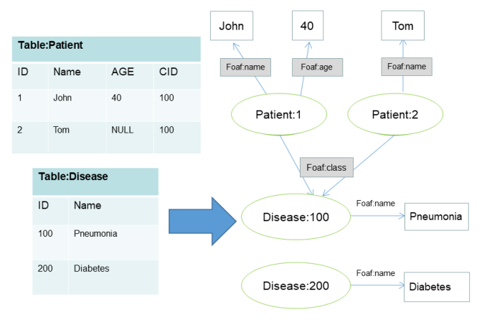
Direct Mapping
Table names of the structured databases are used as concepts
Notes:
Referring to the Direct Mapping standard established by W3C2[7] , we propose a rule-based method to transform medical structured databases into medical knowledge graphs for knowledge fusion. The details are as follows:

Slide 11
Direct Mapping
Columns of tables are regarded as properties

Slide 12
Direct Mapping
Rows of tables are regarded as instances

Slide 13
Direct Mapping
Cell values in each row are literals or instances (if the columnis a foreign key)

Slide 14
Outline
Motivation
Approach
  Direct Mapping
  Medical Entity Description Embedding
  Schema Matching
Experiments
Conclusions and Future Work
References
Notes:
Then, next subsection is Medical Entity Description Embedding

Slide 15
Medical Entity Description Embedding
The existing text-based pre-trained language model (PTLM) lacks medical knowledge to capture the semantic information of low frequency medical professional words
Chinese medical encyclopedia contains rich structured information, which could greatly improve the learning performance of the existing PTLM
We propose a medical entity description embedding framework (MEDE) based on the pre-trained language model
Notes:
The existing text-based pre-trained language model (PTLM) lacks medical knowledge to capture the semantic information of low frequency medical professional words, while the Chinese medical encyclopedia contains rich structured information, which could greatly improve the learning performance of the existing PTLM. To better represent concepts and properties in the medical field, we propose a medical entity description embedding framework (MEDE) based on the pre-trained language model.

Slide 16
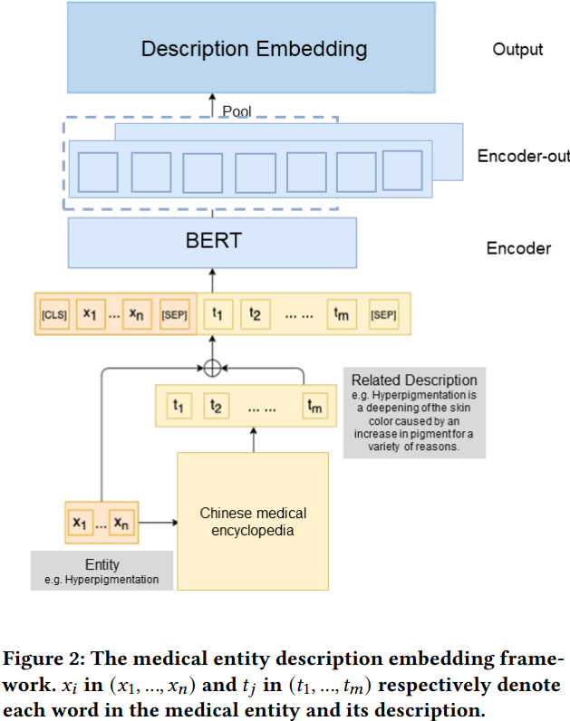
Medical Entity Description Embedding
The medical entity is used as a query to extract a related description from the Chinese medical encyclopedia
Notes:
MEDE consists of the following steps: firstly, the medical entity is used as a query to extract a related description from the Chinese medical encyclopedia,

Slide 17
Medical Entity Description Embedding
The medical entity is used as a query to extract a related description from the Chinese medical encyclopedia
The entity and description are concatenated as the input
Notes:
then the entity and description are concatenated as the input.

Slide 18
Medical Entity Description Embedding
The medical entity is used as a query to extract a related description from the Chinese medical encyclopedia
The entity and description are concatenated as the input
The input will be encoded by BERT[5] encoder, and then pooled into the vector as the output
Notes:
finally, the input will be encoded by BERT encoder, and then pooled into the vector as the output of the encoder.
The input to MEDE consists of the medical entity and its relevant description from the Chinese medical encyclopedia. In this paper, we follow the standard method where the tokens are surrounded respectively by [CLS] and [SEP] on the left and right. For example, if the input entity and description are “Hyperpigmentation” and “Hyperpigmentation is a deepening of the skin color caused by an increase in pigment for a variety of reasons.”, the input to our encoder would be: [CLS]+ “Hyperpigmentation” +[SEP]+ “Hyperpigmentation is a deepening of the skin color caused by an increase in pigment for a variety of reasons.” + [SEP].

Slide 19
Outline
Motivation
Approach
  Direct Mapping
  Medical Entity Description Embedding
  Schema Matching
Experiments
Conclusions and Future Work
References
Notes:
The last subsection of approach is schema matching.

Slide 20
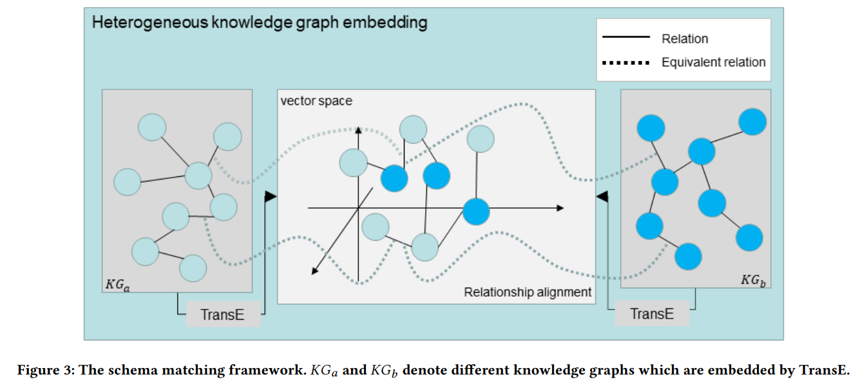
Schema Matching
We present our schema matching framework using knowledge graph embedding
Notes:
We present our schema matching framework using knowledge graph embedding. As shown in figure 3, the proposed framework consists of two modules: heterogeneous knowledge graph embedding module, and relation alignment module

Slide 21
Schema Matching
Heterogeneous knowledge graph embedding module learn knowledge graph embeddings
Notes:
heterogeneous knowledge graph embedding module learn knowledge graph embeddings.
Specially, we firstly initialize entities and relations of heterogeneous knowledge graphs using vectors obtained in the subsection Medical Entity Description Embedding
, then employ the basic translation-based method TransE [6] for the involved knowledge graphs, which embeds different knowledge graph in different spaces, and calculates their common loss function.

Slide 22
Schema Matching
Relation alignment module captures the equivalent relations from different knowledge graphs, and discovers new equivalent relations through iterative training
Notes:
relation alignment module captures the equivalent relations from different knowledge graphs, and discovers new equivalent relations through iterative training.
The objective of relation alignment is to capture the transformation between the vector spaces. We adopt the linear transformation based technology, which has pretty good effectiveness among the alignment methods based on Knowledge Graph Embedding

Slide 23
Outline
Motivation
Approach
  Direct Mapping
  Medical Entity Description Embedding
  Schema Matching
Experiments
Conclusions and Future Work
References
Notes:
Then ,we will show the experiments

Slide 24
Experiment
Datasets
We evaluated our proposed method on a real-world dataset.
The real-world dataset consists of the medical data information from Jiangsu Province Hospital relevant medical treatment combination (Hospital J and Hospital K denote them for privacy) in the third quarter of 2020, manually labeled equivalent relation pairs across the heterogeneous medical data, and medical entity descriptions of the Chinese medical encyclopedia
Notes:
We evaluated our proposed method on a real-world dataset, which consists of the medical data information from Jiangsu Province Hospital relevant medical treatment combination (Hospital J and Hospital K denote them for privacy) in the third quarter of 2020, manually labeled equivalent relation pairs across the heterogeneous medical data, and medical entity descriptions of the Chinese medical encyclopedia.

Slide 25
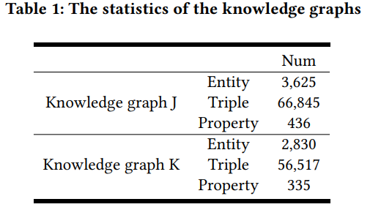
Experiment
Datasets
Data of Hospital J and Hospital K were respectively transformed into medical knowledge graph J and K through direct mapping
Notes:
Data of Hospital J and Hospital K were respectively transformed into medical knowledge graph J and K through direct mapping. Table 1 shows the statistics of the knowledge graphs. We invite medical experts to obtain high-quality labeled data manually.

Slide 26
Experiment
Experimental Results(Comparison with Other approaches)
SMGR [1] adopts the strategies that combine the strengths of Google similarity as a web semantic and regular expression as pattern recognition to identify 1-to-1 schema matching
ISMW [2] proposed an instance-based schema matching approach using the Word2Vec as the semantic similarity to capture accurate relations between heterogeneous data
REMA [3] obtains semantically relevant columns based on context information extracted from the data table to generate pattern matches.
Notes:
We evaluated the effectiveness of the proposed model in the testing set. We compared our method with the following baselines

Slide 27
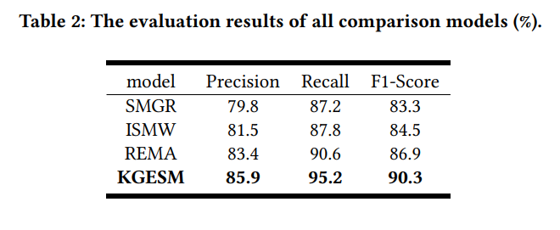
Experiment
Experimental Results(Comparison with Other approaches)
Our proposed model, KGESM achieves the best performance in terms of precision, recall, and F1-score, which is shown in Table 2.
SMGR is inferior to other methods in both accuracy and recall.
Notes:
Our proposed model, KGESM achieves the best performance in terms of precision, recall, and F1-score, which is shown in Table 2. Although SMGR uses Google similarity and regular expressions as the basis of schema matching, the traditional statistical machine learning method SMGR needs large-scale labeled data, which is undoubtedly missing in the medical field, and causes that SMGR being inferior to other methods in both accuracy and recall. In addition, ISMW performs marginally better and verifies the excellent performance of the pre-trained language models. However, owing to the influence of the unknown words which is common in the medical field, it is hard for Word2Vec to encode medical concepts and properties. While BERT uses word-based coding, which avoids the influence of unknown words, so the KGESM model performs better than ISMW model. As for REMA, it also performs well, and shows the power of exploiting contextual information through graph embedding. However, because of large presence of contractions and misspellings as well as vocabulary mismatch between medical databases, the precision of REMA is affected. Instead, KGESM employs medical knowledge from the Chinese medical encyclopedia to correct these errors in the medical databases and effectively improve the results of schema matching.

Slide 28
Experiment
Experimental Results(Comparison with Other approaches)
ISMW performs marginally better and verifies the excellent performance of the pre-trained language models.
REMA also performs well, and shows the power of exploiting contextual information through graph embedding.
Notes:
In addition, ISMW performs marginally better and verifies the excellent performance of the pre-trained language models. However, owing to the influence of the unknown words which is common in the medical field, it is hard for Word2Vec to encode medical concepts and properties. While BERT uses word-based coding, which avoids the influence of unknown words, so the KGESM model performs better than ISMW model. As for REMA, it also performs well, and shows the power of exploiting contextual information through graph embedding. However, because of large presence of contractions and misspellings as well as vocabulary mismatch between medical databases, the precision of REMA is affected. Instead, KGESM employs medical knowledge from the Chinese medical encyclopedia to correct these errors in the medical databases and effectively improve the results of schema matching.

Slide 29
Outline
Motivation
Approach
  Direct Mapping
  Medical Entity Description Embedding
  Schema Matching
Experiments
Conclusions and Future Work
References
Notes:
Next is conclusions and future work

Slide 30
Conclusions and Future Work
Conclusions
we combine the medical domain-specific knowledge and the knowledge graph embedding model to handle the task of medical schema matching.
We first propose a medical schema matching method (KGESM) by knowledge graph embedding to capture equivalent relations between columns of relational tables in heterogeneous databases.
Experimental results show the high quality of KGESM on the real-world dataset.
Future Work
We will explore to mine complex equivalent relations (e.g., 1-to-n and m-to-n matches) between properties in medical schema matching
We plan to develop the framework for automatically matching multiple medical schemas simultaneously.
Notes:
In this paper, we combine the medical domain-specific knowledge and the knowledge graph embedding model to handle the task of medical schema matching. We first propose a medical schema matching method (KGESM) by knowledge graph embedding to capture equivalent relations between columns of relational tables in heterogeneous databases. With the direct mapping method, we extract knowledge from relational databases to construct medical heterogeneous knowledge graphs, then we leverage the Chinese medical encyclopedia to learn better representation of medical concepts and properties. Finally, our proposed schema matching framework employs the knowledge graph embedding to discover the equivalent relations. Experimental results show the high quality of KGESM on the real-world dataset.
As for the future work, we will explore to mine complex equivalent relations (e.g., 1-to-n and m-to-n matches) between properties in medical schema matching. In addition, we plan to develop the framework for automatically matching multiple medical schemas simultaneously.

Slide 31
Outline
Motivation
Approach
  Direct Mapping
  Medical Entity Description Embedding
  Schema Matching
Experiments
Conclusions and Future Work
References
Notes:
In the end is the reference

Slide 32
References
[1] Osama Mehdi, Hamidah Ibrahim, and Lilly Affendey. An approach for instance based schema matching with google similarity and regular expression. International Arab Journal of Information Technology (IAJIT), 14(5), 201
[2] Kenji Nozaki, Teruhisa Hochin, and Hiroki Nomiya. Semantic schema matching for string attribute with word vectors and its evaluation. Int. J. Networked Distributed Comput., 7(3):100–106, 2019.
[3] Christos Koutras, Marios Fragkoulis, Asterios Katsifodimos, and Christoph Lofi. Rema: Graph embeddings-based relational schema matching. In EDBT/ICDT Workshops, 2020.
[4] http://www.a-hospital.com/
[5] Jacob Devlin, Ming-Wei Chang, Kenton Lee, and Kristina Toutanova. Bert: Pre-training of deep bidirectional transformers for language understanding. arXiv preprint arXiv:1810.04805, 2018.
[6] Antoine Bordes, Nicolas Usunier, Alberto Garcia-Duran, Jason Weston, and Oksana Yakhnenko. Translating embeddings for modeling multi-relational data. Advances in neural information processing systems, 26, 2013.
[7] https://www.w3.org/TR/rdb-direct-mapping/

Slide 33


