Slide 1
﻿A Bootstrapped Chinese Biomedical Named Entity
Recognition Model Incorporating Lexicons
Liangping Ding, Zhixiong Zhang*,Huan Liu
National Science Library, Chinese Academy of Sciences
University of Chinese Academy of Sciences

Slide 2
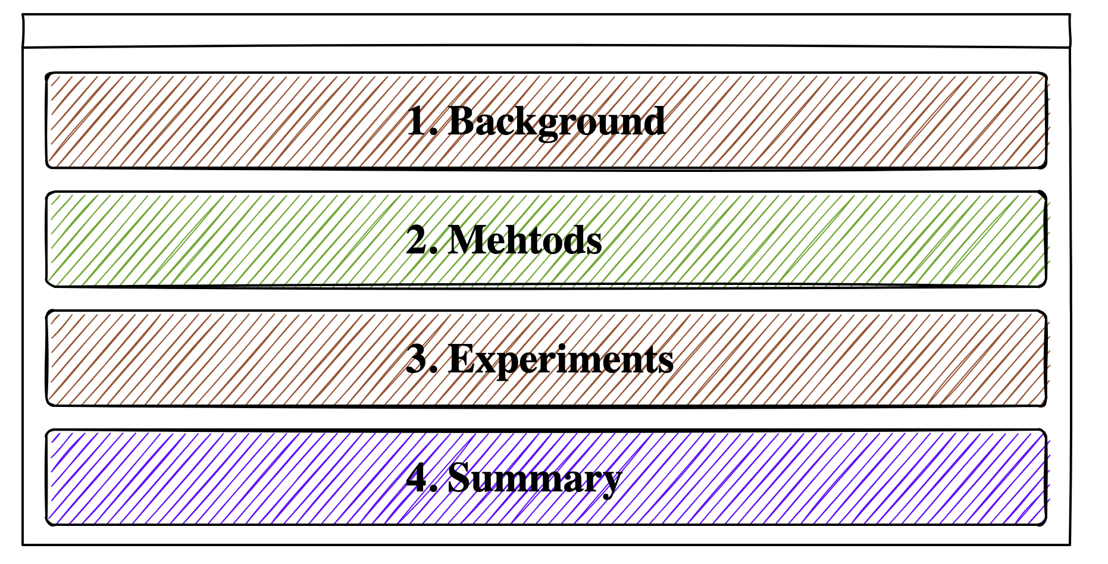
Outline

Slide 3
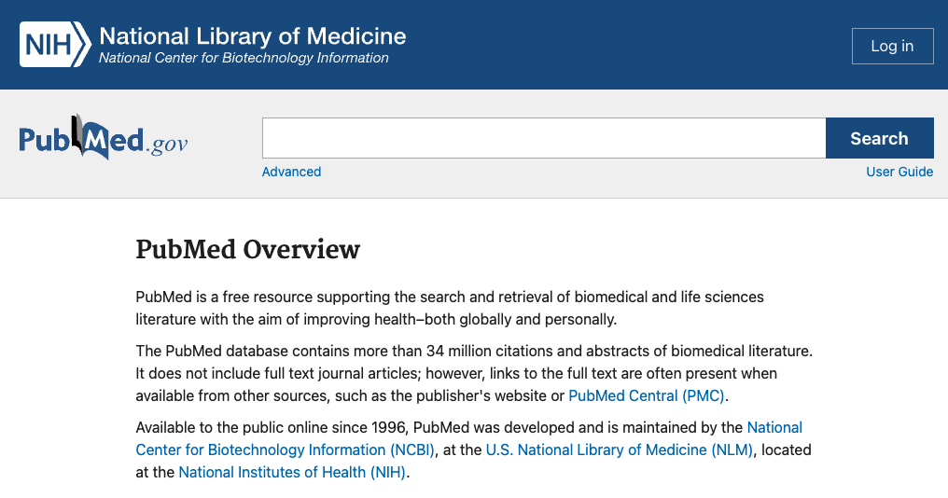
Background
Large number of unstructured scientific medical resources limit knowledge discovery
Title

Slide 4


Background
Transform unstructured data into structured data using Biomedical Named Entity Recognition Method (BioNER)
BioNER

Slide 5
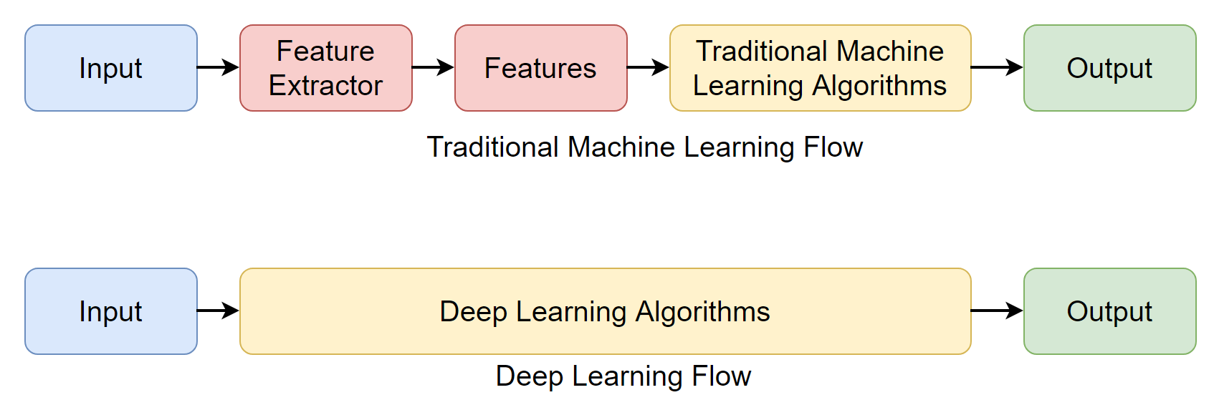



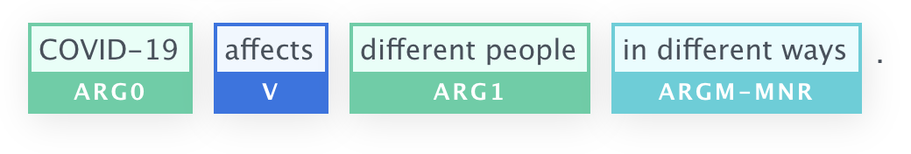
Background
Deep Neural Networks
Automatically extract features
Hard to process rare or unseen phrases
Domain Terminologies
Lexicon Features

Slide 6
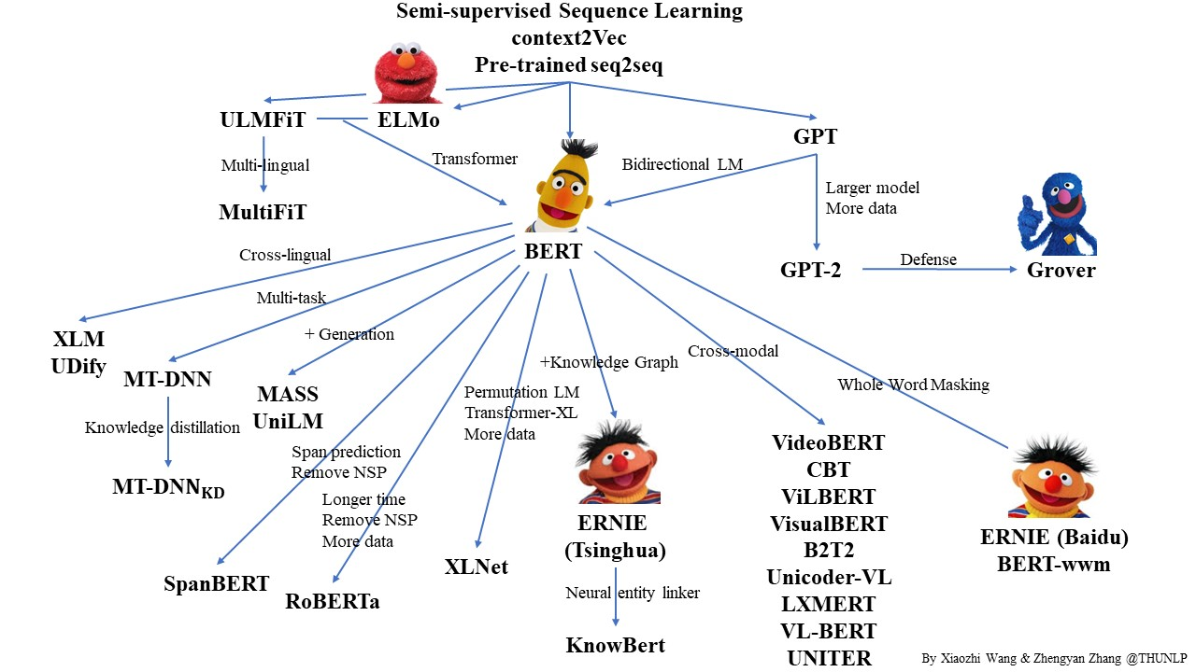
Background
Pretrained Language Model
https://github.com/thunlp/PLMpapers

Slide 7
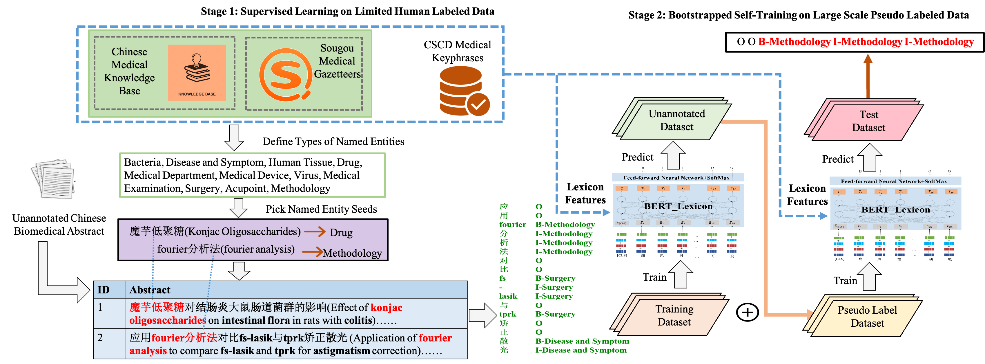
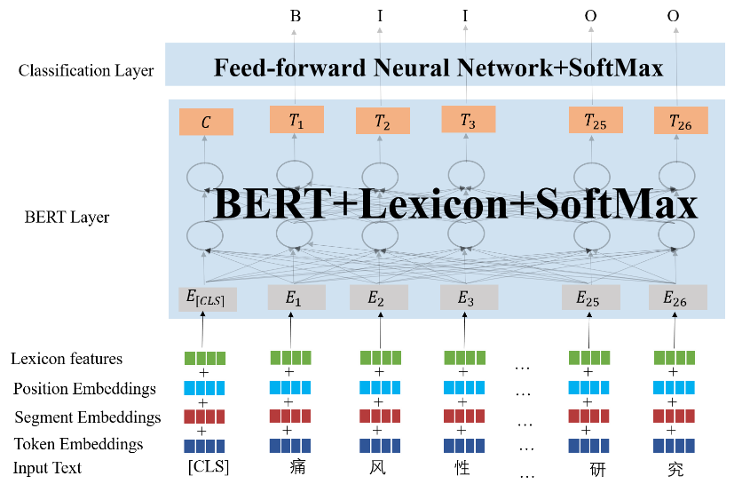


Methods
Regard BioNER of scientific Chinese medical abstracts as a sequence labeling task
propose a bootstrapped model incorporating lexicons
pretrained language model
semi-supervised learning
external lexicon features
+
+
1. define an eleven-category scheme
2. Pick entity seeds and locate matched record
3. Convert the dataset to BIO format
and split into training set(115) and test set(59)
4. Use BERT-Lexicon architecture to train

Slide 8
Methods
Regard BioNER of scientific Chinese medical abstracts as a sequence labeling task
propose a bootstrapped model incorporating lexicons
pretrained language model
semi-supervised learning
external lexicon features
+
+
5. Split the unannotated data into K folders
6. Predict on the split unannotated data
and get the pseudo labeled dataset
7. Retrain BERT_Lexicon model
and repeat self-training

Slide 9
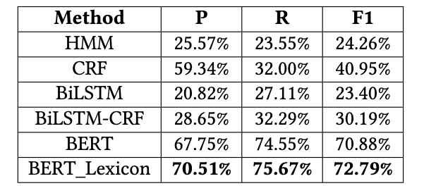
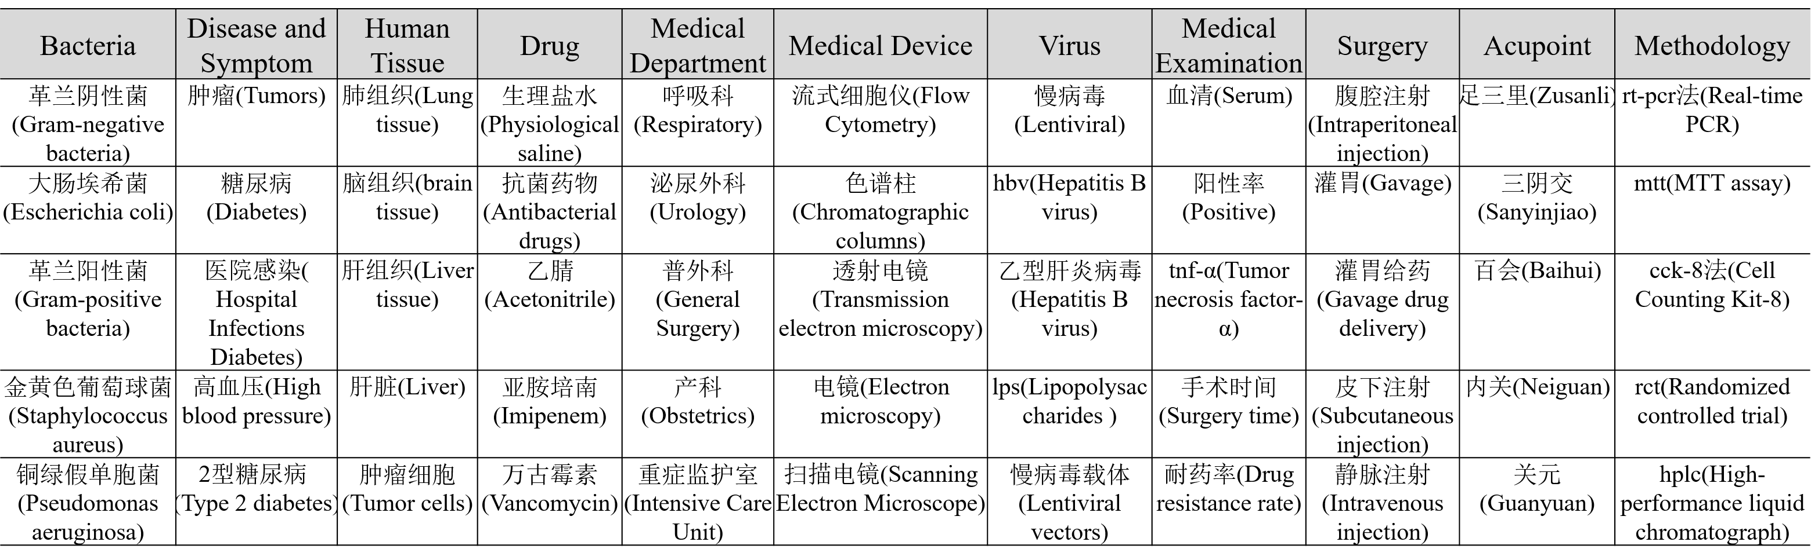
Experiments
Experimental Results on Human Labeled Dataset
Pretrained language model BERT outperformed other baselines a lot(more than 29%) on limited annotated data
The incorporation of lexicon brought a further improvement
Handle the English abbreviations well

Slide 10
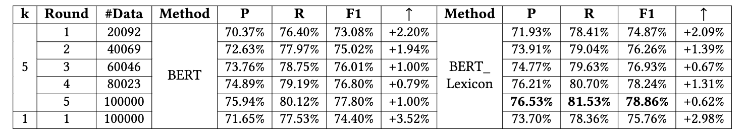
Experiments
Experiment Results on Pseudo Labeled Dataset
The model performance improved by 6.92% and 6.08% for BERT and BERT_Lexicon model respectively
after 5 iteration rounds, outperforming the corresponding model performance under K = 1
+6.92%
+6.08%

Slide 11
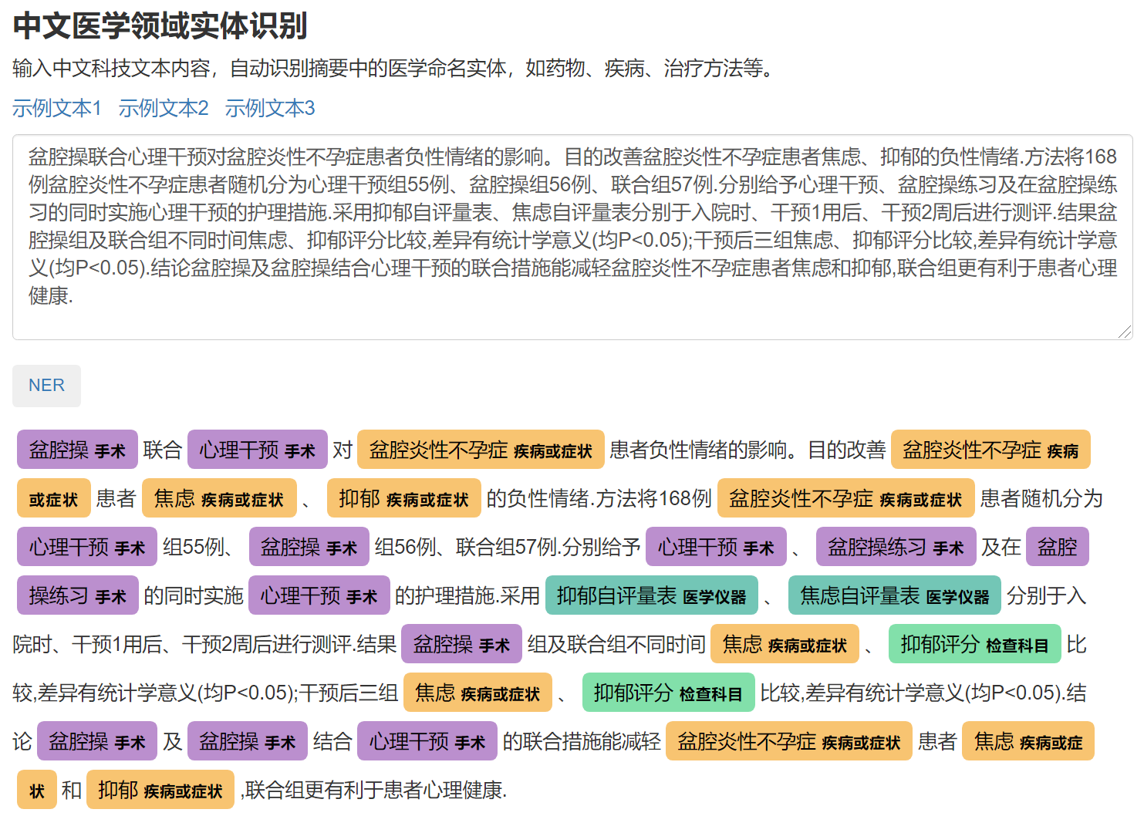
Experiments
http://sciengine.las.ac.cn/NER_MED_CN
Browser Online Demo
Input Box
Button
NER Results

Slide 12
Summary
Take advantage of pretrained language model and external lexicon features to Chinese BioNER task
Construct a two-stage framework to compensate for the shortcomings of limited annotated data.
Propose a bootstrapped semi-supervised algorithm to generate pseudo labeled dataset iteratively, which can further improve the model performance
Provide API for Public Invoke

Slide 13
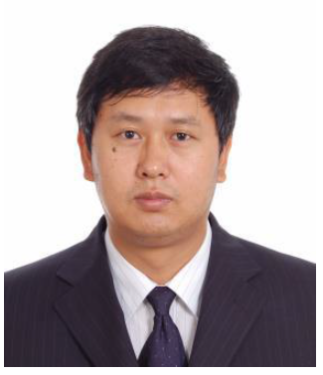

Acknowledgements
& Members in our Research Group
Zhixiong Zhang
Huan Liu

Slide 14
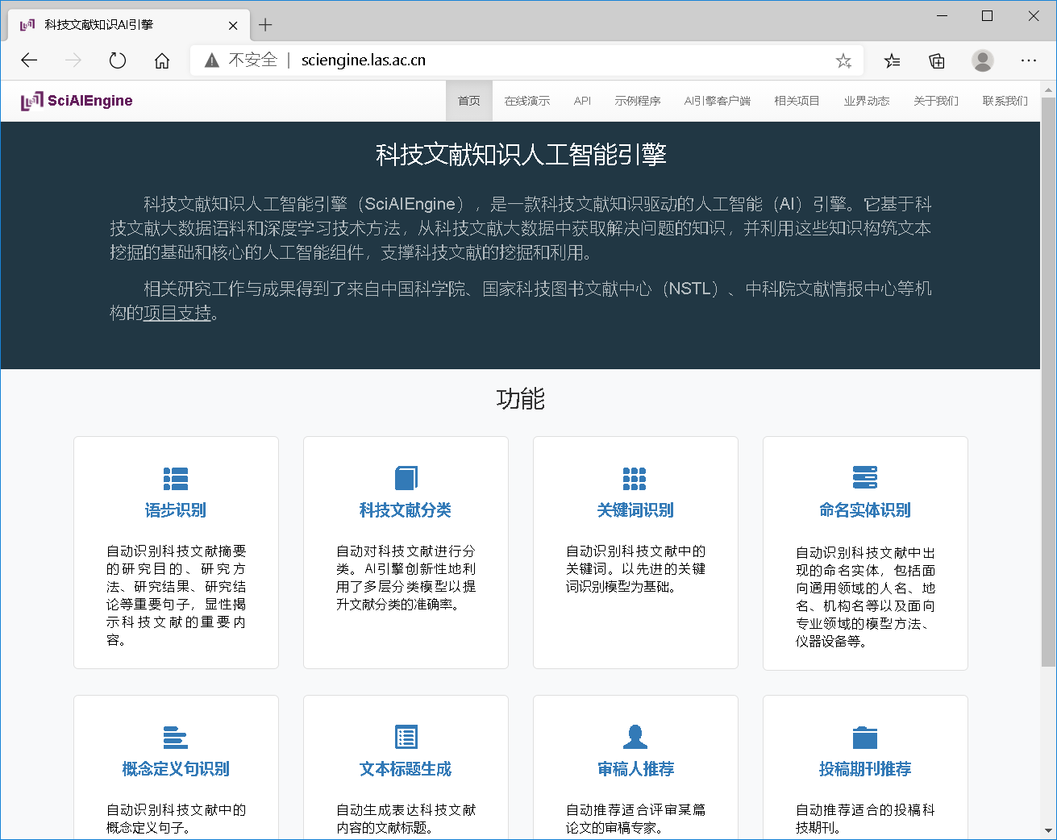
Thank you!
http://sciengine.las.ac.cn/
Contact
dingliangping@mail.las.ac.cn

