Slide 1

An innovative topic modeling method integrating large language models for topic recognition and evolutionary analysis
Jiamin Wang¹, Tao Zhang¹, Xiao Zhou¹ and Jiming Hu²
1. School of Economics and Management, Xidian University, Xi’an, China, 710126
2. School of Information Management, Wuhan University, Wuhan, China, 430072
June 23, 2025

Slide 2
01
Research Background
02
Research Questions
CONTENTS
03
Research Methodology
04
Experiments and Results
05
Conclusion

Slide 3
01 Research Background
The Evolution of Topic Modeling
LDA
Top2Vec
BERTopic
LLM
“pre-trained transformer models”
“large language models”
“bag of words”
“word embeddings”
However, existing research on topic identification based on traditional methods has limitations.
First, there has been little exploration of the impact of embedding models on topic modeling performance.
Second, the semantic relationships between vocabulary are often overlooked, disconnecting some terms from their complete semantic information, resulting in insufficient representation of identified topic keywords and poor topic interpretability.
Furthermore, when identifying domain topics, it is impossible to eliminate human intervention, as this process still relies on experts to interpret and summarize the nuanced meanings of topics, which is time-consuming and prone to subjective bias.

Slide 4




01 Research Background
With the rapid development of large language models (LLMs), artificial intelligence and natural language processing have undergone revolutionary changes. These advanced models, which rely on pre-training with massive data, possess unprecedented contextual understanding capabilities, enabling them to accurately capture semantic differences and implicit relationships in texts, providing new ideas and solutions for topic modeling.

Slide 5
02 Research Questions
In this context, this paper proposes an innovative topic modeling method that integrates large language models with BERTopic, called EPRAG-BERTopic. We collected academic papers in artificial intelligence to construct an original text corpus, initialized the BERTopic model, and employed various embedding models for topic modeling.
To evaluate the effectiveness of different embedding models, we compared the topic modeling performance based on topic coherence and topic diversity metrics and selected the best-performing model for dynamic topic analysis.
Additionally, to enhance the interpretability and practicality of topics, we designed prompts for generating topic names and descriptions, combining them with retrieval-augmented generation technology to automatically generate appropriate topic names and detailed descriptions using the GPT-4 large language model.

Slide 6
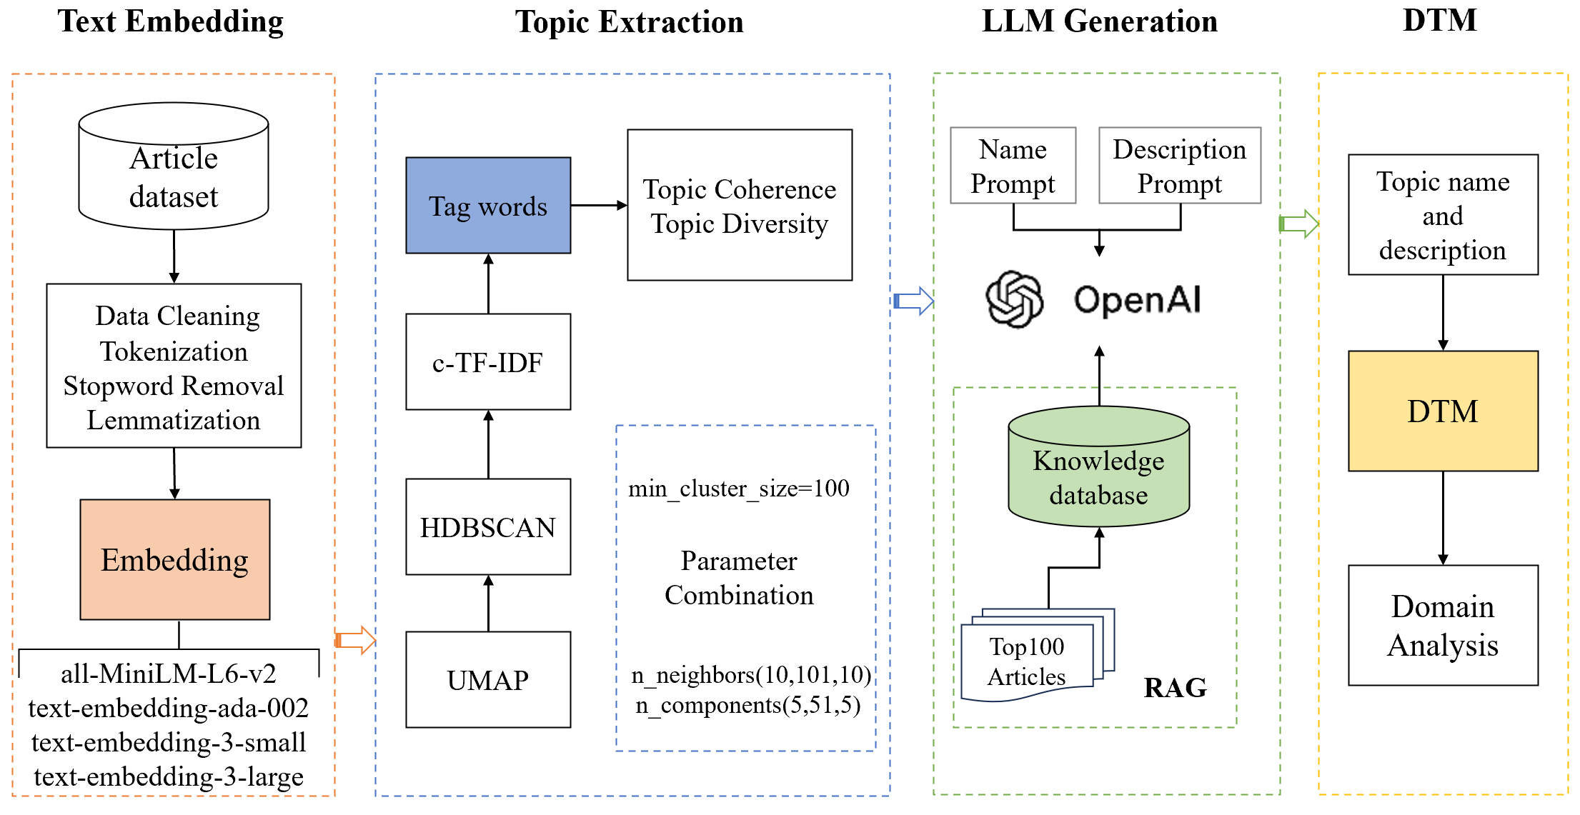
03 Research Methodology
This study proposes a dynamic topic modeling method that integrates large language models with the BERTopic model, to identify core artificial intelligence research topics and to automatically generate topic names and descriptive texts. The research framework is illustrated in Figure 1, and the specific method is divided into four steps.
Figure 1: The framework of the methodology

Slide 7
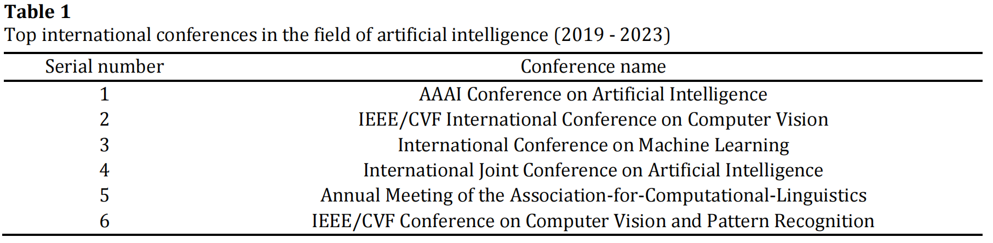
04 Experiments and results
This study selected six international conferences in the field of artificial intelligence recommended by the China Computer Federation (CFF) (see Table 1). Using the Web of Science database, we retrieved the bibliographic information of papers from 2019 to 2023. The search date was October 10, 2024, resulting in a total of 37,837 conference papers retrieved. The selected literature mainly included the titles and abstracts of research papers to comprehensively capture the latest research trends and technological developments in the field.

Slide 8
04 Experiments and results
The control group
The control group used the classic LDA model and the original BERTopic model as performance benchmarks.
The experimental group employed a topic modeling method that integrates BERTopic with large language model embedding techniques.
By systematically combining these parameters, we conducted a total of 500 experiments to explore the topic modeling effects of different embedding models under various parameter configurations.
LDA
number of topics(k)
(1,101,1)
original BERTopic
The experimental group
n_neighbors
(10,101,10)
BERTopic+text-embedding-ada-002
BERTopic+text-embedding-3-small
n_components
(5,51,5)
BERTopic+text-embedding-3-large
Topic coherence
Topic diversity
Model performance evaluation

Slide 9
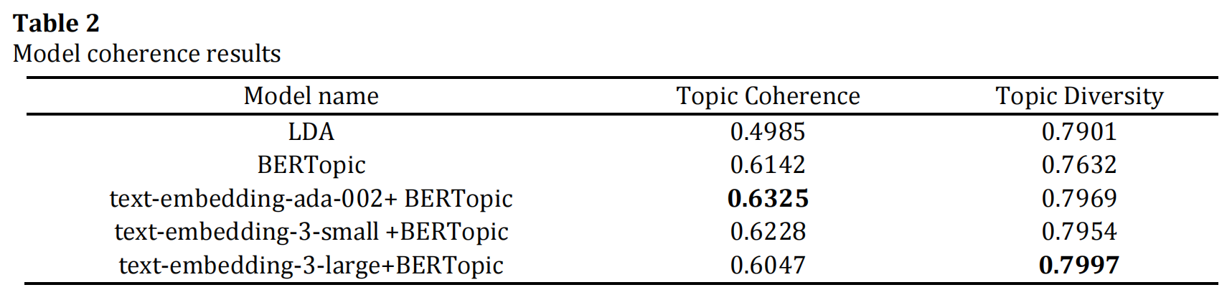
04 Experiments and results
To more accurately assess and compare the topic coherence and diversity of each model, this study selected the top 10 coherence and diversity scores for each model under different parameter combinations and calculated the average of these scores more accurately. The average optimal topic coherence and diversity for the five topic models are shown in Table 2.

Slide 10
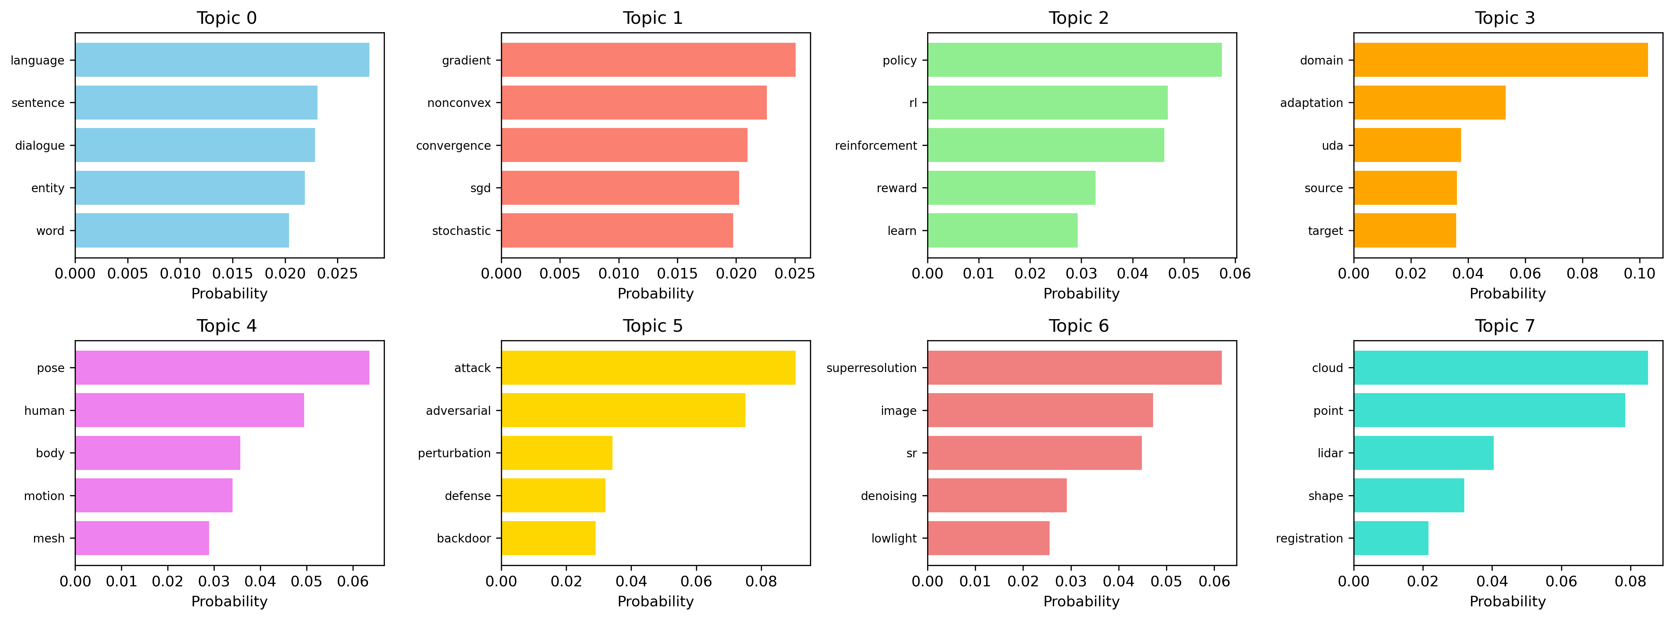
04 Experiments and results
In this study, an in-depth analysis of identified topics was performed using the combination of BERTopic and the text-embedding-ada-002 embedding model. The BERTopic model's topic clustering function automatically identified 45 topics. As shown in Figure, the top eight topics with the most documents are presented, each composed of highly related keywords (with only the top five most related keywords displayed).

Slide 11
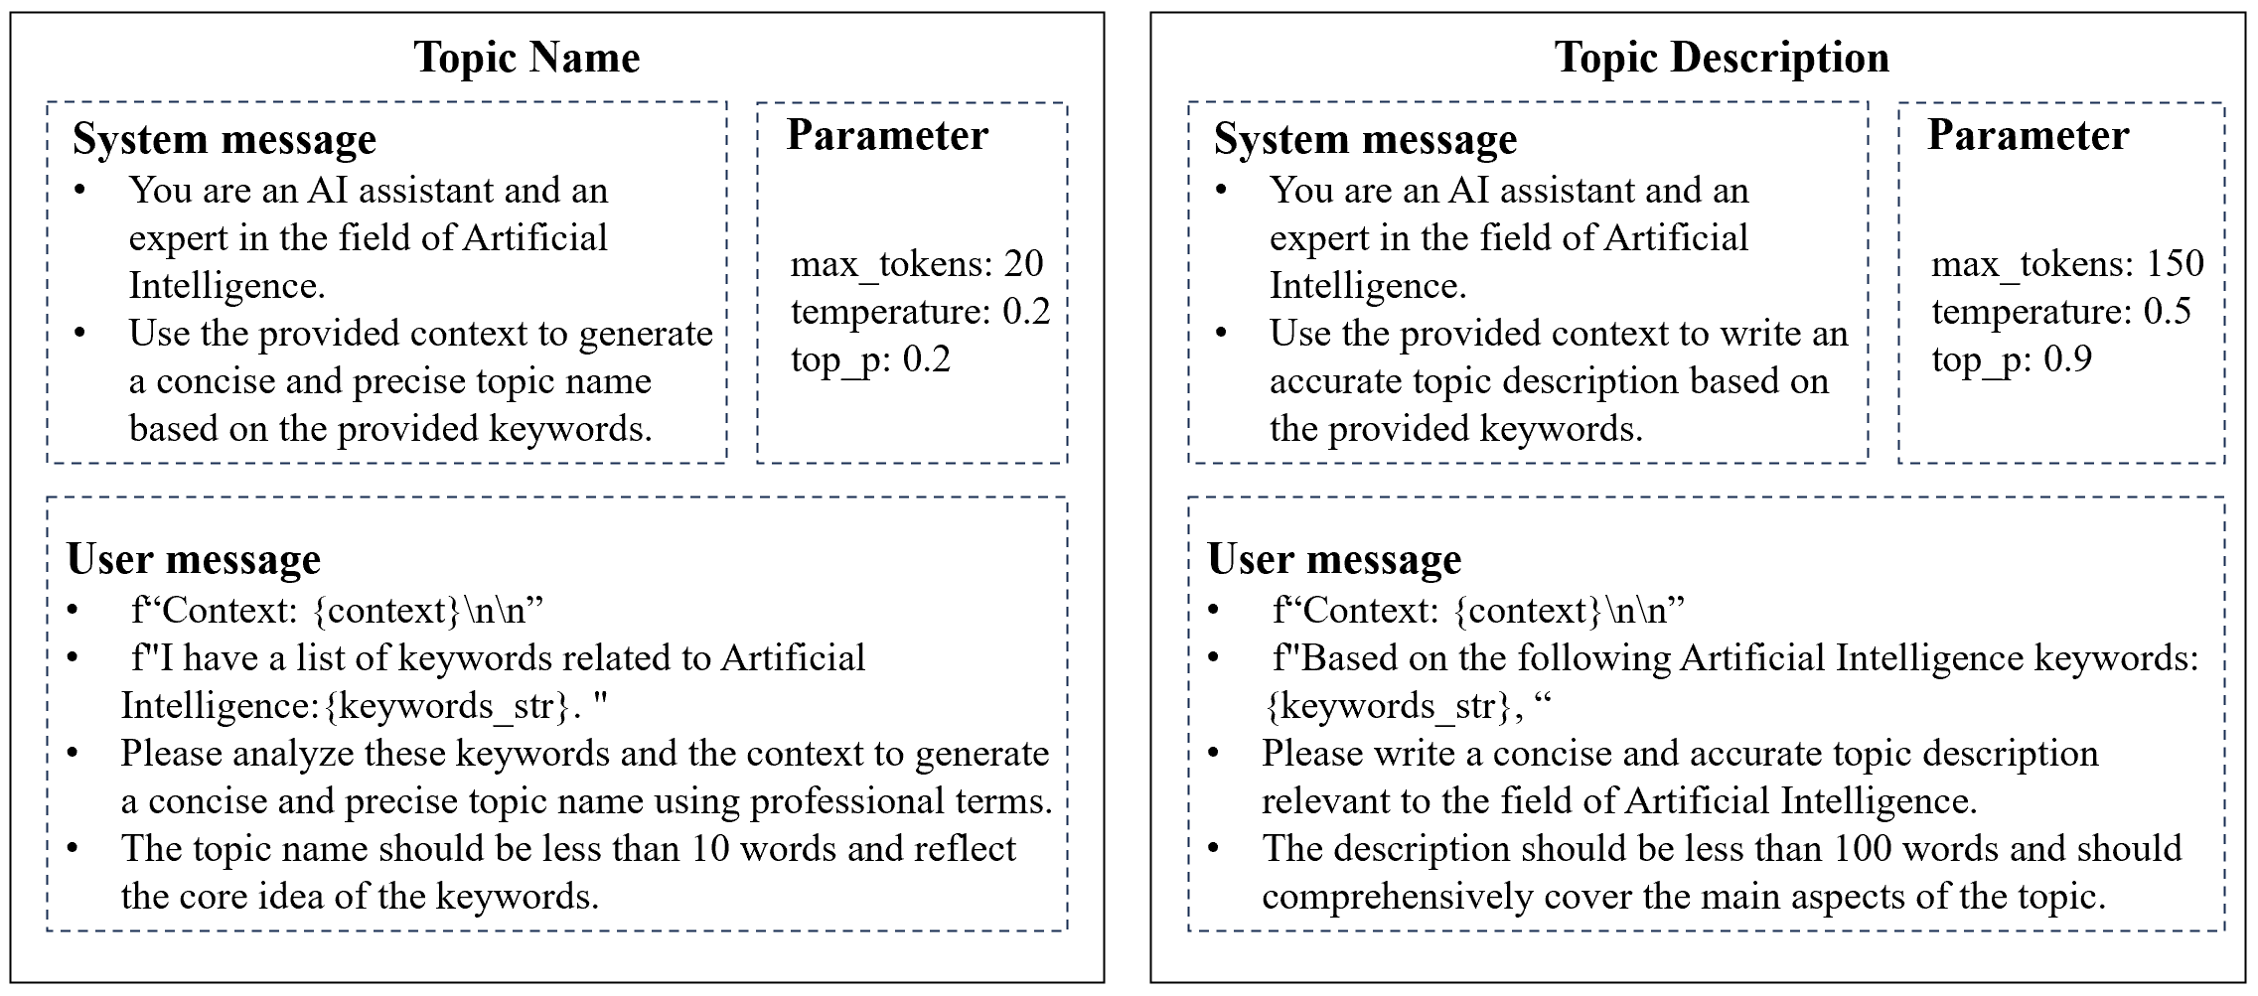
04 Experiments and results
For the study prompt design, we constructed a complete dialogue scenario through the structure of system messages, user messages, and parameter settings to ensure that the large language model could generate high-quality topic names and descriptions based on the provided context and keywords.

Slide 12
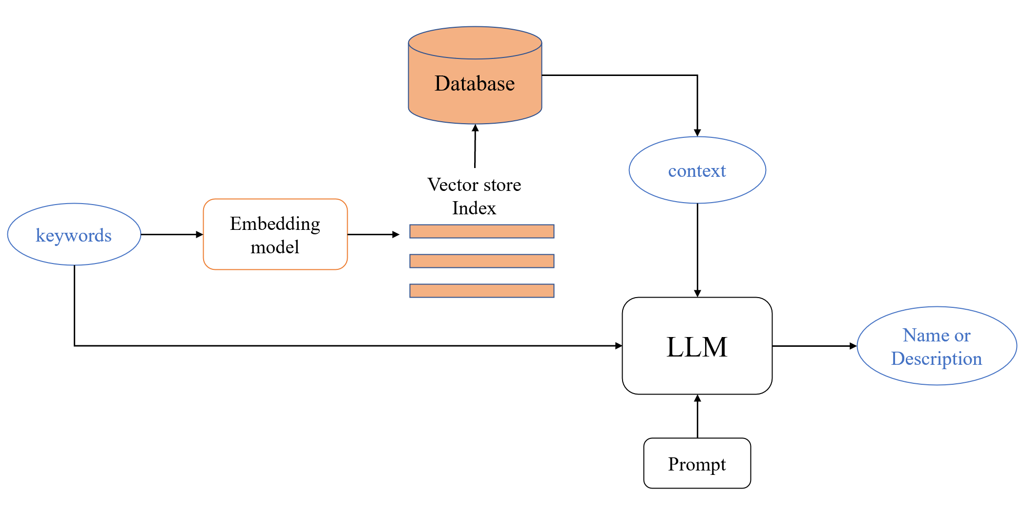
04 Experiments and results
To further enhance the model’s ability to generate high-quality topic names and descriptions, we integrated the RAG framework. We selected the titles and abstracts of 100 top conference papers in the field of artificial intelligence from 2024 as knowledge input and constructed a dedicated knowledge base. We designed a comparative experiment aimed at comparing the differences in generation quality between a method using only prompts (Prompt group) and a prompt method integrated with the RAG framework (Prompt+RAG group).

Slide 13
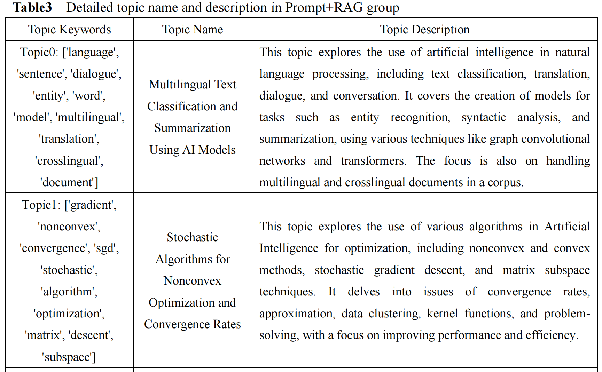
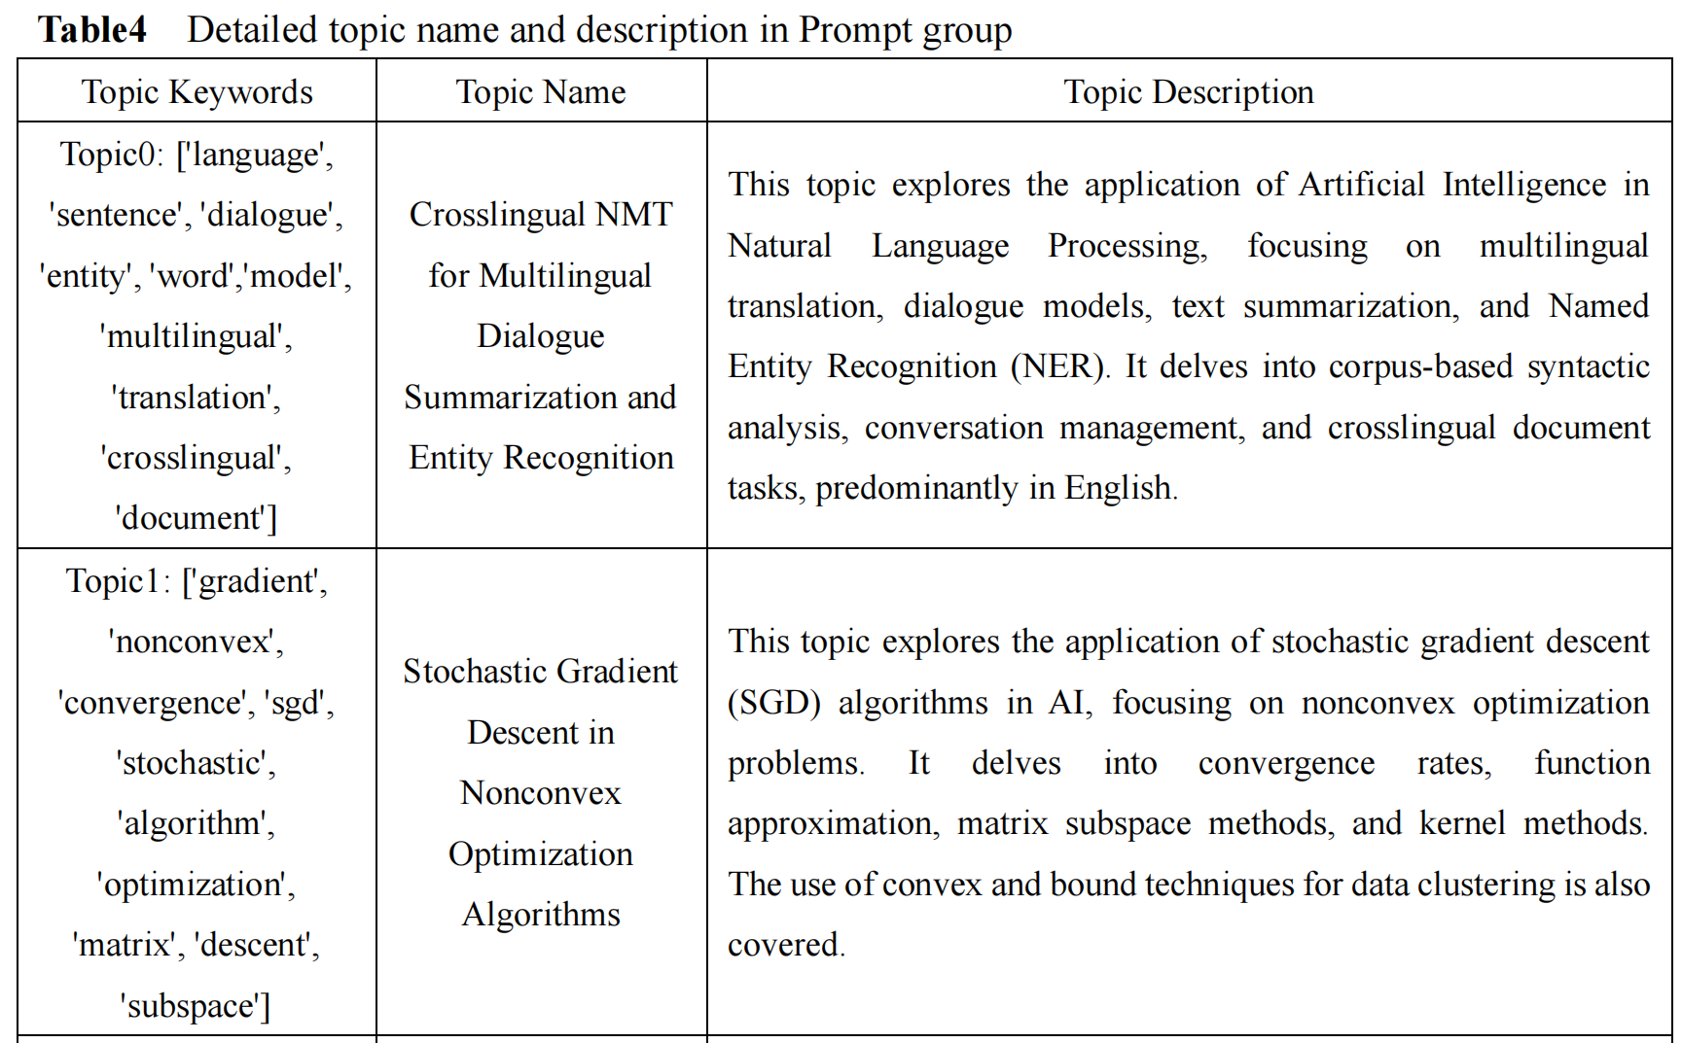
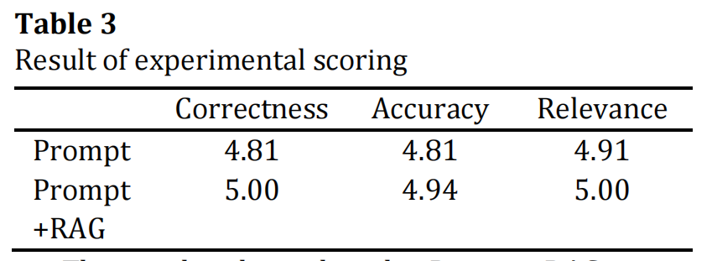
04 Experiments and results
The experiment evaluated the performance of the two methods across three dimensions: correctness, accuracy, and relevance. To assess the quality of the generated topic names and descriptions, we designed a user rating evaluation experiment using a blind selection method. Each participant was required to independently rate the generated results from the Prompt and Prompt+RAG groups for all topics using a five-point Likert scale.

Slide 14
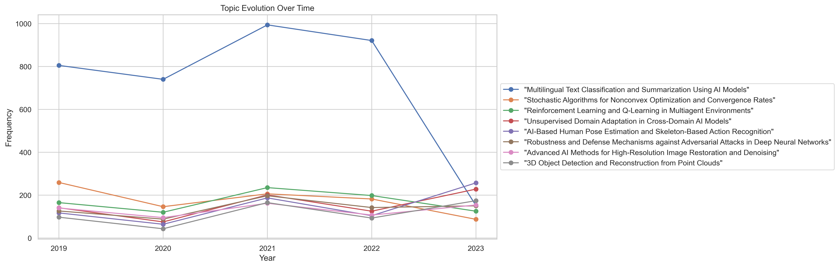
04 Experiments and results
The dynamic topic modeling of BERTopic provides an intuitive perspective on the evolution trends of topics in research fields, revealing the academic community's attention to specific topics and its changes over time. This, in turn, helps analyze the evolution trends of various research directions in the field of artificial intelligence. Figure shows the research popularity over time of the eight research topics listed in this study.

Slide 15
05 Conclusion
The EPRAG-BERTopic method proposed in this study combines large language models with BERTopic, overcoming the limitations of traditional topic modeling methods and significantly enhancing the quality of topic generation. Experimental results show that EPRAG-BERTopic exhibits significant advantages in topic coherence, diversity and domain adaptability, particularly in tasks such as academic literature analysis and technology trend forecasting. Through the embedding technology of large language models, prompt engineering, and RAG functionality, EPRAG-BERTopic generates topic descriptions with deep semantic information, helping users better understand and uncover underlying topic structures. Compared to traditional topic models, EPRAG-BERTopic not only enhances topic coherence and interpretability but also improves the model's adaptability across different domains, especially in rapidly developing technological fields. By optimizing embedding models and integrating domain knowledge, EPRAG-BERTopic provides more accurate topic modeling support for researchers, decision-makers, and businesses, driving the development of academic research and industry applications.
Research limitations：First, the reliance on closed-source large language models (such as GPT-4) results in high computational costs, which poses a challenge for large-scale applications or resource-limited research environments. Second, although multiple powerful text embedding models were used, the rapid advancements in natural language processing suggest that there is still room for optimization in model selection. Finally, while RAG technology enhances domain adaptability by integrating domain-specific knowledge bases, effectively constructing and maintaining high-quality knowledge bases in practical applications remains a challenge.
Future research：Future research could explore the use of open-source large language models or more efficient computational strategies to reduce costs and enhance the model's scalability. Multimodal and self-supervised learning models could further improve the handling of complex texts and cross-domain data. Ensuring that knowledge bases are continually updated and effectively support topic generation will be a key direction for future research.

Slide 16
Thank you for your attention!
Looking Forward to Receiving Your Criticism！
Presenter: Tao Zhang
June 23, 2025

