Slide 1
Course Outline
TOPICS
  What is Machine Learning and Image Processing
  Traditional Features, K-NN classifier
  Linear Classification
  Perceptron Algorithm, Sigmoid Activation Function, Gradient Descent
  Stochastic Gradient Descent, Back-Propagation
  Multi-Layer Neural Network
  Convolution and Pooling
  Mid-Term Examination
  Mid-Term Examination
  Convolutional Neural Networks.
  Training Convolutional Neural Networks: Hyper-Parameters, Activation functions, initialization, dropout, batch normalization
  Recurrent Neural Networks
  Applications of Convolutional Neural Networks for Image Segmentation and Object Classification
  Project Presentations

Slide 2
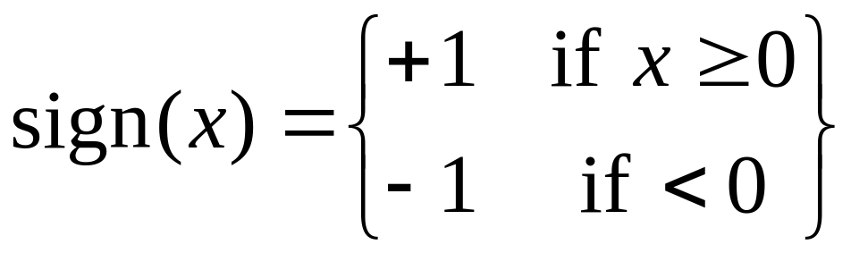
Linear Classifiers
Let’s simplify life by assuming:
  Every instance is a vector of real numbers, x=(x₁,…,x_{n}). (Notation: boldface x is a vector.)
  There are only two classes, y=(+1) and y=(-1)
A linear classifier is vector w of the same dimension as x that is used to make this prediction:
William Cohen and Tom Mitchell Machine Learning Department School of Computer Science, Carnegie Mellon University Spring 2008

Slide 3
Visually, x · w is the distance you get if you “project x onto w”
w
X1 . w
x2
X1
In 3d: line→plane
In 4d: plane→hyperplane
…
X2 . w
The line perpendicular to w divides the vectors classified as positive from the vectors classified as negative.
-W
William Cohen and Tom Mitchell Machine Learning Department School of Computer Science, Carnegie Mellon University Spring 2008

Slide 4
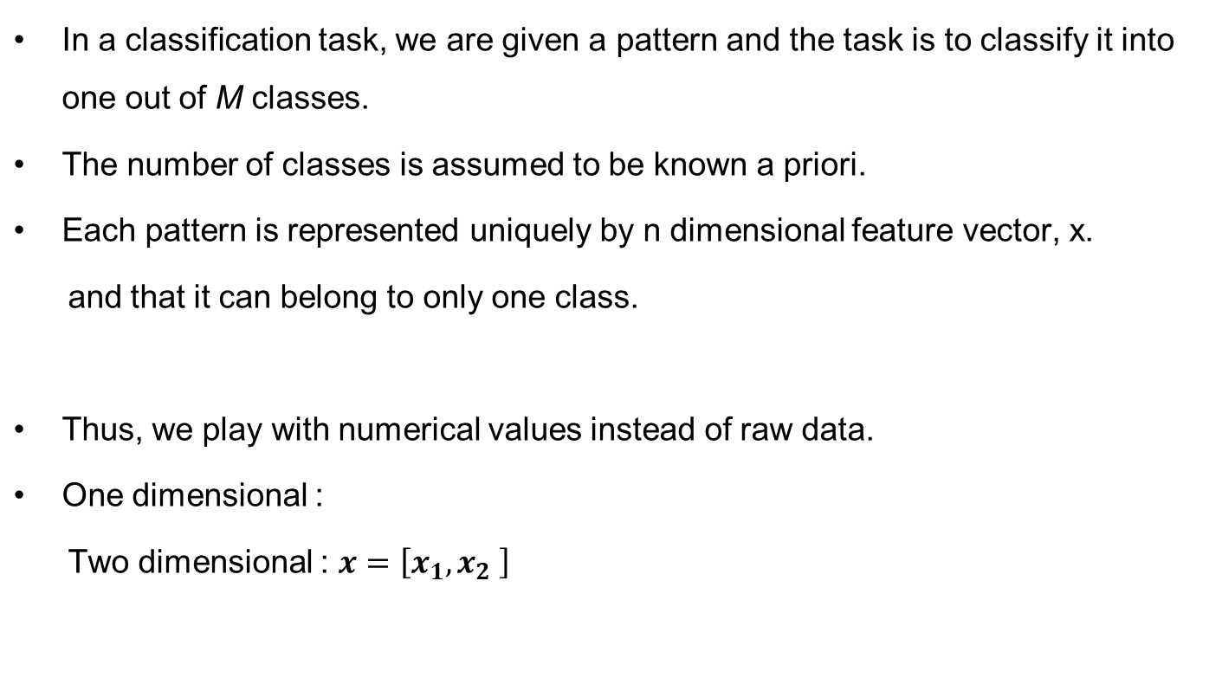


Classification
Sharif University of Technology School of Electrical Engineering Pattern Recognition - 25-617 Fall 2007

Slide 5

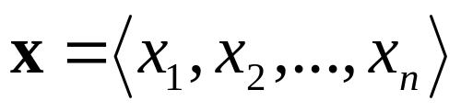
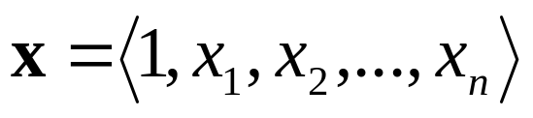
Notice that the separating hyperplane goes through the origin…if we don’t want this we can preprocess our examples:
w
-W
William Cohen and Tom Mitchell Machine Learning Department School of Computer Science, Carnegie Mellon University Spring 2008

Slide 6
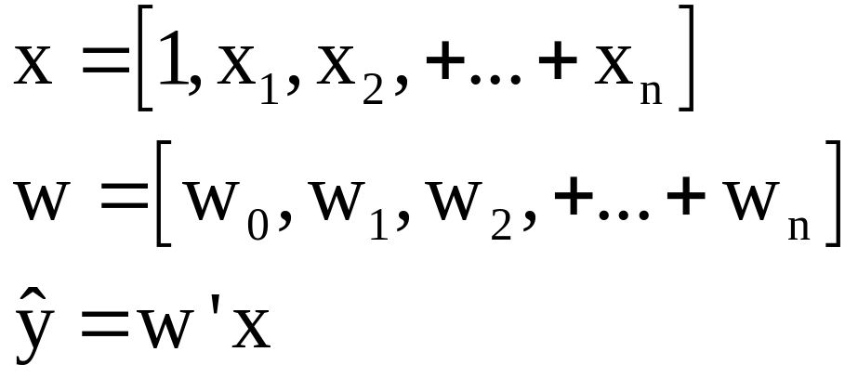
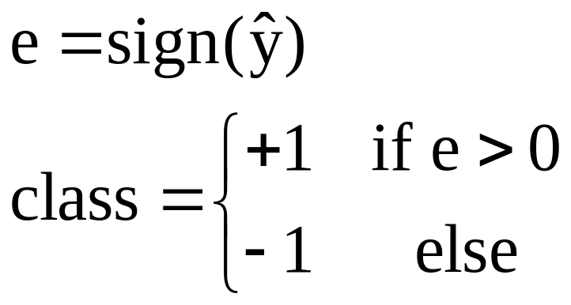
Some Math
If features are scalar values

Slide 7
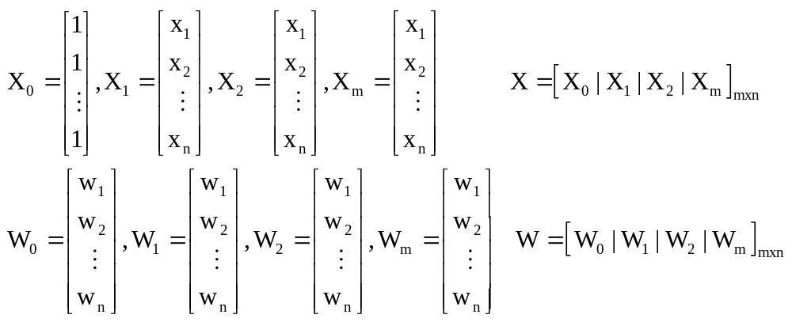




Some Math
If features are in the vector form
?
Therefore, we have to find the sum of all elements in

Slide 8
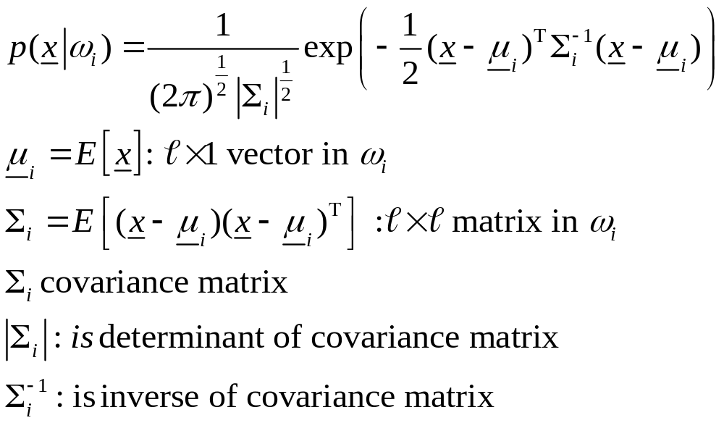
Bayesian Classifier For Normal Distributions
Multivariate Gaussian pdf

Slide 9
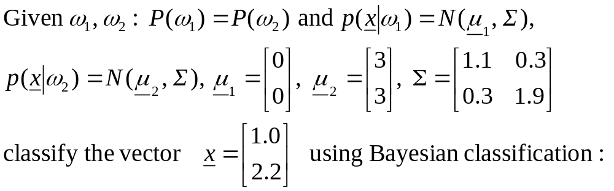
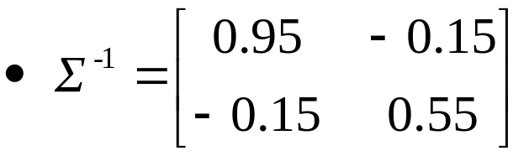
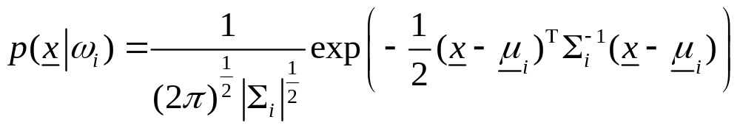
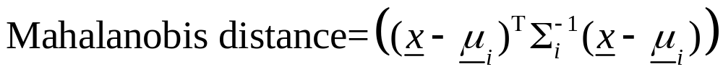
Example:
We can omit the repeated terms, red ones, in both equations. Thus only Mahalanobis distance is enough for classification.

Slide 10
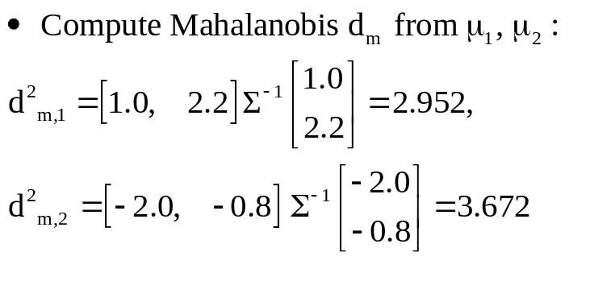
Example:

