Slide 1
Course Outline
TOPICS
  What is Machine Learning and Image Processing
  Traditional Features, K-NN classifier
  Linear Classification
  Perceptron Algorithm, Sigmoid Activation Function, Gradient Descent
  Stochastic Gradient Descent, Back-Propagation
  Multi-Layer Neural Network
  Convolution and Pooling
  Mid-Term Examination
  Mid-Term Examination
  Convolutional Neural Networks.
  Training Convolutional Neural Networks: Hyper-Parameters, Activation functions, initialization, dropout, batch normalization
  Recurrent Neural Networks
  Applications of Convolutional Neural Networks for Image Segmentation and Object Classification
  Project Presentations

Slide 2
Definition of Neural Network
A Neural Network is a system composed of
many simple processing elements operating in
parallel which can acquire, store, and utilize
experiential knowledge.
http://web.cecs.pdx.edu/~mperkows/CLASS_479/

Slide 3
What is Neural Network?

Slide 4
Neurons vs. Units (1)
- Each element of NN is a node called unit.
- Units are connected by links.
- Each link has a numeric weight.
http://web.cecs.pdx.edu/~mperkows/CLASS_479/

Slide 5
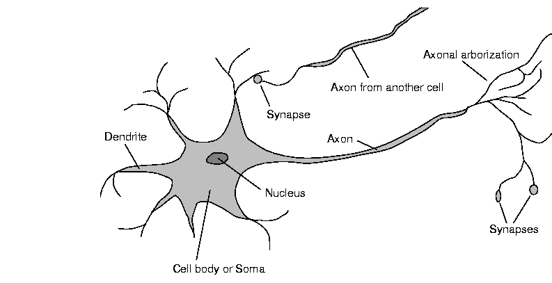
Neurons vs units (2)
Real neuron is far away from our simplified model - unit
Chemistry, biochemistry, quantumness.
http://web.cecs.pdx.edu/~mperkows/CLASS_479/

Slide 6
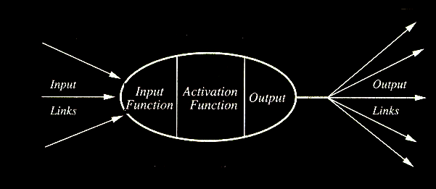
Computing Elements
A typical unit:

Slide 7
Planning in building a Neural Network
Decisions must be taken on the following:
- The number of units to use.
- The type of units required.
- Connection between the units.
http://web.cecs.pdx.edu/~mperkows/CLASS_479/

Slide 8
How NN learns a task
- Initializing the weights.
- Use of a learning algorithm.
- Set of training examples.
- Encode the examples as inputs.
- Convert output into meaningful results.
http://web.cecs.pdx.edu/~mperkows/CLASS_479/

Slide 9
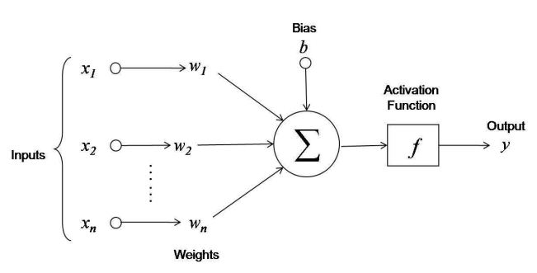
One Layer Neural Network

Slide 10
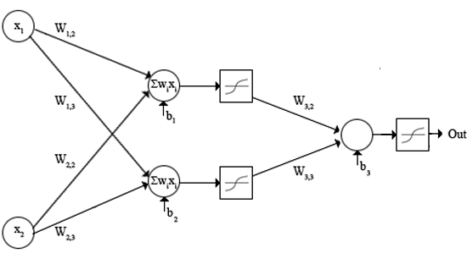
Two Layers Neural Network

Slide 11
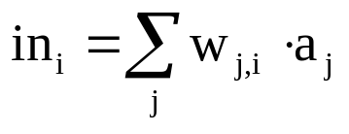
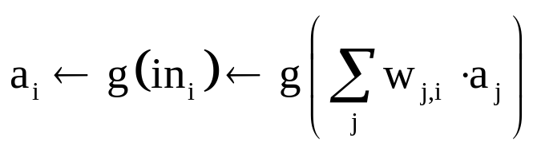
Calculations
Input function:
Activation function g:
http://web.cecs.pdx.edu/~mperkows/CLASS_479/

Slide 12
Activation Functions
- Use different functions to obtain different models.
- 3 most common choices :
1) Step function
2) Sign function
3) Sigmoid function
- An output of 1 represents firing of a neuron down the axon.
http://web.cecs.pdx.edu/~mperkows/CLASS_479/

Slide 13
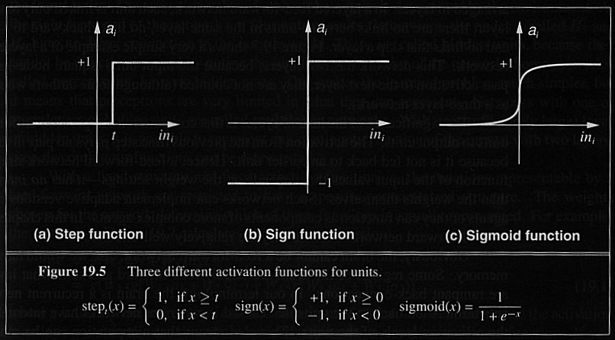
3 Activation Functions

Slide 14
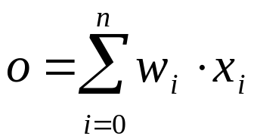

Gradient Descent
To understand, consider simpler linear unit,
Let's learn w_{i} that minimize the squared error,
D={(x₁,t₁),(x₂,t₂), . .,(x_{d},t_{d}),..,(x_{m},t_{m})}
    (t for target)

Slide 15


We want to move the weight vector in the direction that decrease E
w_{i}=w_{i}+Δw_{i} w=w+Δw

Slide 16
One Layer Neural Network

Slide 17
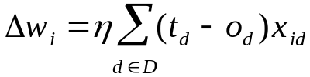
Gradient Descent
Gradient-Descent(training_examples, η)
Each training example is a pair of the form <(x₁,…x_{n}),t> where (x₁,…,x_{n}) is the vector of input values, and t is the target output value, η is the learning rate (e.g. 0.1)
Initialize each w_{i} to some small random value
Until the termination condition is meet,
Do
  Initialize each Δw_{i} to zero
  For each <(x₁,…x_{n}),t> in training_examples
  Do
    Input the instance (x₁,…,x_{n}) to the linear unit and compute the output o
    For each linear unit weight w_{i}
    Do
      Δw_{i}= Δw_{i} + η (t-o) x_{i}
  For each linear unit weight w_{i}
  Do
    w_{i}=w_{i}+Δw_{i}

Slide 18
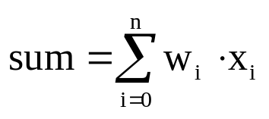
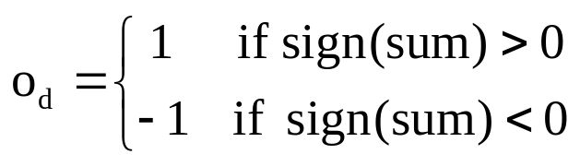
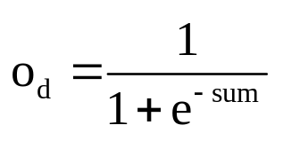

Activation Function
Activation function is used to predict network outputs
Sign activation
function
sigmoid activation
function
loss computation
We can see that there is no special loss function in perceptron. But, we can use any loss function to compute residual.

Slide 19



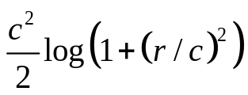
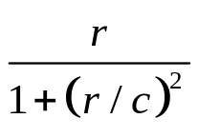
Loss Function
The loss function is enabled together with optimization function, called Gradient Descent, that is used in case of updating the weights.
Loss computation in perceptron
Euclidean loss
Euclidean derivative
Cauchy Loss
Cauchy derivative

Slide 20
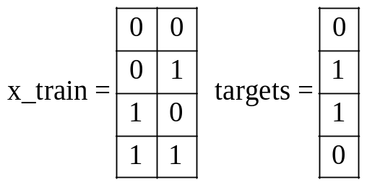

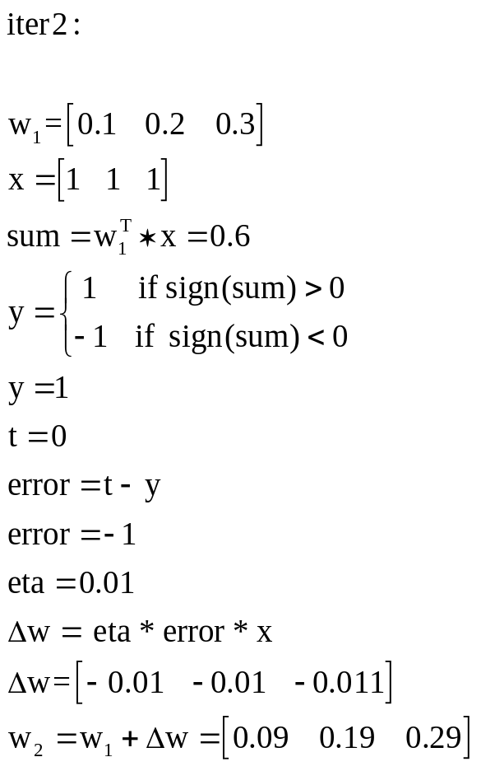
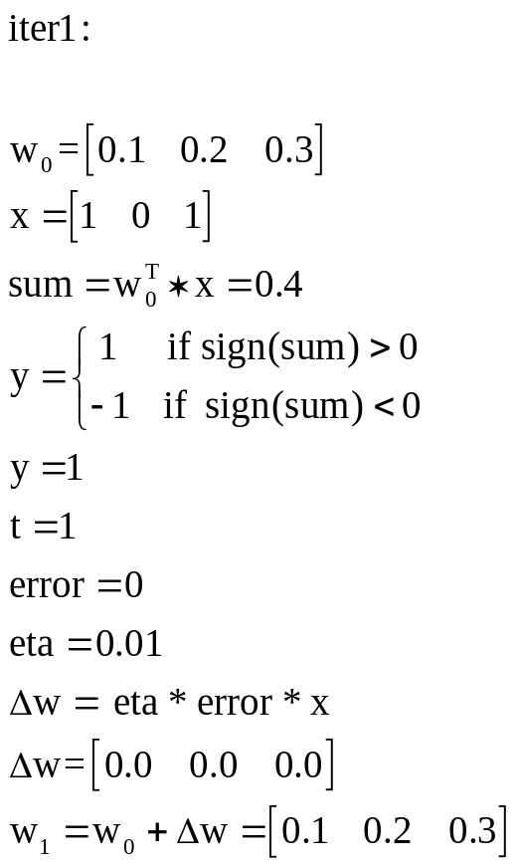
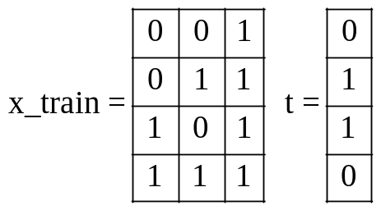
Example: Solving XOR problem with Perceptron by 2 iterations

