Slide 1

Error handling, Deploying, Validation, Rich Controls

Slide 2
Content
Error Handling
Deploying ASP.NET Applications
Validation
Regular Expressions
Rich Controls
  Calendar, AdRotator, Pages with Multiple Views, Wizard
Anadolu University

Slide 3
Error Handling
Common Errors
Exception Handling
Anadolu University

Slide 4
Common Errors
Attempts to divide by zero
Invalid input or missing information
Attempts to connect to a limited resource (database)
Database that does not exist
Security credentials
Null reference exception
Anadolu University

Slide 5
Null Reference Exception
private SqlConnection conOne = new SqlConnection();
private SqlConnection conTwo;
public void cmdDoSomething_Click(object sender, EventArgs e)
{
// This works:
conOne.ConnectionString = "...";
// This does not work:
conTwo.ConnectionString = "...";
}
Anadolu University

Slide 6
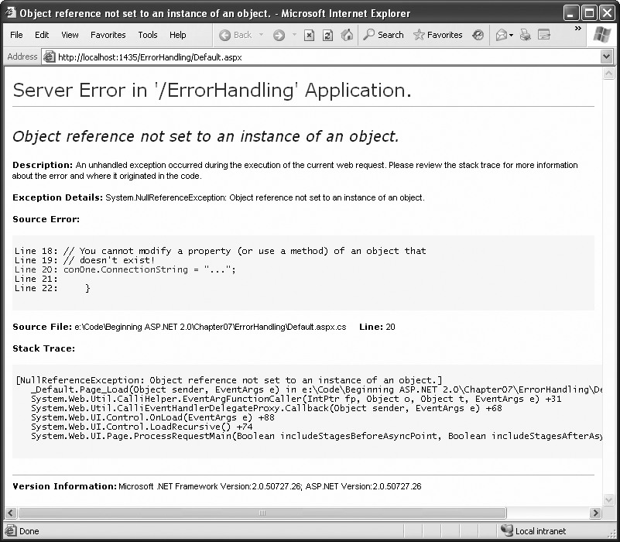
Muzaffer DOĞAN - Anadolu University

Slide 7
Exception Handling
When an error occurs in your application, the .NET Framework creates an exception object that represents the problem
You can catch this object using an exception handler
If you fail to use an exception handler, your code will be aborted, and the user will see an error page
Anadolu University

Slide 8
Features of Exceptions
Exceptions are object-based
Exceptions are caught based on their type
Exception handlers use a modern block structure
Exception handlers are multilayered
Exceptions are a generic part of the .NET Framework
A descriptive information about an exception can be obtained from Message property
Anadolu University

Slide 9
Handling Exceptions
One of the ways is to check potential error conditions before performing an operation:
  if (divisor != 0) {
  // It's safe to divide some number by divisor.
  }
  if (System.IO.File.Exists("myfile.txt")) {
  // You can now open the myfile.txt file
  }
Anadolu University

Slide 10
Handling Exceptions
Even if you perform this basic level of “quality assurance,” your application is still vulnerable
For example, you have no way to protect against all the possible file access problems
Similarly, you have no way to validate a user ID and password for a database before attempting to open a connection
In some cases, it may not be practical to perform the full range of defensive checks, because they may impose a noticeable performance drag on your application
For all these reasons, you need a way to detect and deal with errors when they occur
The solution is structured exception handling
Anadolu University

Slide 11
Structured Exception Handling
try
{
// Risky code goes here (i.e., opening a file, connecting to a
// database).
}
catch
{
// An error has been detected. You can deal with it here.
}
finally
{
// Time to clean up, regardless of whether or not there was an error.
}
Anadolu University

Slide 12
Catching Specific Exceptions
try
{
// Risky database code goes here.
}
catch (System.Data.SqlClient.SqlException err)
{
// Catches common problems like connection errors.
}
catch (System.NullReferenceException err)
{
// Catches problems resulting from an uninitialized object.
}
catch (System.Exception err)
{
// Catches any other errors.
}
Anadolu University

Slide 13
Nested Exception Handlers
protected void Page_Load(Object sender, EventArgs e)
{
try
{
DivideNumbers(5, 0);
}
catch (DivideByZeroException err)
{
// Report error here.
}
}
private decimal DivideNumbers(decimal number, decimal divisor)
{
return number/divisor;
}
Anadolu University

Slide 14
How Visual Studio Helps
When you write the name of the method in Visual Studio, intellisense lists the exceptions the method throws
Also MSDN help lists all exceptions that are thrown by a method
Debug >> Exceptions command lists all possible Exception classes
Anadolu University

Slide 15
Mastering Exceptions
Break down your code into multiple try/catch blocks
Report all errors
Don't use exception handlers for every statement
Anadolu University

Slide 16
Throwing Your Own Exception
private decimal DivideNumbers(decimal number, decimal divisor)
{
if (divisor == 0)
{
DivideByZeroException err = new DivideByZeroException();
throw err;
}
else
{
return number/divisor;
}
}
Anadolu University

Slide 17
Throwing Your Own Exception
private decimal DivideNumbers(decimal number, decimal divisor)
{
if (divisor == 0) {
DivideByZeroException err = new DivideByZeroException(
"You supplied 0 for the divisor parameter. You must be stopped.");
throw err;
}
else {
return number/divisor;
}
}
Anadolu University

Slide 18
Throwing Your Own Exception
If you need to return additional or specialized information, you can create your own custom exception class
Custom exception classes should always inherited from System.ApplicationException class
This allows .NET to distinguish between two broad classes of exceptions–those you create and those that are native to the .NET Framework
Anadolu University

Slide 19
Event Logging
You can write errors to the event log of the operating system:
  catch (Exception err)
  {
  // Write the information to the event log.
  EventLog log = new EventLog();
  log.Source = "DivisionPage";
  log.WriteEntry(err.Message, EventLogEntryType.Error);
  }
Youcan view these errors from Control Panel >> Event Viewer
Anadolu University

Slide 20
Error Pages
Now, you should be familiar with the error pages starting with "Server Error in …"
By default, this rich error page is visible only for local connections
Other clients see a generic error page
You can change this behaviour by customErrors section in web.config file
If an error occurs, you can redirect to a custom page by using the customErrors section
Anadolu University

Slide 21
customErrors Section Example
<configuration>
<system.web>
<customErrors mode="RemoteOnly"
defaultRedirect="DefaultError.aspx" />
</system.web>
</configuration>
Anadolu University

Slide 22
Error-Specific Custom Pages
<configuration>
<system.web>
<customErrors defaultRedirect="DefaultError.aspx">
<error statusCode="404" redirect="404.aspx" />
</customErrors>
</system.web>
</configuration>
Anadolu University

Slide 23
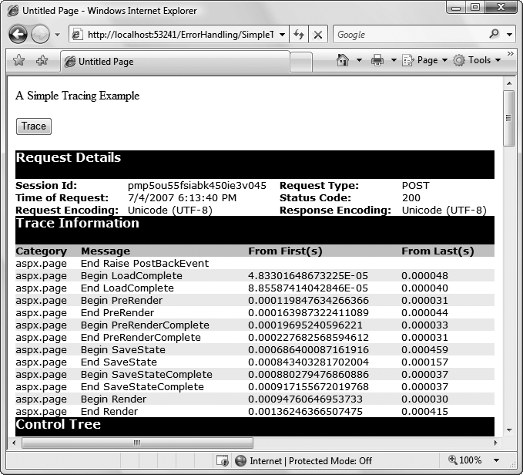
Page Tracing
Anadolu University

Slide 24
Enabling Page Tracing
1. <%@ Page Trace="true" ... %>
2. protected void Page_Load(Object sender, EventArgs e)
{
Trace.IsEnabled = true;
}
Anadolu University

Slide 25
Deploying ASP.NET Applications
Simply copy your all project files and folders to the web server
You can also create a virtual directory on the web server for your application
You can create a virtual directory using IIS Manager
IIS Manager is accessible from Control Panel >> Administrative Tools
You can use Visual Studio's Copy Web Site tool to deploy your application
Anadolu University

Slide 26
Building Better Web Forms
Validation
Rich Controls
User Controls
Styles, Themes, and Master Pages
Website Navigation
Anadolu University

Slide 27
Validation
Users can make the following mistakes:
  Users might leave an important field blank
  Users might write a short-nonsense string to a required field (e.g. non-valid e-mail addresses)
  Users might make a typing error, or enter a non-numeric character to a numeric field
  Malicious users might try to exploit a weakness in your code by entering carefully structured wrong values
Solution: Use Validation controls
Anadolu University

Slide 28
Validator Controls
Control Class | Description
RequiredFieldValidator | Checks is the input control contains an empty string
RangeValidator | Checks if the value in the control is in the specified range
CompareValidator | Checks if the data in the control matches a value in another control
RegularExpressionValidator | Checks if the value matches a specified regular expression
CustomValidator | Validation is performed by a user-defined function
Anadolu University

Slide 29
BaseValidator Class
Property | Description
ControlToValidate | The control that the validator checks
ErrorMessage ForeColor | The message and its color when validator finds an error
Display | Dynamic: No space is reserved for error message Static: A fixed space is reserved
IsValid | Returns if the value is valid (Check the state of entire page)
Anadolu University

Slide 30
Validator-Specific Properties
Validator Control | Added Members
RequiredFieldValidator | None
RangeValidator | MaximumValue, MinimumValue, Type
CompareValidator | ControlToCompare, Operator, Type, ValueToCompare
RegularExpressionValidator | ValidationExpression
CustomValidator | ClientValidationFunction, ValidateEmptyText, ServerValidate event
Anadolu University

Slide 31
Rich Controls
Rich controls are web controls that model complex user interface elements
  Calendar
  AdRotator
  MultiView
  Wizard
Anadolu University

Slide 32
Calendar
Property | Description
SelectedDate | The currently selected date
VisibleDate | The month to be displayed
Auto Format | Auto Format… option can be selected from the Calendar Tasks just near the Calendar control
Anadolu University

Slide 33
AdRotator
Used to display advertisements
An XML file is prepared that contains the advertisement information
This XML file is shown as the AdvertisementFile property of the AdRotator object
The XML file should use the schema http://schemas.microsoft.com/AspNet/AdRotator-Advertisement-File-1.2
For more information, see MSDN help and the book
Anadolu University

Slide 34
Wizard
Wizard control can be used to collect information in several steps (like install wizards)
Wizard control is composed of steps
Each step may contain several web controls
NextButtonClick, PreviousButtonClick, FinishButtonClick, CancelButtonClick, ActiveStepChanged, and SidebarButtonClick events may be handled
For more information, see MSDN help and the book
Anadolu University

Slide 35
MultiView and View
MultiView control acts as a container for a group of View controls
View control is a container for a group of web controls
MultiView control is used to display only a group of controls at a time
In Visual Studio, you can put View objects into a MultiView and put other web controls into View object
For more information, see MSDN help and the book
Anadolu University

Slide 36
References
Beginning ASP.NET 3.5 in C# 2008: From Novice to Professional
MSDN Help
Anadolu University

