Slide 1

GridView Features, DetailsView, FormView

Slide 2
Content
GridView Features
DetailsView
FormView
Anadolu University

Slide 3
Formatting Specific Values
How can you change the formatting for a specific row or even just a single cell?
Handle RowDataBound event of the GridView object and write necessary codes there
Necessary data is stored in a GridViewRowEventArgs object
Check the type of the row
Get data from e.Row.DataItem by DataBinder.Eval method
Anadolu University

Slide 4
Formatting Specific Values
protected void grid_RowDataBound(object sender, GridViewRowEventArgs e)
{
if (e.Row.RowType == DataControlRowType.DataRow)
{
// Get the price for this row.
decimal price = (decimal)DataBinder.Eval(e.Row.DataItem, "UnitPrice");
if (price > 50)
{
e.Row.BackColor = System.Drawing.Color.Maroon;
e.Row.ForeColor = System.Drawing.Color.White;
e.Row.Font.Bold = true;
}
}
}
Anadolu University

Slide 5
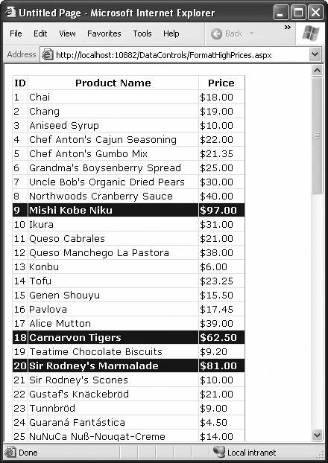
Muzaffer DOĞAN - Anadolu University

Slide 6
GridView Templates
The TemplateField allows you to define a completely customized template for a column.
Add a TemplateField column to the GridView or just click Convert this field into a TemplateField command after clicking Edit Columns… command.
Then, click Edit Templates command or open the source view and put your controls into the template.
Use Eval method to obtain the bound data.
Anadolu University

Slide 7
GridView Templates
<asp:TemplateField HeaderText="Status">
<ItemTemplate>
<b>In Stock:</b>
<%# Eval("UnitsInStock") %><br />
<b>On Order:</b>
<%# Eval("UnitsOnOrder") %><br />
<b>Reorder:</b>
<%# Eval("ReorderLevel") %>
</ItemTemplate>
</asp:TemplateField>
Anadolu University

Slide 8
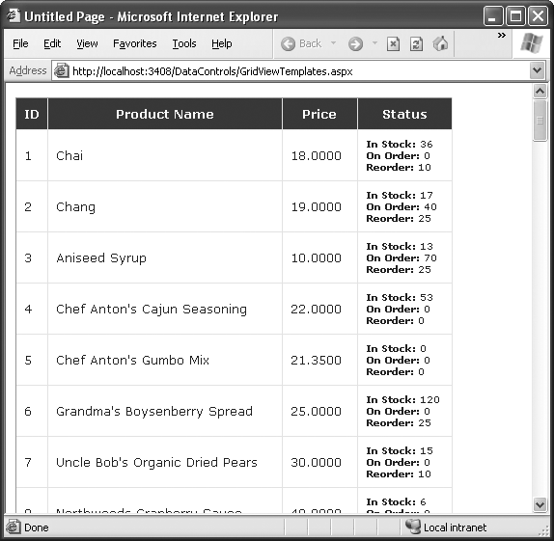
Muzaffer DOĞAN - Anadolu University

Slide 9
DetailsView and FormView
Both show a single row at a time
Both include optional pager buttons that let you step through the records
Both give you an easy way to insert a new record
Both support templates but the FormView requires them
The DetailsView renders its content inside a table, while the FormView gives you the flexibility to display your content without a table
Anadolu University

Slide 10
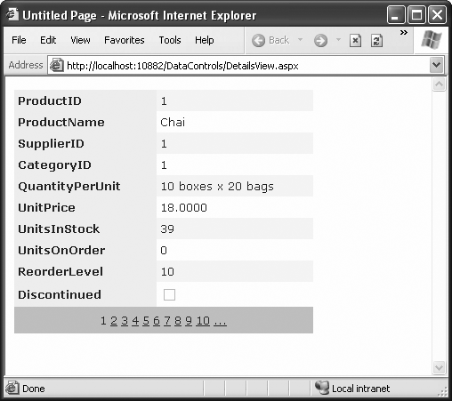
DetailsView Example
Anadolu University

Slide 11
Application
Demonstration of DetailsView and FormView
FormView:
https://www.youtube.com/watch?v=umz8yX7CWqU
Anadolu University

Slide 12
References
Beginning ASP.NET 3.5 in C# 2008: From Novice to Professional
Visual Studio and MSDN Help
Anadolu University

