Slide 1

ASP.NET AJAX

Slide 2
Content
ASP.NET AJAX
Ajax Control Toolkit
Anadolu University

Slide 3
Postback Model
So far, you’ve learned to build web pages that use the postback model.
With the postback model, pages are perpetually being sent back to the web server and regenerated.
During the postback, the entire page is refreshed, including the parts that haven’t changed. This produces a distracting flicker.
Anadolu University

Slide 4
Ajax
Recently, a new generation of web applications has begun to appear.
These applications refresh themselves quickly and flicker-free, and sometimes include slick new features like animation and drag and drop.
Examples: Gmail, Google Maps.
Anadolu University

Slide 5
Ajax
This new breed of web applications uses a set of design practices and technologies known as Ajax.
Ajax is programming shorthand for a set of techniques that create more responsive, dynamic pages.
One of the hallmarks of Ajax is the ability to refresh part of the page while leaving the rest untouched.
Ajax is the short form of Asynchronous Javascript and XML.
Anadolu University

Slide 6
Ajax: The Good
Responsiveness
  Better experience for the user
  Your web application seems more modern and sophisticated
  You can distinguish your web site from other competing similar websites
Ajax offers new features that aren’t possible in traditional web pages.
  Uses more Javascript
Anadolu University

Slide 7
Ajax: The Bad
Complexity
  You need to write Javascript codes (fortunately, we’ll use ASP.NET’s Ajax-enabled features in the class)
Browser Support
  Works only on major browsers
Web pages that use Ajax often do a lot of work on a single page.
Anadolu University

Slide 8
ASP.NET AJAX Toolkit
JavaScript isn’t terribly complex, but it’s remarkably difficult to program correctly, for two reasons:
  Details vary from browser to browser
  JavaScript is a notoriously loose language that tolerates many minor typos and mistakes. Catching these mistakes and removing them is a tedious process.
In the class, we won’t use Javascript directly. Instead, we’ll use a higher-level model called ASP.NET AJAX.
ASP.NET AJAX gives you a set of server-side components and controls that you can use when designing your web page.
Anadolu University

Slide 9
ASP.NET AJAX Control Toolkit
Script Manager
Script Manager Proxy
Update Panel
Timer
Update Progress
Anadolu University

Slide 10
The Script Manager
In order to use ASP.NET AJAX, you need to place a ScriptManager control on your page.
It is the brains of ASP.NET AJAX.
The ScriptManager doesn’t generate any HTML tags. Instead, the ScriptManager adds the links to the ASP.NET AJAX JavaScript libraries.
Each page that uses ASP.NET AJAX features requires an instance of the ScriptManager.
However, you can only use one ScriptManager on a page.
Anadolu University

Slide 11
The Script Manager
The script manager needs to appear before the Ajax controls.
It’s a good idea to always place the script manager at the top of the page.
Anadolu University

Slide 12
Script Manager and Master Pages
You might choose to place the ScriptManager in a master page.
However, this can occasionally cause problems, because different content pages may want to configure the properties of the ScriptManager differently.
The solution is to use the ScriptManager in the master page and the ScriptManagerProxy in content pages.
Each content page can configure the ScriptManagerProxy control in the same way it would configure the ScriptManager.
Anadolu University

Slide 13
Partial Refreshes
The key technique in an Ajax web application is partial refreshes.
With partial refreshes, the entire page doesn’t need to be posted back and refreshed in the browser.
Instead, when something happens the web page asks the web server for more information.
The request takes place in the background, so the web page remains responsive.
When the web page receives the response, it updates just the changed portion of the page.
Anadolu University

Slide 14
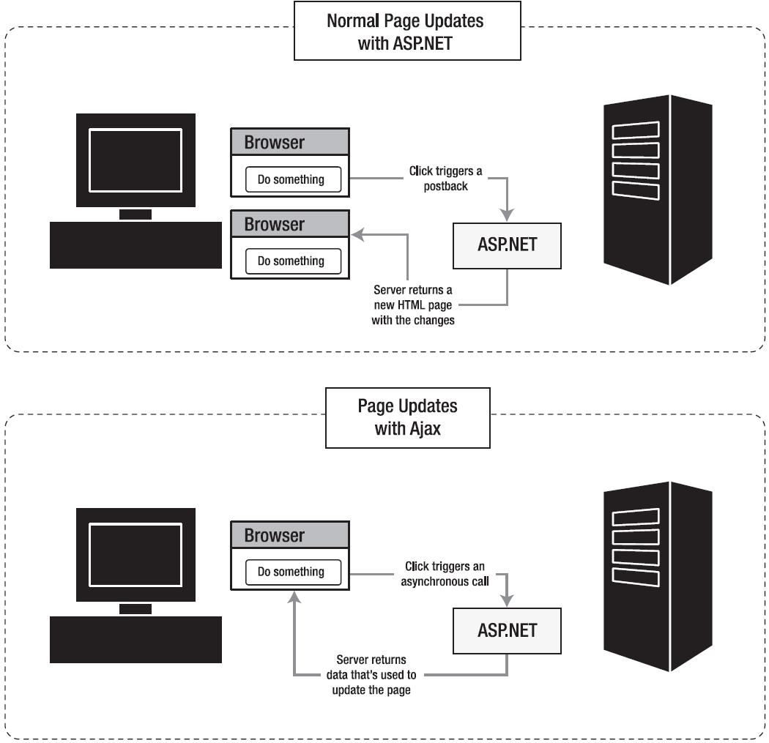
Anadolu University

Slide 15
Update Panel
ASP.NET includes a handy control that lets you take an ordinary page with server-side logic and make sure it refreshes itself in flicker-free Ajax style using partial updates. This control is the UpdatePanel.
The basic idea is that you divide your web page into one or more distinct regions, each of which is wrapped inside an invisible UpdatePanel.
When an event occurs in a control that’s located inside an UpdatePanel, and this event would normally trigger a full-page postback, the UpdatePanel intercepts the event and performs an asynchronous callback instead.
Anadolu University

Slide 16
A Note on FileUpload
FileUpload and HTML File Input controls can’t be used in an UpdatePanel since they require full-page postbacks.
Anadolu University

Slide 17
Conditional Updates
In complex pages, you might have more than one UpdatePanel. In this case, when one UpdatePanel triggers an update, all the UpdatePanel regions will be refreshed.
You can configure the panels to update themselves independently.
Simply change the UpdatePanel.UpdateMode property from Always to Conditional. Now, the UpdatePanel will refresh itself only if an event occurs in one of the controls in that UpdatePanel.
Anadolu University

Slide 18
Triggers
You can explicitly tell the UpdatePanel to be updated by the controls that aren’t inside the UpdatePanel.
In order to achieve this functionality, you can add Triggers to the UpdatePanel.
Anadolu University

Slide 19
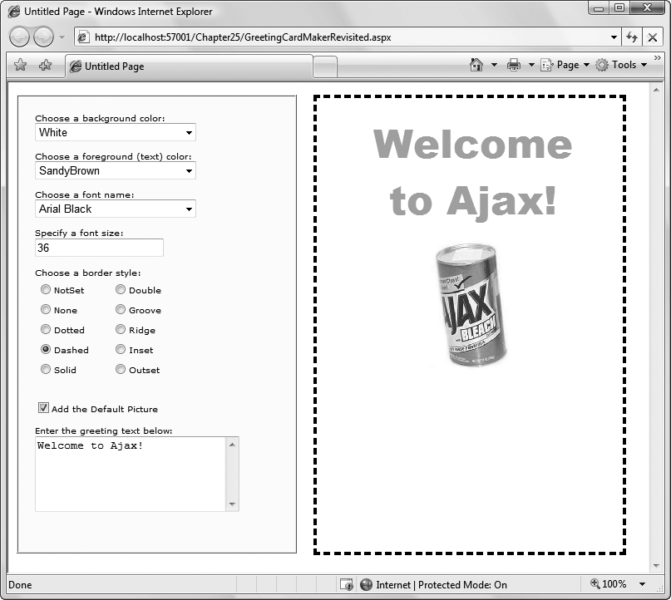
Anadolu University

