Slide 1

ASP.NET MVC

Slide 2
Content
MVC
Anadolu University

Slide 3
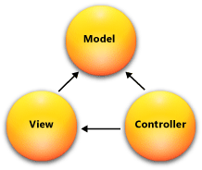
MVC Pattern
MVC is a design pattern and stands for MODEL, VIEW, CONTROLLER.
Anadolu University

Slide 4
MODEL
Model objects are the parts of the application that implement the logic for the application's data domain. Often, model objects retrieve and store model state in a database. For example, a Product object might retrieve information from a database, operate on it, and then write updated information back to a Products table in a SQL Server database.
In small applications, the model is often a conceptual separation instead of a physical one. For example, if the application only reads a dataset and sends it to the view, the application does not have a physical model layer and associated classes. In that case, the dataset takes on the role of a model object.
Anadolu University

Slide 5
VIEWS
Views are the components that display the application's user interface (UI). Typically, this UI is created from the model data. An example would be an edit view of a Products table that displays text boxes, drop-down lists, and check boxes based on the current state of a Product object.
Anadolu University

Slide 6
CONTROLLERS
Controllers are the components that handle user interaction, work with the model, and ultimately select a view to render that displays UI. In an MVC application, the view only displays information; the controller handles and responds to user input and interaction. For example, the controller handles query-string values, and passes these values to the model, which in turn might use these values to query the database.
Anadolu University

Slide 7
WHY MVC
The MVC pattern helps you create applications that separate the different aspects of the application (input logic, business logic, and UI logic), while providing a loose coupling between these elements.
The pattern specifies where each kind of logic should be located in the application.
The UI logic belongs in the view.
Input logic belongs in the controller.
Business logic belongs in the model. This separation helps you manage complexity when you build an application, because it enables you to focus on one aspect of the implementation at a time. For example, you can focus on the view without depending on the business logic.
Anadolu University

Slide 8
WHY MVC
This separation helps you manage complexity when you build an application, because it enables you to focus on one aspect of the implementation at a time.
For example, you can focus on the view without depending on the business logic.
The loose coupling between the three main components of an MVC application also promotes parallel development.
For example, one developer can work on the view, a second developer can work on the controller logic, and a third developer can focus on the business logic in the model.
Anadolu University

Slide 9
When to Create an MVC Application
You must consider carefully whether to implement a Web application by using either the ASP.NET MVC framework or the ASP.NET Web Forms model.
The MVC framework does not replace the Web Forms model; you can use either framework for Web applications.
(If you have existing Web Forms-based applications, these continue to work exactly as they always have.)
Anadolu University

Slide 10
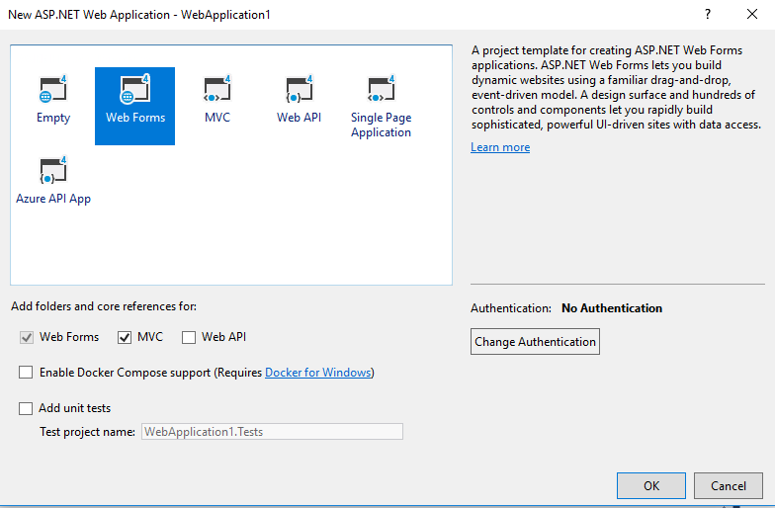
When to Create an MVC Application
Anadolu University

Slide 11
Advantages of an MVC-Based Web Application
It makes it easier to manage complexity by dividing an application into the model, the view, and the controller.
It does not use view state or server-based forms. This makes the MVC framework ideal for developers who want full control over the behavior of an application.
It uses a Front Controller pattern that processes Web application requests through a single controller. This enables you to design an application that supports a rich routing infrastructure. For more information, see Front Controller.
It provides better support for test-driven development (TDD).
It works well for Web applications that are supported by large teams of developers and for Web designers who need a high degree of control over the application behavior.
Anadolu University

Slide 12
Advantages of an Web Forms-Based Web Application
It supports an event model that preserves state over HTTP, which benefits line-of-business Web application development. The Web Forms-based application provides dozens of events that are supported in hundreds of server controls.
It uses a Page Controller pattern that adds functionality to individual pages. For more information, see Page Controller.
It uses view state on server-based forms, which can make managing state information easier.
It works well for small teams of Web developers and designers who want to take advantage of the large number of components available for rapid application development.
In general, it is less complex for application development, because the components (the Page class, controls, and so on) are tightly integrated and usually require less code than the MVC model.
Anadolu University

Slide 13
Example
https://dzone.com/articles/arithmetic-operation-in-aspnet-mvc
https://www.tutorialsteacher.com/mvc/htmlhelper-editor-editorfor
Muzaffer DOĞAN - Anadolu University

Slide 14
Reference
https://dzone.com/articles/arithmetic-operation-in-aspnet-mvc
https://docs.microsoft.com/en-us/aspnet/mvc/overview/getting-started/introduction/getting-started
Muzaffer DOĞAN - Anadolu University

