Slide 1
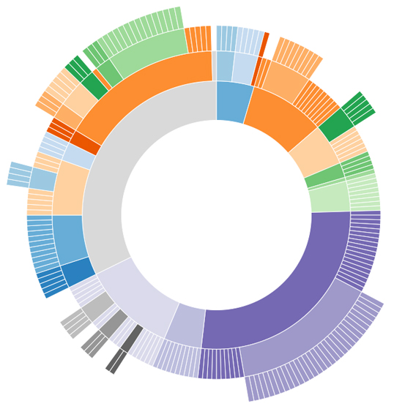
y - axis
Life expectancy
Sanitation services
Drinking water
BMI
x – axis (death rates)
y
Cardiovascular diseases
Infectious diseases
Nervous system diseases
External causes
Blood immune diseases
Neoplasms
x
the Netherlands
Infectious diseases
% of population
Neoplasms
External causes
years

