Slide 1
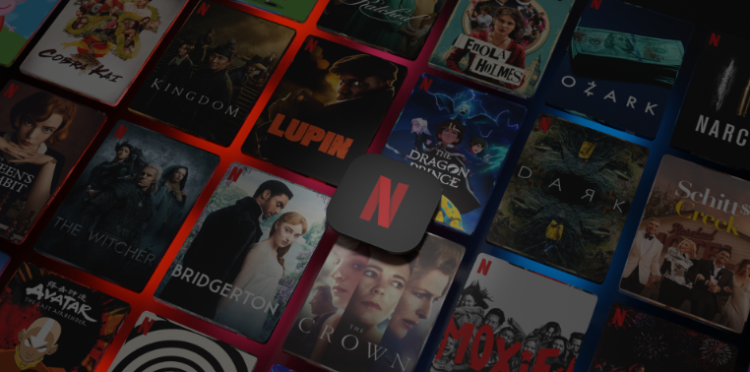
Netflix IMDB Scores Group 8 Presentation
Project Team: Eugenio Elizondo, Andrew Garza, Sierra Sarkis, Marty Thompson, Robert Williard

Slide 2


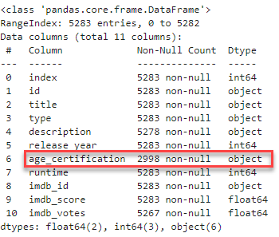
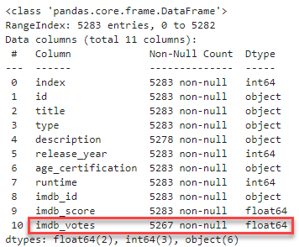
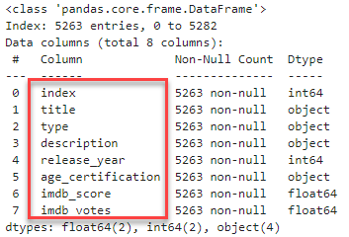
Netflix IMDB Scores
Intro to Dataset: This dataset examines various titles on the Netflix streaming platform along with their IMDB Votes and Scores.
We wanted to uncover trends relating to the popularity of Netflix titles by examining how viewers would rate them.
Data Cleaning Process:
Replaced nulls in the age_certification column with “Unknown”
Dropped nulls from column imdb_votes
Created a clean data frame using specific columns
1
2
3

Slide 3
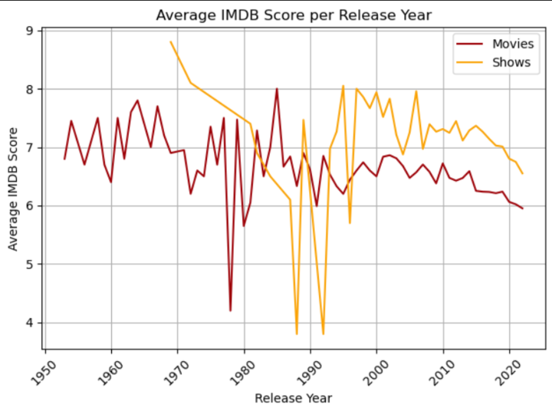
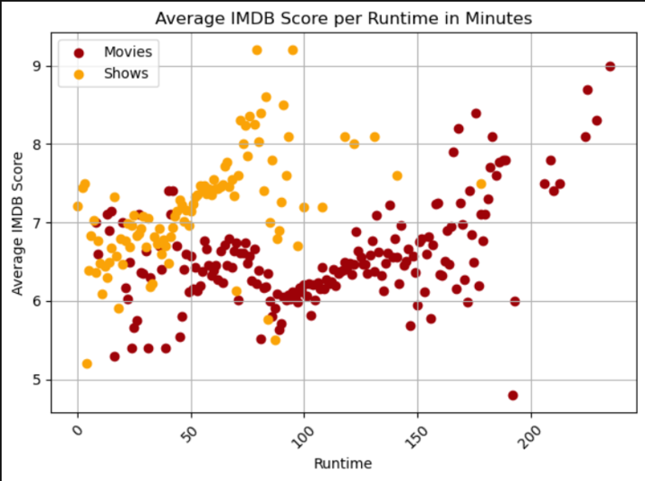
Question 1: What trends can we see when comparing IMDB Score and Release Year or Runtime?
The longer runtimes for movies and shows both show better scores.
Average IMDB scores per release year are trending down.
Note: Earliest Release Year: 1953, Latest Release Year: 2022

Slide 4
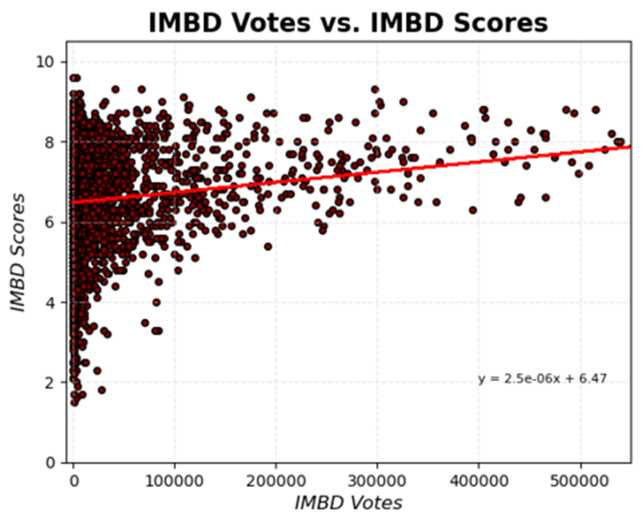
Question 2: Is there a correlation between IMDB Votes and IMDB Scores ?
Clustering on the left
Line of best fit begins at 6.47
Correlation was 0.19 (weak) but positive
What does the shape of the scatter plot look similar to?

Slide 5
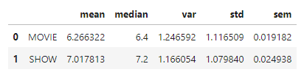
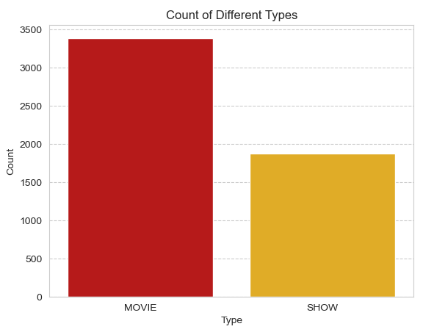
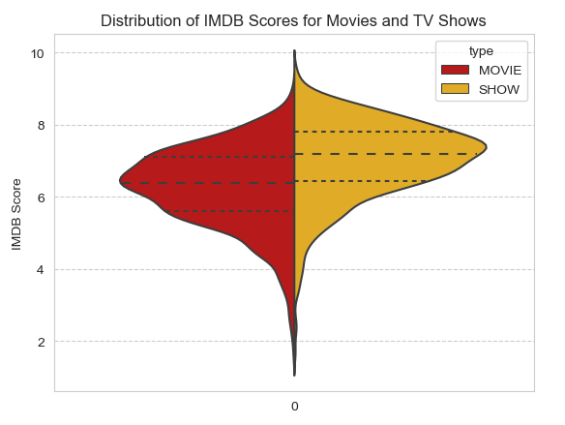
Question 3: Are there significant differences when comparing IMDB Score and Title Type?
Movies > Shows
Normal distribution
TV Shows have a higher mean IMDB Score

Slide 6
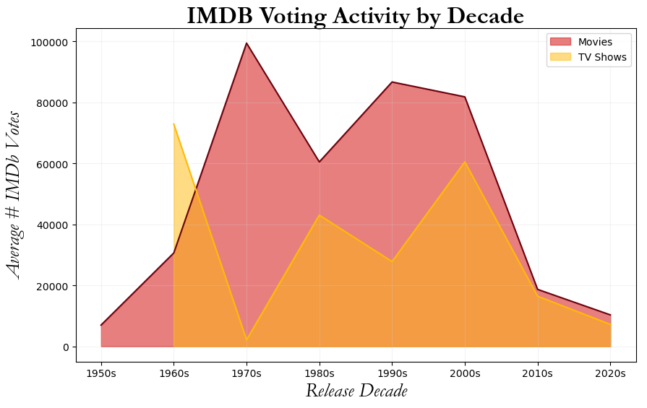
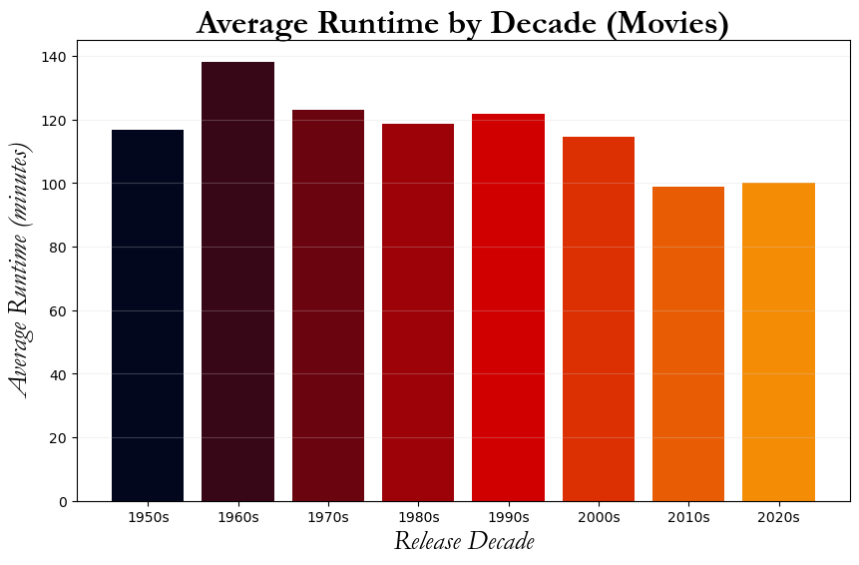
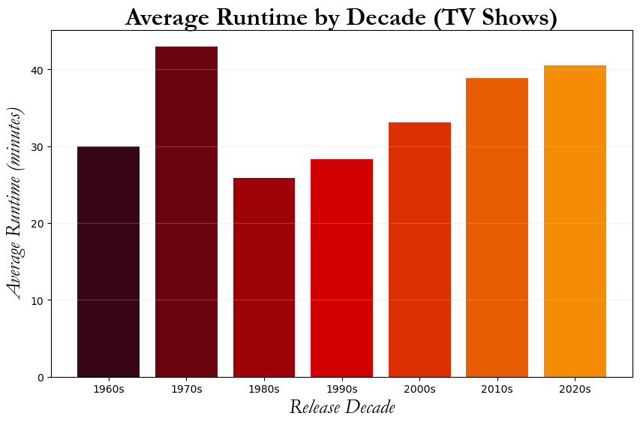
Question 4: What trends can we see when grouping the data by decade?
Voting activity overall appears to be greater for movies
Average runtime for shows appears to be steadily increasing since the 80’s

Slide 7
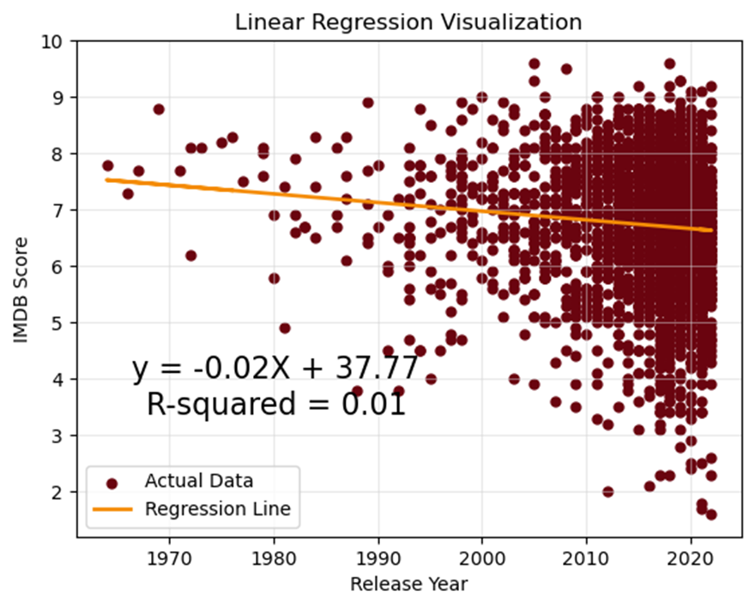
Regression Analysis

Slide 8

Limitations of the data
Biases
Uncertainty about the parameters used to produce a IMDB Score
Uncertainty in the demographics of voters
The data set doesn't have the age certification for the most movies, so it had to be dropped
Collected only through 2022
Netflix may prematurely remove titles that aren't doing well
Different title selection depending on region
Frequency of changing titles results in challenges with keeping the data set current and accurate
Data doesn’t contain genres or seasons data
Netflix is one of many streaming service providers, it would be interesting to look at data from all streaming services
Call to Action
BE A CRITIC!
Make our voices heard

Slide 9
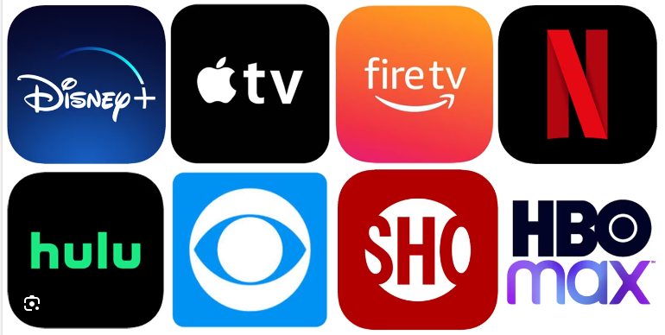
Future Work
Gather & merge datasets using a wider variety of streaming services
Explore additional datasets containing movie and tv show genre
Demographic Data

Slide 10
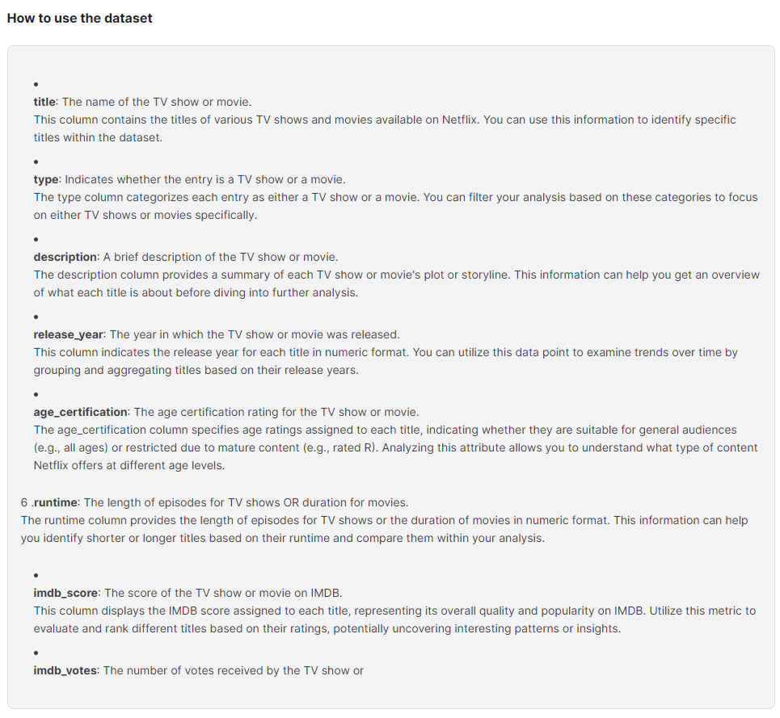
Works Cited
Appendix
Back 2 Viz Basics. Netflix IMDB Scores. (IMDB Scores for Netflix TV Shows and Movies). Kaggle: The Devestator, Updated: 12/3/2023. Kaggle Datasets. Date accessed: 5/27/2024. https://www.kaggle.com/datasets/thedevastator/netflix-imdb-scores/data

